Slide 1
Multilevel Feedback Queue
CSCI3150 Introduction to Operating Systems, Fall 2024
CHEN Yuetao
chenyt@link.cuhk.edu.hk
Oct 17, 2024

Slide 2
Reminder
Assignment 2
Due at 18:00:00 p.m., Mon, Nov 4th
18 days left

Slide 3
Overview
Tutorial this week
Multilevel feedback queue (MLFQ)
Fill the MLFQ table
All examples used in this tutorial:
https://github.com/henryhxu/CSCI3150/tree/2024-Fall/tutorial/T07

Slide 4
Recall MLFQ Rules
We have process A and process B.
Rule 1: If Priority(A) > Priority(B), A runs (B doesn’t).
Rule 2: If Priority(A) = Priority(B), A & B run in round-robin fashion using the time slice (quantum length) of the given queue.
Rule 3: When a job enters the system, it is placed at the highest priority (the topmost queue). For the jobs arriving at the same time, schedule the job with largest(or smallest) pid first.

Slide 5
Recall MLFQ Rules
We have process A and process B.
Rule 4: Once a job uses up its time allotment at a given level (regardless of how many times it has given up the CPU), its priority is reduced (i.e., it moves down one queue and will be at the tail of the target queue, which means it will be scheduled last).
Rule 5: After some time period S, move all the jobs in the system to the topmost queue, and sort all the jobs by pid. The job with the largest(or smallest) pid will be scheduled first.

Slide 6
MLFQ Table Filling
This is a common question that often appears in final exams.
In recent 3 years, it appeared in the final exams of
First term of 2023-2024
First term of 2022-2023
First term of 2021-2022
Second term of 2021-2022

Slide 7
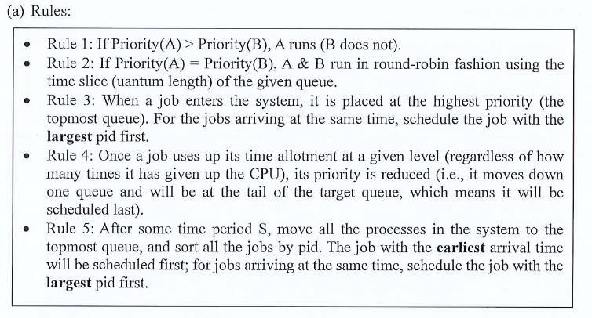
MLFQ Table Filling
This question will give you the MLFQ rules. For example, Question 3 in Course Examination 1st Term, 2023-2024
Pay attention to the details.

Slide 8
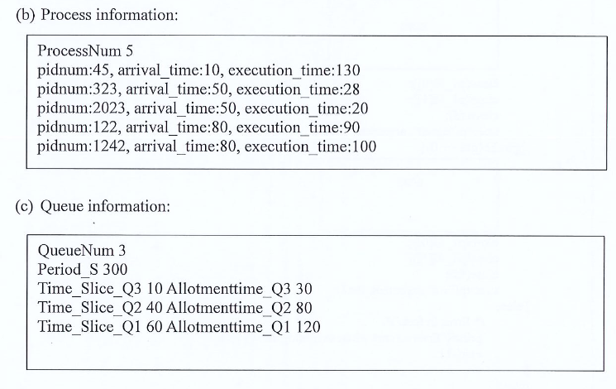
MLFQ Table Filling
Next, this question will give you the related information, such as

Slide 9
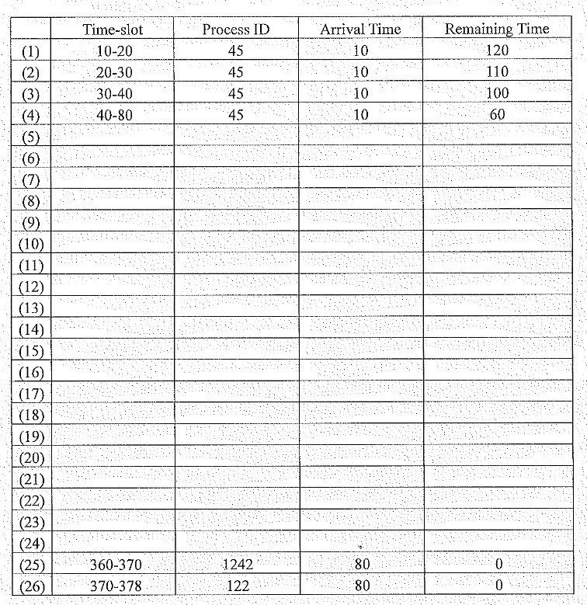
MLFQ Table Filling
Finally, you are required to fill the MLFQ table.

Slide 10
Example
Arriving at the same time → Largest pid first
After period S → Earliest, Largest pid first
pid | arrival | execution
45 | 10 | 130
323 | 50 | 28
2023 | 50 | 20
122 | 80 | 90
1242 | 80 | 100
queue | time slice | allotment
Q3 | 10 | 30
Q2 | 40 | 80
Q1 | 60 | 120
Period_S 300

Slide 11
Example
Arriving at the same time → Largest pid first
After period S → Earliest, Largest pid first
Time: 10
PID (Remaining allotment time)
Q3
45 (30)
Q2
pid | arrival | execution
45 | 10 | 130
323 | 50 | 28
2023 | 50 | 20
122 | 80 | 90
1242 | 80 | 100
Q1
 | Time | PID | Arrive time | Remaining Time
(1)
(2)
(3)
(4)
(5)
(6)
(7)
queue | time slice | allotment
Q3 | 10 | 30
Q2 | 40 | 80
Q1 | 60 | 120
Period_S 300

Slide 12
Example
Arriving at the same time → Largest pid first
After period S → Earliest, Largest pid first
Time: 20
PID (Remaining allotment time)
Q3
45 (20)
Q2
pid | arrival | execution
45 | 10 | 130
323 | 50 | 28
2023 | 50 | 20
122 | 80 | 90
1242 | 80 | 100
Q1
 | Time | PID | Arrive time | Remaining Time
(1) | 10-20 | 45 | 10 | 120
queue | time slice | allotment
Q3 | 10 | 30
Q2 | 40 | 80
Q1 | 60 | 120
Period_S 300

Slide 13
Example
Arriving at the same time → Largest pid first
After period S → Earliest, Largest pid first
Time: 30
PID (Remaining allotment time)
Q3
45 (10)
Q2
pid | arrival | execution
45 | 10 | 130
323 | 50 | 28
2023 | 50 | 20
122 | 80 | 90
1242 | 80 | 100
Q1
 | Time | PID | Arrive time | Remaining Time
(1) | 10-20 | 45 | 10 | 120
(2) | 20-30 | 45 | 10 | 110
queue | time slice | allotment
Q3 | 10 | 30
Q2 | 40 | 80
Q1 | 60 | 120
Period_S 300

Slide 14
Example
Arriving at the same time → Largest pid first
After period S → Earliest, Largest pid first
Time: 40
PID (Remaining allotment time)
Q3
Q2
45 (80)
pid | arrival | execution
45 | 10 | 130
323 | 50 | 28
2023 | 50 | 20
122 | 80 | 90
1242 | 80 | 100
Q1
 | Time | PID | Arrive time | Remaining Time
(1) | 10-20 | 45 | 10 | 120
(2) | 20-30 | 45 | 10 | 110
(3) | 30-40 | 45 | 10 | 100
queue | time slice | allotment
Q3 | 10 | 30
Q2 | 40 | 80
Q1 | 60 | 120
Period_S 300

Slide 15
Example
Arriving at the same time → Largest pid first
After period S → Earliest, Largest pid first
Time: 80
PID (Remaining allotment time)
Q3
2023 (30)
323 (30)
1242 (30)
122 (30)
Q2
45 (40)
pid | arrival | execution
45 | 10 | 130
323 | 50 | 28
2023 | 50 | 20
122 | 80 | 90
1242 | 80 | 100
Q1
 | Time | PID | Arrive time | Remaining Time
(1) | 10-20 | 45 | 10 | 120
(2) | 20-30 | 45 | 10 | 110
(3) | 30-40 | 45 | 10 | 100
(4) | 40-80 | 45 | 10 | 60
queue | time slice | allotment
Q3 | 10 | 30
Q2 | 40 | 80
Q1 | 60 | 120
Period_S 300

Slide 16
Example
Arriving at the same time → Largest pid first
After period S → Earliest, Largest pid first
Time: 90
PID (Remaining allotment time)
Q3
323 (30)
1242 (30)
122 (30)
2023 (20)
Q2
45 (40)
pid | arrival | execution
45 | 10 | 130
323 | 50 | 28
2023 | 50 | 20
122 | 80 | 90
1242 | 80 | 100
Q1
 | Time | PID | Arrive time | Remaining Time
(1) | 10-20 | 45 | 10 | 120
(2) | 20-30 | 45 | 10 | 110
(3) | 30-40 | 45 | 10 | 100
(4) | 40-80 | 45 | 10 | 60
(5) | 80-90 | 2023 | 50 | 10
queue | time slice | allotment
Q3 | 10 | 30
Q2 | 40 | 80
Q1 | 60 | 120
Period_S 300

Slide 17
Example
Arriving at the same time → Largest pid first
After period S → Earliest, Largest pid first
Time: 100
PID (Remaining allotment time)
Q3
1242 (30)
122 (30)
2023 (20)
323 (20)
Q2
45 (40)
pid | arrival | execution
45 | 10 | 130
323 | 50 | 28
2023 | 50 | 20
122 | 80 | 90
1242 | 80 | 100
Q1
 | Time | PID | Arrive time | Remaining Time
(1) | 10-20 | 45 | 10 | 120
(2) | 20-30 | 45 | 10 | 110
(3) | 30-40 | 45 | 10 | 100
(4) | 40-80 | 45 | 10 | 60
(5) | 80-90 | 2023 | 50 | 10
(6) | 90-100 | 323 | 50 | 18
queue | time slice | allotment
Q3 | 10 | 30
Q2 | 40 | 80
Q1 | 60 | 120
Period_S 300

Slide 18
Example
Arriving at the same time → Largest pid first
After period S → Earliest, Largest pid first
Time: 110
PID (Remaining allotment time)
Q3
122 (30)
2023 (20)
323 (20)
1242 (20)
Q2
45 (40)
pid | arrival | execution
45 | 10 | 130
323 | 50 | 28
2023 | 50 | 20
122 | 80 | 90
1242 | 80 | 100
Q1
 | Time | PID | Arrive time | Remaining Time
(1) | 10-20 | 45 | 10 | 120
(2) | 20-30 | 45 | 10 | 110
(3) | 30-40 | 45 | 10 | 100
(4) | 40-80 | 45 | 10 | 60
(5) | 80-90 | 2023 | 50 | 10
(6) | 90-100 | 323 | 50 | 18
(7) | 100-110 | 1242 | 80 | 90
queue | time slice | allotment
Q3 | 10 | 30
Q2 | 40 | 80
Q1 | 60 | 120
Period_S 300

Slide 19
Example
Arriving at the same time → Largest pid first
After period S → Earliest, Largest pid first
Time: 120
PID (Remaining allotment time)
Q3
2023 (20)
323 (20)
1242 (20)
122 (20)
Q2
45 (40)
pid | arrival | execution
45 | 10 | 130
323 | 50 | 28
2023 | 50 | 20
122 | 80 | 90
1242 | 80 | 100
Q1
 | Time | PID | Arrive time | Remaining Time
(4) | 40-80 | 45 | 10 | 60
(5) | 80-90 | 2023 | 50 | 10
(6) | 90-100 | 323 | 50 | 18
(7) | 100-110 | 1242 | 80 | 90
(8) | 110-120 | 122 | 80 | 80
queue | time slice | allotment
Q3 | 10 | 30
Q2 | 40 | 80
Q1 | 60 | 120
Period_S 300

Slide 20
Example
Arriving at the same time → Largest pid first
After period S → Earliest, Largest pid first
Time: 130
PID (Remaining allotment time)
Q3
323 (20)
1242 (20)
122 (20)
Q2
45 (40)
pid | arrival | execution
45 | 10 | 130
323 | 50 | 28
2023 | 50 | 20
122 | 80 | 90
1242 | 80 | 100
Q1
 | Time | PID | Arrive time | Remaining Time
(4) | 40-80 | 45 | 10 | 60
(5) | 80-90 | 2023 | 50 | 10
(6) | 90-100 | 323 | 50 | 18
(7) | 100-110 | 1242 | 80 | 90
(8) | 110-120 | 122 | 80 | 80
(9) | 120-130 | 2023 | 50 | 0
queue | time slice | allotment
Q3 | 10 | 30
Q2 | 40 | 80
Q1 | 60 | 120
Period_S 300

Slide 21
Example
Arriving at the same time → Largest pid first
After period S → Earliest, Largest pid first
Time: 140
PID (Remaining allotment time)
Q3
1242 (20)
122 (20)
323 (10)
Q2
45 (40)
pid | arrival | execution
45 | 10 | 130
323 | 50 | 28
2023 | 50 | 20
122 | 80 | 90
1242 | 80 | 100
Q1
 | Time | PID | Arrive time | Remaining Time
(4) | 40-80 | 45 | 10 | 60
(5) | 80-90 | 2023 | 50 | 10
(6) | 90-100 | 323 | 50 | 18
(7) | 100-110 | 1242 | 80 | 90
(8) | 110-120 | 122 | 80 | 80
(9) | 120-130 | 2023 | 50 | 0
(10) | 130-140 | 323 | 50 | 8
queue | time slice | allotment
Q3 | 10 | 30
Q2 | 40 | 80
Q1 | 60 | 120
Period_S 300

Slide 22
Example
Arriving at the same time → Largest pid first
After period S → Earliest, Largest pid first
Time: 150
PID (Remaining allotment time)
Q3
122 (20)
323 (10)
1242 (10)
Q2
45 (40)
pid | arrival | execution
45 | 10 | 130
323 | 50 | 28
2023 | 50 | 20
122 | 80 | 90
1242 | 80 | 100
Q1
 | Time | PID | Arrive time | Remaining Time
(4) | 40-80 | 45 | 10 | 60
(5) | 80-90 | 2023 | 50 | 10
(6) | 90-100 | 323 | 50 | 18
(7) | 100-110 | 1242 | 80 | 90
(8) | 110-120 | 122 | 80 | 80
(9) | 120-130 | 2023 | 50 | 0
(10) | 130-140 | 323 | 50 | 8
(11) | 140-150 | 1242 | 80 | 80
queue | time slice | allotment
Q3 | 10 | 30
Q2 | 40 | 80
Q1 | 60 | 120
Period_S 300

Slide 23
Example
Arriving at the same time → Largest pid first
After period S → Earliest, Largest pid first
Time: 160
PID (Remaining allotment time)
Q3
323 (10)
1242 (10)
122 (10)
Q2
45 (40)
pid | arrival | execution
45 | 10 | 130
323 | 50 | 28
2023 | 50 | 20
122 | 80 | 90
1242 | 80 | 100
Q1
 | Time | PID | Arrive time | Remaining Time
(8) | 110-120 | 122 | 80 | 80
(9) | 120-130 | 2023 | 50 | 0
(10) | 130-140 | 323 | 50 | 8
(11) | 140-150 | 1242 | 80 | 80
(12) | 150-160 | 122 | 80 | 70
queue | time slice | allotment
Q3 | 10 | 30
Q2 | 40 | 80
Q1 | 60 | 120
Period_S 300

Slide 24
Example
Arriving at the same time → Largest pid first
After period S → Earliest, Largest pid first
Time: 168
PID (Remaining allotment time)
Q3
1242 (10)
122 (10)
Q2
45 (40)
pid | arrival | execution
45 | 10 | 130
323 | 50 | 28
2023 | 50 | 20
122 | 80 | 90
1242 | 80 | 100
Q1
 | Time | PID | Arrive time | Remaining Time
(8) | 110-120 | 122 | 80 | 80
(9) | 120-130 | 2023 | 50 | 0
(10) | 130-140 | 323 | 50 | 8
(11) | 140-150 | 1242 | 80 | 80
(12) | 150-160 | 122 | 80 | 70
(13) | 160-168 | 323 | 50 | 0
queue | time slice | allotment
Q3 | 10 | 30
Q2 | 40 | 80
Q1 | 60 | 120
Period_S 300

Slide 25
Example
Arriving at the same time → Largest pid first
After period S → Earliest, Largest pid first
Time: 178
PID (Remaining allotment time)
Q3
122 (10)
Q2
45 (40)
1242 (80)
pid | arrival | execution
45 | 10 | 130
323 | 50 | 28
2023 | 50 | 20
122 | 80 | 90
1242 | 80 | 100
Q1
 | Time | PID | Arrive time | Remaining Time
(8) | 110-120 | 122 | 80 | 80
(9) | 120-130 | 2023 | 50 | 0
(10) | 130-140 | 323 | 50 | 8
(11) | 140-150 | 1242 | 80 | 80
(12) | 150-160 | 122 | 80 | 70
(13) | 160-168 | 323 | 50 | 0
(14) | 168-178 | 1242 | 80 | 70
queue | time slice | allotment
Q3 | 10 | 30
Q2 | 40 | 80
Q1 | 60 | 120
Period_S 300

Slide 26
Example
Arriving at the same time → Largest pid first
After period S → Earliest, Largest pid first
Time: 188
PID (Remaining allotment time)
Q3
Q2
45 (40)
1242 (80)
122 (80)
pid | arrival | execution
45 | 10 | 130
323 | 50 | 28
2023 | 50 | 20
122 | 80 | 90
1242 | 80 | 100
Q1
 | Time | PID | Arrive time | Remaining Time
(8) | 110-120 | 122 | 80 | 80
(9) | 120-130 | 2023 | 50 | 0
(10) | 130-140 | 323 | 50 | 8
(11) | 140-150 | 1242 | 80 | 80
(12) | 150-160 | 122 | 80 | 70
(13) | 160-168 | 323 | 50 | 0
(14) | 168-178 | 1242 | 80 | 70
(15) | 178-188 | 122 | 80 | 60
queue | time slice | allotment
Q3 | 10 | 30
Q2 | 40 | 80
Q1 | 60 | 120
Period_S 300

Slide 27
Example
Arriving at the same time → Largest pid first
After period S → Earliest, Largest pid first
Time: 228
PID (Remaining allotment time)
Q3
Q2
1242 (80)
122 (80)
pid | arrival | execution
45 | 10 | 130
323 | 50 | 28
2023 | 50 | 20
122 | 80 | 90
1242 | 80 | 100
Q1
45 (120)
 | Time | PID | Arrive time | Remaining Time
(4) | 40-80 | 45 | 10 | 60
… | … | … | … | …
(14) | 168-178 | 1242 | 80 | 70
(15) | 178-188 | 122 | 80 | 60
(16) | 188-228 | 45 | 10 | 20
queue | time slice | allotment
Q3 | 10 | 30
Q2 | 40 | 80
Q1 | 60 | 120
Period_S 300

Slide 28
Example
Arriving at the same time → Largest pid first
After period S → Earliest, Largest pid first
Time: 268
PID (Remaining allotment time)
Q3
Q2
122 (80)
1242 (40)
pid | arrival | execution
45 | 10 | 130
323 | 50 | 28
2023 | 50 | 20
122 | 80 | 90
1242 | 80 | 100
Q1
45 (120)
 | Time | PID | Arrive time | Remaining Time
(4) | 40-80 | 45 | 10 | 60
… | … | … | … | …
(14) | 168-178 | 1242 | 80 | 70
(15) | 178-188 | 122 | 80 | 60
(16) | 188-228 | 45 | 10 | 20
(17) | 228-268 | 1242 | 80 | 30
queue | time slice | allotment
Q3 | 10 | 30
Q2 | 40 | 80
Q1 | 60 | 120
Period_S 300

Slide 29
Example
Period S
Arriving at the same time → Largest pid first
After period S → Earliest, Largest pid first
Time: 300
PID (Remaining allotment time)
Q3
Q2
1242 (40)
122 (48)
pid | arrival | execution
45 | 10 | 130
323 | 50 | 28
2023 | 50 | 20
122 | 80 | 90
1242 | 80 | 100
Q1
45 (120)
 | Time | PID | Arrive time | Remaining Time
(4) | 40-80 | 45 | 10 | 60
… | … | … | … | …
(14) | 168-178 | 1242 | 80 | 70
(15) | 178-188 | 122 | 80 | 60
(16) | 188-228 | 45 | 10 | 20
(17) | 228-268 | 1242 | 80 | 30
(18) | 268-300 | 122 | 80 | 28
queue | time slice | allotment
Q3 | 10 | 30
Q2 | 40 | 80
Q1 | 60 | 120
Period_S 300

Slide 30
Example
Arriving at the same time → Largest pid first
After period S → Earliest, Largest pid first
Time: 300
PID (Remaining allotment time)
Q3
45 (30)
1242 (30)
122 (30)
Q2
pid | arrival | execution
45 | 10 | 130
323 | 50 | 28
2023 | 50 | 20
122 | 80 | 90
1242 | 80 | 100
Q1
 | Time | PID | Arrive time | Remaining Time
(4) | 40-80 | 45 | 10 | 60
… | … | … | … | …
(14) | 168-178 | 1242 | 80 | 70
(15) | 178-188 | 122 | 80 | 60
(16) | 188-228 | 45 | 10 | 20
(17) | 228-268 | 1242 | 80 | 30
(18) | 268-300 | 122 | 80 | 28
queue | time slice | allotment
Q3 | 10 | 30
Q2 | 40 | 80
Q1 | 60 | 120
Period_S 300

Slide 31
Example
Arriving at the same time → Largest pid first
After period S → Earliest, Largest pid first
Time: 310
PID (Remaining allotment time)
Q3
1242 (30)
122 (30)
45 (20)
Q2
pid | arrival | execution
45 | 10 | 130
323 | 50 | 28
2023 | 50 | 20
122 | 80 | 90
1242 | 80 | 100
Q1
 | Time | PID | Arrive time | Remaining Time
(4) | 40-80 | 45 | 10 | 60
… | … | … | … | …
(14) | 168-178 | 1242 | 80 | 70
(15) | 178-188 | 122 | 80 | 60
(16) | 188-228 | 45 | 10 | 20
(17) | 228-268 | 1242 | 80 | 30
(18) | 268-300 | 122 | 80 | 28
(19) | 300-310 | 45 | 10 | 10
queue | time slice | allotment
Q3 | 10 | 30
Q2 | 40 | 80
Q1 | 60 | 120
Period_S 300

Slide 32
Example
Arriving at the same time → Largest pid first
After period S → Earliest, Largest pid first
Time: 320
PID (Remaining allotment time)
Q3
122 (30)
45 (20)
1242 (20)
Q2
pid | arrival | execution
45 | 10 | 130
323 | 50 | 28
2023 | 50 | 20
122 | 80 | 90
1242 | 80 | 100
Q1
 | Time | PID | Arrive time | Remaining Time
(17) | 228-268 | 1242 | 80 | 30
(18) | 268-300 | 122 | 80 | 28
(19) | 300-310 | 45 | 10 | 10
(20) | 310-320 | 1242 | 80 | 20
queue | time slice | allotment
Q3 | 10 | 30
Q2 | 40 | 80
Q1 | 60 | 120
Period_S 300

Slide 33
Example
Arriving at the same time → Largest pid first
After period S → Earliest, Largest pid first
Time: 330
PID (Remaining allotment time)
Q3
45 (20)
1242 (20)
122 (20)
Q2
pid | arrival | execution
45 | 10 | 130
323 | 50 | 28
2023 | 50 | 20
122 | 80 | 90
1242 | 80 | 100
Q1
 | Time | PID | Arrive time | Remaining Time
(17) | 228-268 | 1242 | 80 | 30
(18) | 268-300 | 122 | 80 | 28
(19) | 300-310 | 45 | 10 | 10
(20) | 310-320 | 1242 | 80 | 20
(21) | 320-330 | 122 | 80 | 18
queue | time slice | allotment
Q3 | 10 | 30
Q2 | 40 | 80
Q1 | 60 | 120
Period_S 300

Slide 34
Example
Arriving at the same time → Largest pid first
After period S → Earliest, Largest pid first
Time: 340
PID (Remaining allotment time)
Q3
1242 (20)
122 (20)
Q2
pid | arrival | execution
45 | 10 | 130
323 | 50 | 28
2023 | 50 | 20
122 | 80 | 90
1242 | 80 | 100
Q1
 | Time | PID | Arrive time | Remaining Time
(17) | 228-268 | 1242 | 80 | 30
(18) | 268-300 | 122 | 80 | 28
(19) | 300-310 | 45 | 10 | 10
(20) | 310-320 | 1242 | 80 | 20
(21) | 320-330 | 122 | 80 | 18
(22) | 330-340 | 45 | 10 | 0
queue | time slice | allotment
Q3 | 10 | 30
Q2 | 40 | 80
Q1 | 60 | 120
Period_S 300

Slide 35
Example
Arriving at the same time → Largest pid first
After period S → Earliest, Largest pid first
Time: 350
PID (Remaining allotment time)
Q3
122 (20)
1242 (10)
Q2
pid | arrival | execution
45 | 10 | 130
323 | 50 | 28
2023 | 50 | 20
122 | 80 | 90
1242 | 80 | 100
Q1
 | Time | PID | Arrive time | Remaining Time
(17) | 228-268 | 1242 | 80 | 30
(18) | 268-300 | 122 | 80 | 28
(19) | 300-310 | 45 | 10 | 10
(20) | 310-320 | 1242 | 80 | 20
(21) | 320-330 | 122 | 80 | 18
(22) | 330-340 | 45 | 10 | 0
(23) | 340-350 | 1242 | 80 | 10
queue | time slice | allotment
Q3 | 10 | 30
Q2 | 40 | 80
Q1 | 60 | 120
Period_S 300

Slide 36
Example
Arriving at the same time → Largest pid first
After period S → Earliest, Largest pid first
Time: 360
PID (Remaining allotment time)
Q3
1242 (10)
122 (10)
Q2
pid | arrival | execution
45 | 10 | 130
323 | 50 | 28
2023 | 50 | 20
122 | 80 | 90
1242 | 80 | 100
Q1
 | Time | PID | Arrive time | Remaining Time
(17) | 228-268 | 1242 | 80 | 30
(18) | 268-300 | 122 | 80 | 28
(19) | 300-310 | 45 | 10 | 10
(20) | 310-320 | 1242 | 80 | 20
(21) | 320-330 | 122 | 80 | 18
(22) | 330-340 | 45 | 10 | 0
(23) | 340-350 | 1242 | 80 | 10
(24) | 350-360 | 122 | 80 | 8
queue | time slice | allotment
Q3 | 10 | 30
Q2 | 40 | 80
Q1 | 60 | 120
Period_S 300

Slide 37
Example
Arriving at the same time → Largest pid first
After period S → Earliest, Largest pid first
Time: 370
PID (Remaining allotment time)
Q3
122 (10)
Q2
pid | arrival | execution
45 | 10 | 130
323 | 50 | 28
2023 | 50 | 20
122 | 80 | 90
1242 | 80 | 100
Q1
 | Time | PID | Arrive time | Remaining Time
(23) | 340-350 | 1242 | 80 | 10
(24) | 350-360 | 122 | 80 | 8
(25) | 360-370 | 1242 | 80 | 0
queue | time slice | allotment
Q3 | 10 | 30
Q2 | 40 | 80
Q1 | 60 | 120
Period_S 300

Slide 38
Example
Arriving at the same time → Largest pid first
After period S → Earliest, Largest pid first
Time: 378
PID (Remaining allotment time)
Q3
Q2
pid | arrival | execution
45 | 10 | 130
323 | 50 | 28
2023 | 50 | 20
122 | 80 | 90
1242 | 80 | 100
Q1
 | Time | PID | Arrive time | Remaining Time
(23) | 340-350 | 1242 | 80 | 10
(24) | 350-360 | 122 | 80 | 8
(25) | 360-370 | 1242 | 80 | 0
(26) | 370-378 | 122 | 80 | 0
queue | time slice | allotment
Q3 | 10 | 30
Q2 | 40 | 80
Q1 | 60 | 120
Period_S 300

Slide 39
Q & A

