Slide 1
Operating Systems CSCI 3150
Lecture 9: CPU Scheduling

Slide 2
Roadmap: CPU Scheduling
Introduction
Multi-Level Feedback Queue
Lottery Scheduling

Slide 3
Introduction

Slide 4
Scheduling: Introduction
Workload assumptions:
Each job runs for the same amount of time.
All jobs arrive at the same time.
All jobs only use the CPU (i.e., they perform no I/O).
The run-time of each job is known.

Slide 5

Scheduling Metrics
Performance metric: Turnaround time, or completion time
The time at which the job completes minus the time at which the job arrived in the system.
Job completion time, JCT
Another metric is fairness.
Performance and fairness are often at odds in scheduling.
$$T_{completion}=T_{done}−T_{arrival}$$

Slide 6

First In, First Out (FIFO)
First Come, First Served (FCFS)
Very simple and easy to implement
Example:
A arrived just before B which arrived just before C.
Each job runs for 10 seconds.
A
B
C
0
20
40
60
80
100
120
Time (Second)
$$Average JCT=\frac{10+20+30}{3}=20 sec$$

Slide 7

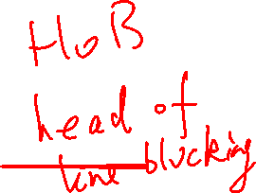
Why FIFO is not that great? – Convoy effect
Let’s relax assumption 1: Each job no longer runs for the same amount of time.
Example:
A arrived just before B which arrived just before C.
A runs for 100 seconds, B and C run for 10 each.
A
B
C
0
20
40
60
80
100
120
Time (Second)
$$Average JCT=\frac{100+110+120}{3}=110 sec$$

Slide 8

Shortest Job First (SJF)
Run the shortest job first, then the next shortest, and so on
Non-preemptive scheduler
Same example:
B
C
A
0
20
40
60
80
100
120
Time (Second)
$$Average JCT =\frac{10+20+120}{3}=50 sec$$

Slide 9
SJF with Late Arrivals from B and C
Let’s relax assumption 2: Jobs can arrive at any time.
Example:
A arrives at t=0 and needs to run for 100 seconds.
B and C arrive at t=10 and each needs to run for 10 seconds
[B,C arrive]
A
B
C
0
20
40
60
80
100
120
Time (Second)
$$Average JCT=\frac{100+\left(110−10\right)+(120−10)}{3}=103.33 sec$$

Slide 10
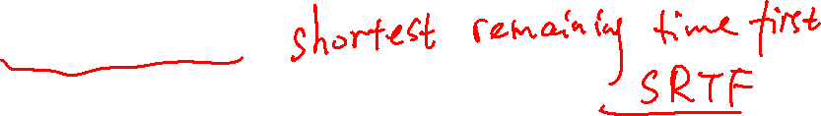
Shortest Time-to-Completion First (STCF)
Add preemption to SJF
Also known as Preemptive Shortest Job First (PSJF)
When a new job enters the system:
Determine the remaining times of all jobs
Schedule the job which has the least time left

Slide 11
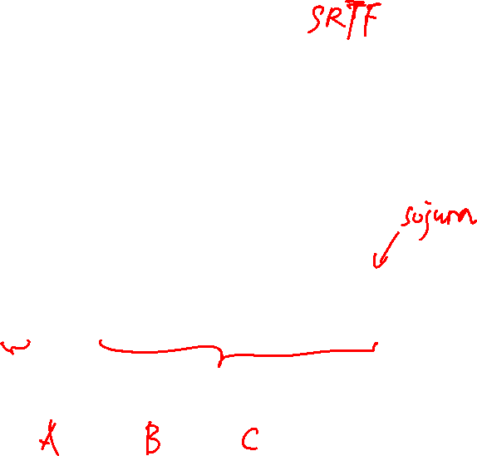
Shortest Time-to-Completion First (STCF)
Example:
A arrives at t=0 and needs to run for 100 seconds.
B and C arrive at t=10 and each needs to run for 10 seconds
[B,C arrive]
A
B
C
A
0
20
40
60
80
100
120
Time (Second)
$$Average JCT=\frac{(120−0)+\left(20−10\right)+(30−10)}{3}=50 sec$$

Slide 12

New scheduling metric: Response time
The time from when the job arrives to the first time it is scheduled.
STCF and related disciplines are not particularly good for response time.
$$T_{response}=T_{firstrun}−T_{arrival}$$
How can we build a scheduler that is
sensitive to response time?

Slide 13

Round Robin (RR) Scheduling
Time slice:
Run a job for a time slice and then switch to the next job in the run queue until all jobs are finished.
Time slice is sometimes also called a scheduling quantum.
The length of a time slice must be a multiple of the timer-interrupt period.
RR is fair, but performs poorly on metrics
such as JCT

Slide 14


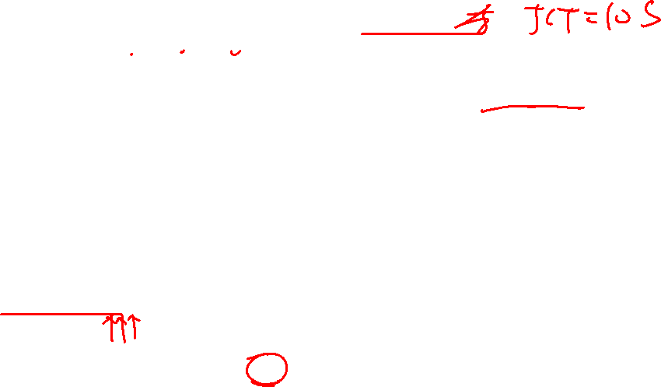
RR Scheduling Example
A, B and C arrive at the same time.
They each wishes to run for 5 seconds.
A
B
C
$$T_{average response}=\frac{0+5+10}{3}=5sec$$
0
5
10
15
20
25
30
Time (Second)
SJF (Bad for Response Time)
What about JCT?
A
B
A
B
A
B
A
B
A
C
C
C
C
B
C
$$T_{average response}=\frac{0+1+2}{3}=1sec$$
0
5
10
15
20
25
30
Time (Second)
RR with a time-slice of 1sec (Good for Response Time)

Slide 15

Length of the time slice is critical
The shorter time slice
Better response time
But the cost of context switching will dominate overall performance.
The longer time slice
Amortize the cost of switching
Worse response time
Deciding on the length of the time slice presents
a trade-off to a system designer

Slide 16
Incorporating I/O
Let’s relax assumption 3: All programs perform I/O
Example:
A and B need 50ms of CPU time each.
A runs for 10ms and then issues an I/O request
I/Os takes 10ms each
B simply uses the CPU for 50ms and performs no I/O
The scheduler runs A first, then B

Slide 17
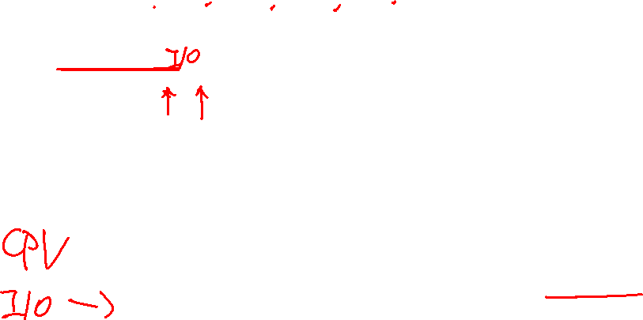
Incorporating I/O (Cont.)
A
A
A
A
A
B
B
B
B
B
0
20
40
60
80
100
120
140
Time (msec)
Poor Use of Resources
A
B
A
B
A
B
A
B
A
B
Maximize the
CPU utilization
0
20
40
60
80
100
120
140
Time (msec)
Overlap Allows Better Use of Resources

Slide 18
Incorporating I/O (Cont.)
When a job initiates an I/O request
The job is blocked waiting for I/O completion.
The scheduler should schedule jobs on the CPU.
When the I/O completes
An interrupt is raised.
The OS moves the process from the wait to the ready state.

Slide 19
Multi-Level Feedback Queue

Slide 20

Motivation
In reality, an OS does not know how long a job needs to run for!
Do you know how long you’ll use the Web browser or game for?
But we still want to schedule jobs well!
Is it possible to still design a good scheduler without any prior knowledge of job’s running time?
Optimize JCT → Run shorter jobs first
Also response time
“huh?”

Slide 21
MLFQ: Key idea
Upon arrival, each job is assumed to be a short, latency-sensitive job
Thus it should be scheduled right away with the highest priority for better response time.
If the job keeps running
It’s obvious that it’s not a short job anymore, and more likely to be a long or loong or looong job
Decrease its priority level, so other (shorter) jobs can run first for better JCT
We can be wrong at the beginning, but that’s a
necessary small price to pay for practicality

Slide 22
MLFQ: Basic Rules
MLFQ has a number of distinct queues.
Each queues is assigned a different priority level.
A job that is ready to run is on a single queue.
A job on a higher queue is chosen to run.
Use round-robin scheduling among jobs in the same queue
Rule 1: If Priority(A) > Priority(B), A runs (B doesn’t).
Rule 2: If Priority(A) = Priority(B), A & B run in RR.

Slide 23
MLFQ: Basic Rules (Cont.)
MLFQ varies the priority of a job based on its observed behavior.
Example:
A job repeatedly relinquishes the CPU while waiting IOs → Keep its priority high
A job uses the CPU intensively for long periods of time → Reduce its priority.

Slide 24
MLFQ Example
[High Priority]
Q8
Q7
Q6
Q5
Q4
Q3
Q2
Q1
A
B
C
[Low Priority]
D

Slide 25
MLFQ: How to Change Priority
MLFQ priority adjustment:
Rule 3: When a job enters the system, it is placed at the highest priority
Rule 4a: If a job uses up an entire time slice while running, its priority is reduced (i.e., it moves down on queue).
Rule 4b: If a job gives up the CPU before the time slice is up, it stays at the same priority level
In this manner, MLFQ approximates SJF

Slide 26
Example 1: A Single Long-Running Job
A three-queue scheduler with time slice 10ms
Q2
Q1
Q0
0
50
100
150
200
Long-running Job Over Time (ms)

Slide 27
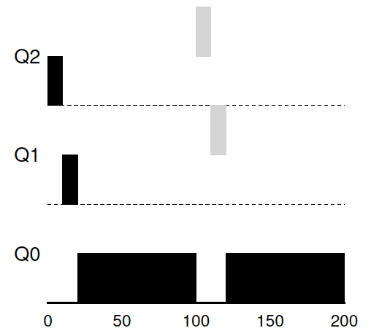
Example 2: Along Came a Short Job
Assumption:
Job A: A long-running CPU-intensive job
Job B: A short-running interactive job (20ms runtime)
A has been running for some time, and then B arrives at time T=100.
Along Came An Interactive Job (ms)

Slide 28
Example 3: What About I/O?
Assumption:
Job A: A long-running CPU-intensive job
Job B: An interactive job that needs CPU only for 1ms before performing an I/O
Q2
A:
Q1
B:
Q0
0
50
100
150
200
A Mixed I/O-intensive and CPU-intensive Workload (msec)
The MLFQ approach keeps an interactive job at the highest priority

Slide 29
Problems with the Basic MLFQ
Starvation
If there are “too many” interactive jobs in the system.
Lon-running jobs will never receive any CPU time.
Game the scheduler, or “cheat”
After running 99% of a time slice, issue an I/O operation.
The job gain a higher percentage of CPU time.
A program may change its behavior over time
CPU bound → I/O process

Slide 30

The Priority Boost
Rule 5: After some time period S, move all jobs in the system to the top queue.
Example:
A long-running job (A) with two short-running interactive jobs (B, C)
Q2
Q2
Q1
Q1
Q0
Q0
0
50
100
150
200
0
50
100
150
200
A:
B:
C:
Without(Left) and With(Right) Priority Boost

Slide 31
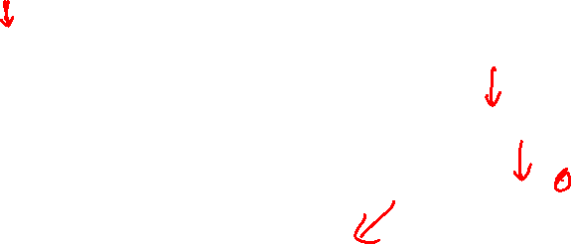
Better Accounting
How to prevent jobs from gaming our scheduler?
Solution:
Rule 4 (Rewrite Rules 4a and 4b): Once a job uses up its time allotment at a given level (regardless of how many times it has given up the CPU), its priority is reduced (i.e., it moves down on queue).
Q2
Q2
Q1
Q1
Q0
Q0
0
50
100
150
200
0
50
100
150
200
Without(Left) and With(Right) Gaming Tolerance

Slide 32
Tuning MLFQ And Other Issues
High-priority queues → Short time slices
E.g., 10 or fewer milliseconds
Low-priority queue → Long time slices
E.g., 100 milliseconds
Lower Priority, Longer Quanta
Q2
Q1
Q0
0
50
100
150
200
Example) 10ms for the highest queue, 20ms for the middle,
40ms for the lowest

Slide 33

MLFQ implementation: on Solaris
For the Time-Sharing scheduling class (TS)
60 Queues
Slowly increasing time-slice length
The highest priority: 20msec
The lowest priority: A few hundred milliseconds
Priorities boosted around every 1 second or so.

Slide 34
MLFQ: Summary
The refined set of MLFQ rules:
Rule 1: If Priority(A) > Priority(B), A runs (and B doesn’t).
Rule 2: If Priority(A) = Priority(B), A and B run in RR.
Rule 3: When a job enters the system, it is placed at the highest priority.
Rule 4: Once a job uses up its time allotment at a given level (regardless of how many times it has given up the CPU), its priority is reduced (i.e., it moves down one queue).
Rule 5: After some time period S, move all the jobs in the system to the topmost queue.
Beauty of MLFQ
It does not require prior knowledge on the CPU usage of a process.

Slide 35
Lottery Scheduling, Fair-share

Slide 36
Proportional Share Scheduler
Fair-share scheduler
Guarantee that each job obtain a certain percentage of CPU time.
Not optimized for JCT or response time

Slide 37
Basic Concept
Tickets
Represents a scheduling opportunity
The percentage of tickets represents a process’s share of the system resource in question.
Example
There are two processes, A and B.
Process A has 75 tickets → receive 75% of the CPU
Process B has 25 tickets → receive 25% of the CPU

Slide 38
Lottery scheduling
The scheduler picks a winning ticket
Load the state of that winning process and runs it.
Example
There are 100 tickets
Process A has 75 tickets: 0 ~ 74
Process B has 25 tickets: 75 ~ 99
Scheduler’s winning tickets:
63 85 70 39 76 17 29 41 36 39 10 99 68 83 63
Resulting scheduler:
A
B
A
A
B
A
A
A
A
A
A
B
A
B
A
The longer these two jobs compete,
The more likely they are to achieve the desired percentages.

Slide 39
Ticket Mechanisms
Ticket currency
A user allocates tickets among their own jobs in whatever currency they would like.
The system converts the currency into the correct global value.
Example
There are 200 tickets (Global currency)
Process A has 100 tickets
Process B has 100 tickets
User A → 500 (A’s currency) to A1 → 50 (global currency)
→ 500 (A’s currency) to A2 → 50 (global currency)
User B → 10 (B’s currency) to B1 → 100 (global currency)

Slide 40
Ticket Mechanisms (Cont.)
Ticket transfer
A process can temporarily hand off its tickets to another process.
Ticket inflation
A process can temporarily raise or lower the number of tickets it owns.
If any one process needs more CPU time, it can boost its tickets.

Slide 41
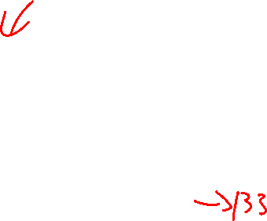
Implementation
Example: There are three processes, A, B, and C.
Keep the processes in a list sorted by the ticket number
Job:A
Tix:100
Job:B
Tix:50
Job:C
Tix:250
head
NULL
1 // counter: used to track if we’ve found the winner yet
2 int counter = 0;
3
4 // winner: use some call to a random number generator to
5 // get a value, between 0 and the total # of tickets
6 int winner = getrandom(0, totaltickets);
7
8 // current: use this to walk through the list of jobs
9 node_t *current = head;
10
11 // loop until the sum of ticket values is > the winner
12 while (current) {
13 counter = counter + current->tickets;
14 if (counter > winner)
15 break; // found the winner
16 current = current->next;
17 }
18 // ’current’ is the winner: schedule it...

Slide 42
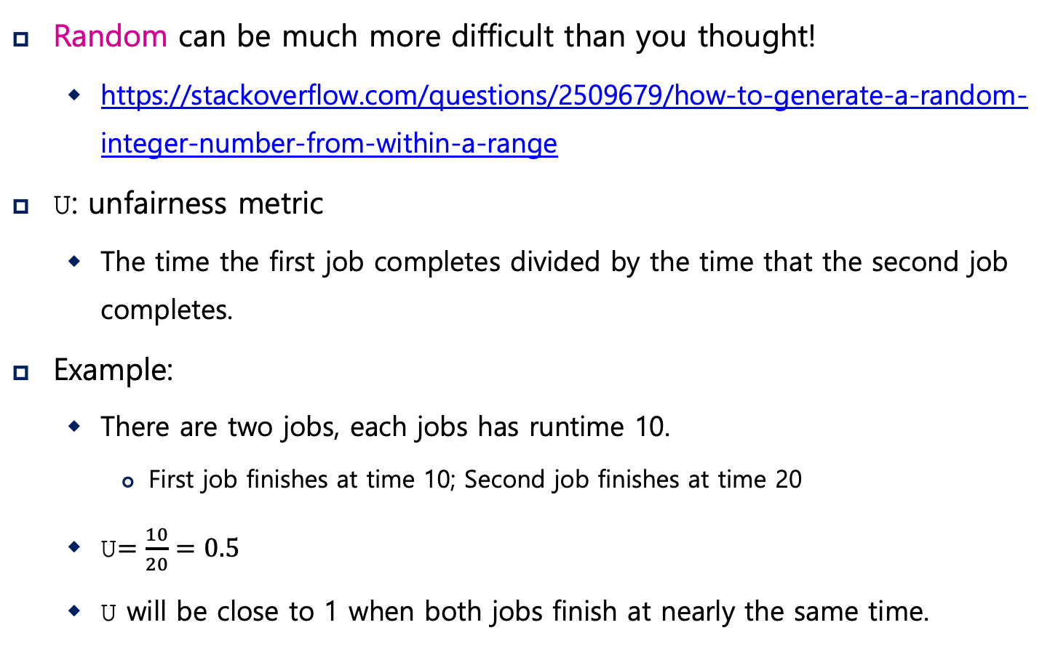
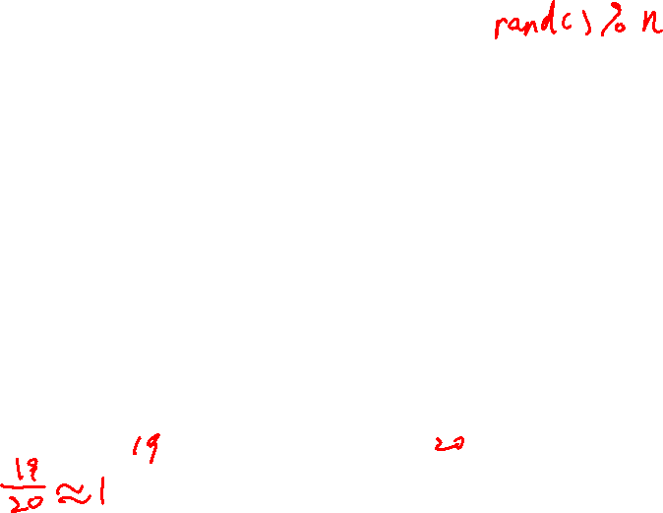
Implementation (Cont.)
Random can be much more difficult than you thought!
https://stackoverflow.com/questions/2509679/how-to-generate-a-random-integer-number-from-within-a-range
U: unfairness metric
The time the first job completes divided by the time that the second job completes.
Example:
There are two jobs, each jobs has runtime 10.
First job finishes at time 10; Second job finishes at time 20
U$=\frac{10}{20}=0.5$
U will be close to 1 when both jobs finish at nearly the same time.

Slide 43
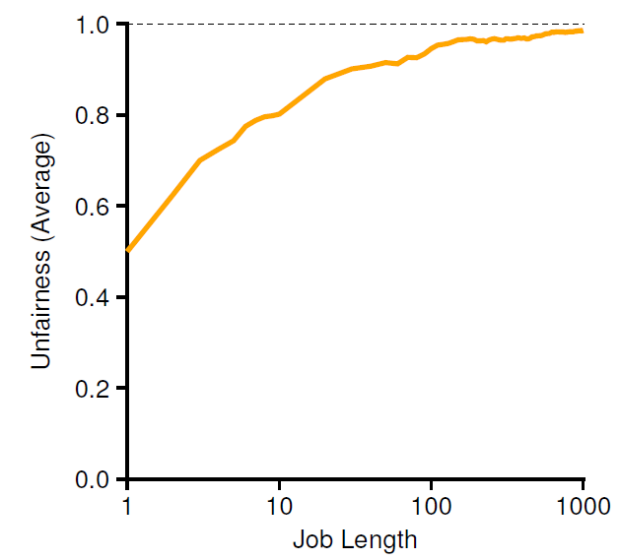
Lottery Fairness Study
There are two jobs.
Each jobs has the same number of tickets (100).
When the job length is not very long,
average unfairness can be quite severe.

Slide 44

Deterministic Approach: Stride Scheduling
Stride of each process
A large number / number of tickets of the process
Example: A large number = 10,000
Process A has 100 tickets → stride of A is 100
Process B has 50 tickets → stride of B is 200
A process runs, increments a counter (pass value) for it by its stride
Pick the process that has the lowest pass value to run
current = remove_min(queue); // pick client with minimum pass
schedule(current); // use resource for quantum
current->pass += current->stride; // compute next pass using stride
insert(queue, current); // put back into the queue
A pseudo code implementation

Slide 45
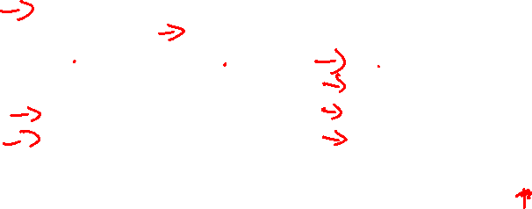
Stride Scheduling Example
Pass(A)
(stride=100)
Pass(B)
(stride=200)
Pass(C)
(stride=40)
Who Runs?
0
100
100
100
100
100
200
200
200
0
0
200
200
200
200
200
200
200
0
0
0
40
80
120
120
160
200
A
B
C
C
C
A
C
C
…
Stride scheduling needs to maintain the per process pass value.
If new job enters with pass value 0 it will monopolize the CPU!
Advantage of Lottery scheduling: no per-process state

Slide 46
The Linux Completely Fair Scheduling (CFS)
Completely Fair Scheduling (CFS)
The current CPU scheduler in Linux
Non-fixed timeslice
CFS assigns process’s timeslice a proportion of the processor.
Priority
Enables control over priority by using nice value.
Efficient data structures
Use red-black tree for efficient search, insertion and deletion of a process.
Notes:
The current Linux approach achieves similar goals in an alternate manner.
Fair-sharing scheduling, but spending little time making scheduling decision.
Scheduling uses about 5% of overall datacenter CPU time. (Study of Google datacenters, Kanev et al)
Recuing overhead is a key goal in modern scheduler architecture.

Slide 47
Basic
Virtual runtime (vruntime)
Denote how long the process has been executing.
Per-process variable
Increase in proportion with physical (real) time when it runs.
CFS will pick the process with the lowest vruntime to run next.
sched_latency
A typical value is 48 (milliseconds)
Process’s timeslice = sched_latency / (the number of process)

Slide 48
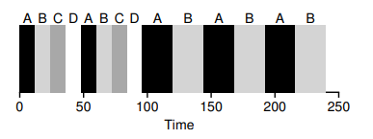
Example
Simple Example
4 processes ( A,B,C,D ) and then 2 processes(C,D) complete.
min_granularity
The minimum timeslice ( 6ms)
Ensure that not too much time is spent in scheduling overhead, When there are too many processes running.

Slide 49
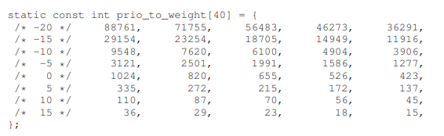
Weight
Nice value
CFS enables control over process priority
Nice parameter is an integer value and can be set from -20 to +19
The nice value is mapped to a weight (value is not important)

Slide 50

Weighting (Niceness)
New timeslice formula
$$time_slice_{k}=\frac{weight_{k}}{\sum_{n=0}^{n−1}{weight_{i}}}∙sched_latency$$
Simple Example
Assign Process A a nice value of -5 and process B a nice value of 0.
Process | nice value | weight | Time slice
A | -5 | 3121 | 36 ms
B | 0 | 1024 | 12 ms

Slide 51

vruntime with weight
Weighting (Niceness)
vruntime formula
Calculate the actual run time; scale it inversely by the weight
$$vruntime_{i}=vruntime_{i}+\frac{weight_{0}}{weight_{i}}∙runtime_{i}$$
$weight_{0}$ is the default weight, 1024
Example
Process | nice value | weight | Accumulated value
A | -5 | 3121 | 1/3 * runtime
B | 0 | 1024 | 1 * runtime

Slide 52
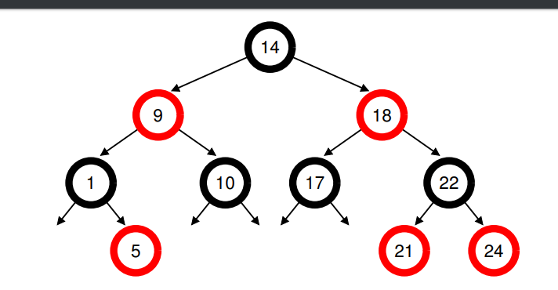
Structure of ready queue
Red-Black Tree
Balanced binary tree (can address worst-case insertion)
Ordering of Red-Black Tree: O(log n)
Efficiently find the process with minimum virtual runtime.
Only running (or runnable) processes are kept therein.

Slide 53
IO and sleeping process
Dealing with I/O and sleeping processes
Avoid the situation where some process monopolizes CPU, if it has significantly small vruntime after sleeping
Set the vruntime of process to the minimum value found in tree when it wakes up.
Cost: Process that sleeps for short periods of time frequently do not ever get their fair share of the CPU
Notes:
만약 2개의 프로세스가 실행되고 있고, 하나의 프로세스가 반복적으로 Sleeping 상태에 들어간다고 가정하자.
2 개의 프로세스의 vruntime의 꾸준히 높아지고 남은 하나는 반복적으로 같은 vruntime을 할당 받는다.
이로 인해 슬립 프로세스는 CPU를 할당 받지 못하였음에도 vruntime이 지속적으로 올라간다.

