Slide 1
Tutorial 8: Midterm Solution
CSCI3150 Introduction to Operating Systems, Fall 2024
CHEN Kaiwen(kwchen@link.cuhk.edu.hk)
LI Jianqiang (1155157143@link.cuhk.edu.hk)
Oct 24, 2024

Slide 2
Reminder
Midterm Result
Collect midterm paper after this tutorial
Assignment 2
Due at 18:00:00 p.m., Mon, Nov 4th
Assignment 3
Will release after this tutorial
Due at 18:00:00 p.m., Mon, Nov 18th

Slide 3
Quick Solution Check
Q1 (2x0.5 = 1)
(a) A; (b) C.
Q2 (0.5 + 2x0.25 = 1)
(a) 4; (b) 3, 7.
Q4 (0.25x4 = 1)
1. sem_wait(&seats);
2. sem_wait(&waiters);
3. sem_post(&waiters);
4. sem_post(&seats);
Q3 (4x0.3 + 2x0.4 = 2)
1. meat == 0
2. pthread_cond_signal(&cond_meat);
3. bread < MAX_BREAD
4. pthread_cond_signal(&cond_bread);
5. pthread_cond_wait(&cond_meat, &mutex);
6. pthread_cond_wait(&cond_bread, &mutex);

Slide 4
Midterm Result Overview
Question | 1 | 2 | 3 | 4 | Total
Avg | 0.35 | 0.55 | 1.38 | 0.90 | 3.18
Median | 0.5 | 0.75 | 1.6 | 1 | 3.5
Max | 1 | 1 | 2 | 1 | 5
SD | 0.30 | 0.44 | 0.73 | 0.26 | 1.12
All codes used in this tutorial:
https://github.com/henryhxu/CSCI3150/tree/2024-Fall/tutorial/T08

Slide 5
Assessment Policy and Hints
Overall Assessment
4 assignments (50%)
5 ureply quizzes (5%) + midterm (5%)
Final (40%)
Midterm serves as a wake-up quiz
Want to do better?
Try bonus question in assignments
Don’t miss the following ureply quizzes in tutorial
Prepare better for final exam

Slide 6
Grade Appeal Policy
Policy
Only accept appeals for incorrect judgement(The correct answer was accidentally judged as wrong)
Time limit: before Fri, Nov 1st
Contact TAs
LI Jianqiang & CHEN Yuetao

Slide 7
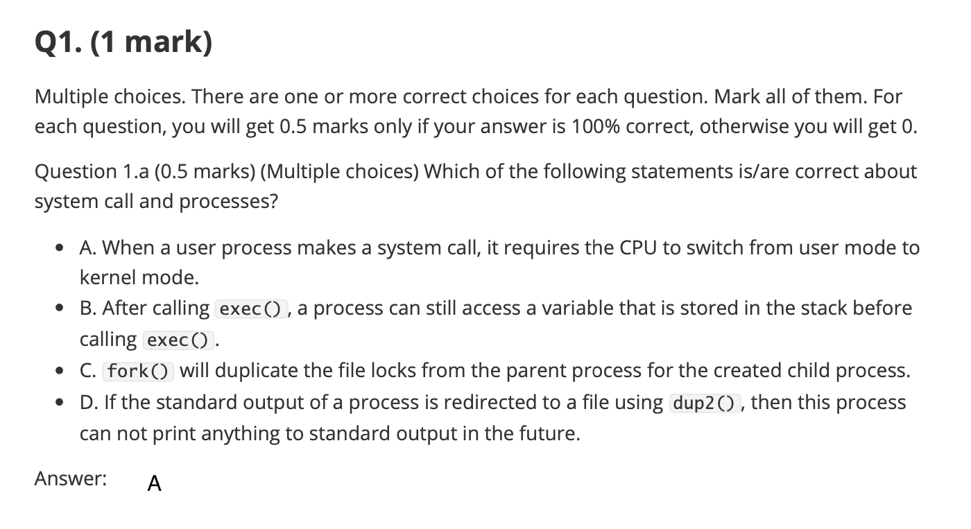
Question 1(a)
A:
correct. When a user process makes a system call, it requests services from the operating system’s kernel. To execute these privileged operations, the CPU must switch from user mode to kernel mode.
C: File locks are associated with the process’s PID , not with file descriptors.
B:
The exec() functions replaces the current process image with a new program. This means the entire memory space of the process, including the stack, is replaced.
D:
dup2() changes where the output is sent,
but the process can still write to standard output—it will just go to the new location (new file) and can be redirected again
Notes:
A. This statement is correct. When a user process makes a system call, it requests services from the operating system’s kernel. To execute these privileged operations, the CPU must switch from user mode to kernel mode.

Slide 8
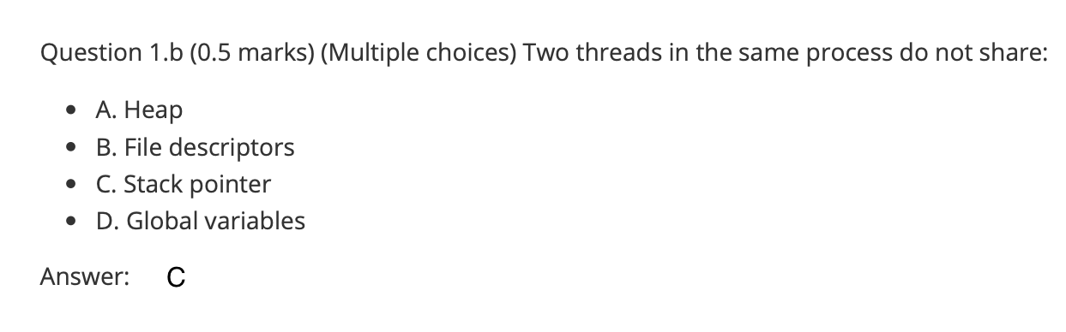
Question 1(b)
Explanation
A: The heap is a region of a process’s memory used for dynamic memory allocation. It is accessible by all threads of the same process, facilitating data sharing and communication within the process.
B: File descriptors are handles used by a process to access files or I/O resources. In a multi-threaded process, all threads share the same set of file descriptors.
C: The stack is used to store a thread’s execution history, including function calls, return addresses, and local variables. The stack pointer points to the top of the current thread’s stack.
D: Global variables are stored in the process’s data segment.
(You can also refer to page 7-8 in lec4-threads)

Slide 9
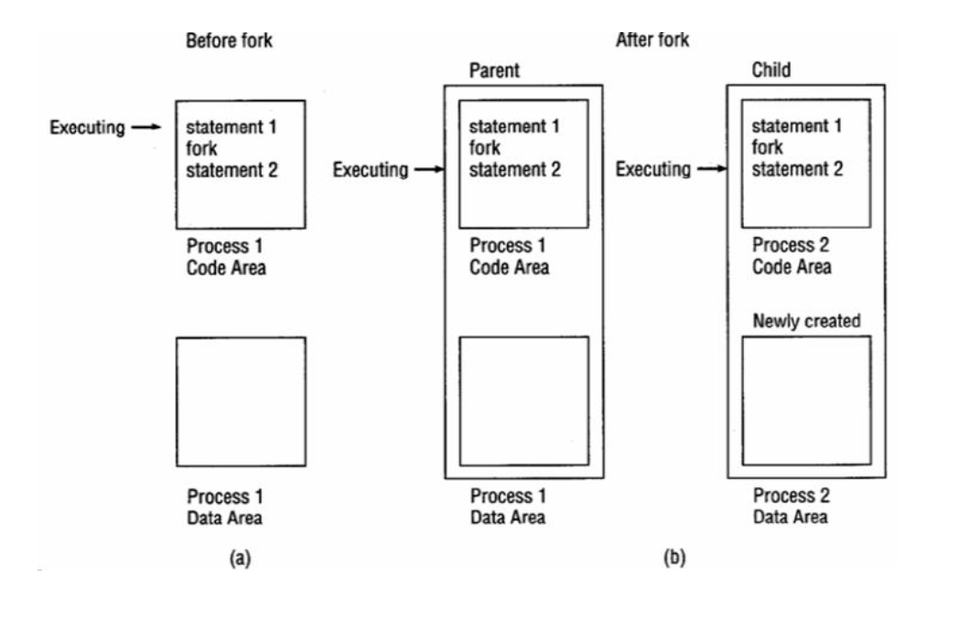
Question 2
A quick review of fork():
The fork() creates a new child process, by duplicating the parent process.
Child Process Start Point: After a successful fork(), both the parent and child processes continue execution independently from the point immediately following the fork() call.

Slide 10
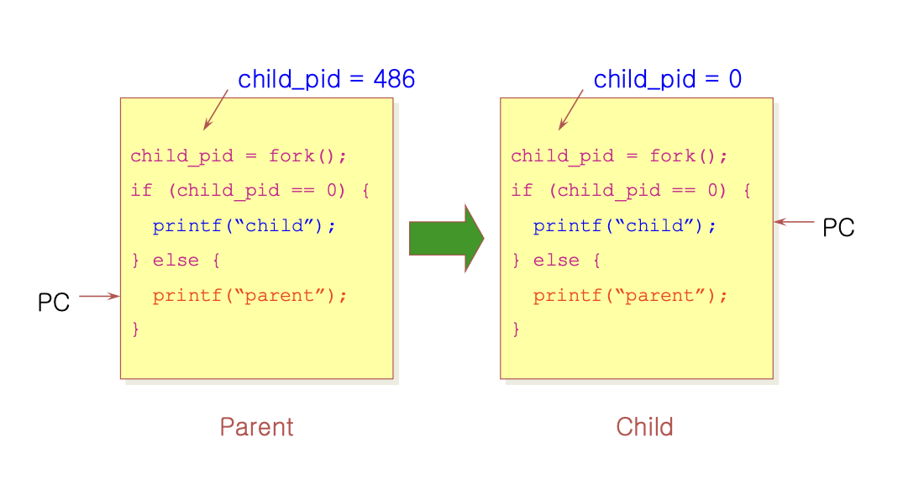
Question 2(cont.)
The fork() function returns different values to the parent and child processes
In the Parent Process: Returns the Process ID (PID) of the newly created child process (a positive integer).
In the Child Process: Returns 0.
On Failure: Returns -1 in the parent process.

Slide 11
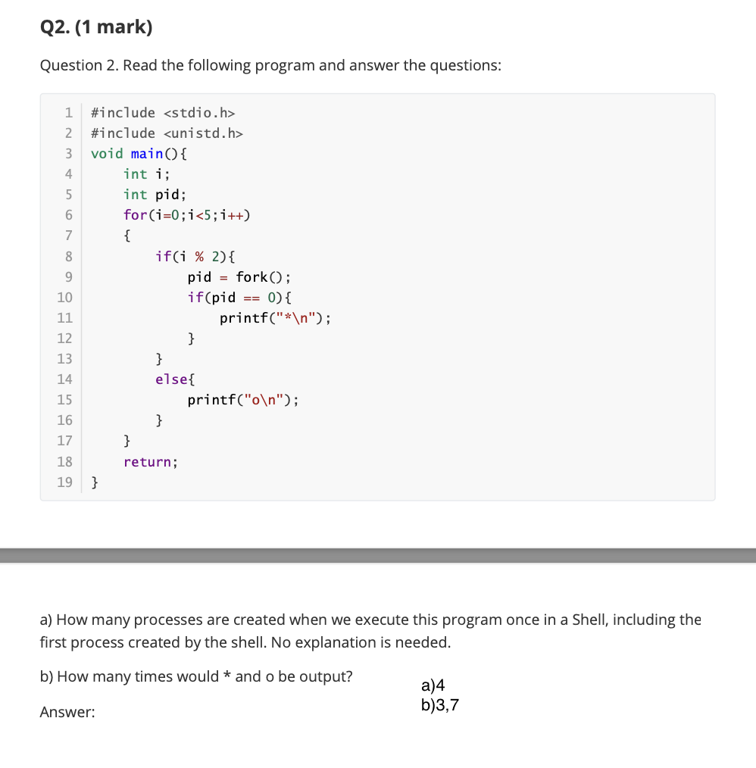
Question 2(cont.)
i=0:
Process 0: “o\n”
i=1:
Process 0:
Process 1: “*\n”
i=2:
Process 0: “o\n”
Process 1: “o\n”
i=3:
Process 0:
Process 1:
Process 2: “*\n”
Process 3: “*\n”
i=4:
Process 0: “o\n”
Process 1: “o\n”
Process 2: “o\n”
Process 3: “o\n”
Notes:
“The modulus of i and 2.”

Slide 12
Question 3
Imagine you run a restaurant specializing in shawarma, a popular street food across the Arab world. You have four workers: a meat supplier, a bread supplier, and two producers who make the shawarma.
The meat supplier only delivers meat when the rotisserie is completely empty, after which the meat volume reaches its maximum capacity. The bread supplier continuously provides bread one by one until a specified limit is reached. Each producer requires one portion of meat and two pieces of bread to make a shawarma.
You are required to fill in the TODOs in the following simulating code. Each TODO only needs one line of code.
Hint -- condition variable related POSIX APIs that may be used:
int pthread_cond_wait(pthread_cond_t *cv, pthread_mutex_t *mutex); -- fall asleep
int pthread_cond_signal(pthread_cond_t *cv); -- wake up other thread(s)

Slide 13
Recap: pthread_cond_wait (from T05)
Purpose: wait for a condition variable to be signaled, releasing the associated mutex.
Syntax:
int pthread_cond_wait(pthread_cond_t *cond, pthread_mutex_t *mutex);
Parameters:
cond: pointer to the condition variable.
mutex: pointer to an associated mutex (must be locked before calling).
Example:
pthread_mutex_lock(&mutex);
while (condition_is_false) {
pthread_cond_wait(&cond, &mutex);
}
pthread_mutex_unlock(&mutex);
use while loops for pthread_cond_wait to handle spurious wakeups.

Slide 14
Recap: pthread_cond_signal (from T05)
Purpose: wake up one (or more) thread(s) waiting on a condition variable.
Syntax:
int pthread_cond_signal(pthread_cond_t *cond);
Parameters:
cond: pointer to the condition variable.
Example:
pthread_mutex_lock(&mutex);
// Change the condition
pthread_cond_signal(&cond);
pthread_mutex_unlock(&mutex);

Slide 15
Question 3 Solution
void* bread_supplier(void* arg) {
while (1) {
pthread_mutex_lock(&mutex);
if (bread < MAX_BREAD) {
bread++;
printf("Bread supplier added a bread. Total bread: %d\n", bread);
pthread_cond_signal(&cond_bread); // Notify producers
}
pthread_mutex_unlock(&mutex);
}
return NULL;
}
void* producer(void* arg) {
while (1) {
pthread_mutex_lock(&mutex);
while (meat < 1) {
pthread_cond_wait(&cond_meat, &mutex); // Wait for meat
}
while (bread < 2) {
pthread_cond_wait(&cond_bread, &mutex); // Wait for bread
}
// Produce one shawarma
meat--;
bread -= 2;
printf("Producer made a shawarma.\n");
shawarma++;
pthread_mutex_unlock(&mutex);
}
return NULL;
}
#include <stdio.h>
#include <pthread.h>
#include <unistd.h>
#define MAX_MEAT 5
#define MAX_BREAD 10
pthread_mutex_t mutex = PTHREAD_MUTEX_INITIALIZER;
pthread_cond_t cond_meat = PTHREAD_COND_INITIALIZER;
pthread_cond_t cond_bread = PTHREAD_COND_INITIALIZER;
int meat = 0;
int bread = 0;
int shawarma = 0;
void* meat_supplier(void* arg) {
while (1) {
pthread_mutex_lock(&mutex);
if (meat == 0) {
meat = MAX_MEAT;
printf("Meat supplier refilled the meat.\n");
pthread_cond_signal(&cond_meat);
}
pthread_mutex_unlock(&mutex);
}
return NULL;
}
add bread if not full;
else do nothing
q3.c
signal producer when not empty
wait meat supplier when no meat
refill if empty;
else do nothing
wait bread supplier when no enough breads
signal producer when not empty

Slide 16
Question 3 Wrong Answer
void* bread_supplier(void* arg) {
while (1) {
pthread_mutex_lock(&mutex);
if (bread < MAX_BREAD) {
bread++;
printf("Bread supplier added a bread. Total bread: %d\n", bread);
pthread_cond_wait(&cond_bread, &mutex); // Notify producers
}
pthread_mutex_unlock(&mutex);
}
return NULL;
}
void* producer(void* arg) {
while (1) {
pthread_mutex_lock(&mutex);
while (meat < 1) {
pthread_cond_signal(&cond_meat); // Wait for meat
}
while (bread < 2) {
pthread_cond_signal(&cond_bread); // Wait for bread
}
// Produce one shawarma
meat--;
bread -= 2;
printf("Producer made a shawarma.\n");
shawarma++;
pthread_mutex_unlock(&mutex);
}
return NULL;
}
#include <stdio.h>
#include <pthread.h>
#include <unistd.h>
#define MAX_MEAT 5
#define MAX_BREAD 10
pthread_mutex_t mutex = PTHREAD_MUTEX_INITIALIZER;
pthread_cond_t cond_meat = PTHREAD_COND_INITIALIZER;
pthread_cond_t cond_bread = PTHREAD_COND_INITIALIZER;
int meat = 0;
int bread = 0;
int shawarma = 0;
void* meat_supplier(void* arg) {
while (1) {
pthread_mutex_lock(&mutex);
if (meat == 0) {
meat = MAX_MEAT;
printf("Meat supplier refilled the meat.\n");
pthread_cond_wait(&cond_meat, &mutex);
}
pthread_mutex_unlock(&mutex);
}
return NULL;
}
q3_wrong.c
wait producer when not empty
signal meat supplier when no meat
signal bread supplier when no enough breads
wait producer when not empty

Slide 17
Question 3 Wrong Answer
void* bread_supplier(void* arg) {
while (1) {
pthread_mutex_lock(&mutex);
if (bread < MAX_BREAD) {
bread++;
printf("Bread supplier added a bread. Total bread: %d\n", bread);
pthread_cond_wait(&cond_bread, &mutex); // Notify producers
}
pthread_mutex_unlock(&mutex);
}
return NULL;
}
void* producer(void* arg) {
while (1) {
pthread_mutex_lock(&mutex);
while (meat < 1) {
pthread_cond_signal(&cond_meat); // Wait for meat
}
while (bread < 2) {
pthread_cond_signal(&cond_bread); // Wait for bread
}
// Produce one shawarma
meat--;
bread -= 2;
printf("Producer made a shawarma.\n");
shawarma++;
pthread_mutex_unlock(&mutex);
}
return NULL;
}
What’s wrong???
“The bread supplier continuously provides bread one by one until a specified limit is reached. ” → shouldn’t wait after adding!
More seriously, the signal by producer will definitely FAIL!!!
Producer repeatedly tries to signal supplier, but doesn’t release the lock!
The waiting supplier may be waken up successfully, but will never get the lock!
As a result, the producer waits supplier to work, the supplier waits producer to release lock (for starting work)
wait producer when not empty
signal meat supplier when no meat
signal bread supplier when no enough breads

Slide 18
Question 4
In your shawarma restaurant, customers must have a seat and then receive service from a waiter before they can begin ordering. When the order is taken, the waiter leaves. When the meal is finished, the customer leaves the seat. This process can be simulated in C syntax (All the necessary header files have already been included).
You are required to fill in the TODOs in the code. Each TODO only need one line of code.
Hint -- semaphore related POSIX APIs that may be used:
int sem_wait(sem_t *);
int sem_post(sem_t *);

Slide 19
Recap: sem_wait (from lec7)
sem_wait()
If the value of the semaphore was one or higher when called sem_wait(), return right away.
It will cause the caller to suspend execution waiting for a subsequent post.
When negative, the value of the semaphore is equal to the number of waiting threads.
1 int sem_wait(sem_t *s) {
2 decrement the value of semaphore s by one
3 wait if value of semaphore s is negative
4 }

Slide 20
Recap: sem_post (from lec7)
sem_post()
Simply increments the value of the semaphore.
If there is a thread waiting to be woken, wakes one of them up.
1 int sem_post(sem_t *s) {
2 increment the value of semaphore s by one
3 if there are one or more threads waiting, wake one
4 }

Slide 21
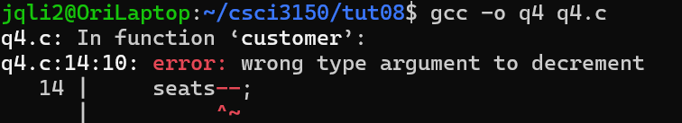
Question 4 Solution
#define NUM_SEATS 5 // Number of available seats
#define NUM_WAITERS 3 // Number of available waiters
#define NUM_CUSTOMERS 10 // Number of customers
sem_t seats; // Semaphore for available seats
sem_t waiters; // Semaphore for available waiters
void* customer(void* type) {
sem_wait(&seats);
sem_wait(&waiters);
order(); // The customer is ordering.
sem_post(&waiters);
eat(); // The customer finishes eating.
sem_post(&seats);
pthread_exit(NULL);
}
int main() {
pthread_t customers[NUM_CUSTOMERS];
sem_init(&seats, 0, NUM_SEATS);
sem_init(&waiters, 0, NUM_WAITERS);
for (int i = 0; i < NUM_CUSTOMERS; i++) {
pthread_create(&customers[i], NULL, customer, &customer_types[i]);
}
/* ... */
}
Requirements: customers must have a seat and then receive service from a waiter before they can begin ordering. When the order is taken, the waiter leaves. When the meal is finished, the customer leaves the seat.
Try to get a seat via wait()
Try to get a waiter via wait()
Order()
Release the waiter via post()
Eat()
Release the seat via post()
q4.c

Slide 22
Q & A

