Slide 1
CSCI3150 Introduction to Operating Systems
Lecture 3: Processes

Slide 2
Processes
This lecture starts a class segment that covers processes, threads, and synchronization
These topics are perhaps the most important in this course
You can rest assured that they will be covered in the exams
Today’s topics are processes and process management
What are the units of execution?
How are those units of execution represented in the OS?
What are the possible execution states of a process?
How does a process move from one state to another?

Slide 3

Users, Programs
Users have accounts on the system
Users launch programs
Many users may launch the same program
One user may launch many instances of the same program
Then what is a process?

Slide 4
The Process
The process is the OS’s abstraction for execution
It is the unit of execution
It is the unit of scheduling
It is the dynamic execution context of a program, a concrete instantiation of the program
A process is sometimes called a job or a task

Slide 5
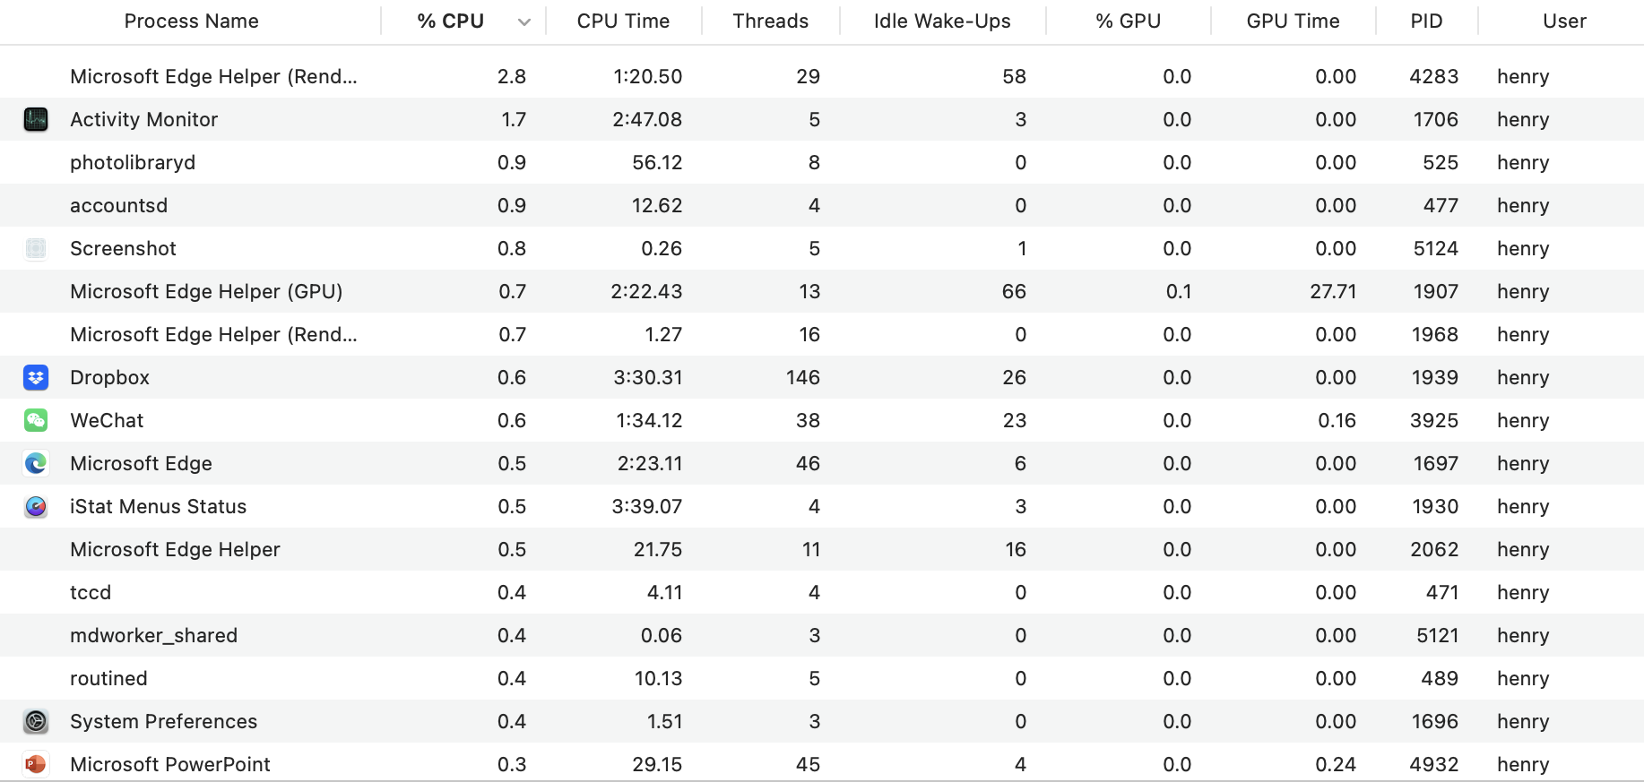
MacOS example: Activity monitor

Slide 6
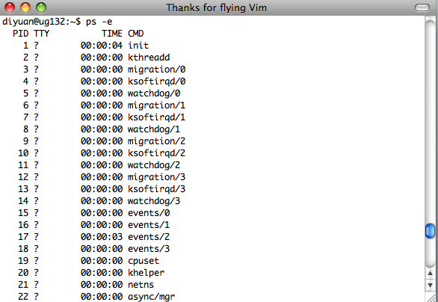
Linux example: ps

Slide 7
So what is a process?
A process is a program in execution
It is one executing instance of a program
It is separated from other instances
It can start (“launch”) other processes
It can be launched by them

Slide 8
Process State
A process has an execution state that indicates what it is doing
Running: Executing instructions on the CPU
It is the process that has control of the CPU
How many processes can be in the running state simultaneously?
Ready: Waiting to be assigned to the CPU
Ready to execute, but another process is executing on the CPU
Waiting: Waiting for an event, e.g., I/O completion
It cannot make progress until event is signaled (disk completes)
As a process executes, it moves from state to state
Unix “ps”: STAT column indicates execution state

Slide 9
Questions
What state do you think a process is in most of the time?
For a uni-processor machine, how many processes can be in running state?
Benefit of multi-core?

Slide 10
Process State Graph
Create Process
New
Ready
I/O Done
Un-schedule Process
Schedule Process
Waiting
I/O, Page Fault, etc.
Terminated
Running
Process Exit
Notes:
New: really is the parent process.
The moment you do I/O --- waiting. Why?

Slide 11
Process Components
Process State
new, ready, running, waiting, terminated, …
Program Counter
the address of the next instruction to be executed for this process;
CPU Registers
index registers, stack pointers, general purpose registers;
CPU Scheduling Information
process priority;

Slide 12
Process Components (cont.)
Memory Management Information
base/limit information, virtual->physical mapping, etc
Accounting Information
time limits, process number; owner
I/O Status Information
list of I/O devices allocated to the process;
An Address Space
memory space visible to one process

Slide 13
Now how about this?
int myval;
int main(int argc, char *argv[])
{
myval = atoi(argv[1]);
while (1)
printf(“myval is %d, loc 0x%lx\n”, myval, (long) &myval);
}
Now simultaneously start two instances of this program
Myval 5
Myval 6
What will the outputs be?

Slide 14
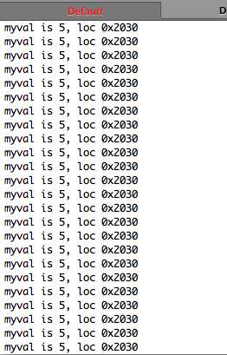
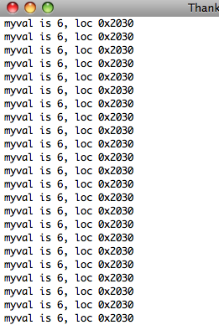
Output differs on your machine!

Slide 15
Address in a Process
The address was always the same
But the values were different
Implications?
The programs aren’t seeing each other
But they think they’re using the same address
Conclusion: addresses here are not w.r.t. the physical memory
How?
Memory mapping
What is the benefit?

Slide 16
A Process’s Address Space
0xFFFFFFFF
Stack
SP
•Allows stack growth
•Allows heap growth
•No predetermined division
Address
Space
Heap
(Dynamic Memory Alloc)
Static Data
(Data Segment)
Code
(Text Segment)
PC
0x00000000

Slide 17
Process Data Structures
How does the OS represent a process in the kernel?
At any time, there are many processes in the system, each in its own state
The data structure representing each process is called the Process Control Block (PCB)
The PCB contains all info about a process
The PCB also is where the OS keeps a process’ hardware execution state (PC, SP, regs, etc.) when the process is not running
This state is everything needed to restore the hardware to the same state it was in when the process was switched out of the hardware

Slide 18
PCB Data Structure
PCB contains a huge amount of information in one big structure
Process ID (PID)
Execution state
Hardware state: PC, SP, regs
Memory management
Scheduling
Pointers for state queues
etc.

Slide 19
struct proc (Solaris)
/*
* One structure allocated per active process. It contains all
* data needed about the process while the process may be swapped
* out. Other per-process data (user.h) is also inside the proc structure.
* Lightweight-process data (lwp.h) and the kernel stack may be swapped out.
*/
typedef struct proc {
/*
* Fields requiring no explicit locking
*/
struct vnode *p_exec; /* pointer to a.out vnode */
struct as *p_as; /* process address space pointer */
struct plock *p_lockp; /* ptr to proc struct's mutex lock */
kmutex_t p_crlock; /* lock for p_cred */
struct cred *p_cred; /* process credentials */
/*
* Fields protected by pidlock
*/
int p_swapcnt; /* number of swapped out lwps */
char p_stat; /* status of process */
char p_wcode; /* current wait code */
ushort_t p_pidflag; /* flags protected only by pidlock */
int p_wdata; /* current wait return value */
pid_t p_ppid; /* process id of parent */
struct proc *p_link; /* forward link */
struct proc *p_parent; /* ptr to parent process */
struct proc *p_child; /* ptr to first child process */
struct proc *p_sibling; /* ptr to next sibling proc on chain */
struct proc *p_psibling; /* ptr to prev sibling proc on chain */
struct proc *p_sibling_ns; /* prt to siblings with new state */
struct proc *p_child_ns; /* prt to children with new state */
struct proc *p_next; /* active chain link next */
struct proc *p_prev; /* active chain link prev */
struct proc *p_nextofkin; /* gets accounting info at exit */
struct proc *p_orphan;
struct proc *p_nextorph;
*p_pglink; /* process group hash chain link next */
struct proc *p_ppglink; /* process group hash chain link prev */
struct sess *p_sessp; /* session information */
struct pid *p_pidp; /* process ID info */
struct pid *p_pgidp; /* process group ID info */
/*
* Fields protected by p_lock
*/
kcondvar_t p_cv; /* proc struct's condition variable */
kcondvar_t p_flag_cv;
kcondvar_t p_lwpexit; /* waiting for some lwp to exit */
kcondvar_t p_holdlwps; /* process is waiting for its lwps */
/* to to be held. */
ushort_t p_pad1; /* unused */
uint_t p_flag; /* protected while set. */
/* flags defined below */
clock_t p_utime; /* user time, this process */
clock_t p_stime; /* system time, this process */
clock_t p_cutime; /* sum of children's user time */
clock_t p_cstime; /* sum of children's system time */
caddr_t *p_segacct; /* segment accounting info */
caddr_t p_brkbase; /* base address of heap */
size_t p_brksize; /* heap size in bytes */
/*
* Per process signal stuff.
*/
k_sigset_t p_sig; /* signals pending to this process */
k_sigset_t p_ignore; /* ignore when generated */
k_sigset_t p_siginfo; /* gets signal info with signal */
struct sigqueue *p_sigqueue; /* queued siginfo structures */
struct sigqhdr *p_sigqhdr; /* hdr to sigqueue structure pool */
struct sigqhdr *p_signhdr; /* hdr to signotify structure pool */
uchar_t p_stopsig; /* jobcontrol stop signal */

Slide 20
struct proc (Solaris) (2)
/*
* Special per-process flag when set will fix misaligned memory
* references.
*/
char p_fixalignment;
/*
* Per process lwp and kernel thread stuff
*/
id_t p_lwpid; /* most recently allocated lwpid */
int p_lwpcnt; /* number of lwps in this process */
int p_lwprcnt; /* number of not stopped lwps */
int p_lwpwait; /* number of lwps in lwp_wait() */
int p_zombcnt; /* number of zombie lwps */
int p_zomb_max; /* number of entries in p_zomb_tid */
id_t *p_zomb_tid; /* array of zombie lwpids */
kthread_t *p_tlist; /* circular list of threads */
/*
* /proc (process filesystem) debugger interface stuff.
*/
k_sigset_t p_sigmask; /* mask of traced signals (/proc) */
k_fltset_t p_fltmask; /* mask of traced faults (/proc) */
struct vnode *p_trace; /* pointer to primary /proc vnode */
struct vnode *p_plist; /* list of /proc vnodes for process */
kthread_t *p_agenttp; /* thread ptr for /proc agent lwp */
struct watched_area *p_warea; /* list of watched areas */
ulong_t p_nwarea; /* number of watched areas */
struct watched_page *p_wpage; /* remembered watched pages (vfork) */
int p_nwpage; /* number of watched pages (vfork) */
int p_mapcnt; /* number of active pr_mappage()s */
struct proc *p_rlink; /* linked list for server */
kcondvar_t p_srwchan_cv;
size_t p_stksize; /* process stack size in bytes */
/*
* Microstate accounting, resource usage, and real-time profiling
*/
hrtime_t p_mstart; /* hi-res process start time */
hrtime_t p_mterm; /* hi-res process termination time */
hrtime_t p_mlreal; /* elapsed time sum over defunct lwps */
hrtime_t p_acct[NMSTATES]; /* microstate sum over defunct lwps */
struct lrusage p_ru; /* lrusage sum over defunct lwps */
struct itimerval p_rprof_timer; /* ITIMER_REALPROF interval timer */
uintptr_t p_rprof_cyclic; /* ITIMER_REALPROF cyclic */
uint_t p_defunct; /* number of defunct lwps */
/*
* profiling. A lock is used in the event of multiple lwp's
* using the same profiling base/size.
*/
kmutex_t p_pflock; /* protects user profile arguments */
struct prof p_prof; /* profile arguments */
/*
* The user structure
*/
struct user p_user; /* (see sys/user.h) */
/*
* Doors.
*/
kthread_t *p_server_threads;
struct door_node *p_door_list; /* active doors */
struct door_node *p_unref_list;
kcondvar_t p_server_cv;
char p_unref_thread; /* unref thread created */
/*
* Kernel probes
*/
uchar_t p_tnf_flags;

Slide 21
struct proc (Solaris) (3)
/*
* C2 Security (C2_AUDIT)
*/
caddr_t p_audit_data; /* per process audit structure */
kthread_t *p_aslwptp; /* thread ptr representing "aslwp" */
#if defined(i386) || defined(__i386) || defined(__ia64)
/*
* LDT support.
*/
kmutex_t p_ldtlock; /* protects the following fields */
struct seg_desc *p_ldt; /* Pointer to private LDT */
struct seg_desc p_ldt_desc; /* segment descriptor for private LDT */
int p_ldtlimit; /* highest selector used */
#endif
size_t p_swrss; /* resident set size before last swap */
struct aio *p_aio; /* pointer to async I/O struct */
struct itimer **p_itimer; /* interval timers */
k_sigset_t p_notifsigs; /* signals in notification set */
kcondvar_t p_notifcv; /* notif cv to synchronize with aslwp */
timeout_id_t p_alarmid; /* alarm's timeout id */
uint_t p_sc_unblocked; /* number of unblocked threads */
struct vnode *p_sc_door; /* scheduler activations door */
caddr_t p_usrstack; /* top of the process stack */
uint_t p_stkprot; /* stack memory protection */
model_t p_model; /* data model determined at exec time */
struct lwpchan_data *p_lcp; /* lwpchan cache */
/*
* protects unmapping and initilization of robust locks.
*/
kmutex_t p_lcp_mutexinitlock;
utrap_handler_t *p_utraps; /* pointer to user trap handlers */
refstr_t *p_corefile; /* pattern for core file */
#if defined(__ia64)
caddr_t p_upstack; /* base of the upward-growing stack */
size_t p_upstksize; /* size of that stack, in bytes */
uchar_t p_isa; /* which instruction set is utilized */
#endif
void *p_rce; /* resource control extension data */
struct task *p_task; /* our containing task */
struct proc *p_taskprev; /* ptr to previous process in task */
struct proc *p_tasknext; /* ptr to next process in task */
int p_lwpdaemon; /* number of TP_DAEMON lwps */
int p_lwpdwait; /* number of daemons in lwp_wait() */
kthread_t **p_tidhash; /* tid (lwpid) lookup hash table */
struct sc_data *p_schedctl; /* available schedctl structures */
} proc_t;

Slide 22
Context switching
When a process is running, its hardware state is in the CPU
The hardware registers contain the current values
When the OS stops running a process, it saves the current values of the registers into the process’ PCB
When the OS is ready to start executing a new process, it loads the hardware registers from the values stored in that process’s PCB
The process of changing the CPU hardware state from one process to another is called a context switch
This can happen 100 or 1000 times a second!

Slide 23
State Queues
How does the OS keep track of processes?
The OS maintains a collection of queues that represent the state of all processes in the system
Typically, the OS has one queue for each state
Ready, waiting, etc.
Each PCB is queued on a state queue according to its current state
As a process changes state, its PCB is unlinked from one queue and linked into another

Slide 24
State Queues
Ready Queue
Firefox PCB
X Server PCB
Idle PCB
Disk I/O Queue
Vim PCB
ls PCB
Console Queue
Sleep Queue
There may be many wait queues, one for each type of wait (disk, console, timer, network, etc.)

Slide 25
PCBs and State Queues
PCBs are data structures dynamically allocated in OS memory
When a process is created, the OS allocates a PCB for it, initializes it, and places it on the ready queue
As the process computes, does I/O, etc., its PCB moves from one queue to another
When the process terminates, its PCB is deallocated

Slide 26
Process Creation
A process is created by another process
Parent is creator, child is created (Unix: ps “PPID” field)
What creates the first (userspace) process? (Unix: init (PID 1))
In some OSes, the parent defines (or donates) resources and privileges for its children
Unix: Process User ID is inherited – children of your shell execute with your privileges
After creating a child, the parent may either wait for it to finish its task, or continue in parallel (or both)

Slide 27
Process Creation: Windows
The system call on Windows for creating a process is called, surprisingly enough, CreateProcess:
BOOL CreateProcess(char *prog, ....) (simplified)
CreateProcess
Creates and initializes a new PCB
Creates and initializes a new address space
Loads the program specified by “prog” into the address space
Initializes the hardware context to start execution at main (or wherever specified in the file)
Places the PCB on the ready queue

Slide 28
Process Creation: Unix
In Unix, processes are created using fork()
int fork(void)
Creates and initializes a new PCB
Creates a new address space
Initializes the address space with a copy of the entire contents of the parent’s address space
Initializes the kernel resources to point to the resources used by parent (e.g., open files)
Places the PCB on the ready queue
A fork() call returns twice
Returns the child’s PID to the parent, “0” to the child
Huh?

Slide 29
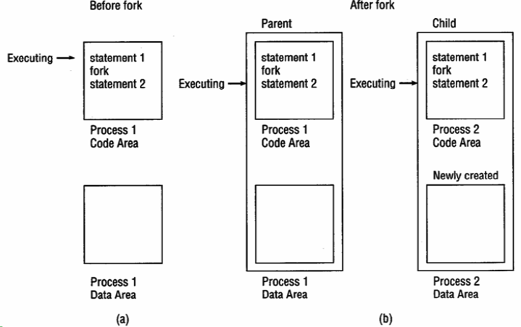
fork() semantics

Slide 30
fork()
int main(int argc, char *argv[])
{
char *name = argv[0];
int child_pid = fork();
if (child_pid == 0) {
printf(”Child of %s is %d\n”, name, getpid());
return 0;
} else {
printf(“My child is %d\n”, child_pid);
return 0;
}
}
What does this program print?

Slide 31
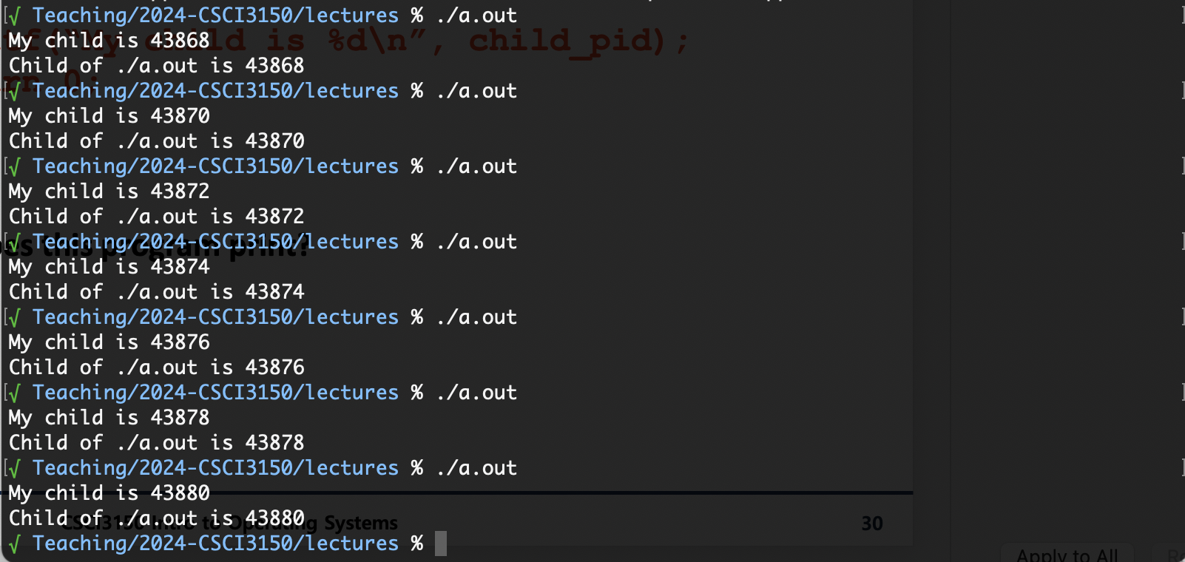

Slide 32
Duplicating Address Spaces
child_pid = 486
child_pid = 0
PC
child_pid = fork();
if (child_pid == 0) {
printf(“child”);
} else {
printf(“parent”);
}
child_pid = fork();
if (child_pid == 0) {
printf(“child”);
} else {
printf(“parent”);
}
PC
Parent
Child

Slide 33
Divergence
child_pid = 486
child_pid = 0
child_pid = fork();
if (child_pid == 0) {
printf(“child”);
} else {
printf(“parent”);
}
child_pid = fork();
if (child_pid == 0) {
printf(“child”);
} else {
printf(“parent”);
}
PC
PC
Parent
Child

Slide 34
Example Continued
> a.out
My child is 486
Child of a.out is 486
> a.out
Child of a.out is 498
My child is 498
Why is the output in a different order?

Slide 35
Why fork()?
Very useful when the child…
Is cooperating with the parent
Relies upon the parent’s data to accomplish its task
Example: Web server
while (1) {
int sock = accept();
if ((child_pid = fork()) == 0) {
Handle client request
}
}

Slide 36
How can fork return differently?
A: Return values are passed through registers
Integer return values use EAX for 32-bit architecture
B: PCB stores the states of all registers
Thus, can do the following trick:
child->PCB[return_value_register] = 0;
parent->PCB[return_value_register] = child_pid;
https://stackoverflow.com/questions/8857830/fork-implementation
https://en.wikipedia.org/wiki/X86_calling_conventions

Slide 37
Process Creation: Unix (2)
Wait a second. How do we actually start a new program?
int exec(char *prog, char *argv[])
exec()
Stops the current process
Loads the program “prog” into the process’ address space
Initializes hardware context and args for the new program
Places the PCB onto the ready queue
Note: It does not create a new process, no new PID
What does it mean for exec to return?

Slide 38
Process Creation: Unix (3)
fork() is used to create a new process, exec is used to load a program into the address space
What happens if you run “exec csh” in your shell?
What happens if you run “exec ls” in your shell? Try it.
fork() can return an error. Why might this happen?
Cannot create child process (return to parent).

Slide 39
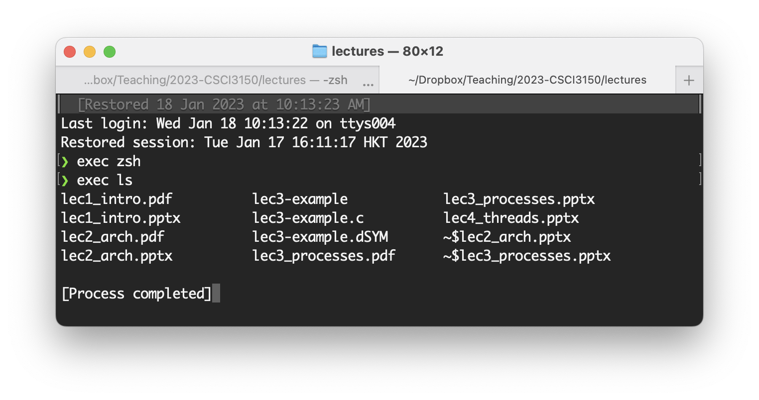
exec() overrides the current process completely
→ If it runs successfully, it never returns!

Slide 40

Process Creation: fork or not?
Why does Windows have CreateProcess while Unix uses fork/exec?
Comparing fork() and CreateProcess()?
Which is more convenient to use?
Which is more efficient?

Slide 41
Process Termination
All good processes must come to an end. But how?
Unix: exit(int status), Windows: ExitProcess(int status)
Essentially, free resources and terminate
Terminate all threads (next lecture)
Close open files, network connections
Allocated memory (and VM pages out on disk)
Remove PCB from kernel data structures, delete
Note that a process does not need to clean up itself
Why does the OS have to do it?

Slide 42

Process Termination
When exit() is called on Unix:
Threads are terminated (next lecture)
Open files, network connections are closed; address space is de-allocated
But the PCB still remains in the process table
To allow the parent to check for its exit status using a wait() variant
Only a parent can remove the PCB
and completely terminate the process, called reap
By calling wait()
Died but not yet reaped process is called a zombie

Slide 43
wait() a second…
Often it is convenient to pause until a child process has finished
Think of executing commands in a shell
Use wait() (WaitForSingleObject)
Suspends the current process until a child process ends
waitpid() suspends until the specified child process ends
Unix: Every process must be reaped by a parent
What happens if a parent process exits before a child?
What do you think a “zombie” process is?

Slide 44
Unix Shells
while (1) {
char *cmd = read_command();
int child_pid = fork();
if (child_pid == 0) {
/*Manipulate STDIN/OUT/ERR file descriptors for pipes, redirection, etc.*/
exec(cmd);
panic(“exec failed”);
} else {
waitpid(child_pid);
}
}
The evolution of the Unix time-sharing system, Dennis M. Ritchie
https://www.bell-labs.com/usr/dmr/www/hist.html

Slide 45
Process Summary
What are the units of execution? Processes
How are those units of execution represented?
Process Control Blocks (PCBs)
How is work scheduled in the CPU?
Process states, process queues, context switches
What are the possible execution states of a process?
Running, ready, waiting
How does a process move from one state to another?
Scheduling, I/O, creation, termination
How are processes created?
CreateProcess (Windows), fork/exec (Unix)

Slide 46
Copy-On-Write
Lazy copy
Proc. A’s address space
Proc. B’s address space
a = 10
fork()
a = 10
b = 20
b = 20
c = 30
c = 30
Physical memory
(RAM)
10
20
30

Slide 47
Copy-On-Write
Lazy copy
Proc. A’s address space
Proc. B’s address space
a = 10
fork()
a = 10
b = 20
b = 20
c = 30
c = 40
Physical memory
(RAM)
10
20
30
40

