Slide 1
Assignment One: Background Knowledge and Code Walk
CSCI3150 Introduction to Operating Systems, Fall 2024
Shaofeng Wu
wsf123@link.cuhk.edu.hk
Sep 12, 2024

Slide 2
Overview of Assignment One (1/1)
Assignment One: Implementation of A Simple Shell
Implement a basic shell that supports
Built-in commands
External commands
Pipe
Aim
Understanding how to interact with an operating system, e.g. Linux
Understanding the design choices and rationales of a shell
Before you start, what you need to know
The behavior of a real (bash) shell
How does the starter code we provide work?
How to compile and run the program?
The code logic of starter code?
How to verify that your program really works?
Github classroom for assignment one:
https://classroom.github.com/a/rrprBsu4

Slide 3
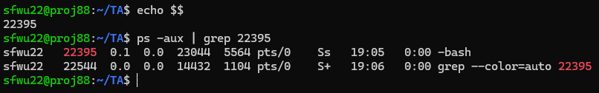
Shell Behavior (1/8)
What is shell?
A computer program that exposes an operating system's services to a human user or other programs
Each shell is a process (quick demo)
Use “echo $$” to check the process id
Use “ps –ax | grep PID” to check the process information
The shell that most people talk about on Linux is bash shell
Other shells, e.g. powershell, zsh, …

Slide 4
Shell Behavior (2/8)
Important feature of bash shell
Builtin commands: cd, echo, …
External commands: ls, find, sleep …
Key difference
Builtin commands are executed in main process of shell
External commands are executed in a child process of the shell
Try to think why?
Disclaimer: for bash shell, for single command

Slide 5
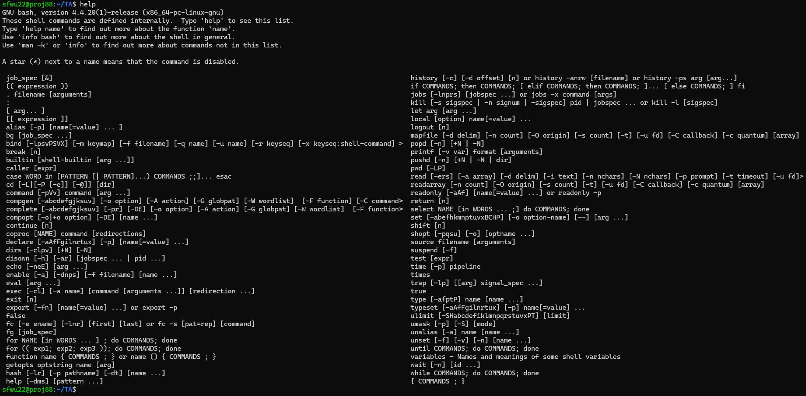
Shell Behavior (3/8)
Quick demo on builtin/exeternal commands
help
This shows all builtin commands

Slide 6

Shell Behavior (4/8)
Quick demo on builtin/exeternal commands
(In terminal 1) read -p "Press enter to continue..."
This executes a builtin command that waits for user input
(In terminal 2) pgrep -P [pid of your terminal 1]
This shows all the child process of the bash shell under test

Slide 7


Shell Behavior (5/8)
Quick demo on builtin/exeternal commands
(In terminal 1) sleep infinity
This executes a builtin command that waits for user input
(In terminal 2) pgrep -P [pid of your terminal 1]
This shows all the child process of the bash shell under test

Slide 8
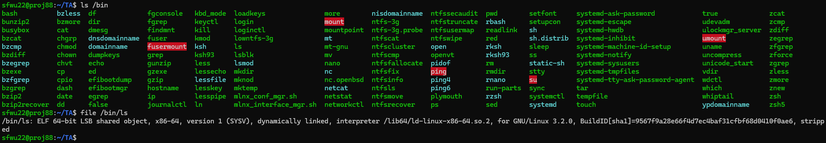
Shell Behavior (6/8)
Binaries of external commands
External commands are executed in a child process with their own pre-built binaries
Where are these binaries? (quick demo)
In “/bin”, “/usr/bin”, etc., they have binaries for different purposes
One take-away here: your own binary can also be a command
How does bash shell invoke these binaries? (next tutorial)

Slide 9
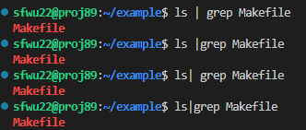

Shell Behavior (7/8)
Pipe
Shell has the following meta characters
\ / < > ! $ % ^ & * | { } [ ] " ' ` ~ ;
Pipe(|) is a feature that Linux shell provides to redirect command output to another command
Use “man 7 pipe” in your shell to check details
Some special notes (quick demo)
Space before and after pipe
In bash shells, space before and after pipe does not affect semantics (we do not require this in asg1, you only need to make sure space before&after pipe is supported)
Several pipes
Builtin commands with pipes: builtin commands will be executed in child process in this case (this behavior is required in asg1)
How does bash shell implement this feature? (next tutorial)

Slide 10


Shell Behavior (8/8)
Putting things together: builtin/external commands + pipe
Single command
Builtin commands in the main process
External commands in child processes
Multiple commands linked by pipes
All commands linked by pipes are executed in a child process

Slide 11
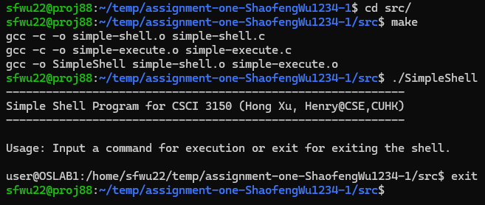
Compile & Run (1/1)
How to compile and run
Use “make” command to compile
You can search by yourself how to write and use a Makefile
Use “./SimpleShell” to run your compiled program
Note: The source code we provided is incomplete
You can successfully compile with the sources we provide, but the program only supports one command “exit”
Your task is to add other commands to the incomplete framework, or implement in your own framework

Slide 12
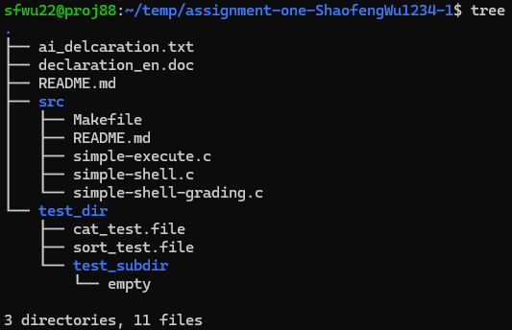
Code Walk (1/3)
Directory structure
.
DO NOT modify any file other than
src/simple-execute.c
ai_declaration.txt
declaration_en.doc.
DO NOT implement your shell by adding new files.

Slide 13
Code Walk (2/3)
/* shell_execute - Function to execute the command with specified command content and command arguments.
* @args String array with command and its arguments.
* @argc Total number of strings including the command, its arguments and the NULL in the end
*/
int shell_execute(char ** args, int argc){
int child_pid, wait_return, status;
/* Execute built-in commands */
/* exit */
if(strcmp(args[0], "exit") == 0 ){
return -1;
}
/* TODO: cd */
/* Non-built-in commands. These commands should be executed in a child process so the parent process can continue to invoke other commands */
/* One command without pipe */
if((child_pid = fork()) < 0){
printf("fork() error \n");
}
else if(child_pid == 0 ){
/* TODO: execute the command and check if the command is correctly executed */
}
/* TODOs: one pipe and two pipes */
/* wait for child process to terminate */
while((wait_return = wait(&status)) > 0);
return 0; }
simple-execute.c
int shell_execute(char ** args, int argc);
Arguments
Args: pointer to the pointer array of parsed command
Argc: number of parsed items
For example, input “ls –l” and enter
Args = {“ls”, “-l”}
Argc = 3
Return value
0 for next loop(normal execution)
-1 for break loop(error or exit)

Slide 14
Code Walk (3/3)
/* shell_execute - Function to execute the command with specified command content and command arguments.
* @args String array with command and its arguments.
* @argc Total number of strings including the command, its arguments and the NULL in the end
*/
int shell_execute(char ** args, int argc){
int child_pid, wait_return, status;
/* Execute built-in commands */
/* exit */
if(strcmp(args[0], "exit") == 0 ){
return -1;
}
/* TODO: cd */
/* Non-built-in commands. These commands should be executed in a child process so the parent process can continue to invoke other commands */
/* One command without pipe */
if((child_pid = fork()) < 0){
printf("fork() error \n");
}
else if(child_pid == 0 ){
/* TODO: execute the command and check if the command is correctly executed */
}
/* TODOs: one pipe and two pipes */
/* wait for child process to terminate */
while((wait_return = wait(&status)) > 0);
return 0; }
shell_execute
Single builtin command
In main process
Single external command
In child process
Multiple commands with pipes
Each one in one child process
Hint: use necessary system calls to implement these functionalities

Slide 15
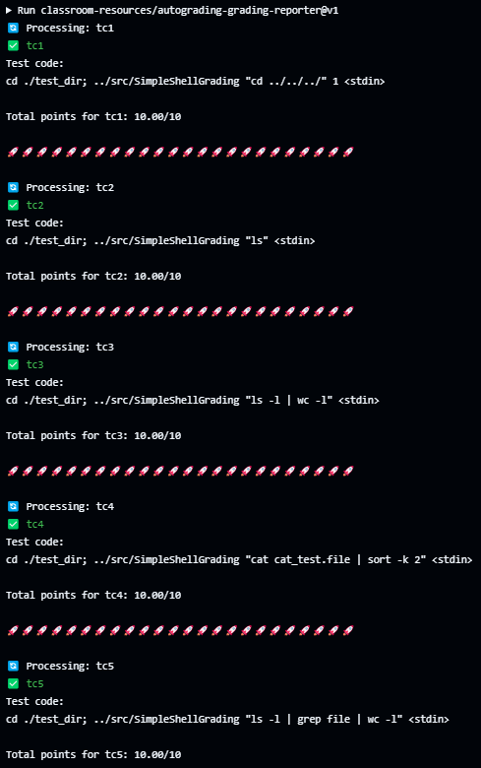
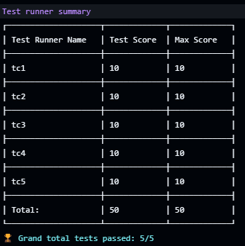
Verification (1/2)
Leveraging auto-grading
Five test cases are provided for your reference
Refer to autograding report to check test cases
We will use another set of test cases for final grading

Slide 16
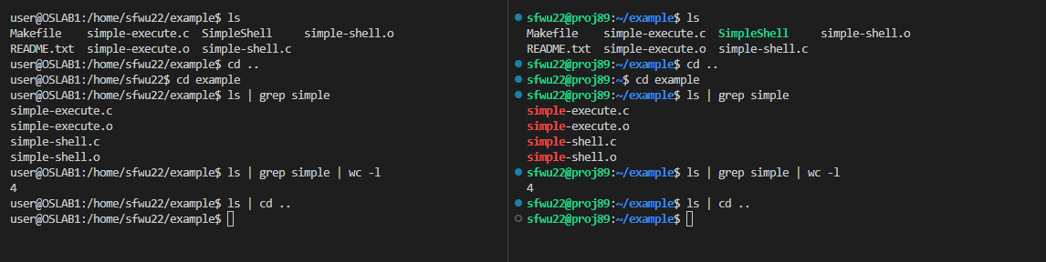
Verification (2/2)
Is autograding always correct?
How do we obtain the groundtruth?
Using a real bash shell to execute the command
So autograding are theoretically 100% correct
You can also compare the output of a real bash shell with your program to validate
Your program
Our autograding system
If you find any mistake without modifying any protected file/path (anything except for src/simple-execute.c), please open a discussion in piazza

Slide 17
Q & A

