Slide 1
Tutorial 11 FAT File System
Tutor: Luo Qin
qluo22@cse.cuhk.edu.hk

Slide 2
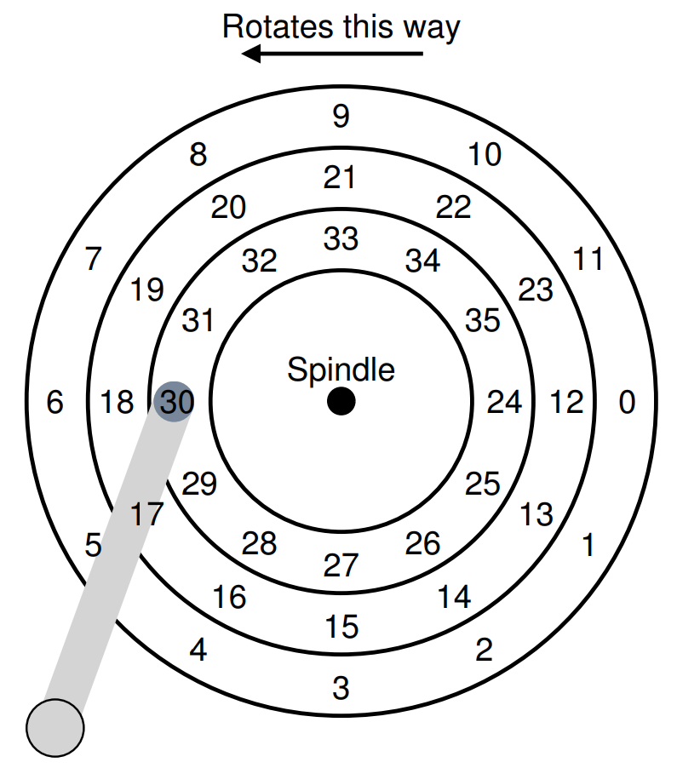
Hard Disk Drive
Sector
(512 Byte)
Cluster (Block)
(8*512 Byte=4KB)

Slide 3
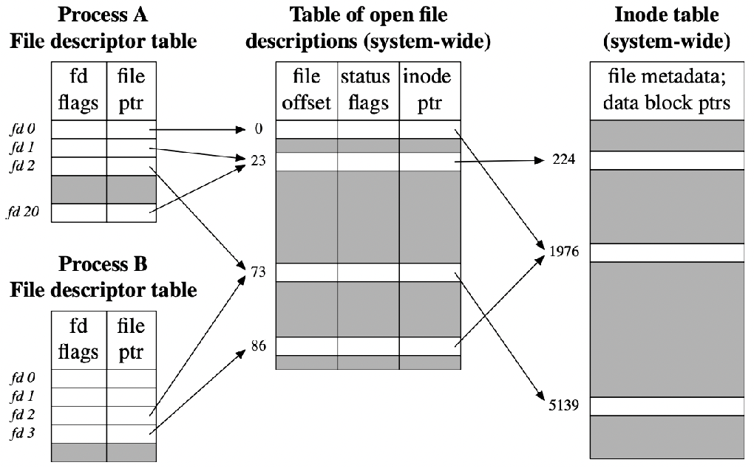
File and Directory
File and Directory is the abstract of the hard disk drive and I/O
File
One file occupy several clusters (data blocks)
inode: a data structure that describes a FS object
Directory
A file
A list of <user-readable filename, low-level name> pairs
Directory Entry
the logical unit in a directory file. A directory file has one or multiple directory entries. A directory entry is the metadata
of a file and could point to a file or a directory file.

Slide 4
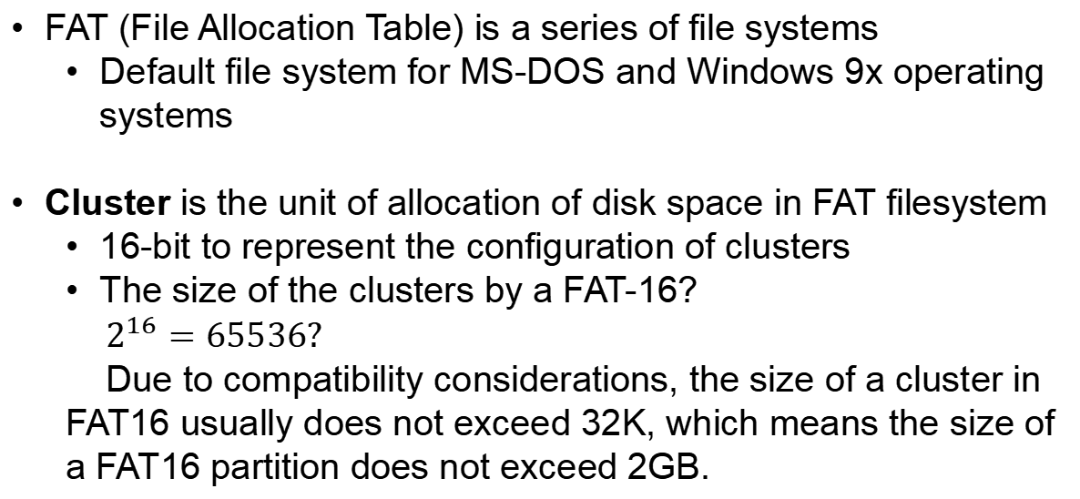
File Allocation Table (FAT)
FAT (File Allocation Table) is a series of file systems
Default file system for MS-DOS and Windows 9x operating systems
Cluster is the unit of allocation of disk space in FAT filesystem
16-bit to represent the configuration of clusters
The size of the clusters by a FAT-16?
$2^{16}=65536?$
Due to compatibility considerations, the size of a cluster in FAT16 usually does not exceed 32K, which means the size of a FAT16 partition does not exceed 2GB.

Slide 5
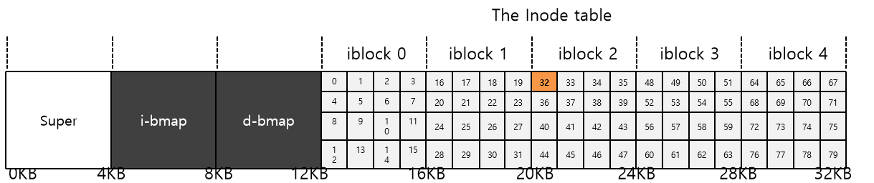
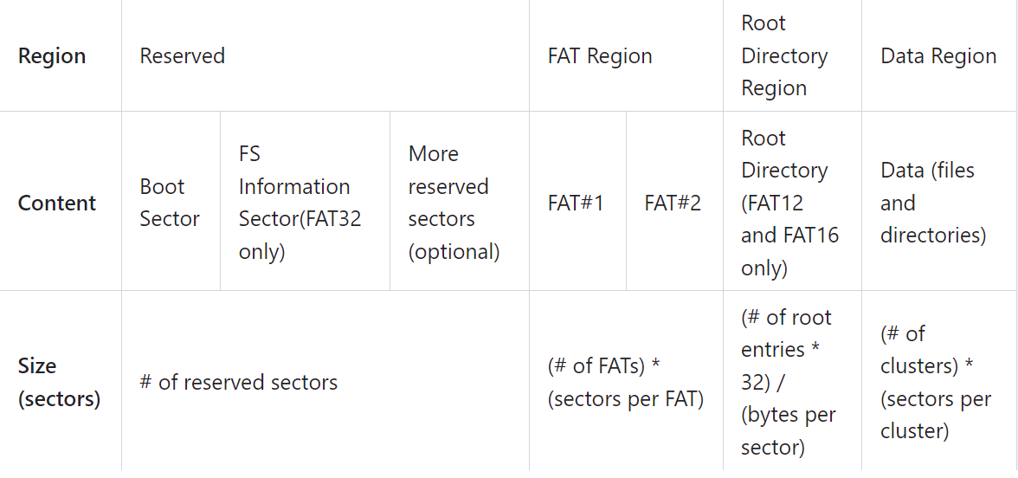
Structure of the FAT file system
Normal structure of file system
FAT file system

Slide 6
Structure of the FAT file system
Reserved sectors: Boot sector includes an area called the BPB which contains some basic file system information and the operating system's boot loader code
FAT Region: FAT indicates the status of clusters. FAT16 has two copies of FAT for redundancy.
Root Directory Region: Store the information of files and directories of root directory. For FAT16, it lies right after reserved region.
Data Region: Store the actual contents of files and directories. Note that a cluster can only be occupied by one file.

Slide 7
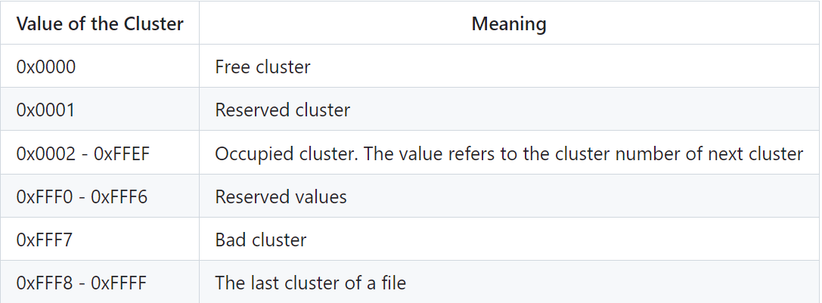
File Allocation Table
FAT contains the metadata for clusters in the filesystem
In FAT16, the size of a FAT entry is 16 bit (2 bytes)
Every cluster in data region will be mapped uniquely mapped to an entry in FAT table
The clusters of a file may not be continuous in the data region, and the file system remembers the relationship of clusters with FAT

Slide 8
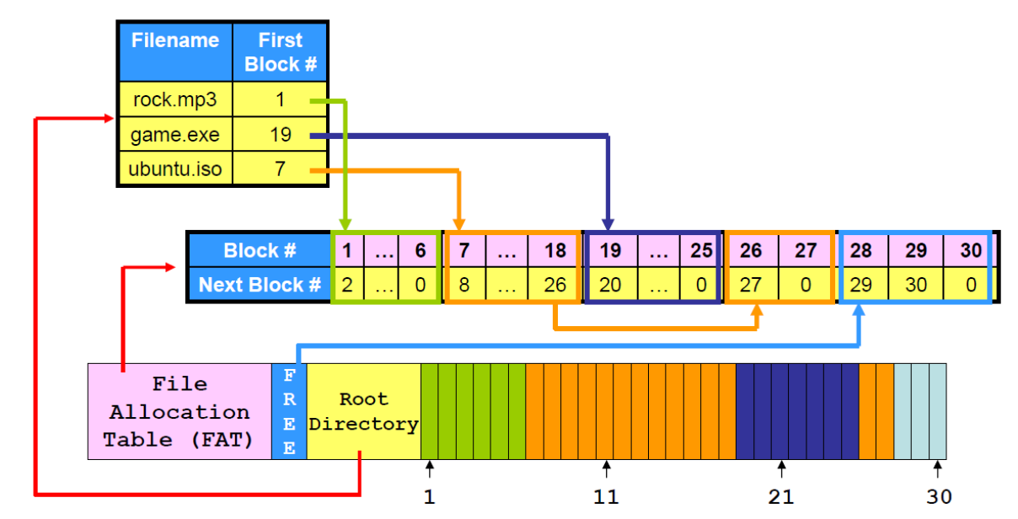
File Storage in FAT file system

Slide 9
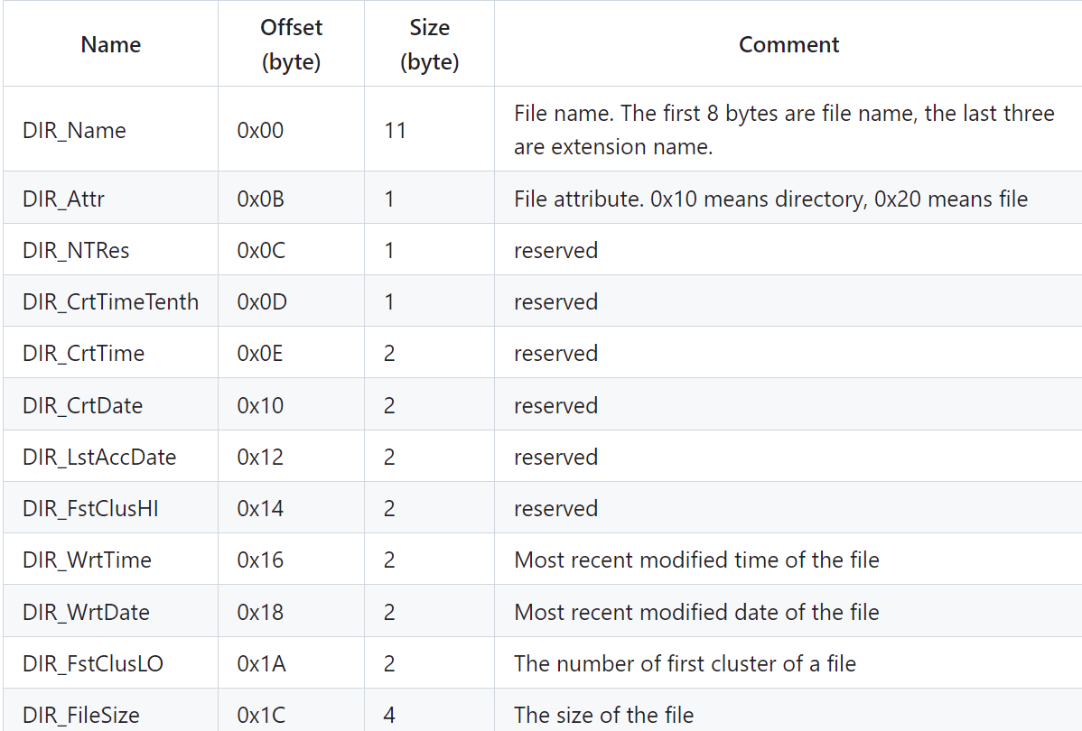
Directory in FAT file system
Directory is also a kind of file in FAT. (Directory entries)
In FAT16, the length of a directory entry is 32 bytes

Slide 10
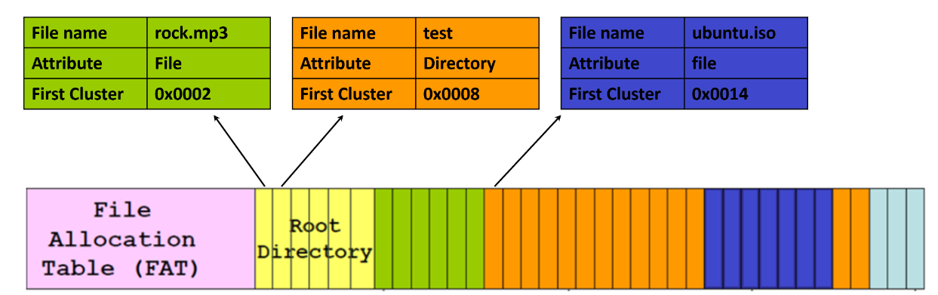
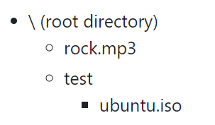
Directory in FAT file system
For example,

Slide 11
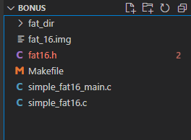
Code Walk
fat16.h: Define some data structures (FAT16 BPB, FAT Directory) and the function prototype
Simple_fat16_main.c: FAT16 initialize, destroy, and the basic information display
Simple_fat16.c: Some operations about files and directory need to be implemented
fat_16.img: disk image for the file system
Makefile: Compiling file

Slide 12
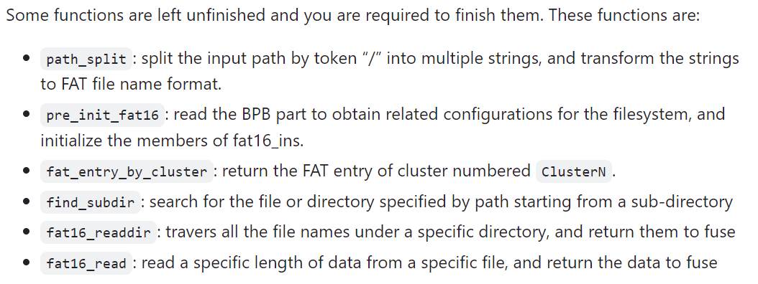
Code Walk

Slide 13
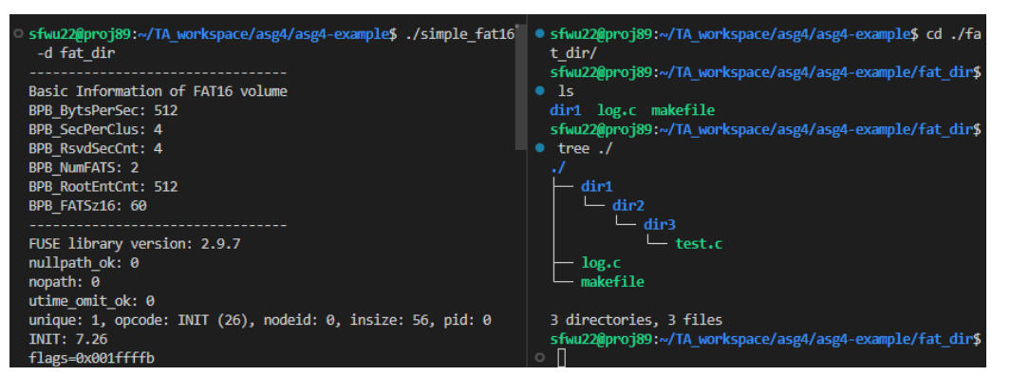
Code Walk
Compile, run, and verify the file system
Compile:
make all
Mount fat_16.img under ./fat_dir or other directories:
./simple_fat16 -d fat_dir

Slide 14
Any Questions?

