Slide 1
Tutorial 11: FAT File System
CSCI3150 Introduction to Operating Systems, Fall 2024
Yang, Yitao
Nov 28, 2024
Notes:
Slide 1: Introduction "Good afternoon, everyone! Today, we will dive into File System APIs, an essential part of understanding how operating systems handle file storage and management. This is Tutorial 11 for our Operating Systems course, CSCI3150.

Slide 2
Reminder
Assignement 4
Due at 6:00:00 p.m., Mon, Dec 9nd
Notes:
Before we start, a quick reminder: Assignment 4 is due on Monday, December 9th, by 6:00 p.m. Please ensure you submit it on time."

Slide 3
File and Directory

Slide 4
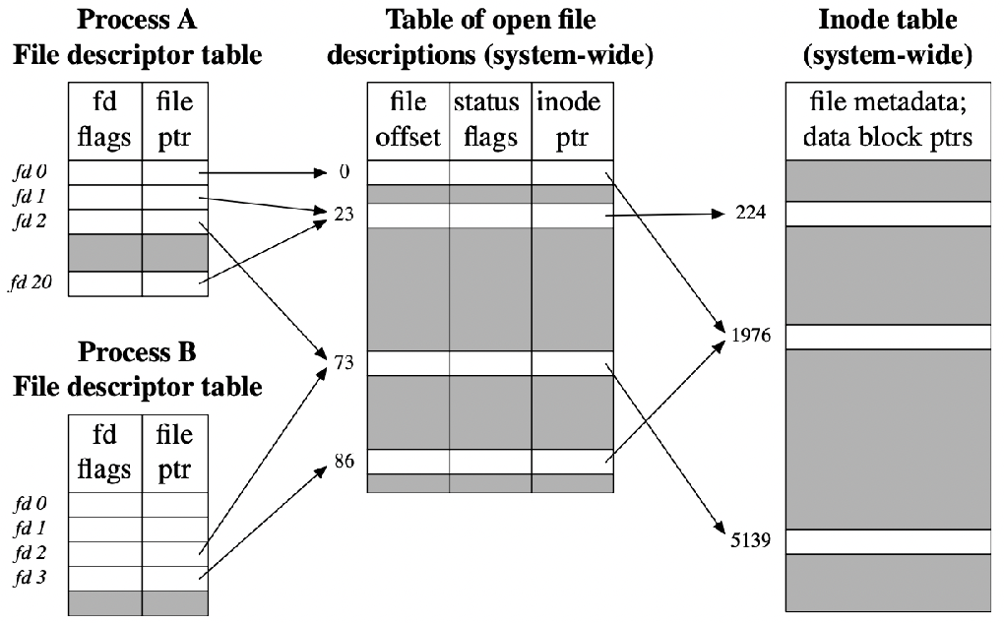
Overall Organization
File and Directory is the abstract of the hard disk drive and I/O.
File
One file occupy several clusters (data blocks)
inode: a data structure that describes a FS object
Directory
A file
A list of <user-readable filename, low-level name> pairs
Directory Entry
the logical unit in a directory file. A directory file has one or multiple directory entries. A directory entry is the metadata
of a file and could point to a file or a directory file.
Notes:
Slide 2: File System Structure "Let’s start with the overall structure of a file system:
The disk is divided into blocks, each typically 4 KB in size, and numbered from 0 to N-1.
There’s a superblock that contains metadata about the file system itself, such as the size and structure.
A bitmap is used to track free and used blocks—0 for free, 1 for in-use.
The inode region contains metadata about files, like file size, permissions, and pointers to data blocks.
Data blocks store the actual content of files. Every file type, whether it’s a directory, link, or regular file, is represented by an inode."

Slide 5
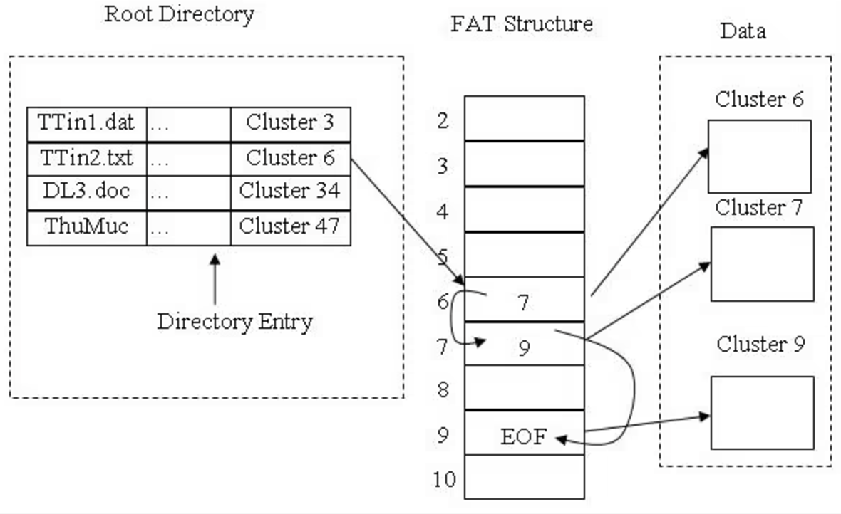
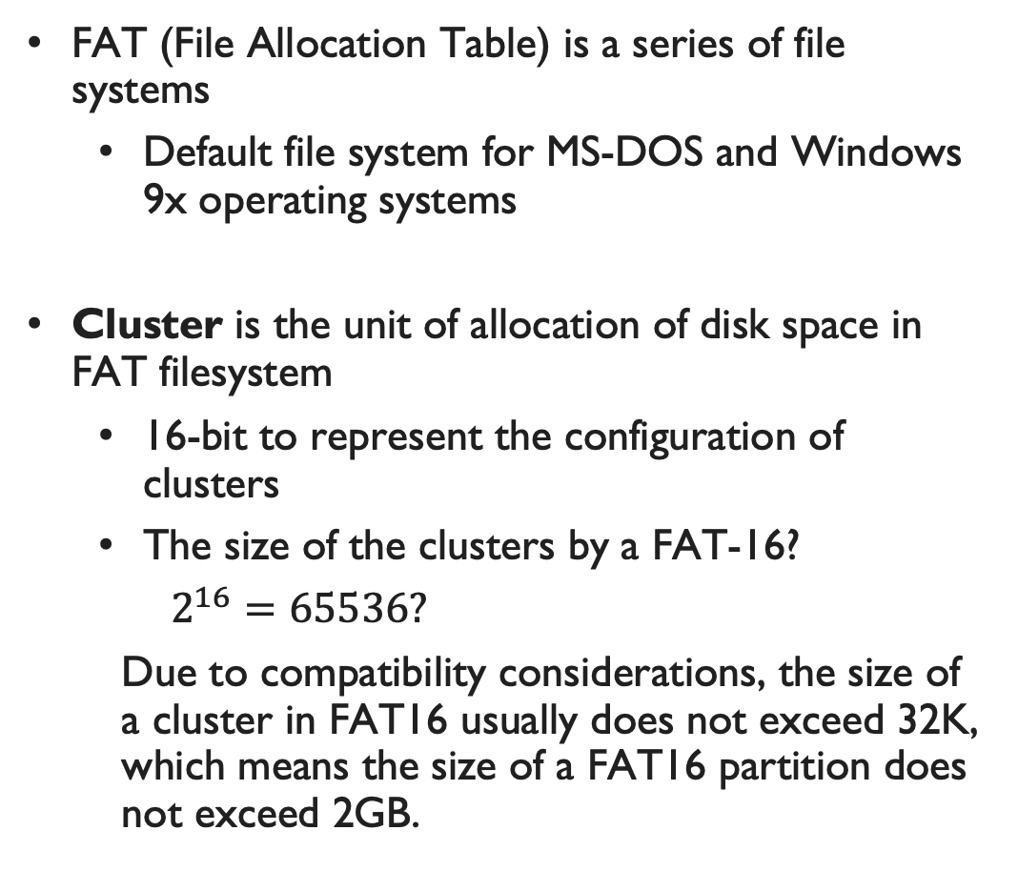
File Allocation Table (FAT)
FAT (File Allocation Table) is a series of file systems
Default file system for MS-DOS and Windows 9x operating systems
Cluster is the unit of allocation of disk space in FAT filesystem
16-bit to represent the configuration of clusters
The size of the clusters by a FAT-16?
$2^{16}=65536?$
Due to compatibility considerations, the size of a cluster in FAT16 usually does not exceed 32K, which means the size of a FAT16 partition does not exceed 2GB.
Notes:
"Inodes are crucial for file management. They store:
Attributes such as file size, permissions, and timestamps.
Direct mappings that directly map logical blocks to physical disk locations.
Indirect mappings at one, two, or even three levels, used for large files requiring multiple layers of indirection. This design ensures efficient access to both small and large files."

Slide 6
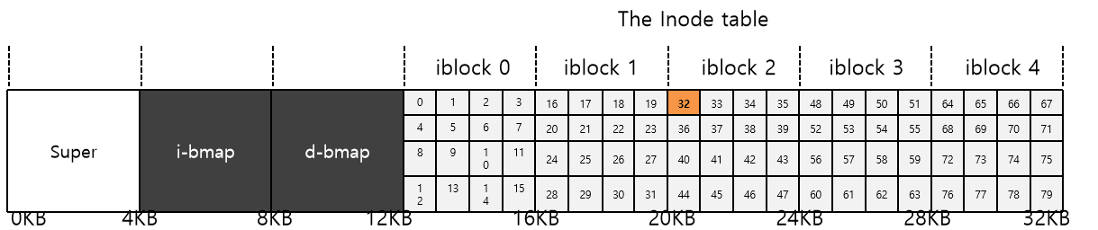
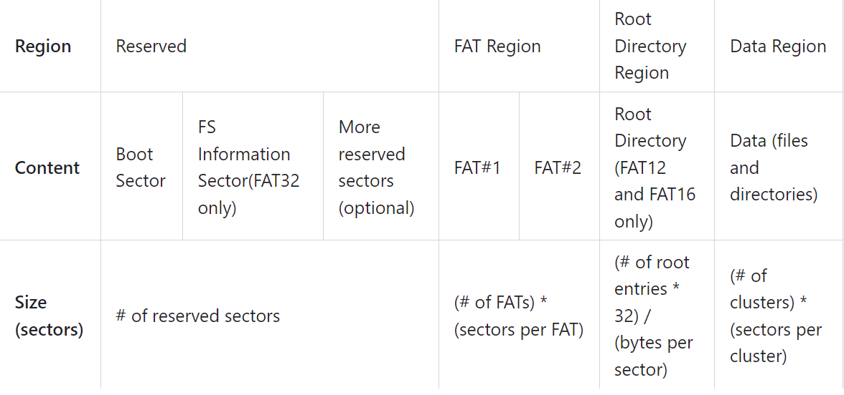
Structure of the FAT file system
Normal structure of file system
FAT file system

Slide 7
Structure of the FAT file system
Reserved sectors: Boot sector includes an area called the BPB which contains some basic file system information and the operating system's boot loader code
FAT Region: FAT indicates the status of clusters. FAT16 has two copies of FAT for redundancy.
Root Directory Region: Store the information of files and directories of root directory. For FAT16, it lies right after reserved region.
Data Region: Store the actual contents of files and directories. Note that a cluster can only be occupied by one file.

Slide 8
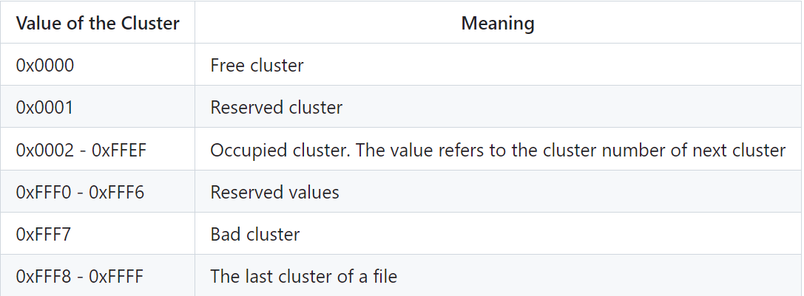
File Allocation Table
FAT contains the metadata for clusters in the filesystem
In FAT16, the size of a FAT entry is 16 bit (2 bytes)
Every cluster in data region will be mapped uniquely mapped to an entry in FAT table
The clusters of a file may not be continuous in the data region, and the file system remembers the relationship of clusters with FAT

Slide 9
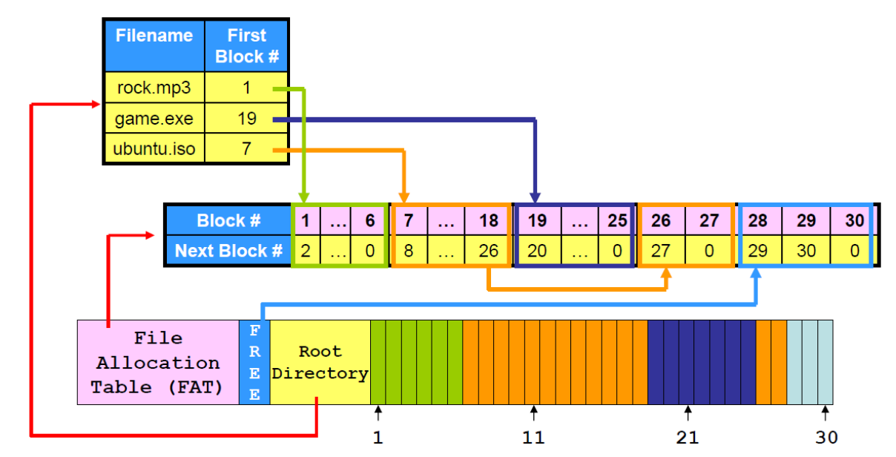
File Storage in FAT file system

Slide 10
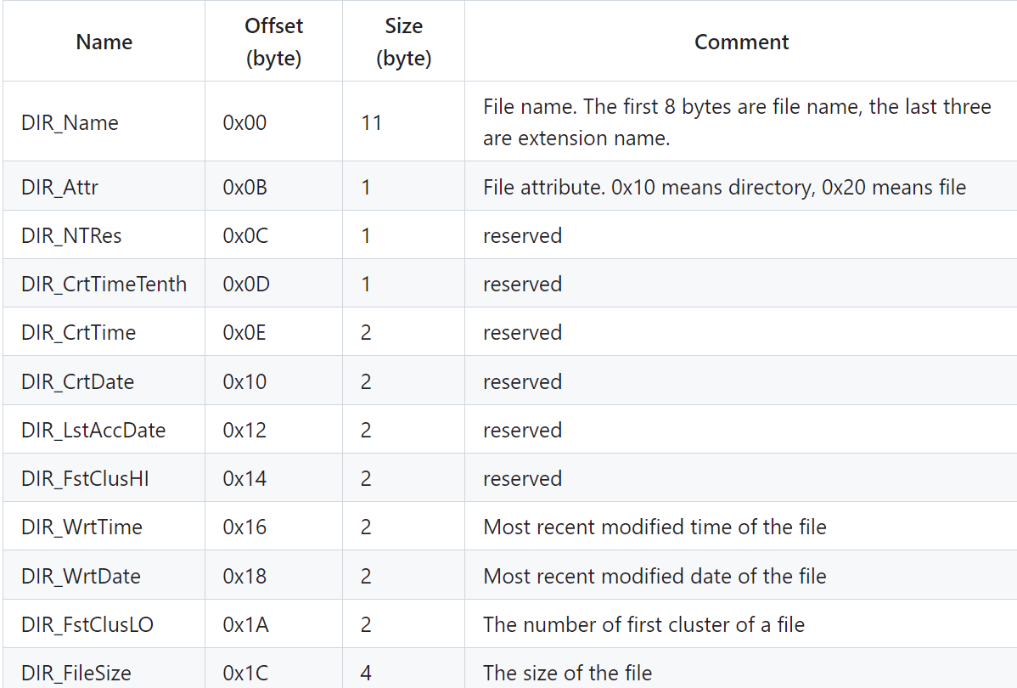
Directory in FAT file system
Directory is also a kind of file in FAT. (Directory entries)
In FAT16, the length of a directory entry is 32 bytes

Slide 11
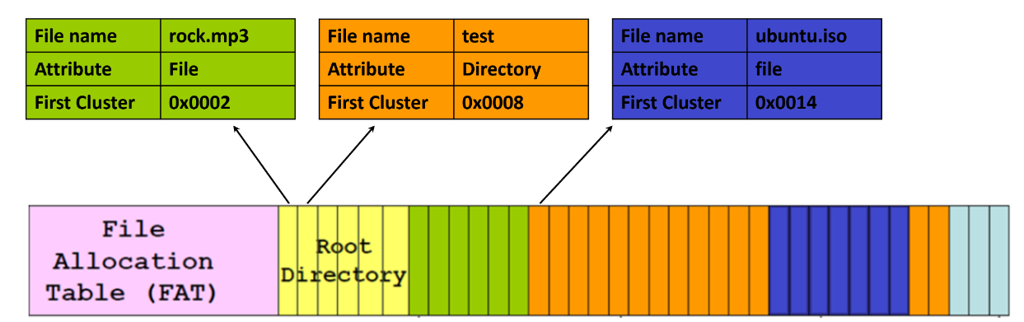
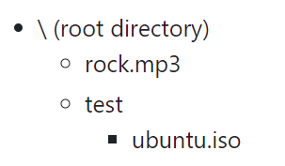
Directory in FAT file system
For example,

Slide 12
Q & A

