Slide 1
Tutorial 10: File System APIs && Filesystem in User Space
CSCI3150 - Introduction to operating system
Tutor: TAN Xin
xtan22@cse.cuhk.edu.hk

Slide 2
File System APIs

Slide 3
Renaming files
rename():rename a file to different name.
It implemented as an atomic call.
Ex) change from foo to bar
Saving a file in an editor
promt > mv foo bar
int fd = open("foo.txt.tmp", O_WRONLY|O_CREAT|O_TRUNC);
write(fd, buffer, size); // write out new version of file
fsync(fd);
close(fd);
rename("foo.txt.tmp", "foo.txt");

Slide 4
Getting Information About Files
stat(): Show the File metadata
metadata is information about each file, ex: size, permission, ..
stat structure is below:
struct stat {
dev_t st_dev; /* ID of device containing file */
ino_t st_ino; /* inode number */
mode_t st_mode; /* protection */
nlink_t st_nlink; /* number of hard links */
uid_t st_uid; /* user ID of owner */
gid_t st_gid; /* group ID of owner */
dev_t st_rdev; /* device ID (if special file) */
off_t st_size; /* total size, in bytes */
blksize_t st_blksize; /* blocksize for filesystem I/O */
blkcnt_t st_blocks; /* number of blocks allocated */
time_t st_atime; /* time of last access */
time_t st_mtime; /* time of last modification */
time_t st_ctime; /* time of last status change */
};

Slide 5
Getting Information About Files (Cont.)
An example of stat()
All information is in a inode
prompt> echo hello > file
prompt> stat file
File: ‘file’
Size: 6 Blocks: 8 IO Block: 4096 regular file
Device: 811h/2065d Inode: 67158084 Links: 1
Access: (0640/-rw-r-----) Uid: (30686/ root) Gid: (30686/ remzi)
Access: 2011-05-03 15:50:20.157594748 -0500
Modify: 2011-05-03 15:50:20.157594748 -0500
Change: 2011-05-03 15:50:20.157594748 -0500

Slide 6
Removing Files
The result of strace to figure out what rm is doing.
rm is Linux command to remove a file
rm calls unlink() to remove a file.
prompt> strace rm foo
...
unlink(“foo”)
...
prompt>

Slide 7
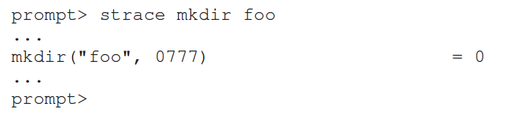
Making Directories
mkdir(): Make a directory
When a directory is created, it is empty.
Empty directory have two entries: . (itself), ..(parent)
prompt> ls -al
total 8
drwxr-x--- 2 roo root 6 Apr 30 16:17 ./
drwxr-x--- 26 root root 4096 Apr 30 16:17 ../

Slide 8
Reading Directories
readdir()
Directory is a file, but with a specific structure.
When reading a directory, we use specific system call other than read().
A sample code to read directory entries.
int main(int argc, char *argv[]) {
DIR *dp = opendir("."); /* open current directory */
assert(dp != NULL);
struct dirent *d;
while ((d = readdir(dp)) != NULL) { /* read one directory entry */
printf("%d %s\n", (int) d->d_ino, d->d_name);
}
closedir(dp); /*close current directory */
return 0;
}

Slide 9
Reading Directories
Structure of the directory entry
struct dirent {
char d_name[256]; /* filename */
ino_t d_ino; /* inode number */
off_t d_off; /* offset to the next dirent */
unsigned short d_reclen; /* length of this record */
unsigned char d_type; /* type of file */
};

Slide 10
Deleting Directories
rmdir(): Delete a directory.
rmdir()requires directory be empty before it deleted.
If you call rmdir()to a non-empty directory, it will fail.

Slide 11
Hard Links
link(): Link old file and a new file.
Create hard link named file2.
The result of link()
Two files have same inode number, but two human name(file, file2)
prompt> echo hello > file
prompt> cat file
hello
prompt> ln file file2 /* create a hard link, link file to file2 */
prompt> cat file2
hello
prompt> ls -i file file2
67158084 file /* inode value is 67158084 */
67158084 file2 /* inode value is 67158084 */
prompt>

Slide 12
Hard Links (Cont.)
How to create hard link file?
Step1. Make an inode, track all information about the file.
Step2. Link a human-readable name to file.
Step3. Put link file into a current directory.
After creating a hard link to file, old and new files have no difference.
Thus, to remove a file, we call unlink().

Slide 13
unlink Hard Links
What unlink() is doing ?
Check reference count within the inode number.
Remove link between human-readable name and inode number.
Decrease reference count.
When only it reaches zero, It delete a file (free the inode and related blocks)

Slide 14
unlink Hard Links (Cont.)
The result of unlink()
prompt> echo hello > file /* create file*/
prompt> stat file
... Inode: 67158084 Links: 1 ... /* Link count is 1 */
prompt> ln file file2 /* hard link file2 */
prompt> stat file
... Inode: 67158084 Links: 2 ... /* Link count is 2 */
prompt> stat file2
... Inode: 67158084 Links: 2 ... /* Link count is 2 */
prompt> ln file2 file3 /* hard link file3 */
prompt> stat file
... Inode: 67158084 Links: 3 ... /* Link count is 3 */
prompt> rm file /* remove file */
prompt> stat file2
... Inode: 67158084 Links: 2 ... /* Link count is 2 */
prompt> rm file2 /* remove file2 */
prompt> stat file3
... Inode: 67158084 Links: 1 ... /* Link count is 1 */
prompt> rm file3

Slide 15
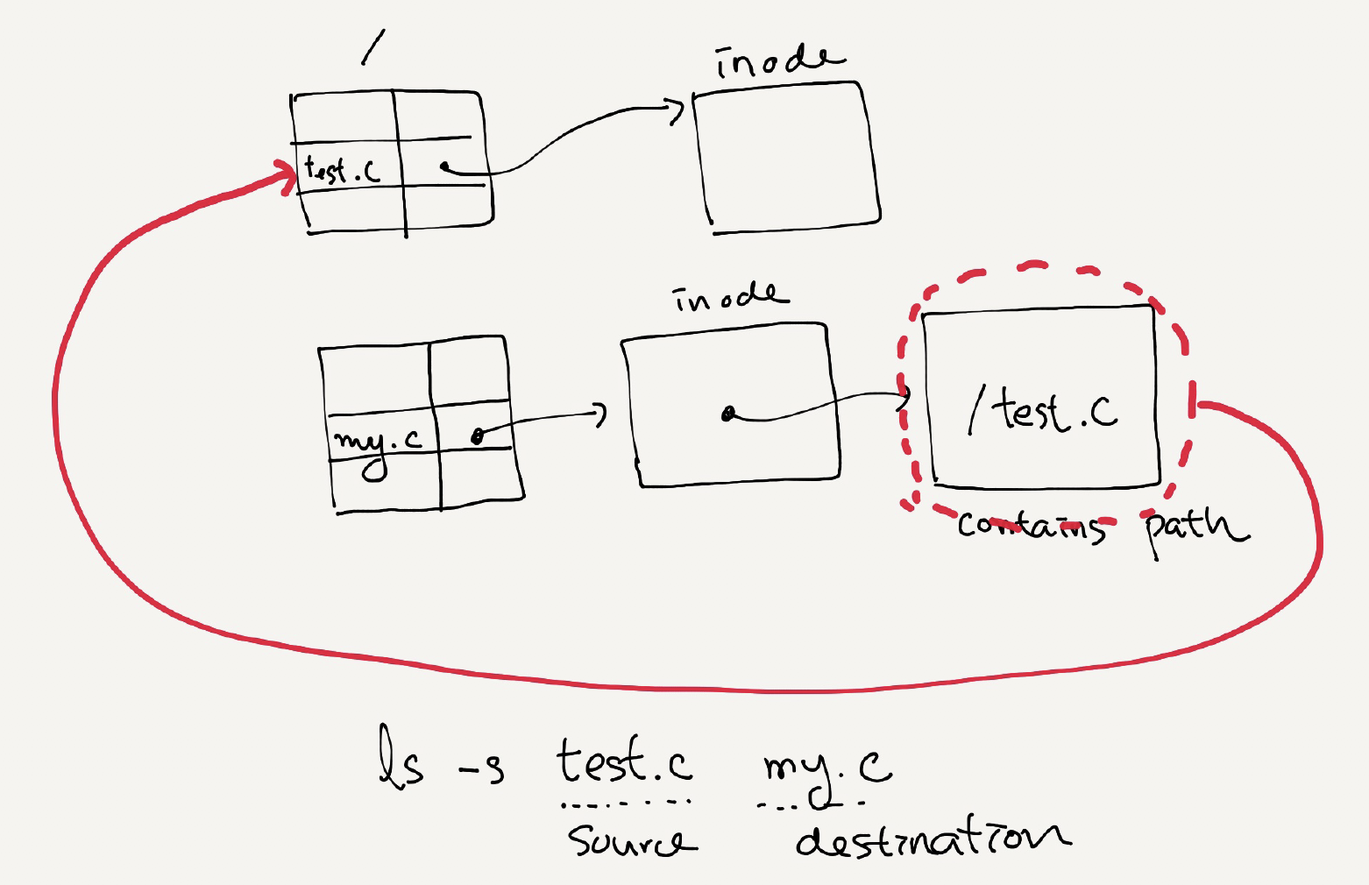
Symbolic Links
Symbolic link
Special file that contains path to the source directory.
Hard Link cannot create to a directory.
Hard Link cannot create to a file to other partition.
An example of symbolic link
prompt> echo hello > file
prompt> ln –s file file2 /* option –s : create a symbolic link, */
prompt> cat file2
hello

Slide 16
Symbolic Links (Cont.)
Symbolic link is different file type.
Symbolic link is subject to the dangling reference.
prompt> ls -al
drwxr-x--- 2 remzi remzi 29 May 3 19:10 ./
drwxr-x--- 27 remzi remzi 4096 May 3 15:14 ../ /* directory */
-rw-r----- 1 remzi remzi 6 May 3 19:10 file /* regular file */
lrwxrwxrwx 1 remzi remzi 4 May 3 19:10 file2 -> file /* symbolic link */
prompt> echo hello > file
prompt> ln -s file file2
prompt> cat file2
hello
prompt> rm file
prompt> cat file2
cat: file2: No such file or directory

Slide 17
Filesystem in userspace

Slide 18
What is FUSE?
FUSE stands for Filesystem in Userspace
FUSE allows you to implement a filesystem entirely in userspace, rather than modifying the kernel. This is accomplished by providing a kernel module that allows userspace programs to communicate with the filesystem through a well-defined API.

Slide 19
Why do we need FUSE?
FUSE is needed because it provides a way to extend the functionality of the operating system by allowing users to mount a custom file system in user space.
Custom file systems: FUSE allows developers to create custom file systems that can be mounted in user space. This makes it easy to implement virtual file systems that operate on top of existing storage devices or provide access to remote data sources.
Simplified development: FUSE simplifies the development of custom file systems by providing a high-level API that abstracts away the details of file system implementation.
Platform independence: FUSE allows file systems to be developed on one platform and used on another, without requiring changes to the file system code.
Security: FUSE provides a security layer that isolates the custom file system from the rest of the operating system. This prevents the file system from causing damage to the underlying operating system or accessing files and data that it should not have access to.

Slide 20
The main components of FUSE
User-space program: A user-space program defines the behavior of the custom file system by implementing a FUSE driver. This driver program uses the FUSE API to define how files are accessed and stored.
FUSE module: When the FUSE driver program is run, it loads a FUSE module into the operating system kernel. This module provides a bridge between the user-space program and the kernel.
Mounting: The user-space program then "mounts" the custom file system using the fuse_mount function. This creates a mount point on the local file system that serves as the root of the FUSE file system.
File system requests: When a user requests a file or performs an operation on a file in the FUSE file system, the FUSE module intercepts the request and forwards it to the user-space program.
FUSE driver handling: The user-space program handles the file system request by implementing the appropriate FUSE API function. For example, if the user requests to read a file, the user-space program will handle this request by implementing the read function of the FUSE API.
Unmounting: When the user is finished with the FUSE file system, they can "unmount" it using the fuse_unmount function. This unloads the FUSE module from the kernel.

Slide 21
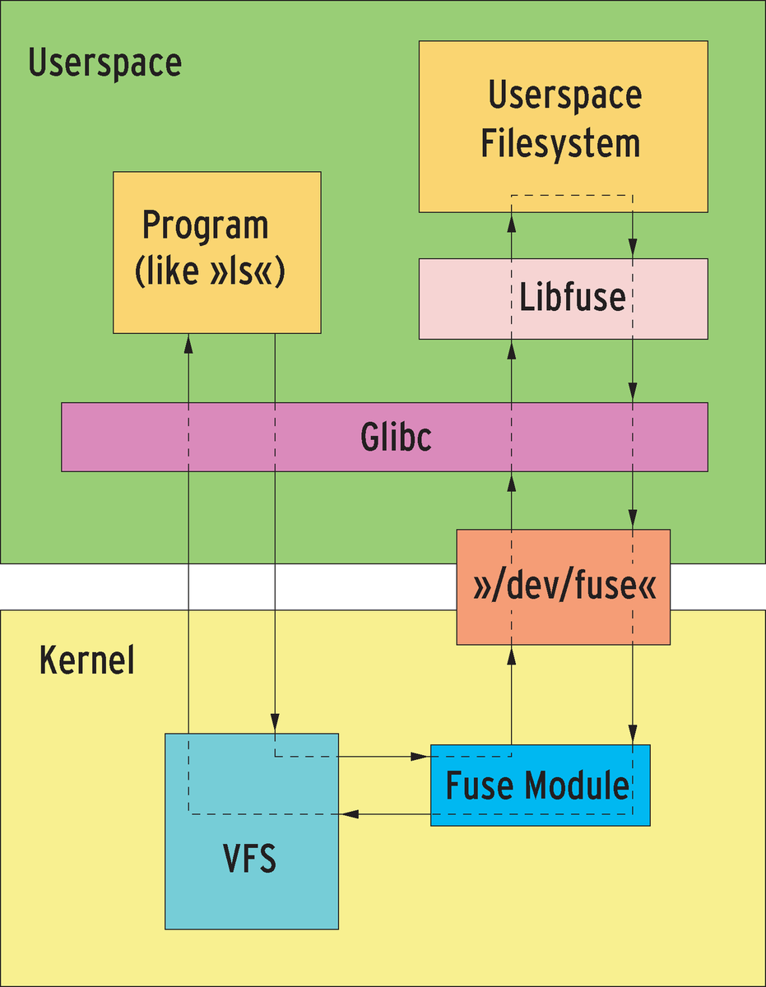
How FUSE works?
The fuse kernel module: It communicates with VFS (Virtual File System). And it provides a device named "/dev/fuse" that can be opened by user-space processes.
The libfuse library: Communicates with kernel-space modules. It receives requests from /dev/fuse and turns these requests into a series of function calls. Then it writes the result back to /dev/fuse. It also provides functions to mount/unmount fuse filesystem.
fusermount utility: It can be used for mount/unmount fuse filesystem.

Slide 22
How FUSE works?
FUSE is particularly useful for writing virtual file systems. Unlike traditional file systems that essentially work with data on mass storage, virtual filesystems don't actually store data themselves. They act as a view or translation of an existing file system or storage device.
The FUSE module is loaded into the kernel. This module provides a communication channel between the kernel and the FUSE file system running in user space.
The user-space FUSE file system is started. This file system is implemented as a separate process that communicates with the kernel through the FUSE module.
When a file system operation is performed, such as reading or writing a file, the request is sent to the FUSE module in the kernel.
The FUSE module forwards the request to the user-space FUSE file system process.
The user-space FUSE file system processes the request and sends a response back to the kernel through the FUSE module.
The kernel then returns the response to the calling process, completing the file system operation.

Slide 23
To Start
To get started with FUSE, you'll need to install the FUSE package for your operating system. Once you have FUSE installed, you can use it to create a new file system by writing a FUSE driver.
A FUSE driver is a program that implements the FUSE API and provides the logic for how files are accessed and stored. FUSE drivers can be written in any programming language that supports the FUSE API, such as C, Python, or Ruby.
To write a FUSE driver:
A handler program linked to the supplied libfuse library needs to be written.
The main purpose of this program is to specify how the file system is to respond to read/write/stat requests. The program is also used to mount the new file system. At the time the file system is mounted, the handler is registered with the kernel. If a user now issues read/write/stat requests for this newly mounted file system, the kernel forwards these IO-requests to the handler and then sends the handler's response back to the user.

Slide 24
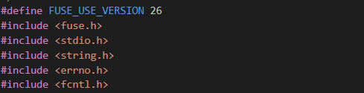
An example
Include the header file
fuse.h: interface of FUSE
fcntl.h: interface of file processing

Slide 25
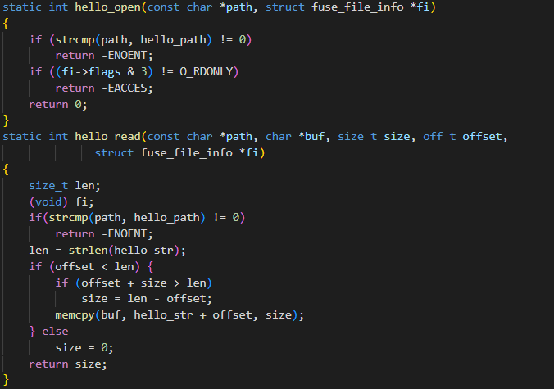
An example
Customize some file operations, like open(), read()…

Slide 26
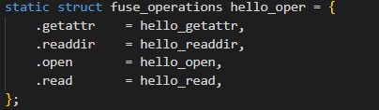
An example
Bind your customized file system operation

Slide 27
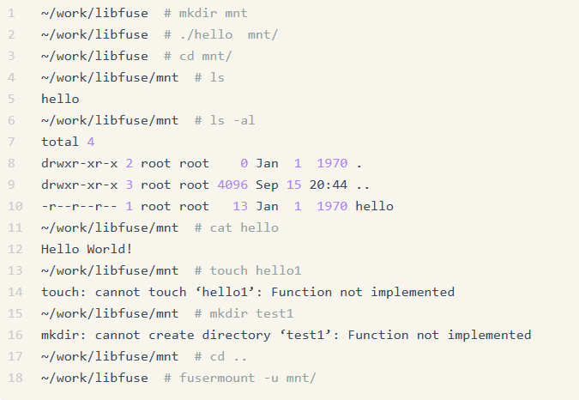
Run the program
Compile:
Execute:

