Slide 1
Operating Systems CSCI 3150
Lecture 12: Memory Management
Part III: Swapping

Slide 2
Overview
Mechanisms
Policies

Slide 3
Beyond Physical Memory: Mechanisms
Use part of disk as memory
OS needs a place to stash away portions of address space that currently aren’t in great demand.
In modern systems, this role is usually served by a hard disk drive.
Registers
Cache
Main Memory
Mass Storage (hard disk, tape, etc...)
Memory hierarchy in modern system

Slide 4
Swap Space
Reserve some space on the disk for moving pages back and forth.
OS needs to remember the swap space, in page-sized unit.
PFN 0
PFN 1
PFN 2
PFN 3
Proc 0 [VPN 0] | Proc 1 [VPN 2] | Proc 1 [VPN 3] | Proc 2 [VPN 0]
Physical
Memory
Block 1
Block 2
Block 3
Block 4
Block 5
Block 6
Block 0
Block 7
Swap
Space
Proc 0 [VPN 1] | Proc 0 [VPN 2] | [Free] | Proc 1 [VPN 0] | Proc 1 [VPN 1] | Proc 3 [VPN 0] | Proc 2 [VPN 1] | Proc 3 [VPN 1]
Physical Memory and Swap Space

Slide 5
Present Bit
Add some machinery higher up in the system in order to support swapping the pages to and from the disk.
When the hardware looks in the PTE, it may find that the page is not present in physical memory.
Value | Meaning
1 | page is present in physical memory
0 | The page is not in memory but rather on disk.

Slide 6
Concepts
Page fault
Accessing page that is not in physical memory.
If a page is not present and has been swapped to disk, the OS needs to swap the page back into memory in order to service the page fault.
Page replacement
The OS likes to page out some pages to make room for the new ones it is about to bring in
The process of picking a page to evict (or replace) is known as page-replacement policy.

Slide 7
When to Perform Page Replacement
Lazy approach…
OS waits until memory is full to start replacing pages.
This is clearly unrealistic… Do not procrastinate!
Swap Daemon, Page Daemon
When there are fewer than LW (low watermark) pages available, a background thread that is responsible for freeing memory runs.
The thread evicts pages until there are HW (high watermark) pages available.

Slide 8
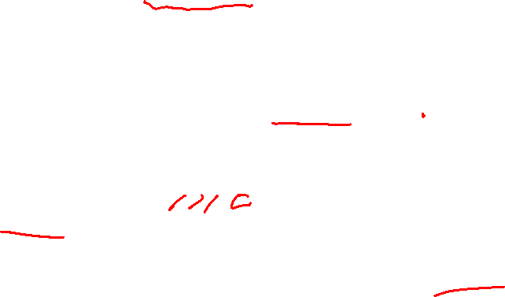
Page Fault Control Flow
PTE used for data such as the PFN of the page for a disk address.
kernel
3. Check storage whether the page exists.
Secondary Storage
1. Reference
2.Trap
Load M
 | i
6. reinstruction
Page Frame
Page Frame
Page Table
...
4. Get the page
5. Reset Page Table.
Page Frame
Page Frame
Address Space
When the OS receives a page fault, it looks in the PTE and issues the request to disk.

Slide 9

Page Fault Control Flow – Hardware
1: VPN = (VirtualAddress & VPN_MASK) >> SHIFT
2: (Success, TlbEntry) = TLB_Lookup(VPN)
3: if (Success == True) // TLB Hit
4: if (CanAccess(TlbEntry.ProtectBits) == True)
5: Offset = VirtualAddress & OFFSET_MASK
6: PhysAddr = (TlbEntry.PFN << SHIFT) | Offset
7: Register = AccessMemory(PhysAddr)
8: else RaiseException(PROTECTION_FAULT)
9: else // TLB Miss
10: PTEAddr = PTBR + (VPN * sizeof(PTE))
11: PTE = AccessMemory(PTEAddr)
12: if (PTE.Valid == False)
13: RaiseException(SEGMENTATION_FAULT)
14: else
15: if (CanAccess(PTE.ProtectBits) == False)
16: RaiseException(PROTECTION_FAULT)
17: else if (PTE.Present == True)
18: // assuming hardware-managed TLB
19: TLB_Insert(VPN, PTE.PFN, PTE.ProtectBits)
20: RetryInstruction()
21: else if (PTE.Present == False)
22: RaiseException(PAGE_FAULT)

Slide 10
Page Fault Control Flow – Software
1: PFN = FindFreePhysicalPage()
2: if (PFN == -1) // no free page found
3: PFN = EvictPage() // run replacement algorithm
4: DiskRead(PTE.DiskAddr, pfn) // sleep (waiting for I/O)
5: PTE.present = True // update page table with present
6: PTE.PFN = PFN // bit and translation (PFN)
7: RetryInstruction() // retry instruction
The OS must find a physical frame for the soon-be-faulted-in page to reside within.
If there is no such page, waiting for the replacement algorithm to run

Slide 11
Summary
Swapping: making the part of disk as memory
Present bit required

Slide 12
22. Swapping: Policies

Slide 13
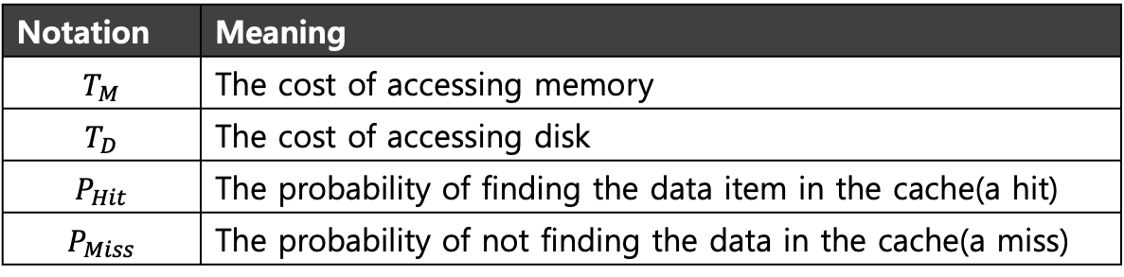


Goal of Cache Management
To minimize cache misses
To improve average memory access time (AMAT)
$$AMAT=\left(P_{Hit}∗T_{M}\right)+(P_{Miss}∗T_{D})$$
Notation | Meaning
$$T_{M}$$ | The cost of accessing memory
$$T_{D}$$ | The cost of accessing disk
$$P_{Hit}$$ | The probability of finding the data item in the cache(a hit)
$$P_{Miss}$$ | The probability of not finding the data in the cache(a miss)

Slide 14
The Optimal Replacement Policy
Lead to the fewest number of misses overall.
Replace the page that will be accessed furthest in the future.
Result in the fewest possible cache misses.
Serve only as a comparison point, to know how close we are to perfection.

Slide 15
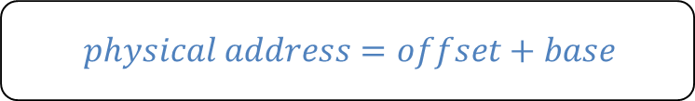
Tracing the Optimal Policy
Reference Row
0
1
2
0
1
3
0
3
1
2
1
Access | Hit/Miss? | Evict | Resulting Cache State
0 | Miss |  | 0
1 | Miss |  | 0,1
2 | Miss |  | 0,1,2
0 | Hit |  | 0,1,2
1 | Hit |  | 0,1,2
3 | Miss | 2 | 0,1,3
0 | Hit |  | 0,1,3
3 | Hit |  | 0,1,3
1 | Hit |  | 0,1,3
2 | Miss | 3 | 0,1,2
1 | Hit |  | 0,1,2
Hit rate is $\frac{Hits}{Hits+Misses}=54.6\%$
Future is unknown!

Slide 16
A Simple Policy: FIFO
Pages were placed in a queue when they enter the system.
When a replacement occurs, the page on the head of the queue (the “first-in” page) is evicted.
Simple to implement
Agnostic to the importance of pages

Slide 17

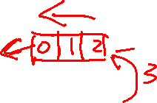
Tracing the FIFO Policy
Reference Row
0
1
2
0
1
3
0
3
1
2
1
Access | Hit/Miss? | Evict | Resulting Cache State
0 | Miss |  | 0
1 | Miss |  | 0,1
2 | Miss |  | 0,1,2
0 | Hit |  | 0,1,2
1 | Hit |  | 0,1,2
3 | Miss | 0 | 1,2,3
0 | Miss | 1 | 2,3,0
3 | Hit |  | 2,3,0
1 | Miss |  | 3,0,1
2 | Miss | 3 | 0,1,2
1 | Hit |  | 0,1,2
Hit rate is $\frac{Hits}{Hits+Misses}=36.4\%$
Even though page 0 had been accessed a number of times, FIFO still kicks it out.

Slide 18
Belady’s Anomaly
We would expect the cache hit rate to increase when the cache gets larger. But in this case, with FIFO, it gets worse.
Reference Row
1
2
3
4
1
2
5
1
2
3
4
5

Slide 19
Another Simple Policy: Random
Picks a random page to replace under memory pressure.
It doesn’t really try to be too intelligent in picking which page to evict
Random does depends entirely upon how lucky Random gets in its choice.
Access | Hit/Miss? | Evict | Resulting Cache State
0 | Miss |  | 0
1 | Miss |  | 0,1
2 | Miss |  | 0,1,2
0 | Hit |  | 0,1,2
1 | Hit |  | 0,1,2
3 | Miss | 0 | 1,2,3
0 | Miss | 1 | 2,3,0
3 | Hit |  | 2,3,0
1 | Miss | 3 | 2,0,1
2 | Hit |  | 2,0,1
1 | Hit |  | 2,0,1

Slide 20
Using History
Learn on the past and use history.
Two types of historical information.
Historical Information | Meaning | Algorithms
Recency | The more recently a page has been accessed, the more likely it will be accessed again | LRU
Frequency | If a page has been accessed many times, It should not be replaced as it clearly has some value | LFU

Slide 21
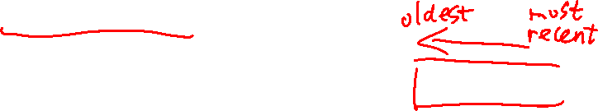
Using History: LRU
Replace the least-recently-used page.
Reference Row
0
1
2
0
1
3
0
3
1
2
1
Access | Hit/Miss? | Evict | Resulting Cache State
0 | Miss |  | 0
1 | Miss |  | 0,1
2 | Miss |  | 0,1,2
0 | Hit |  | 1,2,0
1 | Hit |  | 2,0,1
3 | Miss | 2 | 0,1,3
0 | Hit |  | 1,3,0
3 | Hit |  | 1,0,3
1 | Hit |  | 0,3,1
2 | Miss | 0 | 3,1,2
1 | Hit |  | 3,2,1

Slide 22
Workload Example : The No-Locality Workload
Each reference is to a random page in a set of 100 pages
Workload has 100 accesses over time.
Choosing the next page to refer to at random
The No-Locality Workload
100%
80%
When the cache is large enough to fit the entire workload,
it also doesn’t matter which policy you use.
60%
Hit Rate
OPT
LRU
40%
FIFO
RAND
20%
20
40
60
80
100
Cache Size (Blocks)

Slide 23
Workload Example : The 80-20 Workload
Exhibits locality: 80% of the reference are made to 20% of the page
The remaining 20% of the reference are made to the remaining 80% of the pages.
The 80-20 Workload
100%
80%
LRU is more likely to
hold onto the hot pages.
60%
Hit Rate
OPT
LRU
40%
FIFO
RAND
20%
20
40
60
80
100
Cache Size (Blocks)

Slide 24
Workload Example : The Looping Sequential
Refer to 50 pages in sequence.
Starting at 0, then 1, … up to page 49, and then we loop, repeating those accesses, for total of 10,000 accesses to 50 unique pages.
The Looping-Sequential Workload
100%
80%
60%
Hit Rate
OPT
LRU
40%
FIFO
RAND
20%
20
40
60
80
100
Cache Size (Blocks)

Slide 25
Approximating LRU: Clock Algorithm
Require hardware support: use bit
Whenever a page is referenced, the use bit is set by hardware to 1.
Hardware never clears the bit, though; that is the responsibility of the OS
Clock Algorithm
All pages of the system arranges in a circular list.
A clock hand points to a page to begin with.
The algorithm continues until it finds a use bit that is set to 0.
A
H
B
Use bit | Meaning
0 | Evict the page
1 | Clear use bit and advance hand
G
C
F
D
E
The Clock page replacement algorithm

Slide 26
Workload with Clock Algorithm
Clock algorithm doesn’t do as well as perfect LRU; it does better then approach that don’t consider history at all.
The 80-20 Workload
100%
80%
60%
Hit Rate
OPT
LRU
40%
Clock
FIFO
RAND
20%
20
40
60
80
100
Cache Size (Blocks)

Slide 27
Considering Dirty Pages
The hardware includes a modified bit (a.k.a dirty bit)
Page has been modified and is thus dirty, it must be written back to disk to evict it.
Page has not been modified; the eviction is free.

Slide 28
Prefetching
The OS guesses that a page is about to be used, and thus bring it in ahead of time.
Page 1 is brought into memory
Page 3
Page 4
Page 5
…
Page n
Physical Memory
Page 2
…
Page 1
Page 3
Page 4
Secondary
Storage
Page 2 likely soon be accessed and
thus should be brought into memory too

Slide 29
Clustering, Grouping
Collect a number of pending writes together in memory and write them to disk in one write.
Perform a single large write more efficiently than many small ones.
Pending writes
Page 1
Page 2
Page 3
Page 4
Page 5
…
Page n
Physical Memory
write in one write
Page 2
…
Page 1
Page 3
Page 4
Secondary
Storage

Slide 30
Thrashing
Memory is oversubscribed and the memory demands of the set of running processes exceeds the available physical memory.
Decide not to run a subset of processes.
Reduced set of processes working sets fit in memory.
CPU
Utilization
Trashing
Degree of multiprogramming

Slide 31
Summary
Swapping: use part of disk as memory
Page replacement (page/swap out, page/swap in)
LRU, LFU, Random, FIFO
Approximation to LRU: Clock
Batching the disk IO
Clustering
Grouping
Prefetching

