Slide 1
Operating Systems
Lecture 14: File Systems
Part II: API, A Simple FS

Slide 2
Files and Directories: API

Slide 3
Abstractions
File
A file is data with some properties (name, type, permissions, etc.)
inode, “index node”, a data structure that describes a FS object
Each file has a low-level name as an ’inode number’
Directory
A file; A list of <user-readable filename, low-level name> pairs
/
root directory
vaild files :
/foo/bar.txt
/bar/foo/bar.txt
vaild directory :
/
/foo
/bar
/bar/bar
/bar/foo/
foo
bar
bar.txt
bar
foo
bar.txt
An Example Directory Tree

Slide 4
File System Interface: Creating a file
Use open system call with O_CREAT flag
int fd = open("foo", O_CREAT|O_WRONLY|O_TRUNC, S_IRUSR|S_IWUSR);
O_CREAT : create file.
O_WRONLY : only write to that file while opened.
O_TRUNC : make the file size zero (remove any existing content).
open system call returns a file descriptor
fd is an integer, is used to access files.
Ex) read (file descriptor)
File descriptor table
struct proc {
...
struct file *ofile[NOFILE]; // Open files
...
};

Slide 5
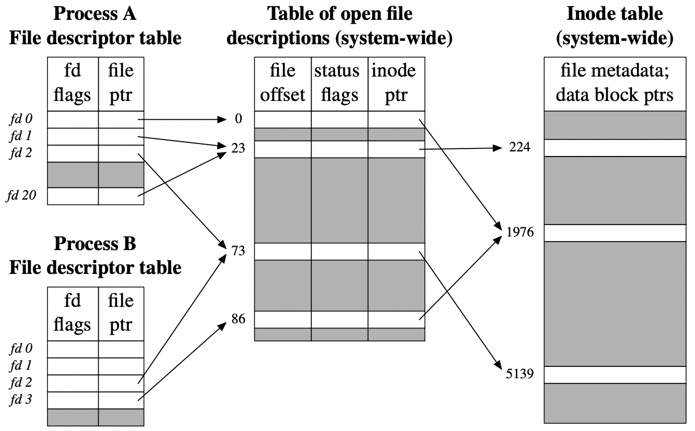
Aside: A Few Tables for Files in Unix/Linux

Slide 6
Aside: A Few Tables for Files in Unix/Linux
File descriptor table
Per-process, one entry for each fd opened by this process
Flags controlling the operations of a fd
Open file table
Global, system-wide, one entry for each file opened by “open”
File offset, access mode, etc.
Terms: Open file table entry, open file description (OFD) (POSIX)
inode table
System-wide, one entry per inode in the fs
File type (regular file, socket, etc.)
Permissions, properties, etc.

Slide 7
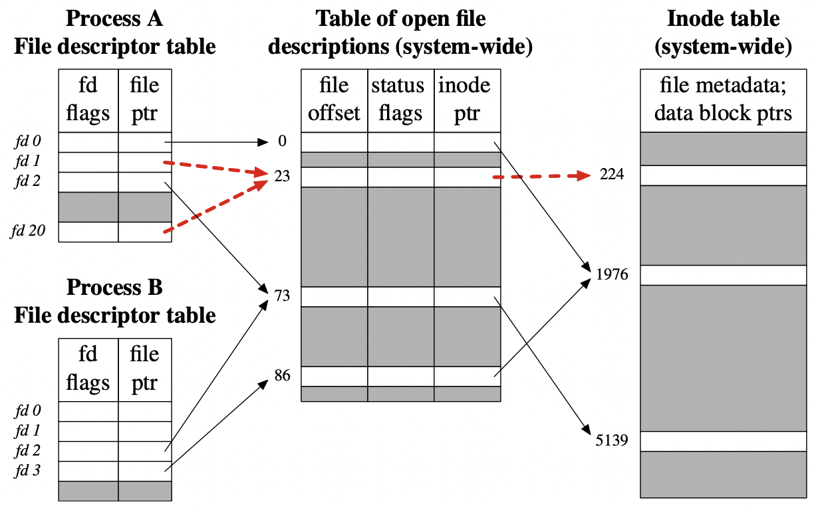
Duplicated File Descriptors (intra-process)
A process may have multiple fds referring to the same OFD
Achieved with dup() or dup2()

Slide 8
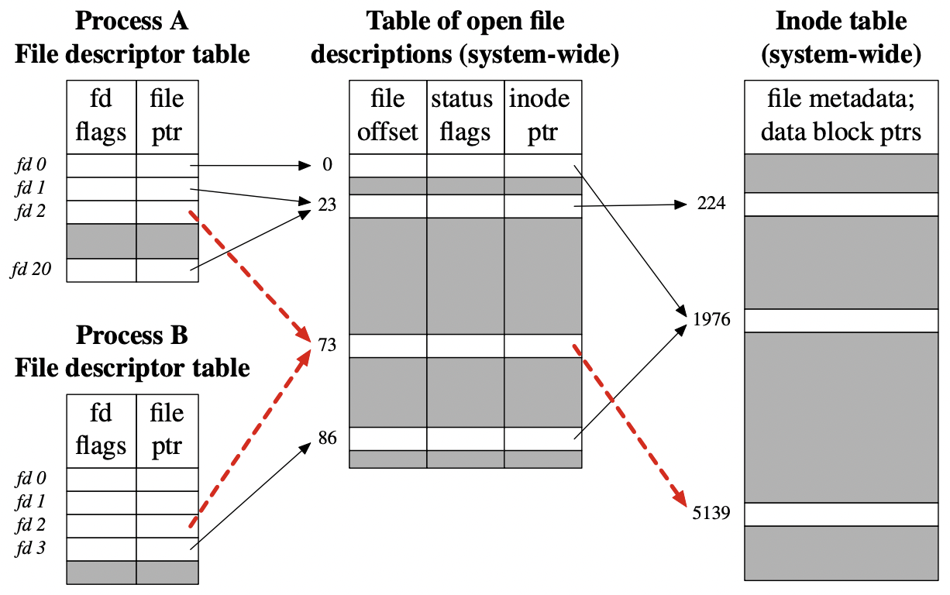
Duplicated File Descriptors (inter-process)
Two processes may have fds referring to the same OFD
As a result of fork()

Slide 9
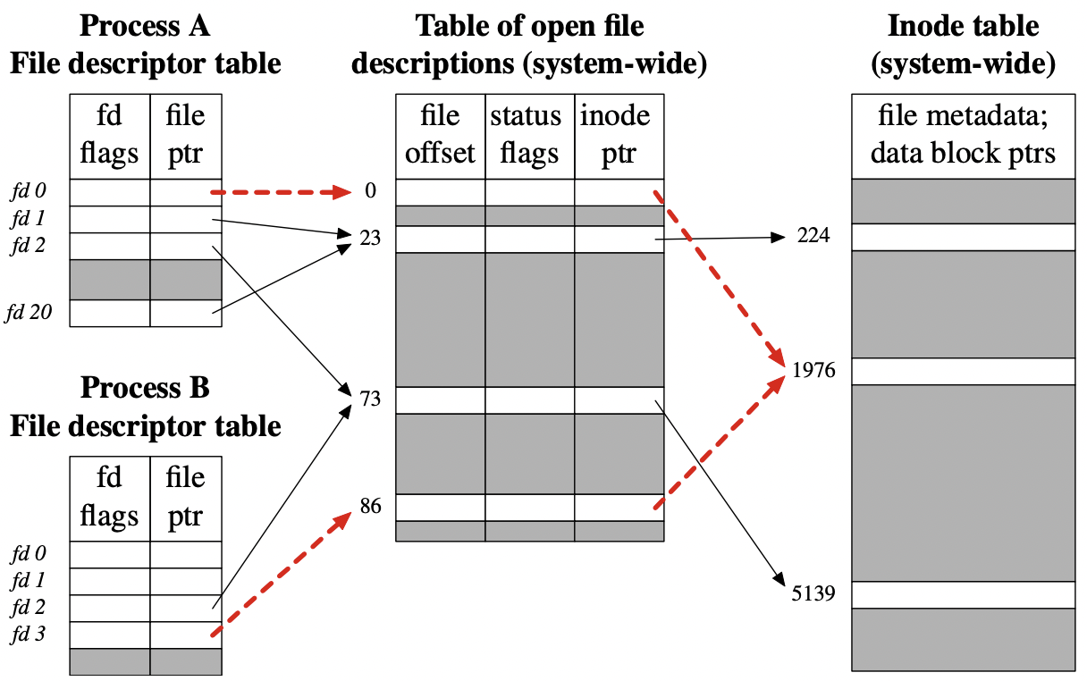
Duplicated OFDs
Two processes may have fds referring to distinct OFDs, or open file table entries, that refer to the same inode
They independently opened the same file

Slide 10
Interface: Reading and Writing Files
An Example of reading and writing ‘foo’ file.
The result of strace to figure out what cat is doing
open(): open file for reading with O_RDOLY and O_LARGEFILE flags.
returns file descriptor 3 ( 0,1,2, is for standard input/output/error)
read(): read bytes from the file.
write(): write buffer to standard output.
prompt> echo hello > foo //save the output to the file foo
prompt> cat foo //dump the contents to the screen
hello
prompt>
prompt> strace cat foo //strace to figure out what cat is doing
…
open(“foo”, O_RDONLY|O_LARGEFILE) = 3
read(3, “hello\n”, 4096) = 6 /*the number of bytes to read*/
write(1, “hello\n”, 6) = 6
hello
read(3, “hello\n”, 4096) = 0
write(1, “hello\n”, 6) = 0
..
prompt>

Slide 11
Reading and Writing Files (Cont.)
OFFSET
The position of the file where we start read and write.
When a file is open, “an offset” is allocated.
Updated after read/write
How to read or write to a specific offset within a file ?
Third argument is how the seek is performed.
SEEK_SET : to offset bytes.
SEEK_CUR: to its current location plus offset bytes.
SEEK_END: to the size of the file plus offset bytes.
offset
off_t lseek(int fd, off_t offset /*location */, int whence);

Slide 12
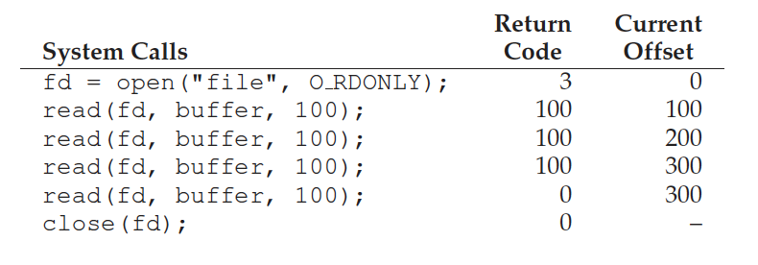
Data structures
struct file {
int ref;
char readable;
char writable;
struct inode *ip;
uint off;
};
struct {
struct spinlock lock;
struct file file[NFILE];
} ftable;

Slide 13
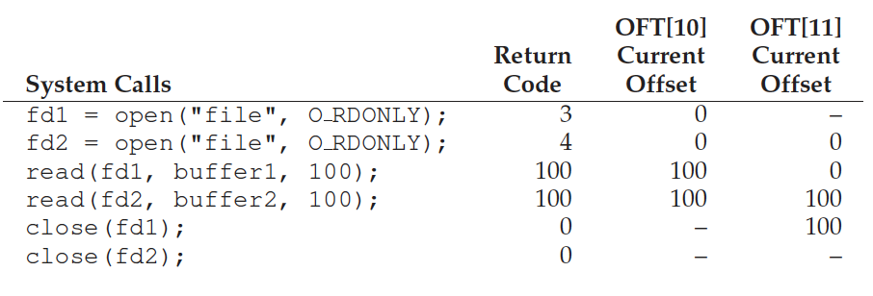
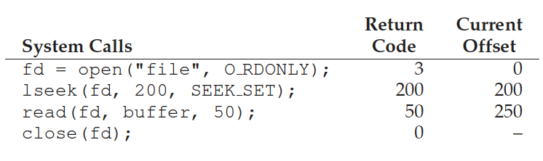
Sample traces

Slide 14
fsync()
Persistency
write():write data to the buffer. Later, save it to the storage.
some applications require more than eventual guarantee. Ex) DBMS
fsync():the writes are forced immediately to disk.
An Example of fsync().
If a file is created, it needs to be durably a part of the directory.
Above code requires fsync() to directory also.
off_t fsync(int fd /*for the file referred to by the specified file*/)
int fd = open("foo", O_CREAT | O_WRONLY | O_TRUNC);
int rc = write(fd, buffer, size);
rc = fsync(fd);

Slide 15
More API calls
More about the file system API will be covered in the tutorials

Slide 16
A Simple File System

Slide 17
Overview
We will study a very simple file system (vsfs)
Basic on-disk structures, access methods, and various policies of fs
We will study...
How can we build a simple file system?
What structures are needed on the disk?
What do they need to track?
How are they accessed?

Slide 18
File System Implementation
What types of data structures are utilized by the file system?
How does a file system organize its data and metadata?
Understand access methods of a file system.
open(), read(), write(), etc.

Slide 19
Overall Organization
Let’s develop the overall organization of the file system data structure.
Divide the disk into blocks.
Block size is 4 KB.
The blocks are addressed from 0 to N -1.
0 7
8 15
16 23
24 31
32 39
40 47
48 55
56 63

Slide 20
Data Region in a FS
Reserve a data region to store user data
The FS has to track which data blocks comprise a file, the size of the file, its owner, etc.
Data Region
D | D | D | D | D | D | D | D
D | D | D | D | D | D | D | D
D | D | D | D | D | D | D | D
0 7
8 15
16 23
24 31
Data Region
D | D | D | D | D | D | D | D
D | D | D | D | D | D | D | D
D | D | D | D | D | D | D | D
D | D | D | D | D | D | D | D
32 39
40 47
48 55
56 63
How we store these inodes in file system?

Slide 21
inode Table
Reserve some space for inode table
This holds an array of on-disk inodes.
Ex) inode tables: 3 ~ 7, inode size : 256 bytes
4-KB block can hold 16 inodes.
The file system contains 80 inodes. (maximum number of files)
inodes
Data Region
 | i | d | I | I | I | I | I
D | D | D | D | D | D | D | D
D | D | D | D | D | D | D | D
D | D | D | D | D | D | D | D
0 7
8 15
16 23
24 31
Data Region
D | D | D | D | D | D | D | D
D | D | D | D | D | D | D | D
D | D | D | D | D | D | D | D
D | D | D | D | D | D | D | D
32 39
40 47
48 55
56 63

Slide 22
Allocation Structures
This is to track whether inodes or data blocks are free or allocated.
Use a bitmap, each bit indicates free(0) or in-use(1)
data bitmap: for data region
inode bitmap: for inode table
inodes
Data Region
 | i | d | I | I | I | I | I
D | D | D | D | D | D | D | D
D | D | D | D | D | D | D | D
D | D | D | D | D | D | D | D
0 7
8 15
16 23
24 31
Data Region
D | D | D | D | D | D | D | D
D | D | D | D | D | D | D | D
D | D | D | D | D | D | D | D
D | D | D | D | D | D | D | D
32 39
40 47
48 55
56 63

Slide 23
Super Blocks
Super block contains meta information for a file system
Ex) The number of inodes, begin location of inode table. etc
Thus, when mounting a file system, OS will read the superblock first, to initialize various information.
Inodes
Data Region
S | i | d | I | I | I | I | I
D | D | D | D | D | D | D | D
D | D | D | D | D | D | D | D
D | D | D | D | D | D | D | D
0 7
8 15
16 23
24 31
Data Region
D | D | D | D | D | D | D | D
D | D | D | D | D | D | D | D
D | D | D | D | D | D | D | D
D | D | D | D | D | D | D | D
32 39
40 47
48 55
56 63

Slide 24
File Organization: The inode
Each inode is referred to by an inode number.
by inode number, the FS calculates where the inode is on the disk.
Ex) inode number: 32
Calculate the offset into the inode region (32 x sizeof(inode) (256 bytes) = 8192
Add start address of the inode table(12 KB) + inode region(8 KB) = 20 KB
The Inode table
iblock 0
iblock 1
iblock 2
iblock 3
iblock 4
Super | i-bmap | d-bmap | 0 | 1 | 2 | 3 | 16 | 17 | 18 | 19 | 32 | 33 | 34 | 35 | 48 | 49 | 50 | 51 | 64 | 65 | 66 | 67
 |  |  | 4 | 5 | 6 | 7 | 20 | 21 | 22 | 23 | 36 | 37 | 38 | 39 | 52 | 53 | 54 | 55 | 68 | 69 | 70 | 71
 |  |  | 8 | 9 | 10 | 11 | 24 | 25 | 26 | 27 | 40 | 41 | 42 | 43 | 56 | 57 | 58 | 59 | 72 | 73 | 74 | 75
 |  |  | 12 | 13 | 14 | 15 | 28 | 29 | 30 | 31 | 44 | 45 | 46 | 47 | 60 | 61 | 62 | 63 | 76 | 77 | 78 | 79
0KB
4KB
8KB
12KB
16KB
20KB
24KB
28KB
32KB

Slide 25
File Structure: Indexed Allocation
direct blocks
Small files do not require separate index blocks
mode
owners (2)
timestamp (3)
size block
Data
count
Data
Data
.
.
.
Contains the addresses of blocks that contain pointers to the actual data blocks
.
.
.
Data
.
.
.
Data
.
.
.
Data
single indirect
Data
double indirect
.
.
.
Data
triple indirect
.
.
.
Data
Data
Index block, contains addresses of blocks that contain data
Pointers to the actual data blocks

Slide 26
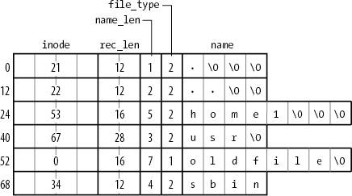
Directory Structure
VSFS
inum | reclen | strlen | name
5 4 2 .
2 4 3 . .
12 4 4 foo
13 4 4 bar
8 7 foobar
EXT4

Slide 27
File Read
Read “/foo/bar”
 | data bitmap | inode bitmap | root inode | foo inode | bar inode | root data | foo data | bar data[0] | bar data[1] | bar data[2]
open(bar) |  |  | read
 |  |  |  |  |  | read
 |  |  |  | read
 |  |  |  |  |  |  | read
 |  |  |  |  | read
read() |  |  |  |  | read
 |  |  |  |  |  |  |  | read
 |  |  |  |  | write
read() |  |  |  |  | read
 |  |  |  |  |  |  |  |  | read
 |  |  |  |  | write
read() |  |  |  |  | read
 |  |  |  |  |  |  |  |  |  | read
 |  |  |  |  | write

Slide 28
File Creation
 | data bitmap | inode bitmap | root inode | foo inode | bar inode | root data | foo data | bar data[0] | bar data[1] | bar data[2]
create (/foo/bar) |  |  | read
 |  |  |  |  |  | read
 |  |  |  | read
 |  |  |  |  |  |  | read
 |  | read
 |  | write
 |  |  |  |  |  |  | write
 |  |  |  |  | read
 |  |  |  |  | write
 |  |  |  | write
write() |  |  |  |  | read
 | read
 | write
 |  |  |  |  |  |  |  | write
 |  |  |  |  | write
...

Slide 29
File Creation (Cont.)
 | data bitmap | inode bitmap | root inode | foo inode | bar inode | root data | foo data | bar data[0] | bar data[1] | bar data[2]
...
write() |  |  |  |  | read
 | read
 | write
 |  |  |  |  |  |  |  |  | write
 |  |  |  |  | write
write() |  |  |  |  | read
 | read
 | write
 |  |  |  |  |  |  |  |  |  | write
 |  |  |  |  | write

Slide 30
Caching and Buffering
Reading and writing are very IO-intensive.
File open: two IO for each directory component and one read for the data.
Buffer Cache
Cache the disk blocks to reduce the IO.
LRU replacement
Static partitioning: 10% of DRAM, inefficient usage
FD
Virtua memory
(90% of page frame)
Buffer cache
(10% of page frame)

Slide 31
Caching and Buffering
Page Cache
Merge virtual memory and buffer cache
A physical page frame can host either a page in the process address space or a file block.
Process uses page table to map a virtual page to a page frame.
A file IO uses “address_space” (Linux) to map a file block to a physical page frame.
Dynamic partitioning
FD
Page cache

Slide 32
Summary
Requirements for building filesystem
File information: inode
File structure: indexed file
Directory (name→inode-number): array of <inode #, name>’s
Free block information: Bitmap
All are flexible.

Slide 33
How to Make it Faster?

Slide 34
Problem of Unix operating system
Unix file system treated the disk as a random-access memory.
Example of random-access blocks with four files.
Data blocks for each file can accessed by going back and forth the disk,
File b and d is deleted.
File E is created with free blocks. (spread across the block)
A1 | A2 | B1 | B2 | C1 | C2 | D1 | D2
A1 | A2 |  |  | C1 | C2
A1 | A2 | E1 | E2 | C1 | C2 | E3 | E4

Slide 35
FFS: Disk Awareness is the solution
FFS is Fast File System designed by a group at Berkeley.
The key idea of FFS is that file system structures and allocation polices need to be “disk aware” to improve performance.
Keep same API with file system. (open(), read(), write(), etc)
Changing the internal implementation.

Slide 36
Cylinder Groups
FFS divides the disk into a bunch of groups, Cylinder Groups
Modern file system call cylinder group as block group.
These groups are used to improve seek performance.
By placing two files within the same group.
Accessing one after the other will not be long seeks across the disk.
FFS needs to allocate the files and directories within each of these groups.
S | ib | db | Inodes | Data
Data structure for each cylinder group.
A copy of the super block for reliability reason.
inode bitmap and data bitmap to track free inode and data block.
inodes and data block

Slide 37
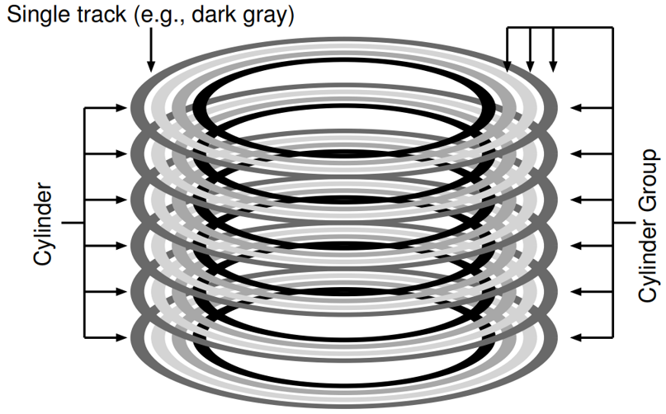
Cylinder Group (Cont.)
Cylinder: Tracks at same distance from center of drive across different surfaces.
All tracks with same color
Cylinder Group: Set of N consecutive cylinders
if N=3, first group does not include black track

Slide 38
How To Allocate Files and Directories?
Policy is “keep related stuff together”
The placement of directories
Find the cylinder group with a low number of allocated directories and a high number of free inodes.
Put the directory data and inode in that group.
The placement of files.
Allocate data blocks of a file in the same group as its inode
It places all files in the same group as their directory

Slide 39
Summary
The introduction of fast file system (FFS)
It makes file system fast, considering characteristic of disk.
Many file systems take cues from FFS.
ex) ext4, ext3, ext4

