Slide 1
Operating Systems
Lecture 15: File Systems
Part III: Log-structured File System

Slide 2
Outline
Key Idea: Writing Sequentially
Indirect Mapping and Checkpoint Region
Directories
Garbage Collection
Crash Recovery

Slide 3


Overview
In the early 90’s, a new file system, the log-structured file system (LFS) was developed
Motivation
Memory sizes were growing.
Large gap between random IO and sequential IO performance.
Existing File System perform poorly on common workloads.
In this chapter, we study Log-Structured Filesystem (LFS).
How can a file system transform all writes into sequential writes?
John Ousterhout
Mendel Rosenblum

Slide 4
Writing to Disk Sequentially
How do we transform all updates to file-system state into a series of sequntial writes to disk?
data update
metadata needs to be updated too. (Ex. inode)
 | D
A0
 | D | I
blk[0]:A0
A0

Slide 5
Writing Sequentially, and Effeciently!
Writing to the disk sequentially is not enough to guarantee the efficient writes.
Disk may rotate between the writes. → loose a single revolution between the writes.
Write buffering.
Segment: a set of sequential writes that are written to the disk with a single unit.
Keep track of updates in memory buffer. ( a few Mbyte)
Write them to disk all at once, when it has sufficient number of updates.
blk[0]:A0
blk[0]:A1
blk[0]:A2
blk[0]:A3
 | D[j,0] | D[j,1] | D[j,2] | D[j,3] |  | D[k,0]
blk[0]:A5
A0
A1
A2
A3
inode[j]
A5
inode[k]

Slide 6
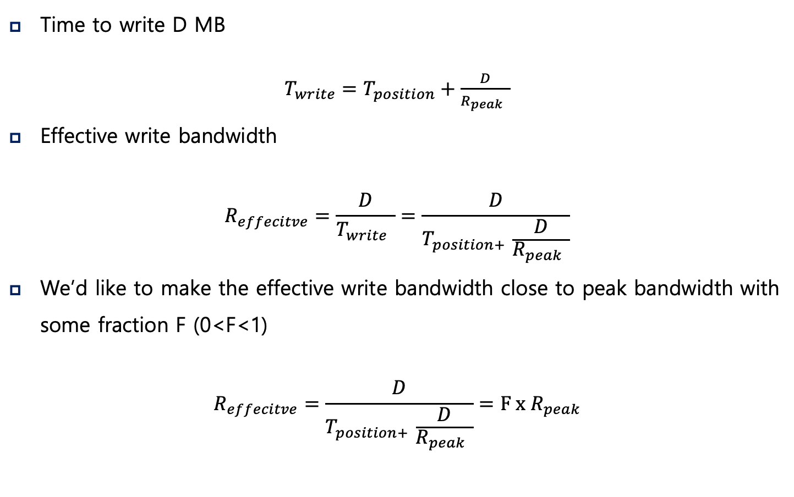
Issue #1: How Much to Buffer
Time to write D MB
$T_{write}=T_{position}+\frac{D}{R_{peak} }$
Effective write bandwidth
$$R_{effecitve}=\frac{D}{T_{write} }=\frac{D}{T_{position+ }\frac{D}{R_{peak} }}$$
We’d like to make the effective write bandwidth close to peak bandwidth with some fraction F (0<F<1)
$$R_{effecitve}=\frac{D}{T_{position+ }\frac{D}{R_{peak} }}=F x R_{peak}$$

Slide 7
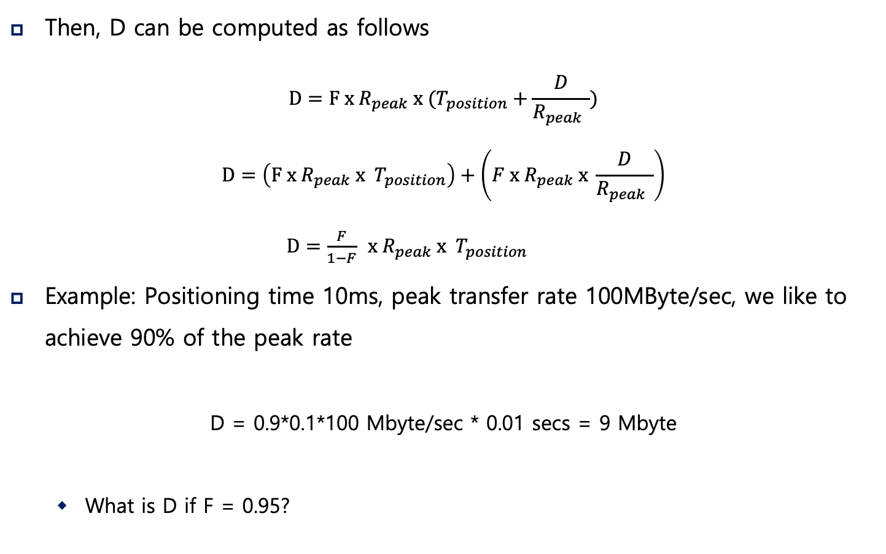
Issue #1: How Much to Buffer
Then, D can be computed as follows
$$D=F x{ R}_{peak} x{ (T}_{position}+\frac{D}{R_{peak} })$$
$$D=\left(F x{ R}_{peak} x { T}_{position}\right)+\left(F x{ R}_{peak} x \frac{D}{R_{peak} }\right)$$
$D=\frac{F}{1−F}$ $x{ R}_{peak} x { T}_{position}$
Example: Positioning time 10ms, peak transfer rate 100MByte/sec, we like to achieve 90% of the peak rate
D = 0.9*0.1*100 Mbyte/sec * 0.01 secs = 9 Mbyte
What is D if F = 0.95?

Slide 8
Outline
Key Idea: Writing Sequentially
Indirect Mapping and Checkpoint Region
Directories
Garbage Collection
Crash Recovery

Slide 9
Issue #2: How to Find Inodes?
The position of the inodes keep changing.
The Inode Map
A data structure that contains the location of the most recent inode for a given inode number.
Places the chunk of updated inode map right next to the updated inode (why?)
Where to find the inode map?
blk[0]:A0
map[k]:A1
 | D | I[k] | imap
A0
A1

Slide 10
Issue #2: How to Find Inodes?
How to find the inode map spread across the disk?
The LFS must have a fixed location on disk to begin a file lookup.
Checkpoint Region
A fixed location in the LFS partition.
Contain the pointers to the latest of the inode map.
Wait, then every update still needs to seek to this CR!
Inode map also helps to solve the recursive update problem (coming up soon)
blk[0]:A0
map[k]:A1
CR |  | D | I[k] | imap
imap
[k..k+N]:
A2
0
(1)
A0
(4)
A1
(3)
A2
(2)

Slide 11
Reading a file from the disk
Reading a file block
Read a checkpoint region
Read inode map
Read inode
Read data block
What about sequential read?
It may become random read.
LFS is optimized for writes.

Slide 12
Outline
Key Idea: Writing Sequentially
Indirect Mapping and Checkpoint Region
Directories
Garbage Collection
Crash Recovery

Slide 13
Issue #3: What About Directories?
Directory: a set of <inode, filename>
How does LFS store directory data?
Creating a file: foo
Update the directory inode. (inode #: dir)
Update the directory entry. (foo, k)
Update inode for the created file. (inode #: k)
Update the data block for the created file.
blk[0]:A0
(foo,k)
blk[0]:A2
map[k]:A1
map[dir]:A3
 | D[k] | I[k] | D[dir] | I[dir] | imap
A0
A1
A2
A3

Slide 14
Issue #3: What About Directories?
Recursive update: A serious problem in any FS that never updates in place
Whenever an inode is updated, its location on disk changes
To keep track of inodes, a directory may have to record a collection of (name, inode-location) pairs instead
This would have also entailed recursive updates to the directory that points to the file, the parent of that directory, …, all the way up the file system tree
LFS cleverly avoids this problem with imap
The directory is still (name, inode-num) pairs.
The imap keeps the inode-num to inode-location mappings
The change in inode location is never reflected in the directory itself

Slide 15
Outline
Key Idea: Writing Sequentially
Indirect Mapping and Checkpoint Region
Directories
Garbage Collection
Crash Recovery

Slide 16
Issue #4: Garbage Collection
LFS keeps writing newer versions of a file.
Garbage: LFS leaves the older versions of file structures all over the disk.
An example of garbage
Overwrite the data block:
Append a block to that original file k:
blk[0]:A0
blk[0]:A4
 | D0 | I[k] |  | D0 | I[k]
A0
(both garbage)
A4
blk[0]:A0
 | D0 | I[k] |  | D1
I[k]
blk[0]:A0
blk[1]:A4
A0
(garbage)
A4

Slide 17
Issue #4: Garbage Collection
What to do with the older versions of the block
Versioning filesystem: keep the old blocks and allow the users to restore to the older version of the filesystem status.
LFS: periodically clean the older versions of the file data, inodes and other structures.
Unit of garbage collection: Segment
Read a number of old segments, M segments.
Identify the valid blocks.
Write them to a number of new segments (in memory), N segments.
Write N segments to the disk.
Then, N < M.

Slide 18
Issue #4: Garbage Collection
Update request
for existing data
Find a free block,
and save the new data
This scenario may continue until there
are not enough free blocks
Invalid
Invalid
Invalid
Invalid
Invalid
Invalid
Invalid
Invalid
New Data
Invalid
Invalid
Invalid
segment (A)
segment (A)
segment (A)
segment (B)
segment (C)
Collect valid blocks into a free segment
Update the map table, and
free invalid (obsolete) segments
Invalid
Invalid
Invalid
Invalid
Invalid
Invalid
Invalid
Invalid
Invalid
Invalid
segment (A)
segment (B)
segment (C)
segment (A)
segment (B)
segment (C)

Slide 19
Mechanism: Segment Summary Block
Store the inode number and the offset for each data block in it.
In garbage collection, we need to identify the obsolete blocks.
Compare the block address of file k, block offset 0, based upon the Segment Summary and based upon the in-memory imap. If they coincide, the block is alive
blk[0]:A0
map[k]:A1
A0: (k,0) SS | D | I[k] | imap
A0
A1

Slide 20
Policy of Garbage Collection
When to clean
Periodically
When a system is idle
When the disk is full
Which block to consolidate? (heuristic from the original LFS paper)
Hot segment: the blocks are updated periodically
Cold segment: the blocks are not updated.
Hot segment: clean later.
Cold segment: clean sooner.
Other policies are possible

Slide 21
Outline
Key Idea: Writing Sequentially
Indirect Mapping and Checkpoint Region
Directories
Garbage Collection
Crash Recovery

Slide 22
Crash recovery
What if the crash happens when the LFS is in the middle of writing the segment to the disk?
LFS maintains a set of segments as a linked list in memory
LFS organizes the filesystem partition as a log (a linked list of the segments).
Two checkpoint regions: one at the beginning and the one at the end.

Slide 23
Crash recovery
Consistent Update on CR
Write timestamp at the beginning of CR.
Write CR body.
Write time stamp at the end of the CR.
When crash occurs, chooses the most recent CR with valid consistent time stamps.
Crash recovery
Read the CR and rebuild imap.
Perform roll-forward.
Start from the first segment in CR.
Scan the valid segment following the “next segment” pointer and update the imap.

Slide 24
Summary
Introduce a new approach to updating the disk.
Shadow paging in database system, Copy-on-Write in file system.
Gather all updates into an in-memory segment.
Write them out together sequentially.
LFS-style is excellent for performance on many different devices.
Hard drives, parity-based RAIDs, even Flash-based SSDs.
Some modern commercial filesystems adopt a similar copy-on-write approach even though it generates garbage.
NetApp’s WAFL, Sun’s ZFS and Linux btrfs
In particular, WAFL turns cleaning problem into a feature, by providing old versions of the file system via snapshots.

