Slide 1
CSCI3150 Introduction to Operating Systems
Lecture 4: Threads

Slide 2
Processes
Recall that a process includes many things
An address space (defining all the code and data pages)
OS resources (e.g., open files) and accounting information
Execution state (PC, SP, regs, etc.)
Creating a new process is costly because of all of the data structures that must be allocated and initialized
Recall struct proc in Solaris
…which does not even include page tables, perhaps TLB flushing, etc.
Communicating between processes is costly because most communication goes through the OS
Overhead of system calls and copying data

Slide 3
Parallel Programs
To execute these programs we need to
Create several processes that execute in parallel
Cause each to map to the same address space to share data
They are all part of the same computation
Have the OS schedule these processes in parallel
This situation is very inefficient
Space: PCB, page tables, etc.
Time: create data structures, fork and copy addr space, etc.
Solutions: possible to have more efficient, yet cooperative “processes”?

Slide 4
Rethinking Processes
What is similar in these cooperating processes?
They all share the same code and data (address space)
They all share the same privileges
They all share the same resources (files, sockets, etc.)
What don’t they share?
Each has its own execution state: PC, SP, and registers
Key idea: Why don’t we separate the concept of a process from its execution state?
Process: address space, privileges, resources, etc.
Execution state: PC, SP, registers
Exec state also called thread of control, or thread

Slide 5
Threads
Modern OSes (Mac, Windows, modern Unix) separate the concepts of processes and threads
The thread defines a sequential execution stream within a process (PC, SP, registers)
The process defines the address space and general process attributes (everything but threads of execution)
A thread is bound to a single process
Processes, however, can have multiple threads
Threads become the unit of scheduling
Processes are now the containers in which threads execute

Slide 6
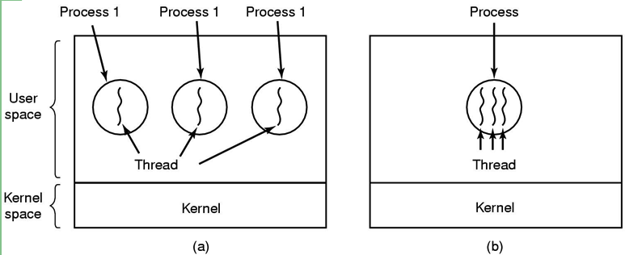
Threads: lightweight processes
execution
environment (resource)
(a) Three processes each with one thread
(b) One process with three threads

Slide 7
The thread model
Shared information
Processor info: parent process, time, etc
Memory: segments, page table, and stats, etc
I/O and file: communication ports, directories and file descriptors, etc
Private state
State (ready, running and blocked)
Registers
Program counter
Execution stack
Why?
Each thread execute separately

Slide 8
Threads in a Process
Stack (T1)
Thread 1
Thread 2
Stack (T2)
Stack (T3)
Thread 3
Heap
Static Data
PC (T3)
PC (T2)
Code
PC (T1)
Notes:
Question: what if one thread’s stack overflow into other threads?
By default, your stack get smashed. But generally compiler will have support to protect (mark the white space as inaccessible)

Slide 9
Threads: Concurrent Servers
Using fork() to create new processes to handle requests in parallel is overkill for such a simple task
Recall our forking Web server:
while (1) {
int sock = accept();
if ((child_pid = fork()) == 0) {
//Handle client request
//Close socket and exit
} else {
//Close socket
}
}

Slide 10
Threads: Concurrent Servers
Instead, we can create a new thread for each request
web_server() {
while (1) {
int sock = accept();
thread_create(handle_request, sock);
}
}
handle_request(int sock) {
Process request
close(sock);
}

Slide 11
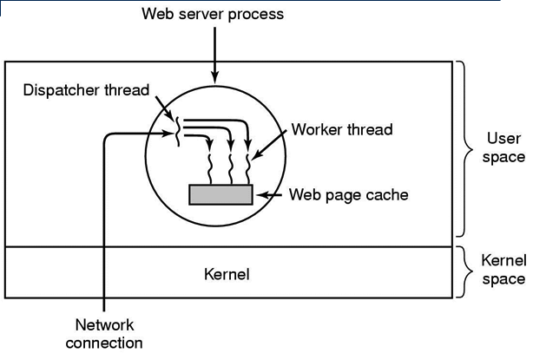
Thread usage: web server

Slide 12
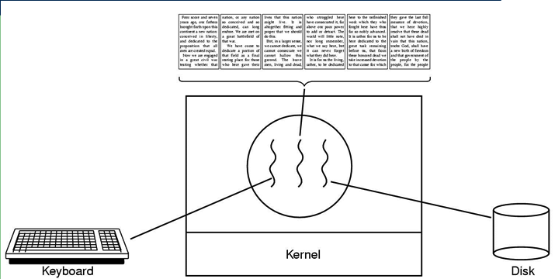
Thread usage: word processor
A thread can wait for I/O, while the other threads can still run.
What if it is single-threaded?

Slide 13
Kernel-Level Threads
We have taken the execution aspect of a process and separated it out into threads
To make concurrency cheaper
As such, the OS now manages threads and processes
All thread operations are implemented in the kernel
The OS schedules all of the threads in the system
OS-managed threads are called kernel-level threads or lightweight processes
Windows: threads
Solaris: lightweight processes (LWP)
POSIX Threads (pthreads): PTHREAD_SCOPE_SYSTEM
Notes:
PTHREAD_SCOPE_SYSTEM: this is scheduled by the OS.

Slide 14
Kernel-level Thread Limitations
Kernel-level threads make concurrency much cheaper than processes
Much less state to allocate and initialize
However, for fine-grained concurrency, kernel-level threads still suffer from too much overhead
Thread operations still require system calls
Ideally, want thread operations to be as fast as a procedure call
For such fine-grained concurrency, need even “cheaper” threads

Slide 15
User-Level Threads
To make threads fast, they need to be implemented at user level
Kernel-level threads are managed by the OS
User-level threads are managed by the run-time system (user-level library)
User-level threads are small, cheap, and fast
A thread is simply represented by a PC, registers, stack, and small thread control block (TCB)
Creating a new thread, switching between threads, and synchronizing threads are done via procedure call
No kernel involvement
User-level thread operations 100x faster than kernel threads
pthreads: PTHREAD_SCOPE_PROCESS

Slide 16
User-level Thread Limitations
Yet, user-level threads are not a perfect solution
As with everything else, they are a tradeoff
User-level threads are invisible to the OS
They are not well integrated with the OS
As a result, the OS can make poor decisions
Scheduling a process with idle threads
Blocking a process whose thread initiated an I/O, even though the process has other threads that can execute
Solving this requires communication between the kernel and the user-level thread manager

Slide 17
Kernel- vs. User-level Threads
Kernel-level threads
Integrated with OS (informed scheduling)
Slow to create, manipulate, synchronize
User-level threads
Fast to create, manipulate, synchronize
Not integrated with OS (uninformed scheduling)
Understanding the differences between kernel- and user-level threads is important
For programming (correctness, performance)
For test-taking

Slide 18
Kernel- and User-level Threads
Or use both kernel- and user-level threads
Can associate a user-level thread with a kernel-level thread
Or, multiplex user-level threads on top of kernel-level threads
Java Virtual Machine (JVM)
Java threads used to be user-level threads
On older Unix, only one “kernel thread” per process
Multiplex all Java threads on this one kernel thread
On Windows NT, some more modern Unix
Can multiplex Java threads on multiple kernel threads
Can have more Java threads than kernel threads
No longer the case today

Slide 19
Kernel- and User-level Threads cont.
Golang today uses user-level threads
Multiplex multiple Goroutines (user-level threads) on multiple kernel level threads

Slide 20
Implementing Threads
Implementing threads has a number of issues
Interface
Context switch
Preemptive vs. Non-preemptive
What do they mean?
Scheduling
Synchronization (next lecture)
Focus on user-level threads
Kernel-level threads are similar to original process management and implementation in the OS

Slide 21
Sample Thread Interface
thread_create(procedure_t, arg)
Create a new thread of control
Start executing procedure_t
thread_yield()
Voluntarily give up the processor
thread_exit()
Terminate the calling thread; also thread_destroy
thread_join(target_thread)
Suspend the execution of calling thread until target_thread terminates
Notes:
example of thread_join. facebook front page.

Slide 22
Thread Scheduling
For user-level thread: scheduling occurs entirely in user-space
The thread scheduler determines when a thread runs
It uses queues to keep track of what threads are doing
Just like the OS and processes
But it is implemented at user-level in a library
Run queue: Threads currently running (usually one)
Ready queue: Threads ready to run
Are there wait queues?

Slide 23
Review of threads
What are shared among threads of the same process? What are not?
Why cannot they share the same stack?
How threads of the same process communicate with each other?
Trade-off between kernel level threads and user level threads?
Blocking system call
Blocking system call: an I/O system call that will wait for the I/O to complete before returning
How do we implement user-level threads

Slide 24
Non-Preemptive Scheduling
Threads voluntarily give up the CPU with thread_yield
What is the output of running these two threads?
Ping Thread
Pong Thread
while (1) {
printf(“ping\n”);
thread_yield();
}
while (1) {
printf(“pong\n”);
thread_yield();
}

Slide 25
thread_yield()
Wait a second. How does thread_yield() work?
it gives up the CPU to another thread
In other words, it context switches to another thread
So what does it mean for thread_yield to return?
It means that another thread called thread_yield!
Execution trace of ping/pong
printf(”ping\n”);
thread_yield();
printf(“pong\n”);
thread_yield();
…

Slide 26
Implementing thread_yield()
thread_yield() {
thread_t old_thread = current_thread;
current_thread = get_next_thread();
append_to_queue(ready_queue, old_thread);
context_switch(old_thread, current_thread);
return;
}
As old thread
As new thread
The magic step is invoking context_switch()
Why do we need to call append_to_queue()?

Slide 27
Thread Context Switch
The context switch routine does all the magic
Saves context of the currently running thread (old_thread)
Push all machine state onto its stack (except stack pointer)
Restores context of the next thread
Pop all machine state from the next thread’s stack
The next thread becomes the current thread
Return to caller as new thread
This is all done in assembly language

Slide 28
Wait a minute
Non-preemptive threads have to voluntarily give up CPU
Only voluntary calls to thread_yield(), or thread_exit() causes a context switch
What if a thread never release the CPU (never calls thread_yield())?
We need preemptive user-level thread scheduling

Slide 29
Preemptive Scheduling
Preemptive scheduling causes an involuntary context switch
Need to regain control of processor asynchronously
How?
Use timer interrupt
Timer interrupt handler forces current thread to “call” thread_yield
How?

Slide 30
Process vs. thread
Multithreading is only an option for “cooperative tasks”
Trust and sharing
Process
Strong isolation but poor performance
Thread
Good performance but share too much
Example: web browsers
Safari: multithreading
one webpage can crash entire Safari
Google Chrome: each tab has its own process

Slide 31
Summary
The operating system as a large multithreaded program
Each process executes as a thread within the OS
Multithreading is also very useful for applications
Efficient multithreading requires fast primitives
Processes are too heavyweight
Solution is to separate threads from processes
Kernel-level threads much better, but still significant overhead
User-level threads even better, but not well integrated with OS
Now, how do we get our threads to correctly cooperate with each other?
Synchronization…

