Slide 1
Assignment One Review & Deadlocks
CSCI3150 Introduction to Operating Systems, Spring 2023
Shaofeng Wu
wsf123@link.cuhk.edu.hk
Feb 16, 2023

Slide 2
Release of Assignment Two
Check course website for codes, documentation and submission entry of asg2.
Content: Implementation of Multi-Level Feedback Queue
Release: 2023.2.16
Due
Normal: 2023.3.6 18:00:00 p.m.
Grace token: 2023.3.7 18:00:00 p.m.

Slide 3
Review
In tutorial four, we mainly talked about
Mutex lock
Semaphore
Conditional variable
Dining philosophers problem
In today’s tutorial, we will
Review assignment one
Discuss deadlocks with examples
Today’s tutorial will take about 35 minutes

Slide 4
Code Example
- My implementation
int shell_execute(char ** args, int argc){
/* parse the arguments to check for "|" */
/* One command */
if(pipe_count==0){
/* Execute one command */
}
/* One pipe, two commands */
else if(pipe_count==1){
/* Pipe and execute two commands */
}
/* Two pipes, three commands */
else if(pipe_count==2){
/* Pipe and execute three commands */
}
/* Wait for all children to terminate */
while((wait_return = wait(&status)) > 0);
return 0;
}
Core logic
One command
Built-in
External
Two commands
Three commands

Slide 5
Code Example
- My implementation
/* One command */
if(pipe_count==0){
/* Execute one command */
if(args[0] is built-in){
return shell_execute_builtin(args);
}
else{
if((child_pid = fork()) < 0){
printf("fork() error \n");
}
else if(child_pid == 0){
if(execvp(args[0], args) < 0){
printf("execvp() error \n");
exit(-1);
}
}
}
Core logic
One command
Built-in
External

Slide 6
/* one pipe */
else if(pipe_count==1){
pipe(pipefd);
/* child 1 */
child_pid = fork();
if(child_pid == 0 ){
/* close un-used READ_END of first child process */
close(pipefd[READ_END]);
/* redirect STDOUT_FILENO to WRITE_END */
dup2(pipefd[WRITE_END], STDOUT_FILENO);
close(pipefd[WRITE_END]);
/* Execute command */
}
/* child 2 */
child_pid = fork();
if(child_pid == 0 ){
/* close un-used WRITE_END of first child process */
close(pipefd[WRITE_END]);
/* redirect STDIN_FILENO to READ_END */
dup2(pipefd[READ_END], STDIN_FILENO);
close(pipefd[READ_END]);
/* Execute command */
}
/* Parent close un-used end */
close(pipefd[WRITE_END]);
close(pipefd[READ_END]);
}
Code Example
- My implementation
Core logic: Two commands with one pipe
Pipe()
Fork two children
Redirect output/input
Close un-used pipe ends
Each one execute one command

Slide 7
Code Example
- My implementation
/* two pipe */
else if(pipe_count==1){
pipe(pipefd);
/* child 1 */
child_pid = fork();
if(child_pid == 0 ){
/* close un-used READ_END of first child process */
close(pipefd[READ_END]);
/* redirect STDOUT_FILENO to WRITE_END */
dup2(pipefd[WRITE_END], STDOUT_FILENO);
close(pipefd[WRITE_END]);
/* Execute command */ }
/* child 3 */
child_pid = fork();
if(child_pid == 0 ){
/* close un-used WRITE_END of first child process */
close(pipefd[WRITE_END]);
/* redirect STDIN_FILENO to READ_END */
dup2(pipefd[READ_END], STDIN_FILENO);
close(pipefd[READ_END]);
/* Execute command */
}
/* Parent close un-used end */
close(pipefd[WRITE_END]);
close(pipefd[READ_END]);
}
Core logic
Three commands
Add something here

Slide 8
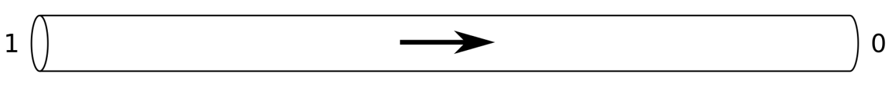
Code Example
- My implementation
Two commands, one pipe
Parent
fd
STDIN
STDOUT
WRITE END
READ END
fork()
fork()
Child One
Child Two
fd
STDIN
STDOUT
WRITE END
READ END
fd
STDIN
STDOUT
WRITE END
READ END

Slide 9
Code Example
- My implementation
Parent
fd
STDIN
STDOUT
WRITE END1
READ END1
WRITE END2
READ END2
Three commands, two pipe
fork()
fork()
fork()
Child Two
Child One
Child Three
fd
STDIN
STDOUT
WRITE END1
READ END1
WRITE END2
READ END2
fd
STDIN
STDOUT
WRITE END1
READ END1
fd
STDIN
STDOUT
WRITE END2
READ END2

Slide 10
Questions from Students
Questions about coding details (5) :
I have trouble with args
I have trouble with execvp
I have trouble with …
A lot of suggestions have been provided
For more high-level suggestions
Be objective
Isolate the buggy part of the code
Try to reason about cause using the error type
Seg fault?(2)
Random behavior?(1)
Unexpected behavior?(3)
Messages from systems calls(1)
Use debug tools
Gdb
Or just printfs : )
Or TAs

Slide 11
Questions from Students
/* A recursive way of executing commands with multiple pipes */
void execute_pipe(char ** args){
if(args == NULL){
return;
}
else{
pipe_index = find_fisrt_pipe(args);
/* create and link pipes */
execute_command(args, pipe_index);
/* recursive call */
return execute_pipe(args, &args[pipe_index+1]);
}
}
Why not recursive calls?
getconf ARG_MAX, bash shell only allow commands up to a specific number of bytes
(For someone visited me on Monday) Parent does not wait for the child of child to terminate
Support arbitrary number of pipes?
A for loop
ls | grep abc | wc –l | …

Slide 12
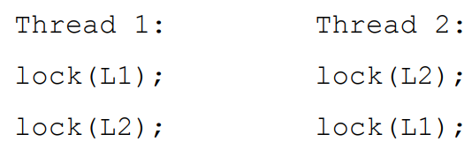
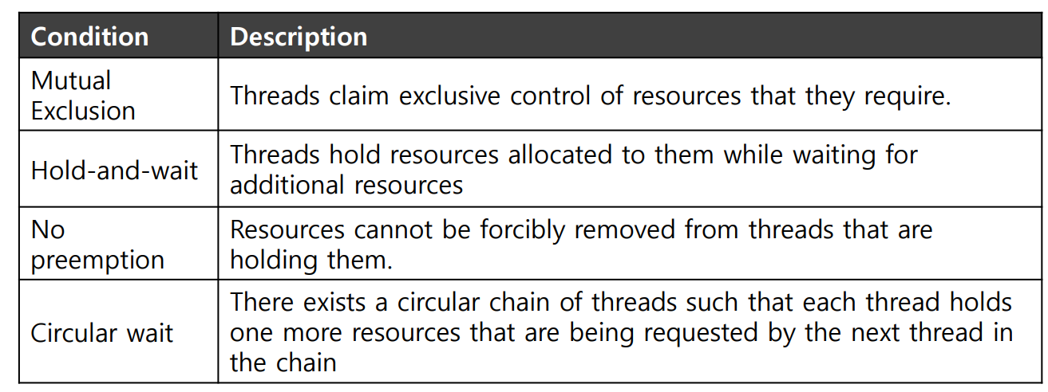
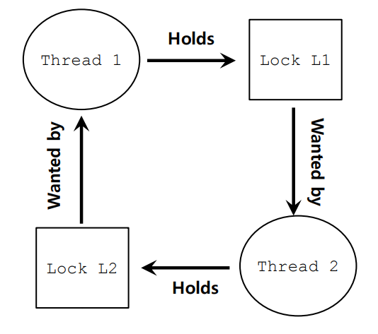
Deadlocks
- What is deadlock
What is deadlock
A deadlock is a situation where two or more competing entities are each waiting for the other to release a resource needed by the other entity in order to proceed. This leads to a stalemate, where both entities will be unable to satisfy their respective needs.
Quick review on lecture content

Slide 13
Deadlocks
- Deadlock example
gcc example.c -lpthread
// function which will be executed by thread1
void* thread1(void *arg)
{
// acquiring lock m1
pthread_mutex_lock(&m1);
printf("Thread 1 acquired lock m1.\n");
// acquiring lock m2
pthread_mutex_lock(&m2);
printf("Thread 1 acquired lock m2.\n");
printf("Thread 1 in critical section.\n");
number ++;
// releasing both locks
pthread_mutex_unlock(&m2);
pthread_mutex_unlock(&m1);
return 0;
}
deadlock.c
thread1
#include <stdio.h>
#include <stdlib.h>
#include <unistd.h>
#include <pthread.h>
int number = 0; // macros
#define RUN_ROUNDS 20 // mutex locks
pthread_mutex_t m1 = PTHREAD_MUTEX_INITIALIZER;
pthread_mutex_t m2 = PTHREAD_MUTEX_INITIALIZER;
int main()
{
// declare two threads
pthread_t t1, t2;
for(int i=0;i<RUN_ROUNDS;i++){
printf("Current round:%d\n",i);
// create threads
pthread_create(&t1, NULL, thread1, NULL);
pthread_create(&t2, NULL, thread2, NULL);
// wait for terminated state of threads
pthread_join(t1, NULL);
pthread_join(t2, NULL);
}
printf("Congratulations! No deadlock occurred. number = %d\n",number);
return 0;
}
deadlock.c
main function
// function which will be executed by thread2
void* thread2(void *arg)
{
// acquiring lock m2
pthread_mutex_lock(&m2);
printf("Thread 2 acquired lock m2.\n");
// acquiring lock m1
pthread_mutex_lock(&m1);
printf("Thread 2 acquired lock m1.\n");
printf("Thread 2 in critical section.\n");
number ++;
// releasing both locks
pthread_mutex_unlock(&m1);
pthread_mutex_unlock(&m2);
return 0;
}
deadlock.c
thread2

Slide 14
Deadlocks
- Deadlock example
Always deadlock? No!
Thread1
Thread2
pthread_mutex_lock(&m1)
pthread_mutex_lock(&m2)
pthread_mutex_lock(&m2)
pthread_mutex_lock(&m1)
No Deadlock!

Slide 15
Deadlocks
- Deadlock example
Possible deadlock
Thread1
Thread2
pthread_mutex_lock(&m1)
pthread_mutex_lock(&m2)
pthread_mutex_lock(&m1)
pthread_mutex_lock(&m2)
Deadlock!

Slide 16
Deadlocks
- Reason
// function which will be executed by thread1
void* thread1(void *arg)
{
// acquiring lock m1
pthread_mutex_lock(&m1);
printf("Thread 1 acquired lock m1.\n");
// acquiring lock m2
pthread_mutex_lock(&m2);
printf("Thread 1 acquired lock m2.\n");
printf("Thread 1 in critical section.\n");
// releasing both locks
pthread_mutex_unlock(&m2);
pthread_mutex_unlock(&m1);
return 0;
}
Where are the four “musts”?
Mutual exclusion: pthread_mutex_lock(&m1);
Hold-and-wait:
Need two locks
No preemption
m1 can only get unlocked via
pthread_mutex_unlock(&m1)
Circular wait
Thread 1 and 2 both need m1 and m2 before entering critical zone
// function which will be executed by thread2
void* thread2(void *arg)
{
// acquiring lock m2
pthread_mutex_lock(&m2);
printf("Thread 2 acquired lock m2.\n");
// acquiring lock m1
pthread_mutex_lock(&m1);
printf("Thread 2 acquired lock m1.\n");
printf("Thread 2 in critical section.\n");
// releasing both locks
pthread_mutex_unlock(&m1);
pthread_mutex_unlock(&m2);
return 0;
}

Slide 17
Deadlocks
- Prevention Method 1
Avoid Hold-and-wait
Make lock acquisition ATOMIC
// function which will be executed by thread1
void* thread1(void *arg)
{
// acquire lock_of_lock to make sure acquisitions of m1 and m2 are atomic
pthread_mutex_lock(&lock_of_lock);
// acquiring lock m1
pthread_mutex_lock(&m1);
printf("Thread 1 acquired lock m1.\n");
// acquiring lock m2
pthread_mutex_lock(&m2);
printf("Thread 1 acquired lock m2.\n");
pthread_mutex_unlock(&lock_of_lock);
printf("Thread 1 in critical section.\n");
number ++;
// releasing both locks
pthread_mutex_unlock(&m2);
pthread_mutex_unlock(&m1);
return 0;
}

Slide 18
Deadlocks
- Prevention Method 2
Avoid circular wait
Acquire m1 and m2 one by one
// function which will be executed by thread1
void* thread1(void *arg)
{
// acquiring lock m1
pthread_mutex_lock(&m1);
printf("Thread 1 acquired lock m1.\n");
// acquiring lock m2
pthread_mutex_lock(&m2);
printf("Thread 1 acquired lock m2.\n");
printf("Thread 1 in critical section.\n");
number ++;
// releasing both locks
pthread_mutex_unlock(&m2);
pthread_mutex_unlock(&m1);
return 0;
}
// function which will be executed by thread2
void* thread2(void *arg)
{
// acquiring lock m1
pthread_mutex_lock(&m1);
printf("Thread 2 acquired lock m1.\n");
// acquiring lock m2
pthread_mutex_lock(&m2);
printf("Thread 2 acquired lock m2.\n");
printf("Thread 2 in critical section.\n");
number ++;
// releasing both locks
pthread_mutex_unlock(&m1);
pthread_mutex_unlock(&m2);
return 0;
}

Slide 19
Deadlocks
- Prevention Method 3
Allow preemption
Use pthread_mutex_trylock
Non-blocking, return EBUSY immediately after acquisition failure
// function which will be executed by thread1
void* thread1(void *arg)
{
// acquiring lock m1
TOP1:pthread_mutex_lock(&m1);
printf("Thread 1 acquired lock m1.\n");
// acquiring lock m2
if(pthread_mutex_trylock(&m2) == EBUSY){
// failed to acquire m2, release m1
pthread_mutex_unlock(&m1);
sleep(1);
goto TOP1;
}
printf("Thread 1 acquired lock m2.\n");
printf("Thread 1 in critical section.\n");
number ++;
// releasing both locks
pthread_mutex_unlock(&m2);
pthread_mutex_unlock(&m1);
return 0;
}
// function which will be executed by thread2
void* thread2(void *arg)
{
// acquiring lock m2
TOP2:pthread_mutex_lock(&m2);
printf("Thread 2 acquired lock m2.\n");
// acquiring lock m1
if(pthread_mutex_trylock(&m1) == EBUSY){
// failed to acquire m1, release m2
pthread_mutex_unlock(&m2);
sleep(1);
goto TOP2;
}
printf("Thread 2 acquired lock m1.\n");
printf("Thread 2 in critical section.\n");
number ++;
// releasing both locks
pthread_mutex_unlock(&m1);
pthread_mutex_unlock(&m2);
return 0;
}

Slide 20
Deadlocks
- Prevention Method 4
No mutex exclusion
Implement your data structure or routine in a way that does not require mutex exclusion for correctness
// function which will be executed by thread1
void* thread1(void *arg)
{
int old;
do{
old = number;
}while(compare_and_add(&number, old) == 0);
return 0;
}
int compare_and_add(int *p, int old){
if(*p == old){
*p = old + 1;
return 1;
}
return 0;
}

Slide 21
Deadlocks
- Prevention Method 5
Scheduling
int main()
{
// declare two threads
pthread_t t1, t2;
int policy = SCHED_FIFO;
pthread_attr_t attr;
pthread_attr_init(&attr);
pthread_attr_setinheritsched(&attr, PTHREAD_EXPLICIT_SCHED);
pthread_attr_setschedpolicy(&attr, policy);
struct sched_param param;
for(int i=0;i<RUN_ROUNDS;i++){
printf("Current round:%d\n",i);
// create threads
pthread_create(&t1, &attr, thread1, NULL);
pthread_create(&t2, &attr, thread2, NULL);
// wait for terminated state of threads
pthread_join(t1, NULL);
pthread_join(t2, NULL);
}
printf("Congratulations! No deadlock occurred. number = %d\n",number);
return 0;
}

Slide 22
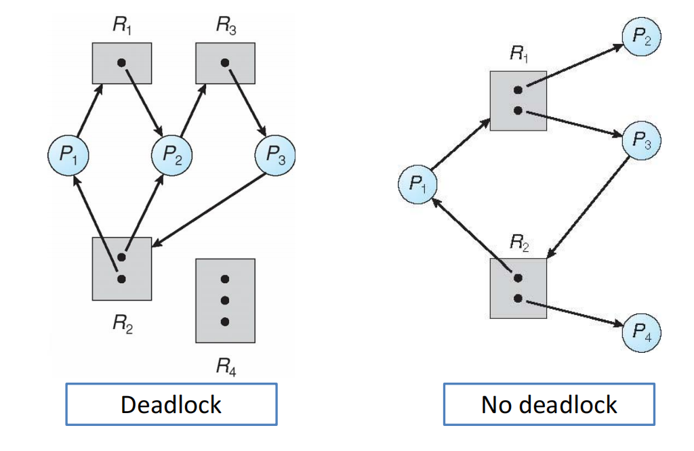
Deadlocks
- Other methods
Avoidance
Banker’s algorithm
Detection and recovery

Slide 23
Thanks for your attention!
Q&A

