Slide 1
CSCI3150 Introduction to Operating Systems
Lecture 1: Introduction

Slide 2
This lecture
Course information
Why learn OS?
What is an OS? What does it do?
Summary

Slide 3
Why learn OS?
Operating system training is important
http://www.youtube.com/watch?v=-3Rt2_9d7Jg
What course is this?
https://matt-welsh.blogspot.com/2010/10/in-defense-of-mark-zuckerberg.html
Software companies love OS students
Most big software companies have systems positions
Academic research in OS is very influential

Slide 4
Goals of this course
Understand operating system concepts
How OS works, and more importantly, why?
What are the reasons that motivated each design?
Basis for future learning
Get hands dirty
Train your problem-solving skills!
Notes:
Face a problem, and solve it, instead

Slide 5
Who am I
Hong Xu (call me Hong, or Henry)
No need to “prof” me
https://henryhxu.github.io/
Research: computer networks, machine learning systems
Brief Bio:
Ph.D., University of Toronto, 2013
B.Eng., IE, CUHK, 2003-2007
Working with some of the largest tech companies
Research results being transferred

Slide 6
Prerequisites (must have)
C programming experiences
Familiarity with Unix
Computer organizations (e.g., CSCI2510, CENG3420)
What is an Instruction (e.g., load, store)?
What is CPU? Memory? Registers?
What is Stack? Stack pointer?
What is Program Counter (PC)?

Slide 7
Course Website
https://github.com/henryhxu/CSCI3150
Provides slides, agenda, grading policy, etc.
All information regarding the labs
Piazza used for discussion
https://piazza.com/cuhk.edu.hk/fall2024/csci3150/home
Sign up code is “3150 rocks!”

Slide 8
Grading
Lab quizzes, 10%
5 random quizzes, each worth 1 mark with 1 simple question
1 midterm quiz, 5%, 20-minute written quiz
Assignments, 50%
4 assignments, programming and/or concept
Final exam, 40%

Slide 9
Course Contents
Overview of computer hardware
Threads and processes
Synchronization and concurrency
Scheduling
Memory Management, Virtual Memory
Disk Management and File Systems
Cloud computing and virtualization

Slide 10
Assignments
Involve both programming and concept/math tasks
Attempt all of them independently! Similar questions may appear in the final exam
Some assignments will have bonus questions
Strongly encouraged to go to the labs!
More info and help for assignments is provided in labs
It may be hard to you.
Start your assignment early!

Slide 11
What to Expect From Assignments
Understanding/Building an OS is difficult
You will spend a lot of time on the assignments
The labs give specifications, not implementations
Our instructions ask that you design well, before you code
Assume that you will do the design/coding outside lab hours
Notes:
11

Slide 12

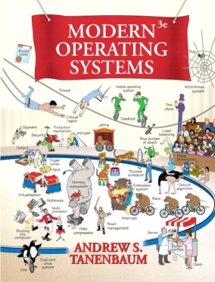
Suggested Textbooks
Operating Systems: Three Easy Pieces
By Remzi H. Arpaci-Dusseau and Andrea C. Arpaci-Dusseau
Modern Operating Systems, 4th Edition
By Andrew S. Tanenbaum and Herbert Bos

Slide 13
Anti-Cheating Policy
Academic integrity
Your work in this class must be your own – we have zero tolerance policy towards cheating of any kind and any student who cheats will get a failure grade in the course
Both the cheater and the student who aided the cheater will be held responsible for the cheating

Slide 14
Approach to Use of AI Tools
Use only with prior permission
“In some courses, it may be appropriate to use these tools in some scenarios or on some assignments but not in others. In those situations, students should be clearly informed of when and how they can and cannot use these tools. It should also make clear the rationale for allowing these tools in some situations but not allowing them in others. It should also explicitly note how these tools ought to be cited or otherwise acknowledged with some examples and help students understand the limits and appropriate uses of these tools.”
https://www.aqs.cuhk.edu.hk/documents/A-guide-for-students_use-of-AI-tools.pdf

Slide 15
How Not to Pass
Skip lectures
It’s nice out there, the slides are online, and materials are in the book anyway
TRUTH: Lecture material is the basis for exams
It is much more efficient to learn through discussion
Copy other people’s code
It is cheating!

Slide 16
How Not to Pass (2)
Not asking questions in lecture, office hours, or piazza
“I don’t want to embarrass myself”
TRUTH: I have very bad memory, and too many students to teach…
TRUTH: asking questions is the best way to clarify the material at the time it is being presented
“There is no such things as stupid question…”
Wait until the last couple of days to start the assignment

Slide 17
Before we start
Any questions?
Though this is a hard class, OS is a very fun topic!
Remember, we are here to help, we want you to enjoy the course (while also being able to learn something)

Slide 18
What is an OS?
Anyone?
Give a few examples of some common OSes?
Desktops?
Smart phones?

Slide 19
What is an OS?
“Code” that:
Sits between programs & hardware
Sits between different programs
Sits between different users
But what does it do?
Managing the hardware resource
Provide a clean set of interface to programs
Real life analogy?
Government

Slide 20
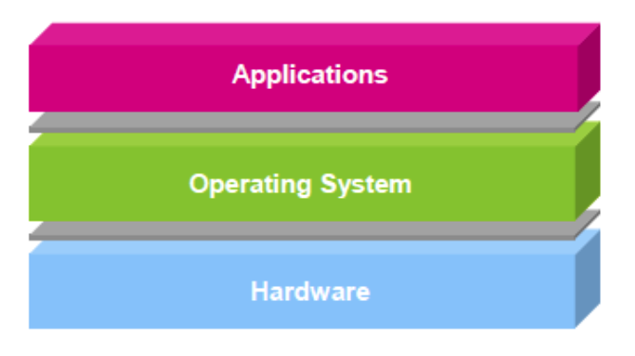
OS is…
Software layer between hardware and applications
The OS is “all the code that you didn’t have to write” to implement your application
Or, OS is a piece of software that you shouldn’t notice its existence, but you’ll feel the pain if it disappears or goes wrong

Slide 21
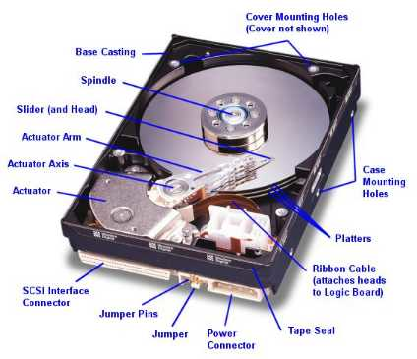

An example comparing life with/without OS
Life with an OS
file = open (“test.txt”, O_WRONLY);
write (file, “test”, 4);
close (file);
Life without an OS
Where is this file on disk? Which block? Which platter, track, and sectors?
Code needs to change on a different system

Slide 22
OS and hardware
The OS abstracts/controls/mediates access to hardware resources (what resources?)
Computation (CPUs)
Volatile storage (memory) and persistent storage (disk, etc.)
Communication (network, modem, etc.)
Input/output devices (keyboard, display, printer, etc.)

Slide 23
Benefits to applications
Simpler
no tweaking device registers
Device independent
all disks look the same
Portable
same program runs on Windows95/98/ME/NT/2000/XP/Vista/7/8/10
Worry less about interference from other applications

Slide 24
What does an OS do?
Manage Resources
Allocation
Protection
Reclamation
Virtualization
Among many running programs

Slide 25
What does an OS do?
Resources
Allocation
Protection
Reclamation
Virtualization
Finite resources
Competing demands
Examples:
CPU
Memory
Disk
Network
Government:
Limited budget, Land,
Natural resources

Slide 26
What does an OS do?
Resources
Allocation
Protection
Reclamation
Virtualization
You can’t hurt me,
I can’t hurt you.
Some degrees of
safety and security
Government:
Law and order

Slide 27
What does an OS do?
Resources
Allocation
Protection
Reclamation
Virtualization
The OS gives,
The OS takes away
Sometimes involuntarily
Government:
Income Tax

Slide 28
What does an OS do?
Resources
Allocation
Protection
Reclamation
Virtualization
Illusion of infinite, private resources
Memory vs. disk
Time-shared CPU
Government:
Social welfare and insurance

Slide 29
Why you want to learn OS?
Foundation to other software
Databases, Browsers, Computational software, … …
OS is one of the hardest software piece to write & debug
Directly talks to hardware (very ugly interfaces)
Abstract into clean interfaces
They are BIG
Lines of code:
Windows Vista (2006): 50M (XP + 10M)
Linux 3.6: 15.9 M
Android 4.0: > 1M

Slide 30
Why you want to learn OS?
Many OS concepts (e.g., protection, resource management) is needed in other places
E.g., browser
OS is used everywhere
Your car/fridge/watch/TV/… is running Linux
The MTR ticketing machines run Windows

Slide 31
What to do now?
Browse the course web site
Enroll yourself on Piazza
Contact me if you have any questions
Let the fun begin!

