Slide 1
Tutorial 08: Review on Assignment2 && Implementation of Page Replacement Algorithms
CSCI3150 - Introduction to operating system
Tutor: TAN Xin
xtan22@cse.cuhk.edu.hk

Slide 2
Review on Assignment2

Slide 3
The special producer and customer problem
Producer_0
Producer_1
…
Producer_N-1
Slot_0(Full)
Slot_1(Empty)
Slot_2 (Empty)
Slot_3 (Empty)
….
Slot_K-1(Full)
Customer_0
Customer_1
…
Customer_M-1

Slide 4
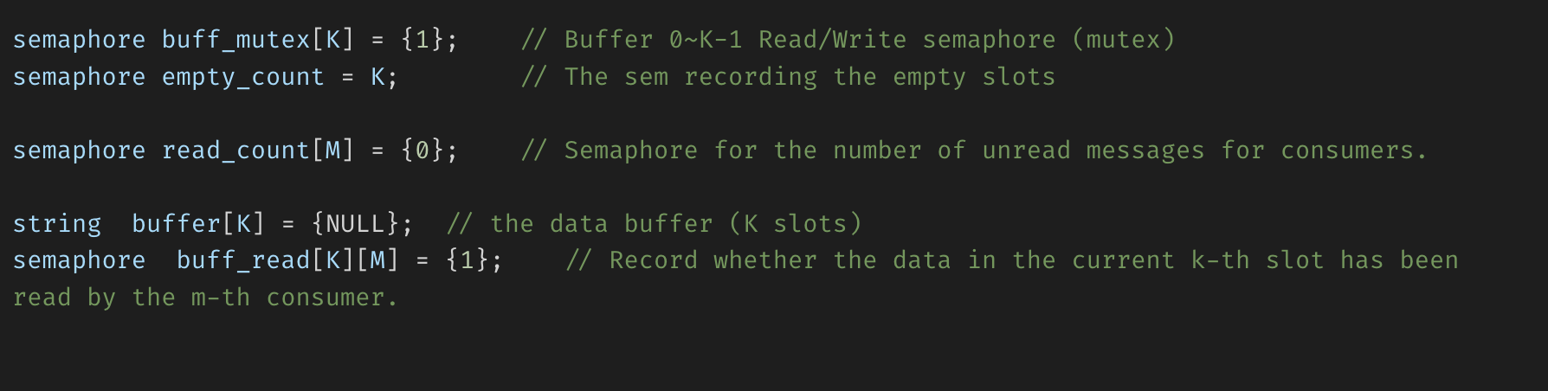
One possible solution (pseudo code)
Semaphore definition

Slide 5
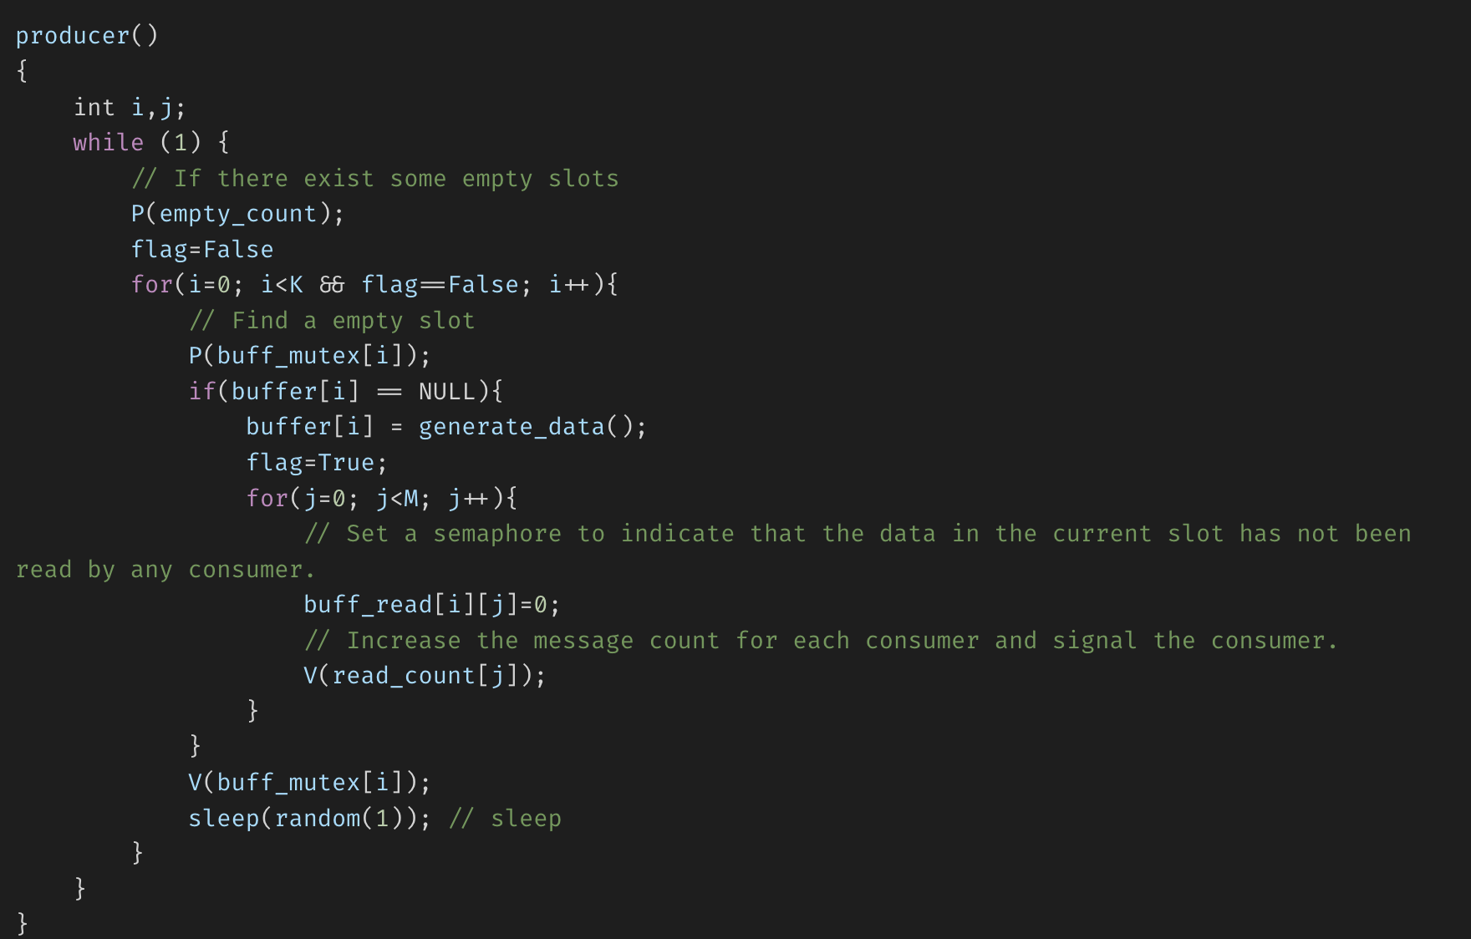
One possible solution (pseudo code)
Producer

Slide 6
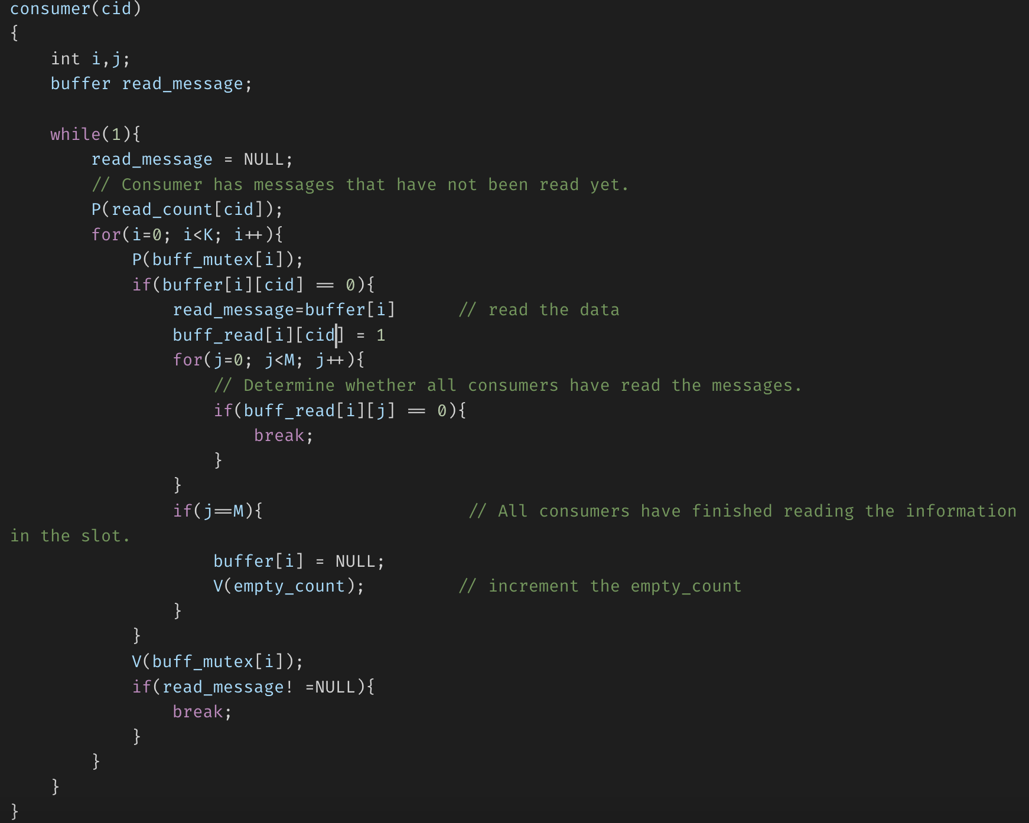
One possible solution (pseudo code)
Customer

Slide 7
The implementation of FIFO Page Replacement Algorithm

Slide 8
Recap
FIFO (First in first out) page replacement algorithm
This is the simplest page replacement algorithm. In this algorithm, operating system keeps track of all pages in the memory in a queue, oldest page is in the front of the queue. When a page needs to be replaced page in the front of the queue is selected for removal.

Slide 9
Example1
Consider page reference string 1, 3, 0, 3, 5, 6 and 3 page slots.
Initially all slots are empty, so when 1, 3, 0 came they are allocated to the empty slots —> 3 Page Faults.
when 3 comes, it is already in memory so —> 0 Page Faults.
Then 5 comes, it is not available in memory so it replaces the oldest page slot i.e 1. —>1Page Fault.
Finally 6 comes, it is also not available in memory so it replaces the oldest page slot i.e 3 —>6 Page Fault.
So total page faults = 5.
1 | 3 | 0 | 3 | 5 | 6
1 | 1 | 1 | 1 | 5 | 5
 | 3 | 3 | 3 | 3 | 6
 |  | 0 | 0 | 0 | 0

Slide 10
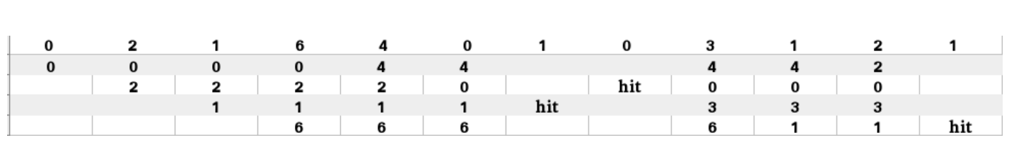
Example2
Consider the following reference string: 0, 2, 1, 6, 4, 0, 1, 0, 3, 1, 2, 1. Using FIFO page replacement algorithm:
So, total number of page faults = 9.

Slide 11
Steps
1. Start traversing the pages.
i) If set holds less pages than capacity.
a) If the new page is not in the slots, insert page into the set and Increment page fault.
b) Simultaneously maintain the pages in the queue to perform FIFO.
ii) Else
If current page is present in set, do nothing.
Else:
a) Remove the first page from the queue as it was the first to be entered in the memory
b) Replace the first page in the queue with the current page in the string.
c) Store current page in the queue. d) Increment page faults.
2. Return page faults.

Slide 12

Implementation
Given memory capacity (as number of pages it can hold) and a string representing pages to be referred, write a function to find number of page faults.

Slide 13
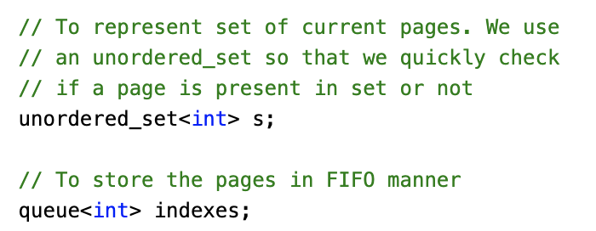
Implementation
Use a set to record the current pages
Use a queue to store the pages in FIFO manner

Slide 14
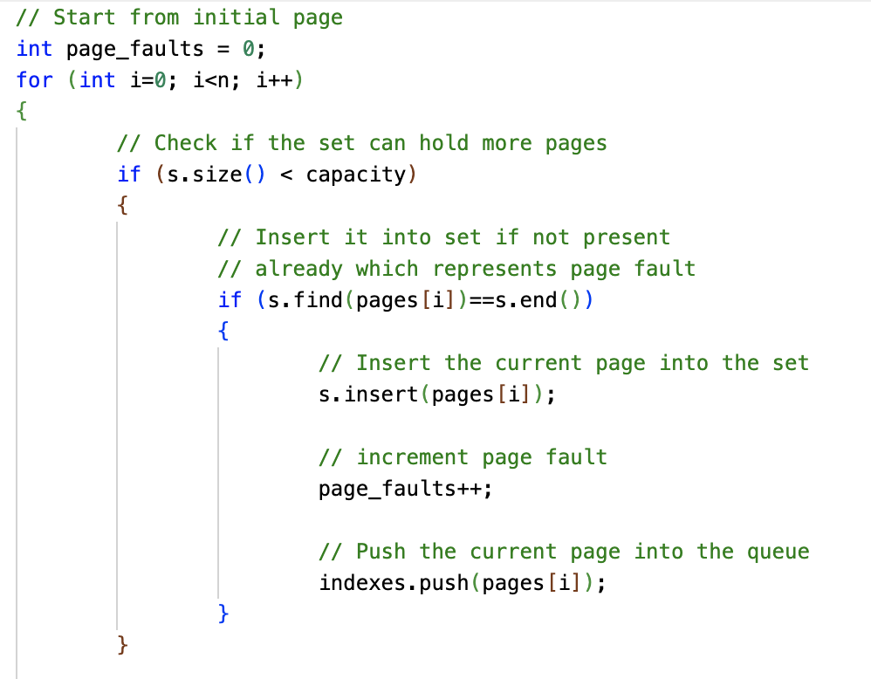
Implementation
Start traversing the pages
Check if the set could hold more pages
Check if the page fault exists

Slide 15
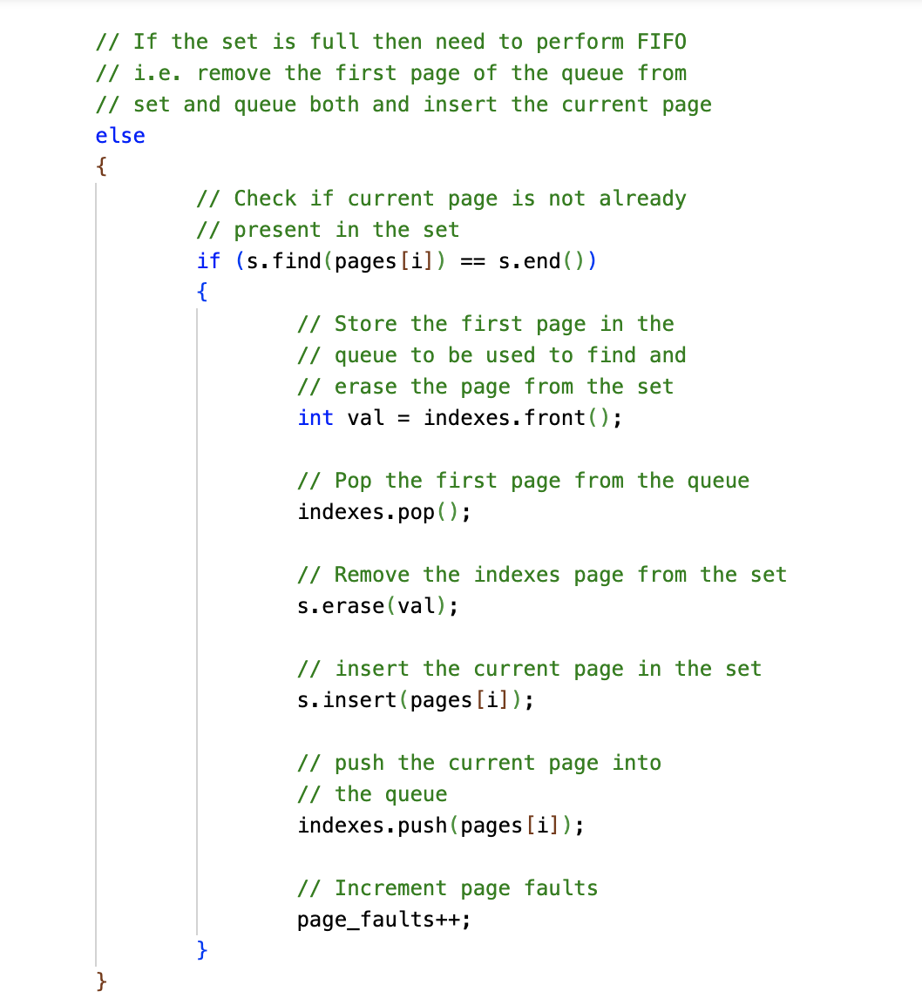
Implementation
If there is no room for a new page
Check if the new page is in the set
If not, remove an oldest page and insert the new one

Slide 16
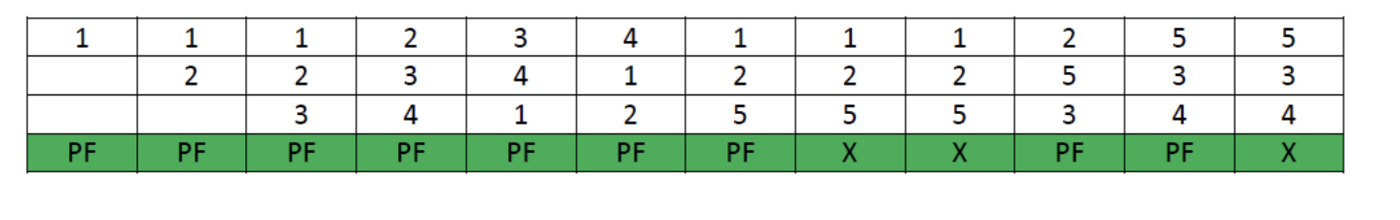
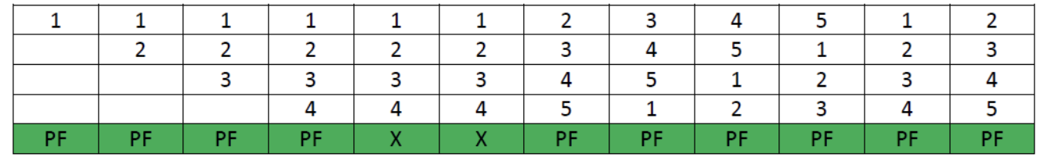
Belady’s anomaly
Belady’s anomaly proves that it is possible to have more page faults when increasing the number of page frames while using the First in First Out (FIFO) page replacement algorithm.
Assuming a system that has no pages loaded in the memory and uses the FIFO Page replacement algorithm. Consider the following reference string:
1, 2, 3, 4, 1, 2, 5, 1, 2, 3, 4, 5
Slots: 3->4
Page Faults:9->10

Slide 17
The implementation of LRU Page Replacement Algorithm

Slide 18
Recap
In Least Recently Used (LRU) algorithm is a Greedy algorithm where the page to be replaced is least recently used.
The LRU algorithm is based on the idea that the pages that have been used the least recently are the ones that are least likely to be used again in the near future.

Slide 19
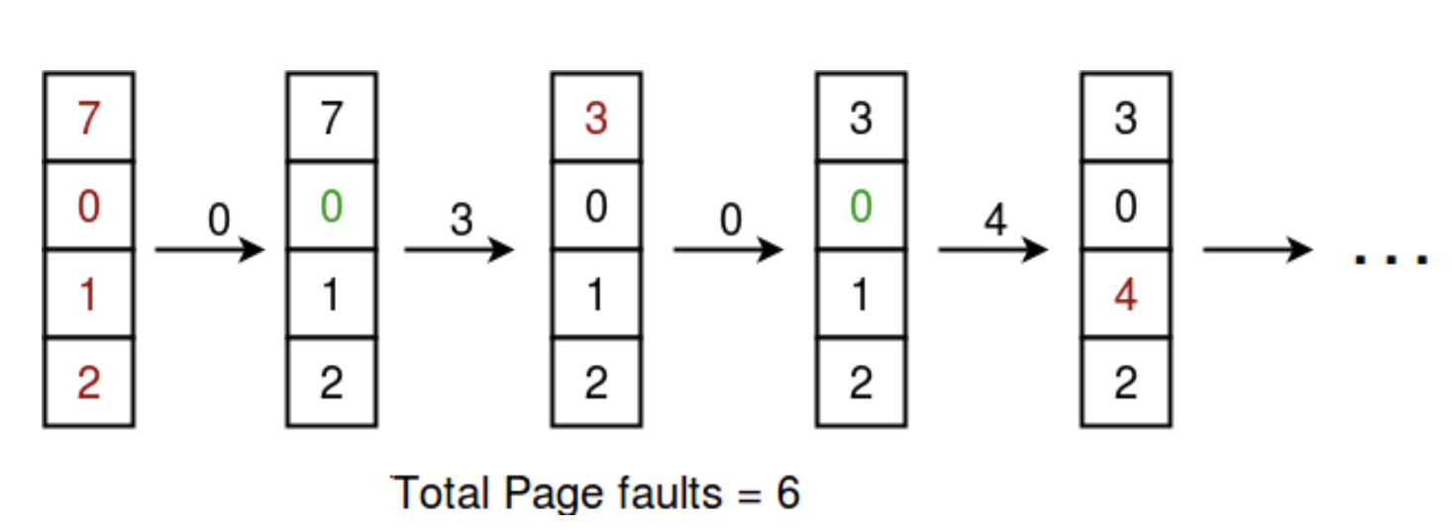
Example
Let say the page reference string 7 0 1 2 0 3 0 4 2 3 0 3 2 .
Initially we have 4 page slots empty.
Initially all slots are empty, so when 7 0 1 2 are allocated to the empty slots —> 4 Page faults
0 is already there so —> 0 Page fault.
when 3 came it will take the place of 7 because it is least recently used —>1 Page fault
0 is already in memory so —> 0 Page fault.
4 will takes place of 1 —> 1 Page Fault
Now for the further page reference string —> 0 Page fault because they are already available in the memory.
7 | 0 | 1 | 2 | 0 | 3 | 0 | 4 | 2 | 3 | 0 | 3 | 2
7 | 7 | 7 | 7 | 7 | 3 | 3 | 3 | 3 | 3 | 3 | 3 | 3
 | 0 | 0 | 0 | 0 | 0 | 0 | 0 | 0 | 0 | 0 | 0 | 0
 |  | 1 | 1 | 1 | 1 | 1 | 4 | 4 | 4 | 4 | 4 | 4
 |  |  | 2 | 2 | 2 | 2 | 2 | 2 | 2 | 2 | 2 | 2

Slide 20
Steps
Let capacity be the number of pages that memory can hold.
Let set be the current set of pages in memory.
Start traversing the pages.
If set holds less pages than capacity.
If the current page is not present, Insert page into the set and increment page fault.
Simultaneously maintain the recent occurred index of each page in a map called indexes.(The one with smallest index will be removed)
Else
If current page is present in set, do nothing.
Else
Find the page in the set that was least recently used. We find it using index array. We basically need to replace the page with minimum index.
Replace the found page with current page.
Increment page faults.
Update index of current page.
2. Return page faults.

Slide 21
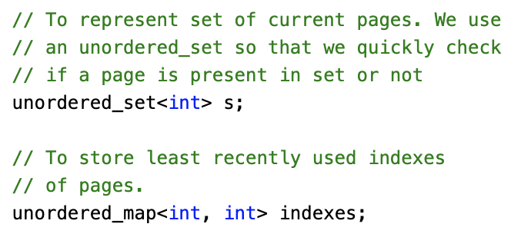
Implementation
A set to record the current pages
A map to record the used time of each pages

Slide 22
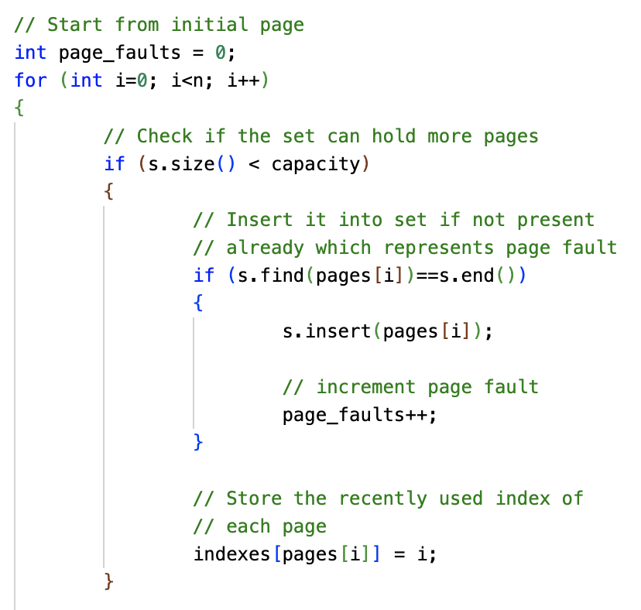
Implementation
Traverse the incoming pages
Check the number of used slot of the set
Insert the new page if it is not present in the slots and increment the page fault accordingly.
Store the recently used index

Slide 23
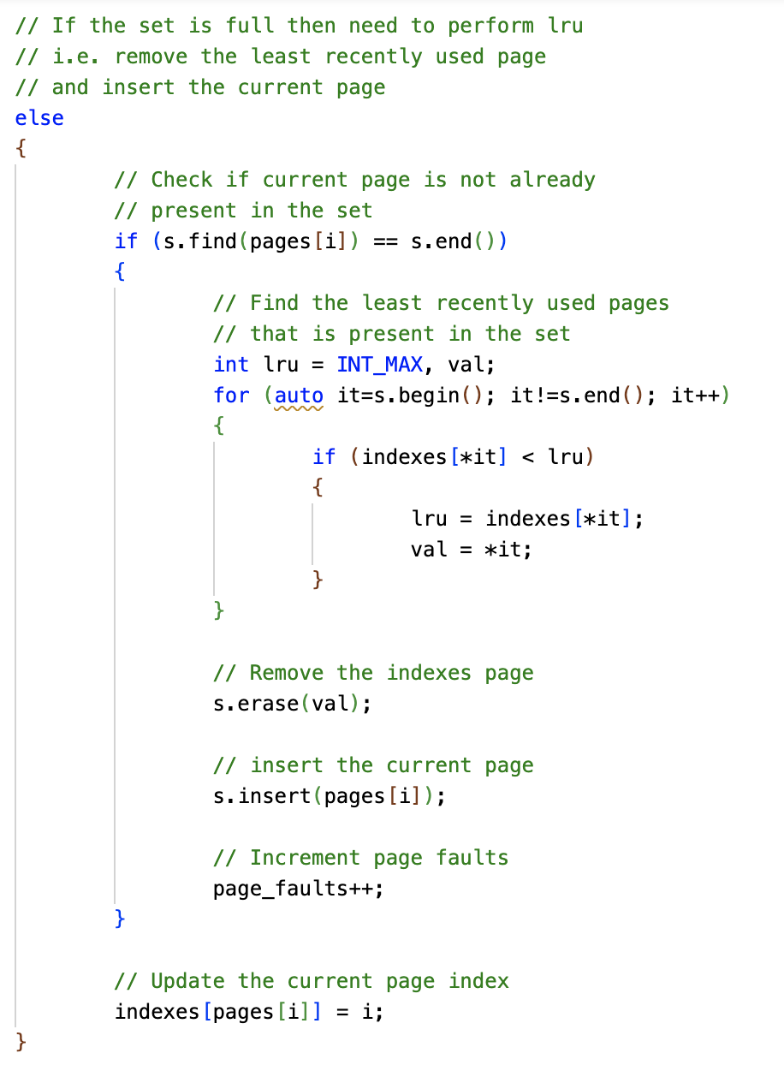
Implementation
The set is full
Check if the new page has existed in the slots
If not, find the old page with the smallest used index and remove it. Insert the new page.
Record the recently used index for the new page.

Slide 24
Q & A
Any questions?

