Slide 1
Tutorial 11: File System API
CSCI3150 Introduction to Operating Systems, Fall 2024
Chen, Kaiwen
Nov 21, 2024

Slide 2
Reminder
Assignement 4
Due at 6:00:00 p.m., Mon, Dec 9nd
New Announcement on Piazza

Slide 3
File System Structure

Slide 4
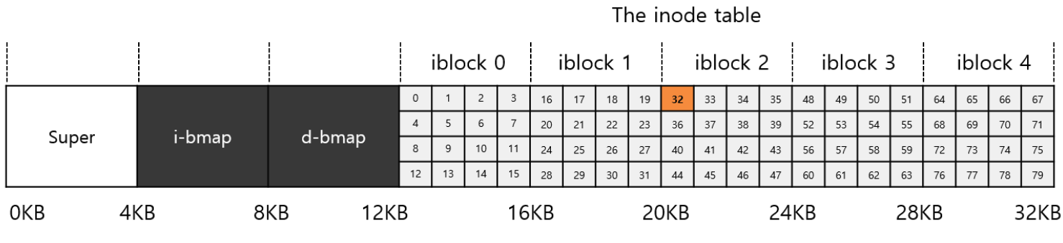
Overall Organization
Divide the disk into blocks (Blk size is 4KB)
Address from 0 to N-1
Superblock: contains metadata information for a file system
Bitmap: each bit indicated free (0) or in-use (1)
Inode/Data Bitmap: for inode/data region
Inode blocks: meta-information of a file + pointers to the data blks
File/directory/link/device/socket all have inode
Metadata: File size, permissions, owner, timestamps, etc.
Data blocks: Store the data

Slide 5
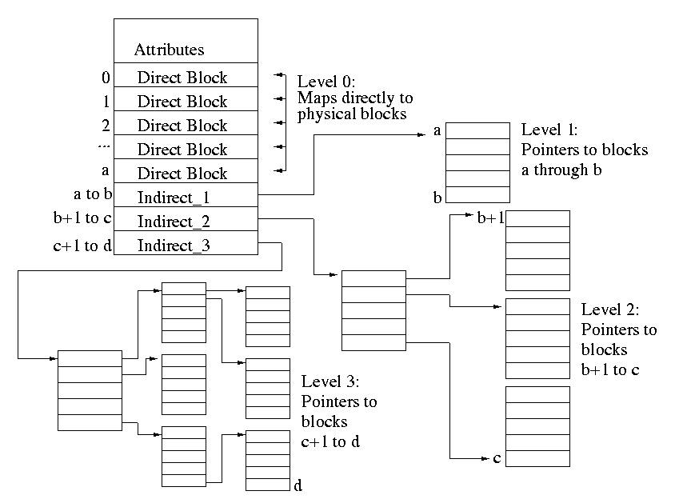
Structure of Inode
Each level-0 or outermost inode is divided into several different fields:
File attribute: most of the good stuff that ls -l reports is stored here
Direct mappings: Entries containing direct forward mappings. These mappings provide a mapping from the logical block number to the location of the physical block on disk
Indirect_1 Mappings: Entries containing indirect mapping requiring one level of indirection.
Indirect_2 Mappings: Entries containing indirect mappings requiring two levels of indirection.
Indirect_3 Mappings: Entries containing mappings requiring three levels of indirection.

Slide 6
File System API

Slide 7
File System APIs Summary
Feature | Description | Examples
File Metadata Handling | Operations to access or modify file metadata such as size, permissions, and modification date. | stat(), os.stat()
File Opening and Closing | Functions to open and close files for various operations like reading, writing. | open(), fopen(), CreateFile(), rename()
File Reading and Writing | Methods to read from and write to files in different modes (binary or text). | read(), write(), fread(), WriteFile()
File Positioning | Functions to manipulate the read/write pointer's position within a file (seek operations). | lseek(), fseek(), SetFilePointer()
File Creation and Deletion | Functions to create or delete files and directories. | unlink(), os.remove(), DeleteFile()
Directory Management | Tools for handling directories, including creation, deletion, and listing contents. | mkdir(), os.mkdir(), shutil.rmtree()
Link Creation and Deletion | Create a direct link to the same underlying file content/shortcut or pointer to another file or directory. | link(), symlink(), unlink()

Slide 8
Getting Information About Files
stat(): Show the File metadata
metadata is information about each file, ex: size, permission, ..
stat structure is below:
struct stat {
dev_t st_dev; /* ID of device containing file */
ino_t st_ino; /* inode number */
mode_t st_mode; /* protection */
nlink_t st_nlink; /* number of hard links */
uid_t st_uid; /* user ID of owner */
gid_t st_gid; /* group ID of owner */
dev_t st_rdev; /* device ID (if special file) */
off_t st_size; /* total size, in bytes */
blksize_t st_blksize; /* blocksize for filesystem I/O */
blkcnt_t st_blocks; /* number of blocks allocated */
time_t st_atime; /* time of last access */
time_t st_mtime; /* time of last modification */
time_t st_ctime; /* time of last status change */
};

Slide 9
Getting Information About Files (Cont.)
An example of stat()
All information is in a inode
prompt> echo hello > file
prompt> stat file
File: ‘file’
Size: 6 Blocks: 8 IO Block: 4096 regular file
Device: 811h/2065d Inode: 67158084 Links: 1
Access: (0640/-rw-r-----) Uid: (30686/ root) Gid: (30686/ remzi)
Access: 2011-05-03 15:50:20.157594748 -0500
Modify: 2011-05-03 15:50:20.157594748 -0500
Change: 2011-05-03 15:50:20.157594748 -0500

Slide 10
Renaming files
rename():rename a file to different name.
It implemented as an atomic call.
Ex) change from foo to bar
Saving a file in an editor
promt > mv foo bar
int fd = open("foo.txt.tmp", O_WRONLY|O_CREAT|O_TRUNC);
write(fd, buffer, size); // write out new version of file
fsync(fd);
close(fd);
rename("foo.txt.tmp", "foo.txt");

Slide 11
Removing Files
The result of strace to figure out what rm is doing.
rm is Linux command to remove a file
rm calls unlink() to remove a file.
prompt> strace rm foo
...
unlink(“foo”)
...
prompt>

Slide 12
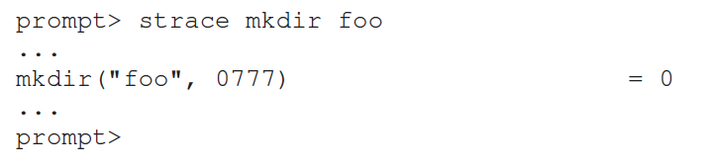
Making Directories
mkdir(): Make a directory
When a directory is created, it is empty.
Empty directory have two entries: . (itself), ..(parent)
prompt> ls -al
total 8
drwxr-x--- 2 roo root 6 Apr 30 16:17 ./
drwxr-x--- 26 root root 4096 Apr 30 16:17 ../

Slide 13
Reading Directories
readdir()
Directory is a file, but with a specific structure.
When reading a directory, we use specific system call other than read().
A sample code to read directory entries.
int main(int argc, char *argv[]) {
DIR *dp = opendir("."); /* open current directory */
assert(dp != NULL);
struct dirent *d;
while ((d = readdir(dp)) != NULL) { /* read one directory entry */
printf("%d %s\n", (int) d->d_ino, d->d_name);
}
closedir(dp); /*close current directory */
return 0;
}

Slide 14
Reading Directories
Structure of the directory entry
struct direct {
char d_name[256]; /* filename */
ino_t d_ino; /* inode number */
off_t d_off; /* offset to the next dirent */
unsigned short d_reclen; /* length of this record */
unsigned char d_type; /* type of file */
};

Slide 15
Deleting Directories
rmdir(): Delete a directory.
rmdir()requires directory be empty before it deleted.
If you call rmdir()to a non-empty directory, it will fail.

Slide 16
Hard Links
link(): Link old file and a new file.
Create hard link named file2.
The result of link()
Two files have same inode number, but two human name(file, file2)
prompt> echo hello > file
prompt> cat file
hello
prompt> ln file file2 /* create a hard link, link file to file2 */
prompt> cat file2
hello
prompt> ls -i file file2
67158084 file /* inode value is 67158084 */
67158084 file2 /* inode value is 67158084 */
prompt>

Slide 17
Hard Links (Cont.)
How to create hard link file?
Step1. Make an inode, track all information about the file.
Step2. Link a human-readable name to file.
Step3. Put link file into a current directory.
After creating a hard link to file, old and new files have no difference.
Thus, to remove a file, we call unlink().

Slide 18
unlink Hard Links
What unlink() is doing ?
Check reference count within the inode number.
Remove link between human-readable name and inode number.
Decrease reference count.
When only it reaches zero, It delete a file (free the inode and related blocks)

Slide 19
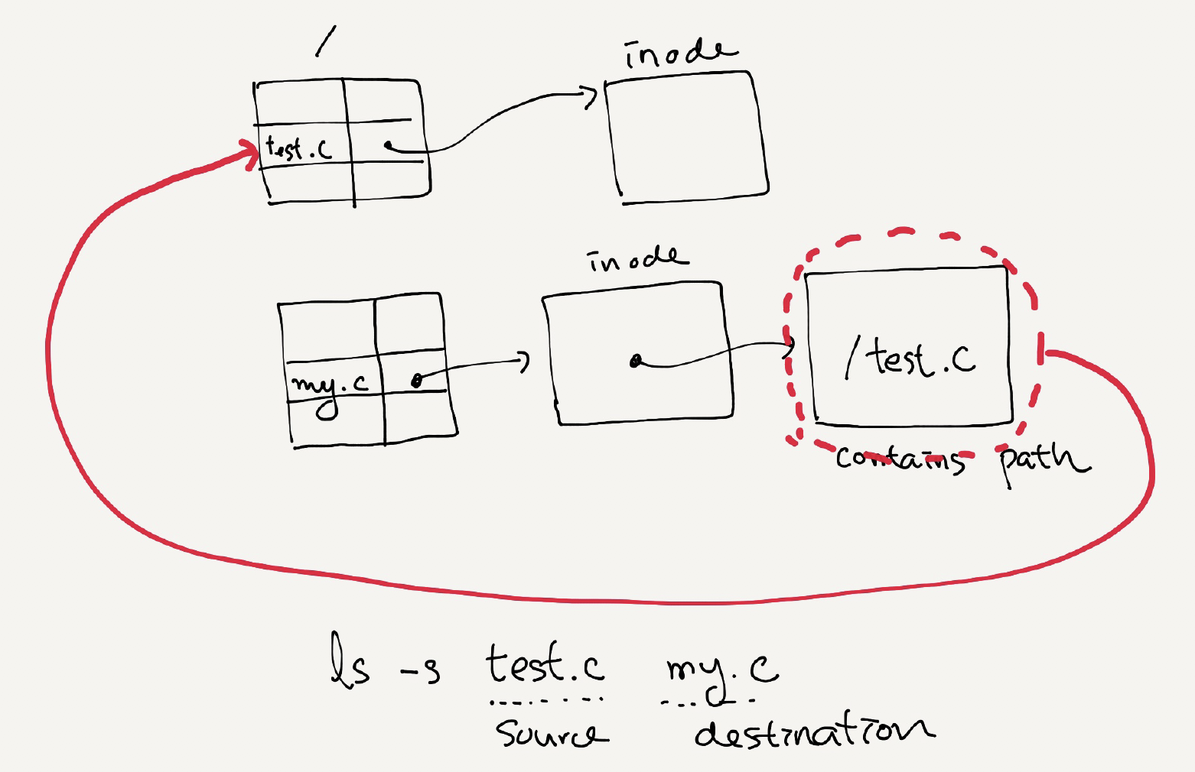
Symbolic Links
Symbolic link
Special file that contains path to the source directory.
Hard Link cannot create to a directory.
Hard Link cannot create to a file to other partition.
An example of symbolic link
prompt> echo hello > file
prompt> ln –s file file2 /* option –s : create a symbolic link, */
prompt> cat file2
hello

Slide 20
Symbolic Links (Cont.)
Symbolic link is different file type.
Symbolic link is subject to the dangling reference.
prompt> ls -al
drwxr-x--- 2 remzi remzi 29 May 3 19:10 ./
drwxr-x--- 27 remzi remzi 4096 May 3 15:14 ../ /* directory */
-rw-r----- 1 remzi remzi 6 May 3 19:10 file /* regular file */
lrwxrwxrwx 1 remzi remzi 4 May 3 19:10 file2 -> file /* symbolic link */
prompt> echo hello > file
prompt> ln -s file file2
prompt> cat file2
hello
prompt> rm file
prompt> cat file2
cat: file2: No such file or directory

Slide 21
Q & A

