Slide 1
Tutorial 10: Paging(Address Translation)
CSCI3150 Introduction to Operating Systems, Fall 2024
Yang, Yitao
Nov 7, 2024

Slide 2
Reminder
Assignment 3
Due at 6:00:00 p.m., Mon, Nov 18th
Assignement 4
Release today
Due at 6:00:00 p.m., Mon, Dec 2nd

Slide 3
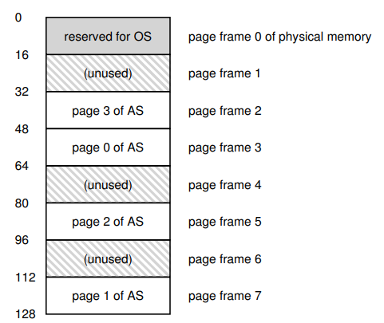
Paging
Convenient for free space management
Reduce the wasted fragmentation
(not larger than one page size)
Allowing the memory space of one process
discontinuous
Creating large virtual memory space within
small memory
Notes:
Paging is a technique used to manage memory efficiently by dividing it into fixed-size blocks known as pages. And let’s recap its benefits.
First, It is Convenient for free space management. Paging Minimizes fragmentation by ensuring no wasted memory exceeds a single page.
Second, As the right figure shows. A process’s memory can be spread across different physical memory locations. So paging can achieve discontinuous allocation.
Third, paging allows a large virtual address space to be mapped into a smaller physical memory.

Slide 4
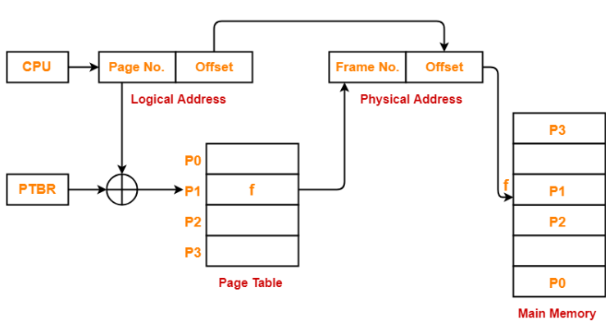
Page Table Mechanism
Page Table Function:
logical addresses -> physical addresses
Each process has its own page table
How the Translation works:
Logical Address Components:
• Page Number + Offset.
Translation Process:
• Page Number + page table + PTBR -> Frame Number.
• Frame Number + Offset -> Physical Address.
Page Table Base Register
Notes:
And let’s recap on page table mechanism
Page Table Function:
• The page table is a data structure used by the operating system to map logical addresses to physical addresses.
• Each process has its own page table that contains the mapping for each logical page to its corresponding physical frame.
How the Translation Works:
• Logical Address Components:
• The logical address from the CPU is divided into two parts: Page Number and Offset.
• Translation Process:
• The Page Number is used to index into the page table, which provides the Frame Number.
• The Offset is then added to the Frame Number to generate the Physical Address.

Slide 5
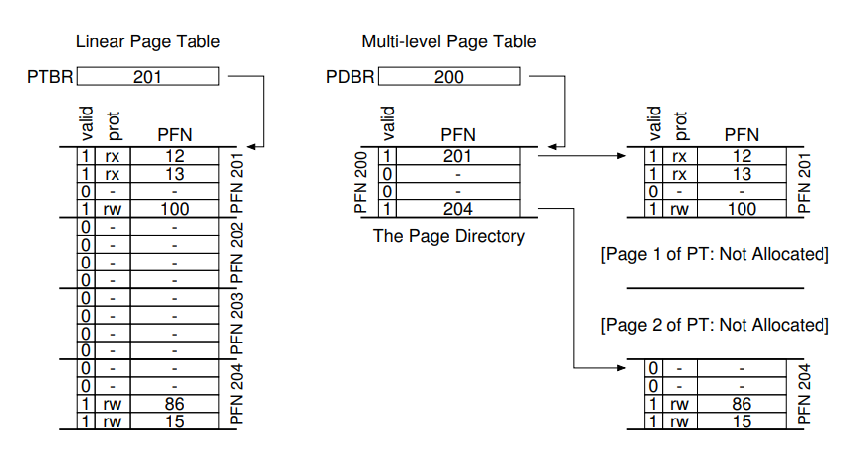
Multi-level Page Tables
Linear vs. Multi-level Page Tables:
Linear Page Table:
• large memory consumption.
Multi-level Page Table:
• Saving memory.
Linear Page Table
Multi-level Page Table
Notes:
A linear (single-level) page table can consume a large amount of memory when dealing with vast virtual address spaces. As you can see from the blue block in the right figure.
We can solve this problem using multi-level page tables. Multi-level page tables reduce this memory requirement by only allocating space for page tables that contain valid entries. You can see the example from the second block in the right figure. Only Page 0 and Page 3 is allocated.
Let’s compare Linear and Multi-level Page Tables:
Linear Page Table maps every possible page, leading to large memory consumption even for unused pages.
Multi-level Page Table introduces a hierarchical structure with a Page Directory and smaller Page Tables. Only the necessary parts of the page table hierarchy are allocated, saving memory for invalid or unused pages.

Slide 6
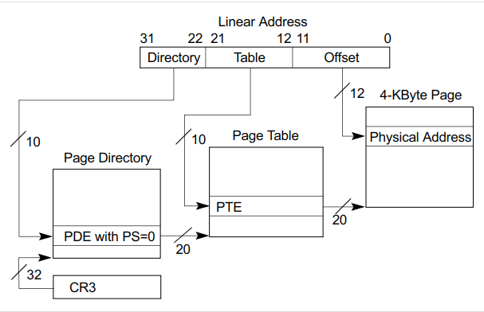
Multi-level Page Tables Example
The two level page table in x86 (32-bit machine)
10
10
12
Notes:
Here is an example, we can look at the two level page table in 32-bit computer using x86.
The virtual address is divided into three parts: Directory, Table, and Offset. Table bits (10) index the page table entry. Offset bits (12) specify the exact location within a 4KB page.
Let’s go through the mapping process. Directory bits (10) identify the page directory entry. The CR3 register holds the base address of the Page Directory. So they help to find the exact Page directory entry.
The PDE points to a specific Page Table. Table bits (10) index the page table entry. So the exact Page Table entry is found.
Then this PTE is used to find the physical frame.
Finally Offset bits (12) specify the exact location within a 4KB page.

Slide 7
Practice
Suppose a machine uses the word addressing(A physical address uniquely identify one word in the memory)and two-level paging. The word length of the machine is 32 bits. The page size is 32 bytes, the page directory has 4 entries, and the page table (PT) has 8 entries. You need to answer the following questions.
a)
What is the size of the virtual address space?
How many bits does a virtual address have?
How many bits should be reserved for the page directory index, page table index and the offset respectively?
Notes:
Then let’s do a practice together.

Slide 8
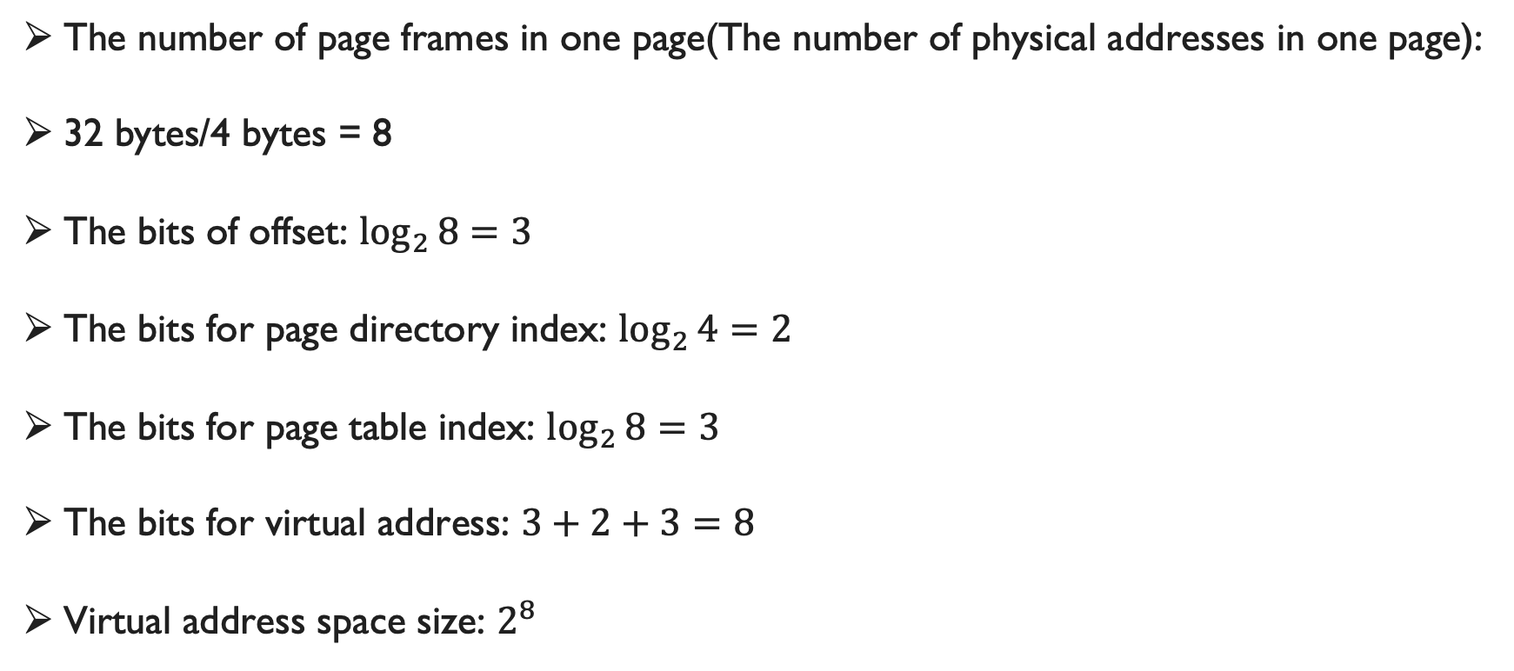
Practice
The number of page frames in one page(The number of physical addresses in one page):
32 bytes/4 bytes = 8
The bits of offset: $\log_{2}{8=3}$
The bits for page directory index: $\log_{2}{4=2}$
The bits for page table index: $\log_{2}{8=3}$
The bits for virtual address: $3+2+3=8$
Virtual address space size: $2^{8}$
Word Length | 32 bits
Page Size | 32 bytes
Page Directory | 4 entries
Page Table | 8 entries
Notes:
The machine has a word length of 32 bits and uses word addressing, so each memory address refers to 32 bits (or 4 bytes) of memory. Therefore the size of one page frame is 4 bytes. The page size is 32 bytes so that there could be 8 page frames in one page. So the number of physical addresses in one page is also 8.
So since log base 2 of 8 equals to 3. So the bits of offset should be 3. We need 3 bits to present which page frame inside the page.
And the page directory has 4 entries. The log base 2 of 4 equals to 2. So the bits for page directory index should be 2
And the page table has 8 entries. The log base 2 of 8 equals to 3. So the bits for page table index should be 3
So the bits for virtual address should be 8, which is the result of 3 + 2 + 3.
And the virtual address space size should be 2 to the power of 8.

Slide 9
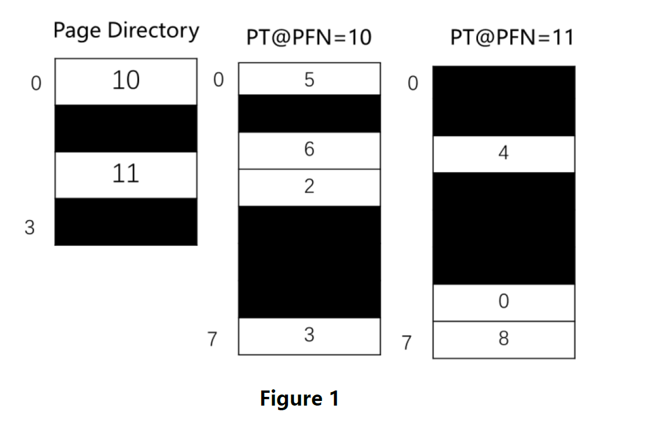
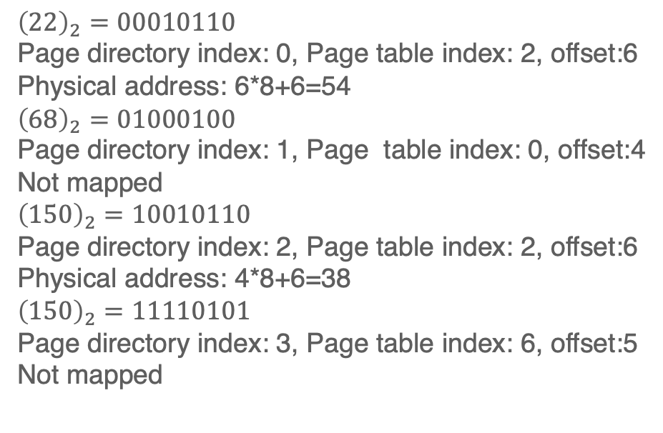
Practice
$$Physical Address=Page Frame Number∗Page Size+Offset$$
b) For virtual address space defined by the two level page table as shown in Figure1, given the following virtual addresses: 22, 68, 150, 245. Which of the above addresses would be mapped? If the virtual address is mapped, what is its corresponding physical address?
$${\left(22\right)}_{2}=00010110$$
Page directory index: 0, Page table index: 2, offset:6
Physical address: 6*8+6=54
$${\left(68\right)}_{2}=01000100$$
Page directory index: 1, Page table index: 0, offset:4
Not mapped
$${\left(150\right)}_{2}=10010110$$
Page directory index: 2, Page table index: 2, offset:6
Physical address: 4*8+6=38
$${\left(150\right)}_{2}=11110101$$
Page directory index: 3, Page table index: 6, offset:5
Not mapped

Slide 10
Q & A

