Slide 1
Basic reviews: Linux, git, gcc, and C programming
CSCI3150 Introduction to Operating Systems, Fall 2024
Shaofeng Wu
wsf123@link.cuhk.edu.hk
Sep 5, 2024

Slide 2

Course & Contact Information (1/2)
TAs
WU, Shaofeng (sfwu22)
Yang, Yitao (ytyang)
Li, Jianqiang (jqli1)
Chen, Kaiwen (kwchen24)
Chen, Yuetao (ytchen24)
Feng, Yicheng (ycfeng)
Tutorial sessions (all on Thursday)
L01, Thu 10:30am - 11:15am, SHB 123
L02, Thu 11:30am - 12:15pm, SHB 123
L03, Thu 2:30pm - 3:15pm, SHB 924
L04, Thu 4:30pm - 5:15pm, SHB 123
L05, Thu 5:30pm - 6:15pm, SHB 123
Course website
(branch: 2024-Fall)

Slide 3
Course & Contact Information (2/2)
Additional tips
Question asking
Methods
Email, Piazza
Scope
Asking TAs to code/debug for you
Coding/thinking before asking
Assignments
Submission: Github classroom
Grace token
Generative AI policies
Course website
(branch: 2024-Fall)

Slide 4
Release of Assignment One (1/1)
Assignment One: Implementation of A Simple Shell
Implement a basic shell that supports
Built-in commands
External commands
Pipe
Aim
Understanding how to interact with an operating system, e.g. Linux
Understanding the design choices and rationales of a shell
Deadline
Oct. 7, 2024, 6:00 p.m. (~1 month)
TODO: link and snapshot of the asg

Slide 5
Outline (1/1)
In this week
Linux basics
Git basics
Review on C programming

Slide 6

Linux basics (1/4)
Concepts: what & why
What is Linux?
A family of Unix-like operating systems
A lot of “distributions”(“versions”, “flavors”)
Ubuntu, Fedora, …
Why Linux?
Open-source
Community support

Slide 7
Linux basics (2/4)
Accessing Linux
Local
WSL
Docker containers (frequently used)
VMs, e.g. using Virtualbox (frequently used)
Dual-system, etc. …
Remote
CSE servers (frequently used)

Slide 8
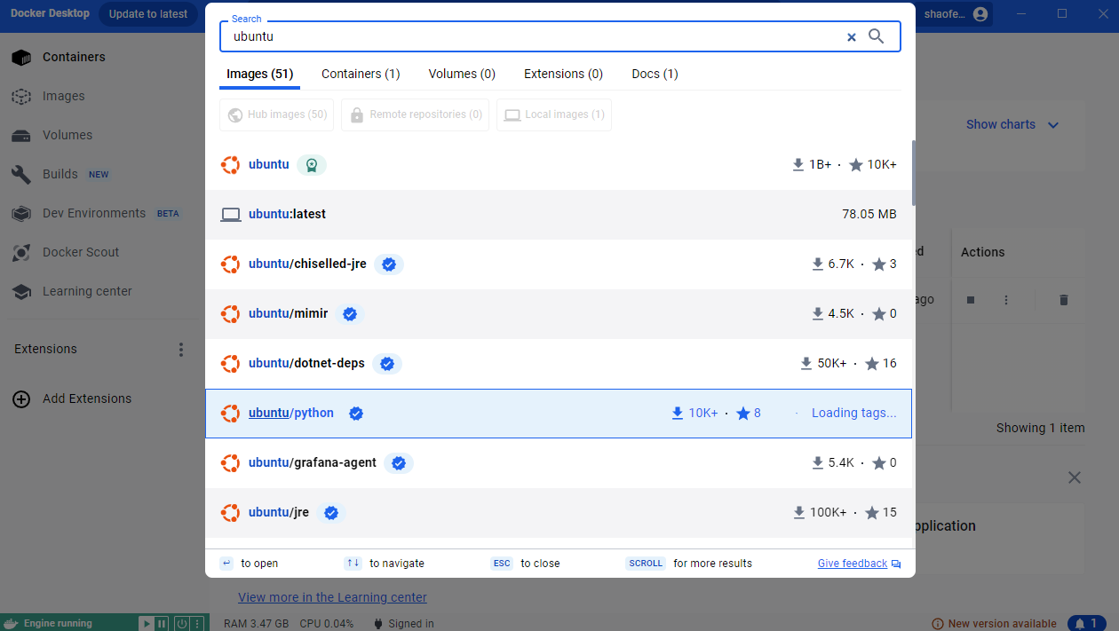
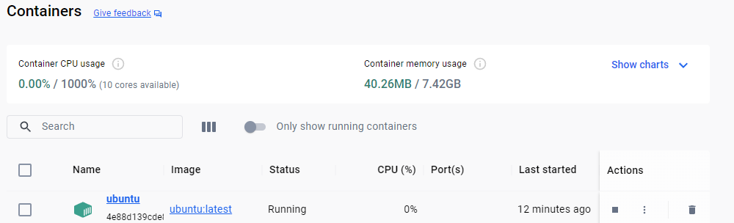
Linux basics (3/4)
Locally accessing Linux: Docker container (quick demo, only tested on Windows)
Install Docker desktop
Search for and install ubuntu image
In powershell, use the following command to start your docker container using host network
docker run -it --name ubuntu --net=host ubuntu:latest
Install dependencies and clone your repo to start working
For more tips on docker, please refer to docker official website
Install ubuntu image
Start docker container

Slide 9
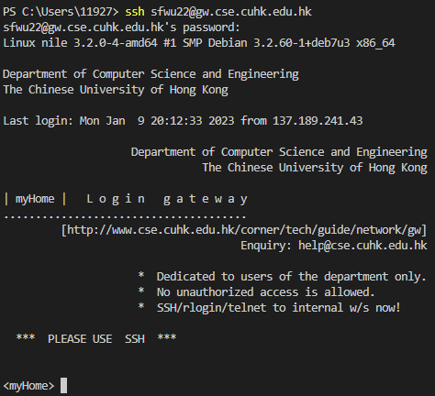
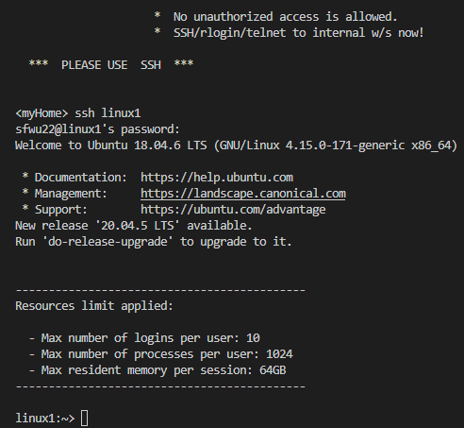
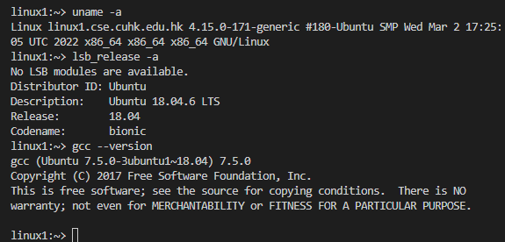
Linux basics (4/4)
Remotely accessing Linux: CSE servers (quick demo)
Find a ssh client: putty, xshell, …
Input command “ssh YourUnixName@gw.cse.cuhk.edu.hk” and enter your password
Wait for prompt, then input “ssh linux[code]”, “[code]” could be 1~16
You can use “uname –a”, “lsb_release -a” and “gcc --version” to check for kernel version, ubuntu version and gcc version of the server.
ssh to gateway
ssh to linux server
connected

Slide 10

Git basics (1/1)
Concepts
What is Git & Github?
A version control tool
An online source code hosting service that uses git
Why using Git/Github?
Automated CI/CD
General workflow (quick demo with C programming examples)
Go to Github and create a repo
Git clone the repo on your local machine
Coding
Git add
Git commit
Git push
Next time you start coding, git pull to get latest updates from collaborators and merge their commits

Slide 11
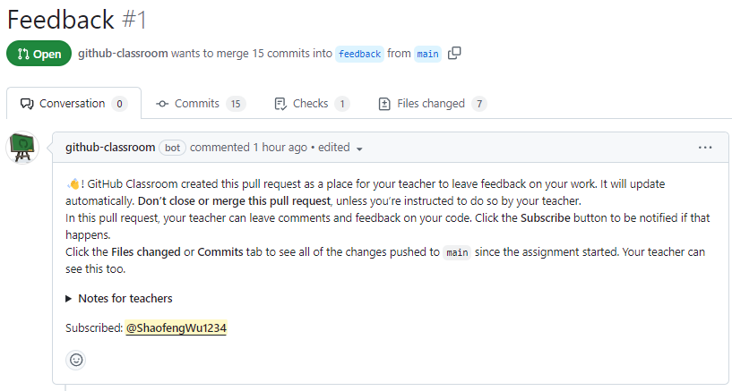
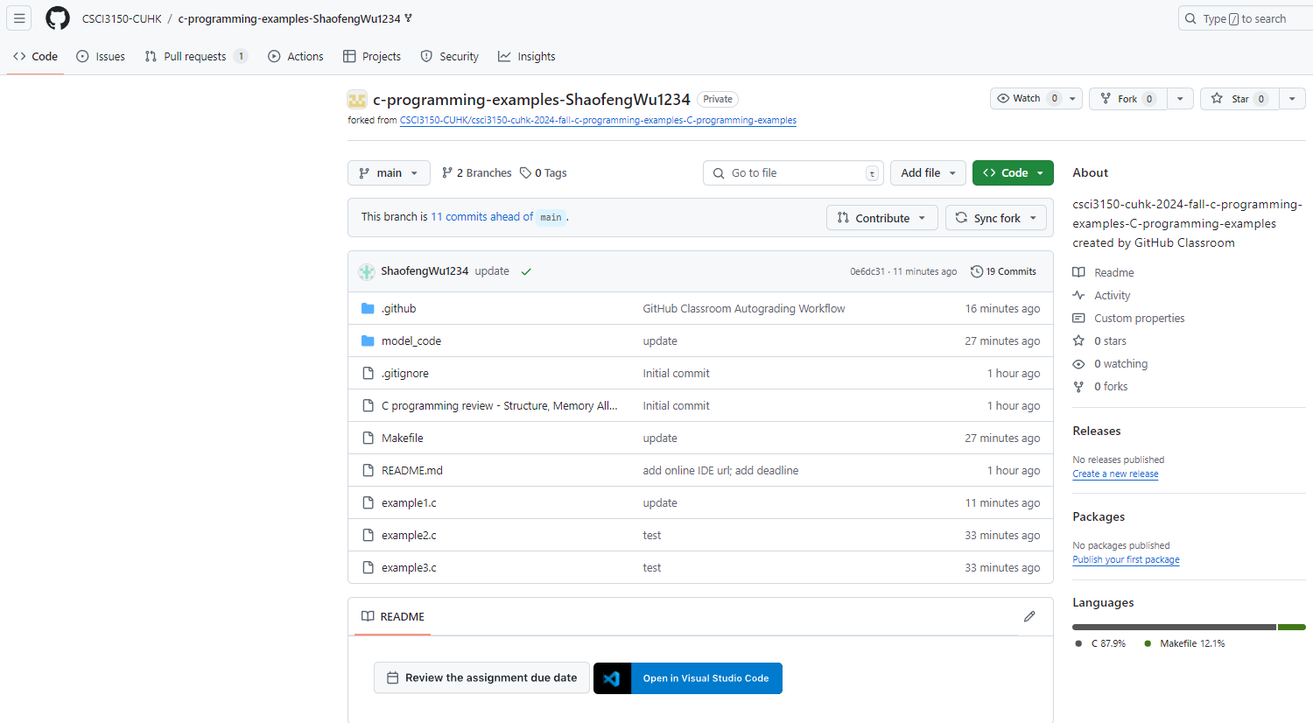
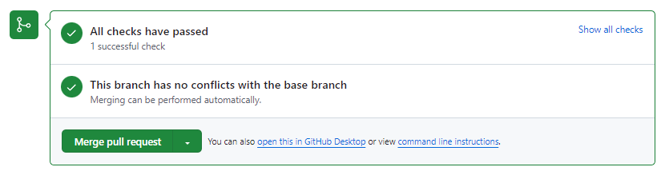
C Programming Examples(1/1)
Review of C programming
Content
Example1: Structures
Example2: Memory allocation
Example3: File I/O
Homework submission/(auto)grading/feedback rehearsal
Github classroom for C programming examples:
https://classroom.github.com/a/hd7U6QDb

Slide 12
Summary & Preview
In this week
Intro to CSCI3150 tutorial sessions
Linux basics
Git basics
Review on C programming
Next week
Background knowledge of asg1
Shell behaviour
Code walk of asg1

Slide 13
Q & A

Slide 14
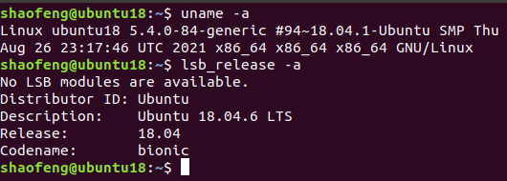
Additional Information
Locally access Linux: VirtualBox as an example
Download VirtualBox: https://www.virtualbox.org/wiki/Downloads
Download a ubuntu 18.04 image: Ubuntu 18.04.6 LTS (Bionic Beaver)
Check this guide for setting up your Linux VM: https://ubuntu.com/tutorials/how-to-run-ubuntu-desktop-on-a-virtual-machine-using-virtualbox
Note: adjust the amount of resources you allocate to the VM according to the capacity of your PC to avoid host starvation

Slide 15
Additional Information
Problems you may encounter with VirtualBox and Ubuntu
Cannot copy from host and paste in VM, VM window is too small, …
Require add-on support to be manually installed(a lot of tutorials online)
Cannot open terminal by clicking or keyboard shortcut(ctrl+alt+t)
Use another terminal tool(i.e. xterm) and input “gnome-terminal”
Check and search the error message online(stackoverflow, google, …)
Account not in sudoers file
Input “su -” to switch to root
Other questions can be searched with google(most questions relating linux set up can actually be found on the Internet) or asked on piazza

