Slide 1
CSCI3150 Introduction to Operating Systems
Lecture 2: Architectural Support

Slide 2
Agenda
Hardware overview
A peek at Unix
Hardware (architecture) support
Summary

Slide 3
Why Start With Hardware?
Operating system functionality fundamentally depends upon hardware
Key goal of an OS is to manage hardware
If done well, applications can be oblivious to HW details
Hardware support can greatly simplify – or complicate – OS tasks
Early PC operating systems (DOS, MacOS) lacked virtual memory in part because the hardware did not support it
https://github.com/microsoft/ms-dos

Slide 4
So what is inside a computer
An abstract overview
http://www.youtube.com/watch?v=Q2hmuqS8bwM
An introduction with a real computer
https://www.youtube.com/watch?v=HB4I2CgkcCo

Slide 5
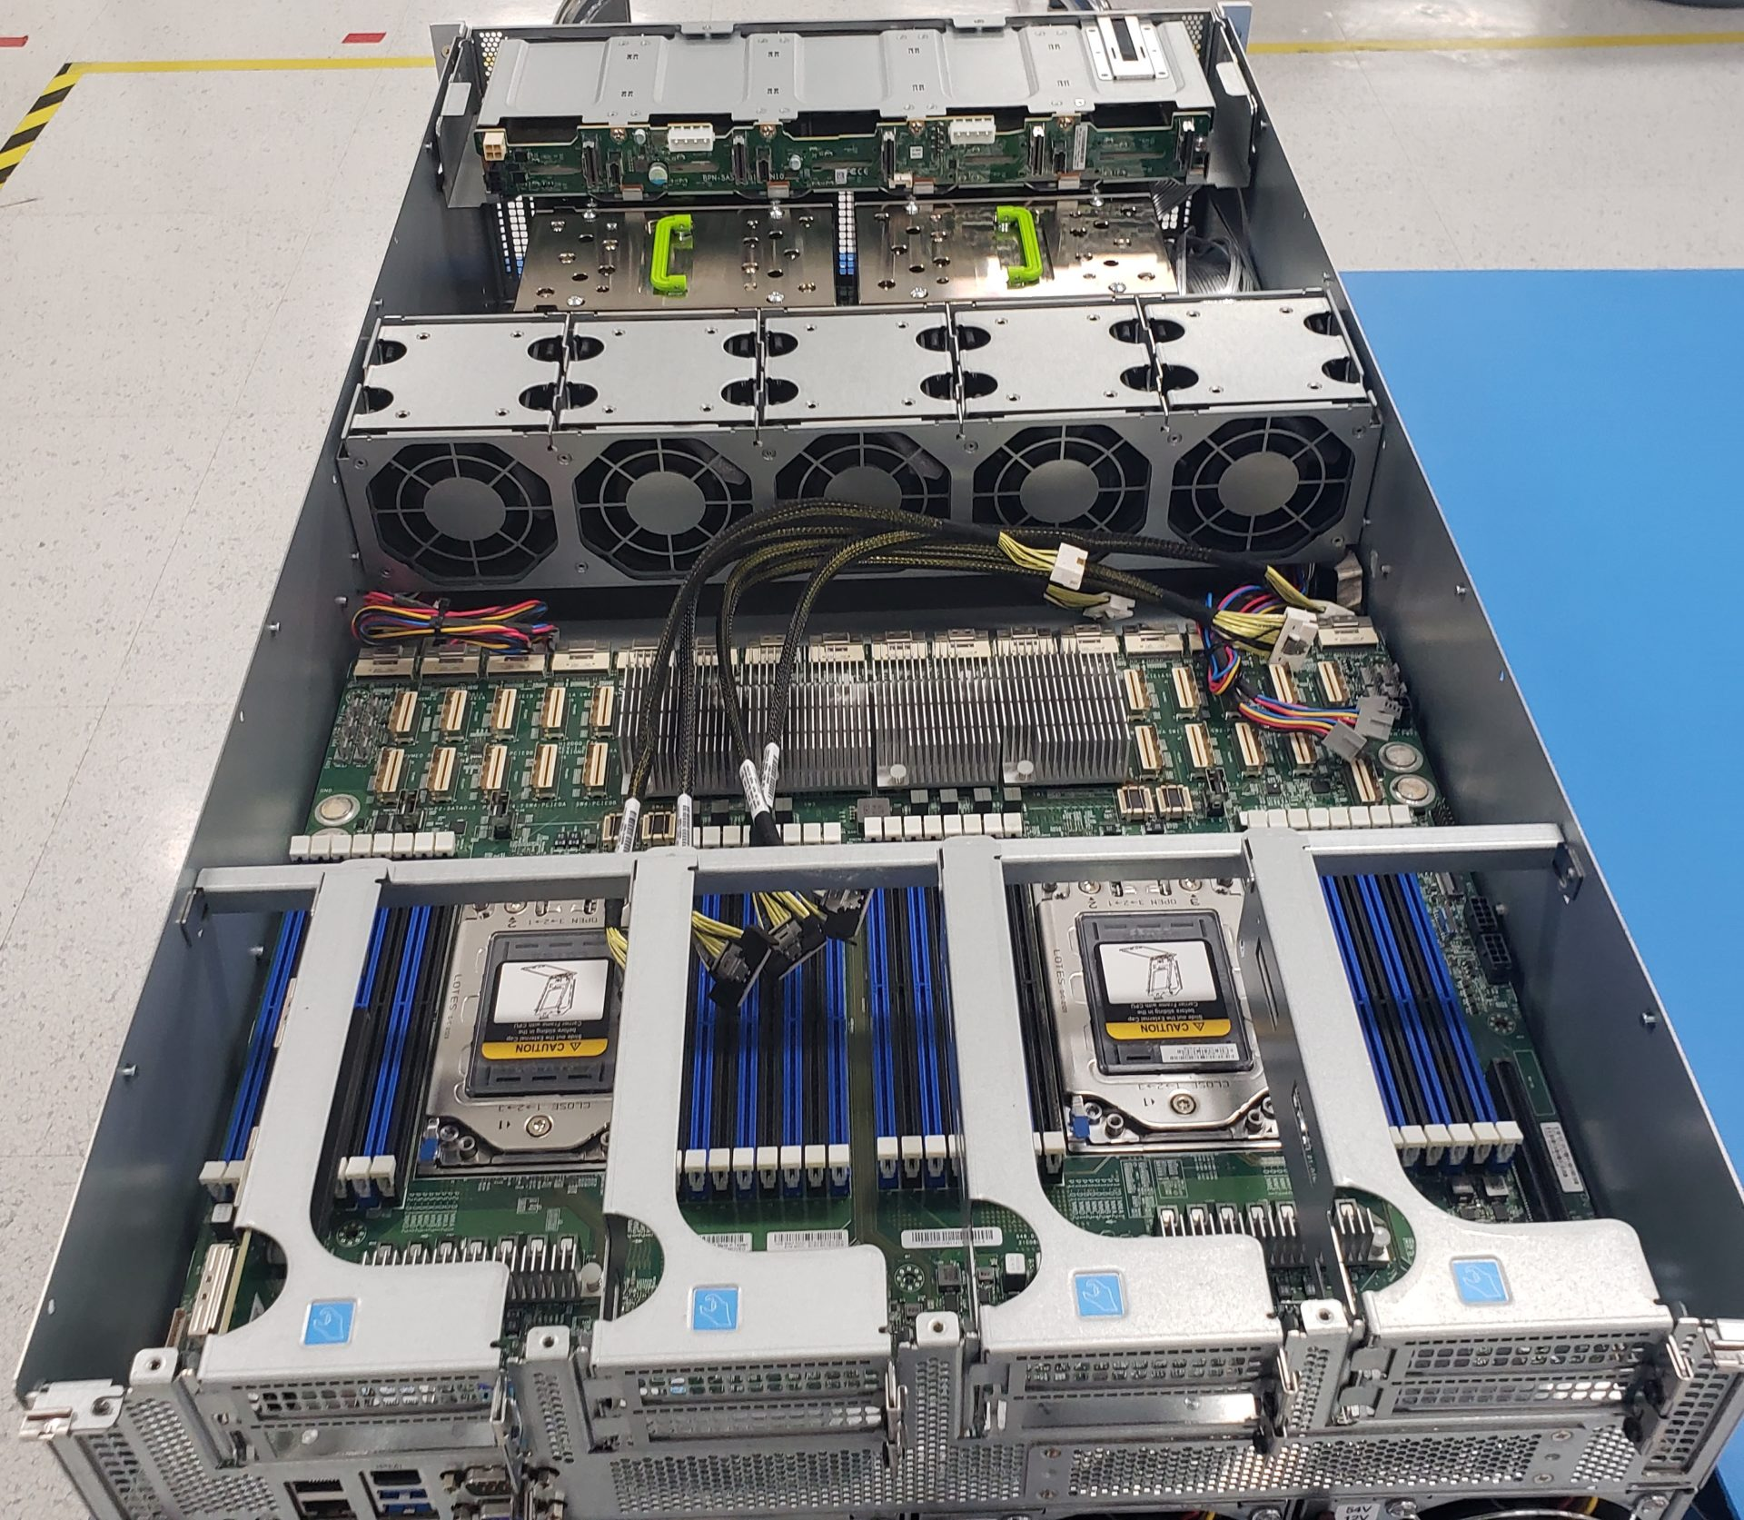
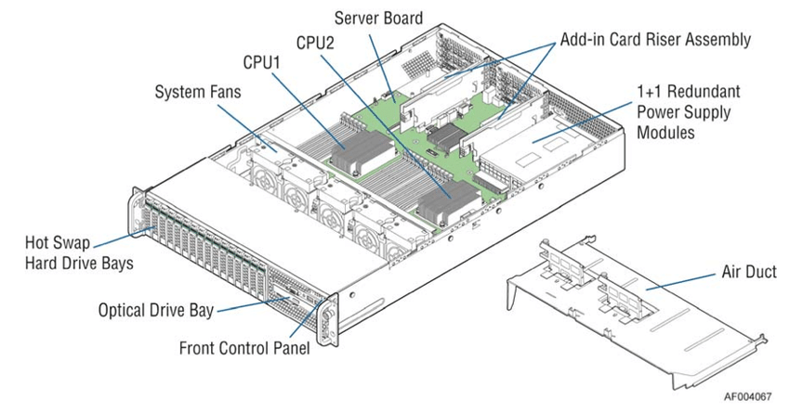
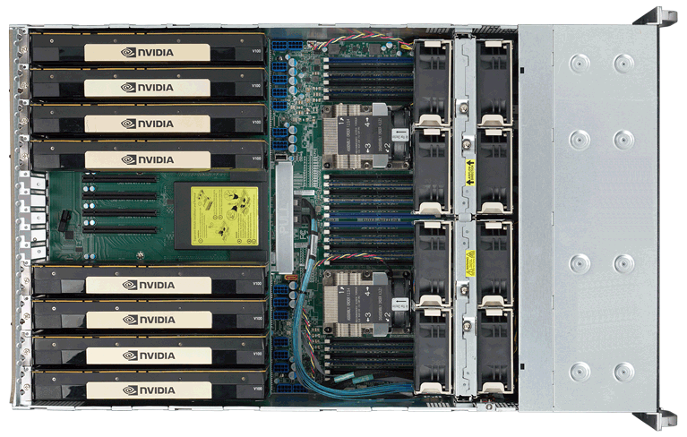
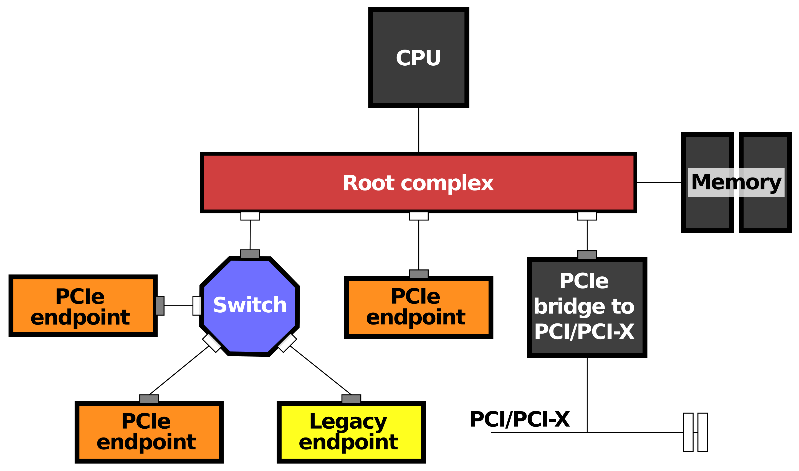
A Typical Computer from a Hardware Point of View

Slide 6
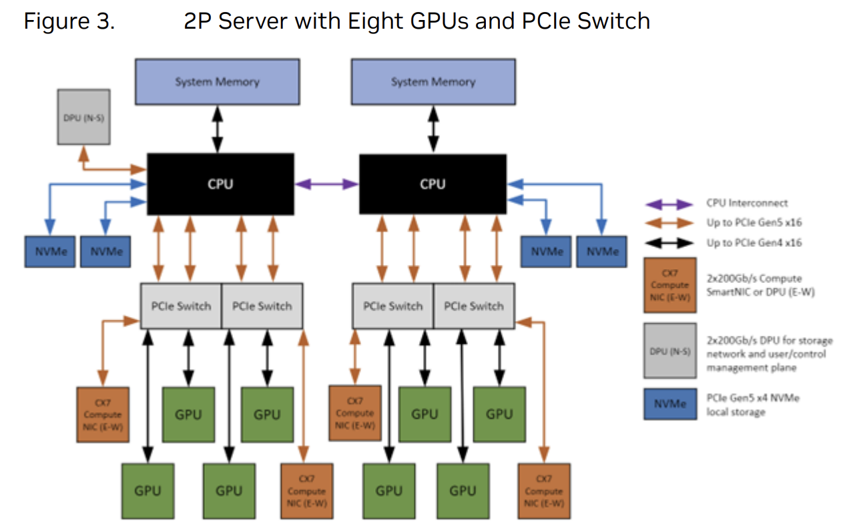
PCIe
Credit: https://docs.nvidia.com/certification-programs/pdf/nvidia-certified-configuration-guide.pdf

Slide 7
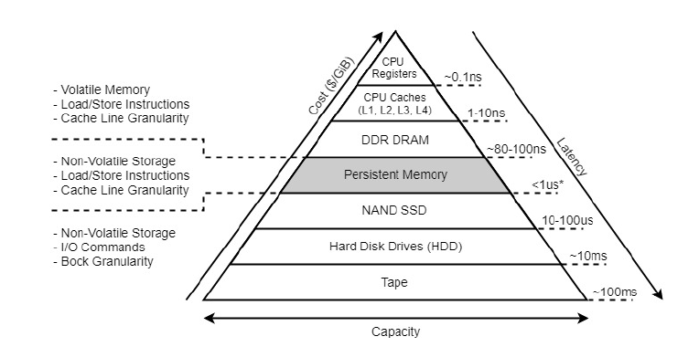
Memory-storage Hierarchy
1 ns = 10⁻⁹ s
Notes:
memory – disk: 100 thousand times
facebook front page

Slide 8
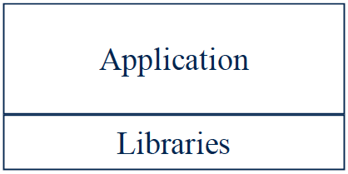
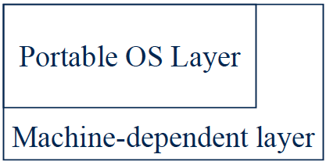
A peek into Unix structure
Written by programmer
Compiled by programmer
Uses library calls (e.g., printf)

Slide 9
A peek into Unix structure
Example: stdio.h
Written by elves
Uses system calls
Defined in headers
Input to linker (compiler)
Invoked like functions
May be “resolved” when
program is loaded.

Slide 10
A peek into Unix structure
System calls (read, open..)
All “high-level” code

Slide 11
A peek into Unix structure
Bootstrap
System initialization
Interrupt and exception
I/O device driver
Memory management
Kernel/user mode switching
Processor management

Slide 12
A peek into Unix structure
Cannot execute “protected_instruction”, e.g., directly access I/O device
User mode
Kernel mode
Some systems do not have clear user-kernel boundary
User/kernel mode is supported by hardware (why?)
Notes:
Explain why protection is needed.

Slide 13

Why hardware has to support User/Kernel mode?
Imaginary OS code (software-only solution)
if ([PC] != protected_instruction)
execute(PC);
else
switch_to_kernel_mode();
Does it work?

Slide 14
Why hardware has to support User/Kernel mode?
Application’s code:
lw $t0, 4($gp)
mult $t0, $t0, $t0
lw $t1, 4($gp)
ori $t2, $zero, 3
mult $t1, $t1, $t2
add $t2, $t0, $t1
sw $t2, 0($gp)
OS: check if next instruction
is protected instruction.

Slide 15
Why hardware has to support User/Kernel mode?
Application’s code:
lw $t0, 4($gp)
mult $t0, $t0, $t0
lw $t1, 4($gp)
ori $t2, $zero, 3
mult $t1, $t1, $t2
add $t2, $t0, $t1
sw $t2, 0($gp)
OS: check if next instruction
is protected instruction.
Performance overhead is too big: OS needs to check every instruction of the application!

Slide 16
Why hardware has to support User/Kernel mode?
OS: set-up the environment;
load the application
Application’s code:
lw $t0, 4($gp)
mult $t0, $t0, $t0
lw $t1, 4($gp)
ori $t2, $zero, 3
mult $t1, $t1, $t2
add $t2, $t0, $t1
sw $t2, 0($gp)
Instead, what we really want is to give the CPU entirely to the application
Bare-metal execution
Return to OS after termination;
OS: schedule next application to
execute..
Any problems?
How can OS check if application
executes protected instruction?
How can OS know it will ever run again?

Slide 17
Why hardware has to support User/Kernel mode?
Give the CPU to the user application
Why: Performance and efficiency
OS will not be executing
Without hardware’s help, OS loses control of the machine!
Analogy: give the car key to someone, how do you know if he will return the car?
This is the most fundamental reason why OS will need hardware support --- not only for user/kernel mode

Slide 18
Hardware Features for OS
Features that directly support the OS include
Protection (kernel/user mode)
Memory protection
System calls
Interrupts and exceptions
Timer (clock)
I/O control and operation
Synchronization

Slide 19
Types of Hardware Support
Manipulating privileged machine state
Protected instructions
Manipulate device registers, TLB entries, etc.
Generating and handling “events”
Interrupts, exceptions, system calls, etc.
Respond to external events
CPU requires software intervention to handle fault or trap
Mechanisms to handle concurrency
Interrupts, atomic instructions

Slide 20
Protected Instructions
A subset of instructions of every CPU is restricted to use only by the OS
Known also as privileged instructions
Only the operating system can
Directly access I/O devices (disks, printers, etc.)
Security, fairness (why?)
Manipulate memory management state
Page table pointers, page protection, TLB management, etc.
Manipulate protected control registers
Kernel mode, interrupt level
Halt instruction (why?)
Notes:
HLT: put the CPU to sleep until the next interrupt is fired.

Slide 21
OS Protection
Hardware must support (at least) two modes of operation: kernel mode and user mode
Mode is indicated by a status bit in a protected control register
User programs execute in user mode
OS executes in kernel mode (OS == “kernel”)
Protected instructions only execute in kernel mode
CPU checks mode bit when protected instruction executes
Setting mode bit must be a protected instruction
Attempts to execute in user mode are detected and prevented
x86: General Protection Fault

Slide 22
Memory Protection
OS must be able to protect programs from each other
OS must protect itself from user programs
We need hardware support
Again: once OS gives the CPU to the user programs, OS loses control

Slide 23
Memory Protection
Memory management hardware provides memory protection mechanisms
Base and limit registers
Page table pointers, page protection, TLB
Virtual memory
Segmentation
Manipulating memory management hardware uses privileged operations

Slide 24
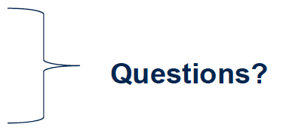
Hardware Features for OS
Features that directly support the OS include
Protection (kernel/user mode)
Privileged instructions
Memory protection
System calls
Interrupts and exceptions
Timer (clock)
I/O control and operation
Synchronization

Slide 25
Events
After the OS has booted, all entry to the kernel happens as the result of an event
event immediately stops current execution
changes mode to kernel mode, event handler is called
An event is an “unnatural” change in control flow
Events immediately stop current execution
Changes mode, context (machine state), or both
The kernel defines a handler for each event type
Event handlers always execute in kernel mode
The specific types of events are defined by the machine
In effect, an OS is a big event handler

Slide 26
OS Control Flow
When the processor receives an event of a given type, it
transfers control to handler within the OS
handler saves program state (PC, registers, etc.)
handler functionality is invoked
handler restores program state, returns to program

Slide 27
Categorizing Events
Two kinds of events, interrupts and exceptions
Exceptions are caused by executing instructions
CPU requires software intervention to handle a fault or trap
Interrupts are caused by an external event
Device finishes I/O, timer expires, etc.
Two reasons for events, unexpected and deliberate
Unexpected events are, well, unexpected
What is an example?
Deliberate events are scheduled by OS or application
Why would this be useful?

Slide 28
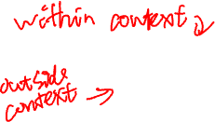
Categorizing Events
This gives us a convenient table:
Terms may be used slightly differently by various OSes, CPU architectures…
No need to “memorize” all the terms
Software interrupt – a.k.a. async system trap (AST), async or deferred procedure call (APC or DPC)
Will cover faults, system calls, and interrupts next
 | Unexpected | Deliberate
Exceptions (sync) | fault | syscall trap software interrupt
Interrupts (async) | interrupt

Slide 29
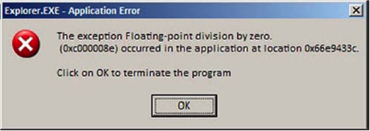
Faults

Slide 30
Faults
Hardware detects and reports “exceptional” conditions
Page fault, divide by zero, unaligned access
Upon exception, hardware “faults” (verb)
Must save state (PC, registers, mode, etc.) so that the faulting process can be restarted
Fault exceptions are a performance optimization
Could detect faults by inserting extra instructions into code (at a significant performance penalty)

Slide 31
Handling Faults
Some faults are handled by “fixing” the exceptional condition and returning to the faulting context
Page faults cause the OS to place the missing page into memory
Fault handler resets PC of faulting context to re-execute instruction that caused the page fault
Some faults are handled by notifying the process
Fault handler changes the saved context to transfer control to a user-mode handler on return from fault
Handler must be registered with OS
Unix signals
SIGSEGV, SIGALRM, SIGTERM, etc.

Slide 32
Handling Faults
The kernel may handle unrecoverable faults by killing the user process
Program faults with no registered handler
Halt process, write process state to file, destroy process
In Unix, the default action for many signals (e.g., SIGSEGV)
What about faults in the kernel?
Dereference NULL, divide by zero, undefined instruction
These faults considered fatal, operating system crashes
Unix panic, Windows “Blue screen of death”
Kernel is halted, state dumped to a core file, machine locked up

Slide 33
System Calls
For a user program to do something “privileged” (e.g., I/O) it must call an OS procedure
Known as crossing the protection boundary, or a protected procedure call
Hardware provides a system call instruction that:
Causes an exception, which vectors to a kernel handler
Passes a parameter determining the system routine to call
Saves caller state (PC, registers, etc.) so it can be restored
Returning from system call restores this state
Requires hardware support to:
Restore saved state, reset mode, resume execution

Slide 34
System Call Functions
Process control
Create process, allocate memory
File management
Create, read, delete file
Device management
Open device, read/write device, mount device
Information maintenance
Get time
Programmers generally do not use system calls directly
They use runtime libraries (e.g., stdio.h)
Why?

Slide 35
Function call
main () {
foo (10);
}
Compile
main: push $10
call foo
.. ..
foo: .. ..
ret

Slide 36
System call
open (path, flags, mode);
open: ;Linux convention:
;parameters via registers.
mov eax, 5 ; syscall number for open
mov ebx, path ; ebx: first parameter
mov ecx, flags ; ecx: 2nd parameter
mov edx, mode ; edx: 3rd parameter
int 80h
open: ; FreeBSD convention:
; parameters via stacks.
push dword mode
push dword flags
push dword path
mov eax, 5
push dword eax ; syscall number
int 80h
add esp, byte 16
More info:
https://stackoverflow.com/questions/1817577/what-does-int-0x80-mean-in-assembly-code

Slide 37
Directly using system call?
Write assembly code
Hard
Poor portability
write different version for different architecture
write different version for different OSes
Application programmers use library
Libraries written by elves

Slide 38
System Call
Firefox: open()
Trap to kernel mode, save state
User mode
Kernel mode
Restore state, return to user level, resume execution
Trap handler
open read handler in vector table
open() kernel routine

Slide 39
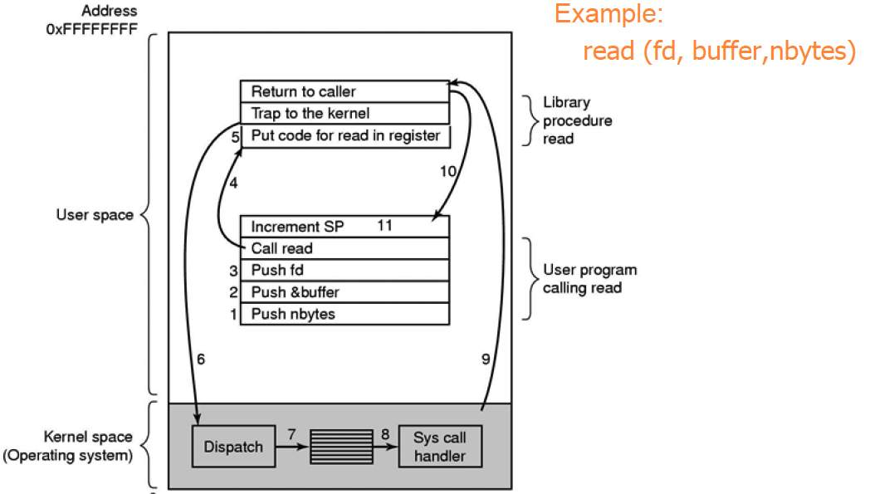
Steps in making a syscall

Slide 40
System Call Issues
What would happen if the kernel did not save state?
Why must the kernel verify arguments?
Why is a table of system calls in the kernel necessary?

Slide 41
Interrupts
Interrupts signal asynchronous events
I/O hardware interrupts
Hardware timers

Slide 42
Interrupt Illustrated
User Mode
Mode bit = 1
User
process
Resume process
Kernel Mode
Mode bit = 0
Return
Mode bit = 1
Suspend user process
Execute OS’s interrupt handler
Save state of process
Execute device driver
Restore
state
Clear
interrupt
Device
Raise
Interrupt

Slide 43
How to find interrupt handlers?
Hardware maps interrupt type to interrupt number
OS sets up the Interrupt Descriptor Table (IDT) at boot time
Also called interrupt vector
IDT is in memory
Each entry is an interrupt handler
OS lets hardware know IDT base
Hardware finds handler using interrupt number as index into IDT
handler = IDT[intr_number]

Slide 44
Timer
The timer is critical for an operating system
It is the fallback mechanism by which the OS reclaims control over the machine
Timer is set to generate an interrupt after a period of time
Setting timer is a privileged instruction
When timer expires, generates an interrupt
Handled by kernel, which controls resumption context
Basis for OS scheduler (more later…)
Prevents infinite loops
OS can always regain control from erroneous or malicious programs that try to hog CPU
Also used for time-based functions (e.g., sleep())

Slide 45
I/O Control
I/O issues
Initiating an I/O
Completing an I/O
Initiating an I/O
Special instructions
Memory-mapped I/O
Device registers mapped into address space
Writing to address sends data to I/O device

Slide 46
I/O Completion
Interrupts are the basis for asynchronous I/O
OS initiates I/O
Device operates independently of rest of machine
Device sends an interrupt signal to CPU when done
OS maintains a vector table containing a list of addresses of kernel routines to handle various events
CPU looks up kernel address indexed by interrupt number, context switches to routine

Slide 47
I/O Example
1. Ethernet receives packet, writes packet into memory
2. Ethernet signals an interrupt
3. CPU stops current operation, switches to kernel mode, saves machine state (PC, mode, etc.) on kernel stack
4. CPU reads address from vector table indexed by interrupt number, branches to address (Ethernet device driver)
5. Ethernet device driver processes packet (reads device registers to find packet in memory)
6. Upon completion, restores saved state from stack

Slide 48
Interrupt Questions
Interrupts halt the execution of a process and transfer control (execution) to the operating system
Can the OS be interrupted? (Consider why there might be different IRQ levels)
Interrupts are used by devices to notify the OS that something needs attention
What is an alternative approach to achieve this?
What are the drawbacks of that approach?

Slide 49
Alternative approach
Polling
Problems?
Analogy:
Polling: keeps checking the email every 30 seconds
Interrupt: when email arrives, give me a ring
while (Ethernet_card_queue_is_empty)
;
// Ethernet card received packets.
handle_packets();

Slide 50
Summary
Protection
User/kernel modes
Protected instructions
System calls
Used by user-level processes to access OS functions
Access what is “in” the OS
Exceptions
Unexpected event during execution (e.g., divide by zero)
Interrupts
Timer, I/O

Slide 51
Summary (2)
After the OS has booted, all entry to the kernel happens as the result of an event
event immediately stops current execution
changes mode to kernel mode, event handler is called
When the processor receives an event of a given type, it
transfers control to handler within the OS
handler saves program state (PC, registers, etc.)
handler functionality is invoked
handler restores program state, returns to program

Slide 52
Architecture Trends Impact OS Design
Processor
Single core to multi-core
OS must better handle concurrency
Network
Disconnected to wired to wireless
OS must manage connectivity more
Isolated to shared to attacked
OS must provide more security/protection
Mobile/battery-operated
OS must pay attention to energy consumption
AI?

