Slide 1
Tutorial 06: RR and MLFQ Scheduling
CSCI3150 - Introduction to operating system
Tutor: TAN Xin
xtan22@cse.cuhk.edu.hk

Slide 2
RR scheduling

Slide 3
Recap on RR Scheduling Algorithm
Step1:Take the process which occurs first and start executing the process(for quantum time only).
Step2: Check if any other process request has arrived. If a process request arrives during the quantum time in which another process is executing, then add the new process to the Ready queue
Step3: After the quantum time has passed, check for any processes in the Ready queue. If the ready queue is empty then continue the current process. If the queue not empty and the current process is not complete, then add the current process to the end of the ready queue.
Step4: Take the first process from the Ready queue and start executing it (same rules)
Step5:Repeat all steps above from 2-4
Step6:If the process is complete and the ready queue is empty then the task is complete

Slide 4
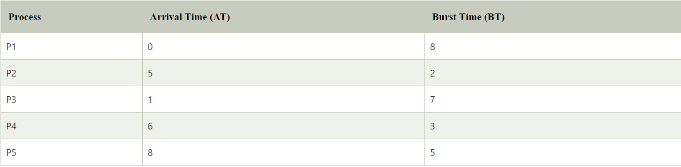
An example
Suppose we have five processes P1, P2, P3, P4,P5. The arrival and burst time of each process are mentioned in the following table, as shown below. The time quantum is 3 units.

Slide 5
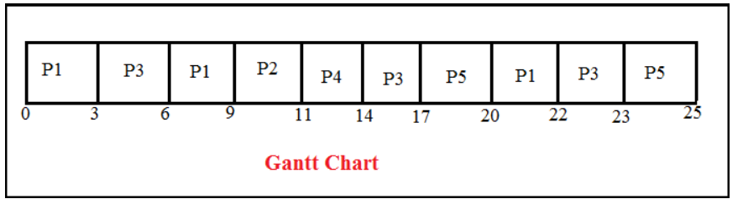
An example
Now we have to create the ready queue and the Gantt chart for Round Robin CPU Scheduler.
Ready queue: P1, P3, P1, P2, P4, P3, P5, P1, P3, P5
Here is the Gantt chart:

Slide 6
Running Process
Step 1: At time 0, process P1 enters the ready queue and starts its execution for the defined time slot 3. During 3 units of the time slice, another process, P3, arrives in the ready queue because its arrival time is 1.
Step 2: Now, process P3 starts its execution with a time slot of 3 units while process P1 has to wait. After execution of process P3, process P1 again resumes its execution for time slot 3.
Step 3: During the execution of process P1, two more processes P2 and P4, arrive in the ready queue to begin their execution. Since process P2 has come first, it will be executed for time quantum 2 units after that P4 is executed.
Step 4: Here, P4 has executed for time slot 3 units, and its task is completed because BT (Burst Time) is 2. Hence it will not go to the ready queue.
Step 5: After that, process P3 is executed from the ready queue for time slot 3 and then process P5 arrives for time slot 3.
Step 6: Meanwhile, process P5 is executed, process P1 and P3 have to wait in the ready queue.
Step 7: Now process P1 is fetched from the ready queue and starts their execution for time slot 2 as it requires only 2 BT to finish its tasks. Hence it will not go to the ready queue for further execution.
Step 8: Now, the process P3 is executed for time slot 1 as it requires only 1 BT to complete its tasks.
Step 9: The final process P5 is executed for time slot 2 because it requires only 2 BT to complete its tasks.

Slide 7
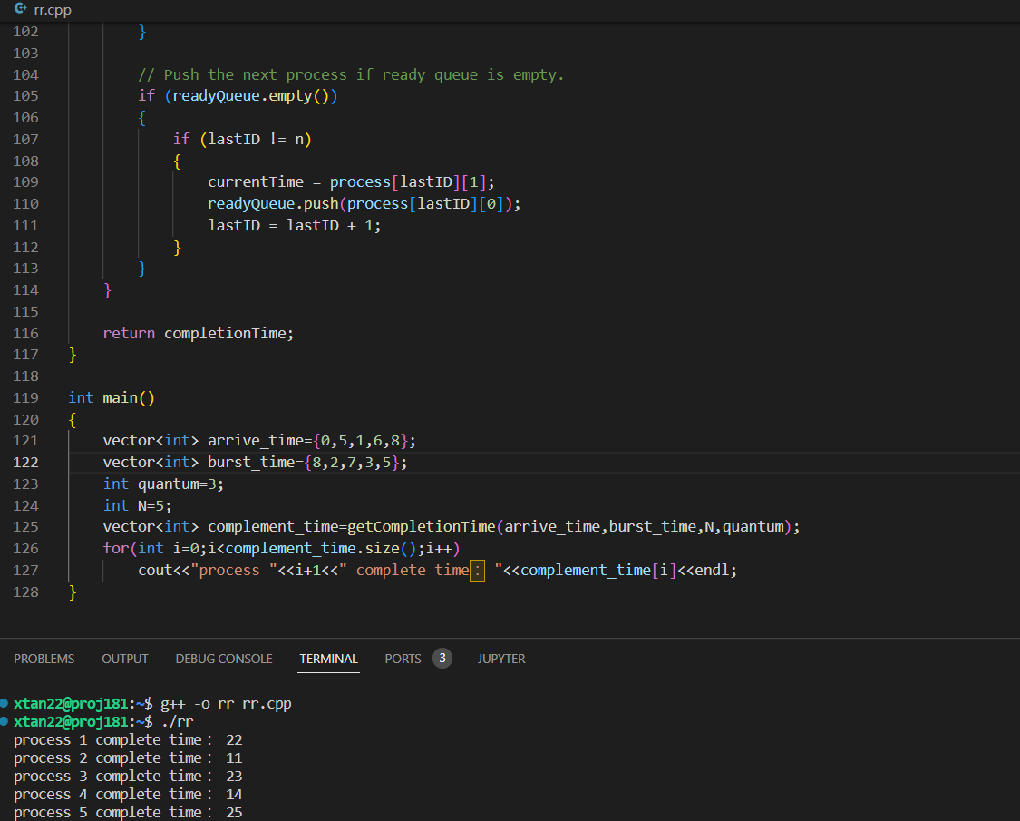
The Program

Slide 8
MLFQ scheduling

Slide 9
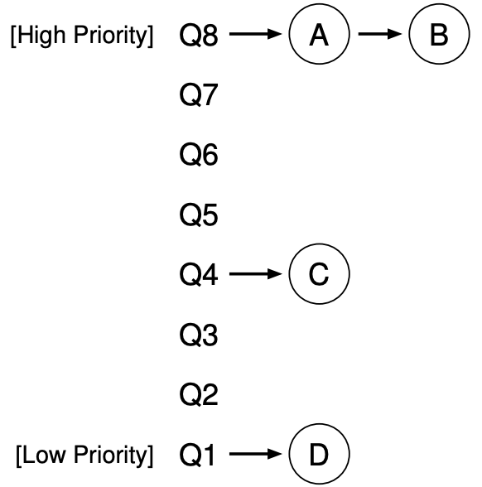
Concept
An example (refer to OSTEP, https://pages.cs.wisc.edu/~remzi/OSTEP/cpu-sched-mlfq.pdf)

Slide 10
MLFQ Scheduling Rules
Rule 1: If Priority(A) > Priority(B), A runs (B doesn’t).
Rule 2: If Priority(A) = Priority(B), A & B run in round-robin fashion using the time slice (quantum length) of the given queue.
Rule 3: When a job enters the system, it is placed at the highest priority (the topmost queue). For the jobs arriving at the same time, schedule the job with smallest pid first.
Rule 4: Once a job uses up its time allotment at a given level (regardless of how many times it has given up the CPU), its priority is reduced (i.e., it moves down one queue and will be at the tail of the target queue, which means it will be scheduled last).
Rule 5: After some time period S, move all the jobs in the system to the topmost queue, and sort all the jobs by pid. The job with the smallest pid will be scheduled first.

Slide 11
Process information
ProcessNum N
pid:X1, arrival_time:X11, execution_time:X12
pid:X2, arrival_time:X21, execution_time:X22
…
pid:XN, arrival_time:XN1, execution_time:XN2
Notes:
Here, the first line denotes there are N processes to be scheduled, and from the second line to the (N+1)th line, each shows the pid (process id), arrival time and execution time of a process with the format like “pid:X1, arrival_time:X11, execution_time:X12”. The time unit here is millisecond (ms).

Slide 12
Queue information
QueueNum n
Period_S S
Time_Slice_QN Xn Allotmenttime_QN Yn
...
Time_Slice_Q2 X2 Allotmenttime_Q2 Y2
Time_Slice_Q1 X1 Allotmenttime_Q1 Y1
Priority
High
Low
Notes:
Here, the first line denotes the number of queues we will use in the scheduler, the second line denotes the period S to move up all jobs to the topmost queue (Rule 5), the third line denotes the time slice for Queue n that is the topmost queue with the highest priority (the smallest time slice), and the subsequent lines define other queues with descending order in terms of priority. The time unit here is millisecond (ms).

Slide 13
MLFQ Scheduling Example
While executing MLFQ scheduling, we need to figure out the processes in different queues during the whole procedure, and the order of these processes.
Given the example of process and queue information:
ProcessNum 5
pidnum:123, arrival_time:60, execution_time:90
pidnum:13, arrival_time:70, execution_time:100
pidnum:1023, arrival_time:10, execution_time:160
pidnum:12, arrival_time:80, execution_time:28
pidnum:36, arrival_time:10, execution_time:10
QueueNum 3
Period_S 300
Time_Slice_Q3 10 Allotmenttime_Q3 30
Time_Slice_Q2 40 Allotmenttime_Q2 80
Time_Slice_Q1 60 Allotmenttime_Q1 120

Slide 14
Demo of MLFQ Scheduling
ProcessNum 5
pidnum:123, arrival_time:60, execution_time:90
pidnum:13, arrival_time:70, execution_time:100
pidnum:1023, arrival_time:10, execution_time:160
pidnum:12, arrival_time:80, execution_time:28
pidnum:36, arrival_time:10, execution_time:10
At the beginning (time 0): No process
High Priority
Tail
Head
Q3
Q2
QueueNum 3
Period_S 300
Time_Slice_Q3 10 Allotmenttime_Q3 30
Time_Slice_Q2 40 Allotmenttime_Q2 80
Time_Slice_Q1 60 Allotmenttime_Q1 120
Q1
Low Priority
Time
Schedule
Time
0

Slide 15
Demo of MLFQ Scheduling
ProcessNum 5
pidnum:123, arrival_time:60, execution_time:90
pidnum:13, arrival_time:70, execution_time:100
pidnum:1023, arrival_time:10, execution_time:160
pidnum:12, arrival_time:80, execution_time:28
pidnum:36, arrival_time:10, execution_time:10
At time 10: Process 36 and 1023 arrive (Rule 3)
High Priority
Tail
Head
PID: 1023
RT: 160
PID: 36
RT: 10
Q3
Q2
QueueNum 3
Period_S 300
Time_Slice_Q3 10 Allotmenttime_Q3 30
Time_Slice_Q2 40 Allotmenttime_Q2 80
Time_Slice_Q1 60 Allotmenttime_Q1 120
Q1
Low Priority
Time
Schedule
Time
0
10

Slide 16
Demo of MLFQ Scheduling
ProcessNum 5
pidnum:123, arrival_time:60, execution_time:90
pidnum:13, arrival_time:70, execution_time:100
pidnum:1023, arrival_time:10, execution_time:160
pidnum:12, arrival_time:80, execution_time:28
pidnum:36, arrival_time:10, execution_time:10
At time 20: Process 36 finishes first slice in Q3
High Priority
Tail
Head
PID: 1023
RT: 160
PID: 36
RT: 0
Q3
Q2
QueueNum 3
Period_S 300
Time_Slice_Q3 10 Allotmenttime_Q3 30
Time_Slice_Q2 40 Allotmenttime_Q2 80
Time_Slice_Q1 60 Allotmenttime_Q1 120
Q1
Low Priority
Time
Schedule
36
Time
0
10
20

Slide 17
Demo of MLFQ Scheduling
ProcessNum 5
pidnum:123, arrival_time:60, execution_time:90
pidnum:13, arrival_time:70, execution_time:100
pidnum:1023, arrival_time:10, execution_time:160
pidnum:12, arrival_time:80, execution_time:28
pidnum:36, arrival_time:10, execution_time:10
At time 30: Process 1023 finishes first slice in Q3
High Priority
Tail
Head
PID: 1023
RT: 150
Q3
Q2
QueueNum 3
Period_S 300
Time_Slice_Q3 10 Allotmenttime_Q3 30
Time_Slice_Q2 40 Allotmenttime_Q2 80
Time_Slice_Q1 60 Allotmenttime_Q1 120
Q1
Low Priority
Time
Schedule
36
1023
Time
0
10
20
30

Slide 18
Demo of MLFQ Scheduling
ProcessNum 5
pidnum:123, arrival_time:60, execution_time:90
pidnum:13, arrival_time:70, execution_time:100
pidnum:1023, arrival_time:10, execution_time:160
pidnum:12, arrival_time:80, execution_time:28
pidnum:36, arrival_time:10, execution_time:10
At time 40: Process 1023 finishes second slice in Q3
High Priority
Tail
Head
PID: 1023
RT: 140
Q3
Q2
QueueNum 3
Period_S 300
Time_Slice_Q3 10 Allotmenttime_Q3 30
Time_Slice_Q2 40 Allotmenttime_Q2 80
Time_Slice_Q1 60 Allotmenttime_Q1 120
Q1
Low Priority
Time
Schedule
36
1023
1023
Time
0
10
20
30
40

Slide 19
Demo of MLFQ Scheduling
ProcessNum 5
pidnum:123, arrival_time:60, execution_time:90
pidnum:13, arrival_time:70, execution_time:100
pidnum:1023, arrival_time:10, execution_time:160
pidnum:12, arrival_time:80, execution_time:28
pidnum:36, arrival_time:10, execution_time:10
At time 50: Process 1023 finishes third slice in Q3
Process 1023 moves down
High Priority
Tail
Head
PID: 1023
RT: 130
Q3
Q2
QueueNum 3
Period_S 300
Time_Slice_Q3 10 Allotmenttime_Q3 30
Time_Slice_Q2 40 Allotmenttime_Q2 80
Time_Slice_Q1 60 Allotmenttime_Q1 120
Q1
Low Priority
Time
Schedule
36
1023
1023
1023
Time
0
10
20
30
40
50

Slide 20
Demo of MLFQ Scheduling
ProcessNum 5
pidnum:123, arrival_time:60, execution_time:90
pidnum:13, arrival_time:70, execution_time:100
pidnum:1023, arrival_time:10, execution_time:160
pidnum:12, arrival_time:80, execution_time:28
pidnum:36, arrival_time:10, execution_time:10
At time 60: Process 123 arrives
High Priority
Tail
PID: 123
RT: 90
Head
Q3
PID: 1023
RT: 120
Q2
QueueNum 3
Period_S 300
Time_Slice_Q3 10 Allotmenttime_Q3 30
Time_Slice_Q2 40 Allotmenttime_Q2 80
Time_Slice_Q1 60 Allotmenttime_Q1 120
Q1
Low Priority
Time
Schedule
36
1023
1023
1023
1023
Time
0
10
20
30
40
50
90

Slide 21
Demo of MLFQ Scheduling
ProcessNum 5
pidnum:123, arrival_time:60, execution_time:90
pidnum:13, arrival_time:70, execution_time:100
pidnum:1023, arrival_time:10, execution_time:160
pidnum:12, arrival_time:80, execution_time:28
pidnum:36, arrival_time:10, execution_time:10
At time 70: Process 13 arrives
High Priority
Tail
PID: 13
RT: 100
Head
PID: 123
RT: 90
Q3
PID: 1023
RT: 110
Q2
QueueNum 3
Period_S 300
Time_Slice_Q3 10 Allotmenttime_Q3 30
Time_Slice_Q2 40 Allotmenttime_Q2 80
Time_Slice_Q1 60 Allotmenttime_Q1 120
Q1
Low Priority
Time
Schedule
36
1023
1023
1023
1023
Time
0
10
20
30
40
50
90

Slide 22
Demo of MLFQ Scheduling
ProcessNum 5
pidnum:123, arrival_time:60, execution_time:90
pidnum:13, arrival_time:70, execution_time:100
pidnum:1023, arrival_time:10, execution_time:160
pidnum:12, arrival_time:80, execution_time:28
pidnum:36, arrival_time:10, execution_time:10
At time 80: Process 12 arrives
High Priority
Tail
PID: 12
RT: 28
Head
PID: 13
RT: 100
PID: 123
RT: 90
Q3
PID: 1023
RT: 100
Q2
QueueNum 3
Period_S 300
Time_Slice_Q3 10 Allotmenttime_Q3 30
Time_Slice_Q2 40 Allotmenttime_Q2 80
Time_Slice_Q1 60 Allotmenttime_Q1 120
Q1
Low Priority
Time
Schedule
36
1023
1023
1023
1023
Time
0
10
20
30
40
50
90

Slide 23
Demo of MLFQ Scheduling
ProcessNum 5
pidnum:123, arrival_time:60, execution_time:90
pidnum:13, arrival_time:70, execution_time:100
pidnum:1023, arrival_time:10, execution_time:160
pidnum:12, arrival_time:80, execution_time:28
pidnum:36, arrival_time:10, execution_time:10
At time 90: Process 1023 finishes first slice in Q2
High Priority
Tail
PID: 12
RT: 28
PID: 13
RT: 100
PID: 123
RT: 90
Head
Q3
PID: 1023
RT: 90
Q2
QueueNum 3
Period_S 300
Time_Slice_Q3 10 Allotmenttime_Q3 30
Time_Slice_Q2 40 Allotmenttime_Q2 80
Time_Slice_Q1 60 Allotmenttime_Q1 120
Q1
Low Priority
Time
Schedule
36
1023
1023
1023
1023
Time
0
10
20
30
40
50
90

Slide 24
Demo of MLFQ Scheduling
ProcessNum 5
pidnum:123, arrival_time:60, execution_time:90
pidnum:13, arrival_time:70, execution_time:100
pidnum:1023, arrival_time:10, execution_time:160
pidnum:12, arrival_time:80, execution_time:28
pidnum:36, arrival_time:10, execution_time:10
At time 100: Process 123 finishes first slice in Q3
High Priority
Tail
PID: 12
RT: 28
PID: 13
RT: 100
PID: 123
RT: 80
Head
Q3
PID: 1023
RT: 90
Q2
QueueNum 3
Period_S 300
Time_Slice_Q3 10 Allotmenttime_Q3 30
Time_Slice_Q2 40 Allotmenttime_Q2 80
Time_Slice_Q1 60 Allotmenttime_Q1 120
Q1
Low Priority
Time
Schedule
36
1023
1023
1023
1023
123
Time
0
10
20
30
40
50
90
100

Slide 25
Demo of MLFQ Scheduling
ProcessNum 5
pidnum:123, arrival_time:60, execution_time:90
pidnum:13, arrival_time:70, execution_time:100
pidnum:1023, arrival_time:10, execution_time:160
pidnum:12, arrival_time:80, execution_time:28
pidnum:36, arrival_time:10, execution_time:10
At time 110: Process 13 finishes first slice in Q3
High Priority
Tail
PID: 123
RT: 80
PID: 12
RT: 28
PID: 13
RT: 90
Head
Q3
PID: 1023
RT: 90
Q2
QueueNum 3
Period_S 300
Time_Slice_Q3 10 Allotmenttime_Q3 30
Time_Slice_Q2 40 Allotmenttime_Q2 80
Time_Slice_Q1 60 Allotmenttime_Q1 120
Q1
Low Priority
Time
Schedule
36
1023
1023
1023
1023
123
13
Time
0
10
20
30
40
50
90
100
110

Slide 26
Demo of MLFQ Scheduling
ProcessNum 5
pidnum:123, arrival_time:60, execution_time:90
pidnum:13, arrival_time:70, execution_time:100
pidnum:1023, arrival_time:10, execution_time:160
pidnum:12, arrival_time:80, execution_time:28
pidnum:36, arrival_time:10, execution_time:10
At time 120: Process 12 finishes first slice in Q3
High Priority
Tail
PID: 13
RT: 90
PID: 123
RT: 80
PID: 12
RT: 18
Head
Q3
PID: 1023
RT: 90
Q2
QueueNum 3
Period_S 300
Time_Slice_Q3 10 Allotmenttime_Q3 30
Time_Slice_Q2 40 Allotmenttime_Q2 80
Time_Slice_Q1 60 Allotmenttime_Q1 120
Q1
Low Priority
Time
Schedule
36
1023
1023
1023
1023
123
13
12
Time
0
10
20
30
40
50
90
100
110
120

Slide 27
Demo of MLFQ Scheduling
ProcessNum 5
pidnum:123, arrival_time:60, execution_time:90
pidnum:13, arrival_time:70, execution_time:100
pidnum:1023, arrival_time:10, execution_time:160
pidnum:12, arrival_time:80, execution_time:28
pidnum:36, arrival_time:10, execution_time:10
At time 130: Process 123 finishes second slice in Q3
High Priority
Tail
PID: 12
RT: 18
PID: 13
RT: 90
PID: 123
RT: 70
Head
Q3
PID: 1023
RT: 90
Q2
QueueNum 3
Period_S 300
Time_Slice_Q3 10 Allotmenttime_Q3 30
Time_Slice_Q2 40 Allotmenttime_Q2 80
Time_Slice_Q1 60 Allotmenttime_Q1 120
Q1
Low Priority
Time
Schedule
36
1023
1023
1023
1023
123
13
12
123
Time
0
10
20
30
40
50
90
100
110
120
130

Slide 28
Demo of MLFQ Scheduling
ProcessNum 5
pidnum:123, arrival_time:60, execution_time:90
pidnum:13, arrival_time:70, execution_time:100
pidnum:1023, arrival_time:10, execution_time:160
pidnum:12, arrival_time:80, execution_time:28
pidnum:36, arrival_time:10, execution_time:10
At time 140: Process 13 finishes second slice in Q3
High Priority
Tail
PID: 123
RT: 70
PID: 12
RT: 18
PID: 13
RT: 80
Head
Q3
PID: 1023
RT: 90
Q2
QueueNum 3
Period_S 300
Time_Slice_Q3 10 Allotmenttime_Q3 30
Time_Slice_Q2 40 Allotmenttime_Q2 80
Time_Slice_Q1 60 Allotmenttime_Q1 120
Q1
Low Priority
Time
Schedule
36
1023
1023
1023
1023
123
13
12
123
13
Time
0
10
20
30
40
50
90
100
110
120
130
140

Slide 29
Demo of MLFQ Scheduling
ProcessNum 5
pidnum:123, arrival_time:60, execution_time:90
pidnum:13, arrival_time:70, execution_time:100
pidnum:1023, arrival_time:10, execution_time:160
pidnum:12, arrival_time:80, execution_time:28
pidnum:36, arrival_time:10, execution_time:10
At time 150: Process 12 finishes second slice in Q3
High Priority
Tail
PID: 13
RT: 80
PID: 123
RT: 70
PID: 12
RT: 8
Head
Q3
PID: 1023
RT: 90
Q2
QueueNum 3
Period_S 300
Time_Slice_Q3 10 Allotmenttime_Q3 30
Time_Slice_Q2 40 Allotmenttime_Q2 80
Time_Slice_Q1 60 Allotmenttime_Q1 120
Q1
Low Priority
Time
Schedule
36
1023
1023
1023
1023
123
13
12
123
13
12
Time
0
10
20
30
40
50
90
100
110
120
130
140
150

Slide 30
Demo of MLFQ Scheduling
ProcessNum 5
pidnum:123, arrival_time:60, execution_time:90
pidnum:13, arrival_time:70, execution_time:100
pidnum:1023, arrival_time:10, execution_time:160
pidnum:12, arrival_time:80, execution_time:28
pidnum:36, arrival_time:10, execution_time:10
At time 160: Process 123 finishes third slice in Q3
High Priority
Tail
PID: 12
RT: 8
PID: 13
RT: 80
PID: 123
RT: 60
Head
Q3
PID: 1023
RT: 90
Q2
QueueNum 3
Period_S 300
Time_Slice_Q3 10 Allotmenttime_Q3 30
Time_Slice_Q2 40 Allotmenttime_Q2 80
Time_Slice_Q1 60 Allotmenttime_Q1 120
Q1
Low Priority
Time
Schedule
36
1023
1023
1023
1023
123
13
12
123
13
12
123
0
10
20
30
40
50
90
100
110
120
130
140
150
160

Slide 31
Demo of MLFQ Scheduling
ProcessNum 5
pidnum:123, arrival_time:60, execution_time:90
pidnum:13, arrival_time:70, execution_time:100
pidnum:1023, arrival_time:10, execution_time:160
pidnum:12, arrival_time:80, execution_time:28
pidnum:36, arrival_time:10, execution_time:10
At time 170: Process 13 finishes third slice in Q3
High Priority
Tail
PID: 12
RT: 8
PID: 13
RT: 70
Head
Q3
PID: 123
RT: 60
PID: 1023
RT: 90
Q2
QueueNum 3
Period_S 300
Time_Slice_Q3 10 Allotmenttime_Q3 30
Time_Slice_Q2 40 Allotmenttime_Q2 80
Time_Slice_Q1 60 Allotmenttime_Q1 120
Q1
Low Priority
36
1023
1023
1023
1023
123
13
12
123
13
12
123
13
0
10
20
30
40
50
90
100
110
120
130
140
150
160
170

Slide 32
Demo of MLFQ Scheduling
ProcessNum 5
pidnum:123, arrival_time:60, execution_time:90
pidnum:13, arrival_time:70, execution_time:100
pidnum:1023, arrival_time:10, execution_time:160
pidnum:12, arrival_time:80, execution_time:28
pidnum:36, arrival_time:10, execution_time:10
At time 178: Process 12 finishes
High Priority
Tail
PID: 12
RT: 0
Head
Q3
PID: 13
RT: 70
PID: 123
RT: 60
PID: 1023
RT: 90
Q2
QueueNum 3
Period_S 300
Time_Slice_Q3 10 Allotmenttime_Q3 30
Time_Slice_Q2 40 Allotmenttime_Q2 80
Time_Slice_Q1 60 Allotmenttime_Q1 120
Q1
Low Priority
36
1023
1023
1023
1023
123
13
12
123
13
12
123
13
12
10
20
30
40
50
90
100
110
120
130
140
150
160
170
178

Slide 33
Demo of MLFQ Scheduling
ProcessNum 5
pidnum:123, arrival_time:60, execution_time:90
pidnum:13, arrival_time:70, execution_time:100
pidnum:1023, arrival_time:10, execution_time:160
pidnum:12, arrival_time:80, execution_time:28
pidnum:36, arrival_time:10, execution_time:10
At time 218: Process 1023 finishes second slice in Q2
High Priority
Tail
Head
Q3
PID: 13
RT: 70
PID: 123
RT: 60
PID: 1023
RT: 50
Q2
QueueNum 3
Period_S 300
Time_Slice_Q3 10 Allotmenttime_Q3 30
Time_Slice_Q2 40 Allotmenttime_Q2 80
Time_Slice_Q1 60 Allotmenttime_Q1 120
Q1
Low Priority
36
1023
1023
1023
1023
123
13
12
123
13
12
123
13
12
1023
20
30
40
50
90
100
110
120
130
140
150
160
170
178
218

Slide 34
Demo of MLFQ Scheduling
ProcessNum 5
pidnum:123, arrival_time:60, execution_time:90
pidnum:13, arrival_time:70, execution_time:100
pidnum:1023, arrival_time:10, execution_time:160
pidnum:12, arrival_time:80, execution_time:28
pidnum:36, arrival_time:10, execution_time:10
At time 258: Process 123 finishes first slice in Q2
High Priority
Tail
Head
Q3
PID: 13
RT: 70
PID: 123
RT: 20
Q2
QueueNum 3
Period_S 300
Time_Slice_Q3 10 Allotmenttime_Q3 30
Time_Slice_Q2 40 Allotmenttime_Q2 80
Time_Slice_Q1 60 Allotmenttime_Q1 120
PID: 1023
RT: 50
Q1
Low Priority
1023
1023
1023
1023
123
13
12
123
13
12
123
13
12
1023
123
30
40
50
90
100
110
120
130
140
150
160
170
178
218
258

Slide 35
Demo of MLFQ Scheduling
ProcessNum 5
pidnum:123, arrival_time:60, execution_time:90
pidnum:13, arrival_time:70, execution_time:100
pidnum:1023, arrival_time:10, execution_time:160
pidnum:12, arrival_time:80, execution_time:28
pidnum:36, arrival_time:10, execution_time:10
At time 298: Process 13 finishes first slice in Q2
High Priority
Tail
Head
Q3
PID: 123
RT: 20
PID: 13
RT: 30
Q2
QueueNum 3
Period_S 300
Time_Slice_Q3 10 Allotmenttime_Q3 30
Time_Slice_Q2 40 Allotmenttime_Q2 80
Time_Slice_Q1 60 Allotmenttime_Q1 120
PID: 1023
RT: 50
Q1
Low Priority
1023
1023
1023
1023
123
13
12
123
13
12
123
13
12
1023
123
13
40
50
90
100
110
120
130
140
150
160
170
178
218
258
298

Slide 36
Demo of MLFQ Scheduling
ProcessNum 5
pidnum:123, arrival_time:60, execution_time:90
pidnum:13, arrival_time:70, execution_time:100
pidnum:1023, arrival_time:10, execution_time:160
pidnum:12, arrival_time:80, execution_time:28
pidnum:36, arrival_time:10, execution_time:10
At time 300: Move all process to topmost level queue
Sort with pid.
High Priority
Tail
Head
Q3
PID: 13
RT: 30
PID: 123
RT: 18
Q2
QueueNum 3
Period_S 300
Time_Slice_Q3 10 Allotmenttime_Q3 30
Time_Slice_Q2 40 Allotmenttime_Q2 80
Time_Slice_Q1 60 Allotmenttime_Q1 120
PID: 1023
RT: 50
Q1
Low Priority
1023
1023
1023
1023
123
13
12
123
13
12
123
13
12
1023
123
13
123
50
90
100
110
120
130
140
150
160
170
178
218
258
298
300

Slide 37
Demo of MLFQ Scheduling
ProcessNum 5
pidnum:123, arrival_time:60, execution_time:90
pidnum:13, arrival_time:70, execution_time:100
pidnum:1023, arrival_time:10, execution_time:160
pidnum:12, arrival_time:80, execution_time:28
pidnum:36, arrival_time:10, execution_time:10
At time 310: Process 13 finishes first slice in Q3
High Priority
Tail
PID: 1023
RT: 50
PID: 123
RT: 18
PID: 13
RT: 20
Head
Q3
Q2
QueueNum 3
Period_S 300
Time_Slice_Q3 10 Allotmenttime_Q3 30
Time_Slice_Q2 40 Allotmenttime_Q2 80
Time_Slice_Q1 60 Allotmenttime_Q1 120
Q1
Low Priority
1023
1023
1023
1023
123
13
12
123
13
12
123
13
12
1023
123
13
123
13
90
100
110
120
130
140
150
160
170
178
218
258
298
300
310

Slide 38
Demo of MLFQ Scheduling
ProcessNum 5
pidnum:123, arrival_time:60, execution_time:90
pidnum:13, arrival_time:70, execution_time:100
pidnum:1023, arrival_time:10, execution_time:160
pidnum:12, arrival_time:80, execution_time:28
pidnum:36, arrival_time:10, execution_time:10
At time 320: Process 123 finishes first slice in Q3
High Priority
Tail
PID: 13
RT: 20
PID: 1023
RT: 50
PID: 123
RT: 8
Head
Q3
Q2
QueueNum 3
Period_S 300
Time_Slice_Q3 10 Allotmenttime_Q3 30
Time_Slice_Q2 40 Allotmenttime_Q2 80
Time_Slice_Q1 60 Allotmenttime_Q1 120
Q1
Low Priority
1023
1023
1023
123
13
12
123
13
12
123
13
12
1023
123
13
123
13
123
100
110
120
130
140
150
160
170
178
218
258
298
300
310
320

Slide 39
Demo of MLFQ Scheduling
ProcessNum 5
pidnum:123, arrival_time:60, execution_time:90
pidnum:13, arrival_time:70, execution_time:100
pidnum:1023, arrival_time:10, execution_time:160
pidnum:12, arrival_time:80, execution_time:28
pidnum:36, arrival_time:10, execution_time:10
At time 330: Process 1023 finishes first slice in Q3
High Priority
Tail
PID: 123
RT: 8
PID: 13
RT: 20
PID: 1023
RT: 40
Head
Q3
Q2
QueueNum 3
Period_S 300
Time_Slice_Q3 10 Allotmenttime_Q3 30
Time_Slice_Q2 40 Allotmenttime_Q2 80
Time_Slice_Q1 60 Allotmenttime_Q1 120
Q1
Low Priority
1023
1023
1023
13
12
123
13
12
123
13
12
1023
123
13
123
13
123
1023
110
120
130
140
150
160
170
178
218
258
298
300
310
320
330

Slide 40
Demo of MLFQ Scheduling
ProcessNum 5
pidnum:123, arrival_time:60, execution_time:90
pidnum:13, arrival_time:70, execution_time:100
pidnum:1023, arrival_time:10, execution_time:160
pidnum:12, arrival_time:80, execution_time:28
pidnum:36, arrival_time:10, execution_time:10
At time 340: Process 13 finishes second slice in Q3
High Priority
Tail
PID: 1023
RT: 40
PID: 123
RT: 8
PID: 13
RT: 10
Head
Q3
Q2
QueueNum 3
Period_S 300
Time_Slice_Q3 10 Allotmenttime_Q3 30
Time_Slice_Q2 40 Allotmenttime_Q2 80
Time_Slice_Q1 60 Allotmenttime_Q1 120
Q1
Low Priority
1023
1023
1023
12
123
13
12
123
13
12
1023
123
13
123
13
123
1023
13
120
130
140
150
160
170
178
218
258
298
300
310
320
330
340

Slide 41
Demo of MLFQ Scheduling
ProcessNum 5
pidnum:123, arrival_time:60, execution_time:90
pidnum:13, arrival_time:70, execution_time:100
pidnum:1023, arrival_time:10, execution_time:160
pidnum:12, arrival_time:80, execution_time:28
pidnum:36, arrival_time:10, execution_time:10
At time 348: Process 123 finishes
High Priority
Tail
PID: 13
RT: 10
PID: 1023
RT: 40
PID: 123
RT: 0
Head
Q3
Q2
QueueNum 3
Period_S 300
Time_Slice_Q3 10 Allotmenttime_Q3 30
Time_Slice_Q2 40 Allotmenttime_Q2 80
Time_Slice_Q1 60 Allotmenttime_Q1 120
Q1
Low Priority
1023
1023
1023
123
13
12
123
13
12
1023
123
13
123
13
123
1023
13
123
130
140
150
160
170
178
218
258
298
300
310
320
330
340
348

Slide 42
Demo of MLFQ Scheduling
ProcessNum 5
pidnum:123, arrival_time:60, execution_time:90
pidnum:13, arrival_time:70, execution_time:100
pidnum:1023, arrival_time:10, execution_time:160
pidnum:12, arrival_time:80, execution_time:28
pidnum:36, arrival_time:10, execution_time:10
At time 358: Process 1023 finishes second slice in Q3
High Priority
Tail
PID: 13
RT: 10
PID: 1023
RT: 30
Head
Q3
Q2
QueueNum 3
Period_S 300
Time_Slice_Q3 10 Allotmenttime_Q3 30
Time_Slice_Q2 40 Allotmenttime_Q2 80
Time_Slice_Q1 60 Allotmenttime_Q1 120
Q1
Low Priority
1023
1023
1023
13
12
123
13
12
1023
123
13
123
13
123
1023
13
123
1023
140
150
160
170
178
218
258
298
300
310
320
330
340
348
358

Slide 43
Demo of MLFQ Scheduling
ProcessNum 5
pidnum:123, arrival_time:60, execution_time:90
pidnum:13, arrival_time:70, execution_time:100
pidnum:1023, arrival_time:10, execution_time:160
pidnum:12, arrival_time:80, execution_time:28
pidnum:36, arrival_time:10, execution_time:10
At time 368: Process 13 finishes
High Priority
Tail
PID: 1023
RT: 30
PID: 13
RT: 0
Head
Q3
Q2
QueueNum 3
Period_S 300
Time_Slice_Q3 10 Allotmenttime_Q3 30
Time_Slice_Q2 40 Allotmenttime_Q2 80
Time_Slice_Q1 60 Allotmenttime_Q1 120
Q1
Low Priority
1023
1023
1023
12
123
13
12
1023
123
13
123
13
123
1023
13
123
1023
13
150
160
170
178
218
258
298
300
310
320
330
340
348
358
368

Slide 44
Demo of MLFQ Scheduling
ProcessNum 5
pidnum:123, arrival_time:60, execution_time:90
pidnum:13, arrival_time:70, execution_time:100
pidnum:1023, arrival_time:10, execution_time:160
pidnum:12, arrival_time:80, execution_time:28
pidnum:36, arrival_time:10, execution_time:10
At time 378: Process 1023 finishes third slice in Q3
Process 1023 moves down
High Priority
Tail
PID: 1023
RT: 20
Head
Q3
Q2
QueueNum 3
Period_S 300
Time_Slice_Q3 10 Allotmenttime_Q3 30
Time_Slice_Q2 40 Allotmenttime_Q2 80
Time_Slice_Q1 60 Allotmenttime_Q1 120
Q1
Low Priority
1023
1023
1023
123
13
12
1023
123
13
123
13
123
1023
13
123
1023
13
1023
160
170
178
218
258
298
300
310
320
330
340
348
358
368
378

Slide 45
Demo of MLFQ Scheduling
ProcessNum 5
pidnum:123, arrival_time:60, execution_time:90
pidnum:13, arrival_time:70, execution_time:100
pidnum:1023, arrival_time:10, execution_time:160
pidnum:12, arrival_time:80, execution_time:28
pidnum:36, arrival_time:10, execution_time:10
At time 398: Process 1023 finishes
High Priority
Tail
Head
Q3
PID: 1023
RT: 0
Q2
QueueNum 3
Period_S 300
Time_Slice_Q3 10 Allotmenttime_Q3 30
Time_Slice_Q2 40 Allotmenttime_Q2 80
Time_Slice_Q1 60 Allotmenttime_Q1 120
Q1
Low Priority
1023
1023
1023
13
12
1023
123
13
123
13
123
1023
13
123
1023
13
1023
1023
170
178
218
258
298
300
310
320
330
340
348
358
368
378
398

Slide 46

Output Format of MLFQ Scheduling
Assume that scheduling begins at time 0, and write down the result in the following format:
1. The time slot is beginning with the earliest arrival_time. x-y denotes the time interval starting at time x and end at time y (Commonly the time interval is the time slice of current queue. If one process finishes without using the whole time slice, the time interval will be the time it used, and the smallest time interval is 1 ms.)
2. Arrival Time is the arrival_time for the process in the given information.
3. Remaining Time is the length of time of which the process still needs to finish.

Slide 47
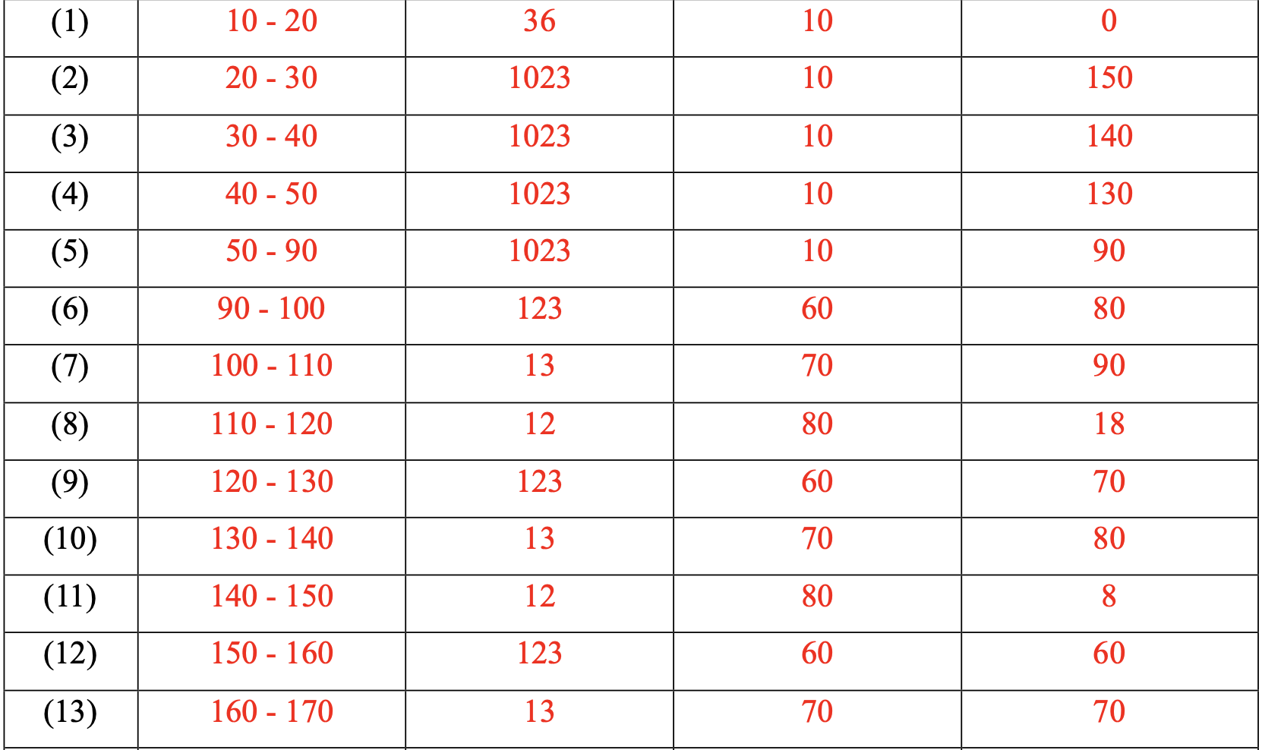
Example of Scheduling Result
1023
1023
1023
13
12
1023
123
13
123
13
123
1023
13
123
1023
13
1023
1023
170
178
218
258
298
300
310
320
330
340
348
358
368
378
398

Slide 48
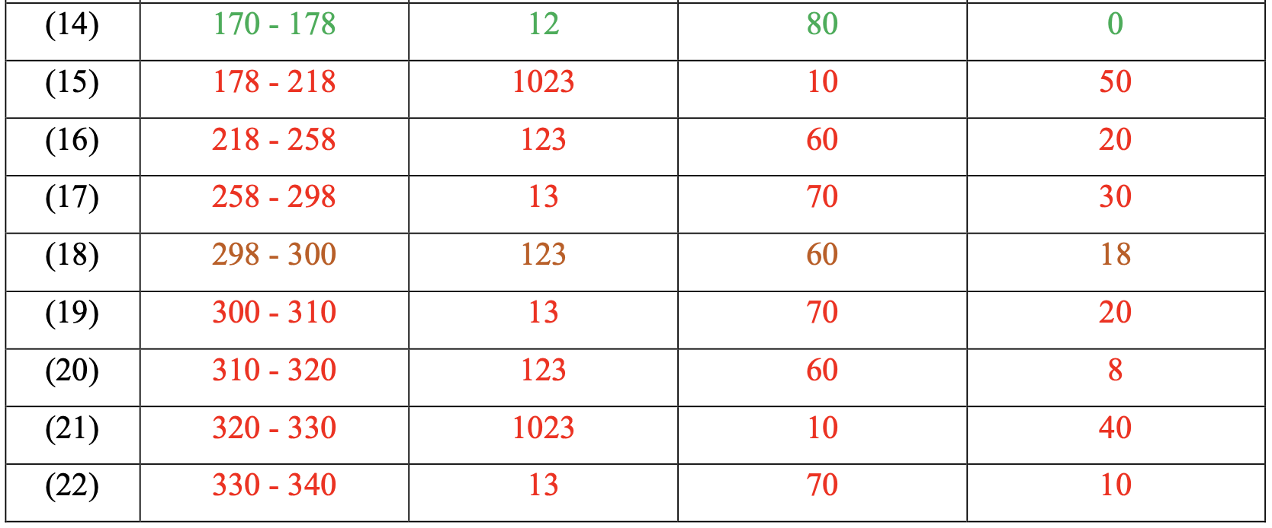
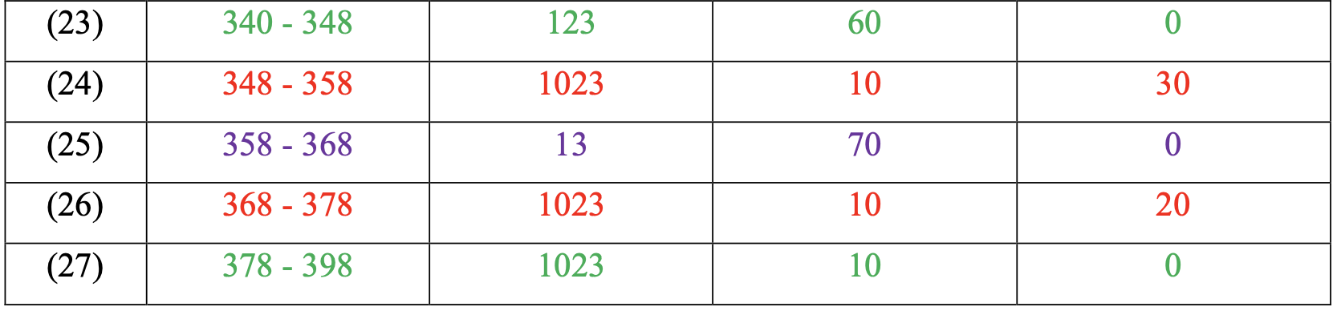
Example of Scheduling Result
1023
1023
1023
13
12
1023
123
13
123
13
123
1023
13
123
1023
13
1023
1023
170
178
218
258
298
300
310
320
330
340
348
358
368
378
398

Slide 49
Q & A
Any questions?

