Slide 1
Operating Systems
Lecture 16: File Systems
Part IV: Solid-State Drive

Slide 2
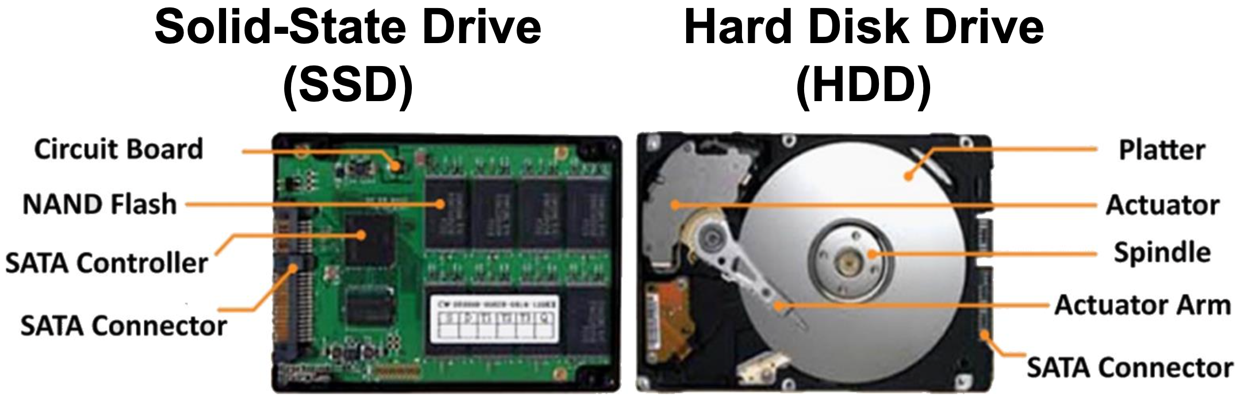
Solid-State Drive vs. Hard Disk Drive (SSD vs. HDD)
SSD’s advantages:
Faster performance
No vibrations or noise; shock-resistance
Lighter, smaller

Slide 3
Overview
Solid-state storage device
No mechanical or moving parts like HDD.
Built out of transistors (like memory and processors).
Retain information despite power loss unlike typical RAM.
NAND Flash based SSD
To write to a given chunk of it, you have to erase a bigger chunk.
The number of erase/write is limited.

Slide 4
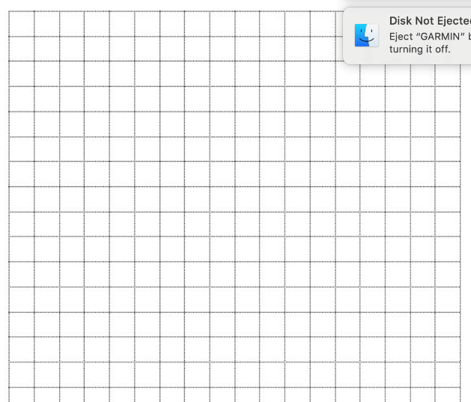
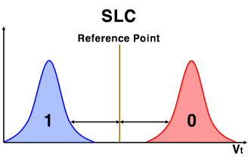
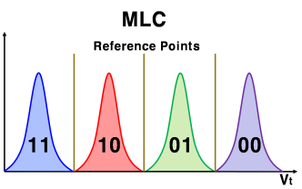
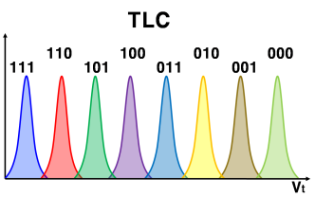
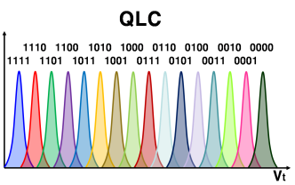
Storing Bits
Single-level cell (SLC): a single bit per cell
Multi-level cell (MLC): two bits per cell
Triple-level cell (TLC): three bits per cell
QLC, PLC
cell
Flash memory

Slide 5
Structure of Flash
block
Flash cells -> Pages
Pages-> Blocks
Page
Data area
Spare area

Slide 6
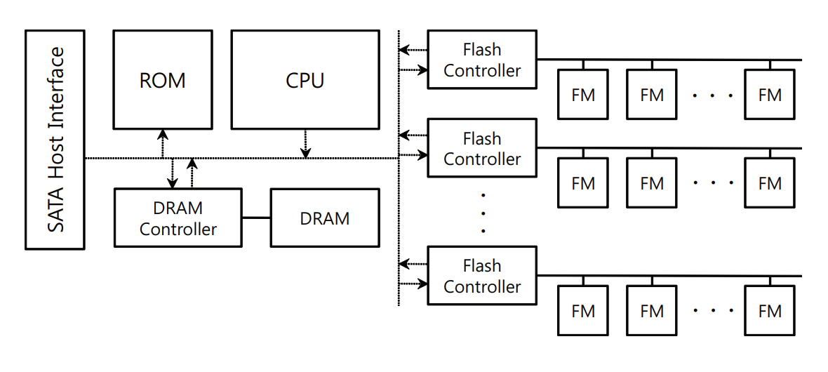
Structure of Flash SSD

Slide 7
Asymmetric Operation Units
Read; Write (program): 1 → 0: in page unit.
Erase: 0 → 1: in block unit
Write-once property: A flash page cannot be overwritten until the residing block is erased first.
Can’t write
Write 0xCC
(11001100)
Write 0xF0
(11110000)
Erase block
1
1
1
1
1
1
1
1
1
1
0
0
1
1
0
0
1
1
0
0
0
0
0
0
1
1
1
1
1
1
1
1
Initial status
write
Erase
Initial status
Block
Block
Block
1010101010101
1010101010101
1111111111111
1010001011101
1010001011101
1111111111111
1111111111111
0000101110100
1111111111111
1111111111111
1111111111111
1111111111111

Slide 8
Reliability of Flash
Wear out
Flash cells wear out as we program/erase it (P/E cycles)
Eventually the block becomes unusable.
Typical erase/wear out cycle
MLC-based block: 10,000 P/E cycles
SLC-based block: 100,000 P/E cycles
Disturbance
When accessing a page, it is possible that some bits in the neighboring pages get flipped (interference)
It is called read disturbance or program disturbance.

Slide 9
Out-of-place update in Flash memory
Flash memory should be erased before written.
Flash SSD uses out-of-place update for write operation.
In-place
out-of-place
Block 1
Block 1
Block 1
sector 0
sector 0
sector 0
sector 1
sector 1
sector 1
sector 2
sector 2
sector 2
sector 1
1
sector 3
sector 3
sector 3
sector 4
sector 4
sector 4
sector 5
sector 5
sector 5
write sector 1
write sector 1

Slide 10
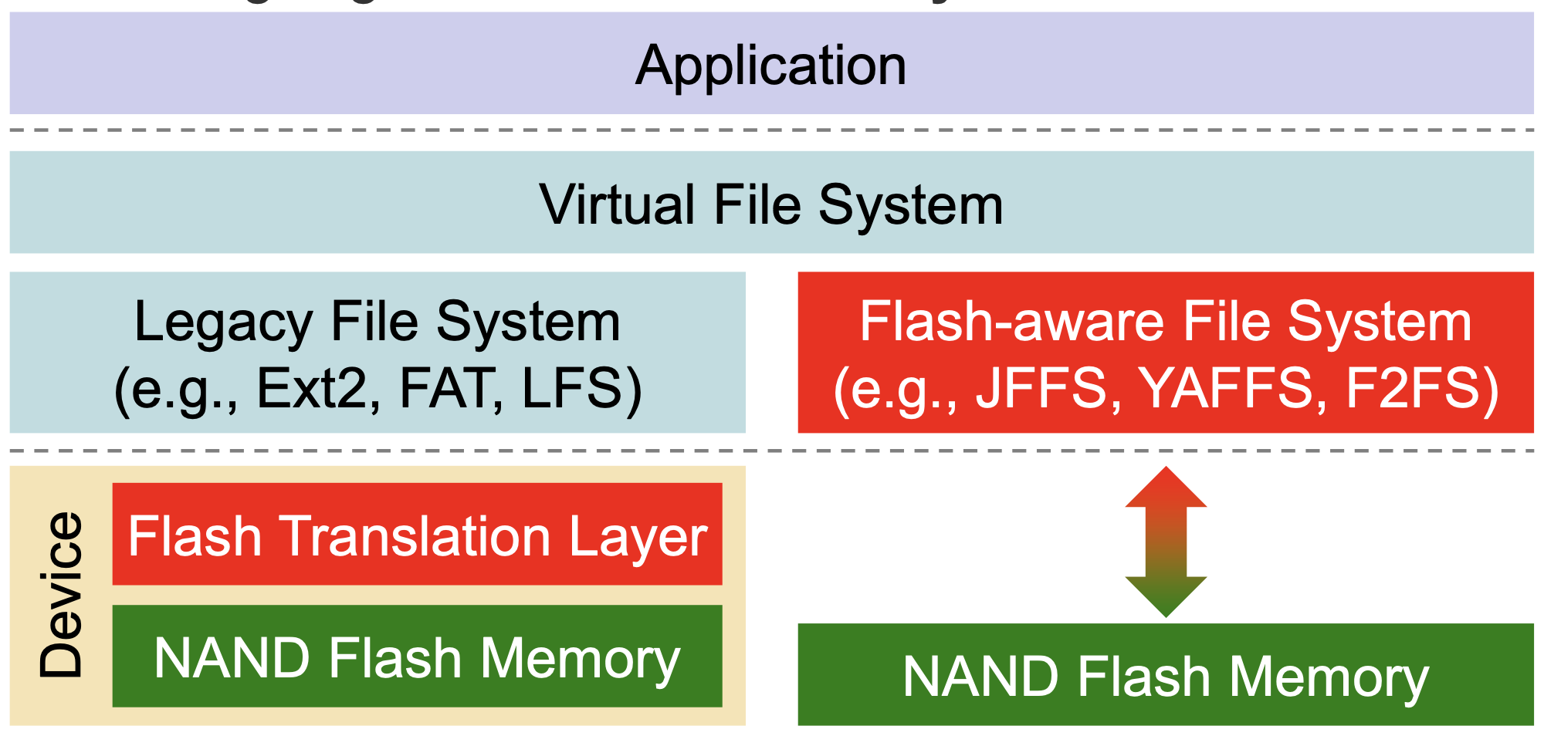
System Architecture
There are two typical ways to address the inherent challenges of flash memory
Implementing a flash translation layer in the device
Designing a flash-aware file system in the host

Slide 11
Flash Translation Layer
Software that makes the SSD look like HDD
Address translation
Program pages within an erased block in order (from low page to high page)
Wear leveling
FTL should try to spread writes across the blocks of the flash
Ensuring that all of the blocks of the device wear out at roughly the same time.
Garbage collection

Slide 12
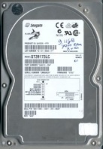
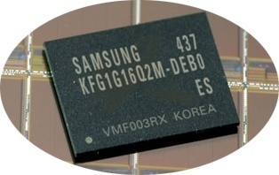
Hard Disk and Flash SSD
File System
File System
Read Sectors
Write Sectors
Read Sectors
Write Sectors
Mismatch!
Read Sectors
Write Sectors
Read
Write
Erase
Device Driver
Device Driver
+
+
Flash Memory
Flash Memory

Slide 13
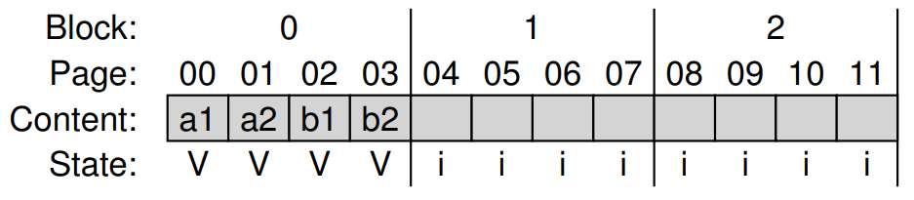

Flash Translation Layer
Append the write to the next free spot in the currently-being-written-to block.

Slide 14
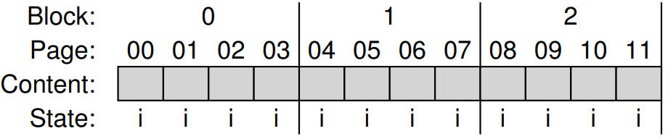

Example
Assume that a page size is 4 Kbyte and a block consists of four pages.
Write(page number)
Write(100) with contents a1
Write(101) with contents a2
Write(2000) with contents b1
Write(2001) with contents b2
The initial state of SSD, with all pages marked INVALID(i).

Slide 15
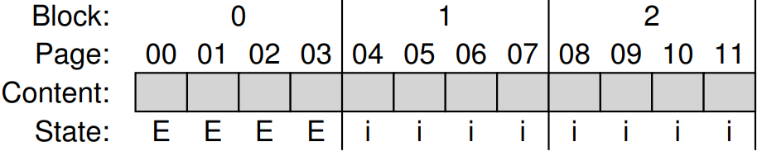
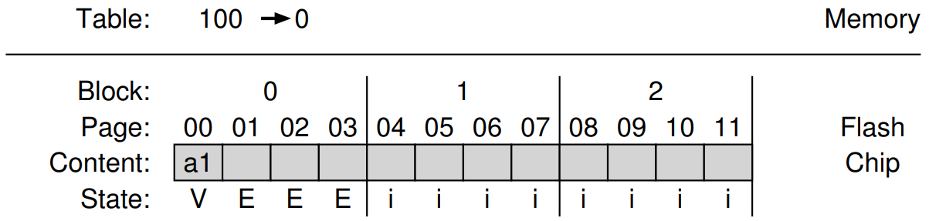
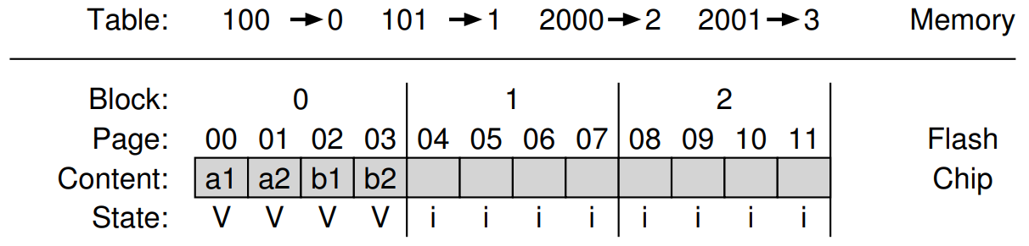
Example
Erase block 0.
Program pages in order and update mapping information (logical block address to physical page address)
After performing four writes.

Slide 16
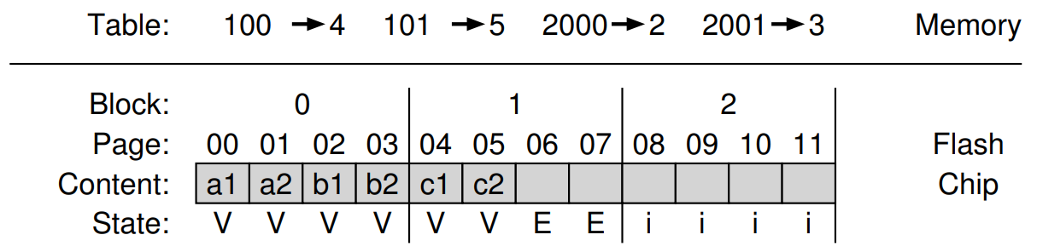

Garbage collection
Update the existing page → old version of data becomes obsolete.
Update logical blocks 100 and 101 with contents c1 and c2.
The pages 0 and 1 in block 0 is old version data and these are called garbage.
These garbage pages must be reclaimed for new writes to take place.
Garbage

Slide 17
Address Translation
Block 125
Block 125
Sec #3045
Sec #3045
Map
Block 125
Map
Page 29
Not Used
(#125, #29)
Block 237
(#237, #4)
Block 237
Page 29
Page 4
Page 4
write
update

Slide 18
Garbage collection
the process of finding garbage blocks and reclaiming them.
Basic process
Find a block that contains one or more garbage pages.
Read in the live(non-garbage) pages from that block.
Write out those live pages to the next writable pages.
Reclaim the entire block for use in writing.

Slide 19
Garbage collection
Update request
for existing data
Find a free page,
and save the new data
This scenario may continue until there
are not enough free blocks
Invalid
Invalid
Invalid
Invalid
Invalid
Invalid
Invalid
Invalid
New Data
Invalid
Invalid
Invalid
Block (A)
Block (A)
Block (A)
Block (B)
Block (C)
Collect valid pages into a free block
Update the map table, and
erase invalid (obsolete) blocks
Invalid
Invalid
Invalid
Invalid
Invalid
Invalid
Invalid
Invalid
Invalid
Invalid
Block (A)
Block (B)
Block (C)
Block (A)
Block (B)
Block (C)

Slide 20
Garbage collection
Garbage collection is expensive
Require reading and rewriting of live data.
Ideal garbage collection is reclamation of a block that consists of only dead pages.
Cost of Garbage Collection
Amount of data blocks that are migrated.
Overprovision the device by adding extra flash capacity→ Cleaning can be delayed.
Run the GC in the background.

Slide 21
Mapping Table Size
Size of page-level mapping table is too large
With a 1TB SSD with a 4byte entry per 4KB page, 1GB of DRAM is needed for mapping.
Some approaches to reduce the costs of mapping
Block-based mapping
Hybrid mapping
Page mapping plus caching

Slide 22
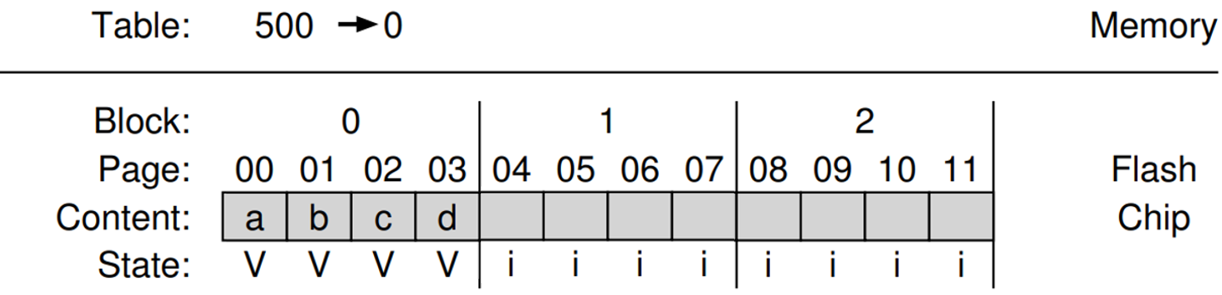

Block Mapping
Mapping at block granularity.
To reduce the size of a mapping table.
Small write problem: When a small write occurs, the FTL must read a large amount of live data from the old block and copy them into a new one.
Logical blocks 2000, 2001, 2002, and 2003 are at the same Flash block (500), and have different offsets (0, 1, 2, and 3).
The FTL records that chunk 500 maps to block 0.

Slide 23
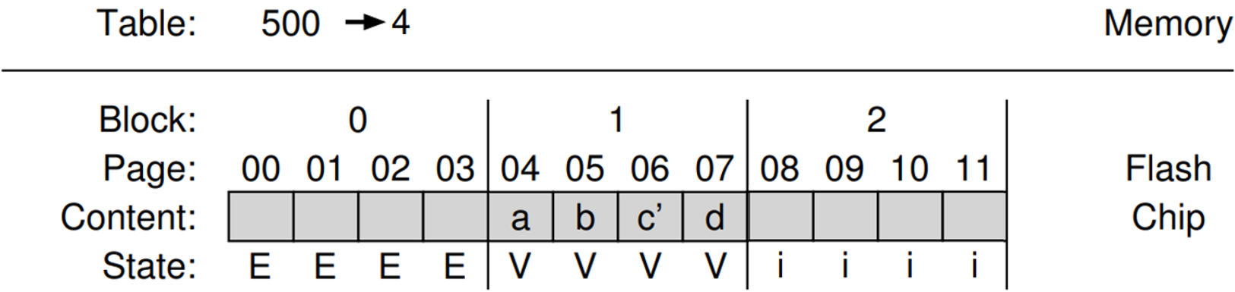
Example
If the logical block 2002 is updated with contents c’,
FTL must read in 2000, 2001, and 2003.
Write out all four logical blocks in a new location.
Update the mapping table.

Slide 24
Hybrid mapping
In hybrid mapping, FTL maintains
Log blocks: page-mapped
Data blocks: block-mapped
Write to log blocks first
When looking for a particular logical block, the FTL will consult the page mapping table and block mapping table in order.
Data Block
Log Block
Write!
Data is written to
the log block
valid
valid
valid
valid

Slide 25
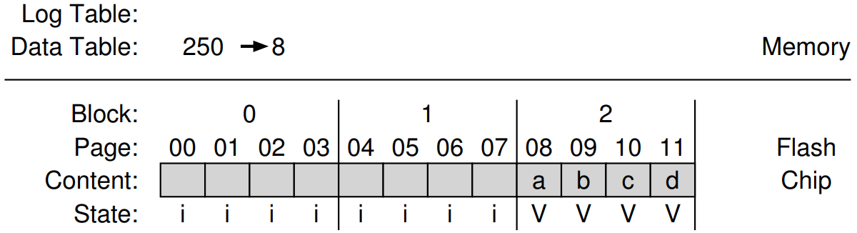
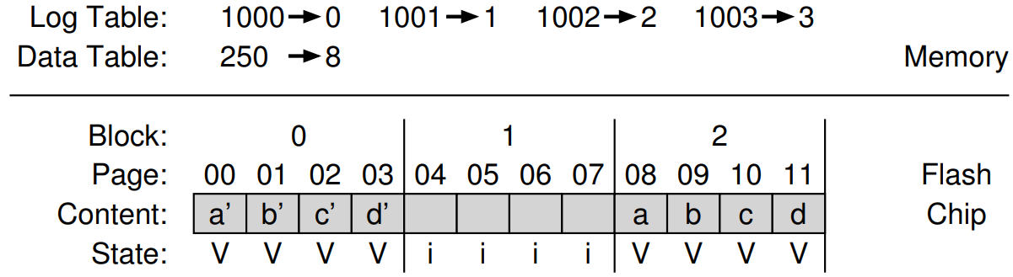
Example
In the following situation,
Update these pages (with data a’, b’, c’, and d’). → write them to the log block. FTL updates the page mapping information.

Slide 26
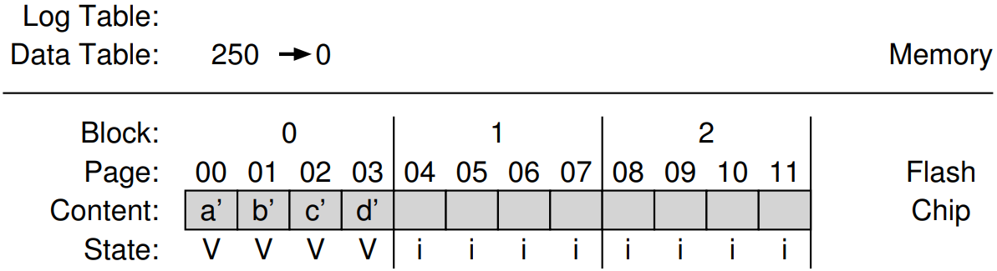
Switch Merge
When log block is full, perform merge.
Switch merge

Slide 27

Switch Merge
Data Block
Data Block
Log Block
valid
valid
valid
valid
valid
valid
valid
valid
Free blocks

Slide 28
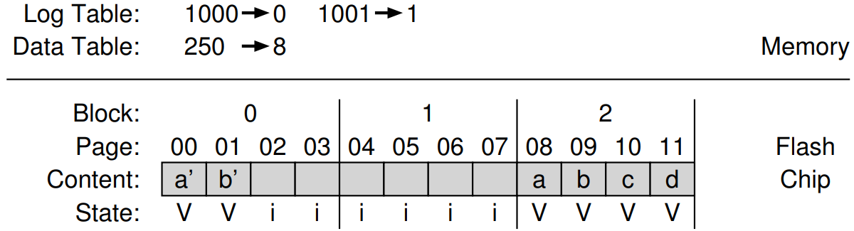

Partial Merge
Client overwrites logical block 1000 and 1001 partially. What happened?
The FTL writes logical block 1000 and 1001(contents a’ and b’) to the available pages in new block.
And then, the FTL appends other live data.

Slide 29
Partial Merge
Data Block
Free Block
Log Block
valid
valid
valid
valid
valid
valid
valid
valid
Free blocks

Slide 30
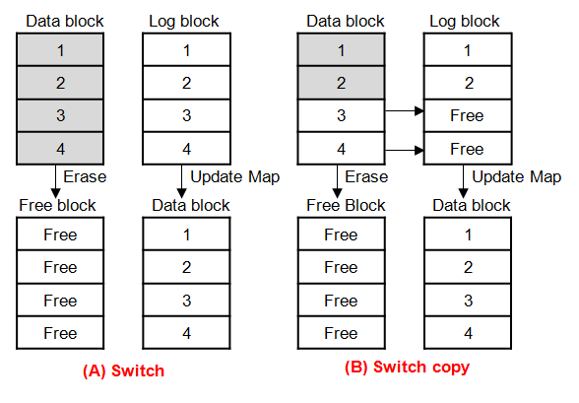
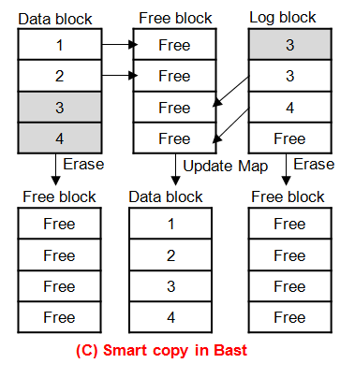
Switch and Merge

Slide 31
Page mapping plus caching
Caching only the active part of the page-mapped FTL in memory.
If a given workload only accesses a small set of pages, the translations of those pages will be stored in the in-memory FTL.
Performance will be excellent without high memory cost.
Cache miss overhead exists.
Memory
Page mapping table
Working set
1000 → 0
1001 → 1
1002 → 2
1003 → 3
1004 → 4
1005 → 5

Slide 32

Wear Leveling
Program/Erase cycle is limited in Flash memory.
If P/E cycle is skewed, that shortens the lifespan of the entire Flash storage.
All blocks should wear out at roughly the same time.
A block may consist of cold data.
The FTL must periodically read all the live data out of such blocks and re-write it elsewhere.
Wear leveling increases the write amplification of the SSD and decreases performance.
Sample Policy: Each Flash Block has a P/E cycle counter.
Maintain |Max(PE cycle) – Min(PE cycle)| < e
Maintain |Max(PE cycle) – Min(PE cycle)|/Max(PE cycle) < e
X
O

Slide 33
Summary
Flash-based SSDs are a common presence in …
laptops, desktops, and servers inside the datacenters.
Flash Translation Layer
Address Translation
Wear Leveling
Garbage Collection

