Slide 1
Operating Systems CSCI 3150
Lecture 11: Memory Management
Part II: Paging

Slide 2
Overview
Paging
Translation lookaside buffer, TLB
Advanced page tables

Slide 3
Paging: Introduction
Notes:
In this lecture, we will explain the basic API’s that deal with the virtual memory.

Slide 4
Concept of Paging
Segmentation divides an address space into variable sizes of segments
Paging splits up an address space into fixed-sized units, or pages
With paging, physical memory is also split into some number of pages called a page frame

Slide 5
Example: A Simple Paging Scheme
128-byte physical memory with 16-byte page frames
64-byte address space with 16-byte pages
0
page frame 0 of physical memory
reserved for OS
16
(unused)
page frame 1
0
32
(page 0 of the address space)
page 3 of AS
page frame 2
16
48
(page 1)
page 0 of AS
page frame 3
32
64
(page 2)
(unused)
page frame 4
48
(page 3)
80
page 2 of AS
page frame 5
64
A Simple 64-byte Address Space
96
(unused)
page frame 6
112
page 1 of AS
page frame 7
128
64-Byte Address Space Placed In Physical Memory

Slide 6
Advantages of Paging
Flexibility: Supporting the abstraction of address space effectively
Don’t need assumption how heap and stack grow and are used.
Simplicity: ease of free-space management
The page in address space and the page frame are the same size.
Easy to allocate and keep a free list

Slide 7
Page table
A page table is needed to translate the virtual address to physical address
So we know where each virtual page is in the physical memory!
In our example, page 0 is in physical frame 3, page 1 in frame 7, page 2 in frame 5, and page 3 in frame 2
Page table is per process
0
reserved for OS
page frame 0 of physical memory
16
(unused)
page frame 1
32
page 3 of AS
page frame 2
48
page 0 of AS
page frame 3
64
(unused)
page frame 4
80
page 2 of AS
page frame 5
96
(unused)
page frame 6
112
page 1 of AS
page frame 7
128

Slide 8
Example: Page Table in Kernel Physical Memory
0
page table
3 7 5 2
page frame 0 of physical memory
16
(unused)
page frame 1
32
page 3 of AS
page frame 2
48
page 0 of AS
page frame 3
64
(unused)
page frame 4
80
page 2 of AS
page frame 5
96
(unused)
page frame 6
112
page 1 of AS
page frame 7
128
Physical Memory

Slide 9
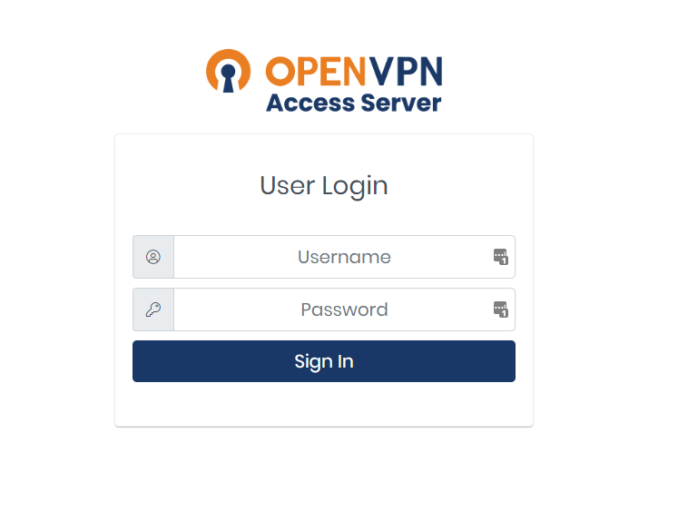
Address Translation
Two components in the virtual address
VPN: virtual page number
Offset: offset within the page
Example: virtual address 21 in a 64-byte address space
(not this one…)
VPN
offset
Va5
Va4
Va3
Va2
Va1
Va0
VPN
offset
0
1
0
1
0
1

Slide 10
Example: Address Translation
The virtual address 21 in 64-byte address space
VPN
offset
Virtual
Address
0
1
0
1
0
1
Address Translation
Physical
Address
1
1
1
0
1
0
1
PFN
offset

Slide 11

Where are Page Tables Stored?
Page tables can get awfully large!
32-bit address space with 4-KB pages, 20 bits for VPN
Page offset for 4 Kbyte pages: 12 bits
${ 2}^{20} entries, \sim 1M, 4 Bytes per page table entry$ => 4MB per process!
Page tables for each process are stored in memory

Slide 12
What Is In The Page Table?
The page table is a data structure that is used to map the virtual address to physical address.
Simplest form: a linear page table, an array
The OS indexes the array by VPN, and looks up the page-table entry (PTE)

Slide 13
Common Flags of Page Table Entry
Valid Bit: Indicating whether the particular translation is valid (unused space)
Protection Bit: Indicating whether the page could be read from, written to, or executed from
Present Bit: Indicating whether this page is in physical memory or on disk (swapped out)
Dirty Bit: Indicating whether the page has been modified since it was brought into memory
Reference Bit (Accessed Bit): Indicating that a page has been accessed

Slide 14

Example: x86 Page Table Entry
31 | 30 | 29 | 28 | 27 | 26 | 25 | 24 | 23 | 22 | 21 | 20 | 19 | 18 | 17 | 16 | 15 | 14 | 13 | 12 | 11 | 10 | 9 | 8 | 7 | 6 | 5 | 4 | 3 | 2 | 1 | 0
PFN
G
PAT
D
A
PCD
PWT
U/S
R/W
P
An x86 Page Table Entry(PTE)
P: present
R/W: read/write bit
U/S: supervisor
A: accessed bit
D: dirty bit
PFN: the page frame number

Slide 15
Paging: Also Too Slow
To find a location of the desired PTE, the starting location of the page table is needed.
For every memory reference, paging requires the OS to perform one extra memory reference

Slide 16
Accessing Memory With Paging
1 // Extract the VPN from the virtual address
2 VPN = (VirtualAddress & VPN_MASK) >> SHIFT
3
4 // Form the address of the page-table entry (PTE)
5 PTEAddr = PTBR + (VPN * sizeof(PTE))
6
7 // Fetch the PTE
8 PTE = AccessMemory(PTEAddr)
9

Slide 17
Accessing Memory With Paging
10 // Check if process can access the page
11 if (PTE.Valid == False)
12 RaiseException(SEGMENTATION_FAULT)
13 else if (CanAccess(PTE.ProtectBits) == False)
14 RaiseException(PROTECTION_FAULT)
15 else
16 // Access is OK: form physical address and fetch it
17 offset = VirtualAddress & OFFSET_MASK
18 PhysAddr = (PTE.PFN << PFN_SHIFT) | offset
19 Register = AccessMemory(PhysAddr)

Slide 18
Translation Lookaside Buffer (TLB)
Notes:
In this lecture, we will explain the basic API’s that deal with the virtual memory.

Slide 19
TLB
Part of the chip’s memory-management unit (MMU).
A hardware cache of popular virtual-to-physical address translation.
TLB
Lookup
MMU
Logical
Address
TLB Hit
Physical
Address
TLB
popular v to p
TLB Miss
CPU
Page Table
all v to p entries
Page 0
Page 1
Page 2
…
Page n
Address Translation with MMU
Physical Memory
Notes:
말그대로 파풀러한 애들을 캐시해주는 거니까 그림이 잘못됬음.

Slide 20
TLB Basic Algorithms
1: VPN = (VirtualAddress & VPN_MASK ) >> SHIFT
2: (Success, TlbEntry) = TLB_Lookup(VPN)
3: if(Success == TRUE){ // TLB Hit
4: if(CanAccess(TlbEntry.ProtectBit) == True ){
5: offset = VirtualAddress & OFFSET_MASK
6: PhysAddr = (TlbEntry.PFN << SHIFT) | Offset
7: AccessMemory(PhysAddr)
8: }else RaiseException(PROTECTION_ERROR)

Slide 21
TLB Basic Algorithms (Cont.)
11: }else{ //TLB Miss
12: PTEAddr = PTBR + (VPN * sizeof(PTE))
13: PTE = AccessMemory(PTEAddr)
14: if(PTE.Valid == False)
RaiseException SEGFAULT) ;
15: else{
16: TLB_Insert( VPN , PTE.PFN , PTE.ProtectBits)
17: RetryInstruction()
18: }
19: }
(11-12 lines) The hardware accesses the page table to find the translation.
(16 lines) updates the TLB with the translation.

Slide 22

Example: Accessing An Array
How a TLB can improve performance
OFFSET 00 04 08 12 16
VPN = 00
VPN = 01
VPN = 03
VPN = 04
VPN = 05
VPN = 06 |  | a[0] | a[1] | a[2]
VPN = 07 | a[3] | a[4] | a[5] | a[6]
VPN = 08 | a[7] | a[8] | a[9]
VPN = 09
VPN = 10
VPN = 11
VPN = 12
VPN = 13
VPN = 14
VPN = 15
0: int sum = 0 ;
1: for(i=0; i<10; i++){
2: sum += a[i];
3: }
First access to a page is a miss, but the subsequent ones are hits
3 misses and 7 hits.
Thus TLB hit rate is 70%.
The TLB improves performance
due to spatial locality

Slide 23
Locality
Temporal Locality
An instruction or data item that has been recently accessed will likely be re-accessed soon again
Spatial Locality
If a program accesses memory at address x, it will likely soon access memory near x.
1st access is page1.
2nd access is also page1.
Page 6
…
Page 1
Page 7
Page 2
Page 3
Page 4
Page 5
Page n
Virtual Memory
1st access is page1.
2nd access is near by page1.
Page 1
Page 2
Page 3
Page 4
Page 5
…
Page n
Virtual Memory

Slide 24
Who Handles The TLB Miss?
Hardware handles the TLB misses entirely on CISC
The hardware has to know exactly where the page tables are located in memory.
The hardware would “walk” the page table, find the correct page-table entry and extract the desired translation, update and retry instruction.
hardware-managed TLB.
Intel x86
RISC has what is known as a software-managed TLB
On a TLB miss, the hardware raises an exception (trap handler)
Trap handler is code within the OS that is written with the express purpose of handling TLB miss.

Slide 25
TLB Control Flow algorithm (OS Handled)
1: VPN = (VirtualAddress & VPN_MASK) >> SHIFT
2: (Success, TlbEntry) = TLB_Lookup(VPN)
3: if (Success == True) // TLB Hit
4: if (CanAccess(TlbEntry.ProtectBits) == True)
5: Offset = VirtualAddress & OFFSET_MASK
6: PhysAddr = (TlbEntry.PFN << SHIFT) | Offset
7: Register = AccessMemory(PhysAddr)
8: else
9: RaiseException(PROTECTION_FAULT)
10: else // TLB Miss
11: RaiseException(TLB_MISS)

Slide 26
TLB entry
TLB is managed by fully-associative* method.
A typical TLB has 32, 64, or 128 entries.
Hardware searches the entire TLB in parallel to find the desired translation.
Other bits: valid bits, protection bits, address-space identifier, dirty bit
VPN
PFN
Other bits
*More on cache associativity: http://csillustrated.berkeley.edu/PDFs/handouts/cache-3-associativity-handout.pdf

Slide 27
TLB Issue: Context Switching
Page 0
Page 1
Process A
Page 2
Insert TLB Entry
access VPN10
…
Page n
TLB Table
Virtual Memory
VPN | PFN | valid | prot
10 | 100 | 1 | rwx
- | - | - | -
- | - | - | -
- | - | - | -
Page 0
Process B
Page 1
Page 2
…
Page n
Virtual Memory
Notes:
현재 프로세스 A, B의 주소공간을 가상공간으로 변경 예정

Slide 28
TLB Issue: Context Switching
Page 0
Page 1
Process A
Page 2
…
Page n
TLB Table
Virtual Memory
VPN | PFN | valid | prot
10 | 100 | 1 | rwx
- | - | - | -
10 | 170 | 1 | rwx
- | - | - | -
Context
Switching
Page 0
Process B
access VPN10
Page 1
Page 2
Insert TLB Entry
…
Page n
Virtual Memory
Notes:
현재 프로세스 A, B의 주소공간을 가상공간으로 변경 예정

Slide 29
TLB Issue: Context Switching
Page 0
Page 1
Process A
Page 2
…
Page n
TLB Table
Virtual Memory
VPN | PFN | valid | prot
10 | 100 | 1 | rwx
- | - | - | -
10 | 170 | 1 | rwx
- | - | - | -
Page 0
Process B
Page 1
Page 2
…
Can’t Distinguish which entry is
meant for which process
Page n
Virtual Memory
Notes:
현재 프로세스 A, B의 주소공간을 가상공간으로 변경 예정

Slide 30
Solution
Add an address space identifier (ASID) field in the TLB
Page 0
Page 1
Process A
Page 2
…
TLB Table
Page n
VPN | PFN | valid | prot | ASID
10 | 100 | 1 | rwx | 1
- | - | - | - | -
10 | 170 | 1 | rwx | 2
- | - | - | - | -
Virtual Memory
Page 0
Process B
Page 1
Page 2
…
Page n
Virtual Memory

Slide 31
Another Case
Two processes share a page
Process 1 is sharing physical frame 101 with Process 2.
P1 maps this frame into the 10th page of its address space.
P2 maps this frame to the 50th page of its address space.
VPN | PFN | valid | prot | ASID
10 | 101 | 1 | rwx | 1
- | - | - | - | -
50 | 101 | 1 | rwx | 2
- | - | - | - | -
Sharing of pages is useful as it reduces the number of physical pages/frames in use.

Slide 32
On the side: ASID vs. PID
ASID seems very similar to PID right?
To distinguish processes
They are related, yes
Can you just use PID then?
Obviously no (otherwise it won’t be called ASID…)
ASID (hardware) uses much fewer bits than PID (OS)
How to use ASID when the PID space is much bigger?
https://stackoverflow.com/questions/52813239/how-many-bits-there-are-in-a-tlb-asid-tag-for-intel-processors-and-how-to-handl
Caveat: ASID is only needed when the process is active (from TLB’s perspective)

Slide 33
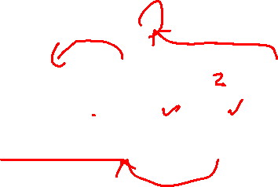
TLB Replacement Policy
Least Recently Used, LRU
Evict an entry that has not recently been used
Take advantage of locality in the memory-reference stream.
Reference Row
7
0
1
2
0
3
0
4
2
3
0
3
2
1
2
0
1
7
7
7
2
7
4
4
4
0
1
1
Page Frame:
0
0
0
0
0
0
3
3
3
0
1
1
3
3
2
2
2
2
2
Total 11 TLB miss

Slide 34
A Real TLB Entry
All 64 bits of this TLB entry (example of MIPS R4000)
0 1 2 3 4 5 6 7 8 9
10 11 … 19 … 31
VPN
G
ASID
PFN
C
D
V
Flag | Content
19-bit VPN | The rest reserved for the kernel.
24-bit PFN | Systems can support with up to 64GB of main memory( pages ).
Global bit(G) | Used for pages that are globally-shared among processes.
ASID | OS can use to distinguish between address spaces.
Coherence bit(C) | determine how a page is cached by the hardware.
Dirty bit(D) | marking when the page has been written.
Valid bit(V) | tells the hardware if there is a valid translation present in the entry.

Slide 35
Advanced Page Tables
Notes:
In this lecture, we will explain the basic API’s that deal with the virtual memory.

Slide 36

Paging: Linear Tables
We usually have one page table for every process in the system.
Assume 32-bit address space with 4KB pages and 4-byte page-table entry.
4B
entry
4KB
Page 0
entry
entry
Page 1
…
Page 2
…
entry
Page n
Page Table of
Process A
Physical Memory
Page table size = $\frac{2^{32}}{2^{12}}∗4Byte=4MByte$
Page table are too big and thus consume too much memory.
Notes:
여백 감소 페이지 사이의 간격을 없애기.

Slide 37
Paging: Smaller Tables
Page tables are too big and thus consume too much memory.
Assume that 32-bit address space with 16KB pages and 4-byte page-table entry.
4B
entry
16KB
Page 0
entry
entry
Page 1
…
Page 2
…
entry
Page n
Page Table of
Process A
Physical Memory
$\frac{2^{32}}{2^{16}}∗4=1MB$ per page table
Big pages lead to internal fragmentation.
Notes:
여백 감소 페이지 사이의 간격을 없애기.

Slide 38
Problem
Single page table for the address space of process.
Virtual Address
Space
Physical Memory
0
1
2
3
4
5
6
7
8
9
10
11
12
13
14
15
16
17
18
19
20
21
22
23
24
25
PFN | valid | prot | present | dirty
10 | 1 | r-x | 1 | 0
- | 0 | - | - | -
- | 0 | - | - | -
- | 0 | - | - | -
15 | 1 | rw- | 1 | 1
… | … | … | … | …
- | 0 | - | - | -
3 | 1 | rw- | 1 | 1
23 | 1 | rw- | 1 | 1
code
 | 0
 | 1
 | 2
 | 3
 | 4
 | 5
 | 6
 | 7
 | 8
 | 9
 | 10
 | 11
 | 12
 | 13
 | 14 15
Allocate
heap
A Page Table For 16KB Address Space
stack
A 16KB Address Space with 1KB Pages

Slide 39
Problem
Most of the page table is unused, full of invalid entries.
Virtual Address
Space
Physical Memory
0
1
2
3
4
5
6
7
8
9
10
11
12
13
14
15
16
17
18
19
20
21
22
23
24
25
 | 0
 | 1
 | 2
 | 3
 | 4
 | 5
 | 6
 | 7
 | 8
 | 9
 | 10
 | 11
 | 12
 | 13
 | 14 15
PFN | valid | prot | present | dirty
9 | 1 | r-x | 1 | 0
- | 0 | - | - | -
- | 0 | - | - | -
- | 0 | - | - | -
15 | 1 | rw- | 1 | 1
… | … | … | … | …
- | 0 | - | - | -
3 | 1 | rw- | 1 | 1
23 | 1 | rw- | 1 | 1
code
Allocate
heap
A Page Table For 16KB Address Space
stack
A 16KB Address Space with 1KB Pages

Slide 40
Hybrid Approach: Paging and Segments
Page table for each segment
The base register for each of these segments contains the physical address of a linear page table for that segment.
The bound register: indicate the end of the page table.
Example: Each process has three page tables associated with it.
31 30 29 28 27 26 25 24 23 22 21 20 19 18 17 16 15 14 13 12 11 10 9 8 7 6 5 4 3 2 1 0
Seg
VPN
Offset
32-bit virtual address space with 4KB pages
Seg value | Content
00 | unused segment
01 | code
10 | heap
11 | stack

Slide 41
TLB miss on Hybrid Approach
The hardware gets physical address from page table.
The hardware uses the segment bits (SN) to determine which base-and-bounds pair to use.
The hardware then takes the physical address therein and combines it with the VPN as follows to form the address of the page table entry (PTE)
01: SN = (VirtualAddress & SEG_MASK) >> SN_SHIFT
02: VPN = (VirtualAddress & VPN_MASK) >> VPN_SHIFT
03: AddressOfPTE = Base[SN] + (VPN * sizeof(PTE))

Slide 42
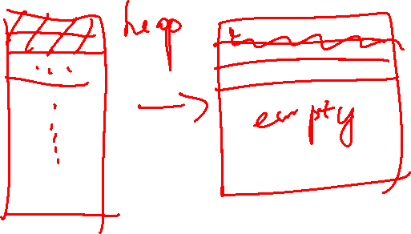
Problem of the Hybrid Approach
Hybrid approach is not without problems.
If we have a large but sparsely-used heap, we can still end up with a lot of page table waste.
Causing external fragmentation, again!

Slide 43
Multi-Level Page Tables
Turn the linear page table into something like a tree.
Chop up the page table into page-sized units.
If an entire page of page-table entries is invalid, don’t allocate that page of the page table at all.
To track whether a page of the page table is valid, use a new structure, called page directory.

Slide 44
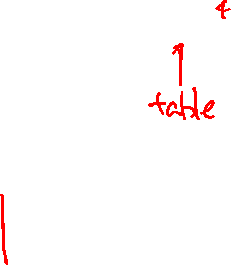

Multi-level Page Tables
Linear Page Table
PTBR
201
Multi-level Page Table
prot
PDBR
200
valid
1 | rx | 12
1 | rx | 13
0 | - | -
1 | rw | 100
0 | - | -
0 | - | -
0 | - | -
0 | - | -
0 | - | -
0 | - | -
0 | - | -
0 | - | -
PFN
valid
valid
prot
PFN
PFN201
PFN
1 | 201
0 | -
0 | -
1 | 203
1 | rx | 12
1 | rx | 13
0 | - | -
1 | rw | 100
PFN200
PFN201
PFN202
The Page Directory
[Page 1 of PT: Not Allocated]
PFN203
[Page 2 of PT: Not Allocated]
0 | - | -
0 | - | -
1 | rw | 86
1 | rw | 15
0 | - | -
0 | - | -
1 | rw | 86
1 | rw | 15
PFN204
PFN204

Slide 45
Multi-level Page Tables
Page Directory
The page directory contains one entry per page of the page table.
It consists of a number of entries, i.e. page directory entries (PDE).
A PDE has a valid bit and page frame number (PFN).
Advantage
Only allocates page-table space in proportion to the amount of address space you are using.
The OS can grab the next free page when it needs to allocate or grow a page table.
Disadvantage
Multi-level table is a small example of a time-space trade-off.
Complexity.

Slide 46
On-the-side: Indirection
Does this remind you of something familiar?
Adding another table for a table => adding another level of indirection
All problems in computer science can be solved by another level of indirection.
- David Wheeler

Slide 47

Example
code
code
(free)
(free)
heap
heap
(free)
(free)
stack
stack
Page 0,1: code
Page 4,5: heap
Page 254, 255: stack
0000 0000
0000 0001
...
0000 0100
0000 0101
…..
1111 1110
1111 1111

Slide 48
Example
Flag | Detail
Address space | 16 KB (2^14 Byte)
Page size | 64 B
Virtual address | 14 bit
VPN | 8 bit
Offset | 6 bit
Page table entry | 4 Byte
A 16-KB Address Space With 64-byte Pages
13 | 12 | 11 | 10 | 9 | 8 | 7 | 6 | 5 | 4 | 3 | 2 | 1 | 0
VPN
Offset
Single level paging
256 page table entries: 2^8 entries
Page table size: 256 * 4 Byte = 1 Kbyte
Page table needs 16 pages of physical memory (64B each): 1024/64 = 16

Slide 49
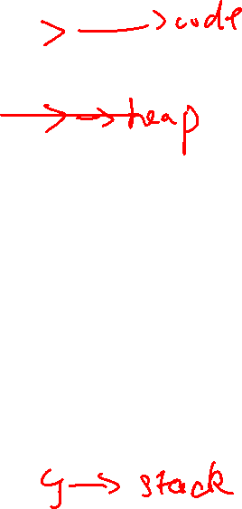
Example: single level page table
PFN: 10
PFN: 23
Page 0
16 entries
PFN: 80
PFN: 59
2^8 page table entries
Page 1
. . .
Page 15
PFN: 55
PFN: 45

Slide 50
Example: two level paging
Page directory index
The page table has 16 pages.
16 entries for page directory: one entry per page of the page table.
16*4B = 64B is required for page directory. → One page
4 bits for page directory index.
PDEAddr = PageDirBase + (PDIndex * sizeof(PDE))
If the page-directory entry is invalid, raise an exception (The access is invalid).
Page Directory Index
13 | 12 | 11 | 10 | 9 | 8 | 7 | 6 | 5 | 4 | 3 | 2 | 1 | 0
VPN
Offset

Slide 51

Example: two level paging
Page Table pages
16 entries
Page 0
Page page directory
16 entries
Page 1
16 entries
16 entries
Page 2
16 entries
Page 15

Slide 52
Example: Page Table Index
Page table index
It is used to find the address of the page table entry.
PTEAddr = (PDE.PFN << SHIFT) + (PTIndex * sizeof(PTE))
Page Directory Index
Page Table Index
13 | 12 | 11 | 10 | 9 | 8 | 7 | 6 | 5 | 4 | 3 | 2 | 1 | 0
VPN
Offset
14-bits Virtual address

Slide 53
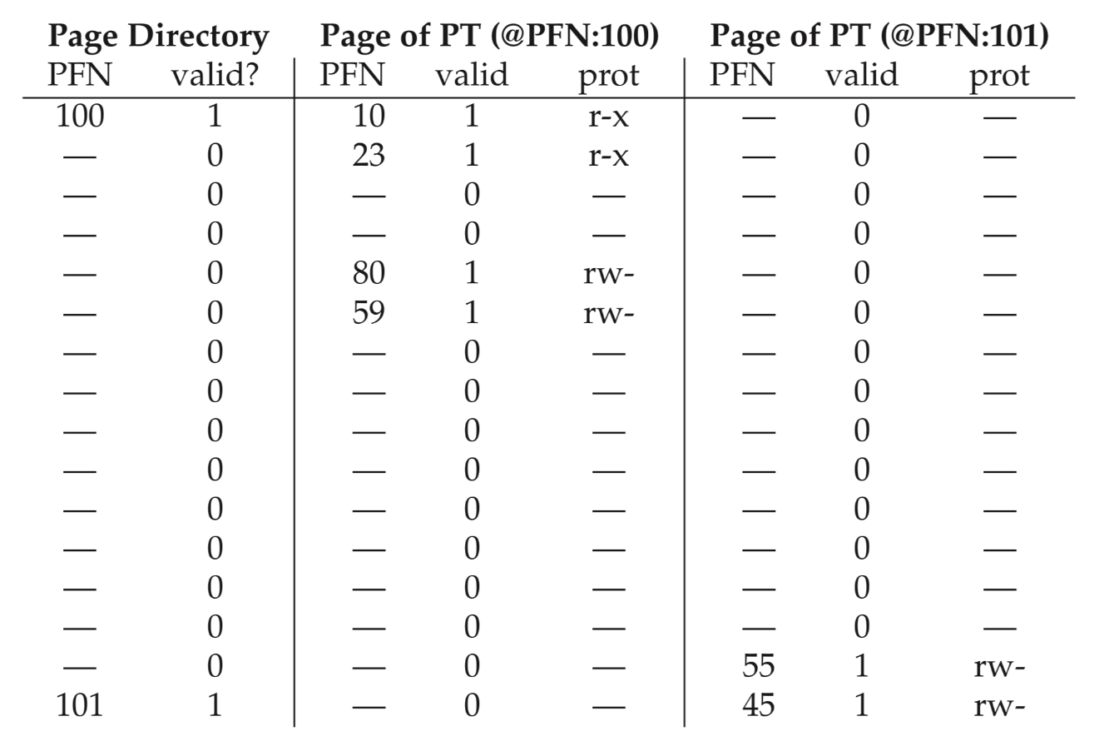
Examples
code
PFN: 10
PFN: 23
heap
PFN: 80
PFN: 59
Single level paging: 16 pages
→ Two level paging: 3 pages
stack
PFN: 55
PFN: 45

Slide 54
Multi-level Page Table Control Flow
01: VPN = (VirtualAddress & VPN_MASK) >> SHIFT
02: (Success,TlbEntry) = TLB_Lookup(VPN)
03: if(Success == True) //TLB Hit
04: if(CanAccess(TlbEntry.ProtectBits) == True)
05: Offset = VirtualAddress & OFFSET_MASK
06: PhysAddr = (TlbEntry.PFN << SHIFT) | Offset
07: Register = AccessMemory(PhysAddr)
08: else RaiseException(PROTECTION_FAULT);
09: else // perform the full multi-level lookup
(1 lines) extract the virtual page number (VPN)
(2 lines) check if the TLB holds the translation for this VPN
(5-8 lines) extract the page frame number from the relevant TLB entry, and form the desired physical address and access memory

Slide 55
Multi-level Page Table Control Flow
11: else
12: PDIndex = (VPN & PD_MASK) >> PD_SHIFT
13: PDEAddr = PDBR + (PDIndex * sizeof(PDE))
14: PDE = AccessMemory(PDEAddr)
15: if(PDE.Valid == False)
16: RaiseException(SEGMENTATION_FAULT)
17: else // PDE is Valid: now fetch PTE from PT
(11 lines) extract the Page Directory Index(PDIndex)
(13 lines) get Page Directory Entry(PDE)
(15-17 lines) Check PDE valid flag. If valid flag is true, fetch Page Table entry from Page Table

Slide 56
The Translation Process: Remember the TLB
18: PTIndex = (VPN & PT_MASK) >> PT_SHIFT
19: PTEAddr = (PDE.PFN << SHIFT) + (PTIndex * sizeof(PTE))
20: PTE = AccessMemory(PTEAddr)
21: if(PTE.Valid == False)
22: RaiseException(SEGMENTATION_FAULT)
23: else if(CanAccess(PTE.ProtectBits) == False)
24: RaiseException(PROTECTION_FAULT);
25: else
26: TLB_Insert(VPN, PTE.PFN , PTE.ProtectBits)
27: RetryInstruction()

Slide 57
Inverted Page Tables
Keeping a single page table that has an entry for each physical page of the system.
The entry tells us which process is using this page, and which virtual page of that process maps to this physical page.

