Slide 1
Tutorial 9 Assignment 3 Preliminaries and Hints
Tutor: Luo Qin
qluo22@cse.cuhk.edu.hk

Slide 2
Assignment Overview
There would be two parts in Assignment 3.
Part 1 Madatory Part (100 marks)
You are required to complete this part.
A written problem (Problem 1) and a programming problem (Problem 2)
Part 2 Bonus Part (20 marks)
We would consider the marks added in your final grade of the course if you do it.
A case study problem
DDL: 00:00:00 am, Apr 17th (Mon)

Slide 3
Hints about Problem 1
Written Problem about address translation
You need to review the segmentation and multi-level paging
The concept about the word addressing
word: the unit of data used by a particular processor design
word length = the width of the data bus
32-bit machine, the word length is 32 bit (4 bytes, 1 byte = 8 bit)
addressing: The bits of a data could be stored in a physical address
The capacity of memory with one physical address is usually the times of bytes
Word addressing and byte addressing

Slide 4
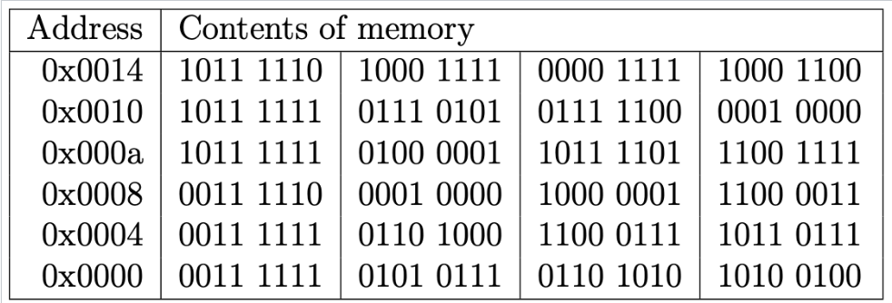
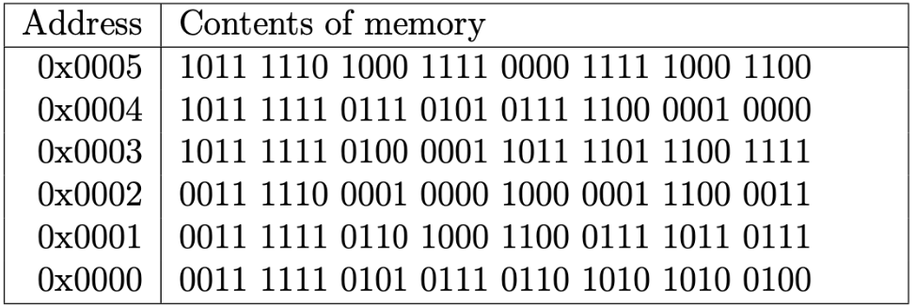
Hints about Problem 1
Word Addressing v.s. Byte Addressing
32-bit machine (Word Length: 32 bit)
Byte Addressing
Word Addressing

Slide 5
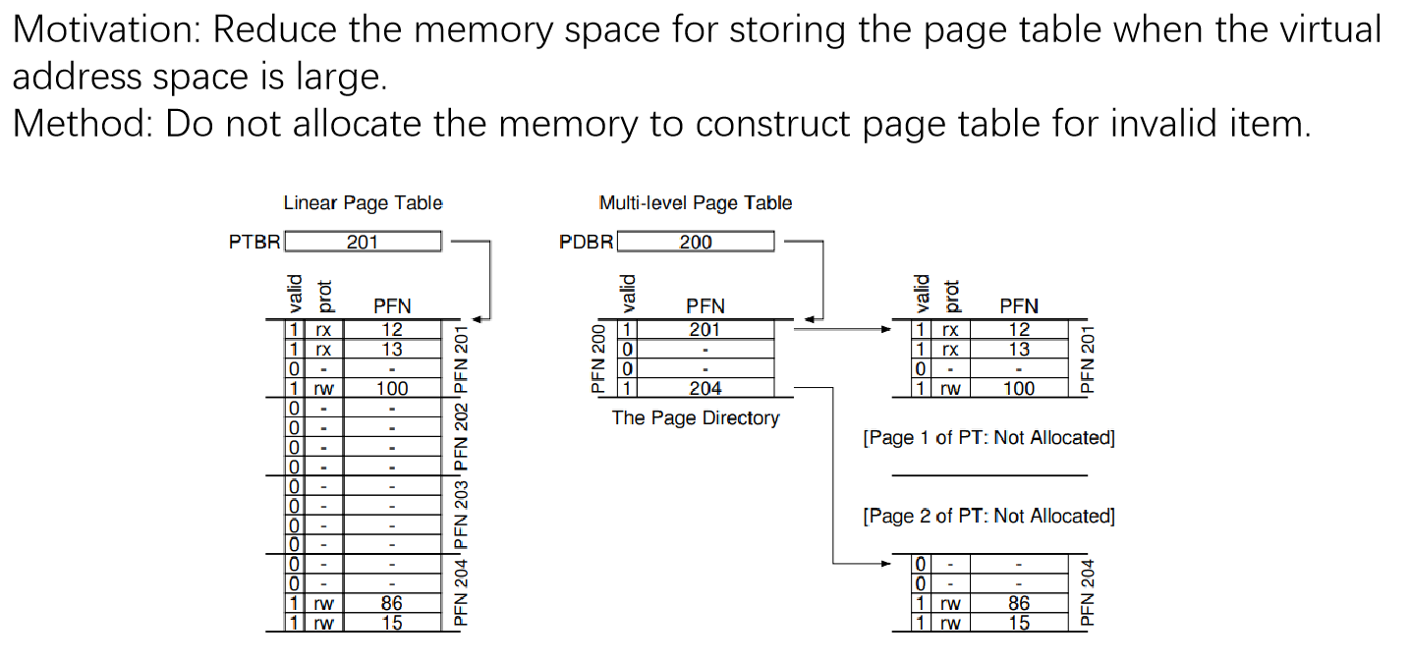
Hints about Problem 1
Multi-level Page Table

Slide 6
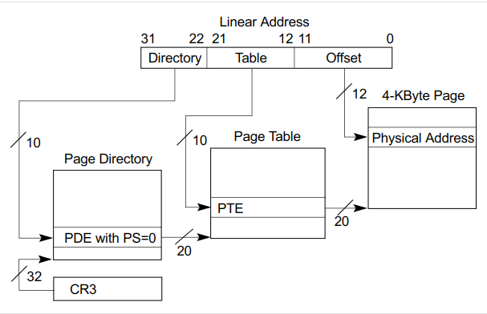
Hints about Problem 1
The two level page table in x86 and x86-64 (32-bit machine)
10
10
12

Slide 7
Hints about Problem 2
Programming problem about FIFO and LRU policies
Why important? Used in swapping, TLB hit, and some cache algorithms
Requirements:
Using the Singly Linked List to represent FIFO and LRU cache
Extra Array to record the order or the recency of the elements in cache is
not allowed
The status of FIFO and LRU cache should be recorded and reported after every visiting, and the times of the Page missing (Page fault) should be reported at the end.
We provide a framework for you to implement
It is better to use it.
But you could ignore it and implement on your own, but your implementation should satisfy the above requirements. Besides, you should add a Readme file for me how to compile and run your file.

Slide 8
Hints about Problem 2
Brief Review about FIFO and LRU algorithm
Reference Row: 1 2 3 1 4 1 3
FIFO (First-in First-come)
1 | 1 | 1 | 1 | 2 | 3 | 3
 | 2 | 2 | 2 | 3 | 4 | 4
 |  | 3 | 3 | 4 | 1 | 1
Page Fault (Missing) Times: 5
LRU (Least Recently Used)
1 | 1 | 1 | 2 | 3 | 3 | 4
 | 2 | 2 | 3 | 1 | 4 | 1
 |  | 3 | 1 | 4 | 1 | 3
Page Fault (Missing) Times: 4

Slide 9
Hints about Problem 2
How to implement FIFO and LRU?
Three cases to be considered
If the visited page hits, then?
If the cache is not full, then?
If the cache is full, then?
Data structure used for implementation of LRU
FIFO: queue structure
LRU:
Use array to mark the recency of the page in cache
Potential overflow of the recency value if the page is not hitted.
Use linked list and move the recent hitted page at the head or tail of the linked list
Use linked list and the hash map (improve the timing complexity of finding the existence of page in cache)

Slide 10
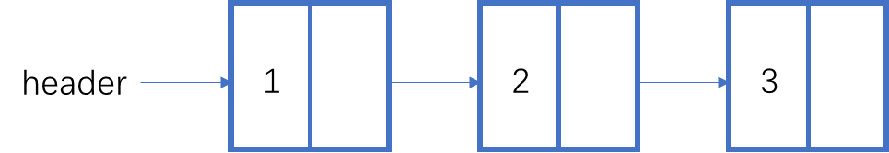
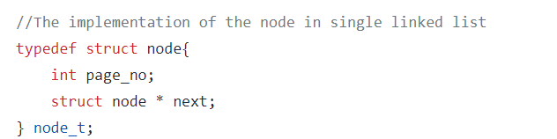
Hints about Problem 2
Review of the Singly linked list
page_no
next
Three operations:
Find a node in the singly linked list
Insert a node into the singly linked list
Delete a node in the singly linked list
Hints: Please have a review of these operations
about singly linked list in your data structure coarse.
node.h

Slide 11
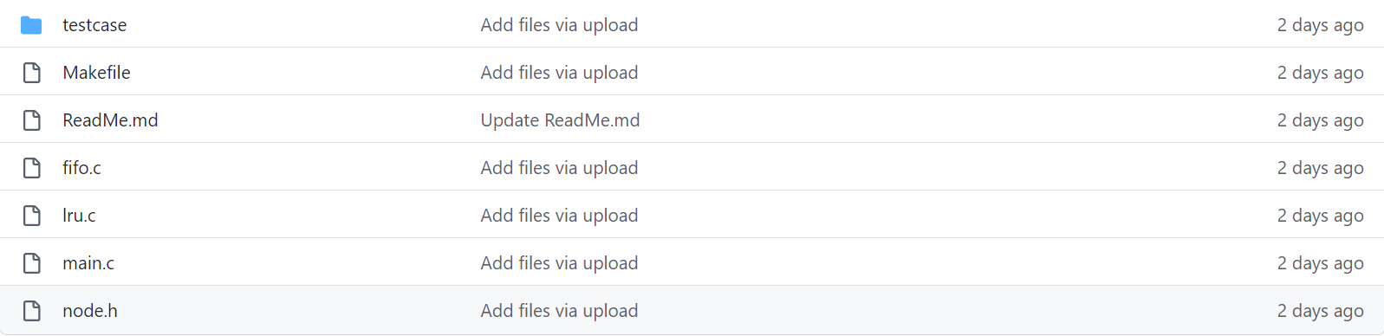
Hints about Problem 2
Code Walk
Node.h: Definition of the node in the linked list
fifo.c & lru.c Your implementation of the FIFO and LRU algorithm
main.c File I/O, visualize the status of the cache and calculate the page missing
Makefile

Slide 12
Hints about Problem 2
Code Walk
fifo.c & lru.c
int FIFO_cache_put(int Newpageno, node_t **head_fifo, int cache_capacity)
int LRU_cache_put(int Newpageno, node_t **head_lru, int cache_capacity)
Paremeters:
Newpageno：The page number intended to be accessed.
head_fifo, head_lru: The pointer pointing at the header of FIFO and LRU cache
(Why double pointer? May need to change the header of FIFO and LRU cache in these two functions.)
cache_capacity: The capacity of the FIFO and LRU cache
Reture Value:
Whether the page is missed, 1-misses 0-hits

Slide 13

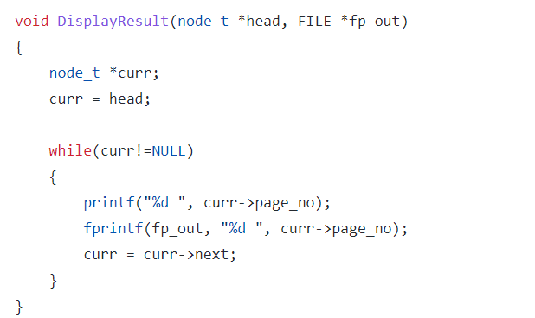
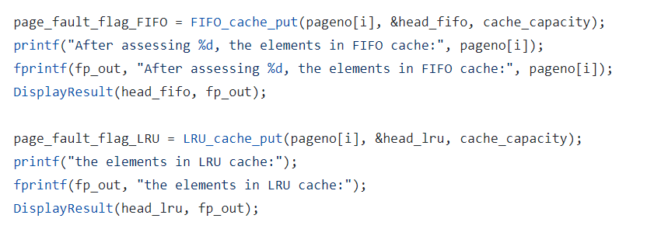
Hints about Problem 2
Code Walk
main.c
report the status of cache after assessing each page in the reference row and calculate the total number of
missing pages
The header of FIFO and LRU cache
Display the status of the cache

Slide 14
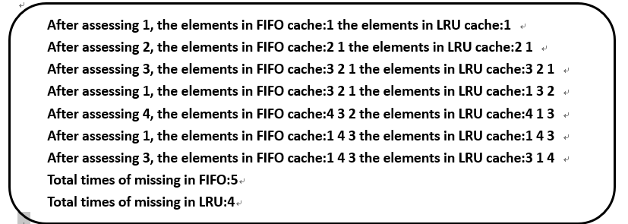

Hints about Problem 2
Testcase
2 testcases are provided for you to check your implementation
<cache capacity>
<number of pages K>
<visited page number 1>, <visited page number 2>, …, <visited page number K>
For example, testcase for the example in page 8 of this ppt
testcase
output for the testcase

Slide 15
Hints about Problem 2
How to compile and run
Use “make” command to compile
Use the following command to run:
./main -in_file <in_file> -out_file <out_file>
For example, if we want to run testcase1
./main -in_file ./testcase/case1.txt -out_file ./testcase/case1_out.txt

Slide 16
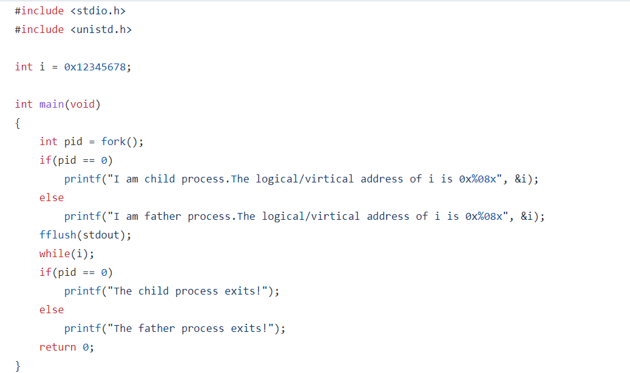
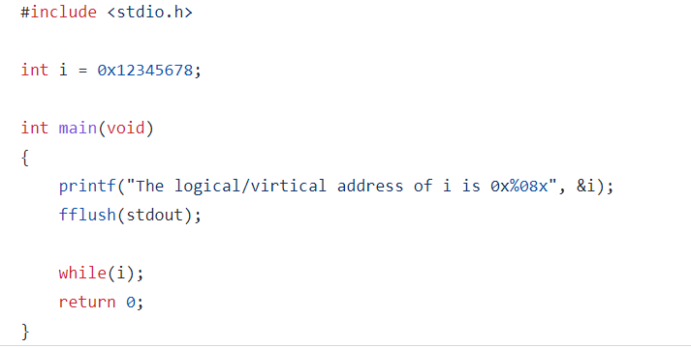
Hints about Bonus Part
Initialize ‘i’ with non-zero value, but when it meets while(i), there would be infinite loop
Objective: Look into the os kernel. Find the physical address of variable ‘i’ and make its value zero to
terminate the indefinite loop.
How to get physical address: Firstly calculate logical address using segmentation and physical address
Using paging
test.c
Single Process
Example in this Tutorial
homework.c
Multi Processes
Example in Assignement 3

Slide 17
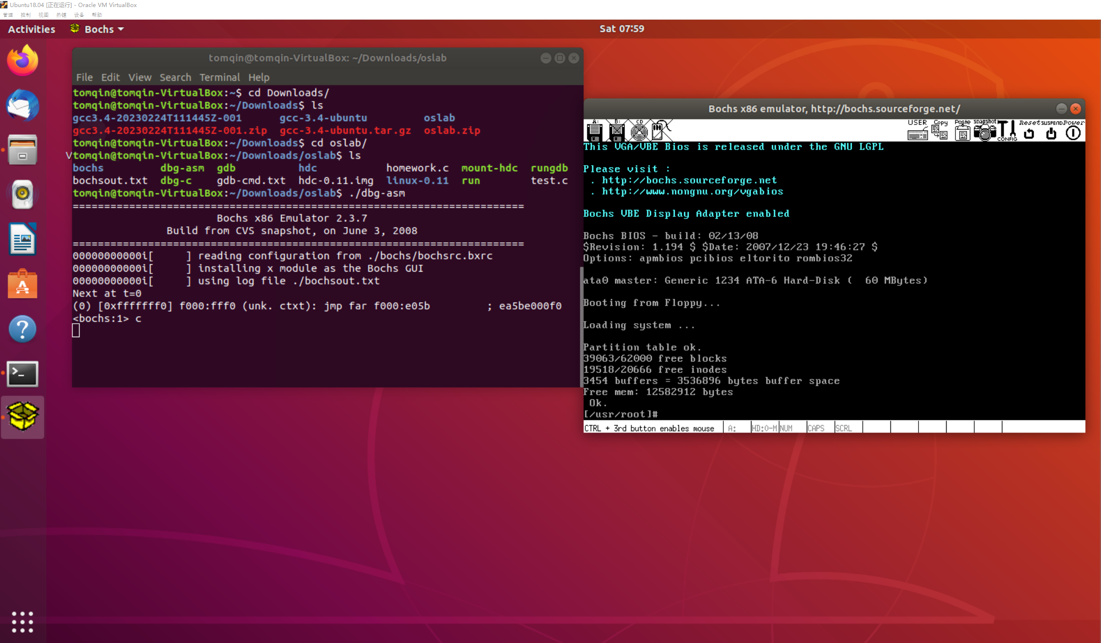
Hints about Bonus Part
Environment Setting (Required)
VirtualBox + Ubuntu-18.04
g++3.4 & gcc 3.4
Bochs IA-32 Emulation Platform
Linux-0.11 source code (oslab code)
The setup instruction of the lab environment
would be in Enviorment_Setup_Instructions.pdf
Bochs IA-32 Emulation : x86 PC emulator to run
the linux-0.11

Slide 18
Hints about Bonus Part
Some useful commands in Bochs IA-32
Ctrl+C and c
Ctrl+c means pausing the program and it would show what it executes before pausing. c means continuing running the program from the place where the program is paused by Ctrl+c.
sreg
sreg is the command used for seeing the status of the segment registers. It is used for finding the base address and the size of the segment.
creg
creg is the command used for seeing the status of the control registers, like cr0-cr3. cr3 stores the starting address of the page directory.
xp
xp is command used for seeing the contents in the memory cells with the given physical address.
setpmem
setpmem is command used for setting the corresponding memory cell with the given number.
You could refer to Enviorment_Setup_Instructions.pdf to see how to use it.

Slide 19
Hints about Bonus Part
Demo for the journey of ‘i’. (Stop the indefinite loop in test.c using
address translation)
Zoom link: https://cuhk.zoom.us/rec/share/YiSXwJu47YbBeE5K7aqwNRm0SzZ1RCo7oPHwwgY297Icq9GWOfUFxGMHNywxIhUh.ymrIjNPCrpbr8aYm?startTime=1679493977000
Password: NECKA2c?

Slide 20
Any Questions?

