Slide 1
Tutorial 11: FAT File System
CSCI3150 Introduction to Operating Systems, Fall 2024
Yang, Yitao
Nov 28, 2024
Notes:
Slide 1: Introduction "Good afternoon, everyone! Today, we will dive into FAT File System , an essential part of understanding how conventional operating systems handle file storage and management. This is Tutorial 12 for our Operating Systems course, CSCI3150.

Slide 2
Reminder
Assignement 4
Due at 6:00:00 p.m., Mon, Dec 9nd
Notes:
Before we dive into today's topic, I'd like to remind you that Assignment 4 is due on December 9th at 6 p.m. Please ensure you've reviewed the requirements and managed your time well to submit on time. Now, let’s move on to today’s tutorial.

Slide 3
File and Directory

Slide 4
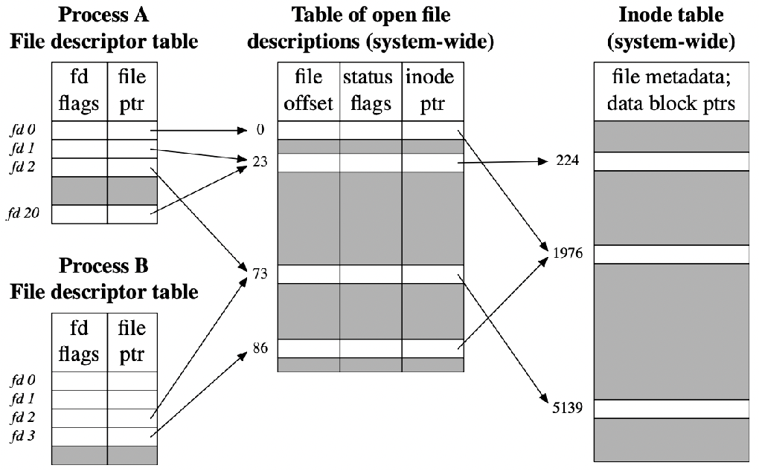
Overall Organization
File and Directory is the abstract of the hard disk drive and I/O.
File
One file occupy several clusters (data blocks)
inode: a data structure that describes a FS object
Directory
A file
A list of <user-readable filename, low-level name> pairs
Directory Entry
the logical unit in a directory file. A directory file has one or multiple directory entries. A directory entry is the metadata
of a file and could point to a file or another directory file.
Notes:
Today, we’ll begin by discussing the basic concepts of files and directories.
A file is an abstract representation of data stored on the disk, and it can occupy multiple clusters.
The inode is a critical data structure that provides information about the file.
Directories, on the other hand, are special types of files that store lists of filename and low-level name pairs.
Each entry in a directory is a metadata unit pointing to a file or another directory.
This organization allows the file system to maintain a clear and efficient structure for accessing data."

Slide 5
FAT Overview
Simple - and common - file system
Found on all Windows OS and many devices
FAT12: Developed 1977 (MS Disk BASIC)
FAT16: Developed 1987 (MS-DOS 3.31)
FAT32: Developed 1996 (Win95 OSR2)
Few data structures supported:
Cluster: Basic storage unit for files
Directory: Lists file name, starting cluster, and length
File Allocation Table: Contains cluster status and pointer to next cluster in chain
Notes:
The FAT file system, or File Allocation Table, is one of the simplest and most common file systems in use.
It has evolved over the years, from FAT12 in 1977 to FAT32 in 1996.
It uses three main data structures: clusters, directories, and the FAT itself.
Clusters are the fundamental storage units, while the FAT keeps track of cluster usage and relationships.
This system has been foundational for many devices and operating systems, particularly Windows."

Slide 6
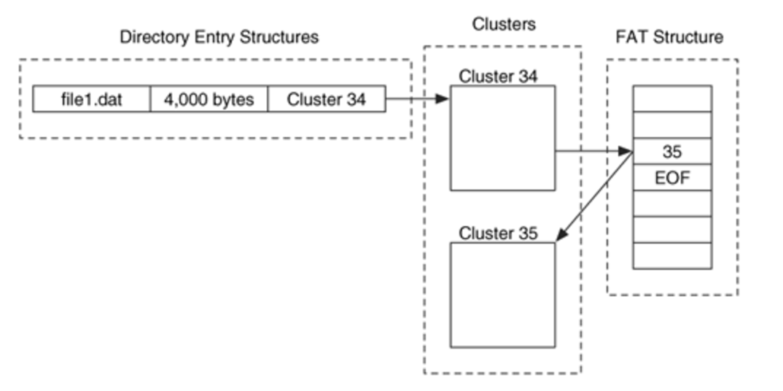
FAT Example
Relationship between the directory entry structures, clusters, and FAT structure:
Notes:
This slide illustrates how files are stored and tracked in a FAT file system.
Each file occupies one or more clusters, and its directory entry provides the starting cluster and file length.
The FAT links clusters to form a chain for files that span multiple clusters.
This example demonstrates the relationship between directory entries, clusters, and the FAT structure, highlighting how data and metadata interact

Slide 7
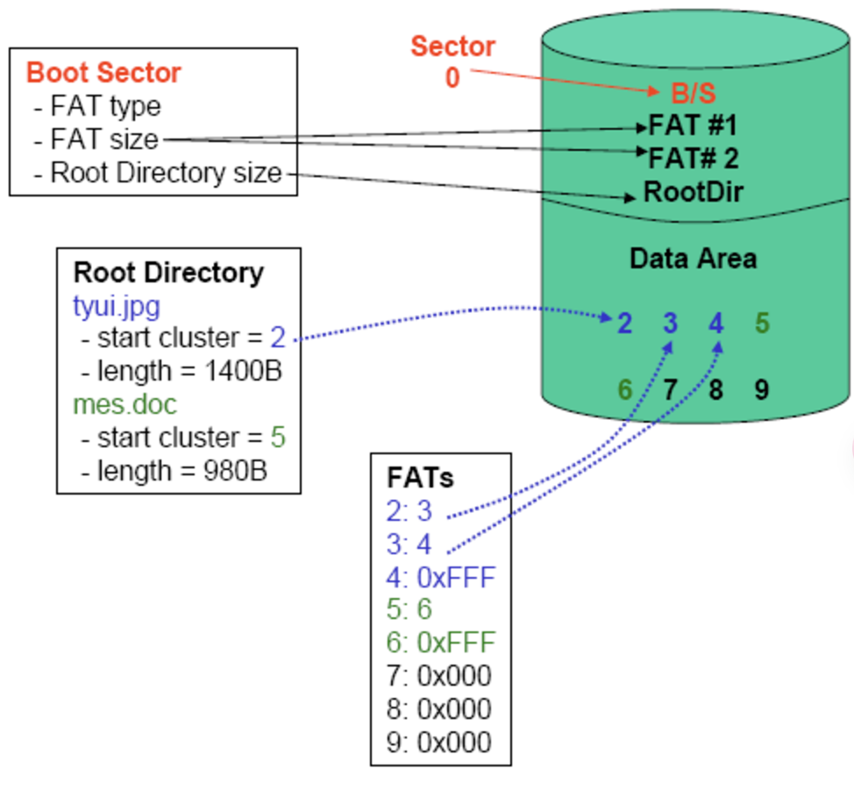
File Allocation Table (FAT)
File tyui.jpg:
occupies clusters 2, 3, and 4.
The file size is 1,400 bytes, it occupies 1,536 bytes (3 clusters) on the disk, and cluster 4 includes 136 bytes of slack space.
File mes.doc:
occupies clusters 5 and 6.
The file size is 980 bytes, it occupies 1,024 bytes (2 clusters), and has 44 bytes of slack space in cluster 6.
Clusters 7, 8, and 9 are unallocated.
Notes:
In this example, the file 'tyui.jpg' occupies three clusters, though it includes some slack space in the last cluster.
Similarly, 'mes.doc' occupies two clusters with some unused space. Unallocated clusters are also shown, indicating free space.
This example underscores how the FAT manages storage allocation and tracks slack space, which can affect storage efficiency.

Slide 8
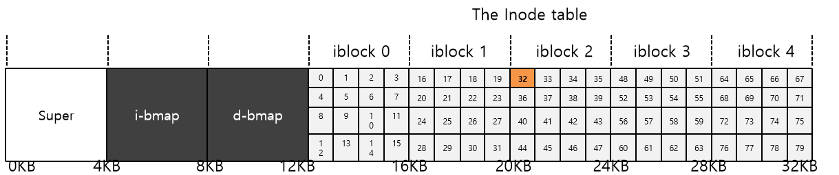
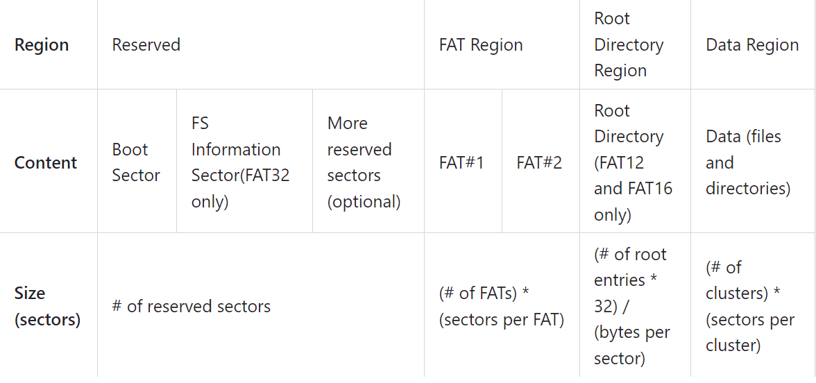
Structure of the FAT file system
Normal structure of file system
FAT file system
Cluster is a group of consecutive sectors
Sector: usually 512B
Cluster: 1,2,4,8,…,64 sectors
Notes:
This slide illustrates the typical organization of a FAT file system. Clusters are composed of consecutive sectors, with their sizes varying depending on the system configuration. This structure allows the system to efficiently map logical file organization onto physical storage, supporting flexible file management.
Reserved sectors: Boot sector includes an area called the BPB which contains some basic file system information and the operating system's boot loader code
FAT Region: FAT indicates the status of clusters. FAT16 has two copies of FAT for redundancy.
Root Directory Region: Store the information of files and directories of root directory. For FAT16, it lies right after reserved region.
Data Region: Store the actual contents of files and directories. Note that a cluster can only be occupied by one file.
A cluster is a group of consecutive sectors A sector is usually 512 B
A cluster is 1, 2, 4, 8, 16, 32, or 64 sectors (i.e., it can range from 512 B to 32 KB)

Slide 9
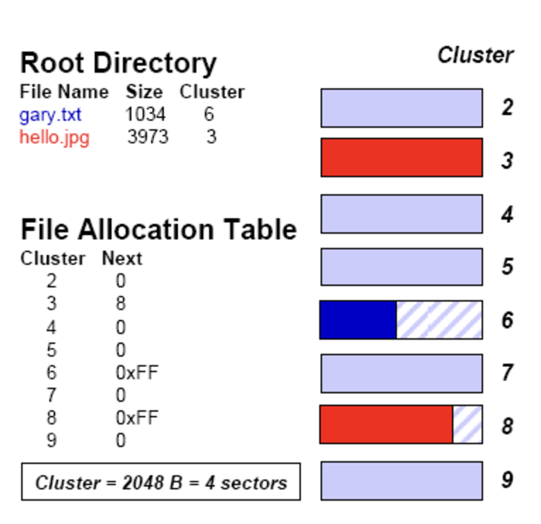
Structure of the FAT file system
Clusters 3, 6, and 8 are allocated; clusters 2, 4, 5, 7, and 9 are unallocated
Clusters 6 and 8 are only partially filled; the unused portion is slack space
File gary.txt:
logical size is 1,034 bytes
physical size is 2,048 bytes (slack = 1,014 B)
File hello.jpg:
logical size is 3,973 bytes
physical size is 4,096 bytes (slack = 123 B)
Notes:
Here, we see allocated and unallocated clusters, as well as slack space.
For example, 'gary.txt' uses two clusters but leaves significant slack space in the second cluster.
Similarly, 'hello.jpg' has minimal slack space due to its near-perfect fit into the allocated clusters.
Such examples help us understand how file size and storage efficiency are interrelated in a FAT system.

Slide 10
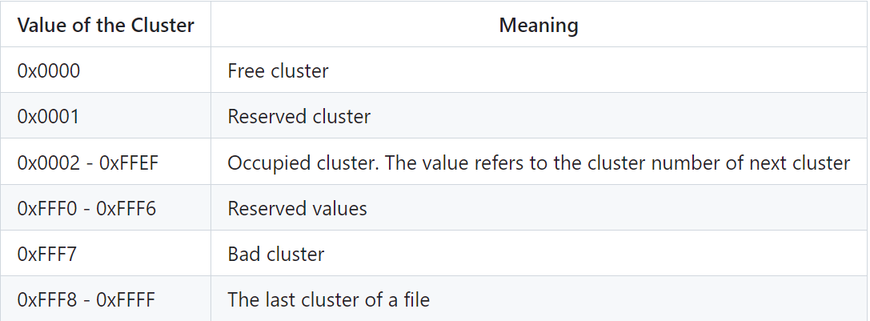
File Allocation Table
FAT contains the metadata for clusters in the filesystem
In FAT16, the size of a FAT entry is 16 bit (2 bytes)
Every cluster in data region will be mapped uniquely mapped to an entry in FAT table
The clusters of a file may not be continuous in the data region, and the file system remembers the relationship of clusters with FAT
Notes:
The FAT itself is a critical part of the system, storing metadata about each cluster.
In FAT16, each entry is 16 bits long, providing a unique mapping for each cluster.
The table ensures that even non-continuous files can be correctly read by maintaining a chain of cluster pointers.
This mechanism is vital for the file system's reliability.

Slide 11
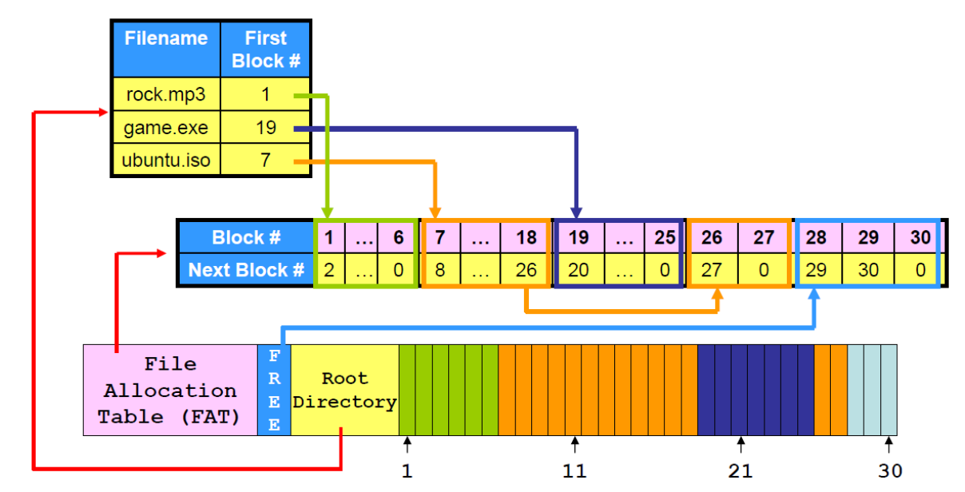
File Storage in FAT file system
Notes:
File storage in FAT is based on its cluster allocation and metadata tracking.
Even though clusters may not be contiguous, the FAT ensures the logical continuity of files.
Understanding this concept is essential for diagnosing issues or optimizing storage in FAT-based systems.
Non-continuous of the game.exe, lead to fragmentation

Slide 12
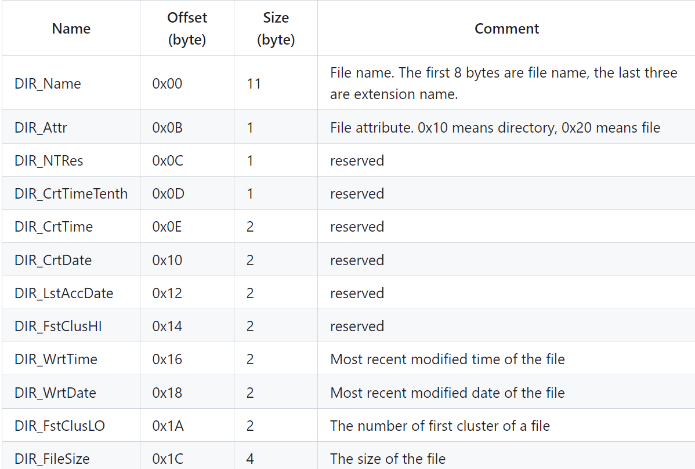
Directory in FAT file system
Directory is also a kind of file in FAT. (Directory entries)
In FAT16, the length of a directory entry is 32 bytes
Notes:
A directory in the FAT file system is essentially a special type of file.
It contains directory entries, each 32 bytes in length for FAT16.
These entries map human-readable file names to their corresponding low-level data locations.
This structure simplifies user interaction while maintaining the system's internal organization.

Slide 13
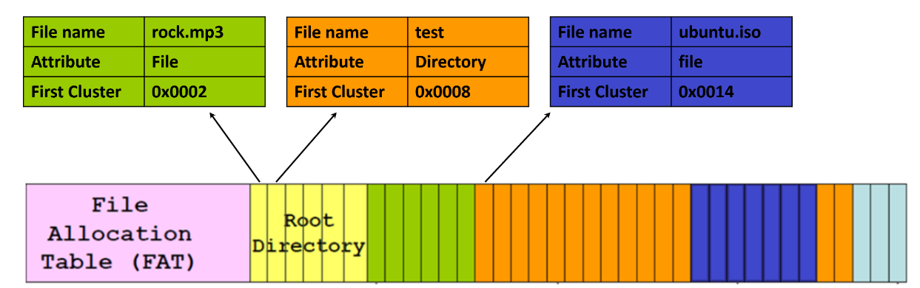
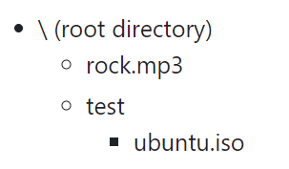
Directory in FAT file system
For example,
Notes:
This example demonstrates how directory entries link to file clusters. Each entry contains metadata such as the file name and starting cluster. Understanding this structure is key to navigating and manipulating FAT file systems effectively.

Slide 14
Comparing FAT and File Systems discussed in class
FAT File System:
Advantages:
Simple and easy to implement.
Low overhead for small devices with limited storage.
Universally compatible, supported by most operating systems.
Disadvantages:
Poor scalability for large storage systems.
Fragmentation issues as files grow.
Inefficient for managing large directories or large numbers of files.
Notes:
If a file grows beyond its initially allocated clusters, the system finds new free clusters elsewhere on the disk, often non-contiguously. This process creates fragmentation as the file becomes spread across multiple, disjointed clusters.

Slide 15
Todays file system (discussed in class)
Advantages:
Supports large-scale file systems with hierarchical structure.
Efficiently handles large directories and files.
Better at minimizing fragmentation due to advanced allocation strategies.
Disadvantages:
More complex to implement and maintain.
Higher overhead in metadata storage.
Requires additional steps to access data through inodes.

Slide 16
Q & A

