Slide 1

SMART INDIA HACKATHON 2026
TITLE PAGE
Problem Statement ID: SIH26249
Problem Statement Title: Air Power — Predictive Maintenance & Fleet Availability
Organisation: Ministry of Defence
Idea: FLIGHTLINE — Fleet Availability Twin
Team Name: Code Byte
Notes:
Keep it plain. One sentence: every other team predicts when a part fails; FLIGHTLINE predicts how many sortie-days the fleet is about to lose, and names the single action that saves the most of them.

Slide 2
IDEA TITLE
Code Byte
FLIGHTLINE — Fleet Availability Twin
A decision layer that joins the four maintenance silos, predicts how many sortie-days the fleet is about to lose, and names the action that saves the most of them — scored in aircraft-days, not RMSE.
THE PROBLEM :
FLIGHTLINE :
WHAT THE OFFICER GETS :
The statement names fragmentation, not accuracy: “fragmented and largely reactive … not adequately integrated”.
Health monitoring, technical records, spares and MRO agencies never meet
A fault predicted on Tuesday collides with a six-week spares lead time — the aircraft sits on the ground anyway
RUL models report RMSE; nobody reports aircraft-days
ONE GRAPH OF THE FOUR SILOS
tail → LRU → part → stock → depot bay → sorties
PROGNOSIS WITH HONEST INTERVALS
Remaining life as a 90% conformal interval; abstains when unsure
FLEET SIMULATOR + OPTIMISER
90 days, day by day; CP-SAT re-sequences depot inductions and expedites
CANNIBALISATION, PRICED
Every swap returns a net in aircraft-days over 30 days
Ranked actions, each scored in aircraft-days gained
“Why this number?” — the trace of which silo said what
Availability attribution: why Ao is what it is
Live what-if: ground aircraft, delay spares, surge sorties
Printable draft maintenance order
It ranks and prices. It never authorises — the signature stays with the officer.
Notes:
The statement does not say the models are inaccurate. It says the data never meets. So we do not compete on accuracy: we join the four silos and optimise the number the Air Force already runs on — operational availability.

Slide 3
THE REFRAME: APH
Code Byte
APH = P( t_{warning} ≤ t_{failure} − ( spares lead + depot queue + bay time ) )
A prediction is worth nothing if it arrives after the last day you could have acted on it.
Two real models · same training data · same 108 held-out run-to-failure units
Measure | Short-horizon model (RUL capped at 15, literature convention) | FLIGHTLINE (uncapped + conformal)
RMSE on the model's own target | 0.9 cycles | 48.6 cycles
RMSE in the last 15 cycles before failure | 3.7 cycles | 7.1 cycles
APH — failures warned in time | 32% | 99%
Aircraft-days lost to late warnings / 100 failures | 877 | 9
Fleet backtest: sorties lost in 90 days (no prognosis: 18) | 12 | 8
More accurate near failure — and still loses. The capped model cannot see past 15 cycles (≈22 days); most spares take longer than that to arrive. FLIGHTLINE warns at a median 1.8× the decision window.
Notes:
A model with RMSE 0.9 sounds better than 48.6. But that 0.9 is measured against RUL capped at 15 cycles — the convention most C-MAPSS papers use — and a capped model cannot warn earlier than the cap. APH is the share of failures warned early enough to get the spare, the bay and the crew in place. Ours: 99%. Then in a 90-day backtest on true failures, both models drive pre-emptive spares orders: 12 sorties lost vs 8.

Slide 4
TECHNICAL APPROACH
Code Byte
HEALTH MONITORING
TECHNICAL RECORDS
SPARES
MRO AGENCIES
144 installed LRUs · multivariate sensor histories, 6 operating regimes (N-CMAPSS shape)
14 phase inspections due · durations · cannibalisation history
18 stock locations · lead times 7–60 days · orders in transit
2 depots · 3 bays · one induction crew per depot per day
FLEET TWIN one NetworkX graph · 200 nodes · 392 edges · tail → installed LRU → part number → stock location → depot bay → sortie plan
1 PROGNOSIS
2 SIMULATOR
3 OPTIMISER
4 DECISION LAYER
5 DELIVERY
HistGradientBoosting on rolling mean / std / slope per sensor + age
Mondrian conformalised quantile regression → 90% RUL interval
Abstains when interval > decision window
90 days, day by day; wear ∝ sorties flown
Base-stock (S−1, S) spares, FIFO
Every down-day = one labelled “hold” → exact attribution
OR-Tools CP-SAT: induction day + depot, expedites
Max sortie-days, then aircraft-days
2 passes + simulator check; deterministic budget
Cannibalisation priced over 30 days
Spare unlock ranking (monotone replay)
Actions in aircraft-days + causal trace
FastAPI + offline dashboard
Live what-if, re-solves in ≈1 s
Printable draft maintenance order
TECHNOLOGY STACK
DATA
SQLite · seeded generator · N-CMAPSS / C-MAPSS loader
ML
scikit-learn HistGradientBoosting · split-conformal
OPTIMISATION
Google OR-Tools CP-SAT
GRAPH
NetworkX
SERVING
Python · FastAPI · uvicorn · Chart.js (vendored)
ASSURANCE
77 pytest tests · same seed → same numbers
Notes:
The twin that matters is of the maintenance system, not the engine. Air-gapped by construction: no cloud call, no LLM, no GPU, one SQLite file. Units: the model predicts RUL in cycles (sorties); it becomes days only when divided by planned utilisation. The headline delta is always simulator vs simulator — never the optimiser's own objective.

Slide 5
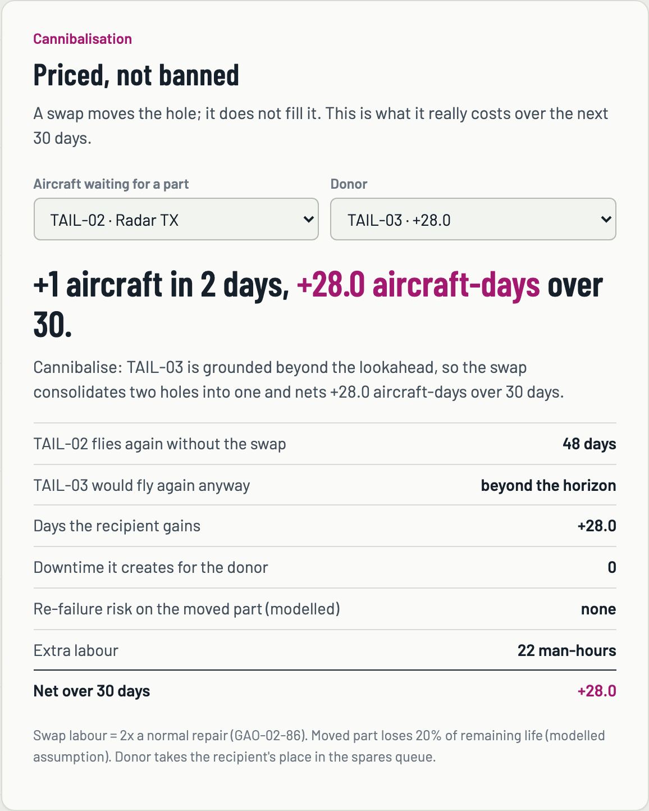
CANNIBALISATION, PRICED
Code Byte
What GAO-02-86 found (US Navy + Air Force, FY1996–2000)
So FLIGHTLINE prices it
≈850,000 | cannibalisations reported
≈5.3 million | additional maintenance hours
≥ 2× | “at least twice as long as normal repairs”
111 parts | missing from one aircraft
903–1,756 days | four cannibalised FA-18s not flown
> 25% | readiness fell when the Army stopped (1987 test)
net = recipient gain − donor loss − re-failure
The donor takes the recipient's place in the spares queue: the swap moves the hole, it does not fill it. Swap labour 2× normal (GAO). Moved part loses 20% of remaining life — a modelled assumption, labelled on screen.
Same radar transmitter for grounded TAIL-02:
Donor TAIL-03 grounded for the horizon
+28.0
Donor TAIL-06 down 11 more days anyway
+8.9
Services' own policy: cannibalisations “aggravate the very same supply problems that they are meant to overcome.” Load-bearing and corrosive at once.
Donor TAIL-03 flying today
−2.0
aircraft-days over 30 days
Live card in the prototype (TAIL-01 and TAIL-03 grounded)
Source: GAO-02-86, Military Aircraft: Services Need Strategies to Reduce Cannibalizations, Nov 2001.
Notes:
It is both necessary and corrosive, so we do not ban it — we price it. The officer on this panel has signed cannibalisation authorisations; nobody has shown them this number. Robbing a flying aircraft is always net negative: it only moves the hole. Robbing an aircraft that is down anyway can pay handsomely.

Slide 6
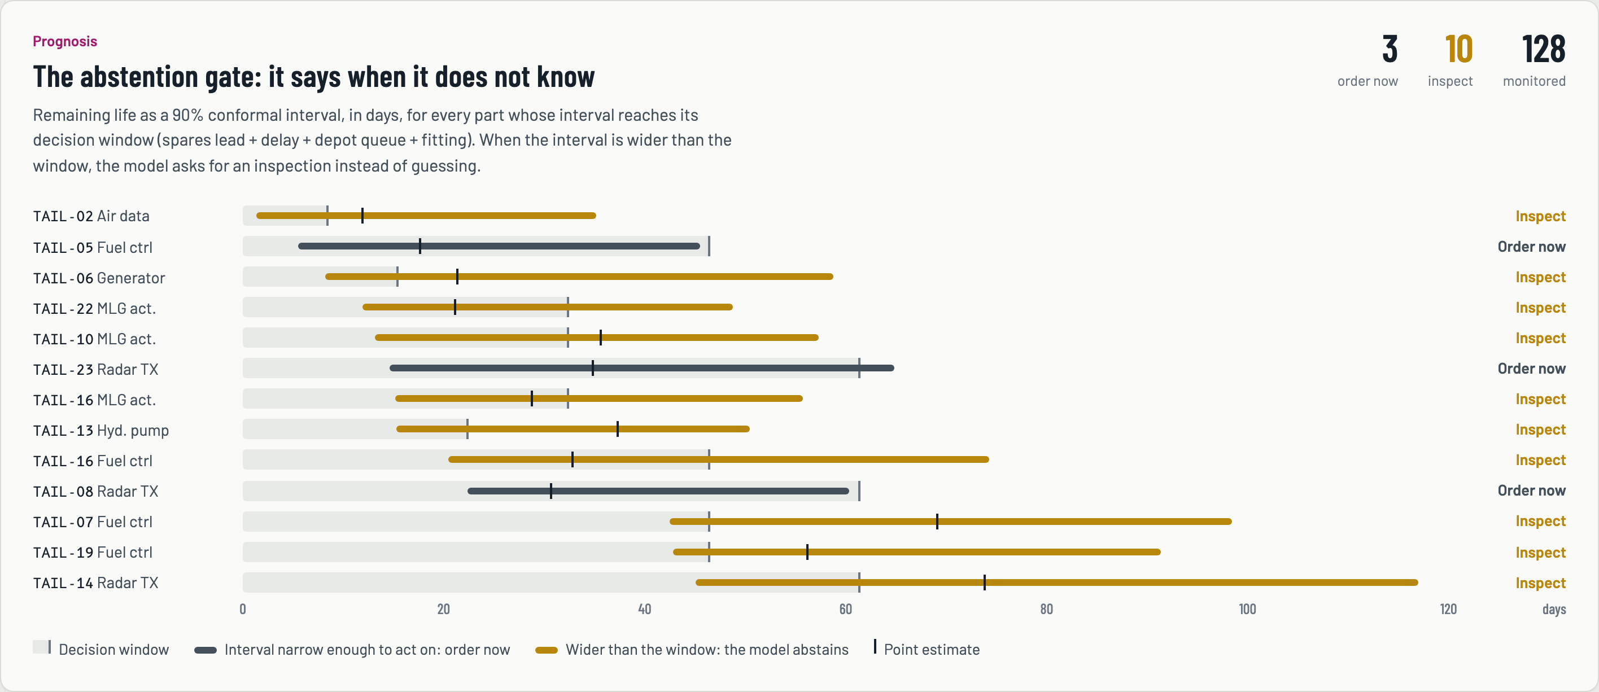
THE ABSTENTION GATE
Code Byte
We can tell you when we don't know.
Rule
Abstain when the 90% interval is wider than the decision window and its lower edge falls inside it.
→ recommend inspection, not a prediction
91.6%
coverage on 1,296 held-out points (target 90%)
94%
coverage in the last 20 cycles before failure (85 points)
10
parts flagged for inspection today; 3 confident enough to order; 128 monitored
Dark bar = 90% interval narrow enough to act on: order now. Amber bar = wider than its decision window (shaded): the model abstains.
Where a false negative can cost aircrew and a false positive wastes a sortie, a system that knows the limits of its own confidence is worth more than one that is slightly more accurate on average.
Mondrian conformalised quantile regression: calibrated separately in three bands of predicted RUL, so the guarantee holds near failure, not just on average.
Notes:
Say this slowly. Conformal prediction gives a distribution-free coverage guarantee: no assumption about the error distribution. A single global correction gave 92% overall but about 80% near failure — exactly the wrong place to be overconfident — so we calibrate per band.

Slide 7
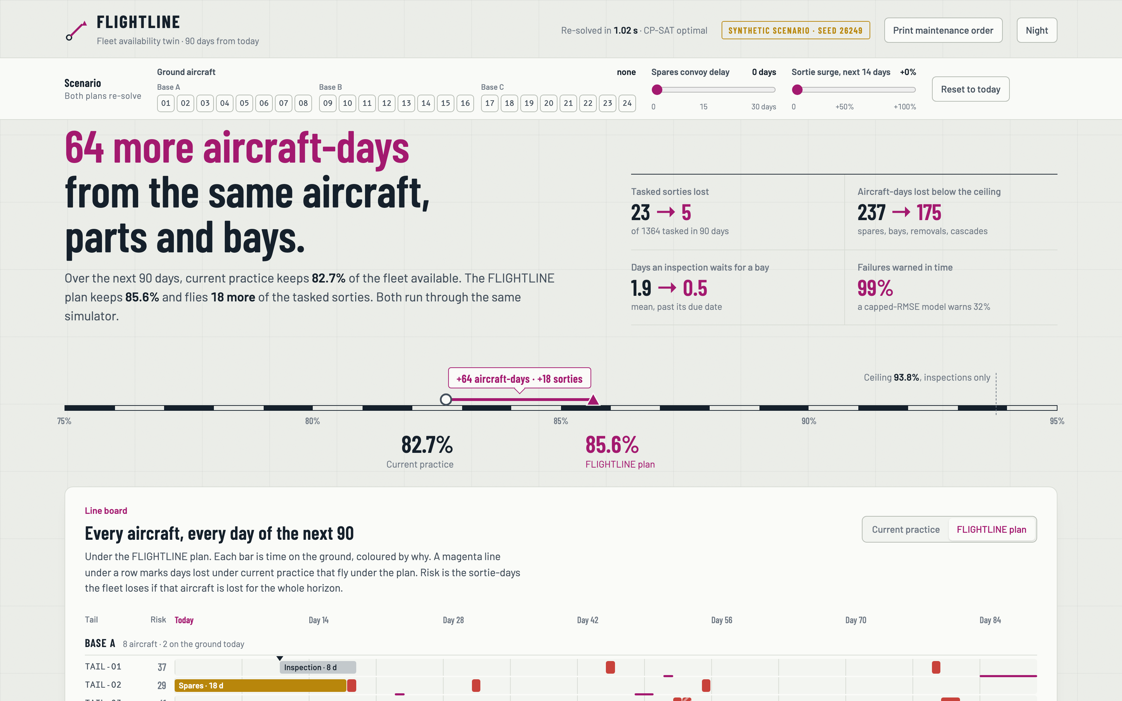
LIVE DEMO
Code Byte
Let the panel break it
“Ground two aircraft at Base A.”
Click 01 and 03
Ao falls to 79.0%. Top action becomes: cannibalise the radar from grounded TAIL-03 to TAIL-02, +28.0 aircraft-days.
“Spares convoy is 10 days late.”
Drag convoy delay to 10
Spares share of the gap 8.0 → 9.9 pts; order-now parts 3 → 10; priced cannibalisation +60.
“Surge: 40% more sorties.”
Drag sortie surge to +40%
Sorties lost: 64 under current practice vs 39 under the plan (+83 aircraft-days).
Running prototype · 127.0.0.1:8000 · offline · seed 26249 · re-solves in ≈1.0 s
Ao 82.7% → 85.6% · +64 aircraft-days · +18 sorties flown · sorties lost 23 → 5
Every action carries “Why this number?” — the trace of which silo said what.
Notes:
Do not play a recording. Hand them the controls. Change anything you like — both plans are re-simulated and CP-SAT re-solves in about a second, with the reason printed next to every recommendation. Press Reset before you start.

Slide 8
FEASIBILITY AND VIABILITY
Code Byte
HONEST ABOUT DATA
PLATFORM-AGNOSTIC
RISKS → MITIGATIONS
We have no IAF data and do not pretend to. The badge says SYNTHETIC SCENARIO on every screen
Degradation: 432 run-to-failure units with the shape of NASA N-CMAPSS
Drop real N-CMAPSS / C-MAPSS files in data/raw and the model retrains on real engines; logistics stay synthetic and the badge says so
Decisions never see ground truth; it is used only to backtest
Swap the degradation model; everything above it is unchanged. Fewer labelled failures do not make it unsafe — the interval widens and it warns earlier:
Model ≠ real fleet | Decision layer is model-agnostic; conformal recalibrates on a small held-out set
Classified data | Air-gapped on one base server; no cloud, no external API
Trust | Ranks and prices, never authorises; every number traceable
Optimiser approximations | Every plan re-scored by the full simulator
APH stays 95%–100% from 12 to 216 labelled failures. More data buys efficiency, not safety.
RESEARCH AND REFERENCES
Arias Chao M. et al., Aircraft engine run-to-failure dataset under real flight conditions (N-CMAPSS), Data 6(1):5, 2021 · Saxena A. et al., C-MAPSS, PHM 2008
Romano Y., Patterson E., Candès E., Conformalized Quantile Regression, NeurIPS 2019
US GAO, GAO-02-86, Military Aircraft: Services Need Strategies to Reduce Cannibalizations, 2001 · Sherbrooke C., METRIC, Operations Research 16(1), 1968
Google OR-Tools CP-SAT solver · scikit-learn HistGradientBoostingRegressor · NetworkX
Notes:
Volunteer the weakness before the panel finds it. Our claim is not that this model transfers to a Su-30. Our claim is that the decision layer is platform-agnostic: the twin, the simulator, the attribution, the optimiser, the cannibalisation price and the abstention gate are unchanged when the degradation model is swapped.

Slide 9
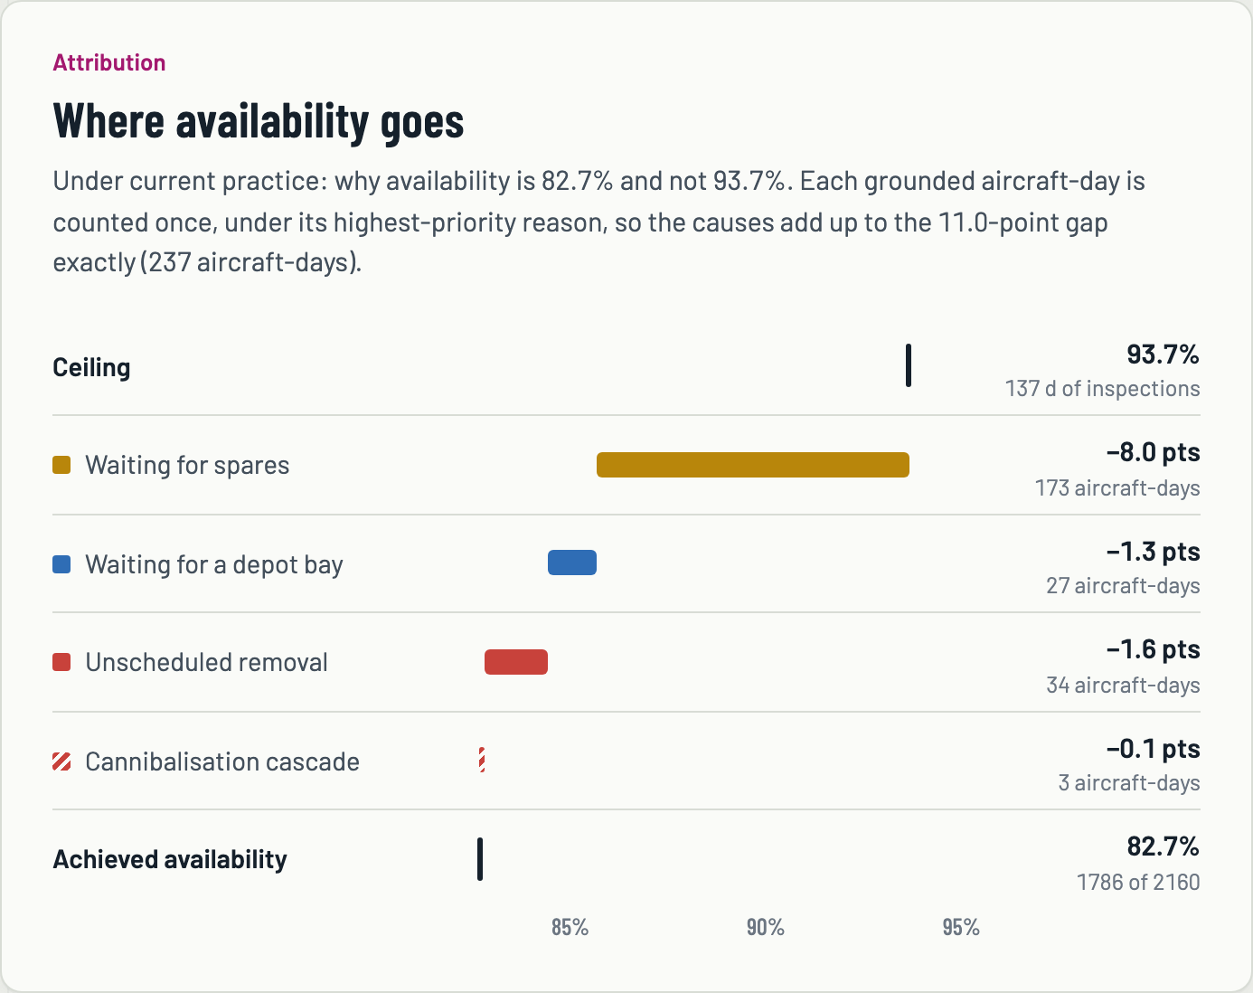
AVAILABILITY ATTRIBUTION
Code Byte
Why is availability 82.7% and not 93.7%?
Cause | Points of Ao | Aircraft-days
Waiting for spares | 8.0 | 173
Waiting for a depot bay | 1.3 | 27
Unscheduled removal | 1.6 | 34
Cannibalisation cascade | 0.1 | 3
Total gap below the ceiling | 11.0 | 237
Every grounded aircraft-day is counted once, under its highest-priority reason, so the causes add up to the gap exactly. It is a unit-tested invariant, not a chart.
This is the screen a Base Maintenance Officer opens at 0700.
Notes:
Under current practice the fleet loses 11.0 points of availability below its inspection-only ceiling of 93.7%: 8.0 to spares lead time, 1.3 to depot contention, 1.6 to unscheduled removals, 0.1 to cannibalisation cascades. Nobody else is doing lost-availability attribution.

Slide 10
IMPACT AND BENEFITS
Code Byte
+64
23 → 5
1.9 → 0.5
99%
aircraft-days in 90 days on a 24-aircraft fleet (+3.0 pts Ao), same aircraft, parts and bays
tasked sorties lost to unavailability, current practice → plan
mean days an inspection waits for a depot bay
of failures warned in time to act (capped-RMSE model: 32%)
BASE MAINTENANCE OFFICER
LOGISTICS OFFICER
ENGINEERING OFFICER
Why availability is what it is, by cause
Which depot induction to move, and when
Which spare, stocked where, unlocks the most
Which order to expedite, with its aircraft-days
Cannibalisation priced before it is signed
Inspect-or-order, with the model's own uncertainty
DEPLOYMENT
Air-gapped by construction: one base server, one SQLite file, open-source stack. No cloud call, no LLM, no GPU, no foreign dependency. Nothing leaves the base network.
WHAT WE NEED NEXT
Labelled removals for one LRU family
Lead-time history and stock levels by base
Bay counts and phase intervals for one type; cannibalisation logs
Notes:
Aircraft-days recovered from the same aircraft, parts and bays — by joining the data, not by buying anything. Air-gapped by construction: nothing leaves the base network. The numbers are from the synthetic scenario; the first step with real data is one LRU family at one base.

