Slide 1


Gartner Webinars
Gartner delivers actionable, objective insight, guidance and tools to enable stronger performance on your organization’s mission critical priorities

Slide 2


Enhance your webinar experience
Ask a Question
Download Attachments
Watch Again
RESTRICTED DISTRIBUTION
© 2023 Gartner, Inc. and/or its affiliates. All rights reserved.

Slide 3







Generative AI: Changing How Business Innovates and Operates
Connect with Gartner
Eric Goodness
VP Analyst
Annette Jump
Sr. Director Analyst
Vibha Chitkara
Specialist, Research
RESTRICTED DISTRIBUTION
© 2023 Gartner, Inc. and/or its affiliates. All rights reserved.

Slide 4


Generative AI Offers Us Much More Than Unique Visuals and the Best Words
This Person Does Not Exist
Text-to-Image: Stable Diffusion
Stable Diffusion 2-1 - a Hugging Face Space by stabilityai
Source: Wikimedia Commons
4
© 2023 Gartner, Inc. and/or its affiliates. All rights reserved. Gartner is a registered trademark of Gartner, Inc. and its affiliates.

Slide 5
Generative AI Definition
Generative AI Generative AI refers to AI techniques that learn a representation of artifacts from data, and use it to generate brand-new, unique artifacts that resemble but don’t repeat the original data.
Generative AI can produce totally novel content (including text, images, video, audio, structures), computer code, synthetic data, workflows and models of physical objects.
Generative AI also can be used in art, drug discovery or material design.

Slide 6
Generative AI Began to Quickly Emerge as a Topic on Earnings Calls in Early 2023
S&P Global 1200 Company CEOs
2% of CEOs discussed GenAI in their earning calls
1% of CEOs discussed deploying GenAI
(From January to April 2023)
Company | CEO
Genpact | Nallicheri Vaidyanathan Tyagarajan President, CEO and Director
Etsy | Joshua G. Silverman CEO, President and Director
Accenture | Julie T. Spellman Sweet CEO and Chairman
Meta Platforms | Mark Elliot Zuckerberg Founder, Chairman and CEO
Cadence Design Systems | Anirudh Devgan CEO
Leidos Holdings | Roger A. Krone Chairman and CEO

Slide 7
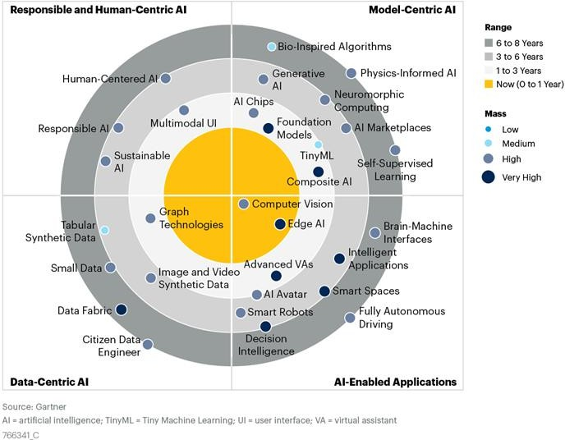
Emerging Tech Impact Radar: Artificial Intelligence

Slide 8
Business Artifacts That GenAI Can Generate Today
Generative AI
Artifacts
Learning Methods
Audio/Visual
Programming & Data Assets
Natural Language
Designs
Strategies
Tactics
2D/3D faces/ bodies
Drawings/ photographs
Art
Voice/visual characters
Music
Training data — e.g., events, POS, behavior
Test and synthetic data
Code
Context data — e.g., market conditions
Questions/ answers
Summaries/ roundups
Stories/narratives
Documents
Job listings
Product designs
Materials
3D models
Game worlds
Process flows
Schematics/ specifications
— e.g., drugs, infrastructure and buildings, film edits
Unprogrammed game strategies
Unanticipated strategic scenarios
Rules/inferences
Reinforcement learning models
Alternative learning mechanisms

Slide 9
Possible Scenarios and Trajectories for GenAI
2024
2025
2026
2027
Use of synthetic data created with generative AI will reduce the volume of real data needed for machine learning by 50%.
30% of outbound marketing messages from large organizations will be synthetically generated.
Generative AI will automate 60% of the design effort for new websites and mobile apps.
Over 100 million humans will engage robocolleagues (synthetic virtual colleagues) to contribute to enterprise work.
By 2027, nearly 15% of new applications will be automatically generated by AI without a human in the loop, up from 0% today.
Source: Predicts 2022: Generative AI Is Poised to Revolutionize Digital Product Development 11 January 2022 - ID G00757883 By Brent Stewart, Van Baker, Joachim Herschmann

Slide 10
Tech & Service Provider Response to the Generative AI Opportunity
Service Providers
Tech Stack
ISVs
New applications, waves of new ‘AI-Natives, Growing need for modernization
Business & IT Consulting, FMs- as-a-Service
FMs-as-a-Service, AIChips, vector database, HPC

Slide 11
ETT Case Based Research (CBR)
A structured field study seeking to reveal ongoing technology and business demands for emerging technologies.
Interviewed (30) vendors offering software/platforms enabled by generative AI.
Collected nearly 100 case studies and related use cases.
Field survey process spanned Q4-22 through Q1-23 (with a few additional engagement in Q2-23).
Published research from the CBR study is currently available with several documents in process.

Slide 12
AI Avatars

Slide 13
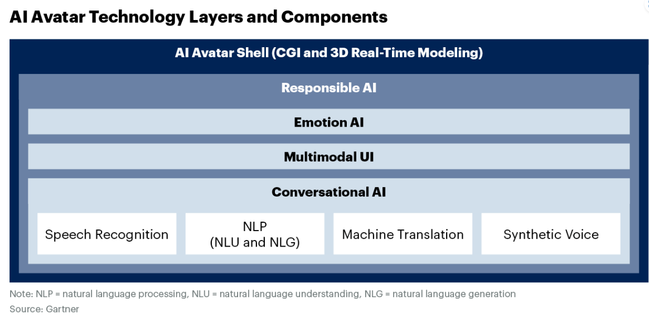
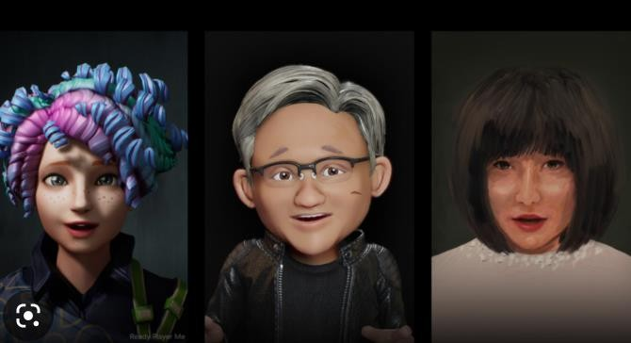
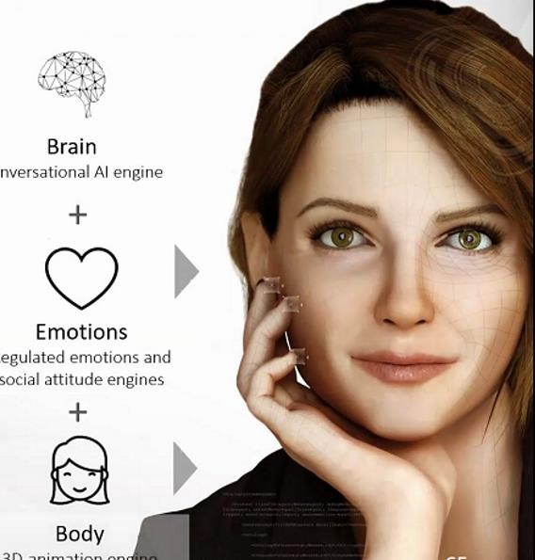
AI Avatars Are Complex Technological Creations
Sample Vendors: Amelia; DAVI; Openstream.ai (Eva); Klleon, NVIDIA (Omniverse Avatar Cloud Engine); Rephrase.ai, Soul Machines; Synthesia, UneeQ

Slide 14
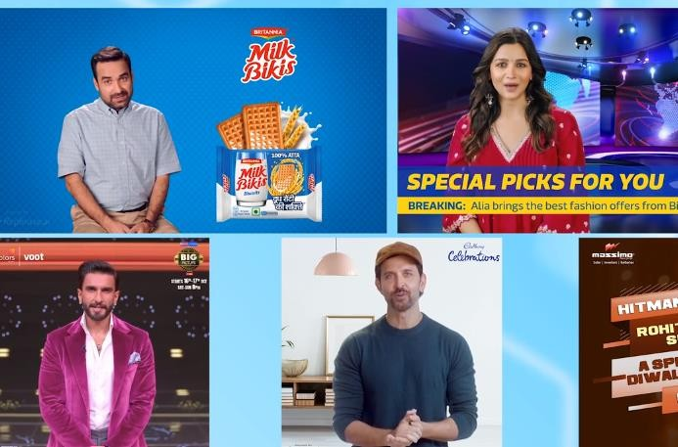

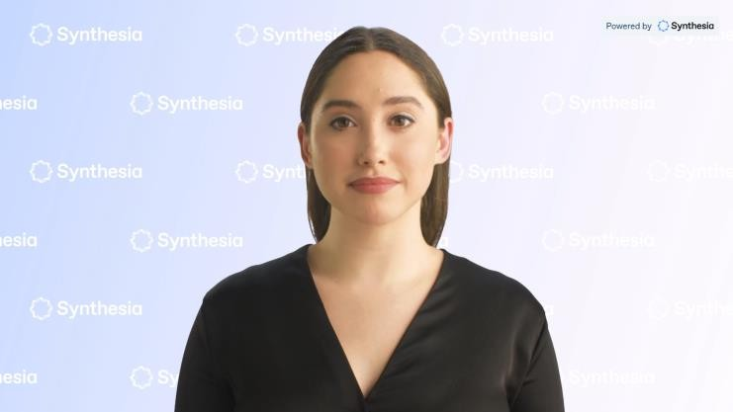
Advanced in Generative AI Speed Up Creation of AI Avatars and Open Up New Use Cases
Use Case examples:
Customer support representatives
Virtual salesperson or financial advisor
Supporting hybrid or virtual coworking and collaboration.
Customer assistant in a kiosk in an airport or
a social venue.
Training assistant (possibly in a metaverse) for employees or students.
Virtual presence at entertainment events, like
a virtual concert or gallery.
By 2025, AI avatars leveraging text-to-video using generative AI technology will support 70% of digital and marketing communications from less than 5% in 2022.

Slide 15
AI Avatar Implications & Recommendations
Implications
AI avatars leveraging text-to-video will enhance the creativity and humanize internal and customer
communications, enabling hyper personalization.
Two biggest technical challenges are combining various emerging technologies to enable realistic, human-centered and super responsive AI avatars and applying this at scale.
Concerns about deepfakes, nascent but lagging legal protection for users and content, and responsible
application of AI principles are challenges to scaling future AI avatar deployments.
Recommendations
Identify use cases where AI avatars can add quantifiable business value to your software products, as
brand ambassadors, digital customer care reps or even in the metaverse.
Further enhance VA offerings by integrating synthetic voice and emotion AI technology into voice interfaces, like AI avatars in kiosks, virtual training or immersive environments.
Create visually realistic AI avatars by determining which technological elements can be developed internally, such as avatar CGI shells, and by collaborating with pertinent NLT providers for features like synthetic voice, multimodal AI or emotion AI.

Slide 16
AI-Generated Content

Slide 17


AI-Generated Content – Market Landscape
Video
AI
Avatars
AI-generated trailers
Output
Image
AI for Marketing Content
Domain
Content
AI Writing Assistants
Text
Video analytics
Text
Image
Video
RESTRICTED DISTRIBUTION
17 © 2023 Gartner, Inc. and/or its affiliates. All rights reserved.
Input

Slide 18
Use Case For Text Automation
General – Q&A, Translation, Summarization
Domain specific
Summarization and Translation of Legal Document
Automated Report Writing from Clinical Trial Data in Pharma
Business Model, Market Sizing, SWOT Analysis, PEST Analysis, Brand Naming
Media by Converting Sports Data Into News
Sports Player Performance Report From Video Analytics
Real Time Market Insights From Financial Market Data

Slide 19
Use Case: Automated Clinical Trial Reports
Business Challenge
To reduce third party dependency to build reports from clinical trial data.
To reduce time, cost and effort required to build one report.
To reduce human error and operational efficiency.
Business Value Achieved
65% reduction in time spent on documentation generation hence faster approvals.
40% expected cost reduction on medical writing.
50% reduction in reviews required.
Increase operational efficiencies with more standardized and streamlined process.
Source https://www.narrativa.com/4-benefits-of-automating-clinical-study-reports-csrs/, https://www.narrativa.com/narrativa-lls-bring-ai-generated-reporting-to-the-clinical-trial-process/

Slide 20
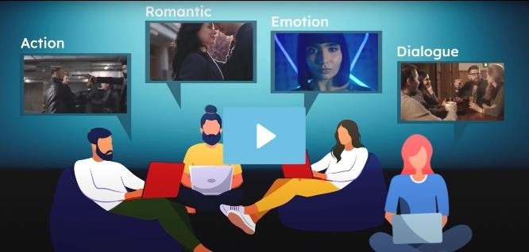
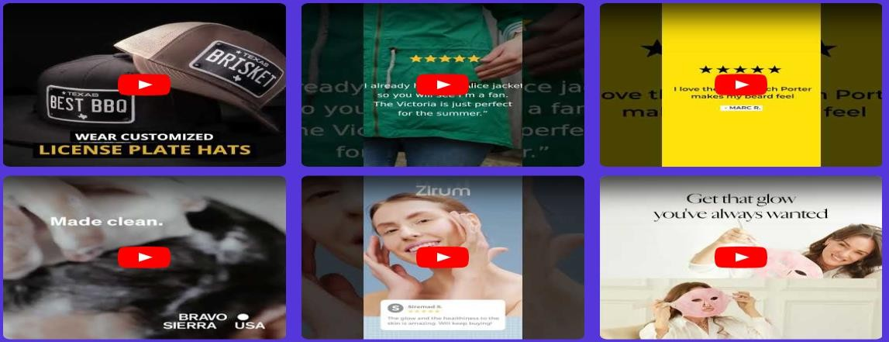
Use Cases For Image and Video Automation
Personalized and Customized Advertisement Content based on Geography, Race, Age Group, Profession
Creative Advertisement for Marketing Across Different Channels
AI-generated customized video trailer based on preference towards emotions, thriller, action etc.

Slide 21

Use Case: Creative Ads Using Generative AI
Business Challenge
To reduce cost per acquisition by 50% and find the best performing creatives ads for a dog food brand.
Business Value Achieved
16 ads tested to find the best performing ads.
Average 15% reduction in cost per acquisition.
Max 56% reduction in cost per acquisition.
Source https://www.trypencil.com/mini-case-studies

Slide 22
AI-Generated Content Implications & Recommendations
Implications
By 2027, Nearly 50% of outbound marketing messages from large organizations will be synthetically generated; up from less than 5% today.
Broad spectrum marketing and advertising support: copy, images, video driving massive disruption to internal and third-party marketing ecosystems.
Same technology can be put to misuse and can lead to creation of fake news and propaganda.

Slide 23
AI-Generated Content Implications & Recommendations
Recommendations
Build transformational generative AI domain-specific solutions by applying generative AI to information-driven processes.
Include veracity and validation as part of your offerings in line with the risk profile of your key business use cases.
Ensure responsible and ethical use of AI by being transparent. Amend privacy disclosures to include information about the role these tools play in shaping digital experience.

Slide 24
Novel Molecule & Compound Discovery

Slide 25
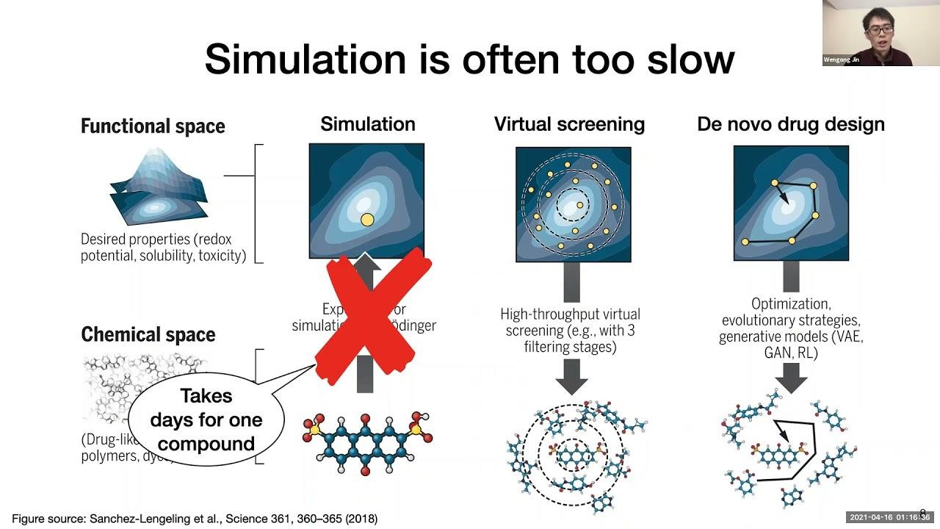
Generative AI for Novel Molecules and Compounds
Deep generative models, such as:
Generative adversarial networks (GANs)
Variational autoencoders (VAEs), and,
Deep reinforcement learning algorithms,
are utilized to generate novel molecules, optimize existing compounds, and predict properties and activities of potential drugs, chemicals and materials.

Slide 26
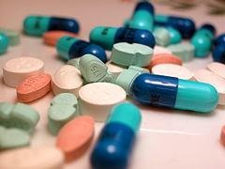
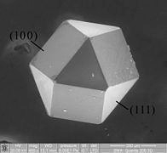
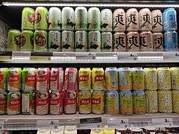
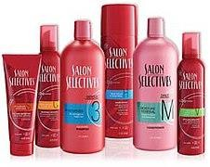
Novel Molecule and Compounds Use Cases
Drug discovery
Material science
Representative vendors
Standigm
Iktos
Chempass
IBM
Insilico
Food & Beverage
Consumer Packed Goods

Slide 27
Novel Molecule and Compounds Implications & Recommendations
Implications
Faster, cheaper and expanded discovery potential to massively advance human health; Lower costs mean pharma and biotech make more bets
Massive fundraising and less cost-intensive in vitro work are lowering capital barriers for startup discovery efforts.
A fast-growing body of treatments entering preclinical trials over the last five years.
Recommendations
Selling picks and shovels for the gold rush, is the new gold rush. Technology stacks,
consulting and managed services for Foundation Models (as-a-Service).
Capitalize on the value of IP generated and secure contingent revenue from royalties, out- licensing, JVs or becoming asset-owning.
Pursue specific, high-value use cases that are directly aligned with specific discovery
programs.

Slide 28
Recommendations
Focus on potential use cases that are most important to your installed base, and prioritize specialized industry and domain solutions when incorporating generative AI in your products.
The key to success is to quantify value and impact for your prospects.
Develop new product and service catalogs focused on existing customer data assets to operationalize Foundation Model-based value.
Aggressively partner with innovative, generative- native companies to accelerate
customer value.
Investigate an acquihire strategy which offers intellectual property and scarce skillsets.
28 © 2023 Gartner, Inc. and/or its affiliates. All rights reserved. Gartner is a registered trademark of Gartner, Inc. and its affiliates.

Slide 29

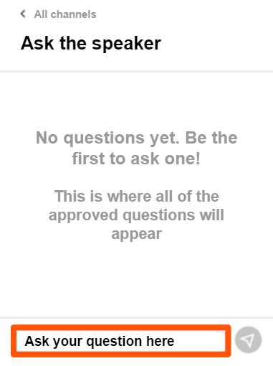
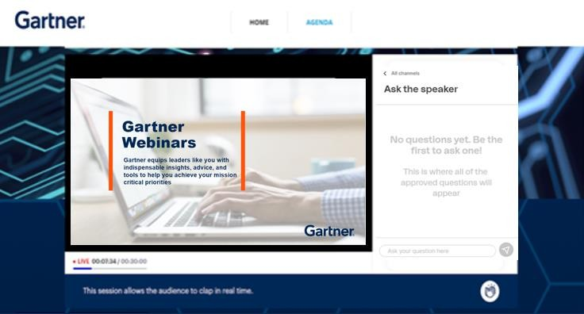

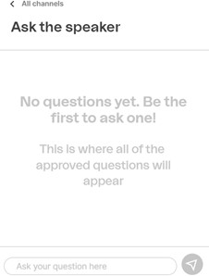

Ask the speaker
RESTRICTED DISTRIBUTION
29 © 2023 Gartner, Inc. and/or its affiliates. All rights reserved.

Slide 30

Gartner CIO Leadership Forum
11 – 12 July 2023 | Tokyo, Japan
26 – 27 February 2024 | Phoenix, AZ
26 – 27 March 2024 | Hollywood, FL
Gartner CIO Leadership Forum is an unrivaled experience — a place where you’ll access the most timely advice, actionable tools and CIO peer insights to adapt faster and stay ahead of change.
Learn more: gartner.com/conf/cio
Register with code WEBINAR
for an exclusive discount.
At this year’s conference, you’ll learn:
Short and long-term strategies to lead you and your team to success in dynamic times.
Reshape organizational structures and attitudes for greater agility
Engage peers to co-create ways of working that remove digital friction to speed business outcomes.
© 2023 Gartner, Inc. and/or its affiliates. All rights reserved.

Slide 31


Top Trends for Tech Providers in 2023
Explore the top trends product leaders must evaluate across all dimensions of their business. These trends are the effects of three broad themes grouped below:
Increased reliance on tech
Opportunities through new tech
Impact of macro forces
Download the Research

Slide 32
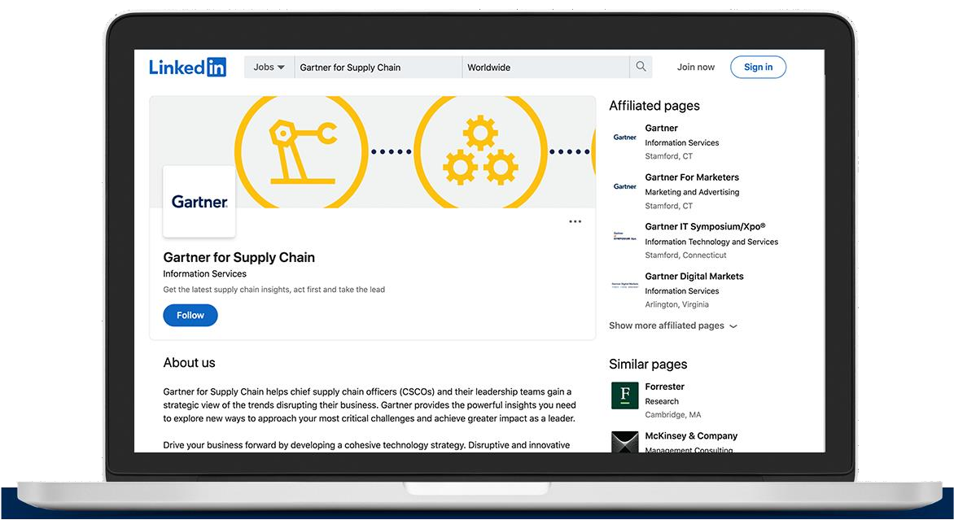
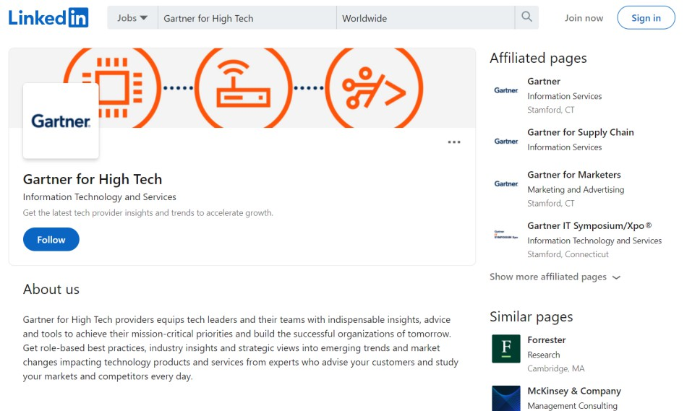


Want More High Tech Insights?
Our Gartner for High Tech LinkedIn page
is dedicated to providing you with the latest insights, best practices, and strategic views into the most important topics impacting tech and service providers.
Follow us on
Looking for insights delivered to your inbox? Subscribe to our bi-weekly newsletter.

Slide 33
Become a Client
Clients receive 24/7 access to proven management and technology research, expert advice, benchmarks, diagnostics and more.
Fill out the form to connect with a representative and learn more.
Learn More
Or give us a call: +441784614280 | +1 855 637 0291
8 a.m. – 7 p.m. ET
8 a.m. – 5 p.m. GMT
Monday through Friday
RESTRICTED DISTRIBUTION
33 © 2023 Gartner, Inc. and/or its affiliates. All rights reserved.

Slide 34


Get more Gartner insights
Download the research slides
View upcoming and on-demand Gartner webinars at gartner.com/webinars
Rate this session

Slide 35

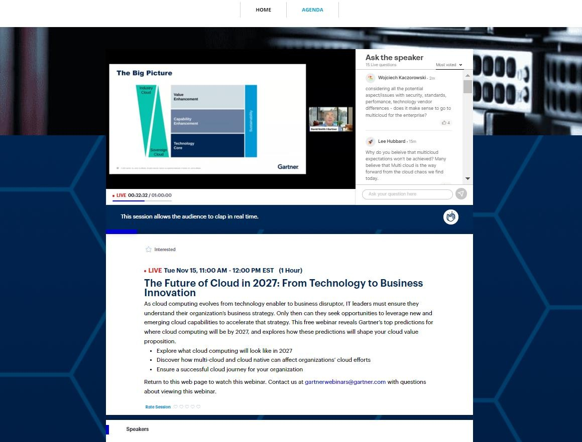
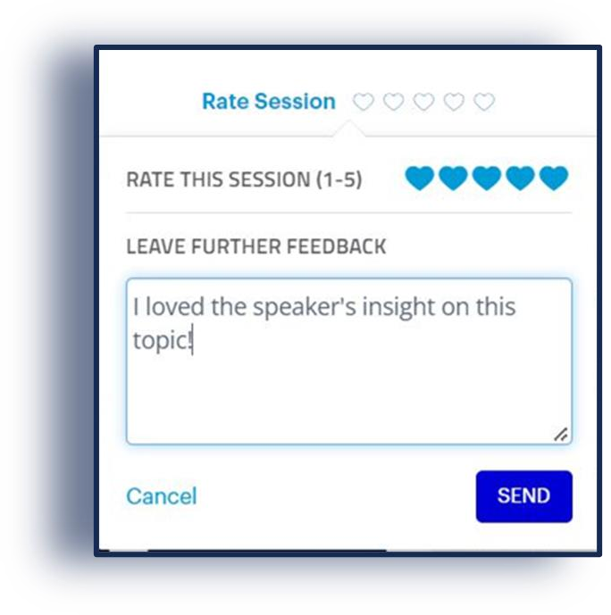

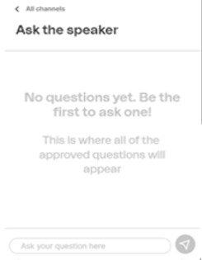

Rate this session

