Slide 1
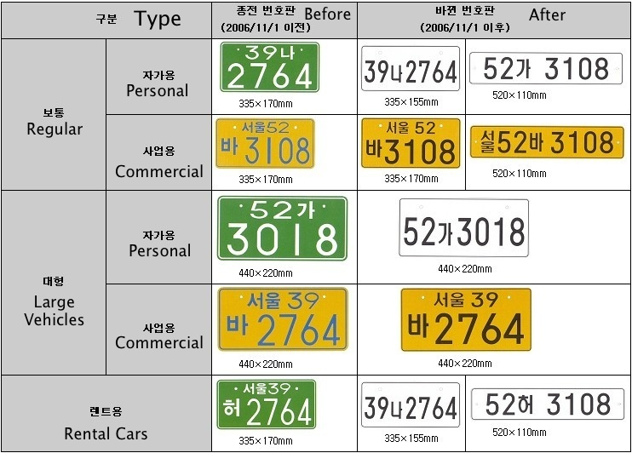

Slide 2
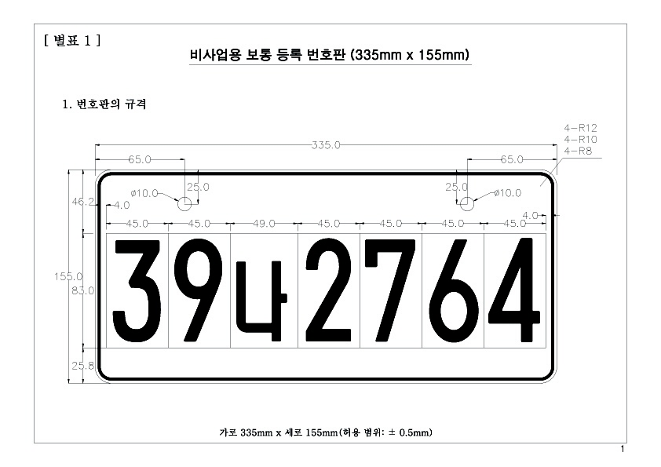
Regular Personal After 2006

Slide 3
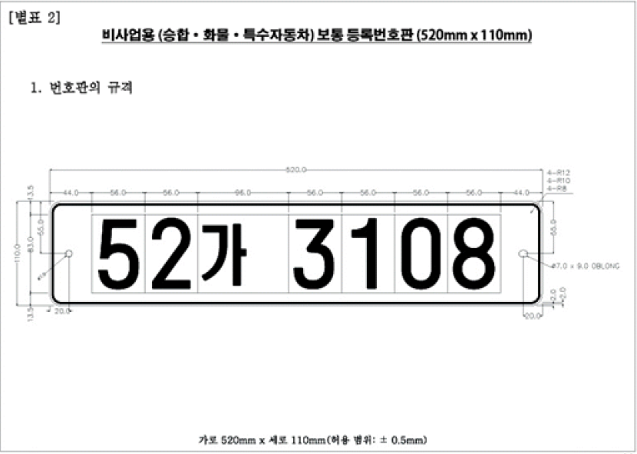
Regular Personal After 2006

Slide 4
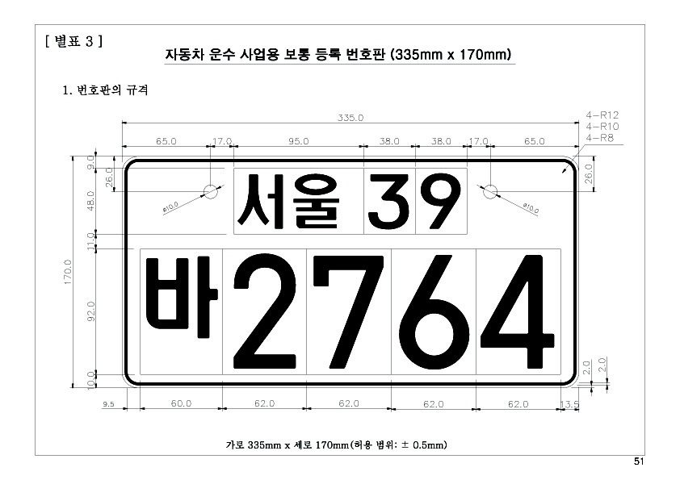
Regular Commercial After 2006 -1

Slide 5
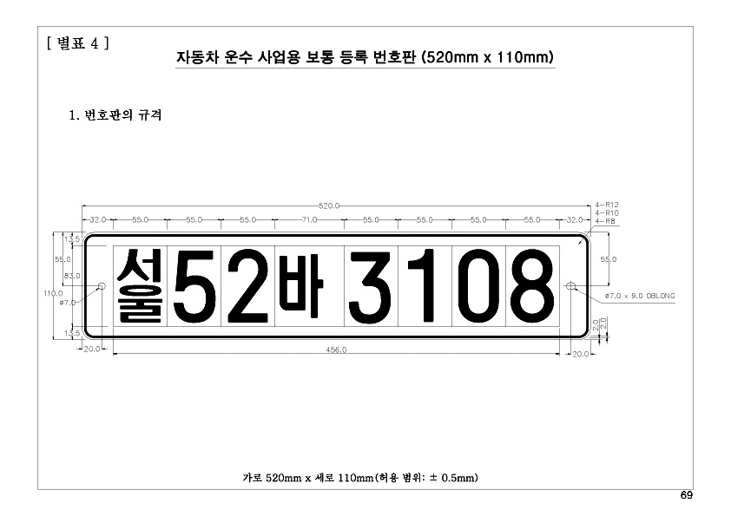
Regular Commercial After 2006 -2

Slide 6
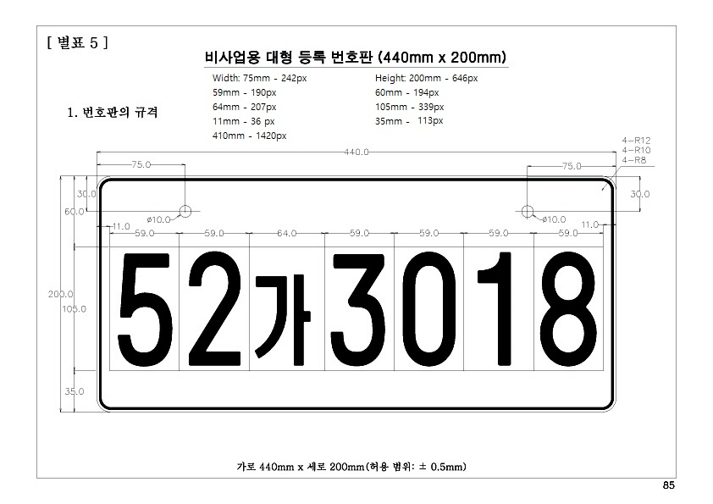
Large Vehicles Personal After 2006

Slide 7
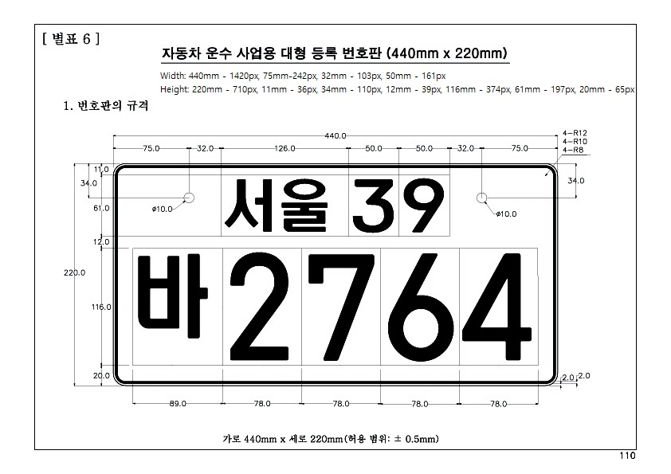
Large Vehicles Commercial
After 2006

Slide 8
https://namu.moe/w/%EC%B0%A8%EB%9F%89%20%EB%B2%88%ED%98%B8%ED%8C%90

