Slide 1

2026 RED BULL BOX CART RACE
Pick ‘n Pay × Kwik Kwik Nawu Nawu
Fresh Ideas. Fast Delivery. South African Innovation.

Slide 2
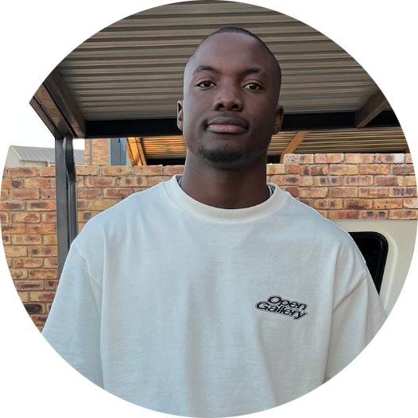
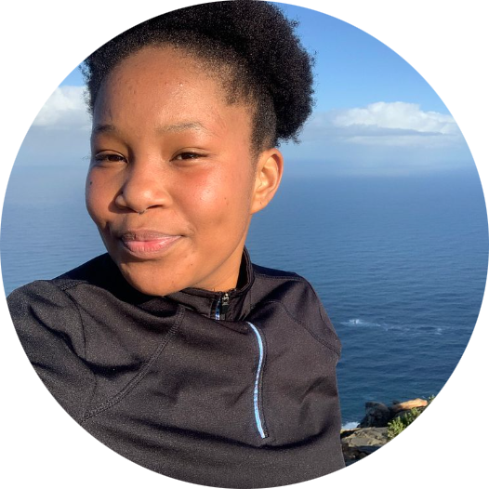

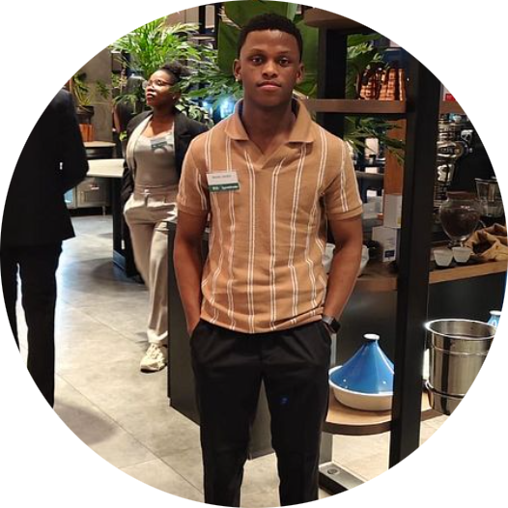
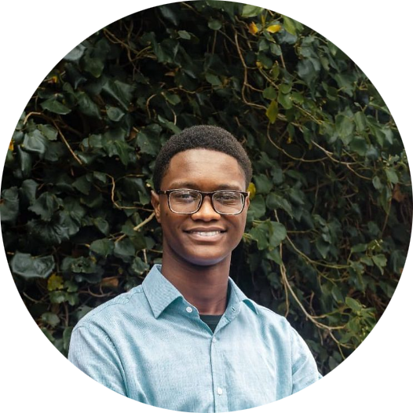
Meet the Team
Our dedicated group of engineering students bringing the Kwik Kwik Nawu Nawu vision to life.
Katlego Malogadithare
Shela Kunutu
Raibim Alam
Captain
Team Management and Budget.
Performances and Aesthetics
Responsible for the cart's visual appeal, translating brand identity into a compelling and unique physical design.
Lead Designer
Manages the construction process, turning conceptual designs into a robust and race-ready box cart.
Monde Jacobs
Nsuku Mareana
Delivery man
Main driver for race day
Mechanic
Optimizes the cart for speed and stability, applying principles of mechanical engineering and fluid dynamics.

Slide 3
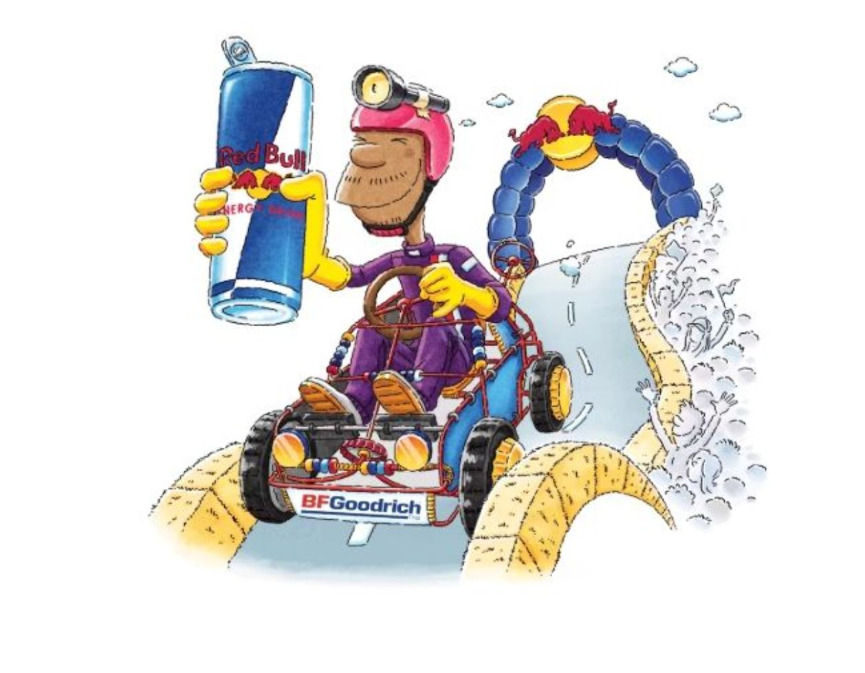
THE EVENT
About the Red Bull Box Cart Race
The Red Bull Box Cart Race is an international spectacle — part engineering challenge, part performance art, part entertainment. Teams design and race gravity-powered carts down a steep urban course, judged on creativity, speed, and showmanship. Taking Place on the 4th of October 2026 in Sandton, Johannesburg. For more information: Red Bull Box Cart Race 2026 - Joburg, South Africa | Event
Entry applications for the competition closed on the 17th of July 2026.
Link: (5) Hilarious Cart Racing! Red Bull Soapbox Race L.A. LIVE 🇺🇸 - YouTube
🌍 Global Reach
📸 Massive Exposure
🔬 Engineering + Creativity
Red Bull's international platform with millions of viewers worldwide.
Professional media coverage, social media virality, and a large live audience.
A unique blend of technical design and theatrical performance.

Slide 4
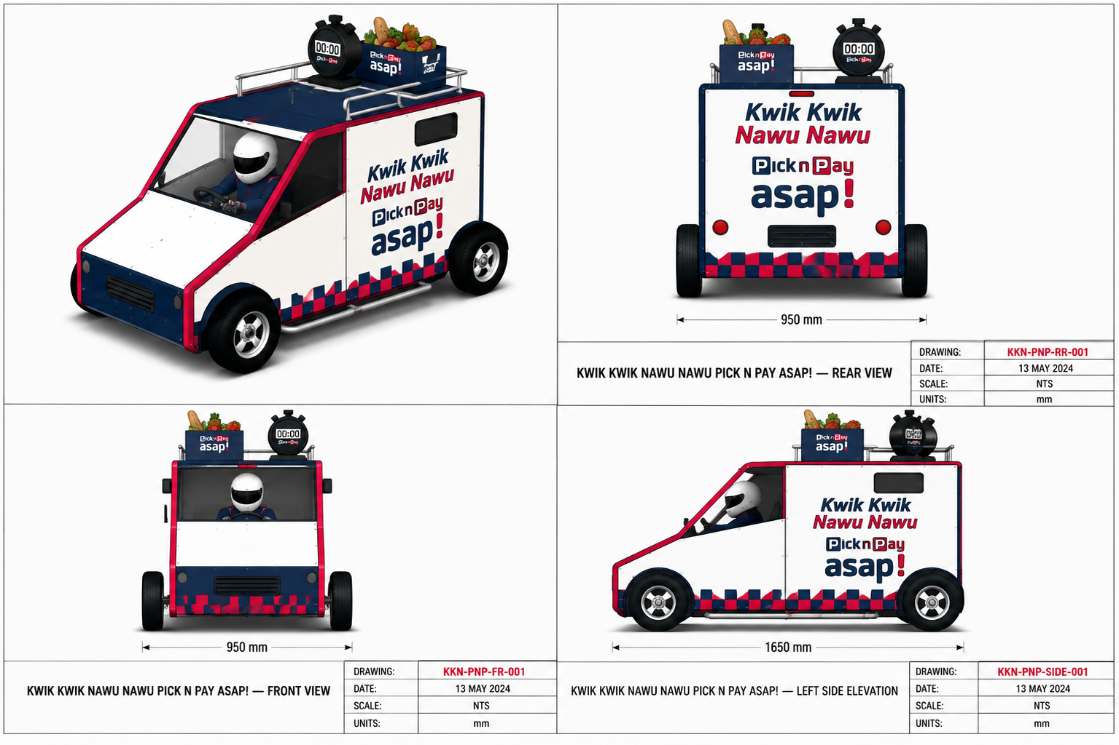
OUR STORY
Why "Kwik Kwik Nawu Nawu"?
The name "Kwik Kwik Nawu Nawu" was born from a playful South African phrase that people often say when something's happening quickly, like, "I'll be back now now." It captures the sense of speed and urgency in everyday life. For our team, it perfectly reflects the excitement of racing against the clock, whether in deliveries or in the Red Bull Box Car Race. It also carries a uniquely South African humour that makes the name both familiar and memorable..
⚡ Speed
Inspired by the fast-paced world of on-demand delivery.
😄 Humor
A distinctly South African phrase that audiences instantly recognize and love.
🏁 Urgency
The thrill of racing against time — both on the road and on the track.

Slide 5
THE CONCEPT
The Fastest Grocery Delivery in South Africa
Our cart tells a story — from order to doorstep, every second counts. Each race obstacle becomes a delivery challenge.
01
02
Order Placed
Shop picks
Customer taps "Buy Now."
Order pulled from shelves.
03
04
Pack & Load
Race Begins
Groceries boxed, cart loaded.
Cart launches — traffic awaits.
05
06
Obstacles = Traffic
Finish Line = Delivered
Each hurdle is a delivery delay.
Order complete. Customer happy.

Slide 6

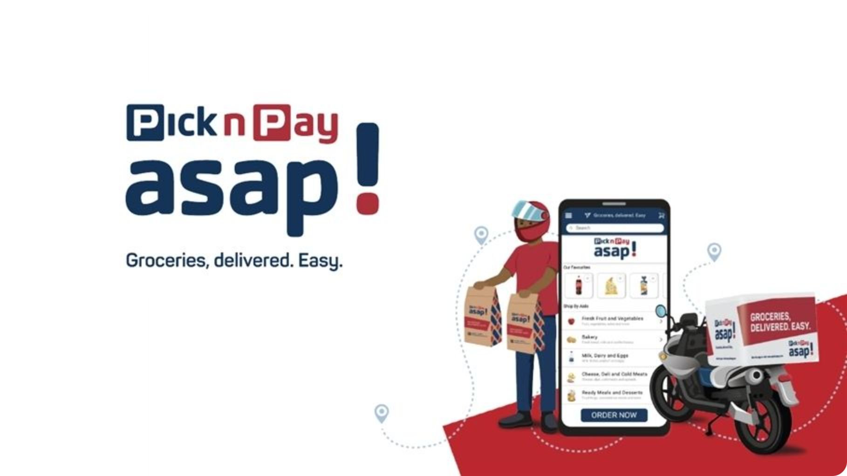
PARTNERSHIP FIT
Why Pick N Pay asap!?
Pick n Pay isn't just a retailer — it's a national institution built on speed, innovation, and customer obsession. These are the exact values that drive our team.
SA's Largest Retailer
Unmatched national brand recognition and customer trust.
Innovation & Technology
A brand that invests in tech-forward solutions — just like engineering students.
Fast Delivery Promise
Speed is your brand. Speed is our race. The alignment is perfect.
National Reach
From Cape Town to Johannesburg — Pick n Pay is everywhere South Africans are.

Slide 7
DESIGN
The Cart: Engineering Meets Brand Story
Proposed Cart Design

Slide 8
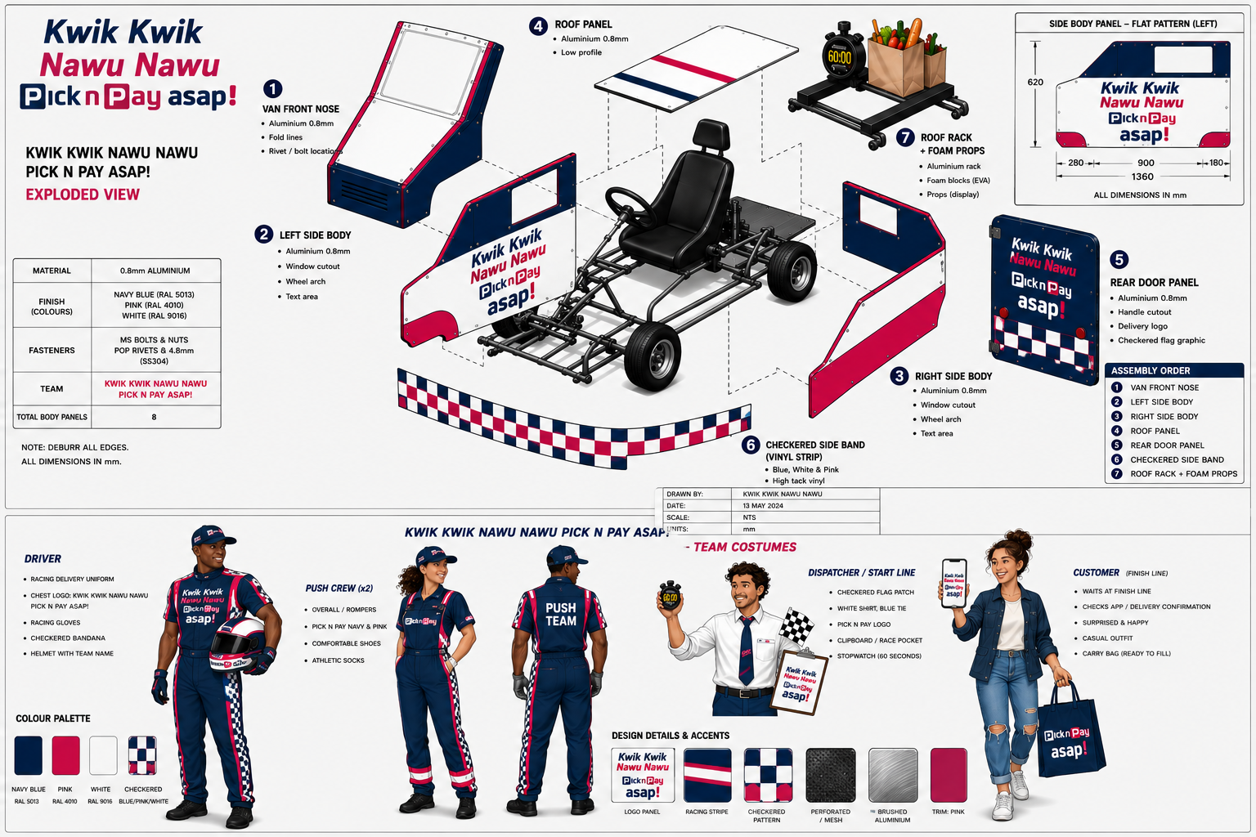
The Cart: Engineering Meets Brand Story
Costumes and Exploded view

Slide 9
BRAND VALUE
Brand Visibility & What We Offer
Pick n pay brand will be seen, shared, and celebrated — on track, online, and in the media.
Vehicle Branding
Team Uniforms
Full Pick n Pay delivery on the race cart.
Branded apparel at every public appearance.
Social Media
Photography & Media
Build-up content, race-day reels, and behind-the-scenes footage.
Professional photo and video assets for Pick n Pay's channels.
Media Interviews
Red Bull Exposure
Red Bull event coverage with Pick n Pay mentions.
Live audience, broadcast, and digital reach.

Slide 10
Budget Breakdown
Full costing for a 2-month build and event weekend in Sandton
Item | Detail | Cost (ZAR)
Build space (Cape Town) | R10k/month × 2 months | R20,000
Cart materials | Chassis, tires, panels | R30,000
Tools | Rentals + consumables | R6,000
Spare parts | ~12% of materials | R3,500
First aid kit | Build-site kit | R900
Costumes | 5 people, branded (or PnP in-kind) | R6,000
Transport to Sandton | Flights + cart courier | R32,500
Accommodation | 3 nights, house rental | R6,000
Local transport (Uber) | Build phase + airport transfers | R4,000
Food | Labour + The weekend event | R10,000
SUBTOTAL
R121,000
CONTINGENCY (10%)
R12,100
TOTAL ASK
R135,000
Rounded for clean planning
KWIK KWIK NAWU NAWU × PICK N PAY
01

