Slide 1
JSP
나만의 웹 포트폴리오 제작
201644008 2-A 박규민
ls_al@kakao.com

Slide 2
JSP Project
UI Navigator – General
Main Page
Portfolio
Journey
About Me
Contact
Page List
Login
Post Detail
Root Auth

Slide 3
JSP Project
UI Navigator – Root auth
Main Page
Portfolio
Journey
About Me
Contact
Page List
Logout
Post Insert
Post Detail
General
Post Update
Post Delete

Slide 4
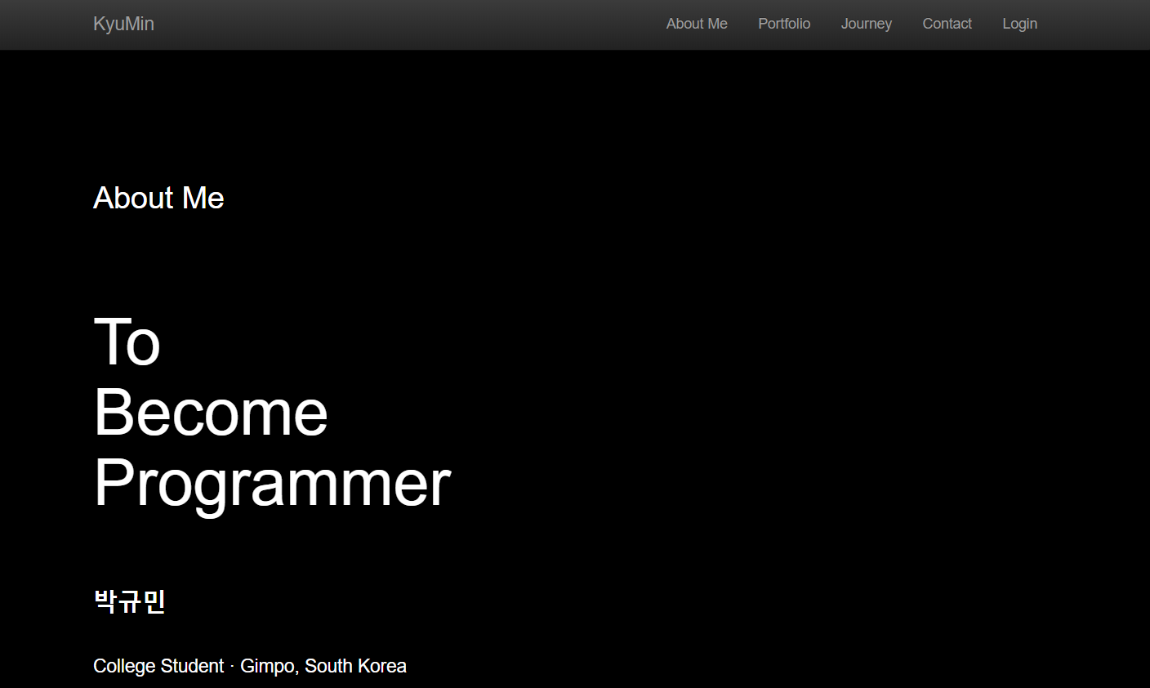
JSP Project
Screen Design – “/”, “KyuMin”, “About Me”

Slide 5
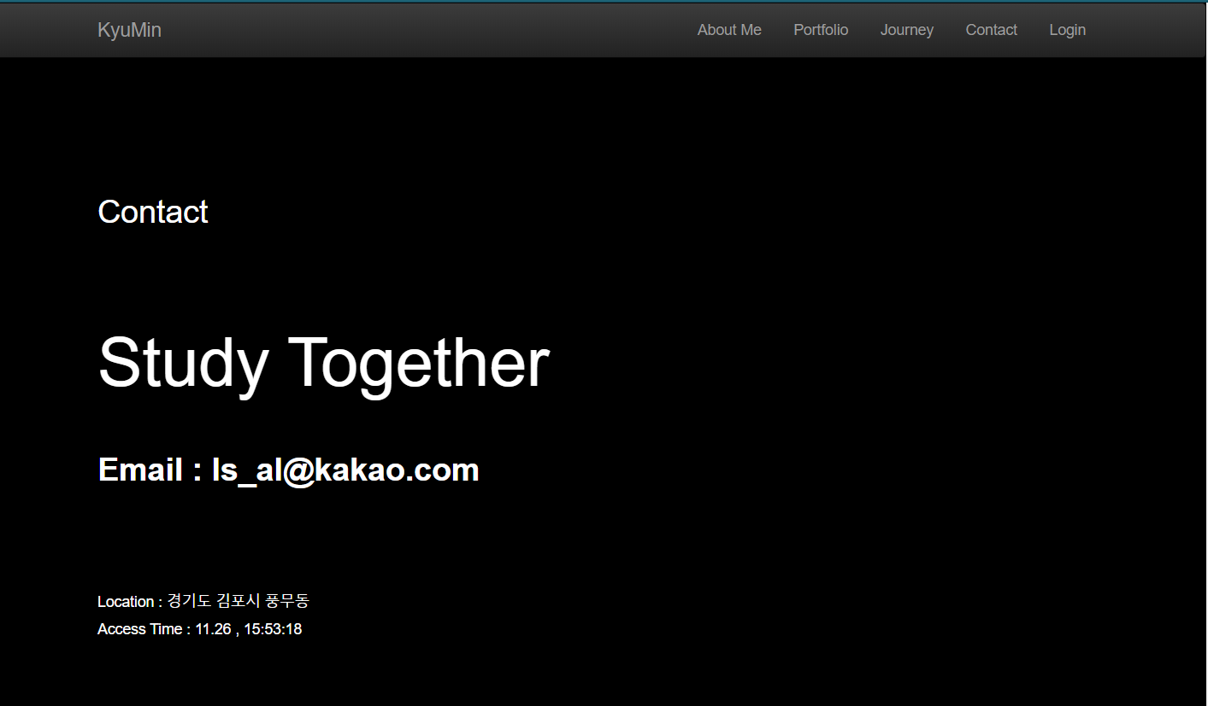
JSP Project
Screen Design – “Contact”

Slide 6
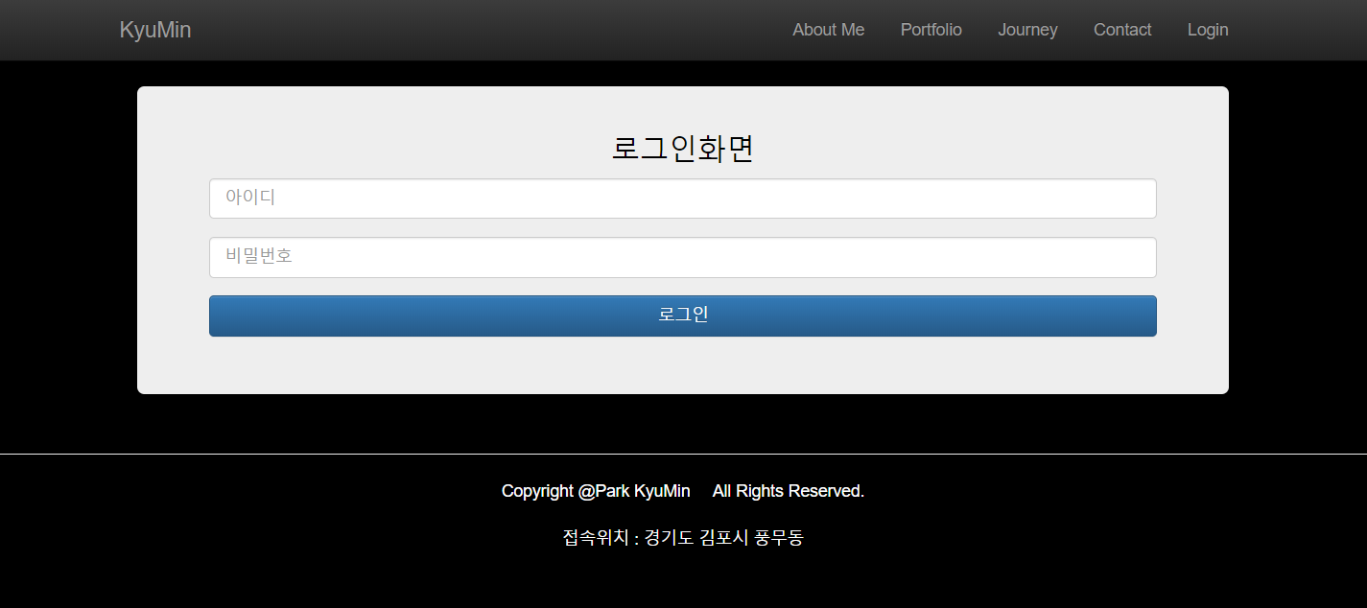
JSP Project
Screen Design – “Login”

Slide 7
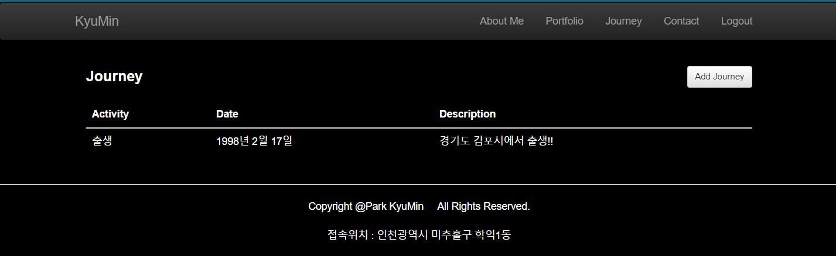
JSP Project
Screen Design – “Journey”

Slide 8
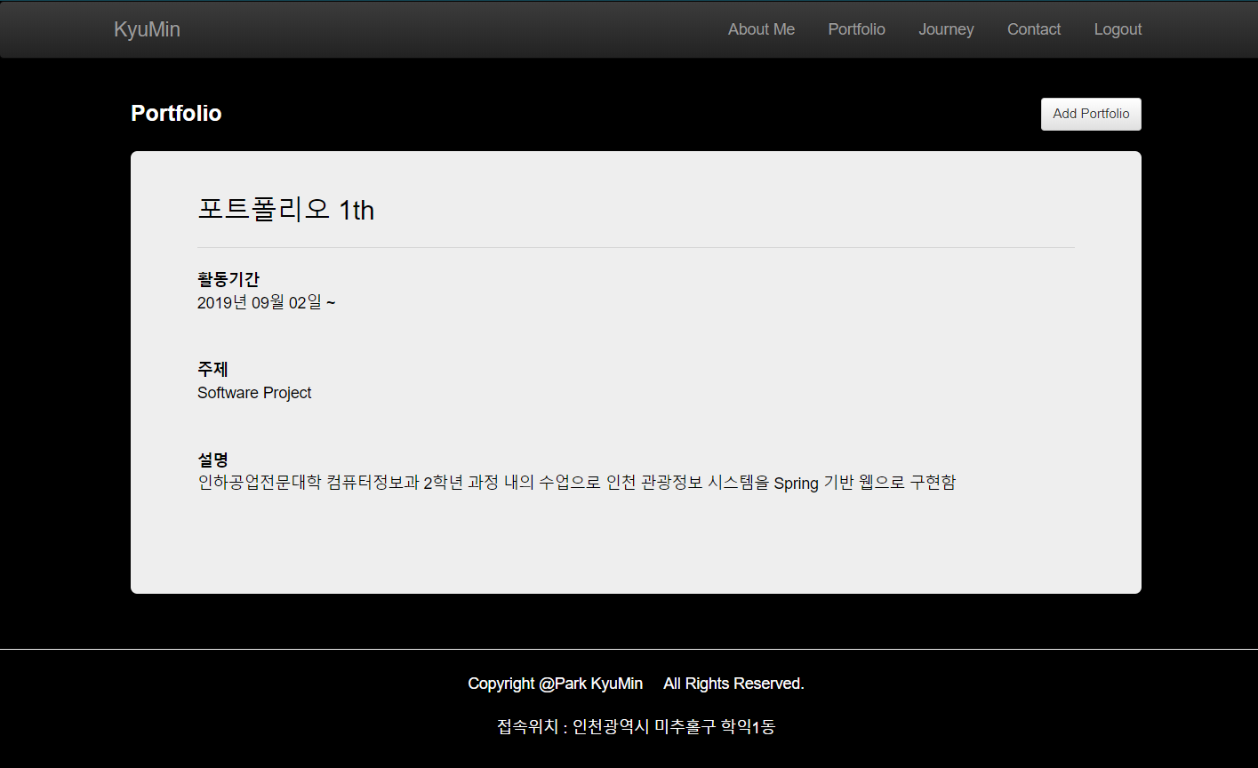
JSP Project
Screen Design – “Portfolio”

Slide 9
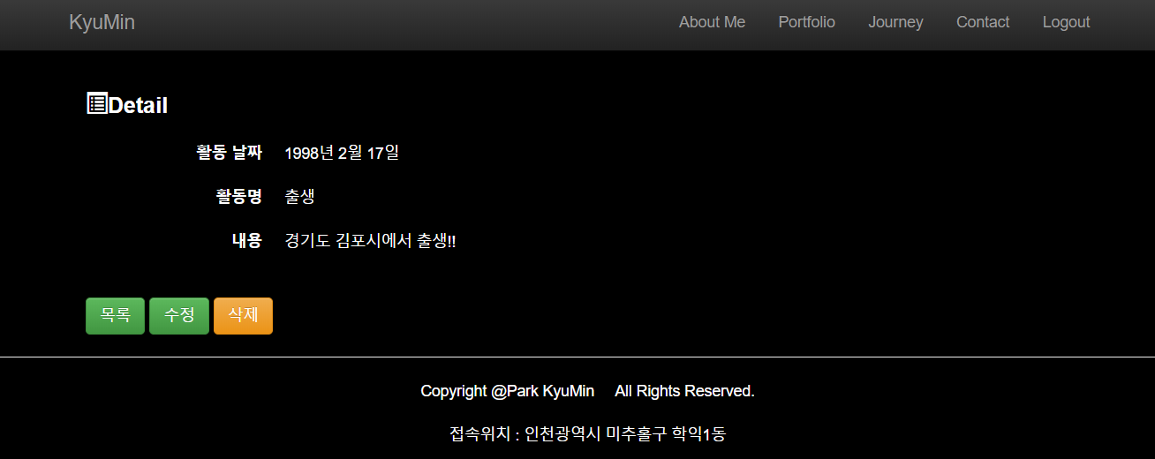

JSP Project
Screen Design – “JourneyDetail”

Slide 10
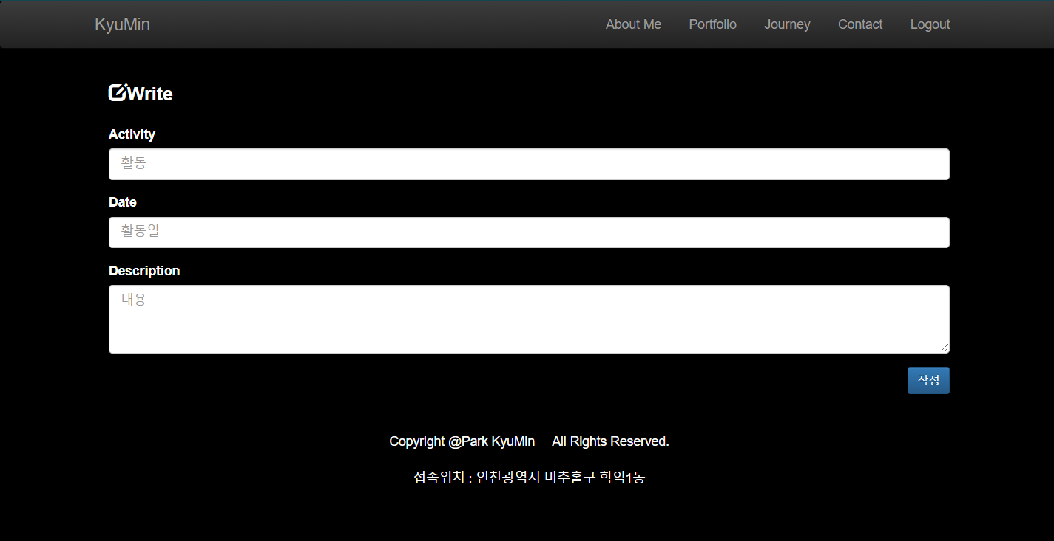
JSP Project
Screen Design – “JourneyInsert”, “JourneyUpdate”

Slide 11
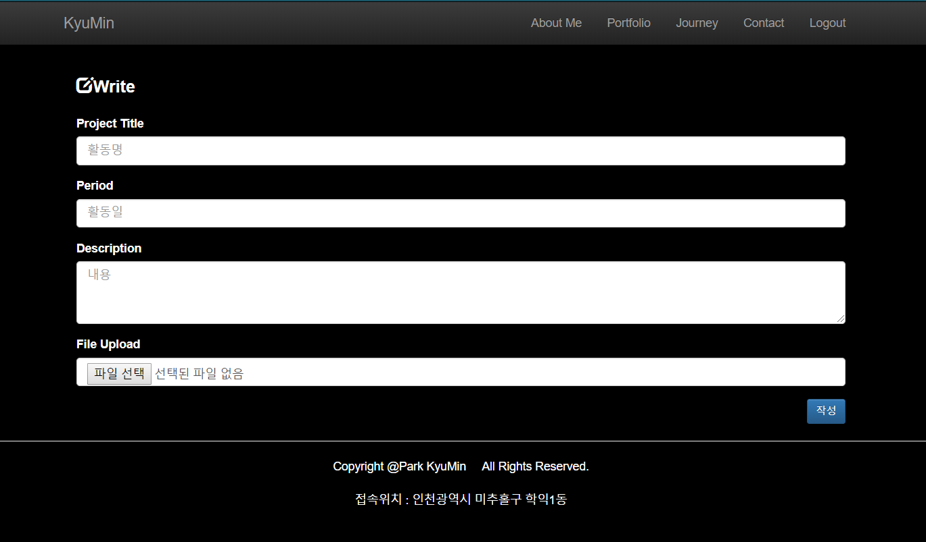
JSP Project
Screen Design – “PortfolioInsert”

Slide 12
THANK YOU

