Slide 1
인천 관광
시스템
201644008
박규민

Slide 2
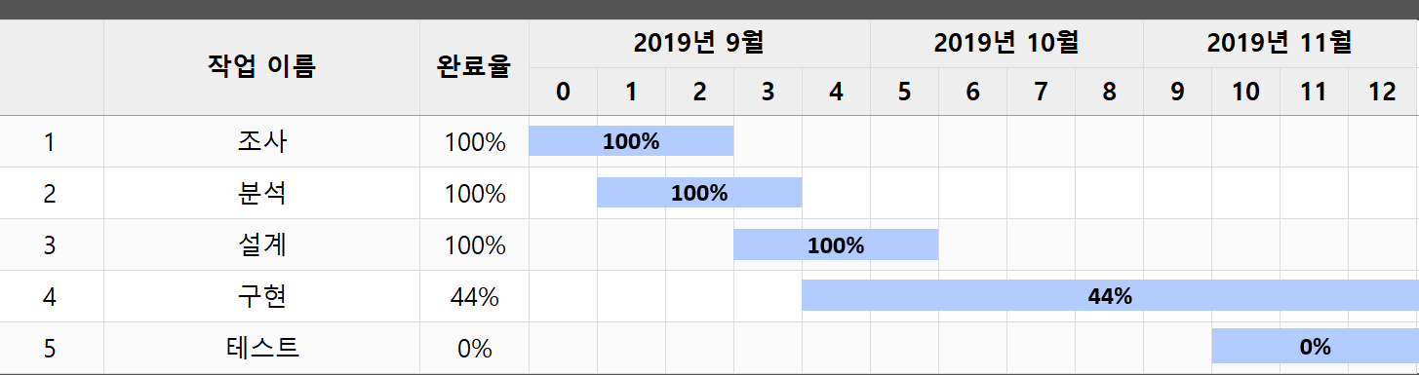
일정

Slide 3
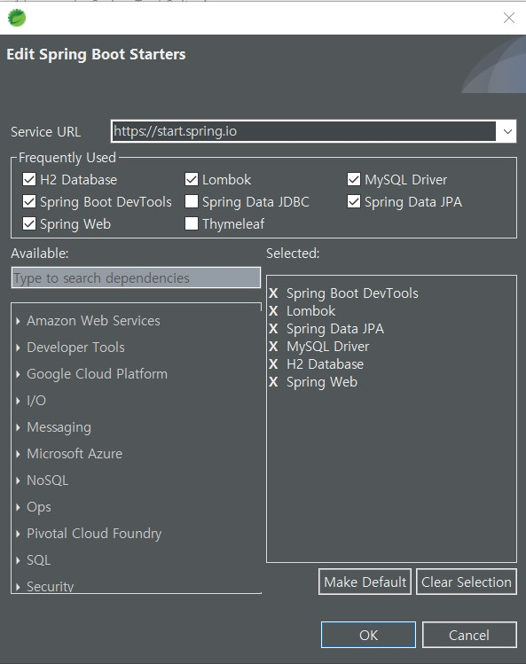
JPA-Mysql
<dependency> <groupId>org.apache.tomcat.embed</groupId> <artifactId>tomcat-embed-jasper</artifactId> <scope>provided</scope> </dependency> <dependency> <groupId>javax.servlet</groupId> <artifactId>jstl</artifactId> </dependency>

Slide 4
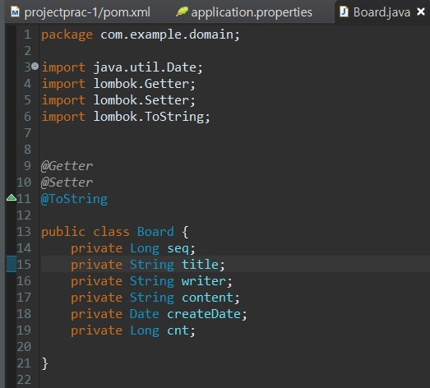

JPA-Mysql

Slide 5
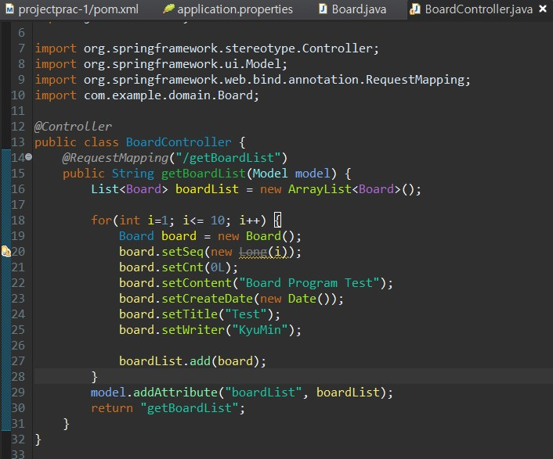
JPA-Mysql

Slide 6
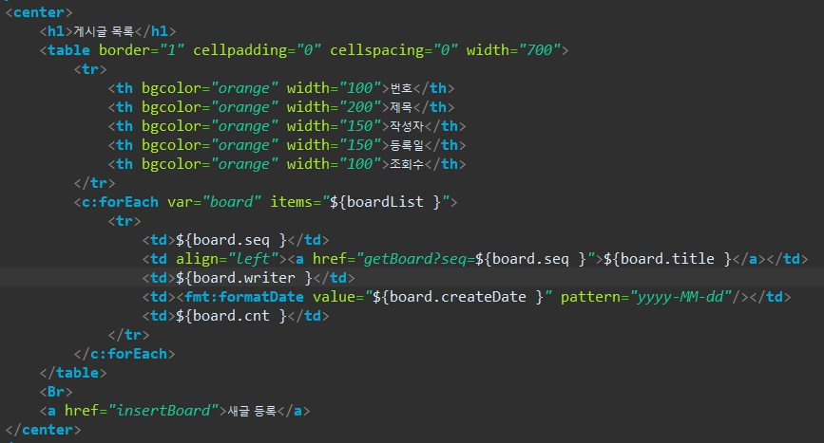
JPA-Mysql

Slide 7
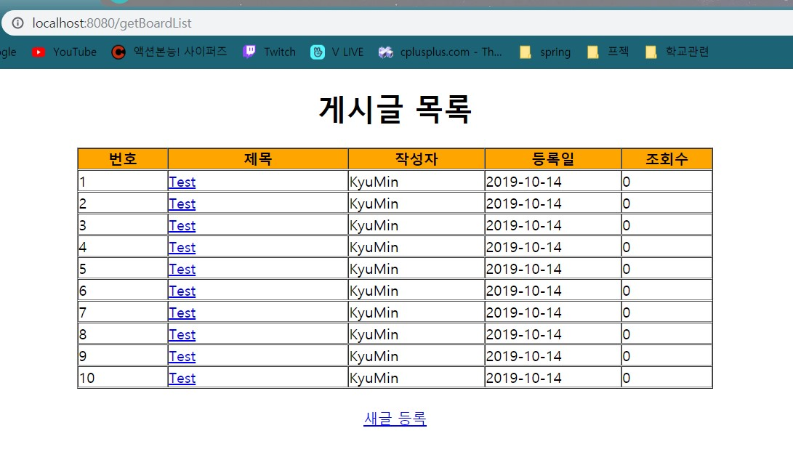
JPA-Mysql

Slide 8
JPA-Mysql
# BoardServicelmpl.java
@Service
Public class BoardServicelmpl{
@Autowired
Private BoardRepository boardRepo;
Public List<Board> getBoardList(Board board)
return (List<Board> boardRepo.findAll();
…이후 CRUD Define
- DB Query
# application.properties
Spring.jpa.hibernate.ddl-auto=create
Spring.jpa.generate-ddl=false
Spring.jpa.show-sql=true
…
- JPA 설정
#BoardRepository.java
Public interface BoardRepository extends CrudRepository<Board, Long>{ }
- Repository interface(DB와 관련 표시)

Slide 9
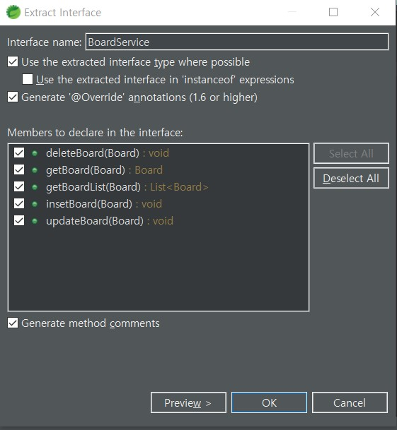
JPA-Mysql
# BoardService.java
Public interface BoardService{
List<Board> getBoardList(Board board);
Void insertBoard(Board board);
Board getBoard(Board board);
Void updateBoard(Board board);
Void deleteBoard(Board board);
}
- Service interface
Class -> Service

Slide 10
JPA-Mysql

Slide 11
JPA-Mysql
# BoardController.java
@Autowired
Private BoardService boardservice;
@RequestMapping(“/getBoardList”)
Public String getBoardList(Model model, Board board){
List<Board> boardList = boardService.getBoardList(board);
Model.addAttribute(“boardList”, boardList);
Return “getBoardList”;
}
- Component set

Slide 12
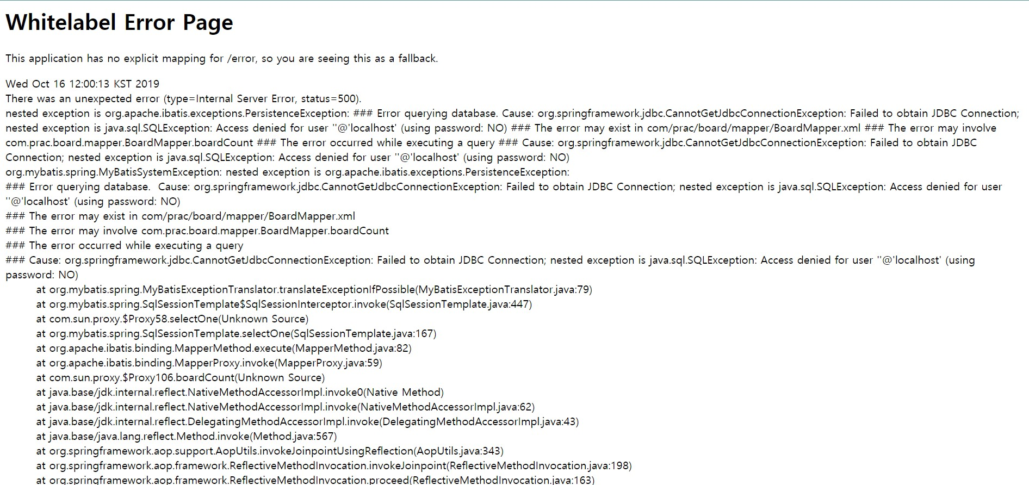

Slide 13
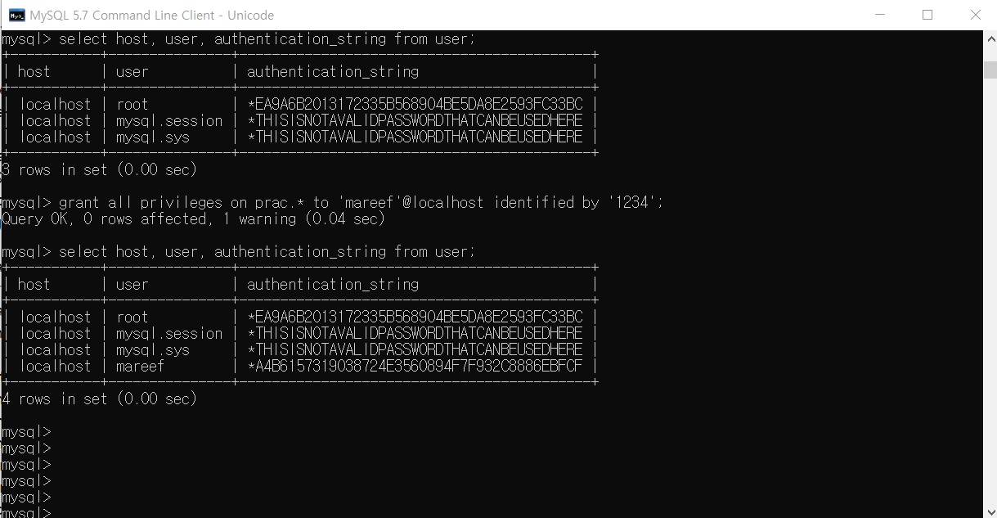
access denied for user ''@'localhost' (using password: no)
Mysql
User, Auth 설정

Slide 14
차주 계획
시험
DB 해결

Slide 15
감사합니다

