Slide 1
인천 관광
시스템
201644008
박규민

Slide 2
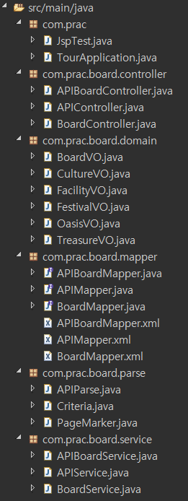
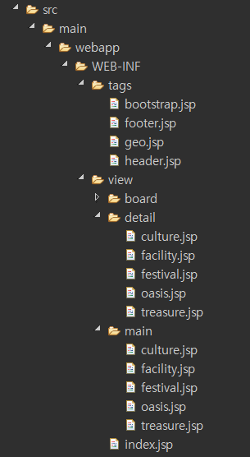
Spring Structure

Slide 3
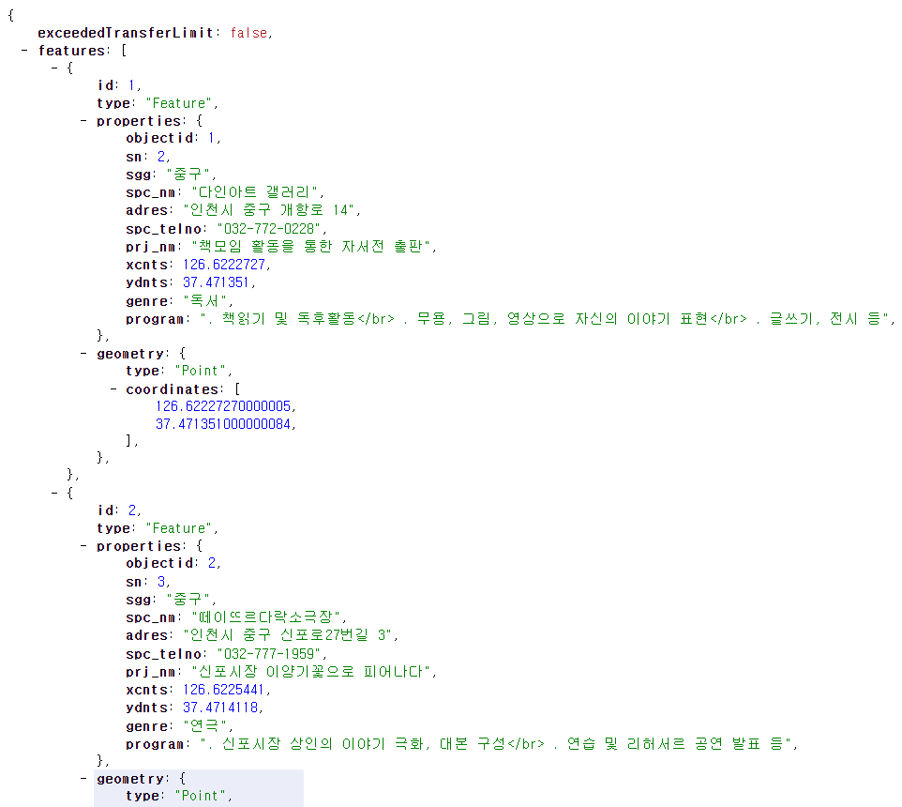
Spring API Parsing
Oasis
{ features [
{
properties {
#data
}
}
{
…

Slide 4
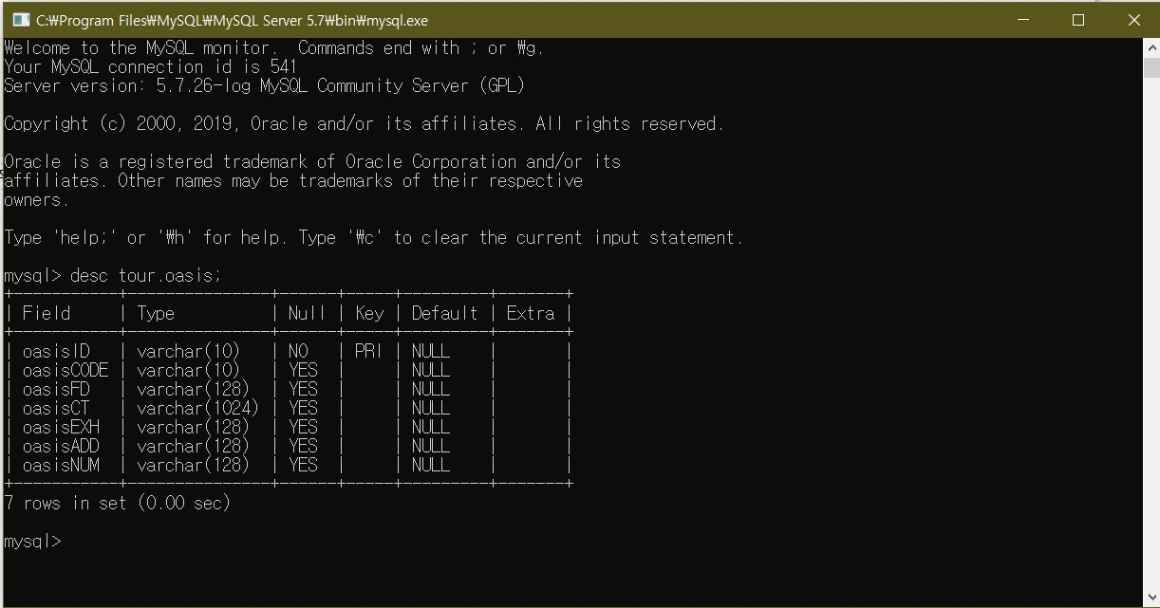
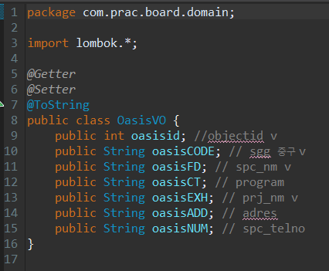
Spring API Parsing
Oasis

Slide 5
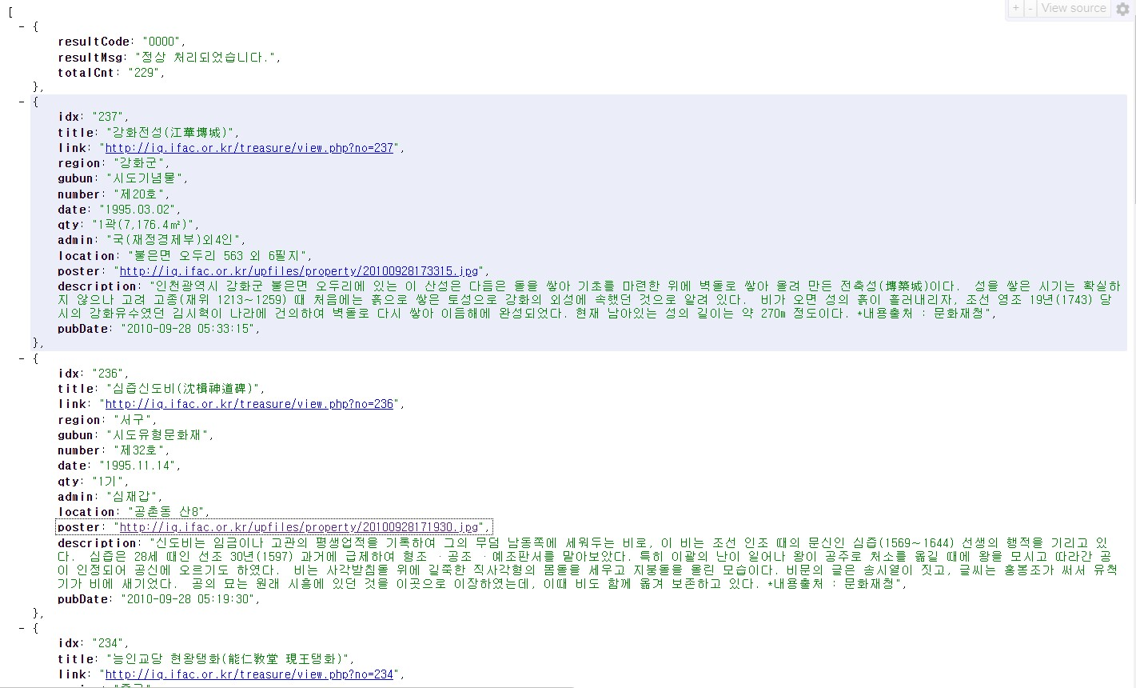
Spring API Parsing
Treasure
[ {
resultSet
}
{
#data
}
…

Slide 6
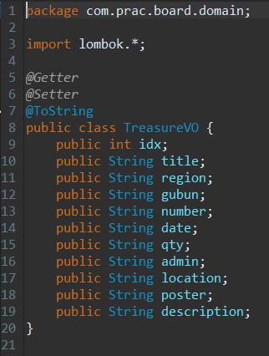
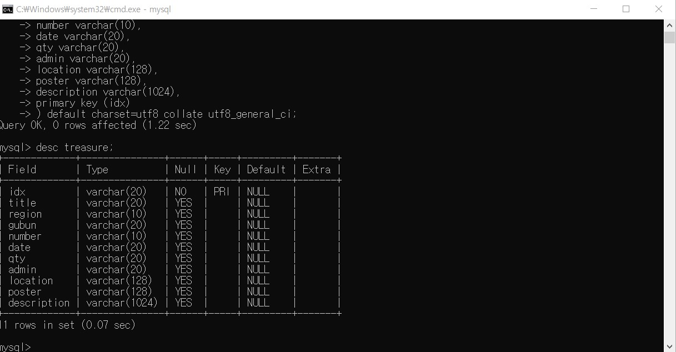
Spring API Parsing
Treasure

Slide 7
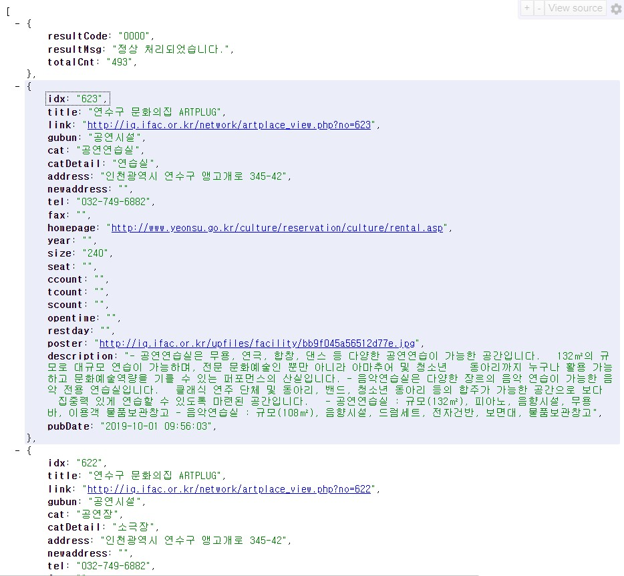
Spring API Parsing
Facility
[ {
resultSet
}
{
#data
}
…

Slide 8
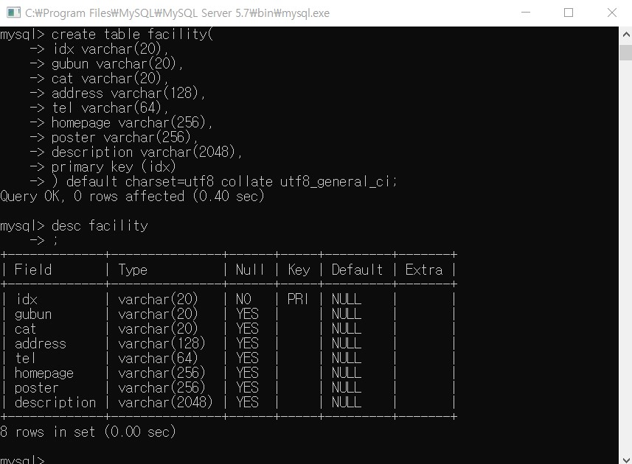
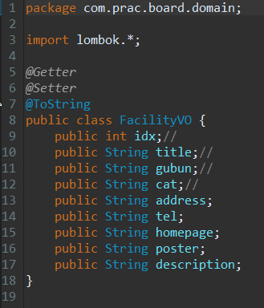
Spring API Parsing
Facility

Slide 9
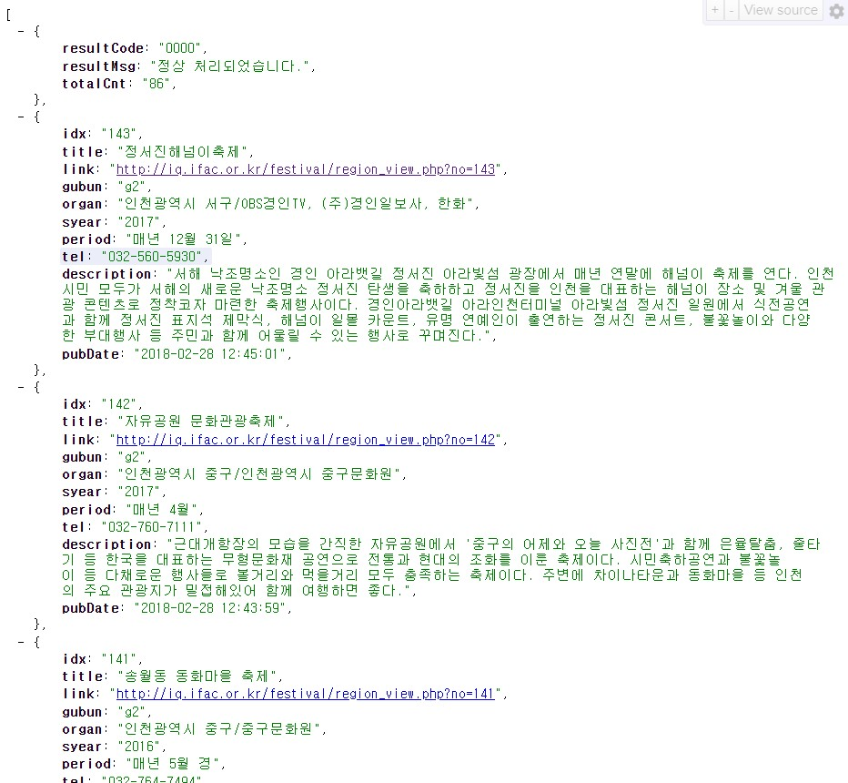
Spring API Parsing
Festival
[ {
resultSet
}
{
#data
}
…

Slide 10
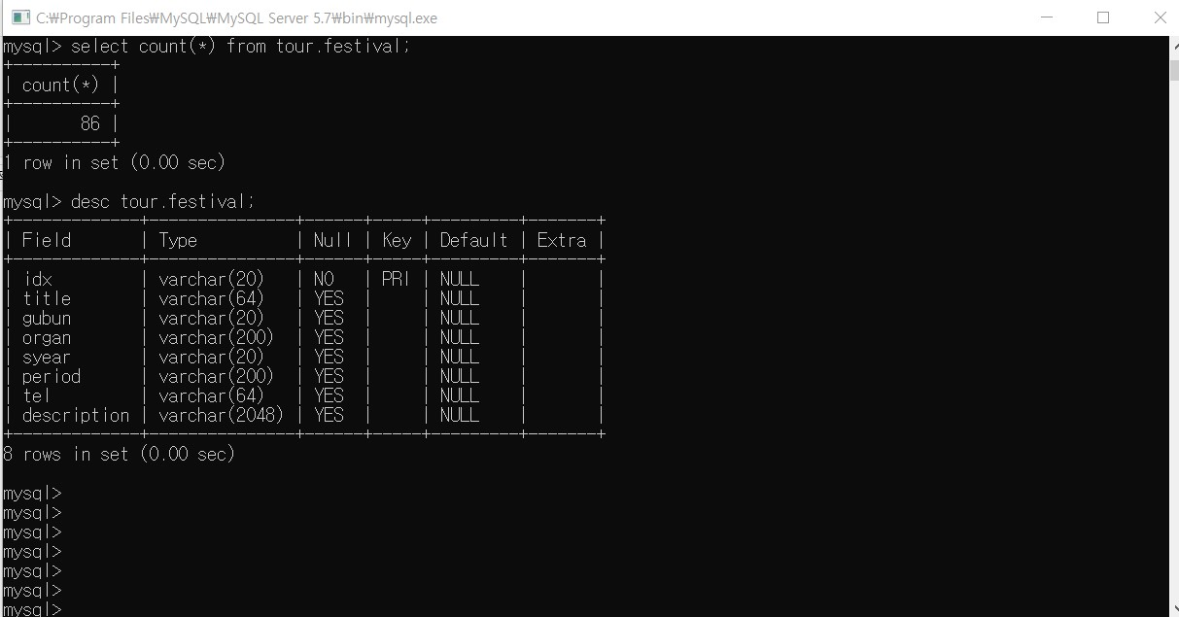
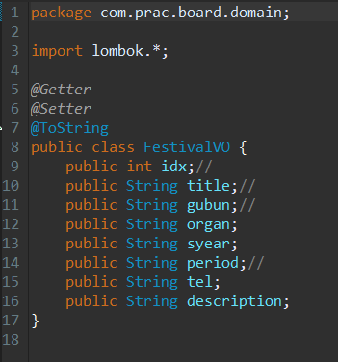
Spring API Parsing
Festival

Slide 11
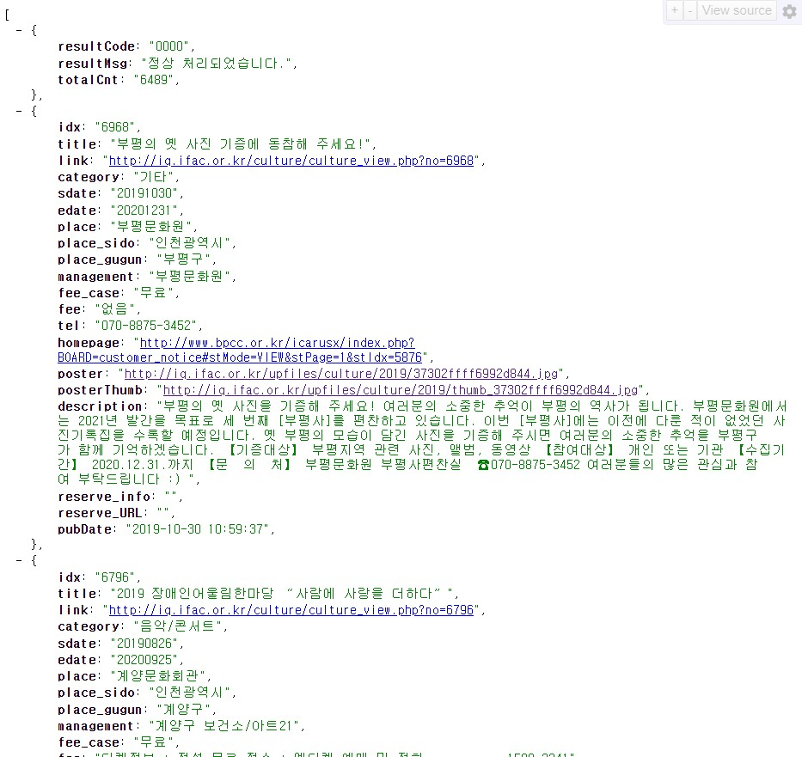
Spring API Parsing
Culture
[ {
resultSet
}
{
#data
}
…

Slide 12
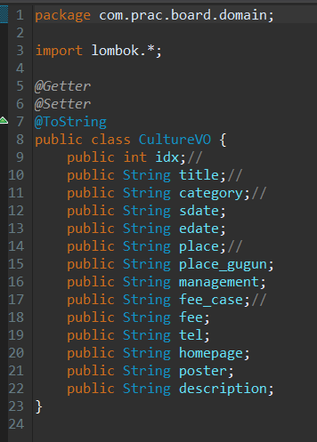
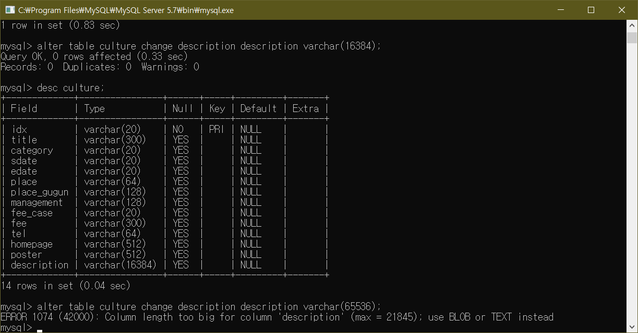
Spring API Parsing
Culture

Slide 13
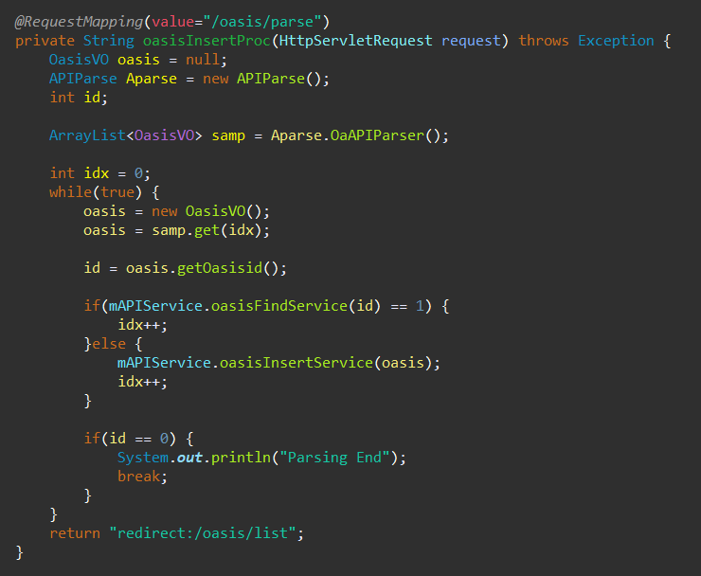
MVC - Controller

Slide 14
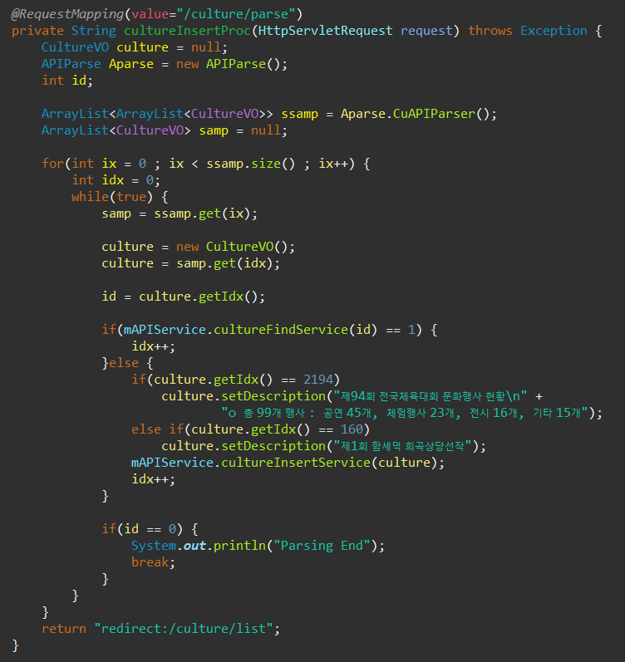
MVC - Controller

Slide 15
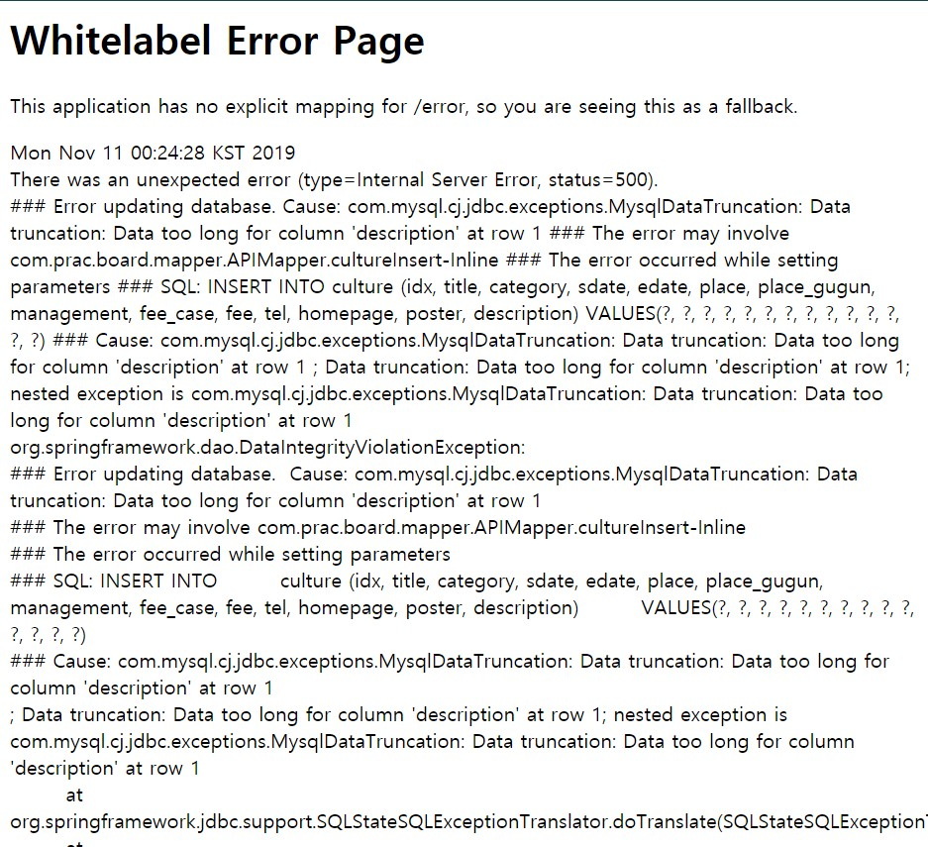
MVC - Controller

Slide 16
MVC - Controller

Slide 17
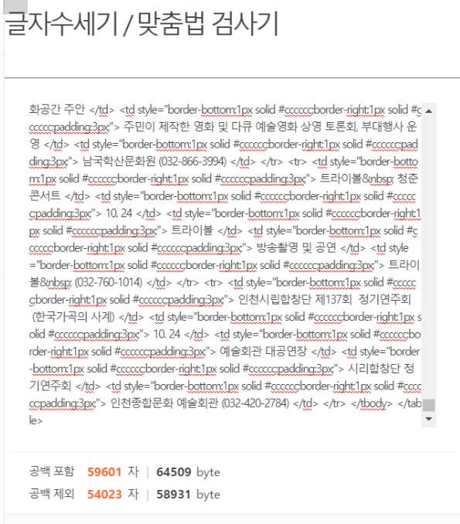
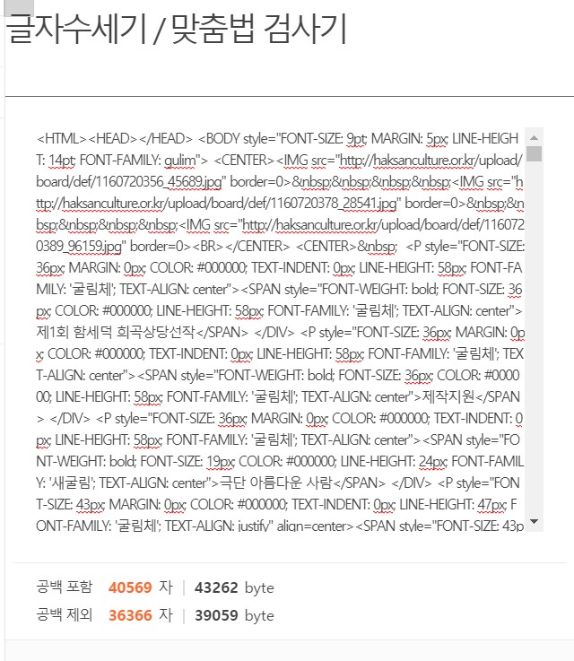
MVC - Controller

Slide 18
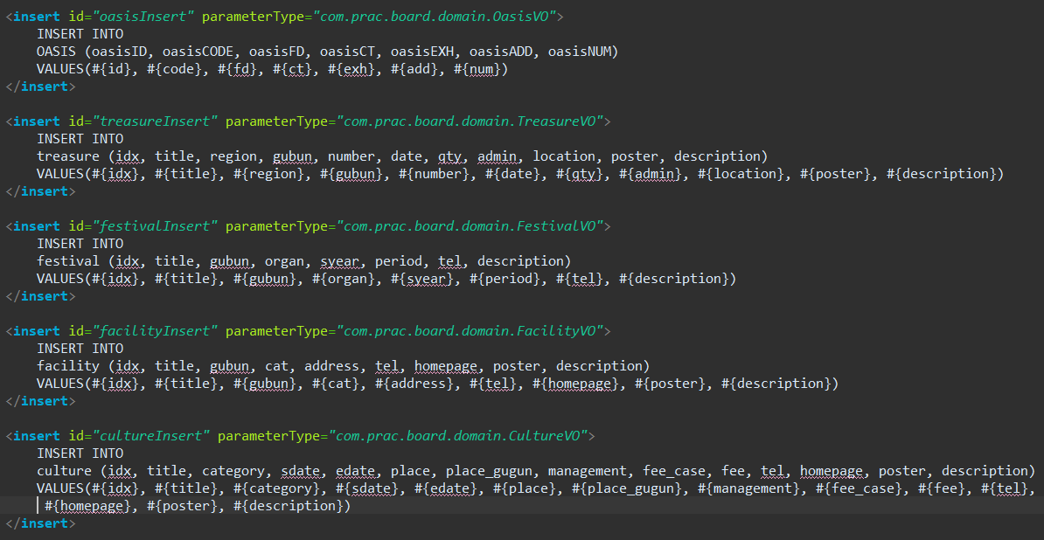
MVC – Model

Slide 19
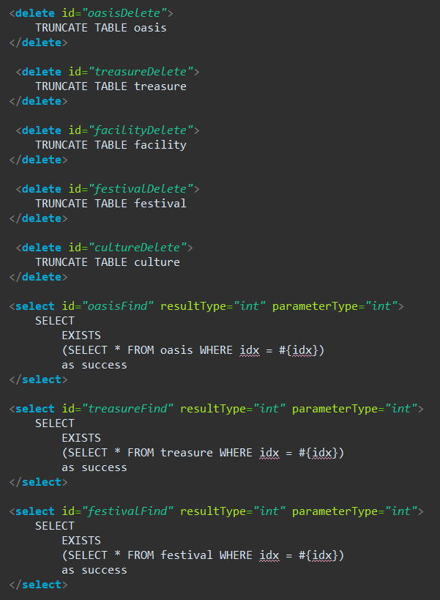
MVC – Model

Slide 20
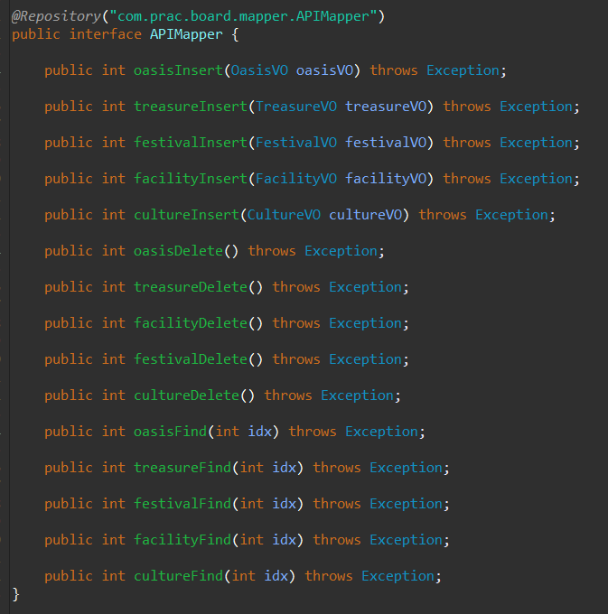
MVC – Model

Slide 21
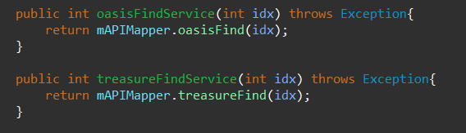
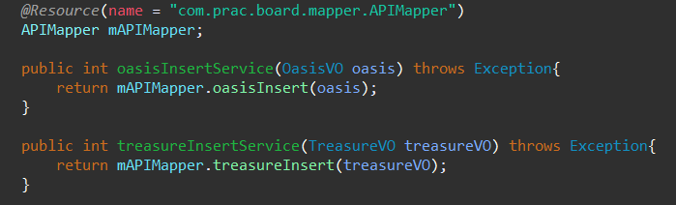
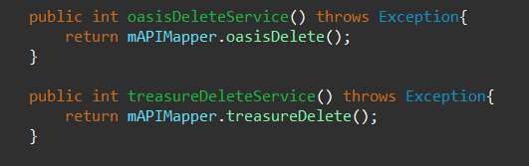
MVC – Model

Slide 22
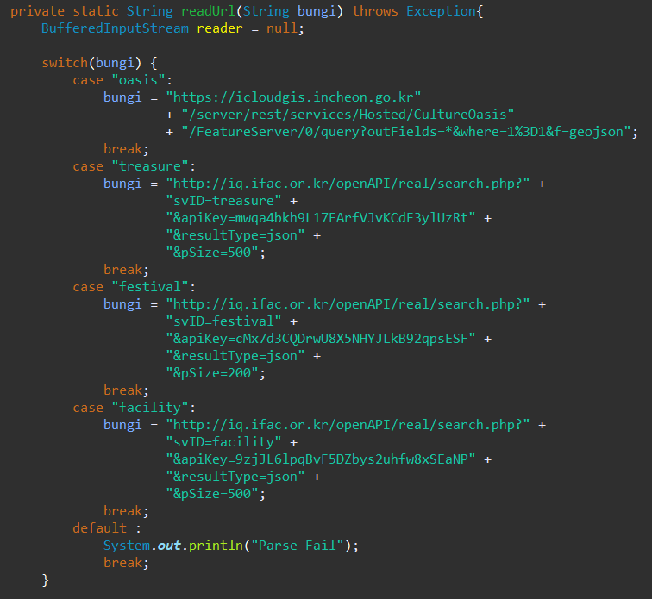
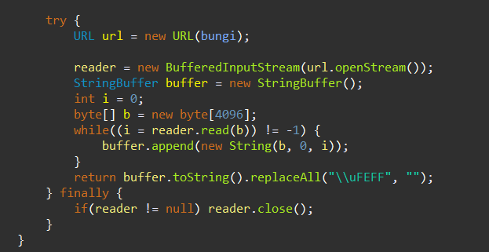
MVC – Model

Slide 23
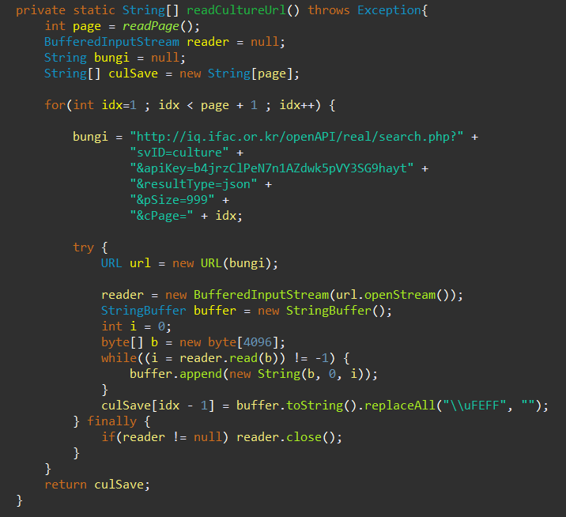
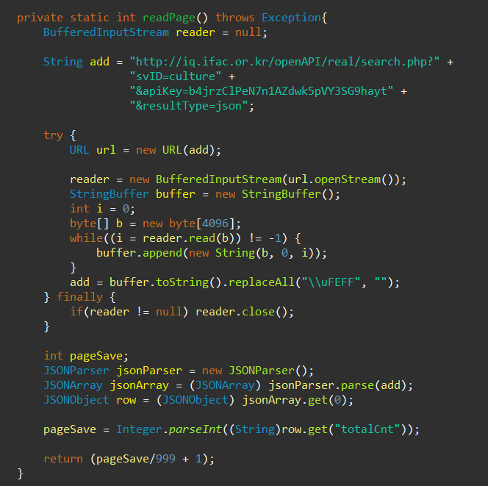
MVC – Model

Slide 24
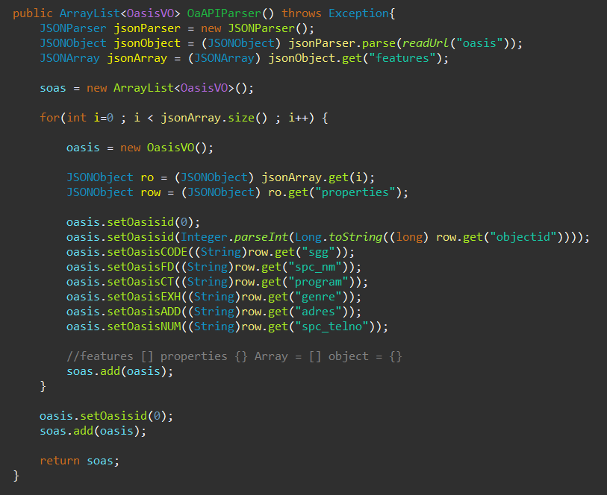
MVC – Model

Slide 25
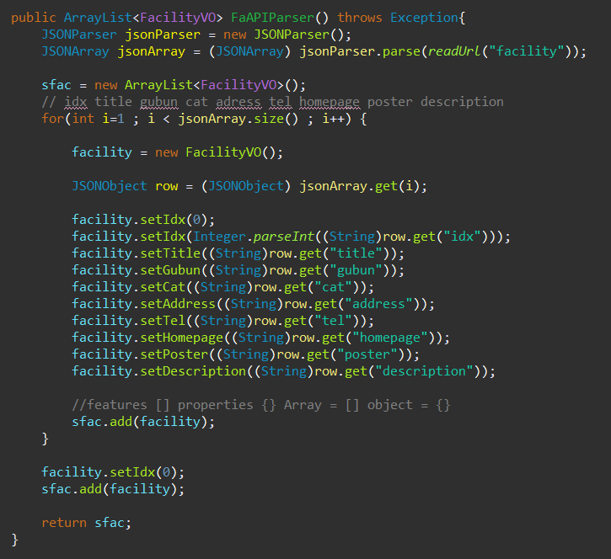
MVC – Model

Slide 26
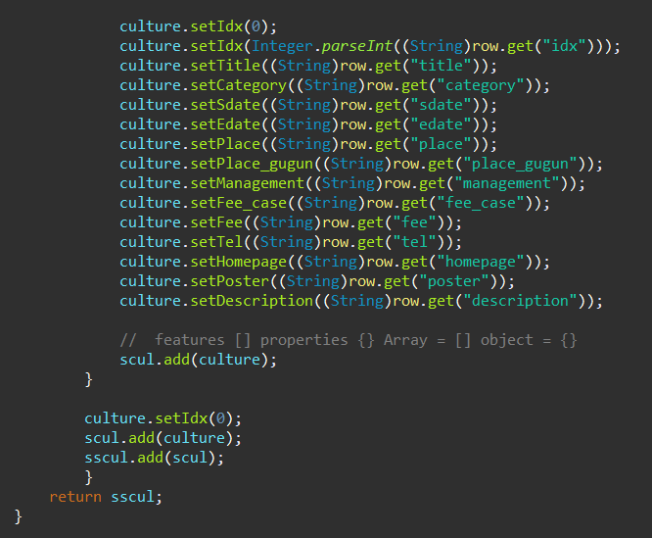
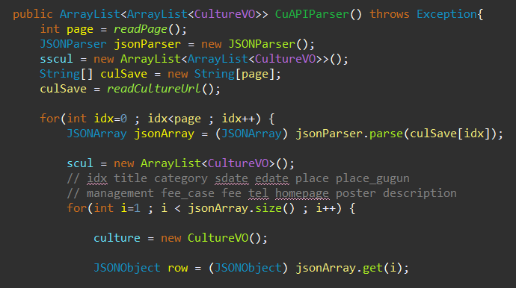
MVC – Model

Slide 27
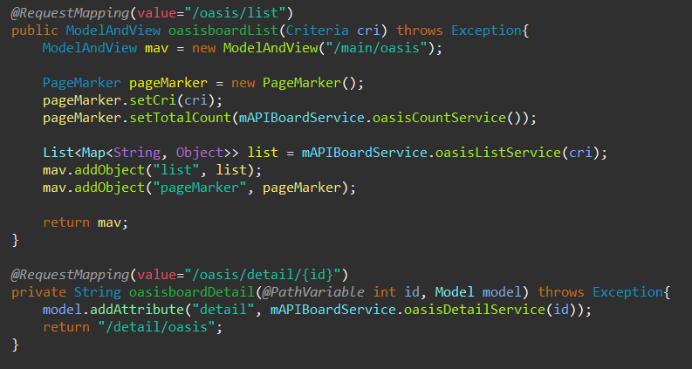
MVC - Controller

Slide 28
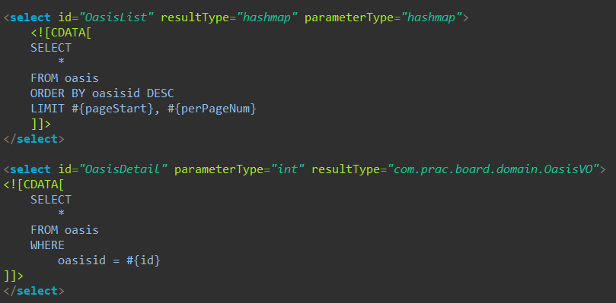
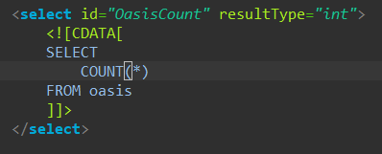
MVC - Model

Slide 29
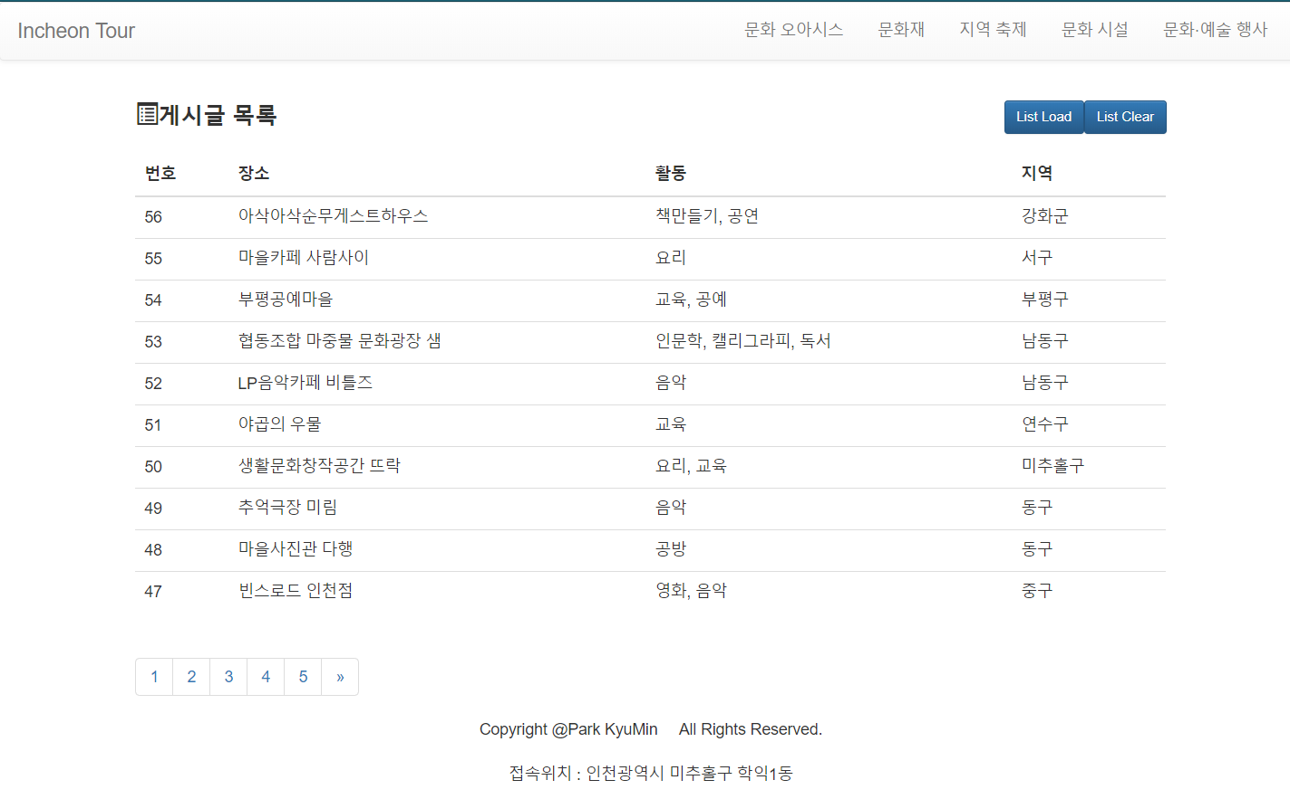
MVC - View

Slide 30
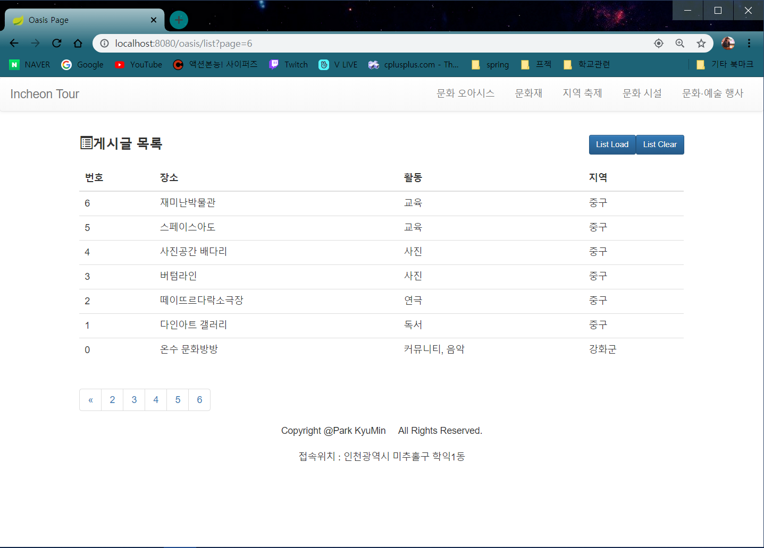
MVC - View

Slide 31
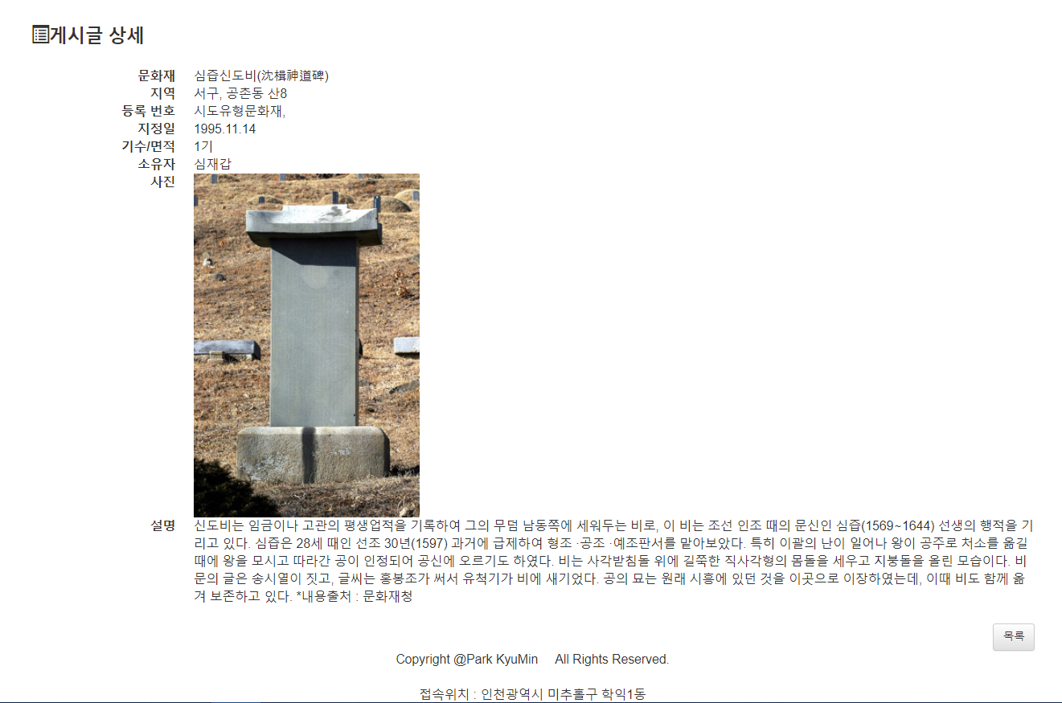
MVC - View

Slide 32
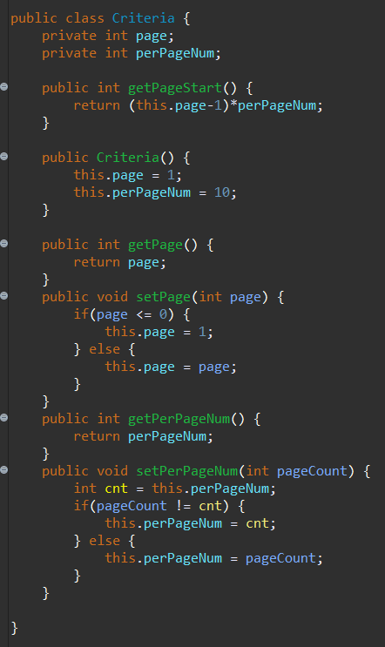
MVC – View
Paging

Slide 33
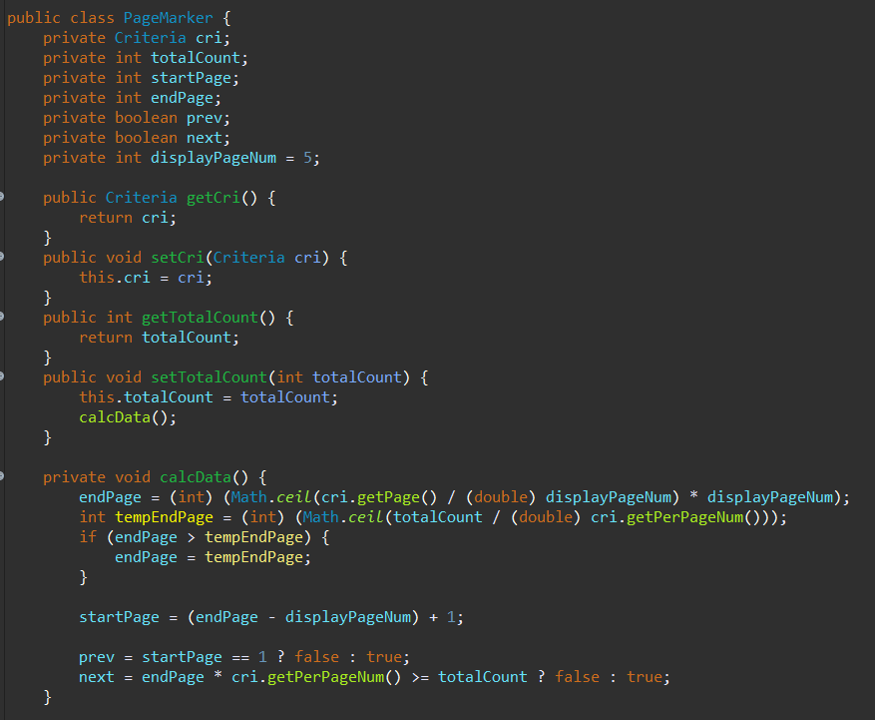
MVC – View
Paging

Slide 34
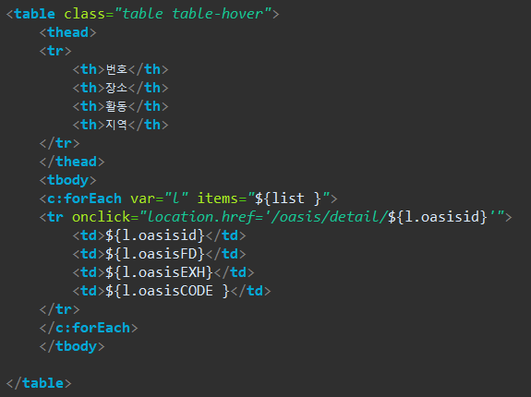
MVC - View

Slide 35
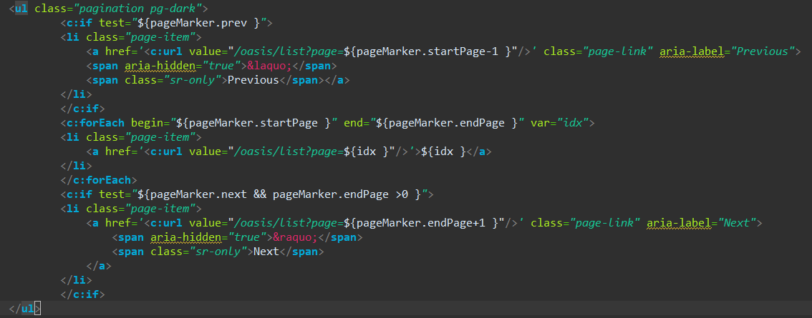
MVC - View

Slide 36
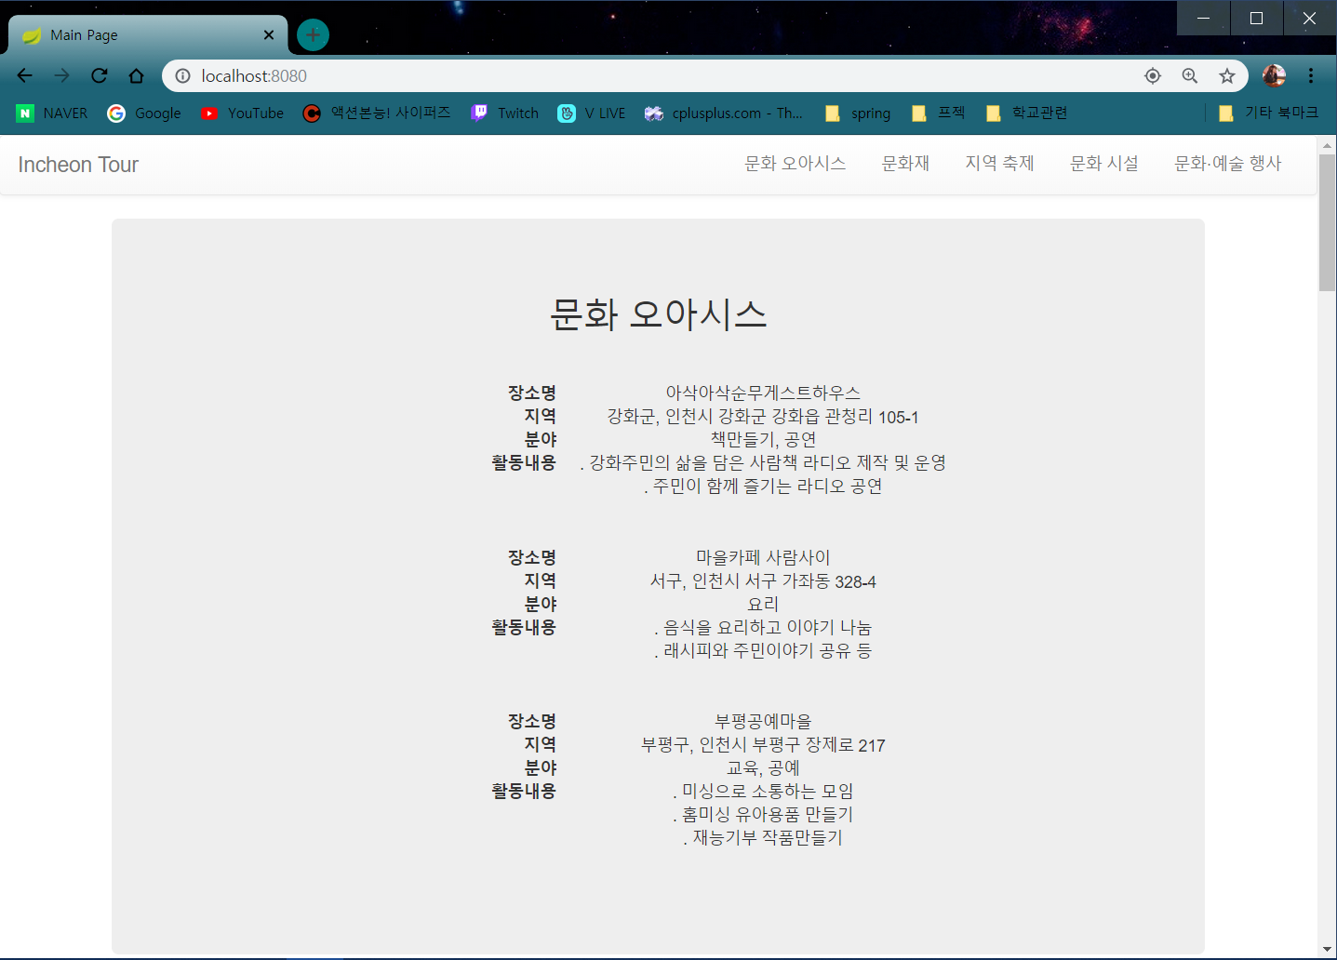
MVC - View

Slide 37
차주 계획
Main Page // BootStrap
시간/공간적 데이터 활용 // @RequestParam

Slide 38
감사합니다

