Slide 1
Dramatic entré

Slide 2
THE
SQUAD GAMES
Five posts that test your skills: problem solving, knowledge, speed etc.
Gain or loose money — don’t worry, not real money.
We play with an imaginary currency: fc (flex-coins).
All teams start wit 100fc in their bank.
The team with highest balance in their bank at the end of the Game– wins!

Slide 3
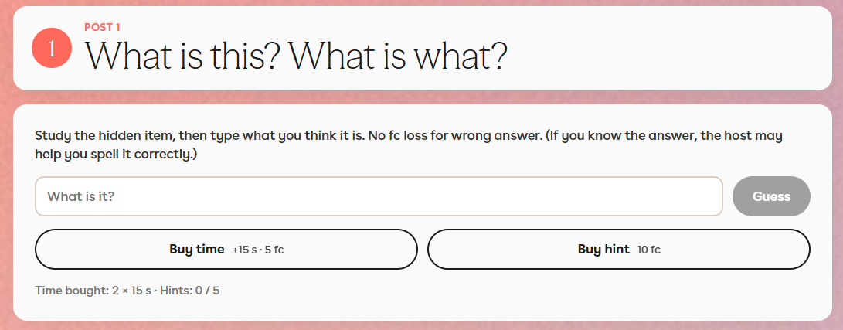

Slide 4
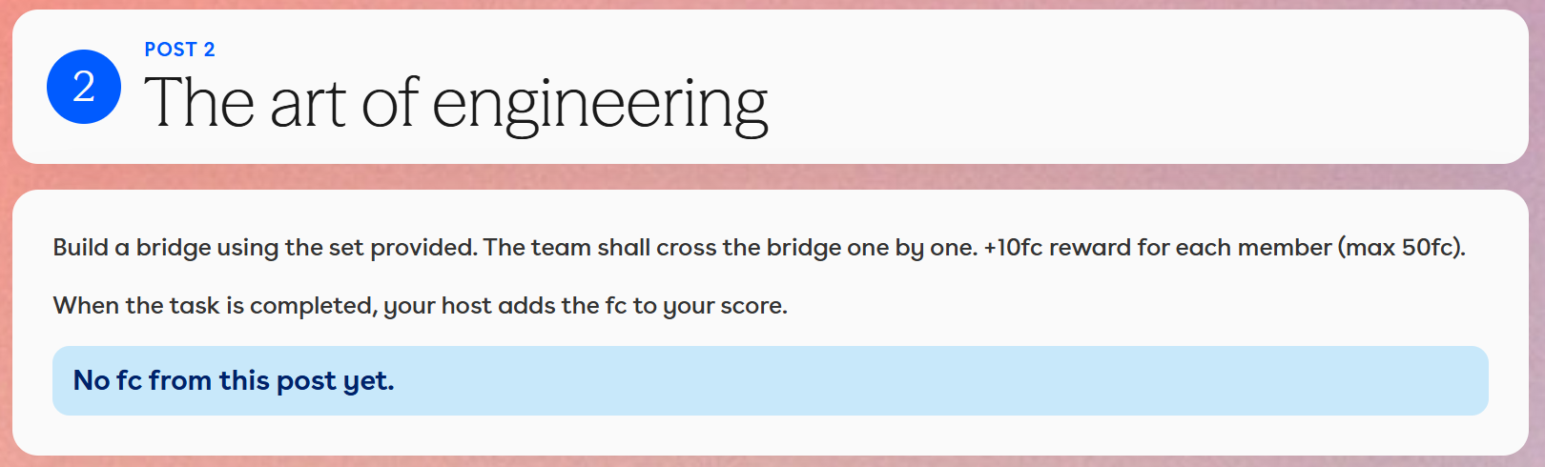

Slide 5
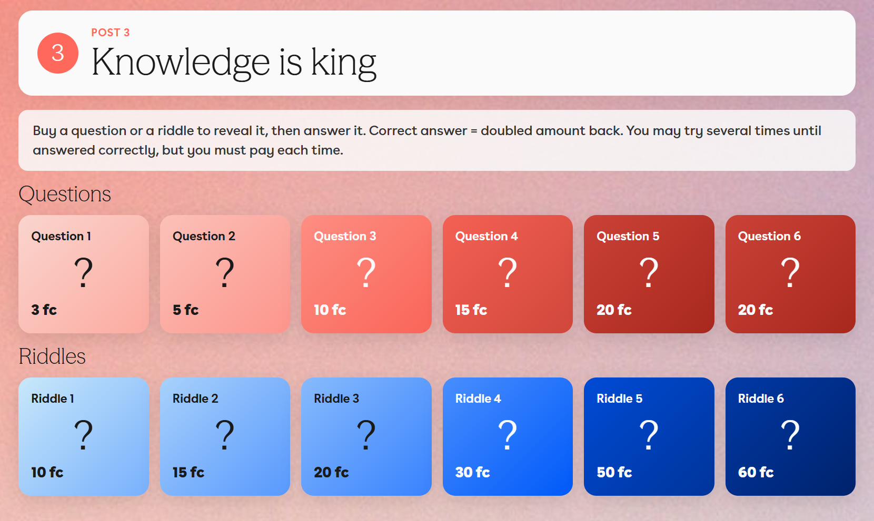

Slide 6
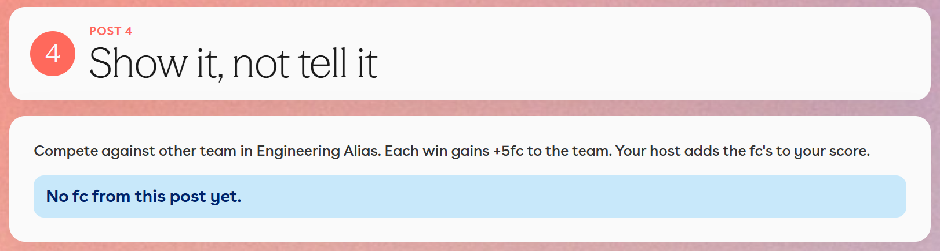

Slide 7
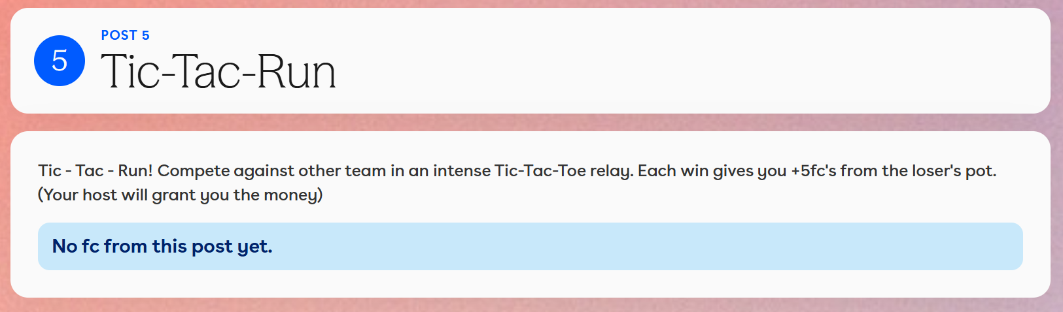

Slide 8
The Rules
Use of AI, web-search, etc is not allowed ,unless clearly instructed by the Host.
Dirty tricks allowed. You may buy or steal information from other teams, as well as set them up for failure.
The game ends at 17:30:00 CET.
The Host at the post execute the rules, and has the right to add a fee for breaking the rules of the game or fair play.
In case of severe violation of the rules the team can be disqualified.
The Game Master has the final word in case of any objection or disagreement.

Slide 9
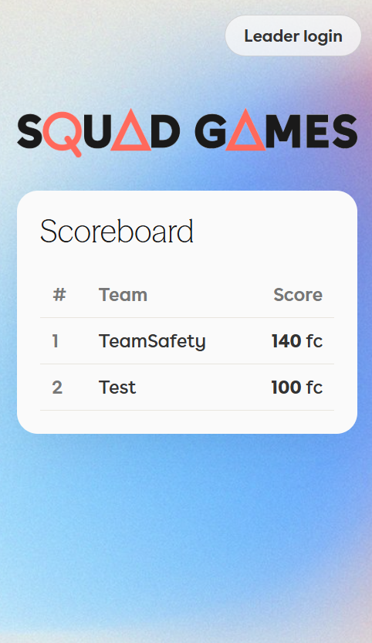
How do we play?
Go to: squadgames.tech
If you are a team leader – go to «Leader login»
If not, ignore the button and just follow the scores live

Slide 10
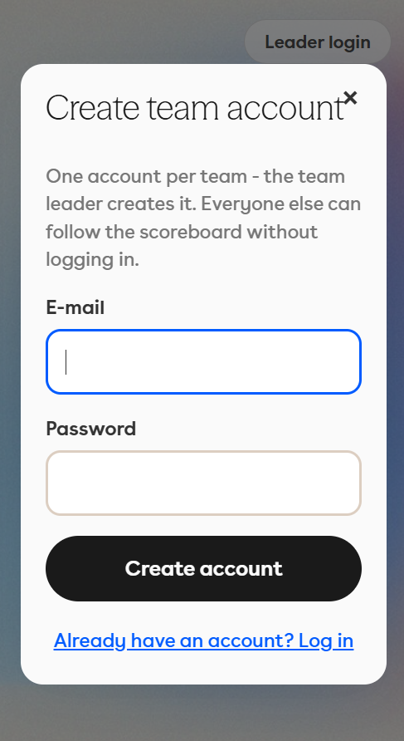
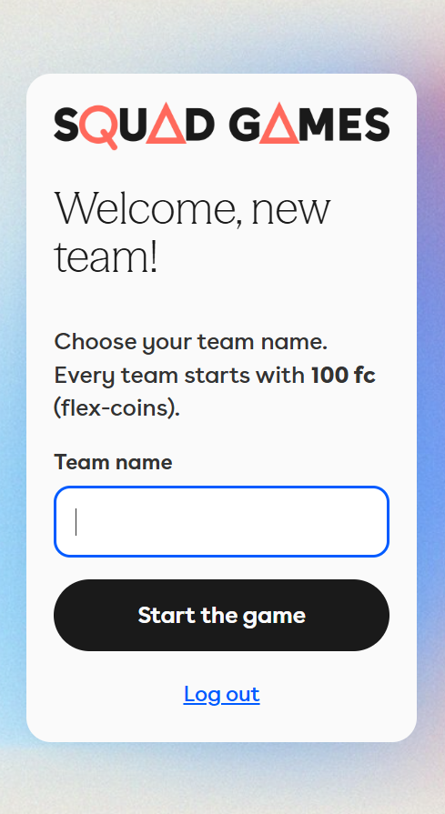
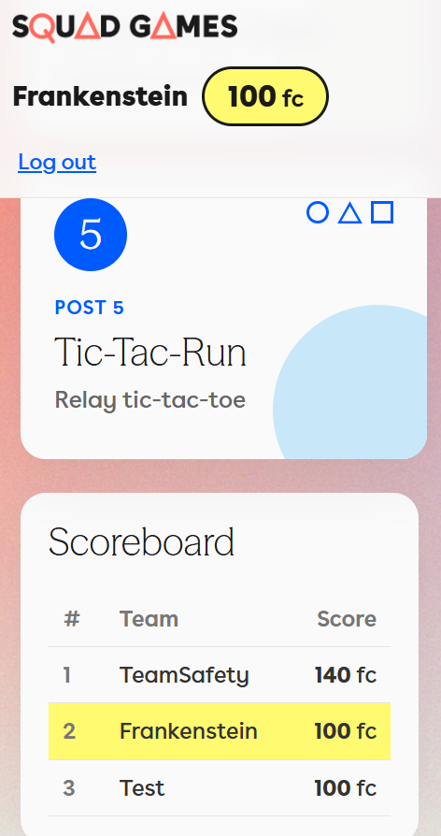
For leaders only:
Create account using e-mail and password.
Select a name for your team
(to be shown in the scoreboard)
You should have your team name and score shown on top and highlighted on the scoreboard.
Contact Game Master if any question.

Slide 11
Disclaimers
All activity related to the game happens at own risk of the contestant.
The App runs in Firebase, (hosting, database and authentication). It is to be de-activated or deleted after the game.
The game does not contain or store any sensitive information or intelectual property of the company.

