Slide 1
Chernobyl
Marek Chyra, Lukáš Hvizdoš, Marek Horňák

Slide 2
Content
Impact on nature
Impact on land
Air pollution
Gamma rays
Half-life of elements in reactor

Slide 3
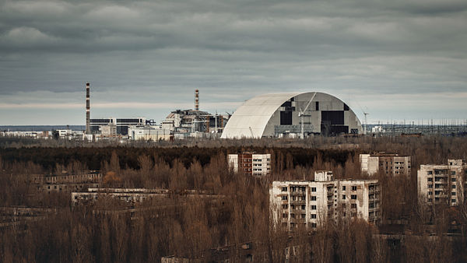
Impact on nature
The explosion caused the death of wildlife, basically the death of e.g. pigeons.
According to reports by Soviet scientists, the Chernobyl accident (September 1990) reached radioactive fallout levels of up to 4.81 GBq/m² in a 10 km zone around the plant.
The "red forest" of pine trees destroyed by the strong radioactive fallout lies in this 10 km zone, starting just behind the reactor complex.
The name of the forest comes from the days after the accident, when the trees appeared dark red as they died from the effects of radiation.
The Red Forest area has remained one of the most contaminated areas in the world.

Slide 4
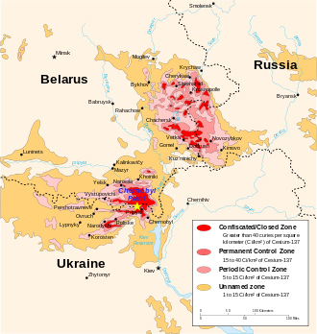
Impact on land
toxic/radioactive substances have leaked into the soil and drinking water supplies
within a radius of 10 km, plants began to die and within a wider radius they began to mutate
landscapes affected by the accident: Belarus, Ukraine, Russia, Sweden, Finland, Austria, Norway, Bulgaria, Switzerland, Greece, Slovenia, Italy and Moldova

Slide 5
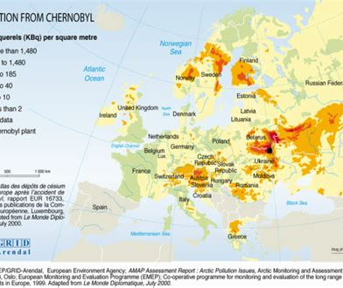
Air pollution
high concentration of these elements: Iodine-131 (I-131), Caesium-134 (Cs-134), and Caesium-137 (Cs-137) were present in air currents of Europe

Slide 6
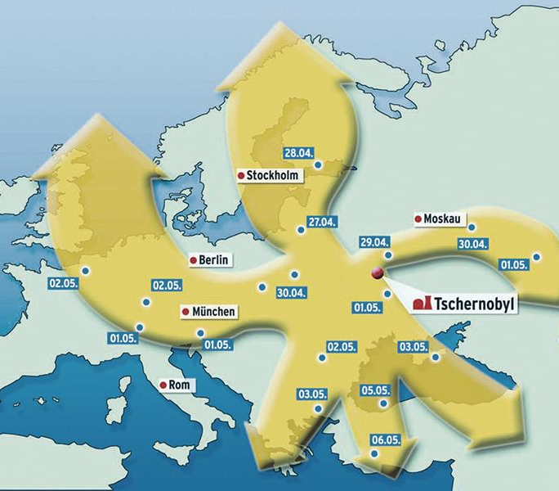
Gamma rays
they are high energy particles which can pass through biological material and disrupt its structure (DNA). it is dangerous and the lethal radiation is stronger than X-rays. They are found freely in space and are also produced by the death of stars (supernova)
these rays were found after the Chernobyl reactor explosion. these rays were damaging the surrounding nature and all living things

Slide 7
Half-life of elements in reactor
half-life is how long it takes for half of the nuclei in an atomic nucleus to decay
it takes 10 cycles to almost completely decay elements
235-Uran - half-life 710 million years
239-Plutonium - half-life 24 400 years
137-Ceasium - half-life 30 years
90-Stroncium - half-life 29 years
it can take more than 300 years to chernobyl become habitable again

Slide 8
Sources
http://chemie.falconis.cz/polocas-rozpadu.php
https://cs.wikipedia.org/wiki/Polo%C4%8Das_p%C5%99em%C4%9Bny
https://cs.wikipedia.org/wiki/Thorium
https://www.deepl.com/translator
https://www.cez.cz/edee/content/file/static/encyklopedie/encyklopedie-energetiky/03/palivo_4.html
https://www.cez.cz/edee/content/file/static/encyklopedie/vykladovy-slovnik-energetiky/hesla/palivo_jader.html
https://en.wikipedia.org/wiki/Iodine-131
https://en.wikipedia.org/wiki/Plutonium
https://en.wikipedia.org/wiki/Strontium-90
https://www.duckduckgo.com
Peter Dupkanič

