Slide 1



BRAIN STORM
Yellow team
Theme: Homework

Slide 2

YELLOW TEAM
Germany: Celine Brauer, Lucas Kössler, Ilyas Bal
Czech Republic: Marek Havel, Adam Sipták, Joseph Adam Saunders, Petr Novotný, Nikol Hegiyová
Poland: Norbert Zapora, Natalia Szczygiel
Italy: Alessandro D’Urso, Luigi Seminara, Manuele Seminara, Mario Muscianisi, Matteo Puglisi, Daniele Muscianisi, Mario Fisichella, Rebecca Sambataro
2

Slide 3
WHAT IS THE APP FOR?
Works as a very simple forum
Intended for quick research using the power of a growing community
3

Slide 4
WHAT WAS DONE IN Germany
Planning of the application;
Flow diagram;
Ideas for the app icon;
Documentation base;
5

Slide 5
WHAT WAS DONE IN Italy
First usable app demo – with design;
Example subjects;
6

Slide 6
WHAT WAS DONE IN Czech Republic
Activity reconstruction
General planning
DB preparation
7

Slide 7
WHAT WAS DONE IN Poland
Backend and frontend code
Database communication and storage
Final (almost) functional APK
7

Slide 8
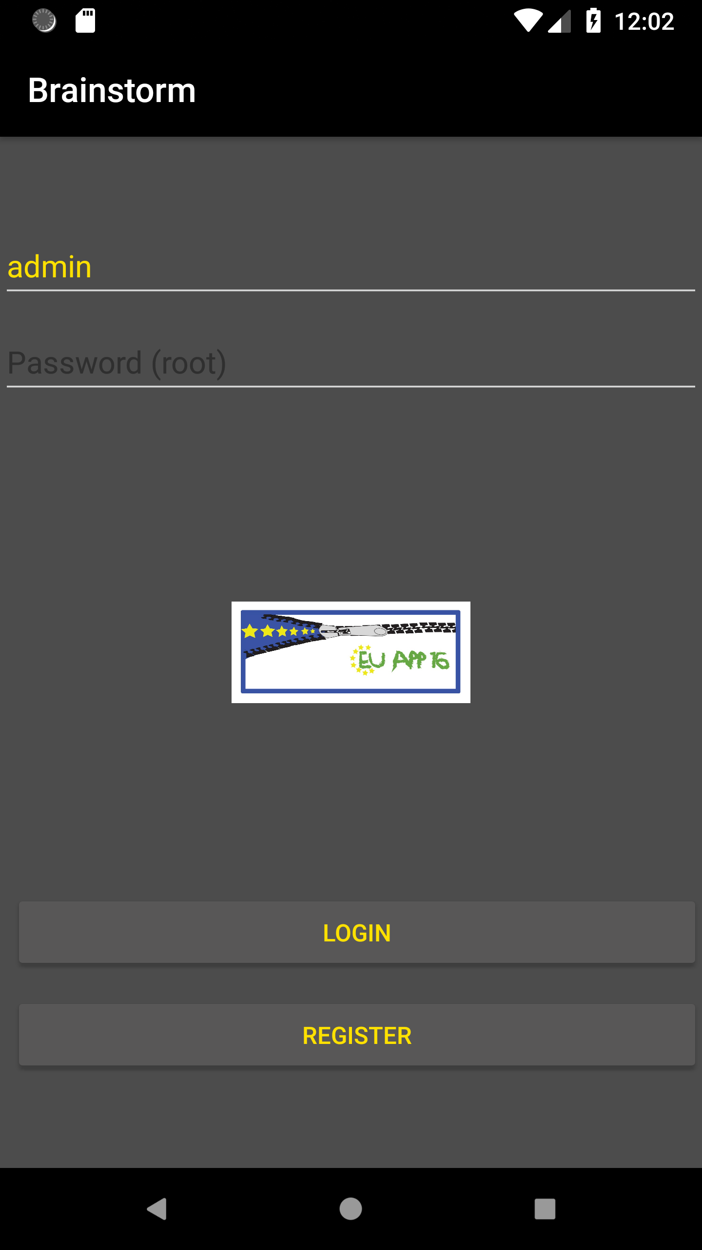
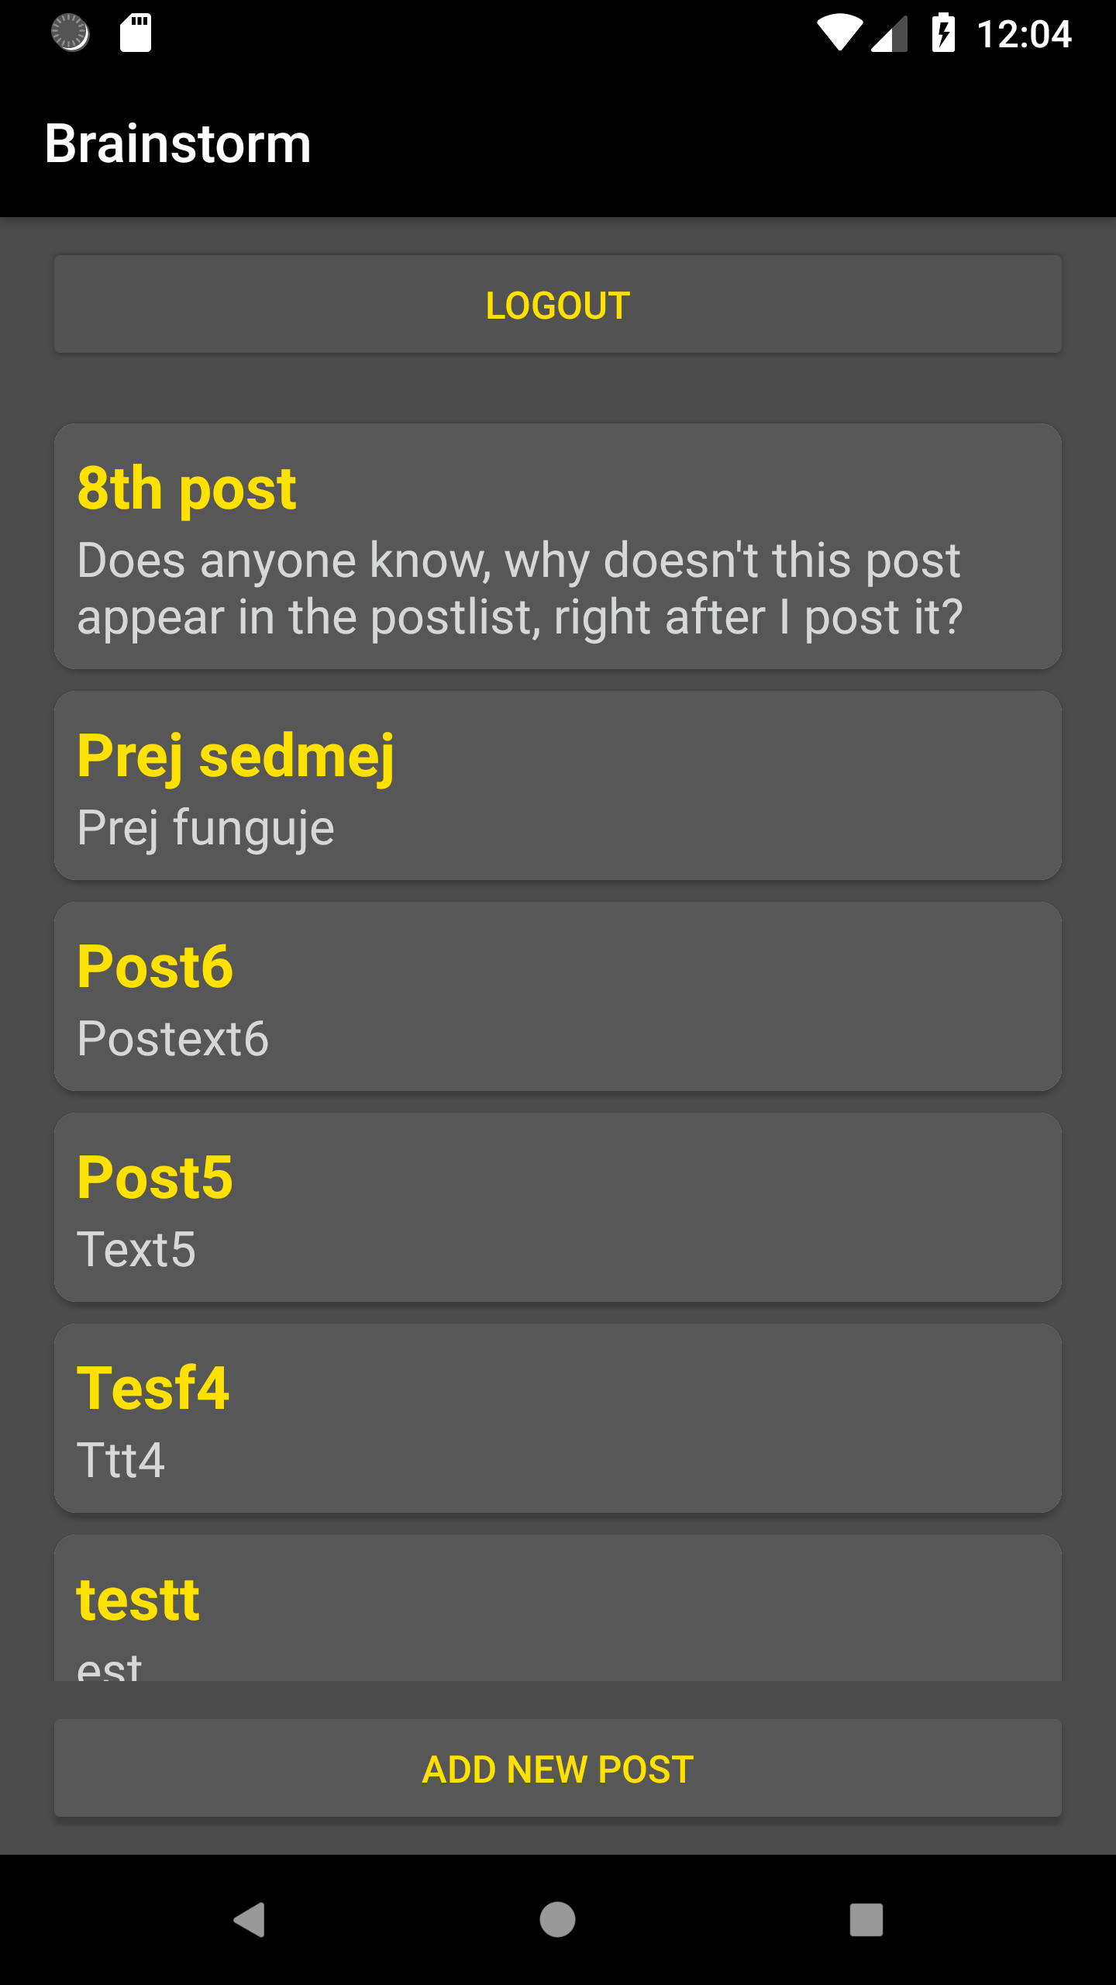
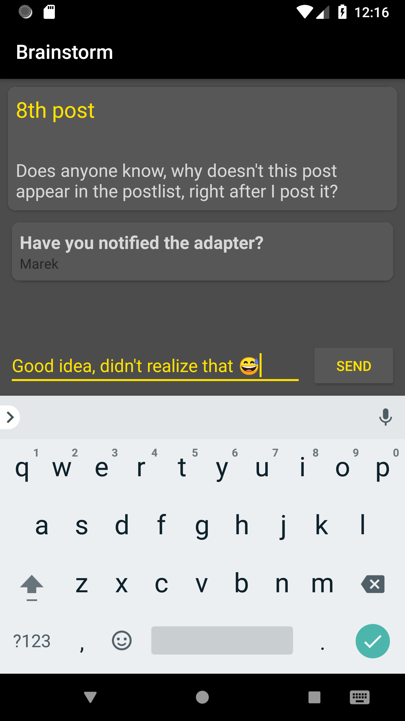
App preview
8

Slide 9
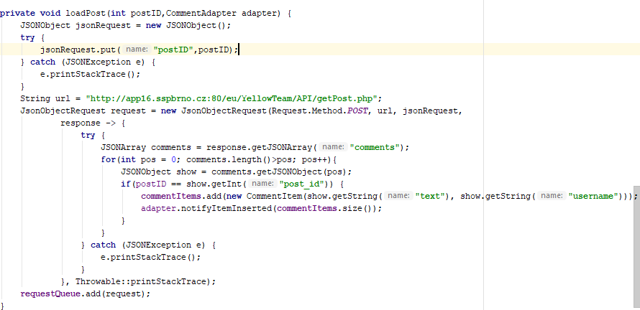
Code preview
9

Slide 10
LIVE DEMO!
9

Slide 11
WHERE TO FIND US
Everything related to our application has been published on GitHub:
https://github.com/MarekHavel/Brainstorm
9

Slide 12

END!
FINE!
KONIEC!
KONEC!
ENDE!
Thanks for your attention!

