Slide 1
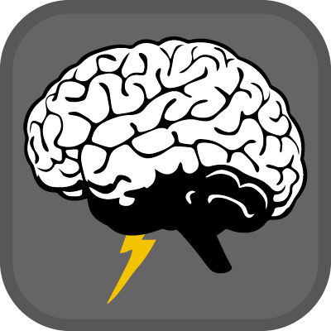


BRAIN STORM
Yellow team
Theme: Homework

Slide 2

YELLOW TEAM
Coordinators:
Marek Havel
Designer:
Matteo Puglisi,Celine Brauer,Norbert Zapora
Programmer:
Luigi Seminara,Daniele Muscianisi
Documenter:
Alessandro D’Urso, Mario Fisichella,Manuele Seminara
2

Slide 3

What does this app do?
This app will :
help the user with homework;
help the user with is favourite subjects;
help the user and him/her classmates;
help the user if he/she is too lazy to do homework
3

Slide 4
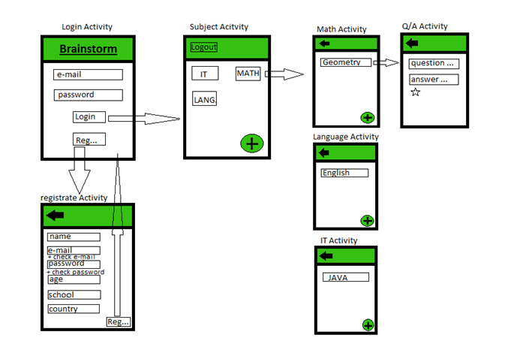
APP PLAN
4

Slide 5
WHAT WAS DONE IN GERMANY
Planning of the application;
Layout;
Ideas for the app icon;
Documentation base;
5

Slide 6
WHAT WE DID IN ITALY
Programming;
Create the icon;
Example subjects;
6

Slide 7
WHAT WE HAVE TO DO IN CZECH
Integrate our database;
Integrate login;
7

Slide 8
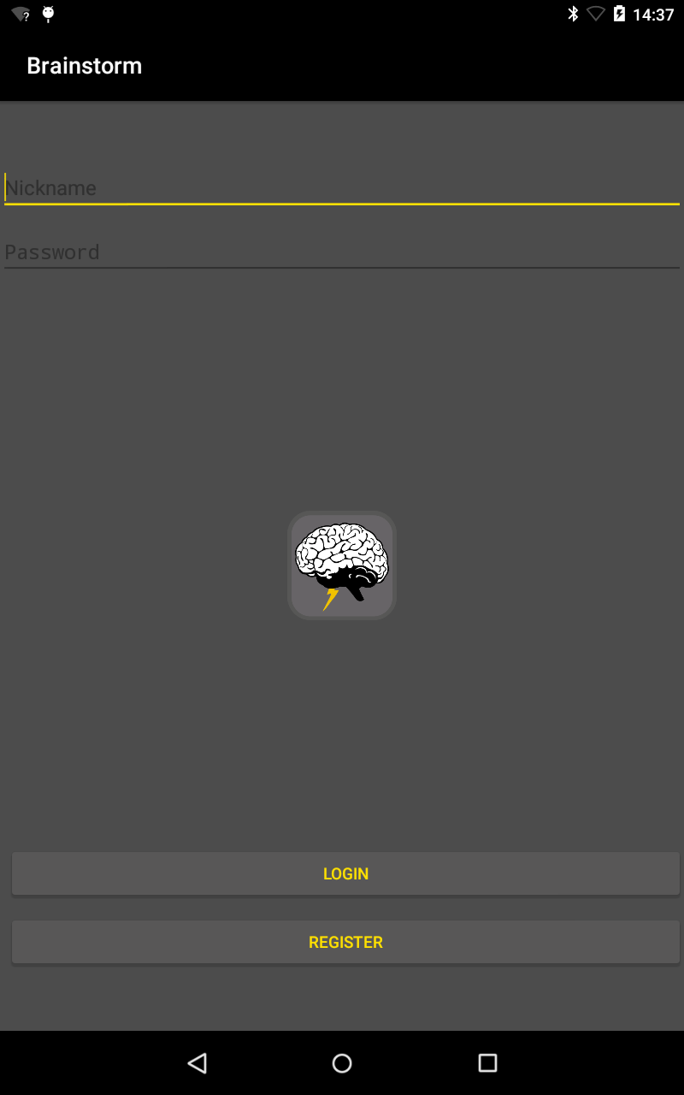
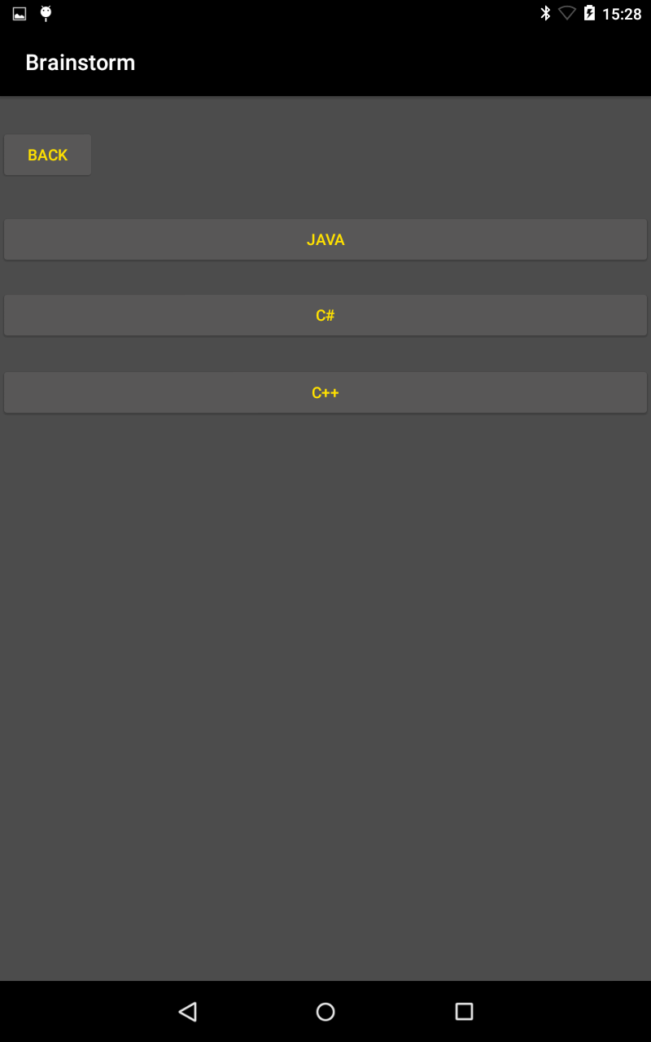
App preview
8

Slide 9
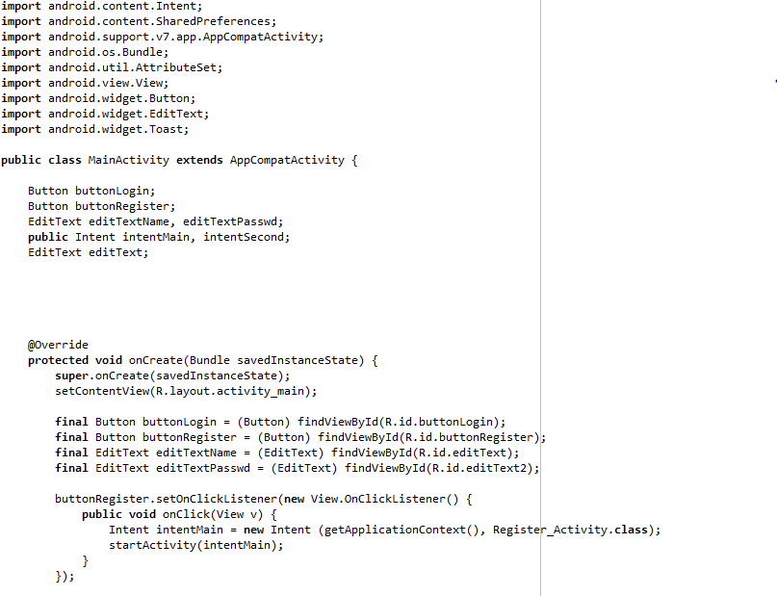
Code preview
9

Slide 10

END!
FINE!
KONIEC!
KONEC!
ENDE!
Thanks for your attention!

