Slide 1


[ Your
portrait
picture
here ]
excited to be presenting at the
Marek Mateják
IKEM & Charles University
Chemical 2.0
(Free open-source
Modelica library)
Lucerne, Switzerland
September 8 -10

Slide 2
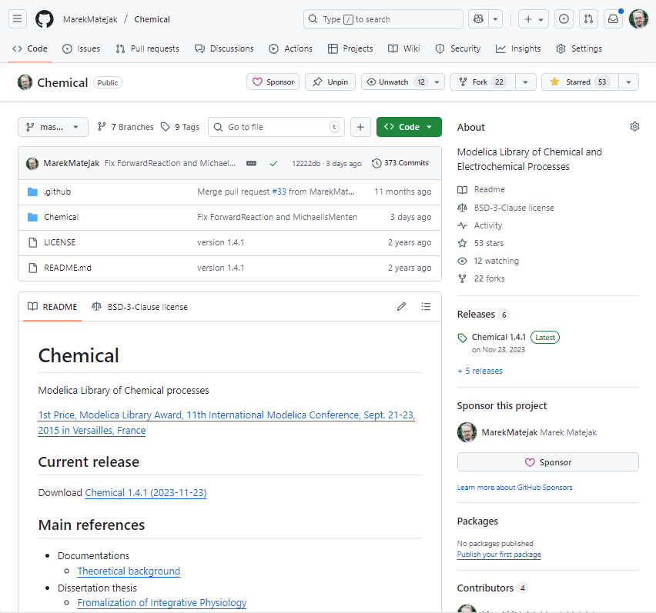
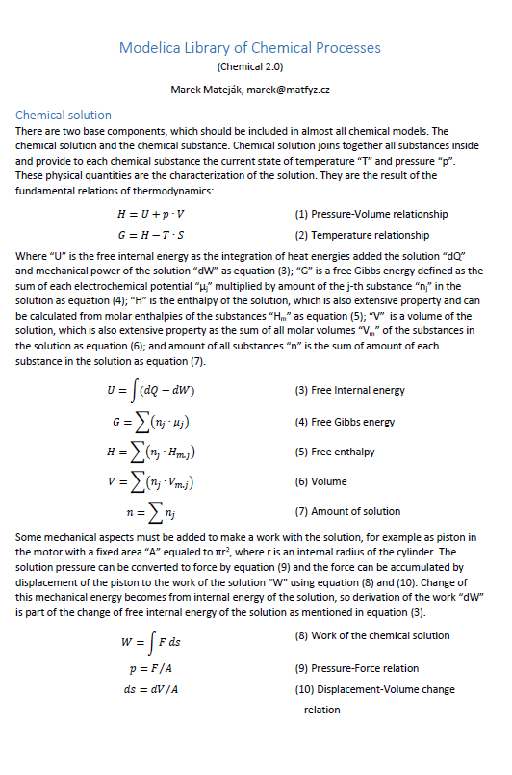
github: MarekMatejak/Chemical

Slide 3
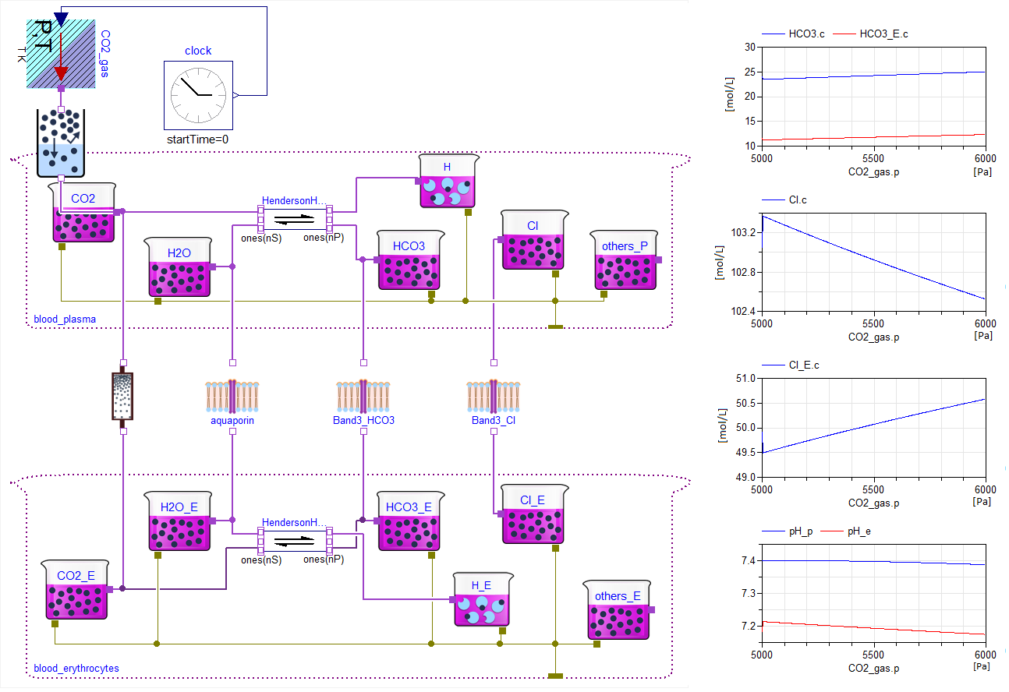
Chemical 1.4

Slide 4
Upgrade
definition of substances/processes
chemical kinetics
support of chemical pathways

Slide 5
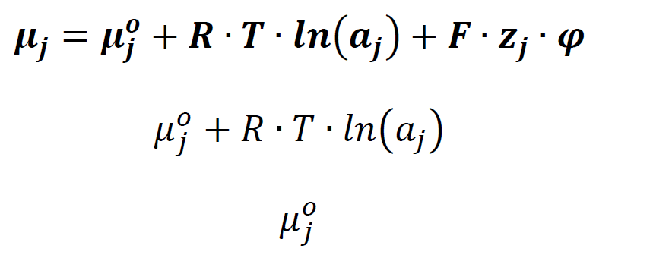
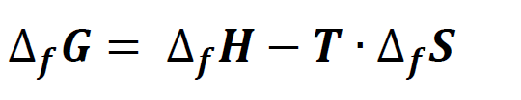
Electro-chemical potential

Slide 6


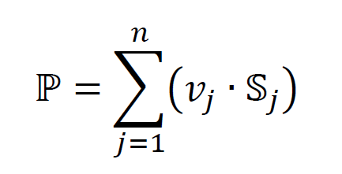
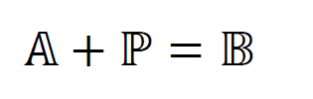
Substance and process definition
Substrate
Product
Substances
Process
Process
Stoichiometric numbers

Slide 7
Example of usage (Chemical 2.0)
import Chemical.Interfaces.Definition;
import Chemical.Substances.Gas;
import Chemical.Substances.Liquid;
import Chemical.Interfaces.processData;
Definition H2O_formation = Gas.H2O - (Gas.H2 + 0.5*Gas.O2);
Definition O2_aq = Gas.O2 + processData(0.0013, -1500*R);
Definition NO_aq = Gas.NO + processData(0.0014, -1500*R);
Definition ProteinAForm1 = Liquid.Unknown;
Definition ProteinAForm2 = ProteinAForm1 + processData(K, dH);

Slide 8
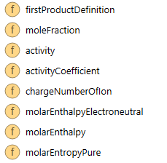
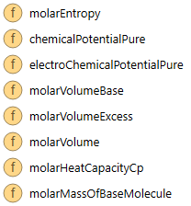
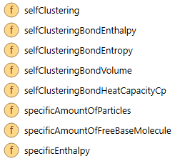
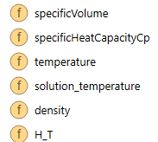
Observing chemical properties (Chemical 2.0)
uNO_aq = Properties.electroChemicalPotentialPure(NO_aq,SATP);
hO2 = Properties.molarEnthalpyElectroneutral(Gas.O2,heatingSolution);
sO2 = Properties.molarEntropyPure(Gas.O2,heatingSolution);
uH2 = Chemical.Interfaces.Properties.electroChemicalPotentialPure(Gas.H2,heatingSolution);
uH2O = Chemical.Interfaces.Properties.electroChemicalPotentialPure(Gas.H2O,heatingSolution);

Slide 9
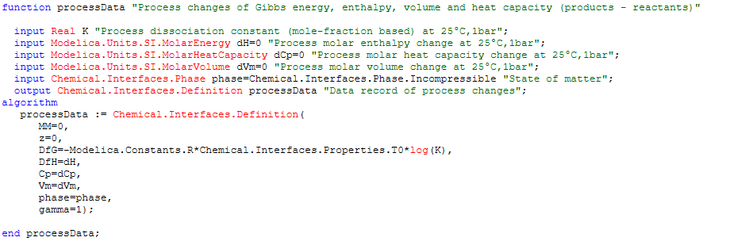
Process parametrization

Slide 10
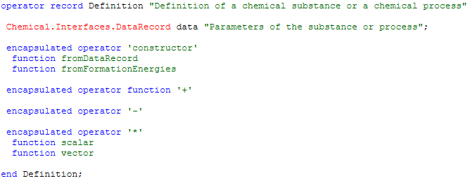
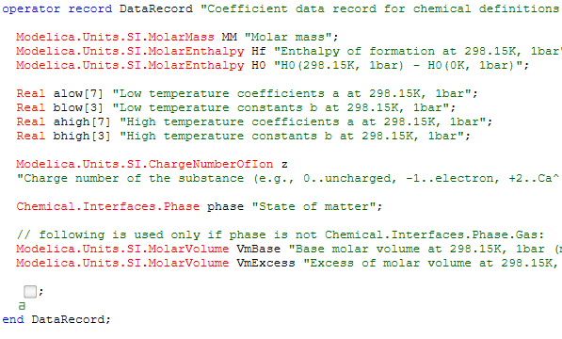
Definition … as operation record

Slide 11
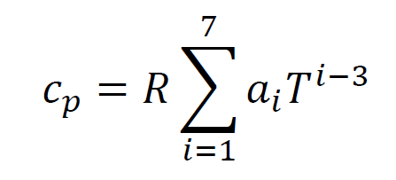
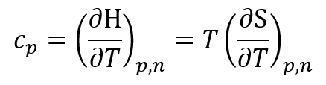
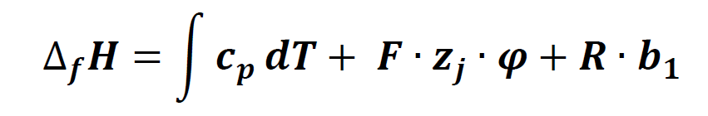
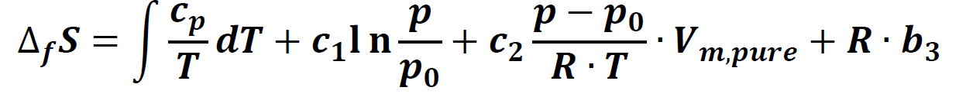
Substance and process parametrization
Ref: McBride B.J., Zehe M.J., and Gordon S. (2002): NASA Glenn Coefficients for Calculating Thermodynamic Properties of Individual Species. NASA report TP-2002-211556

Slide 12
Upgrade
definition of substances/processes
chemical kinetics
support of chemical pathways

Slide 13
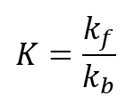


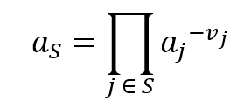

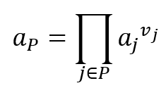

Traditional chemical kinetics
Reaction rate
Dissiciation coefficient
Arrhenius equation
Forward rate coefficient
Substrates activity
Products activity
Backward rate coefficient

Slide 14
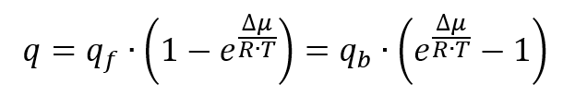

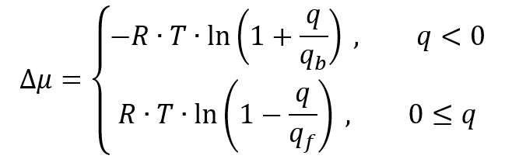
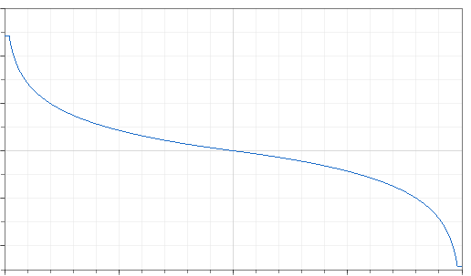



Traditional potential difference function

Slide 15
Upgrade
definition of substances/processes
chemical kinetics
support of chemical pathways

Slide 16
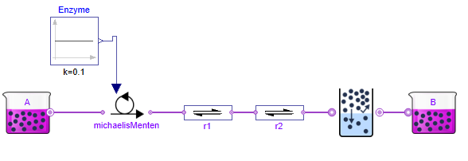
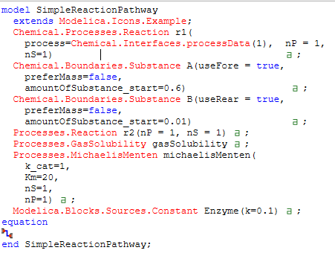
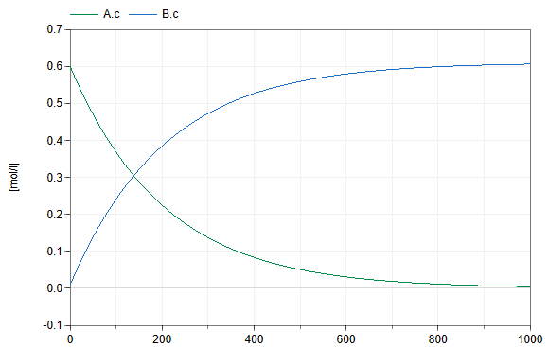
Example of usage (Chemical 2.0)

Slide 17

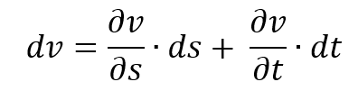



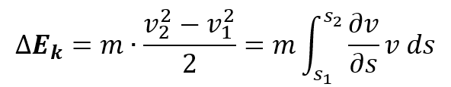

Background
velocity
acceleration
Vm
A
molar flow
v
kinetic energy change
force
derivation of energy

Slide 18
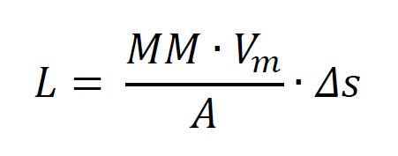
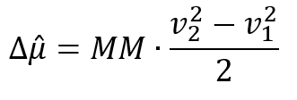
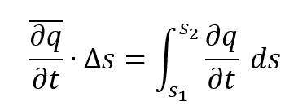
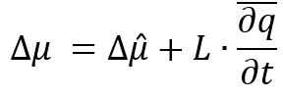
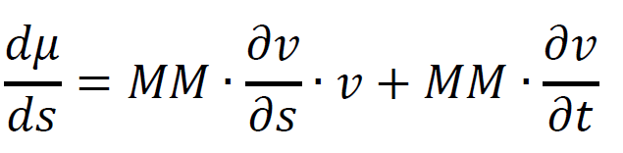
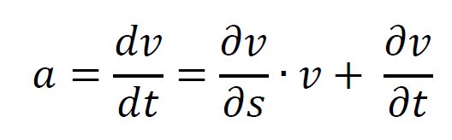
Chemical inertia
Flow acceleration on step Δs
Chemical inetria
Kinetic electro-chemical potential

Slide 19


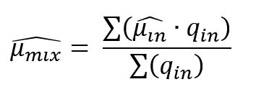
Inertial connections (Chemical 2.0)
flow
non-flow
effort
Input/output

Slide 20

Inertial process (Chemical 2.0)
flow
non-flow
effort
Input/output
stoichiometric numbers

Slide 21
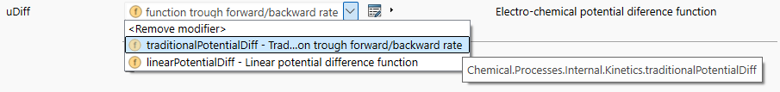
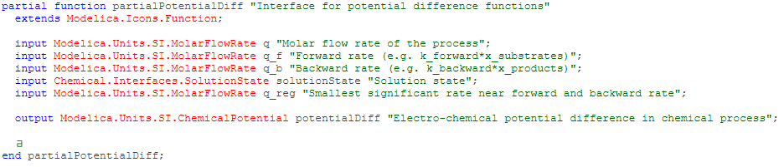
Chemical kinetics (Chemical 2.0)

Slide 22
Conclusion - upgrade Chemical 1.4 -> 2.0
definition of substances/processes
chemical kinetics
support of chemical pathways

Slide 23
Thank for your attention
https://github.com/MarekMatejak/Chemical
marek@matfyz.cz

