Slide 1

Charles University in Prague
First Faculty of Medicine
Integrative Physiology in Modelica
Marek Mateják
2015

Slide 2
Hypotézy
Fyziologický model je možné rozširovať tak, že rozšírenie je minimálne tak dobré ako pôvodný model.
Matematickú formalizáciu a integráciu praktických fyziologických znalostí o jednom organizme je možné implementovať do jedného komplexného fyziologického modelu.
Formalizované matematické modely a ich simulácie môžu slúžiť na výuku, vedu a vývoj integratívnej fyziológie.

Slide 3
Primary objectives
HumMod implementation in Modelica (for Medical Simulators)
  HumMod – “The best, most complete, mathematical model of human physiology ever created” [http://www.hummod.org]
  Modelica – “Modelica® is a non-proprietary, object-oriented, equation based language to conveniently model complex physical systems containing, e.g., mechanical, electrical, electronic, hydraulic, thermal, control, electric power or process-oriented subcomponents.” [http://www.modelica.org]

Slide 4
Prínosy
výuka, trenažéry, medical simulators..
Konzistence nových teorií
Predikce, clinical trials

Slide 5
Results
Physiolibrary (http://www.physiolibrary.org)
  Modelica tool for integrative physiology (1st Price in 10th International Modelica Conference + vlozit certifikat)
Physiomodel (http://www.physiomodel.org)
  Extended Modelica implementation of HumMod with advanced gases transport and acid-base calculations based on Physiolibrary

Slide 6
State of Art
HumMod [http://www.hummod.org]
  Dr. Arthur Guyton, Dr. Thomas Coleman, Dr. Robert Hester, ..
Physiome [http://www.Physiome.org, http://www.vph-institute.org]
  Dr. James Bassingthwaighte, Dr. Gary Raymond, Dr. Stephen Randall Thomas
JSim [www.physiome.org/jsim]
System Biology Markup Language [http://sbml.org]
  Dr. Herbert Sauro, Dr. Michael Hucka
CellML [http://www.cellml.org]

Slide 7
Differential Equation based Modeling
FORTRAN, IBM, NY, USA
Mathematica, Wolfram, IL, USA
MATLAB Simulink, MathWorks, MA, USA
SysML, subset of UML (2003, unusable)
VHDL-AMS, hardware description language (1993) + analog (1999)
MATLAB Simscape (2008b, unstable)
Modelica, Modelica Association (1997, stable 2012)

Slide 8
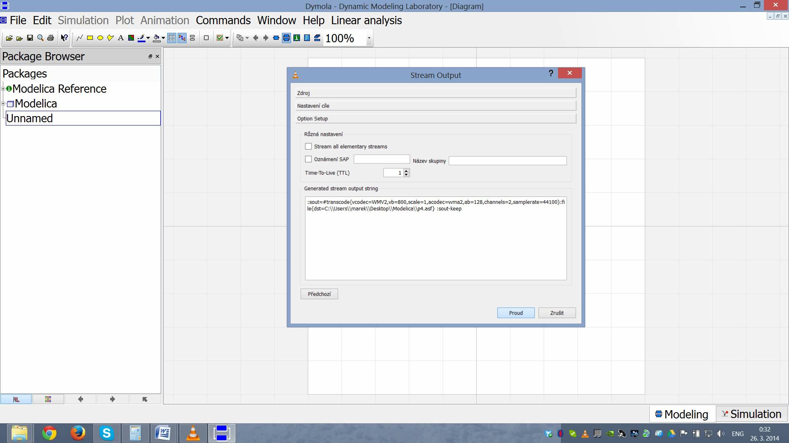

Slide 9

Connectors
ChemicalPort
  molar concentration, molar flow
HydraulicPort
  pressure, volumetric flow
ThermalPort
  temperature, heat flow
OsmoticPort
  osmolarity, osmotic volumetric flow
PopulationPort
  size of population, change of population

Slide 10
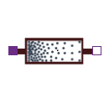



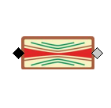

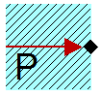

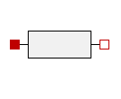



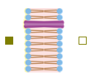
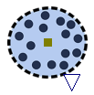






 | Resistance | Accumulation | Stream | Inertia | Effort source
Chemical
Hydraulic
Thermal
Osmotic
Population
Electrical

Slide 11
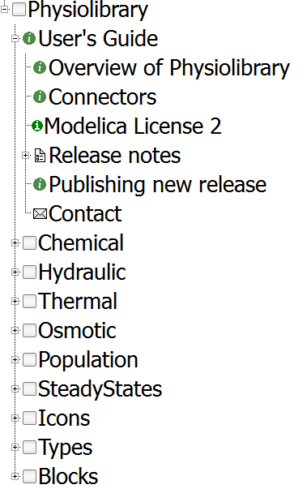
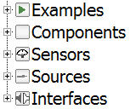

Physiolibrary Structure

Slide 12
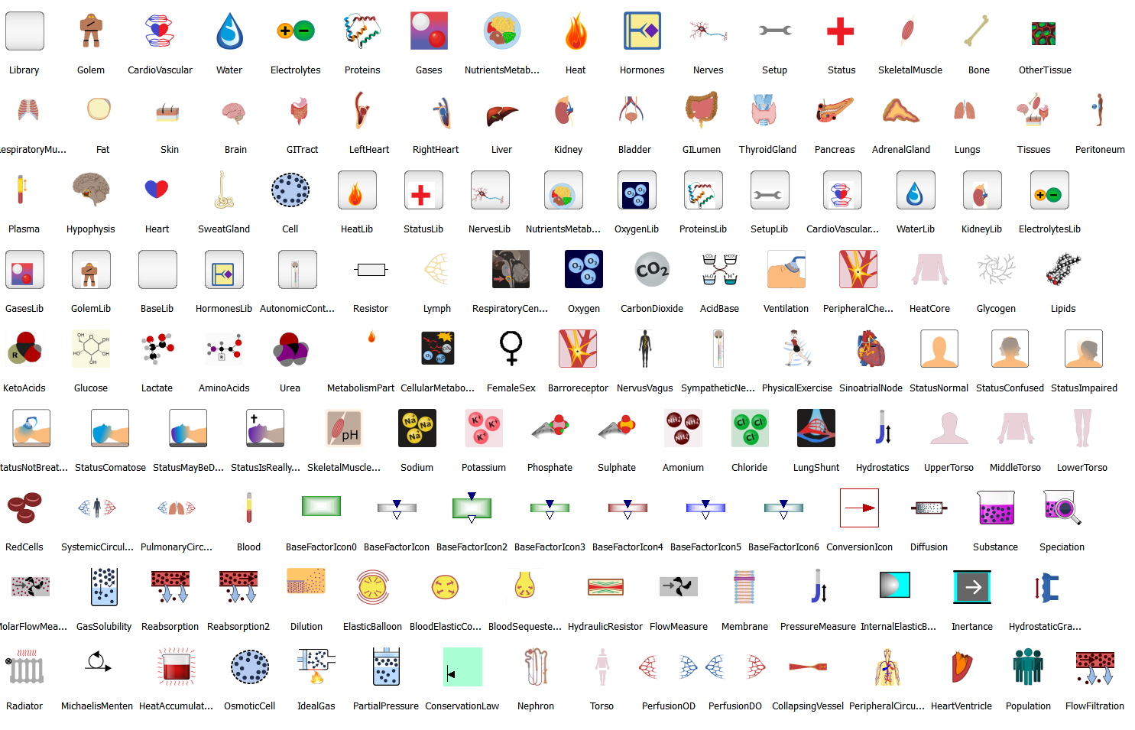
Icons

Slide 13
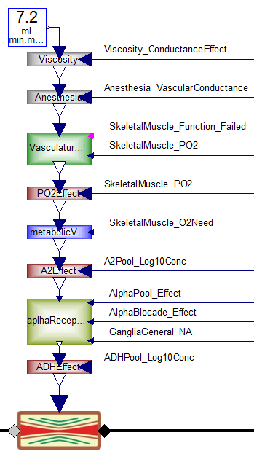
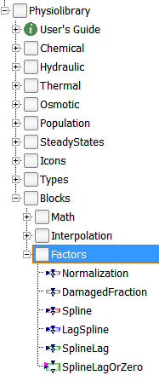
Blocks.Factors

Slide 14
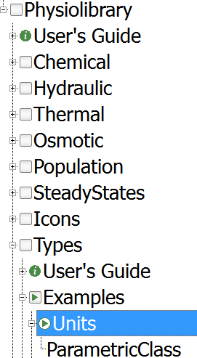
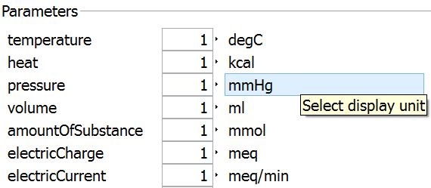
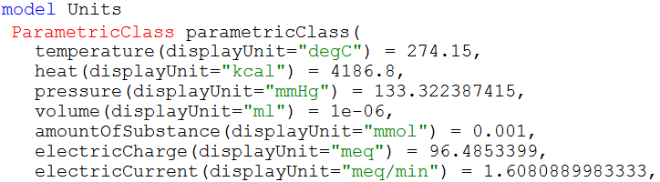
Types

Slide 15
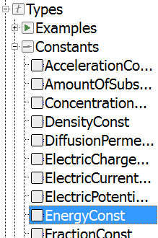
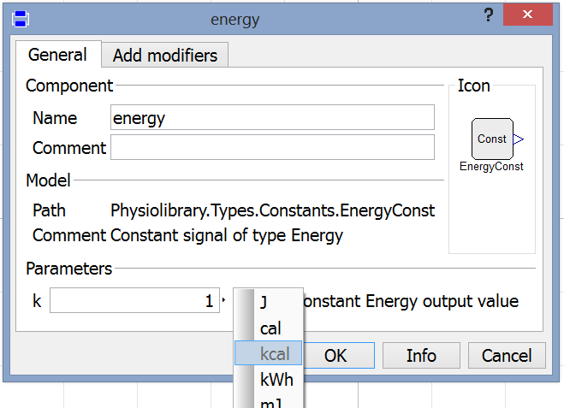
Types.Constants

Slide 16
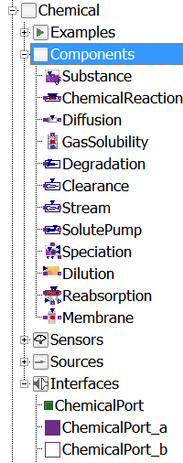
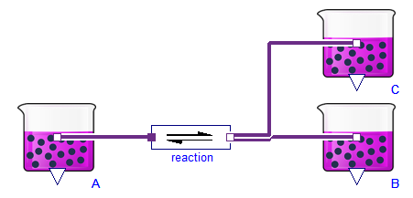
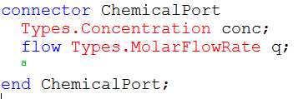
Chemical

Slide 17

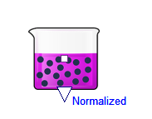

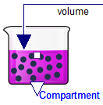
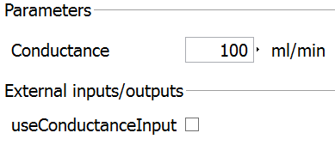
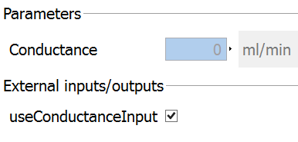


CONDITIONAL INPUTS

Slide 18

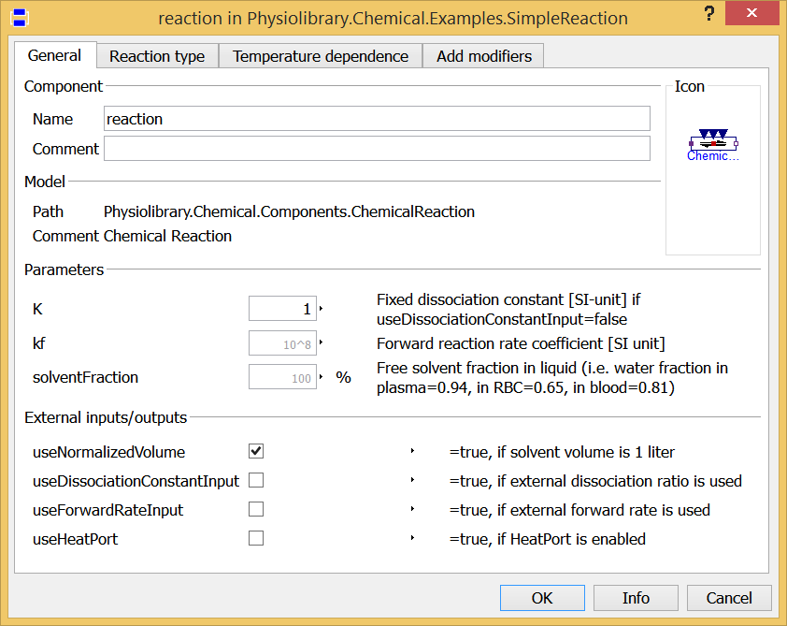
Chemical Reaction

Slide 19
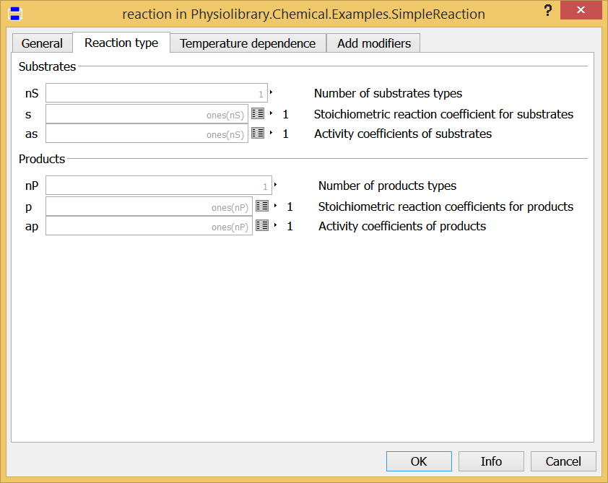
Chemical Reaction

Slide 20
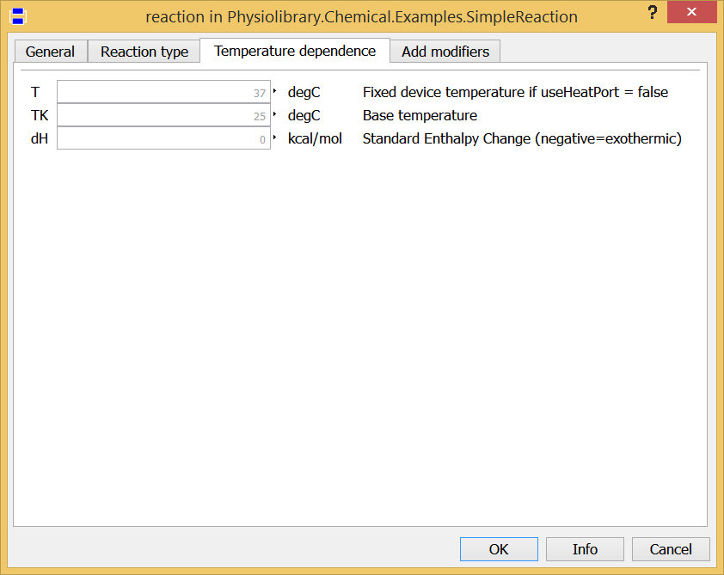
Chemical Reaction

Slide 21
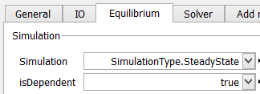
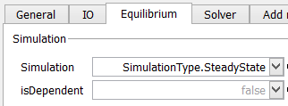
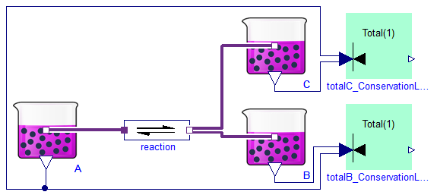

STEADY STATES
Zero derivations (dependent equation set)

Slide 22
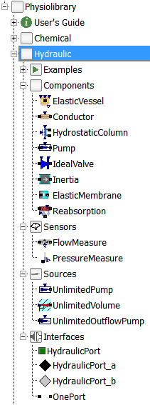
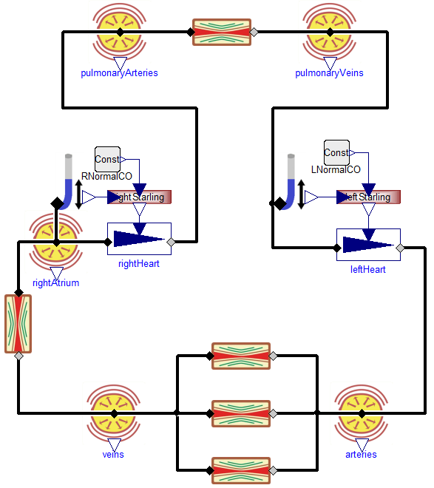
Hydraulic

Slide 23
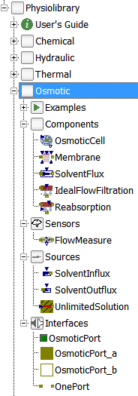
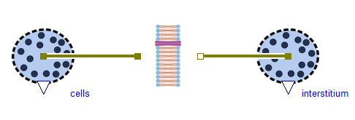
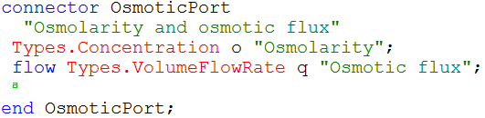
Osmotic

Slide 24
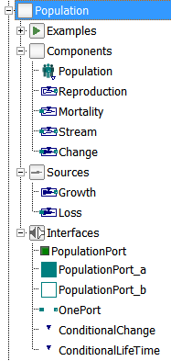
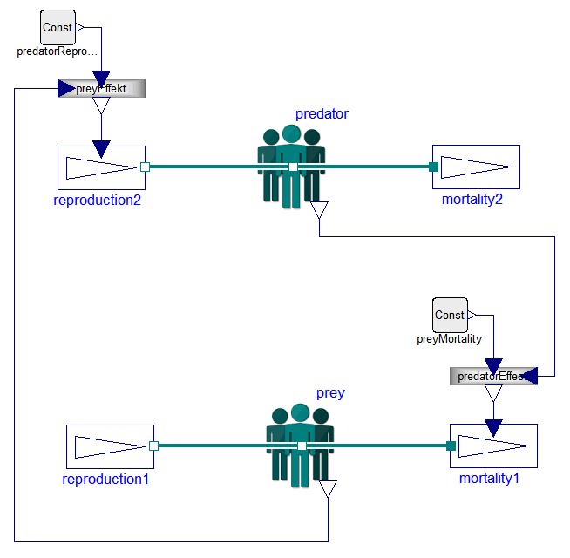
Population

Slide 25
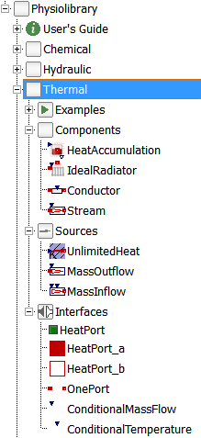
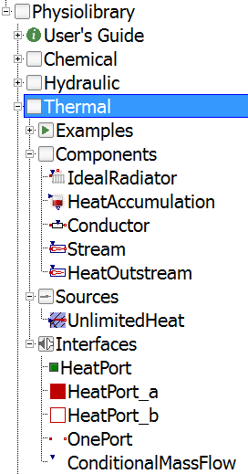
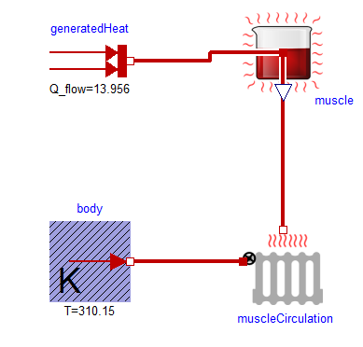
Thermal

Slide 26
Publications & Presentations
Marek Mateják, Tomáš Kulhánek, Jan Šilar, Pavol Privitzer, Filip Ježek, Jiří Kofránek: Physiolibrary - Modelica library for Physiology, In Conference Proceeding, 10th International Modelica Conference, March 12, 2014, Lund, Sweden, (DOI:10.3384/ECP14096499)
Marek Mateják: Physiology in Modelica, MEFANET Journal 2014; 2(1); ISSN:1805-9171. Available at WWW: http://mj.mefanet.cz/mj-03140307
T. Kulhánek, J. Kofránek, and M. Mateják: Modeling of short-term mechanism of arterial pressure control in the cardiovascular system: Object-oriented and acausal approach, Computers in Biology and Medicine, vol. 54, pp. 137-144, 11/1/ 2014. IF: 1.475
Kulhánek T, Tribula M, Kofránek J, Mateják M: Simple models of the cardiovascular system for educational and research purposes. MEFANET Journal 2014; 2(2); ISSN:1805-9171. Available at WWW: http://mj.mefanet.cz/mj-04140914.
Marek Mateják, Tomáš Kulhánek, Stanislav Matoušek: Adair-based hemoglobin equilibrium with oxygen, carbon dioxide and hydrogen ion activity. Scandinavian Journal of Clinical & Laboratory Investigation 2015; pp. 1-8; ISSN: 0036-5513. IF: 2.009

Slide 27
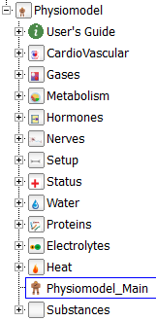
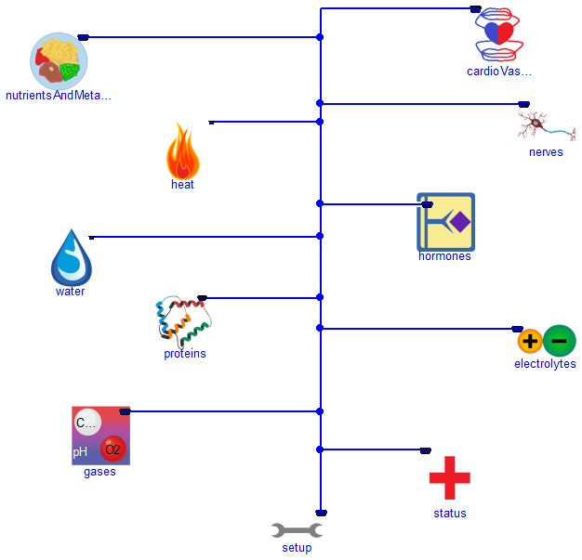
Physiomodel

Slide 28
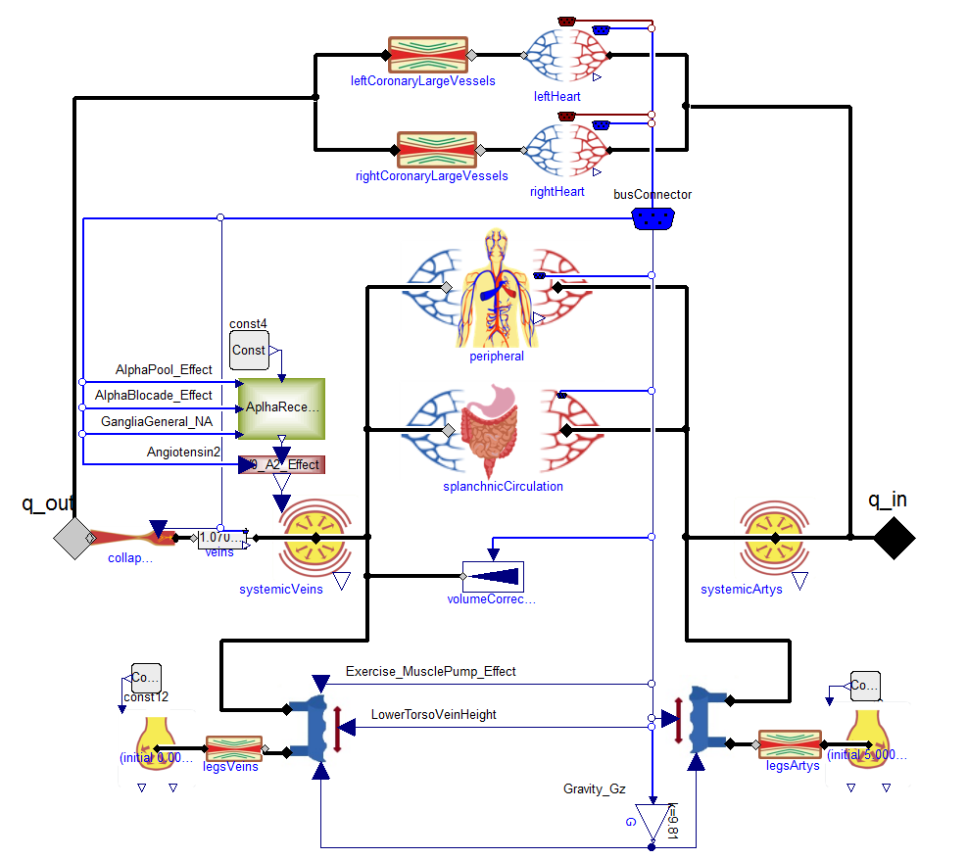
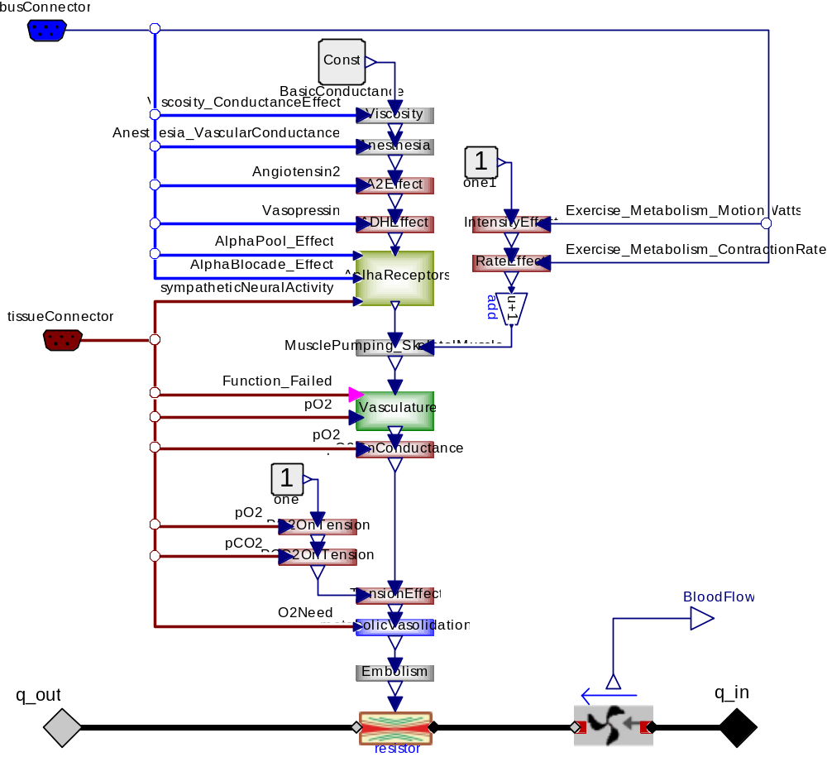
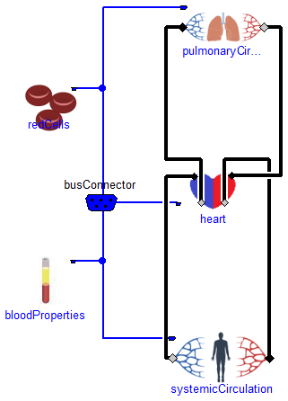
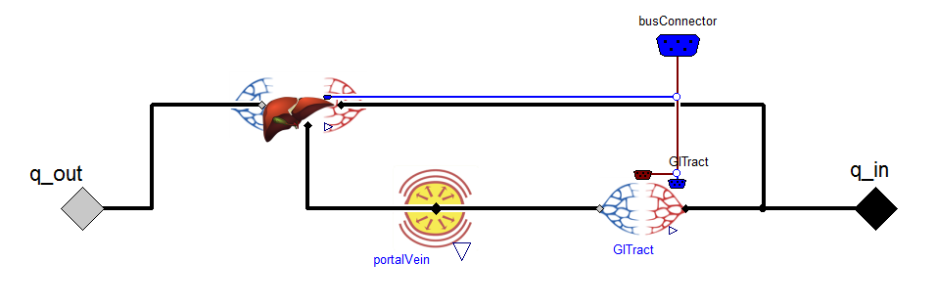

Slide 29
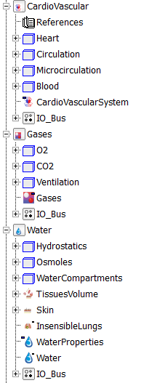
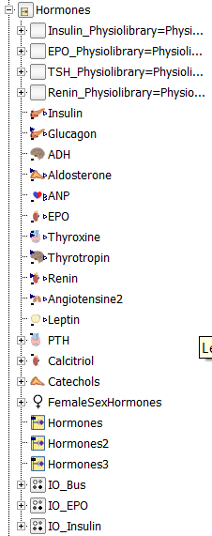
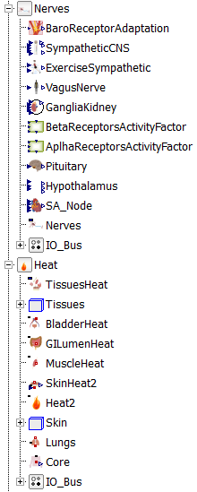
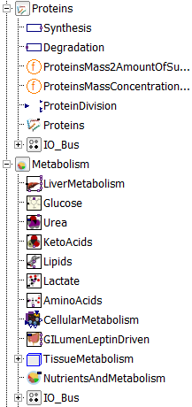

Slide 30



Slide 31


Slide 32



Slide 33


Slide 34
Conclusion
Physiolibrary 2.3.0 – stable in Dymola, OpenModelica, JModelica
  (podiel mojej práce: 100% teorie, 98% Modelica kódu)
HumMod Golem Edition v 0.4980 – stable in Dymola, OpenModelica
  (podiel mojej práce: 5% teorie, 100% Modelica kódu)
Physiomodel 1.0.0 – stable in Dymola
  (podiel mojej práce: 10% teorie, 100% Modelica kódu)
Open Source Physiomodel Consortium?

Slide 35
Thank you for your attention!

