Slide 1
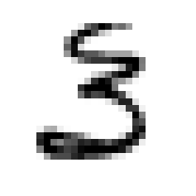
2: OUR MULTILAYER PERCEPTRON
Built from scratch with numpy, fully vectorized
0
Each layer = weight matrix W + bias b
Forward: h = W·V + b, V = θ(h)
Backward: δ = (Wᵀ δ) ⊙ θ'(h)
Batch = columns of X → one matmul per layer
Prediction = argmax of the 10 outputs
Optimizers are swappable: GD, Momentum, Adam
1
2
3
4
5
6
7
8
9
784 inputs
28 × 28 pixels
128 hidden
sigmoid
10 outputs
one per digit
Notes:
This is the model we use for the whole exercise: a multilayer perceptron written from scratch with numpy.
On the left you see the idea. Each image is 28 by 28 pixels, which we flatten into 784 inputs. Those go through one hidden layer, here 128 sigmoid units, and then into 10 output units, one per digit. The predicted digit is simply the output unit with the highest value.
Every layer is a weight matrix. The forward pass is h = W times V plus b, followed by the activation. Backpropagation sends the error back with W transposed times delta, multiplied by the derivative of the activation.
We put the samples of a batch in the columns of the input matrix, so a whole batch goes through a layer in one matrix product. That is why a 60-epoch run takes seconds instead of minutes.
To make sure the implementation is right we wrote tests: we check backpropagation against a numerical derivative, against one step we calculated by hand for the 2-2-1 network, and we check that both 2-2-1 and 2-3-2-1 learn XOR.

Slide 2
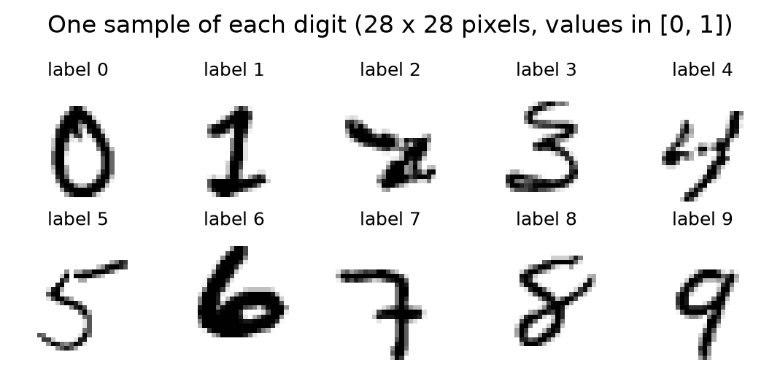
2A: HOW DO WE EVALUATE OUR SYSTEM?
digits.csv
12 449 images
split once 80 / 20
Train · 9 959
fits the weights
Validation · 2 490
picks hyperparameters
mean of 3 seeds
digits_test.csv · 2 497
"production"
used once, at the end
Metrics
Accuracy → the client's target
Per-class recall → catches a digit that is always wrong
Confusion matrix → which digits get mixed up
Train / validation MSE per epoch → convergence, overfitting
Notes:
Question 2a: how do we evaluate the system?
The top row is our protocol. digits.csv is the only data we learn from. We split it once, 80 percent for training and 20 percent for validation. Training fits the weights; validation is what we use to compare variants and pick hyperparameters. Every variant is trained with three different seeds, and we compare the mean.
digits_test.csv plays the role of production. We use it exactly once, on the single model we picked on validation. If we looked at it while tuning, it would stop being an honest estimate of the real world.
For metrics: accuracy is the client's own target, so it is the main number. But accuracy alone can hide a digit the model never gets right, so we also look at recall per class and at the confusion matrix. And we track the training and validation loss every epoch, to see whether the model converges and whether it starts to overfit.
As a preview: the final model scores 96.9 percent on validation and 86.4 percent on the test set, both averaged over three seeds. We will explain that gap at the end.

Slide 3
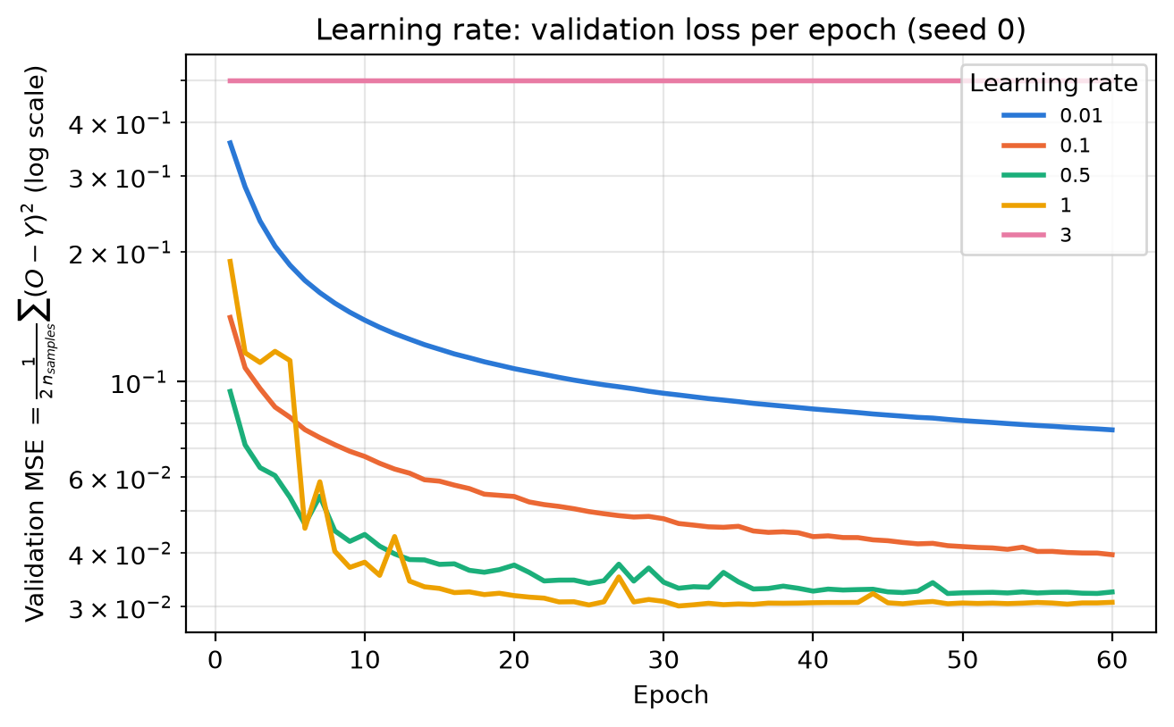
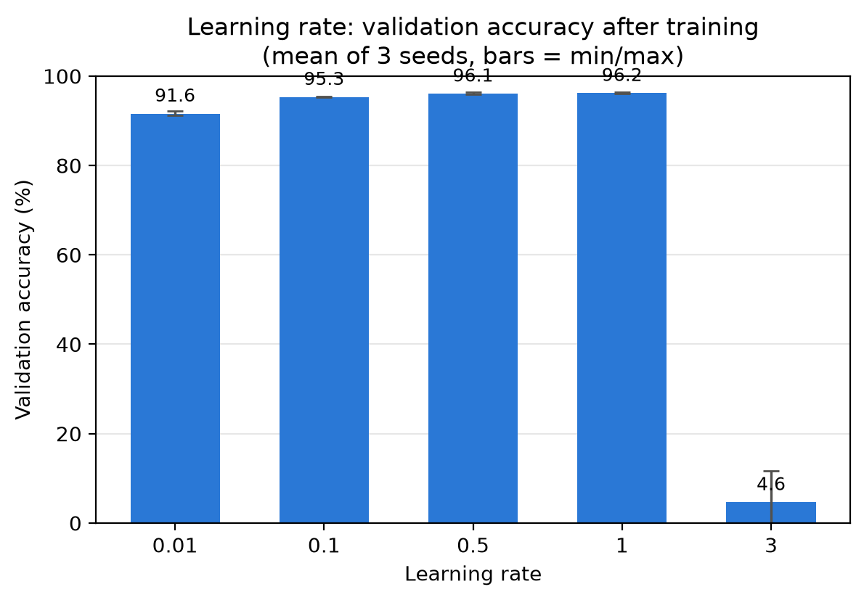
2B: WHICH VARIANTS DID WE TRY?
Learning rate · gradient descent, [784, 64, 10], batch 32, 60 epochs
0.01 → too slow, still dropping at epoch 60
0.5 – 1 → fastest, ≈ 96 %
3.0 → sigmoids saturate, θ' ≈ 0, loss stuck at 0.50
Notes:
Question 2b: which variants did we try? We changed one thing at a time, starting from the same baseline, and the first one is the learning rate, with plain gradient descent.
On the left is the validation loss per epoch, on a log scale. With 0.01 the curve is still going down after 60 epochs: it learns, but far too slowly. 0.1 is better, and 0.5 and 1 converge fastest and end around 96 percent accuracy, as the bar chart shows.
The interesting case is 3.0. The line is flat at the top: the loss is stuck at 0.5 from the second epoch. What happens is that the first updates are so large that the sigmoid units saturate. Their outputs are pinned at 0 or 1, the derivative of the sigmoid is practically zero there, and so no gradient flows back. The network stops learning completely: the three seeds ended at 0, 12 and 2 percent, which is chance level or worse.
So the learning rate has a window: too small wastes epochs, too large kills the gradient. We kept 0.5 as the baseline for the other studies, and the final model uses 1.0, the other value at the top of that window.

Slide 4
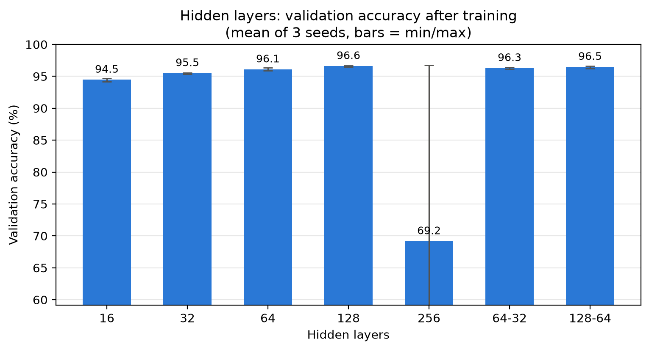
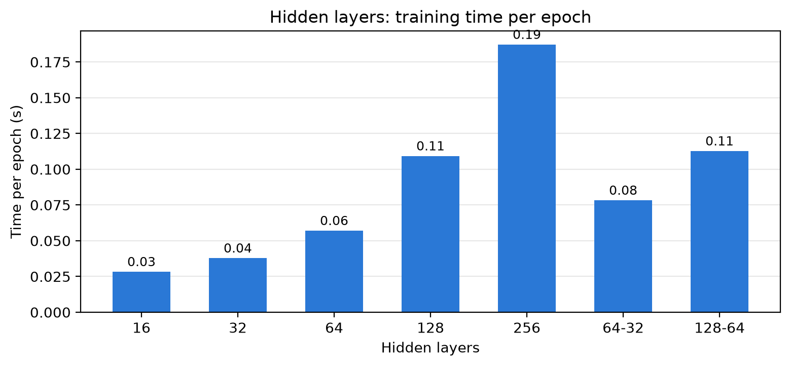
2B: WHICH VARIANTS DID WE TRY?
Architecture · learning rate 0.5, batch 32
16 → 128 units: 94.5 % → 96.6 %
2nd hidden layer: no gain
256: 1 of 3 seeds collapsed (14 %)
Cost grows with the number of weights
Notes:
Next, the architecture. We tried one hidden layer of 16, 32, 64, 128 and 256 units, and two networks with two hidden layers.
Going from 16 to 128 units, the validation accuracy goes up steadily, from 94.5 to 96.6 percent. Adding a second hidden layer did not help: 64-32 and 128-64 are no better than a single layer of 128.
256 units looks bad in the chart, but look at the error bar. Two of the three seeds reached about 96.5 percent; one seed collapsed to 14 percent. That is the same saturation problem as the large learning rate: with more inputs feeding each output unit, the outputs saturate more easily at this learning rate. So a bigger network is not automatically better; it also needs a matching learning rate.
The chart on the right shows the cost. Time per epoch grows with the number of weights, from about 0.03 seconds for 16 units to almost 0.2 for 256. 128 units gave the best accuracy for a reasonable cost, and it became our final architecture.

Slide 5
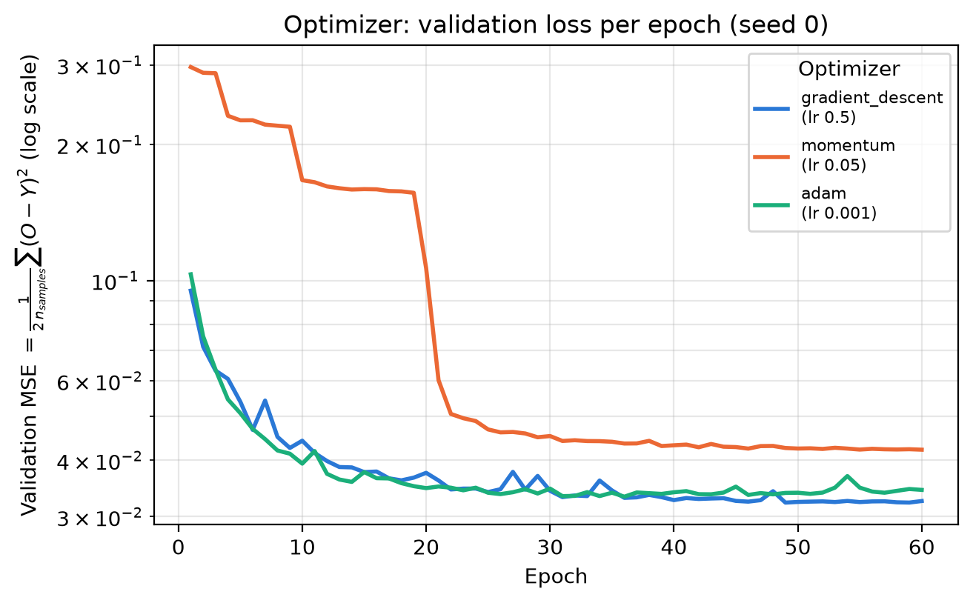
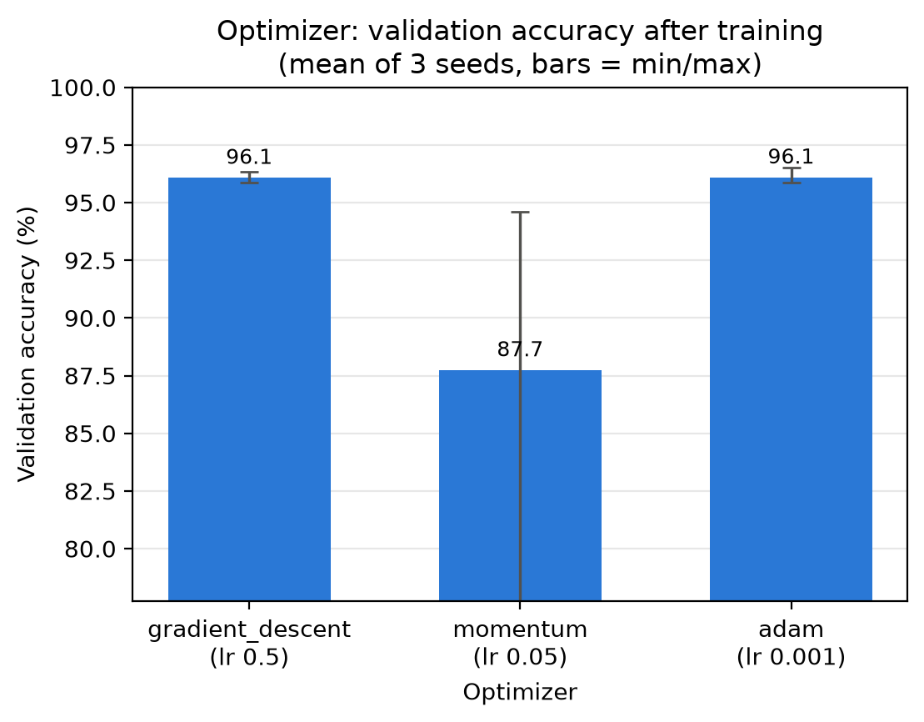
2B: WHICH VARIANTS DID WE TRY?
Optimization method · [784, 64, 10], batch 32
Own learning rate each: GD 0.5, Momentum 0.05, Adam 0.001
GD ≈ Adam → 96.1 %
Momentum: plateaus, 1 seed stuck at 74 %
Notes:
Third, the optimization method. We compared plain gradient descent, momentum and Adam.
They do not share one learning rate: each rule scales its step differently, so we gave each one a rate that suits it. Momentum with alpha 0.9 accumulates roughly ten times the step, so 0.05 for momentum is about the same as 0.5 for gradient descent. Adam normalises the gradient, so its usual value is 0.001.
Gradient descent and Adam follow almost the same loss curve and end at the same accuracy, 96.1 percent.
Momentum behaves differently. In the loss plot you see long flat plateaus followed by sudden drops: the output units are saturated for a while and then escape. In one seed two of the output units never escaped, which means the network never predicts those two digits, and it ends at 74 percent.
So for this problem the optimizer mattered less than the learning rate, and the main risk with momentum here is the extra speed pushing units into saturation.

Slide 6
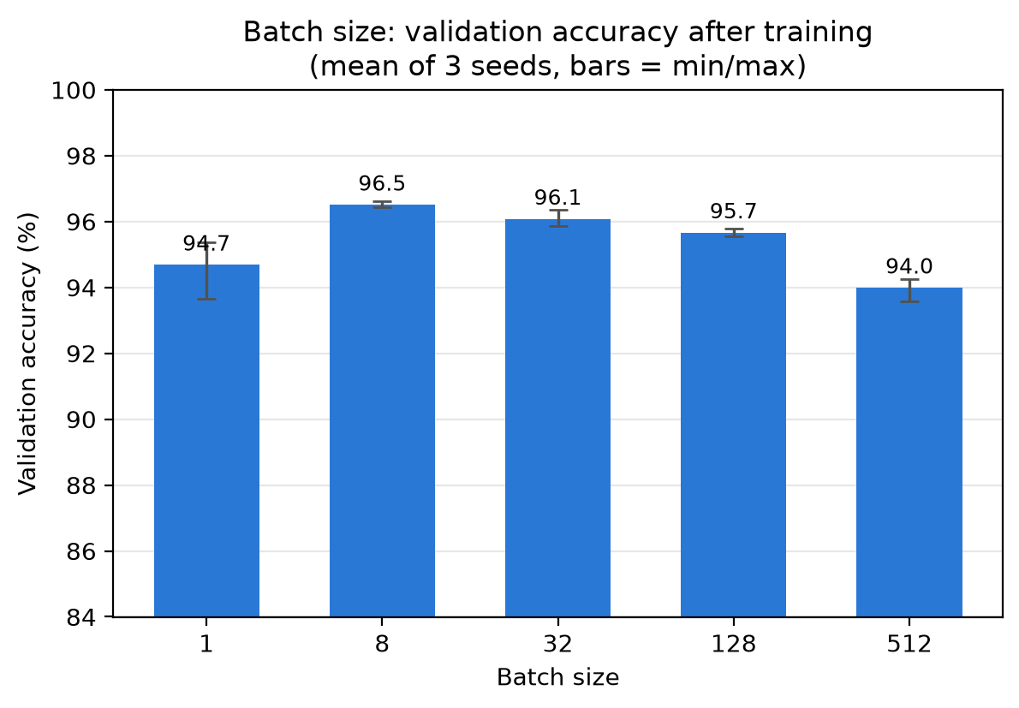
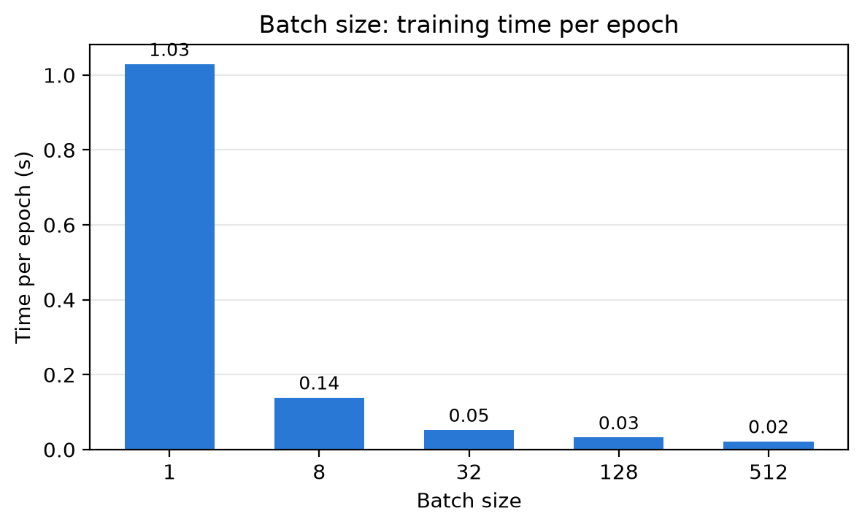
2B: WHICH VARIANTS DID WE TRY?
Batch size · online → mini-batch → large batch (lr 0.5, [784, 64, 10])
Online (1): slowest, noisiest
Batch 8: best accuracy, 96.5 % → final model
Batch 32: 96.1 %, 2× faster per epoch
Batch 512: only 20 updates/epoch → not converged
Notes:
Finally, the batch size, which is how we choose between online, mini-batch and batch training. Batch 1 is online learning: one update per sample.
The key to this chart is the number of weight updates per epoch, which is the training set size divided by the batch size: almost 10,000 updates for online, only 20 for batch 512.
The chart on the right shows that online learning is by far the slowest per epoch, about one second, because each update is a tiny matrix product and Python overhead dominates. It is also the noisiest: the error bar is the widest.
Batch 512 is the fastest per epoch, but with only 20 updates per epoch it simply has not converged after 60 epochs, so it ends lowest at 94 percent.
Batch 8 gave the best accuracy, 96.5 percent: many updates per epoch, while still using matrix operations. Batch 32 is close, at 96.1, and more than twice as fast per epoch, but accuracy is the client's target, so the final model uses batch 8.

Slide 7
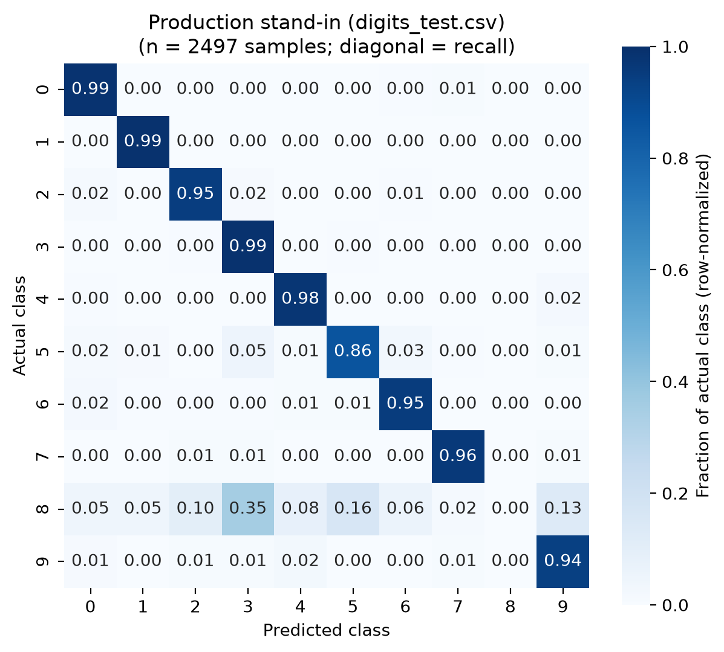
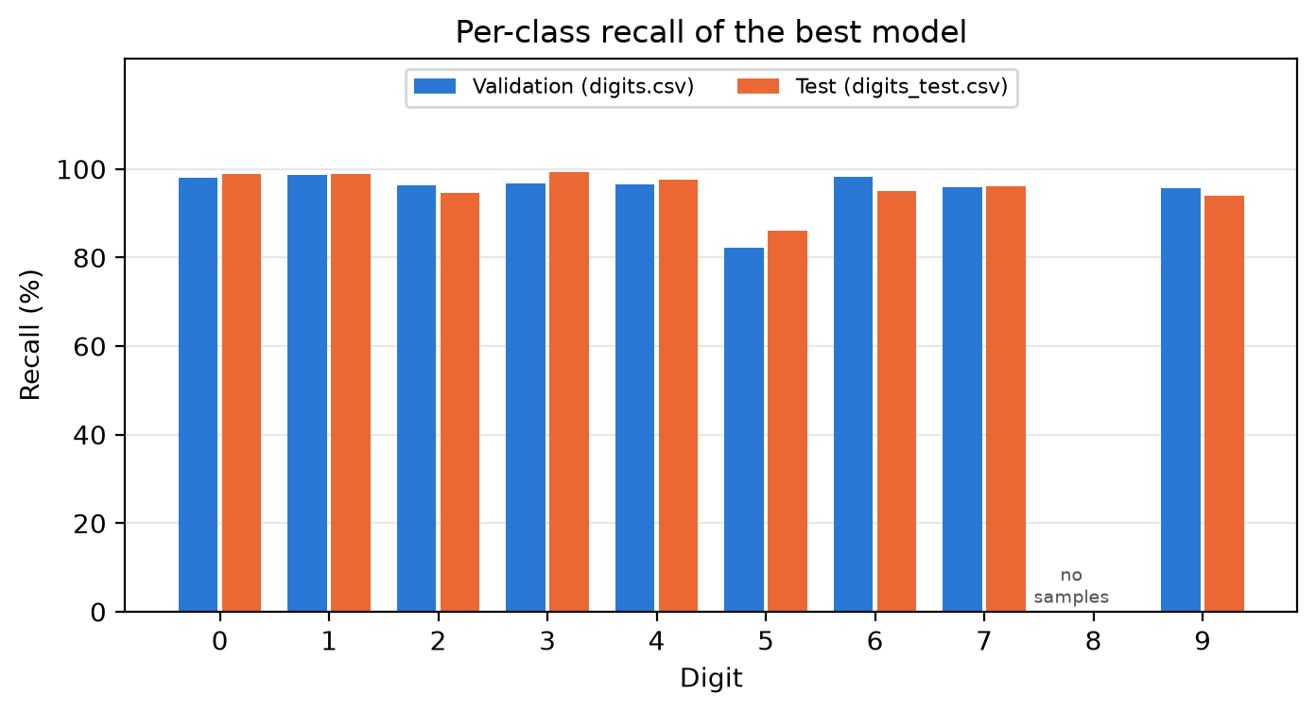
2: FINAL MODEL IN "PRODUCTION"
[784, 128, 10] · sigmoid, β = 1 · gradient descent · lr 1.0 · batch 8 · 50 epochs
96.9%
Best of each study combined
No 8s in training → never predicted
Best reachable: 90.3 %
Test without 8s: 95.8 %
validation · ± 0.2 (3 seeds)
86.4%
test · ± 0.2 (3 seeds)
0%
recall on digit 8
Notes:
This is our final model. We combined the winner of each study: a learning rate of 1.0 from the top of the learning-rate window, one hidden layer of 128 units, and batch size 8. That combination is better than any single variant from the studies, and it is also the configuration Exercise 3 starts from. We trained it with three seeds and evaluated it once on digits_test.csv, our stand-in for production.
On validation it scores 96.9 percent, plus or minus 0.2 over the three seeds. On the test set it drops to 86.4 percent. The confusion matrix shows where the drop comes from. Every row is close to perfect except one: the row for digit 8 has zero on the diagonal. The model never predicts an 8.
The reason is simple: there is not a single 8 in digits.csv. The network has no output that was ever trained to fire for an 8. 243 of the test images are eights, almost 10 percent, so the best accuracy this model could ever reach on this test set is 90.3 percent, whatever we tune.
If we leave the eights out, the test accuracy is 95.8 percent, close to validation, so the model itself generalises well.
The second weakest digit is 5, with 82 to 86 percent recall depending on the seed, which you can see in the recall chart on the right. As the next slide shows, 5 is also the digit with the fewest training examples.

Slide 8
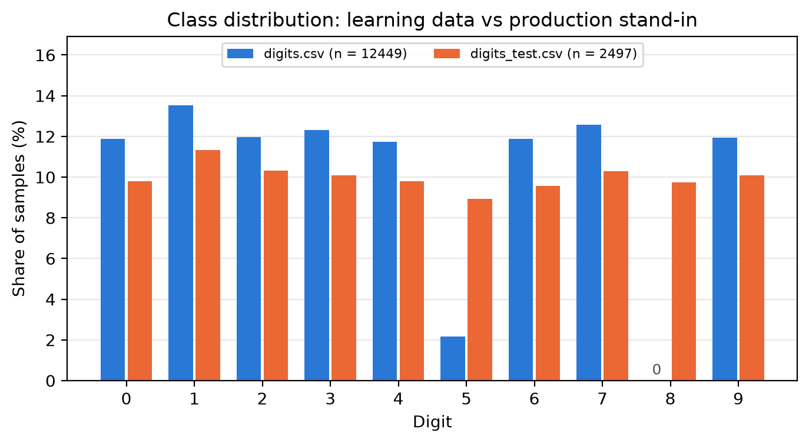
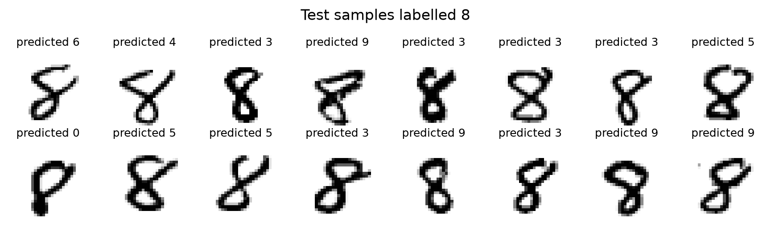
2: WHY THE TEST SCORE DROPS: THE DATA
digits.csv: zero 8s
Only 271 fives (≈ 2 %)
Test set: ≈ 10 % per digit
Unseen 8s → mostly predicted as 3
Fix = more data, not more tuning → Exercise 3
Notes:
So why the gap? It is a data problem, not a model problem.
The chart compares how often each digit appears. In the test set every digit is about 10 percent. In digits.csv, 8 is completely missing and 5 has only 271 images, about 2 percent, against around 1,500 for every other digit.
At the bottom are real test images labelled 8, with what our model predicted. They are clear eights to a human, but the network can only answer with digits it has seen, so it picks the closest shape it knows: mostly 3, then 5, 9 or 2. That matches the confusion matrix on the previous slide.
No learning rate, architecture or optimizer can fix this: you cannot learn a class you have never seen. That is exactly the point of Exercise 3, where the new data in more_digits.csv includes eights and many more fives. Part of the improvement there will come from the data, not only from our techniques.

