Slide 1
POVa Road segmentation
Marek Mudroň
Tomáš Dubský
Filip Osvald
Notes:
Mesh shaders:
- Field: Low-level rendering graphics
- New graphics pipeline that works with small meshes instead of vertices/triangles.
- Allows major speedups on large scenes with hundred thousands/millions triangles.

Slide 2
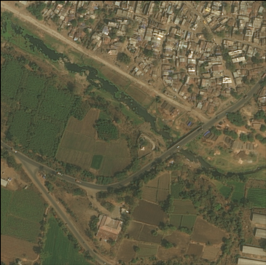
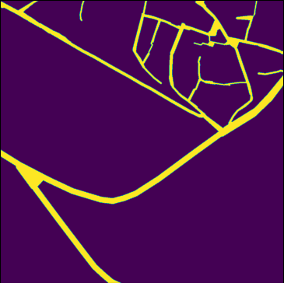
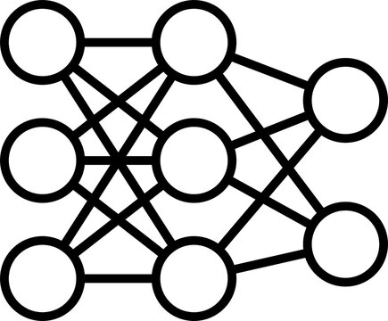
Notes:
In our project we performed the task of road segmentetion/extraction from satellite images using neural networks

Slide 3
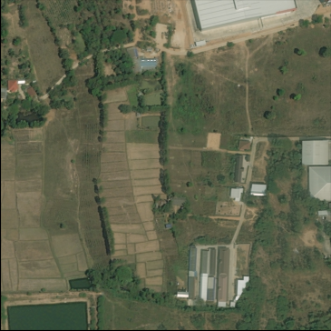
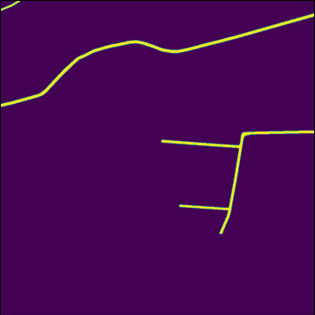
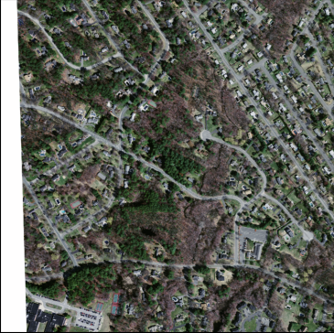
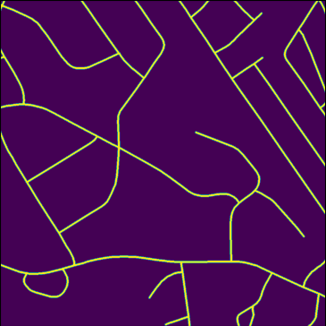

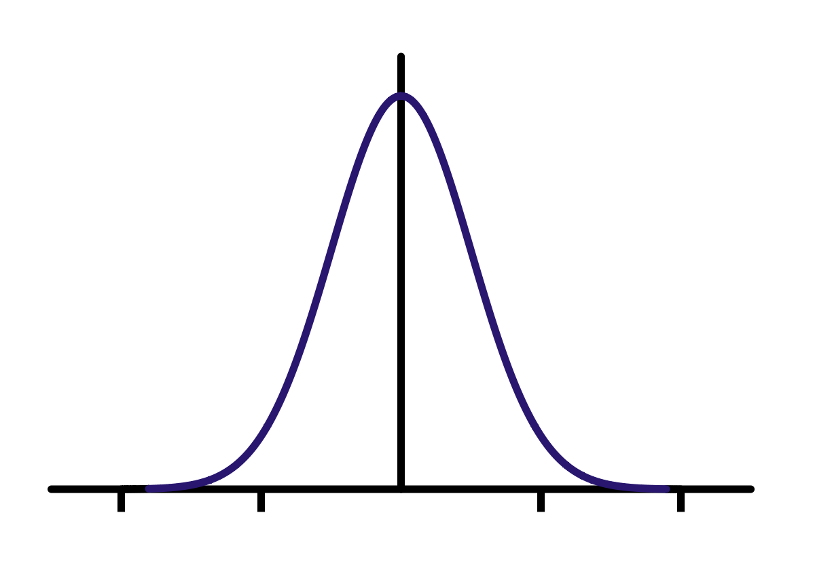
Data
DeepGlobe Road Extraction Dataset
7334 instances
Massachusetts Roads Dataset
1108 instances
1024
1536
1024
1536
1024x1024
Notes:
We used these datasets. The first one contains primarily countryside images with vegetative coverage and cart-roads. The other is composed of instances of urban area photos with lots of disturbing elements like buildings and vegetation. Before merging these datasts all of the instances were cut to the shown dimensions and normalized.

Slide 4
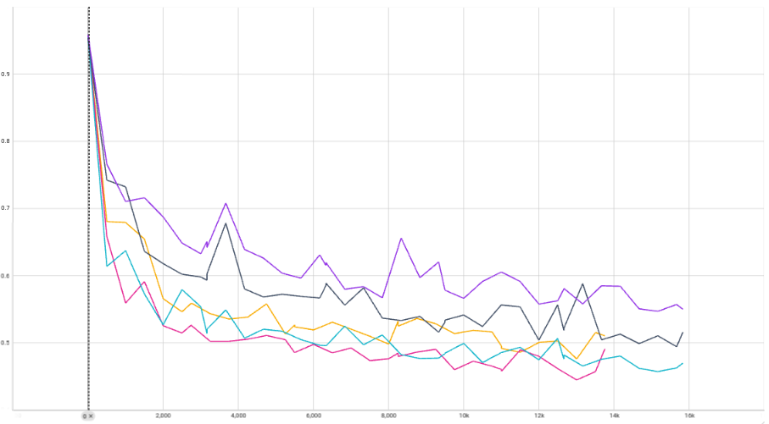
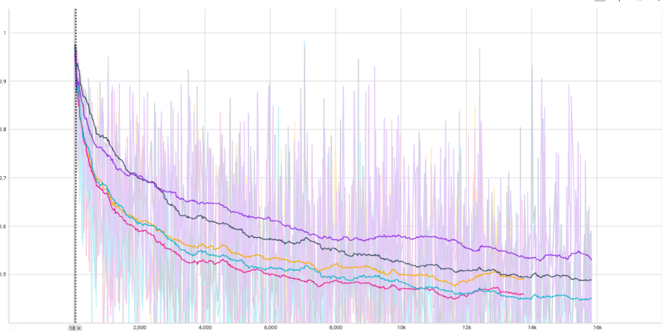
Models
Encoder: ResNet18
Backbone: UNet
Model | Enc. layers | Dataset | Enc. pretrained | Data augmented
1. | 3 | combined | no | no
2. | 5 | combined | no | no
3. | 5 | combined | yes | no
4. | 5 | DeepGlobe | yes | no
5. | 5 | DeepGlobe | yes | yes
Training IoU
Validation IoU
Notes:
We trained multiple variations of model that follows this architecture. By comparing these models we performed following experiments. Each of them was trained for 5 epochs.

Slide 5
Experiments
Does number of encoder layers affect model accuracy?
How does transfer learning contribute to model training?
Can data augmentation compensate for distinctive features of different dataset?

Slide 6
Experiment
Does number of encoder layers affect model accuracy?​
Tested on combined dataset
Model | Enc. layers | Dataset | Enc. pretrained | Data augmented
1. | 3 | combined | no | no
2. | 5 | combined | no | no
3. | 5 | combined | yes | no
4. | 5 | DeepGlobe | yes | no
5. | 5 | DeepGlobe | yes | yes
IoU = 0.449
IoU = 0.484

Slide 7
2. Experiment
How does transfer learning contribute to model training?
Tested on combined dataset
Model | Enc. layers | Dataset | Enc. pretrained | Data augmented
1. | 3 | combined | no | no
2. | 5 | combined | no | no
3. | 5 | combined | yes | no
4. | 5 | DeepGlobe | yes | no
5. | 5 | DeepGlobe | yes | yes
2. IoU = 0.484
3. IoU = 0.526

Slide 8
3. Experiment
Can data augmentation compensate for distinctive features of different dataset?
Tested on Massachusetts dataset
Model | Enc. layers | Dataset | Enc. pretrained | Data augmented
1. | 3 | combined | no | no
2. | 5 | combined | no | no
3. | 5 | combined | yes | no
4. | 5 | DeepGlobe | yes | no
5. | 5 | DeepGlobe | yes | yes
4. IoU = 0.430
5. IoU = 0.439
Augmentations
Random flip (horizontal/vertical/both)
Gaussian Blur
Hue, saturation, value

Slide 9
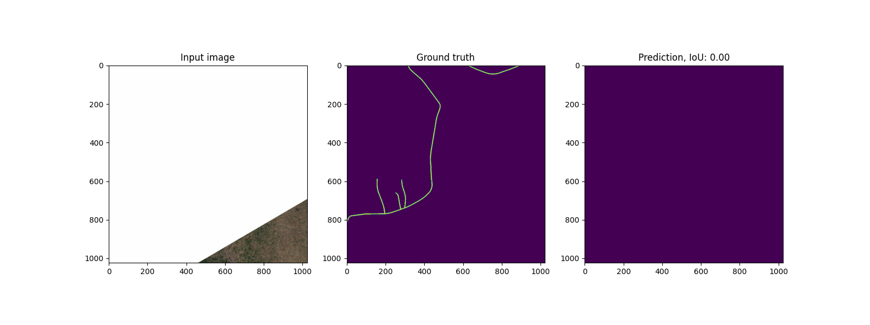
Faulty instances
Notes:
The reason why loss function fluctuates a lot during training is because of frequent presence of faulty instances in data.

Slide 10
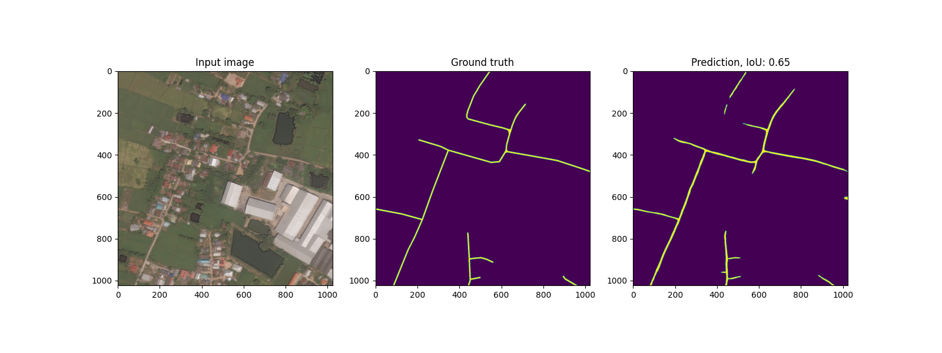
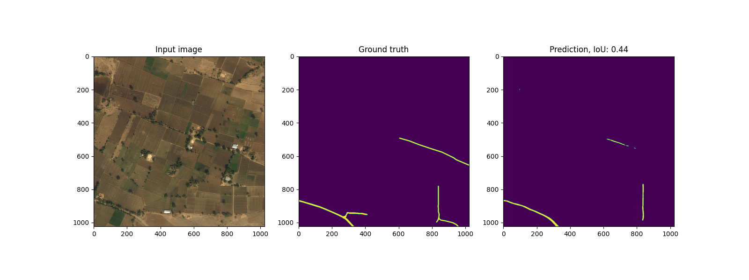
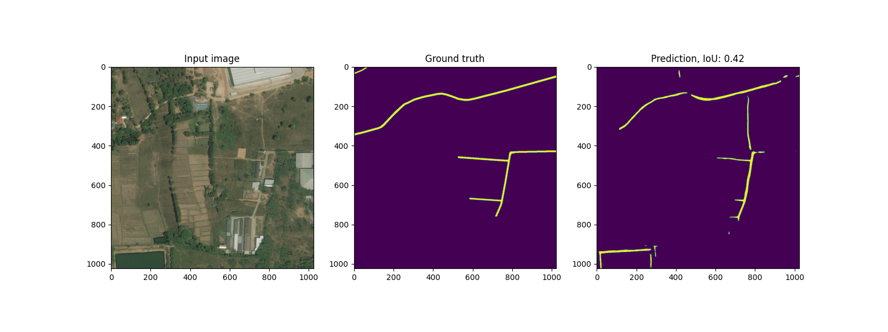
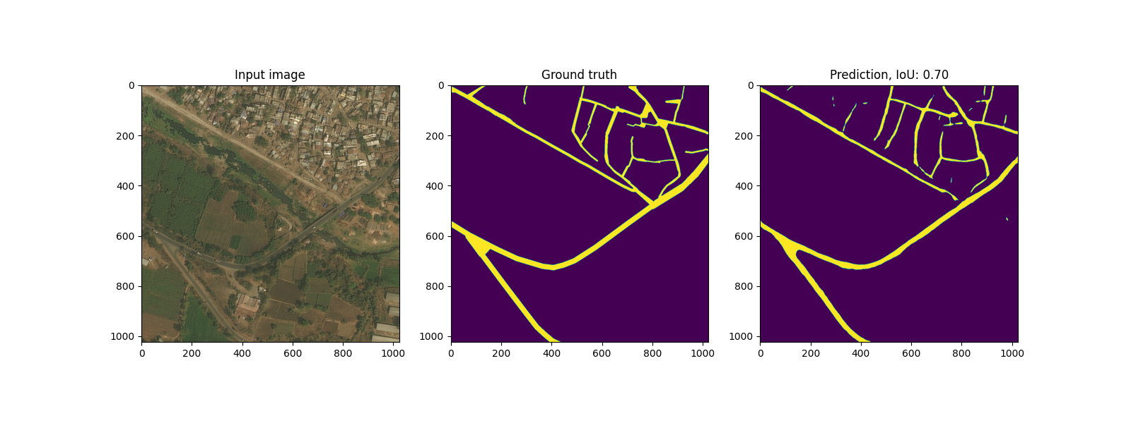
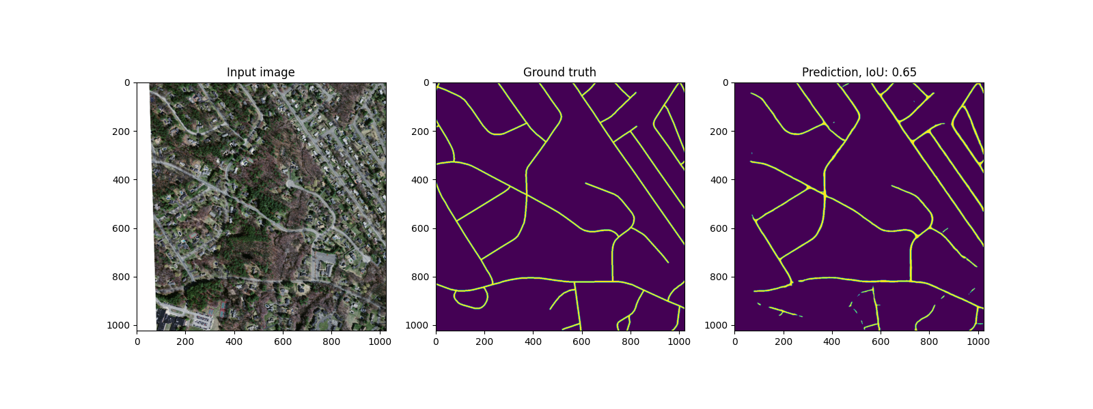
Quality assessment

