Slide 1


Git : Version Control
UWICS EVENT – Git Introduction

Slide 2
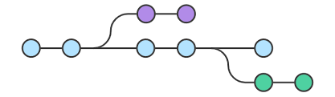
What is Version Control and Git?
Version Control records changes to files so you can recall specific versions of those files.
Git is a version control system for tracking changes.
Notes:
Version control:
Track project history
Collaborate together
Version control systems are a category of software tools that help a software team manage changes to source code over time

Slide 3

Why use Git?
a = 1
b = 2
c = “five”
a = 1
b = 2
c = “five”
monster = “elmo”
a = 1
c = “five”
monster = “elmo”
sleepy = True
broke = True
Create a file
Add a line
Add two lines and delete one line
It keeps track of changes to code.
Synchronize
Revert to older versions.
Notes:
Git is a command line tool that will help us with version control in several different ways:
Provides an effective way to keep track of changes we make to our code by saving snapshots of our code at any given point in time.
Allowing us to easily synchronize code between different people working on the same project by allowing us to pull information from and push information to a web repository.
Allowing us to revert back to earlier versions of our code if we realize we’ve made a mistake.
It compresses content and doesn’t store duplicates.

Slide 4

Installing Git Is git installed already?
Open command terminal: For windows – Click the search icon and type in “cmd” (without quotation marks) or Windows key + R to open the Run command window
For MacOS- command + space and then type terminal
When the terminal opens type in (git --version)
Notes:
Git --version : This command displays the version of the currently installed Git application on your pc. Example

Slide 5
Installing Git
To install git you can download it from the website -> https://git-scm.com/
Notes:
Link to download Git application https://git-scm.com/download/win (when it is opened in the browser, the download starts automatically)

Slide 6

Configuring Git to open text editor
git config –global core.editor “code –wait”
Link to download Visual Studio Code text editor https://code.visualstudio.com
Notes:
*Add VSCode to your environement path. This issue will have to be resolved by the user as each operating system have different instruction to adding VSCode to your path.
Another command:
git --help -> This command provides a list of common commands used in git and a description of what each command can achieve.

Slide 7

IT’S OPEN SOURCE! Think of it like a hub world from a game. An area on the internet where developers can continually return to access their own repositories and other developers' repositories. Also create their own repositories to store their projects with the option to allow other developers contribute.
Notes:
Github link to setup account -> https://github.com/join?ref_cta=Sign+up&ref_loc=header+logged+out&ref_page=%2F&source=header-home
GitHub is a website that allows you to store repositories remotely on the web.

Slide 8
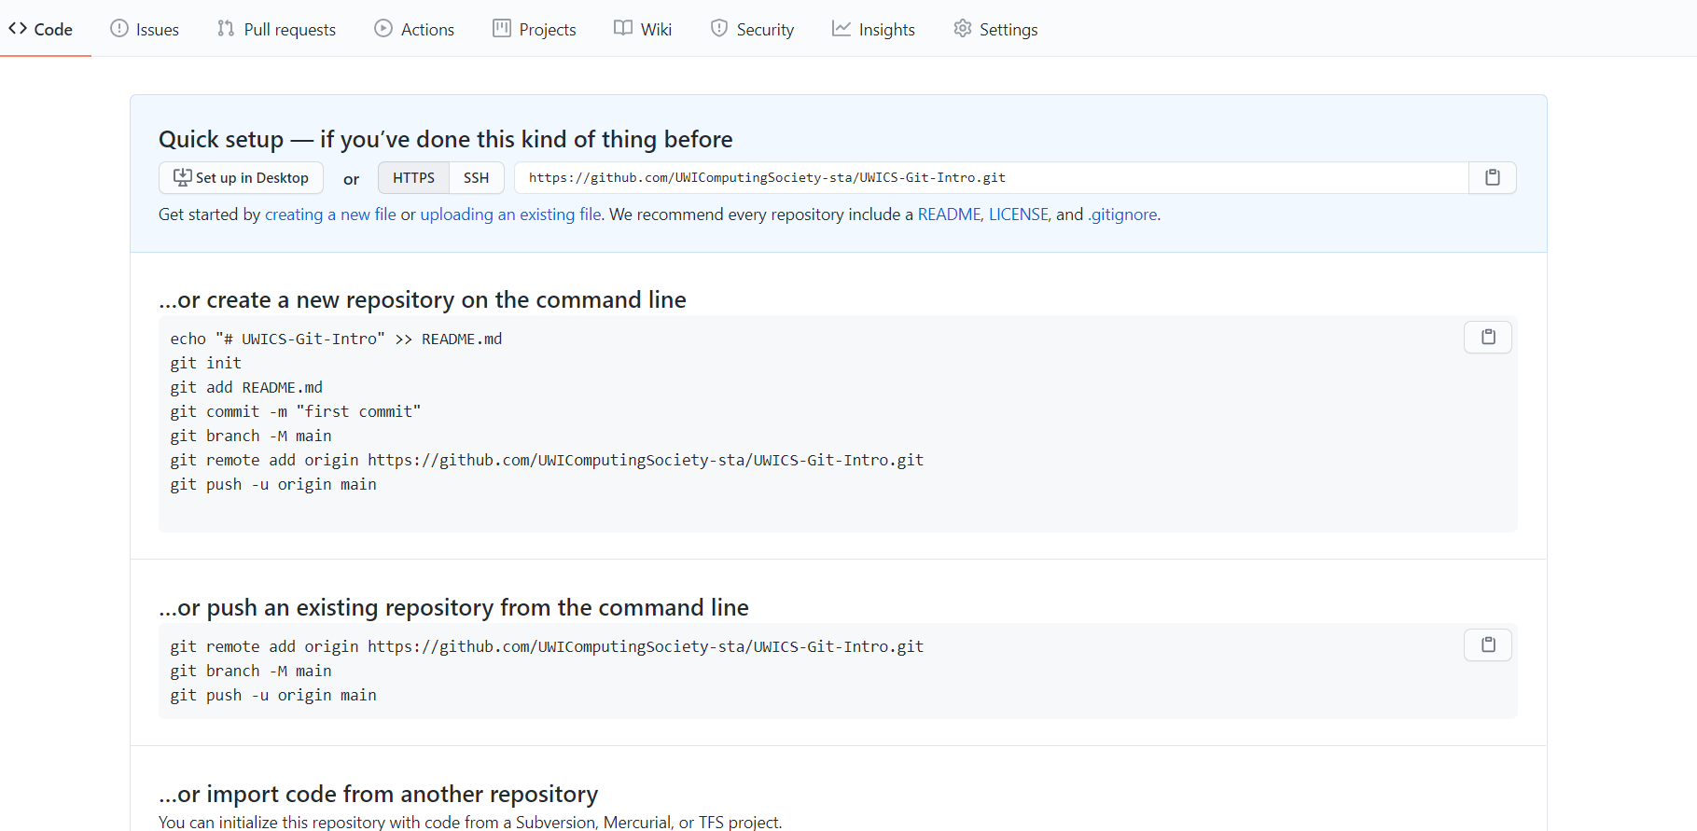
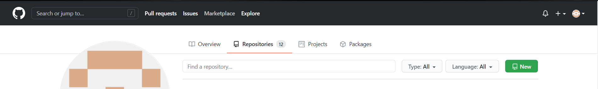
Creating a GitHub repository
Notes:
To create a new repository on GitHub:
Make sure that you have a GitHub account set up.
Click the + in the top-right corner, and then click “New repository” or click the green button on the right with the word new on it.
Create a repository name that describes your project
(Optional) Provide a description for your repository
Choose whether the repository should be public (visible to anyone on the web) or private (visible just to you and others you specifically grant access)
(Optional) Decide whether you want to add a README, which is a file describing your new repository.

Slide 9


Cloning repository
a = 1
b = 2
c = “five”
Notes:
In your terminal, run git clone <repository url>. This will download the repository to your computer. If you didn’t create a README, you will get the warning: You appear to have cloned into an empty repository. This is normal, and there’s no need to worry about it.

Slide 10
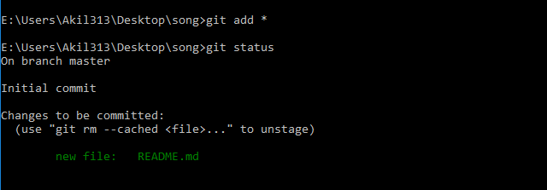
Adding changes
“git add <filename>”
“git status”
Notes:
We then move onto git add and git status. Git add “adds” all changes which include new files, modification and deleted files.
git add <filename> or “git add .”
Git status shows the status of our changes and adds, modifications and deletions.

Slide 11

Ready for commitment?
“git commit –m [MESSAGE]”
ALTERNATIVELY:
“git commit –am “[message]”
Notes:
So git commit locally saves the changes made to all the files that have been added. This can be considered as a local version.
You can use git commit –am “message” if you have only changed existing files and not made new ones.
Sometimes, the remote repository on GitHub will be more up to date than the local version. In this case, you want to first commit any changes, and then run git pull to pull any remote changes to your repository.

Slide 12
Commit Messages
Good | Bad
Create user model to store user session information | Add user.rb
Added “analyse()” function that accepts any picture and returns what the object is. | Added function
“calc1()” function crashes program after addition of name array “names” | Yall … I really gonna cry if nobody fix this tbh :’(

Slide 13
git push
a = 1
b = 2
c = “five”
Notes:
Git push now allows us to carry over our locally committed version to the remote repository we created earlier.

Slide 14
Time to branch out.
git branch verse2
git checkout verse2
Edit files
git checkout master
git merge [branch]
Notes:
Git branch create a branch of this workflow or tree that we have created. It takes what is currently in master and creates a side module, separate from the master branch. This branch can be edited as a version of master but not the same. This can then be merged with the master to update it with the changes using “git merge [branch]”.
git branch bugfix # Creates a new branch called bugfix
git checkout bugfix # Switches to the bugfix branch
git switch bugfix # Same as the above
git switch -C bugfix # Creates and switches
git branch -d bugfix # Deletes the bugfix branch

Slide 15
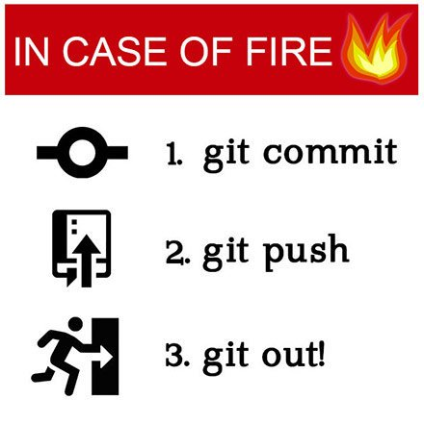

Slide 16
FORKS
PULL REQUESTS

Slide 17
Git Commands used.
Commands | Descriptions
git clone <repo link> | Clones the repository to your machine
git add | Stages the file so git can keep tack of it
git commit –m “message” | Saves the changes of the files in the staging area with a message.
git push | Pushes the saved files, after you run the commit command, to the online repository on github.
git status | Shows the status of the files in the staging area
git log | Shows a full history of the commits made in the repository.
Notes:
Potentially even more helpful, if you realize that you’ve made a mistake, you can revert back to a previous commit using the command git reset in one of two ways:
git reset --hard <commit> reverts your code to exactly how it was after the specified commit.
To specify the commit, use the commit hash associated with a commit which can be found using git log as shown above.
git reset --hard origin/master reverts your code to the version currently stored online on Github.

Slide 18
GitHub Pages
GitHub Pages: GitHub Pages is a simple way to publish a static site to the web.
Create a new GitHub repository. Name the repository “<GitHubUserName>.github.io”
Clone the repository and make changes locally, making sure to include an index.html file
Push those changes to GitHub
Navigate to the Settings page of your repository, scroll down to GitHub Pages, and choose the master branch in the dropdown menu
Scroll back down to the GitHub Pages part of the settings page, and after a few minutes, you should see a notification that “Your site is published at: …” including a URL where you can find your site

