Slide 1
CLOSEST BICIMAD STATIONS TO PUBLIC SCHOOLS
BiciMAD SCHOOL
Margarita Montenegro Villalba

Slide 2







OBJECTIVE
Create a Python App that allow their potential users to find the nearest BiciMAD station to public schools.
RESOURCES USED
(Pandas, Numpy, requests,
shapely, geopandas)
files.py
Argparse
Terminal

Slide 3
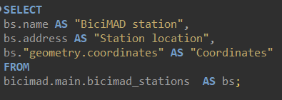
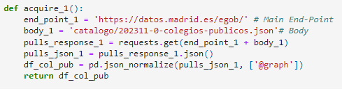
GET THE DATASETS
Used DBeaver to Access the BICIMAD database. I selected the columns that interested me and exported the table to csv.
I accesed the API REST from the Portal de datos abiertos del Ayuntamiento de Madrid via Python.

Slide 4
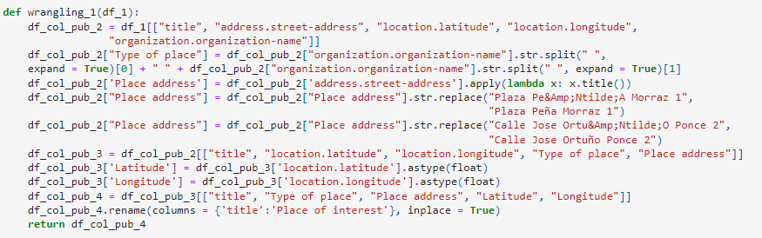
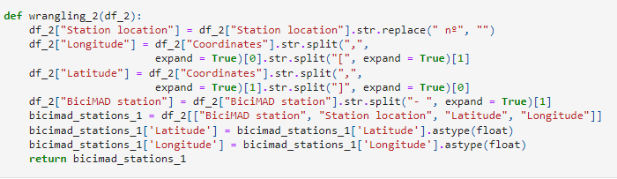
DATA WRANGLING
Then I cleaned both datasets after loading them. I had to change and rearrange column names, split columns, apply .title to the streets, convert latitude and longitude to float, etc.

Slide 5
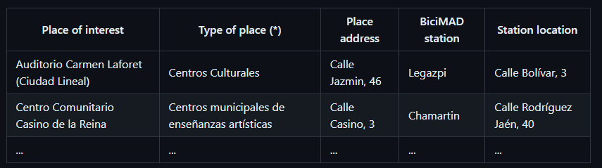
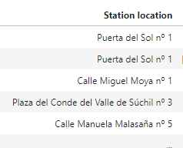
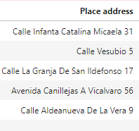
problem
I wanted the format of both addresses to be with a comma, like in the sample table:
This was easy because I just had to change “nº” for “,”: df_2["Station location"] = df_2["Station location"].str.replace(" nº", ",")
But this one I didn’t know how to do it, I tried different things and after losing a lot of time decided to leave both adresses without a comma.

Slide 6
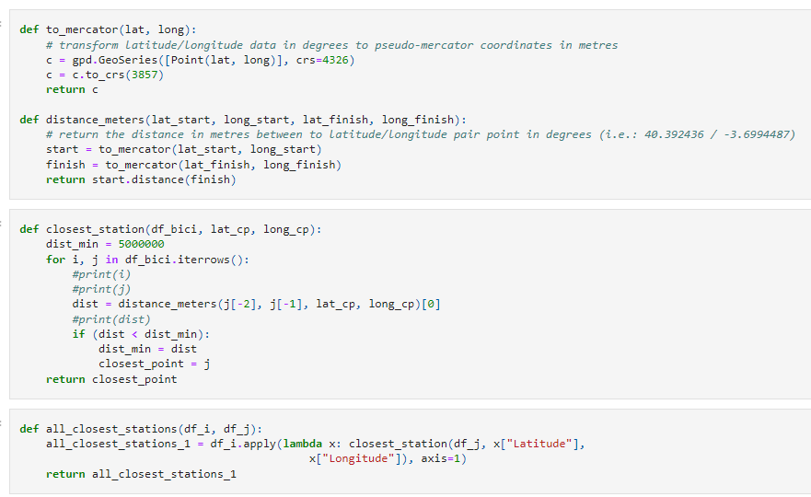
DATA ANALYSIS
I used functions to calculate the closest BiciMAD station to a specific public School. Then, to calculate the closest station to every public School.

Slide 7
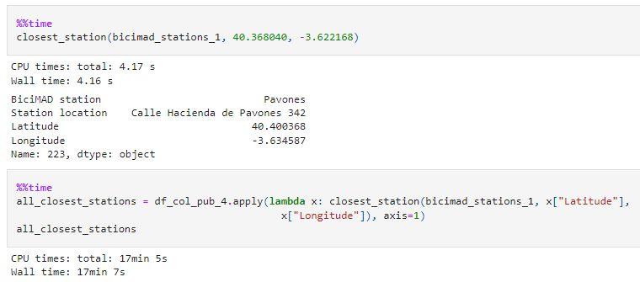
problem
It takes 4.17 s to calculate the closest BiciMAD station to a specific school. So, to calculate all of them it takes 17 min.

Slide 8
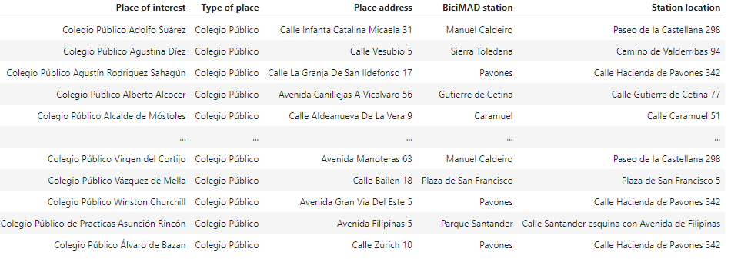
FINAL TABLE

Slide 9
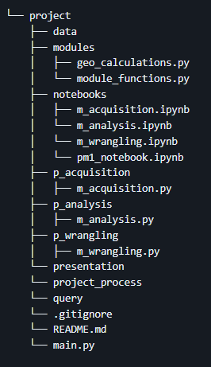
DATA PIPELINE
problem
When I executed the main in the Terminal, it never finished the distances calculations. I had to change environment for it to work.
I also had some trouble getting the arparse to work properly until I finally made it work after long hours of trying.

Slide 10
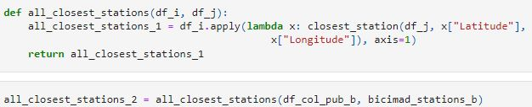
IRONHACK DATA CODE BEAUTY PAGEANT

