Slide 1
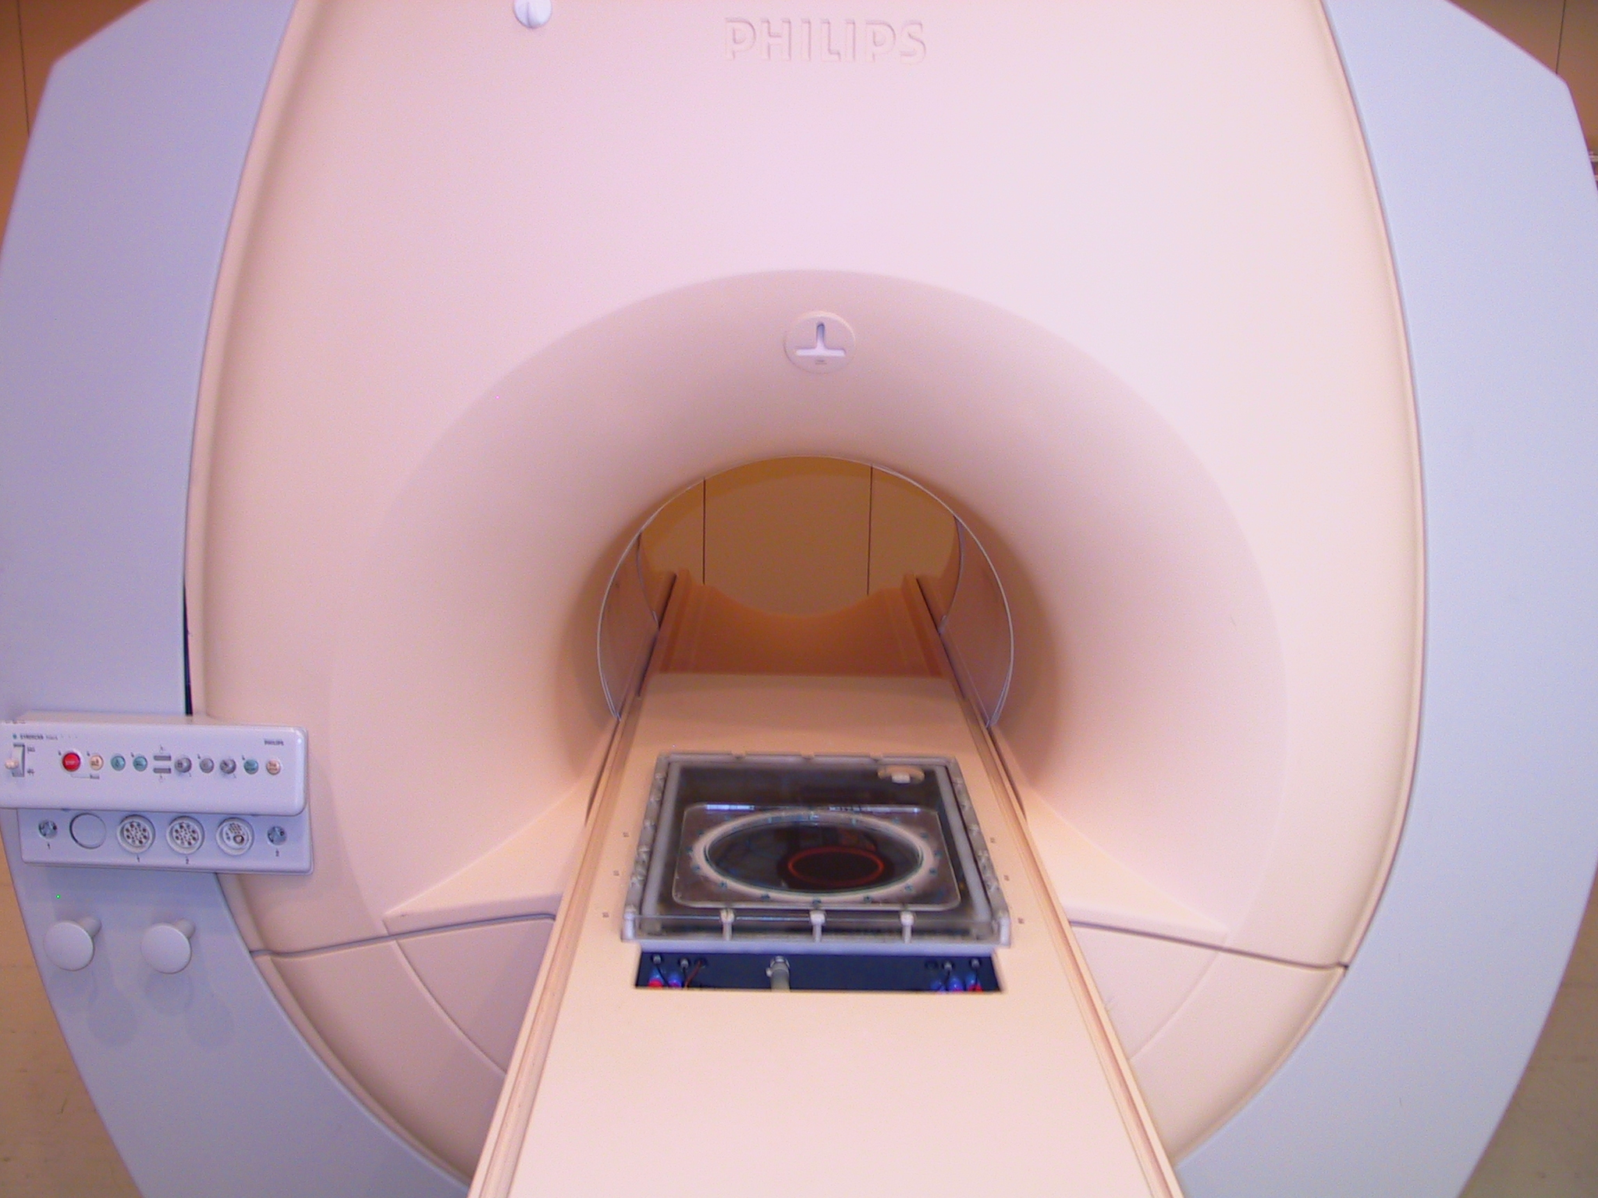
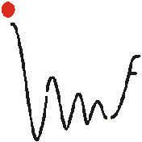
MRgHIFU
3D spatial and temporal
Temperature control
Charles Mougenot^{1,2}, Chrit Moonen¹
¹Molecular & Functional Imaging, France
²Philips Medical Systems, France
Notes:
I would like to thank the ISTU6 organization for having invited me.
I’m going to talk about the 3 dimension spatial and temporal temperature control with MR guided focused ultrasound developed by IMF research laboratory and Philips Medical Systems.

Slide 2
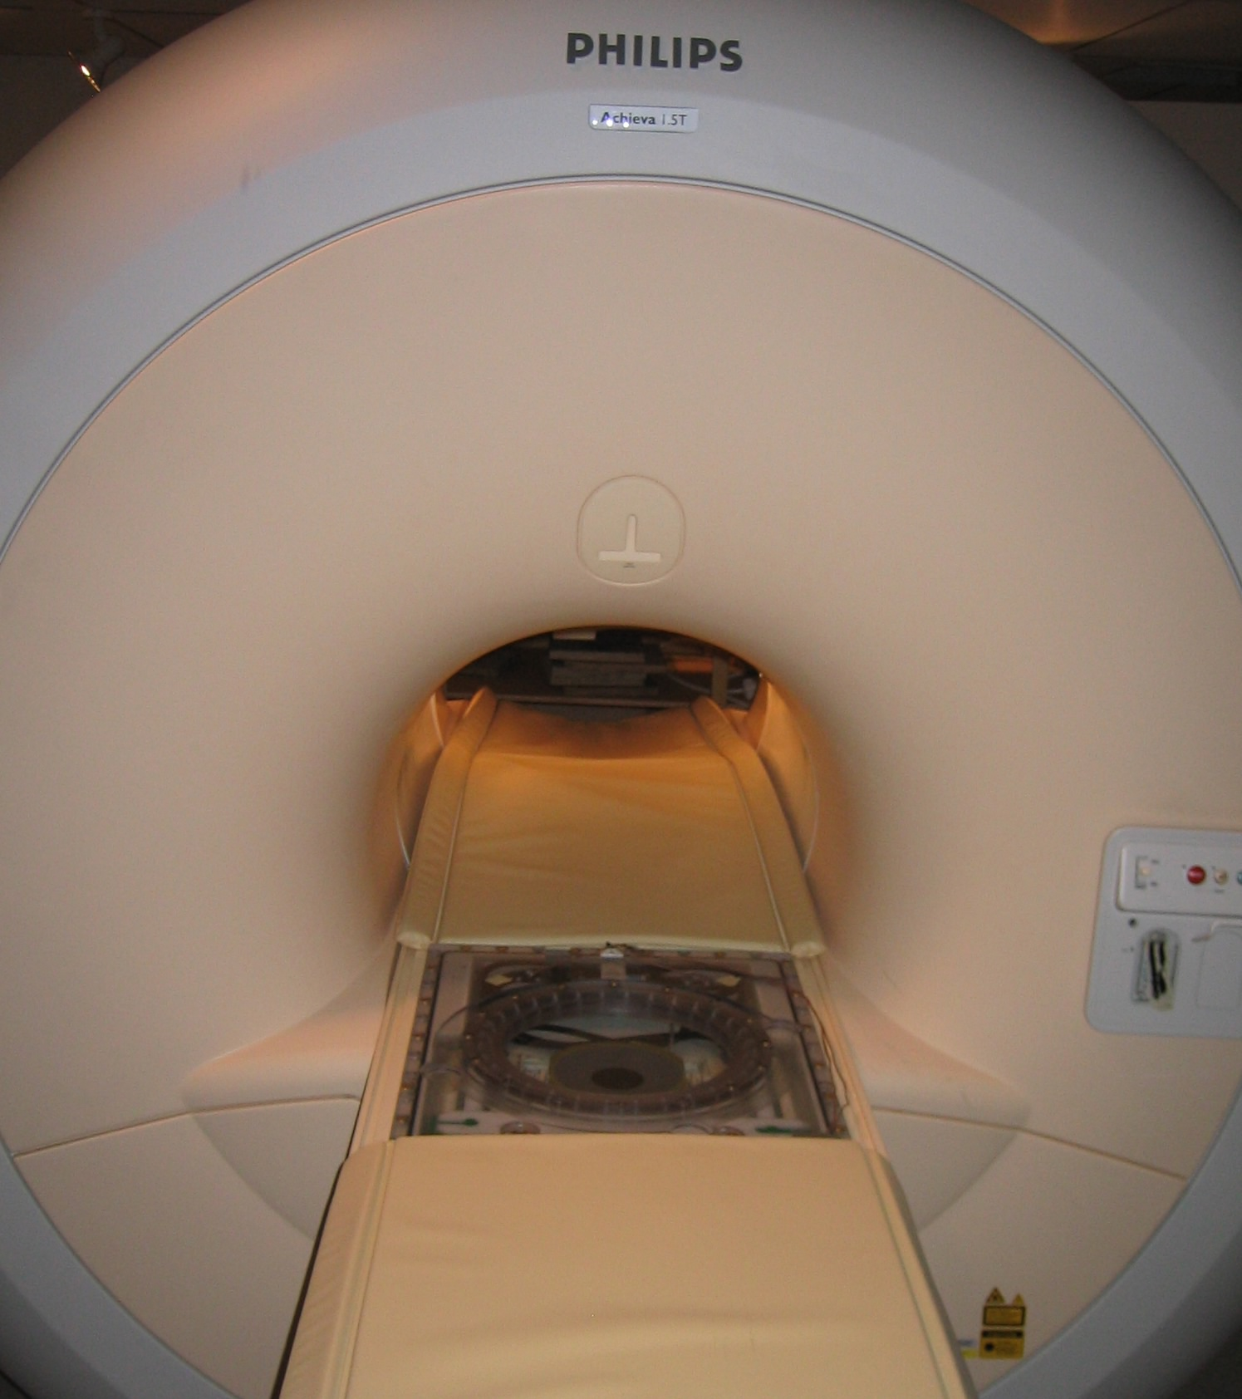
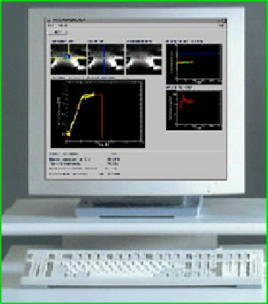
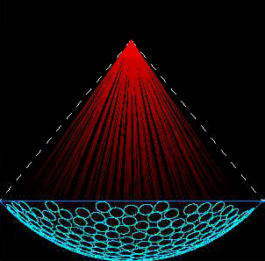
MRI feedback controlled HIFU heating
M R I
1.5T Philips
P C
Anatomical and
Thermal Mapping
Thermo-therapy
Position and
Power control
TRANSDUCER
256 channels 1.5MHz
Notes:
This is the full installation for MRI guided HIFU :
A closed magnet at 1.5 Tesla provides anatomical and thermal mapping. All data are transferred to a personal computer,
Which analyzes in real time temperature maps in order to regulate the temperature.
A 256 channel phased array transducer adjusts the intensity and the position of the focal point 15 times per second.
This loop is repeated for each MR image acquired every 2.4s.

Slide 3
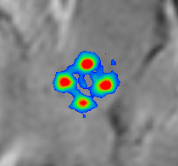
Spatial and temporal temperature control
Points regulated with independent PID feedback
Derivative control
Integral
control
Temperature
Proportional control
Time
Ensure stable convergence of temperature in each point
Notes:
With this platform, the temperature is adjust by a proportional, integral and derivative controller for each point.
This graph of the controlled temperature shows the three parameters which are taking into account in order to adjust the heating.
The proportional control is equal to the instantaneous error between the temperature measured in yellow and the target temperature in red.
The integral control is defined by the sum of the past temperature errors.
The derivative control is determined by the present temperature variation in order to reach the future target temperature.
This automatic control ensures a stable convergence of the temperature in each point.

Slide 4
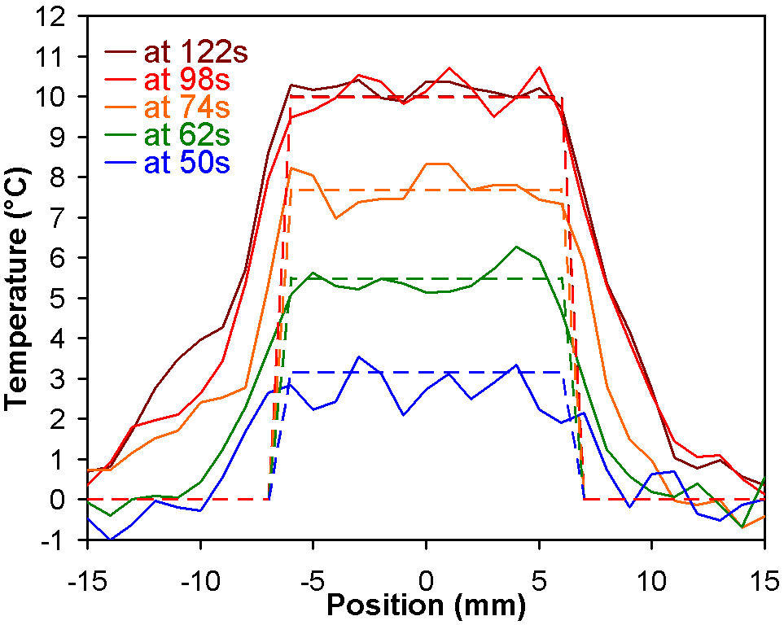
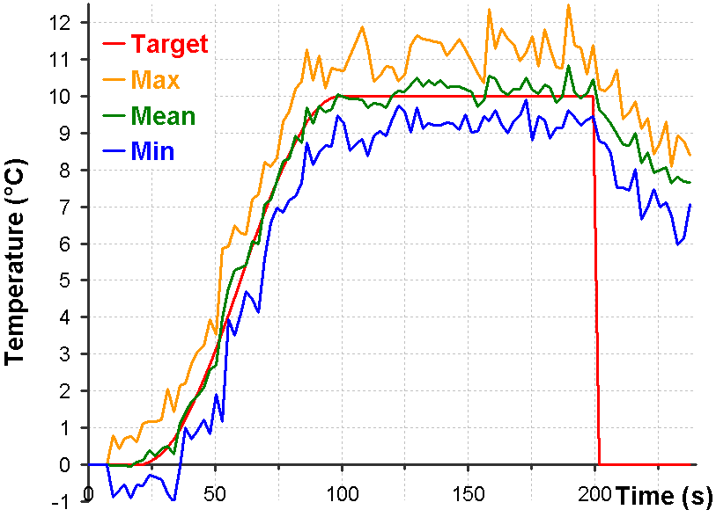
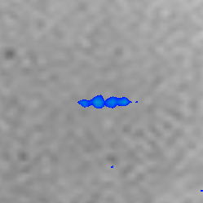
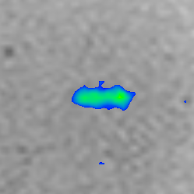
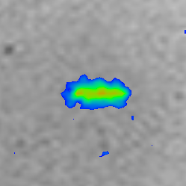
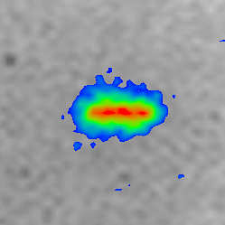
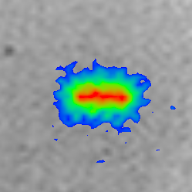
Linear control: segment 13mm
13 points regulated
50s
62s
74s
98s
122s
10°C
6°C
1cm
1cm
1cm
1cm
1cm
2°C
Notes:
This is an example of such spatial and temporal temperature control performed on a gel along a 13mm segment composed of 13 points.
The graph on the left shows the homogenous temperature increased produced along this segment at 5 five different times of the heating control.
Corresponding MR slices acquired are presented bellow with a color scale ranging from 2°C to 10°C.
Between 6 slices acquired, only the central slices are presented.
For a statistical analysis, the graph on the right presents the maximum, average and minimum temperature of those 13 points in regards to the target temperature.
The average temperature corresponds precisely to the target temperature with a difference between the minimum and the maximum which mainly corresponds to the noise measurement.

Slide 5


Ultrasound Overlap
Overlap
Focal points
Focal points
Overlap
Overlap enlarged heating volume along beam axis
Lele PP, 1980
Notes:
As described by those schematic drawing when several focal point are performed, there is a superposition of each acoustic field.
This effect, reported by Lele in 1980, induces an overlap which enlarged the heating volume along the beam axis.
For the extension of the spatial temperature control in 3 dimension this effect, relatively important, should be take into account.

Slide 6
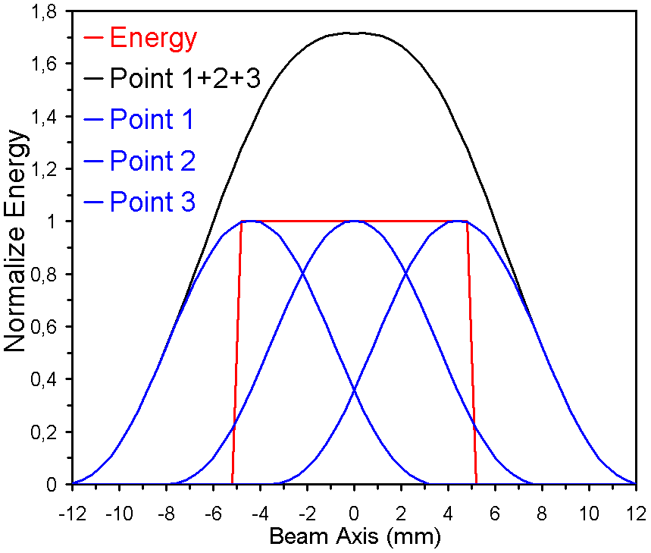
Maximum detection algorithm
Sonication density
equal to required energy
Notes:
When several focal points are performed along the beam axis, the energy required could not be assimilate to the density of sonication.
Otherway the overlap of each focal produce an overshooting.
The sonication density could be computed using a maximum detection algorithm.
This algorithm consist to take 90% of the maximum detected for example a point on the border.
Next, the second point is equal to 90% of the remaining energy.
Iteratively, the third point is equal to 90% of the remaining energy.
With this method, the sonication density take into account the overlap effect and produce the required energy.

Slide 7
Maximum detection algorithm
Sonication density
equal to required energy
Over shooting
Notes:
When several focal points are performed along the beam axis, the energy required could not be assimilate to the density of sonication.
Otherway the overlap of each focal produce an overshooting.
The sonication density could be computed using a maximum detection algorithm.
This algorithm consist to take 90% of the maximum detected for example a point on the border.
Next, the second point is equal to 90% of the remaining energy.
Iteratively, the third point is equal to 90% of the remaining energy.
With this method, the sonication density take into account the overlap effect and produce the required energy.

Slide 8
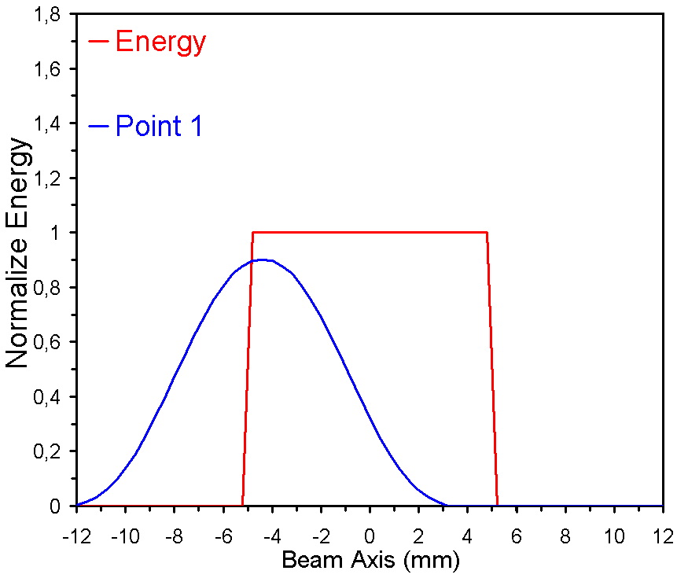
Maximum detection algorithm
Sonication density
equal to required energy
Sonication density computed with
maximum detection algorithm
Maximum 1 × 90%
→ Point 1
Over shooting
Notes:
When several focal points are performed along the beam axis, the energy required could not be assimilate to the density of sonication.
Otherway the overlap of each focal produce an overshooting.
The sonication density could be computed using a maximum detection algorithm.
This algorithm consist to take 90% of the maximum detected for example a point on the border.
Next, the second point is equal to 90% of the remaining energy.
Iteratively, the third point is equal to 90% of the remaining energy.
With this method, the sonication density take into account the overlap effect and produce the required energy.

Slide 9
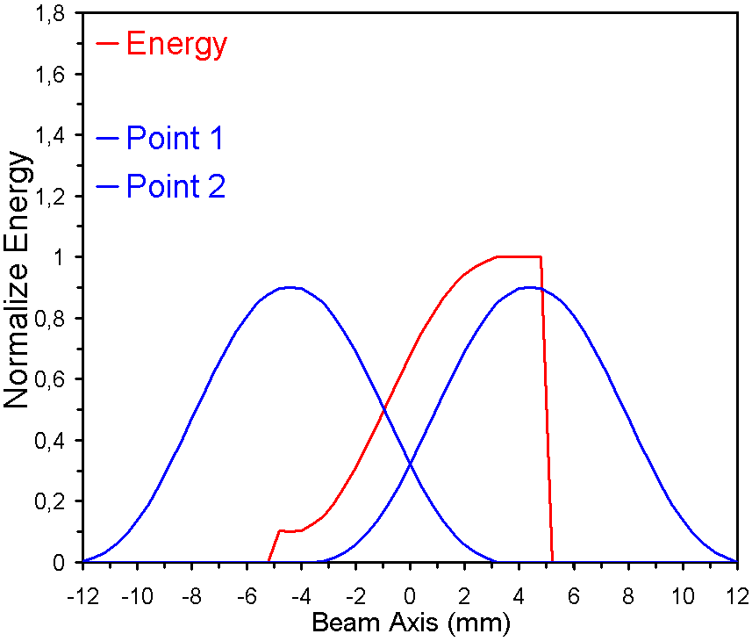
Maximum detection algorithm
Sonication density
equal to required energy
Sonication density computed with
maximum detection algorithm
Maximum 2 × 90%
→ Point 2
Over shooting
Notes:
When several focal points are performed along the beam axis, the energy required could not be assimilate to the density of sonication.
Otherway the overlap of each focal produce an overshooting.
The sonication density could be computed using a maximum detection algorithm.
This algorithm consist to take 90% of the maximum detected for example a point on the border.
Next, the second point is equal to 90% of the remaining energy.
Iteratively, the third point is equal to 90% of the remaining energy.
With this method, the sonication density take into account the overlap effect and produce the required energy.

Slide 10
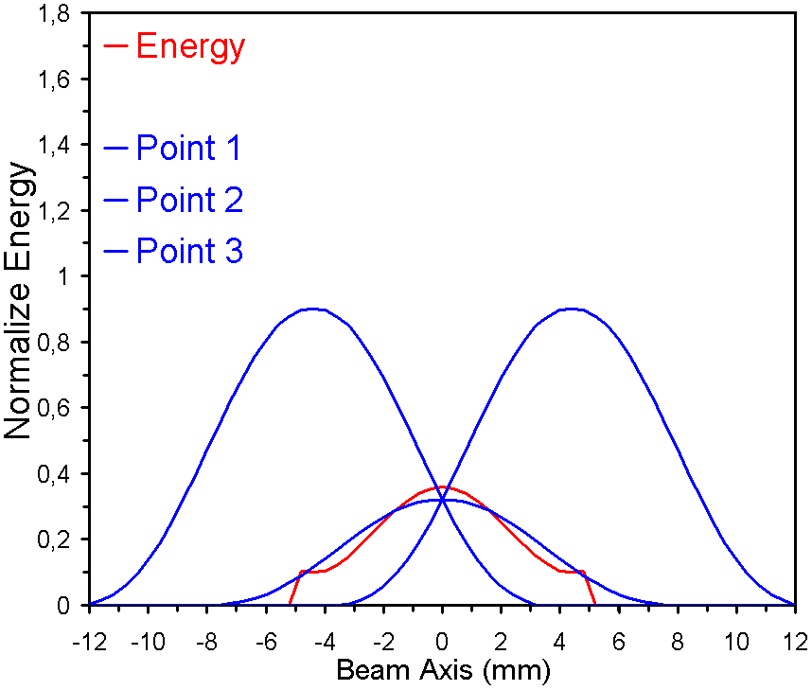
Maximum detection algorithm
Sonication density
equal to required energy
Sonication density computed with
maximum detection algorithm
Maximum 3 × 90%
→ Point 3
Over shooting
Notes:
When several focal points are performed along the beam axis, the energy required could not be assimilate to the density of sonication.
Otherway the overlap of each focal produce an overshooting.
The sonication density could be computed using a maximum detection algorithm.
This algorithm consist to take 90% of the maximum detected for example a point on the border.
Next, the second point is equal to 90% of the remaining energy.
Iteratively, the third point is equal to 90% of the remaining energy.
With this method, the sonication density take into account the overlap effect and produce the required energy.

Slide 11
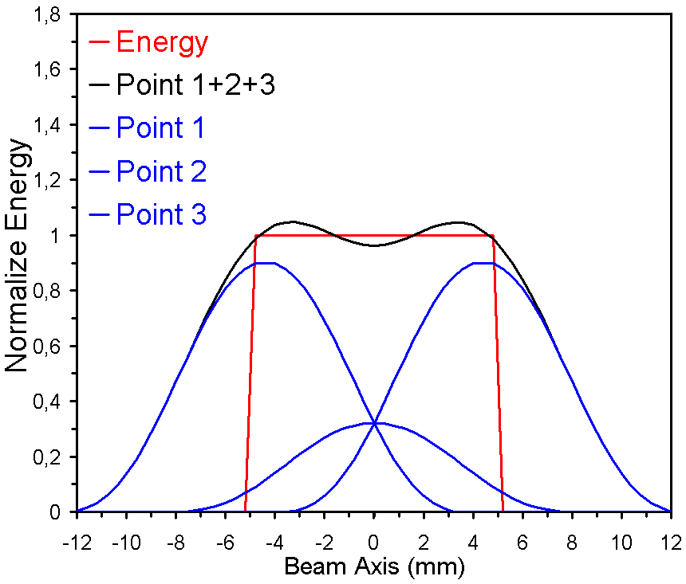
Maximum detection algorithm
Sonication density
equal to required energy
Sonication density computed with
maximum detection algorithm
Take into account
Overlap effect
Over shooting
Notes:
When several focal points are performed along the beam axis, the energy required could not be assimilate to the density of sonication.
Otherway the overlap of each focal produce an overshooting.
The sonication density could be computed using a maximum detection algorithm.
This algorithm consist to take 90% of the maximum detected for example a point on the border.
Next, the second point is equal to 90% of the remaining energy.
Iteratively, the third point is equal to 90% of the remaining energy.
With this method, the sonication density take into account the overlap effect and produce the required energy.

Slide 12
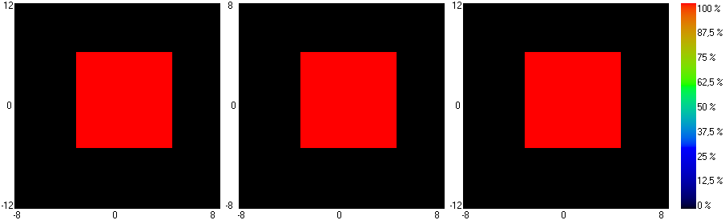
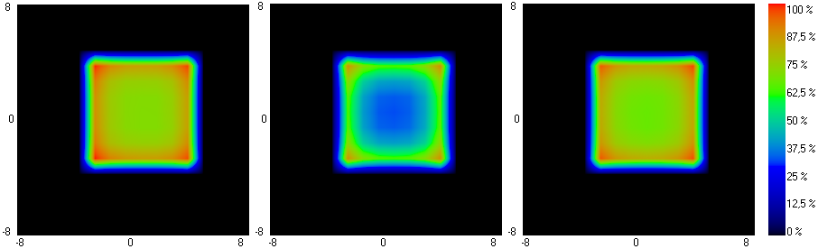
Volume control: cube 7×7×12 mm³
Slice 1
Slice 2
Slice 3
Energy required
Sonication density
Sonication localisation at the border of the volume
Notes:
This an example in 3 dimension, with a cubic volume of 7×7×12 mm³ under control disposed on 3 slice of 4mm.
Images bellow describes sonication density computed with maximum detection algorithm in order to produces this homogenous energy deposition.
It appears that most of sonication should be performed on corners and surfaces of this cube.

Slide 13
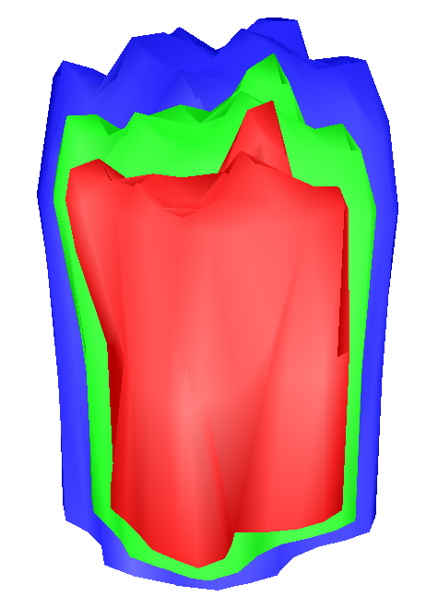
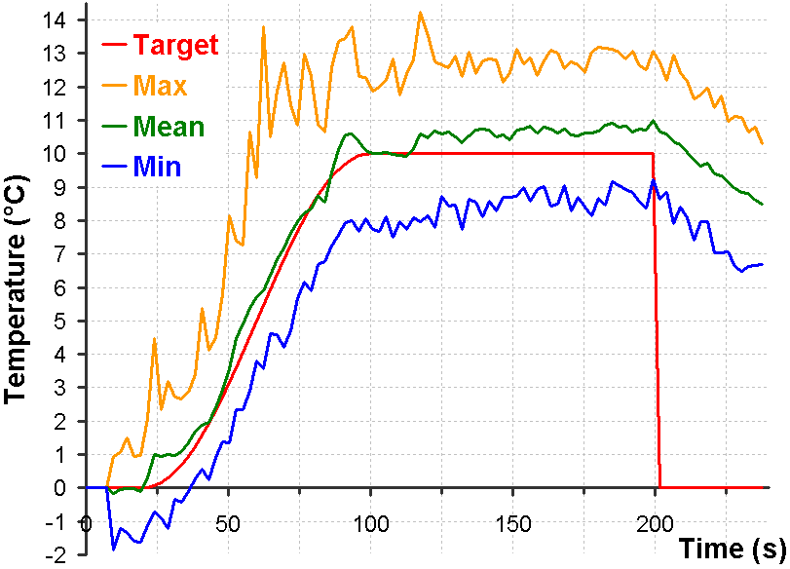
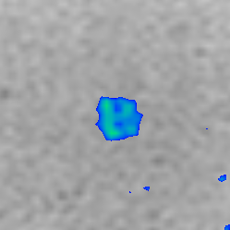
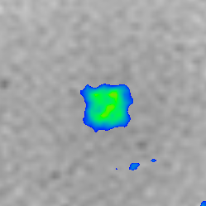
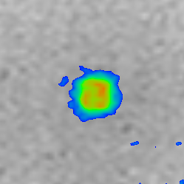
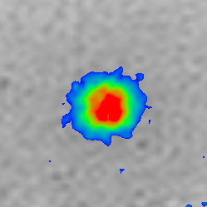
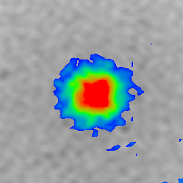
Volume control: cube 7×7×12 mm³
147 points regulated
6°C < < 8°C < < 10°C <
50s
62s
74s
98s
122s
10°C
6°C
1cm
1cm
1cm
1cm
1cm
2°C
Notes:
This is the results of the PID control performed over this cubic volume of 147 points.
The 3D surface render on the left shows clearly this cubic volume in red corresponding to 10°C temperature increased.
However the lower part of the cube is missing because the MR acquisition was limited to 6 slices.
Central MR slice acquired at different time are presented bellow. They show homogeneity of the temperature into this cubic volume.
The statistical analysis is presented on the right graph with a comparison of the minimum, average and maximal temperature of those 147 points under control.
The average temperature stay close to the target temperature.
And the difference between the minimum and the maximum temperature is equal to 4°C because a larger number of point observed.
To resume, the temperature control is performed successfully over those 147 point.

Slide 14
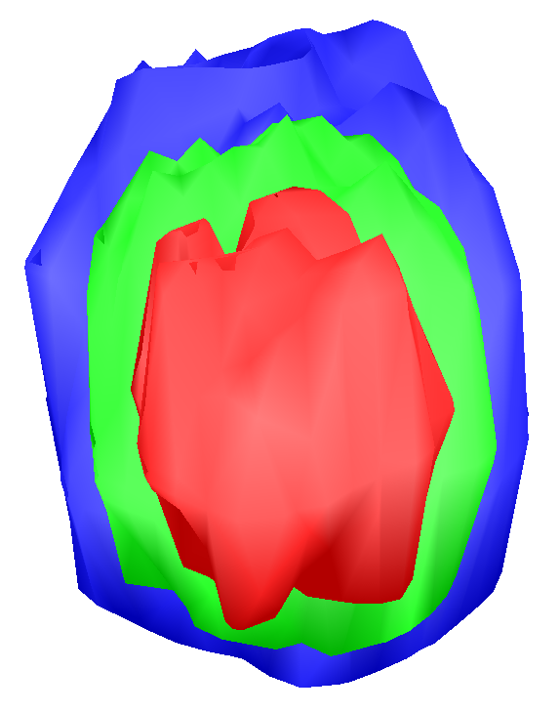
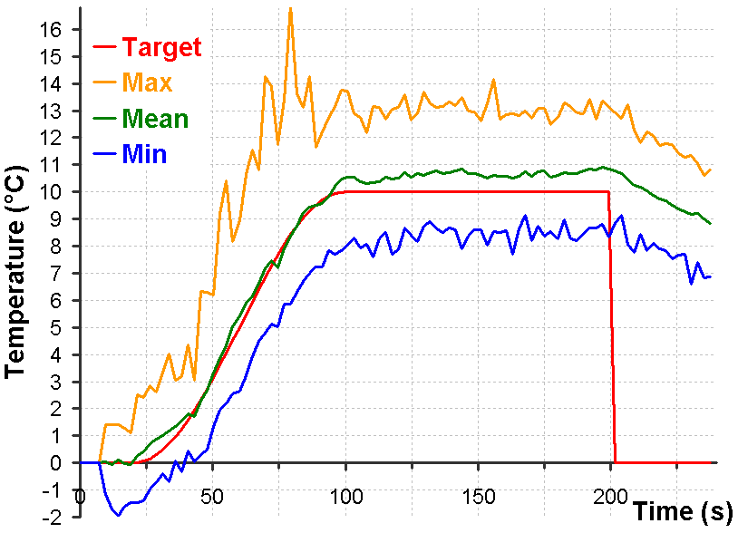
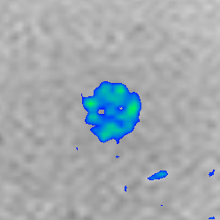
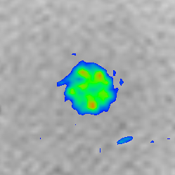
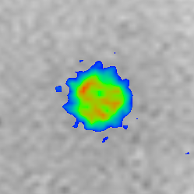
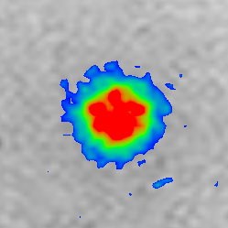
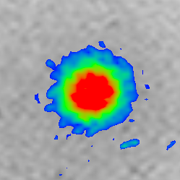
Volume control: sphere 12×12×12 mm³
195 points regulated
Poster 49
6°C < < 8°C < < 10°C <
50s
62s
74s
98s
122s
10°C
6°C
1cm
1cm
1cm
1cm
1cm
2°C
Notes:
However cubic tumor doesn’t exist,
So this is an other example with a spherical volume of 12mm diameter
composed of 195 points
Similar results are obtained on this larger volume.
With this spherical surface render of temperature and the homogenous inside temperature observed on central MR slices.
The statistical analysis on the right graph also present similar results.
The average temperature corresponds precisely to the target temperature and tends to over pass this target temperature.
This effect is mainly due to the temperature inside the sphere which is larger than the temperature at the border of the sphere as if only sonication at the border of the volume are performed.
I recommend you to see the poster 49 which describes this effect more precisely.

Slide 15
3D spatial and temporal temperature control
Advantage:
· Regulate temperature over a volume
· Minimize energy deposed
· Accept any volume shape
Limitation
· Elongated shape of the focal point
· Energy accumulation along beam axis
· 3D MR sequence
Notes:
To conclude,
The 3D spatial and temporal temperature control offers the advantage:
· To regulate the temperature in each point of the volume,
· To minimize the energy deposed
· To accept any volume shape.
However this method is limited by:
· The elongated shape of the focal point which forbids flat volume.
· The energy accumulation along the beam axis which increases with the size of the volume.
· The 3D MR sequence which limits the number of points under control.

Slide 16
ACKNOWLEDGMENT.
Ligue Contre le Cancer
Ministère de la Recherche
Imasonic
Thank You
Notes:
Thank you for your attention

