Slide 1

Riby Sales Dashboard (2010-2017)
Power BI Desktop
Total Revenue
$665bn
Total Cost
$469bn
Total Country
185
Total Profit
$196bn
Total Region
7
Presented By Margaret Oluwadare

Slide 2
RIBY SALES REPORT(2010-2017)
Year

Power BI Desktop
All 
Total Revenue
$665bn
Total Cost Total Profit
$469bn $196bn
Total Country
185
Total Region
7
Item Type

Region

All 
All

Profit by Region
Total Revenue by Region
Year 2016 2017
20%
Sub-Saharan Africa
Europe
Asia Middle East and North Africa Central America and the Cari…
$174bn
$172bn
$97bn
10%
$83bn
$72bn
$0bn
$50bn
$100bn
$150bn
0%
Asia
Australia and Oceania
Central Europe America
and the …
Middle East and North A…
North Sub-Sa…
America Africa
Profit by Country and Region
Asia
Australia and Oceania
$1,120M
$1,110M
Sub-Saharan Africa recorded the Highest Revenue of $174 billion followed by Europe with $172 billion and also generated $23 billion contributing profit of 15.94% and 10.26% in 2016 and 2017 respectively.
North America has the lowest Revenue of $15 billion and contributed 1.31% (2016) and 0.86% (2017) of the total profit.
Serbia in Europe Region recorded the highest profit of $1,129m followed by Rwanda in the Sub-Saharan Africa which highlighted
$1,127m
$1,112M $1,112M
Europe
Sub-Saharan Africa
$1,120M
$1,110M
$1,129M
$1,127M
Australia
Lesotho Maldives Namibia New Zeal… Rwanda Samoa Serbia Singapore Ukraine
Australia
Lesotho Maldives Namibia New Zeal… Rwanda Samoa Serbia Singapore Ukraine

Slide 3
Top Item Type by Region
Power BI Desktop
Units Sold by Region
$40bn
Cosmetics Household Office Supplies
0.6bn
0.65bn
0.65bn
$30bn
0.4bn
0.36bn
$20bn
0.31bn
0.27bn
0.20bn
$10bn
0.2bn
0.05bn
$0bn
0.0bn
Sub-Sa… Africa
Europe
Asia
Middle East and North Africa
Central America and the Caribb…
Australia and Oceania
North America
Sub-Sahar… Africa
Europe
Asia
Middle East and North Africa
Central America and the Caribbean
Australia and Oceania
North America
Region  | Unit Cost | Unit Price | Units Sold
Sub-Saharan Africa | 24,452,747.56 | 34,690,133.04 | 651,852,367
North America | 2,046,216.81 | 2,901,109.01 | 54,235,843
Middle East and North Africa | 11,660,375.63 | 16,533,307.31 | 310,359,376
Europe | 24,200,461.92 | 34,336,346.33 | 646,416,168
Central America and the Caribbean | 10,137,358.79 | 14,380,777.96 | 269,684,393
Australia and Oceania | 7,592,155.13 | 10,771,970.52 | 202,896,949
Total | 93,764,282.17 | 133,018,374.19 | 2,499,568,055
The Sub-Saharan Region recorded the highest unit sold while North America recorded the least unit sold.
Sub-Saharan Region unit cost has a more higher unit price to accommodate its profit, North America Region has a unit cost of $2,045m and a slight increase on the unit price stating $2,091, thereby contributing only 0.83% of the profit in 2017.
Riby team in the North America Region should entice customers to purchase more of the item types through discount sales, bundle sales and other incentives.

Slide 4
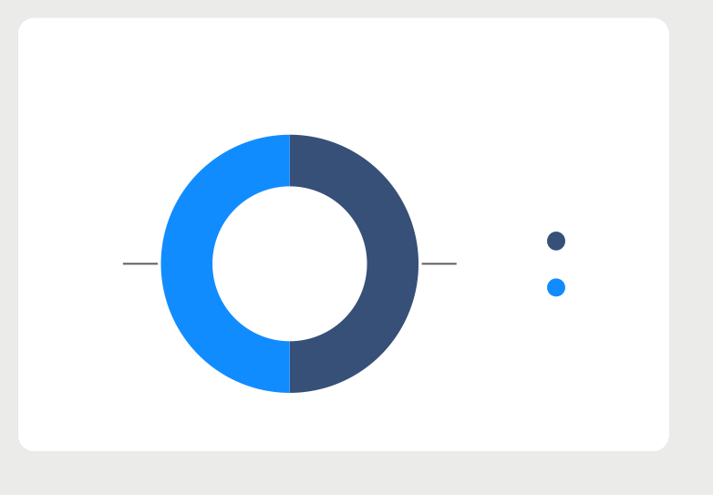
Units Sold by Order Priority
Power BI Desktop
Top 5 Item Type by Profit
100%
Revenue by Sales Channel
C
L M
Cosmetics Household Office Supplies Baby Food Cereal
$36bn
$35bn
$26bn
$20bn
$18bn
625M H
Offline Online
50%
50%
625M
625M
624M
50.9%
Quarter | Total Revenue  | Total Cost | Total | Profit
Qtr 2 | $170,965,606,222 | $120,502,548,341 | $50,463,057,881
Qtr 1 | $169,719,884,603 | $119,604,036,561 | $50,115,848,042
Qtr 3 | $164,456,324,812 | $115,999,324,117 | $48,457,000,695
Qtr 4 | $159,906,339,353 | $112,702,263,677 | $47,204,075,676
Total | $665,048,154,991 | $468,808,172,697 | $196,239,982,294
Revenue by Month
$58.0bn
$58.9bn
The sales channels shows equal revenue of 50% each on the online and offline channels. The L,C and H order Priority recorded the same unit sold of $625 million while L has
$623 million. This shows that equal attention id given on the order priority.
Cosmetics Product shows the highest profit($36 billion) followed by household item($35 billion), while cereal item type shows the least profit representing $18 billion.
Qtr 2 recorded the highest profit of $50,463,057,881 while Qtr 4 recorded the least profit of $47,204,075,676 in the period under review.
The month of May, March and July recorded a Total Revenue as $58 billion each while there was a sharp decline in the month of September which represents $52 billion between 2010 to 2017.
$58bn
$58.4bn
$56.2bn
$55.7bn
$56bn
$56.2bn
$56.3bn
$54.4bn
$54bn
$53.8bn
$52.7bn
$52.4bn
$52.1bn
$52bn
January
February
March
April
May
June
July
August
September
October
November
December

