Slide 1





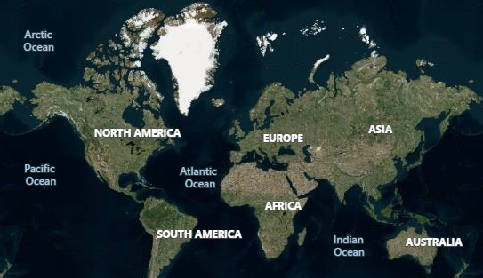




UNDERSTANDING CUSTOMER TRANSACTION
Power BI Desktop
392.48K
Total Profit
2bn
Units Sold
BY
ANISHERE MARIAM ADEOLA (GROUP 1); WTF/23/DS/C/032
1.41M
1.33M
937.62K 1.88M
Time Taken to ship item (Days)
Offline Online
Correletion between Cost and Profit of Items
Total Profit Total Cost
Item Type
Total Profit by Year
24.99
25.01
2010
2011
2012
2013
2014
2015
2016
2017
At 869,337.60, Cosmetics had the highest Total Profit and was 7,147.89% higher than Fruits, which had the lowest Total Profit at 11,994.35.
Total Profit and total Total Cost are positively correlated with each other.
Total Cost and Total Profit diverged the most when the Item Type was Office Supplies, when Total Cost were 1,991,701.85 higher than Total Profit.
Across all 12 Item Type, Total Profit ranged from 11,994.35 to 869,337.60 and Total Cost ranged from 34,440.22 to 2,622,366.63.
Total Profit by Region
© 2022 TomTom,, Earrtthssttarr Geogrraphiiccss SIIO,, © 2023 Miiccrrossofftt Corrporrattiion,, © OpenSttrreettMap
Region
Item Type
Baby Food
Beverages
Cereal
Clothes
Cosmetics
Fruits
Household
Meat
Office Supplies
Personal Care
Snacks
Vegetables
All 
Country
All 
Shipping Time (Days)
0
50

