Slide 1



Recovery_visualisation
View in Power BI
Last data refresh:
1/25/2023 10:11:52 AM UTC
Downloaded at:
1/25/2023 10:18:31 AM UTC

Slide 2
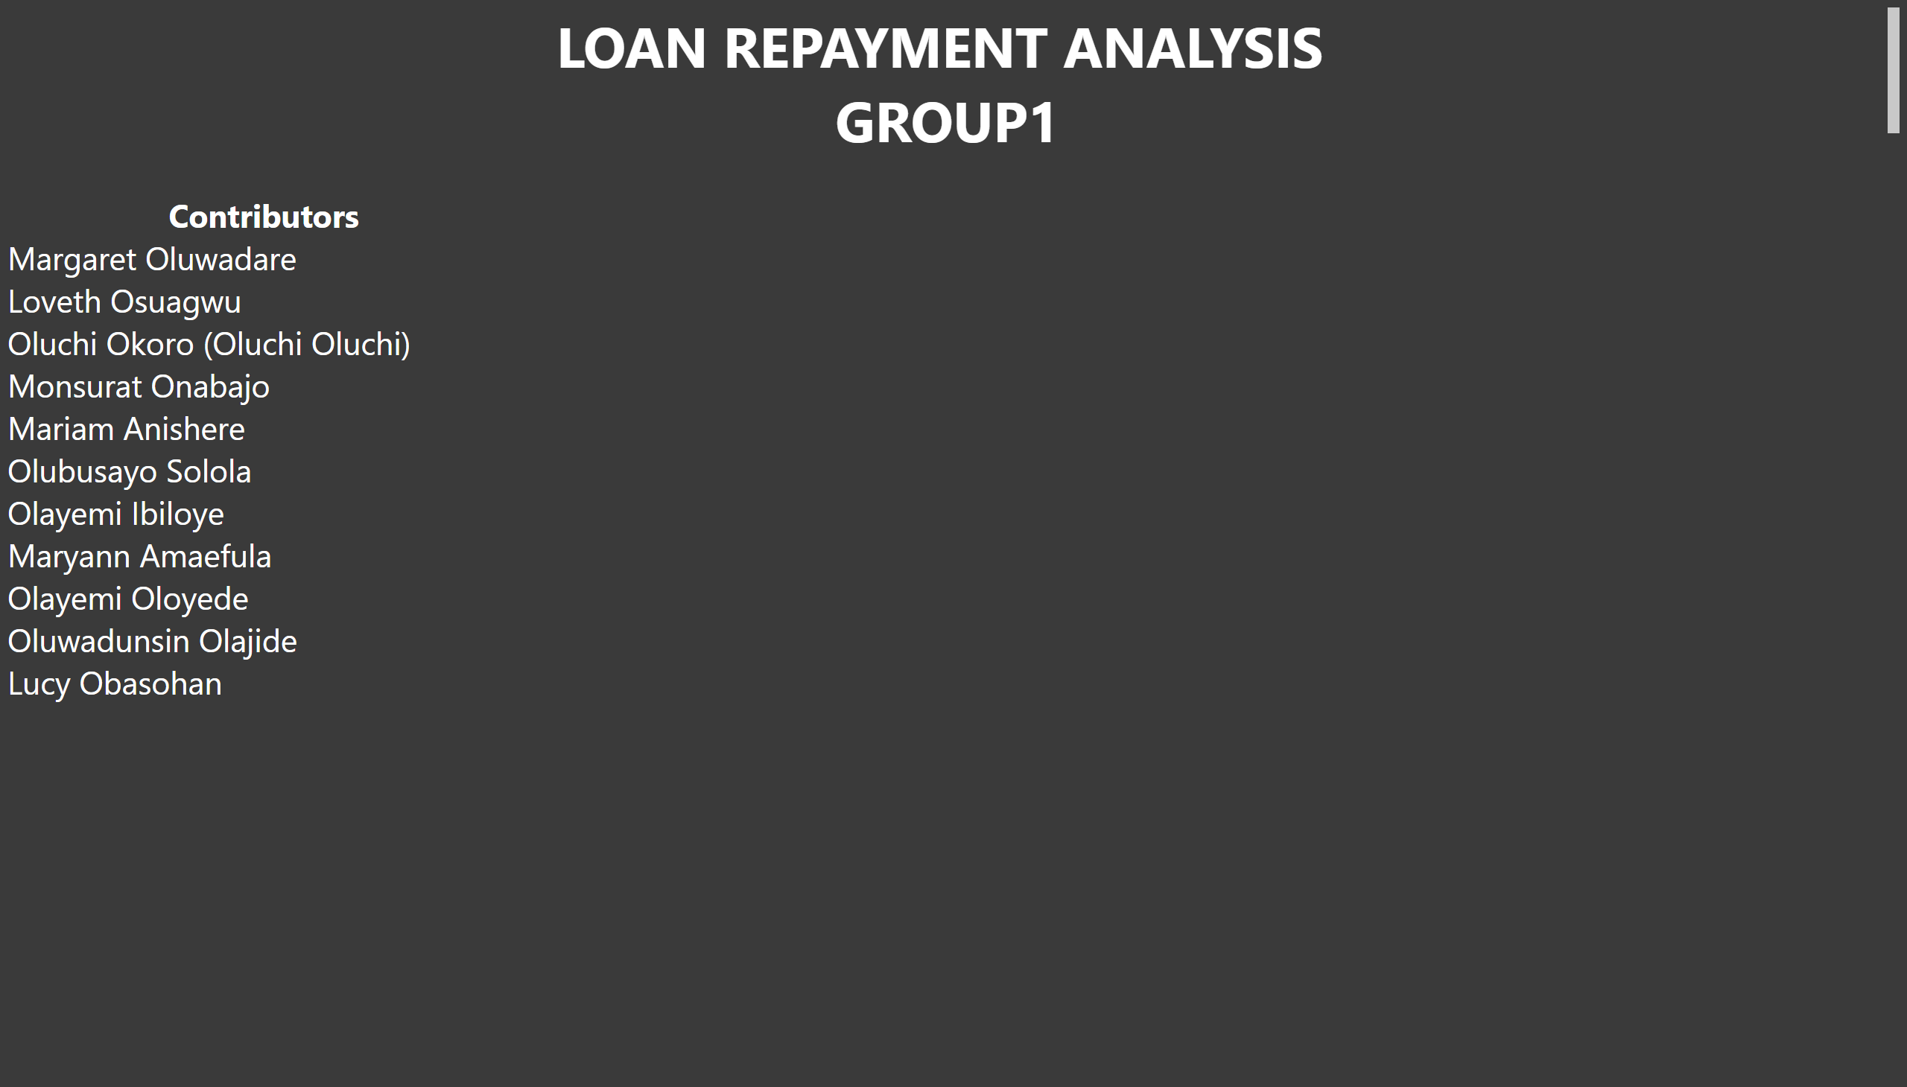
Cover Page
Notes:
textbox
No alt text provided
textbox
No alt text provided

Slide 3
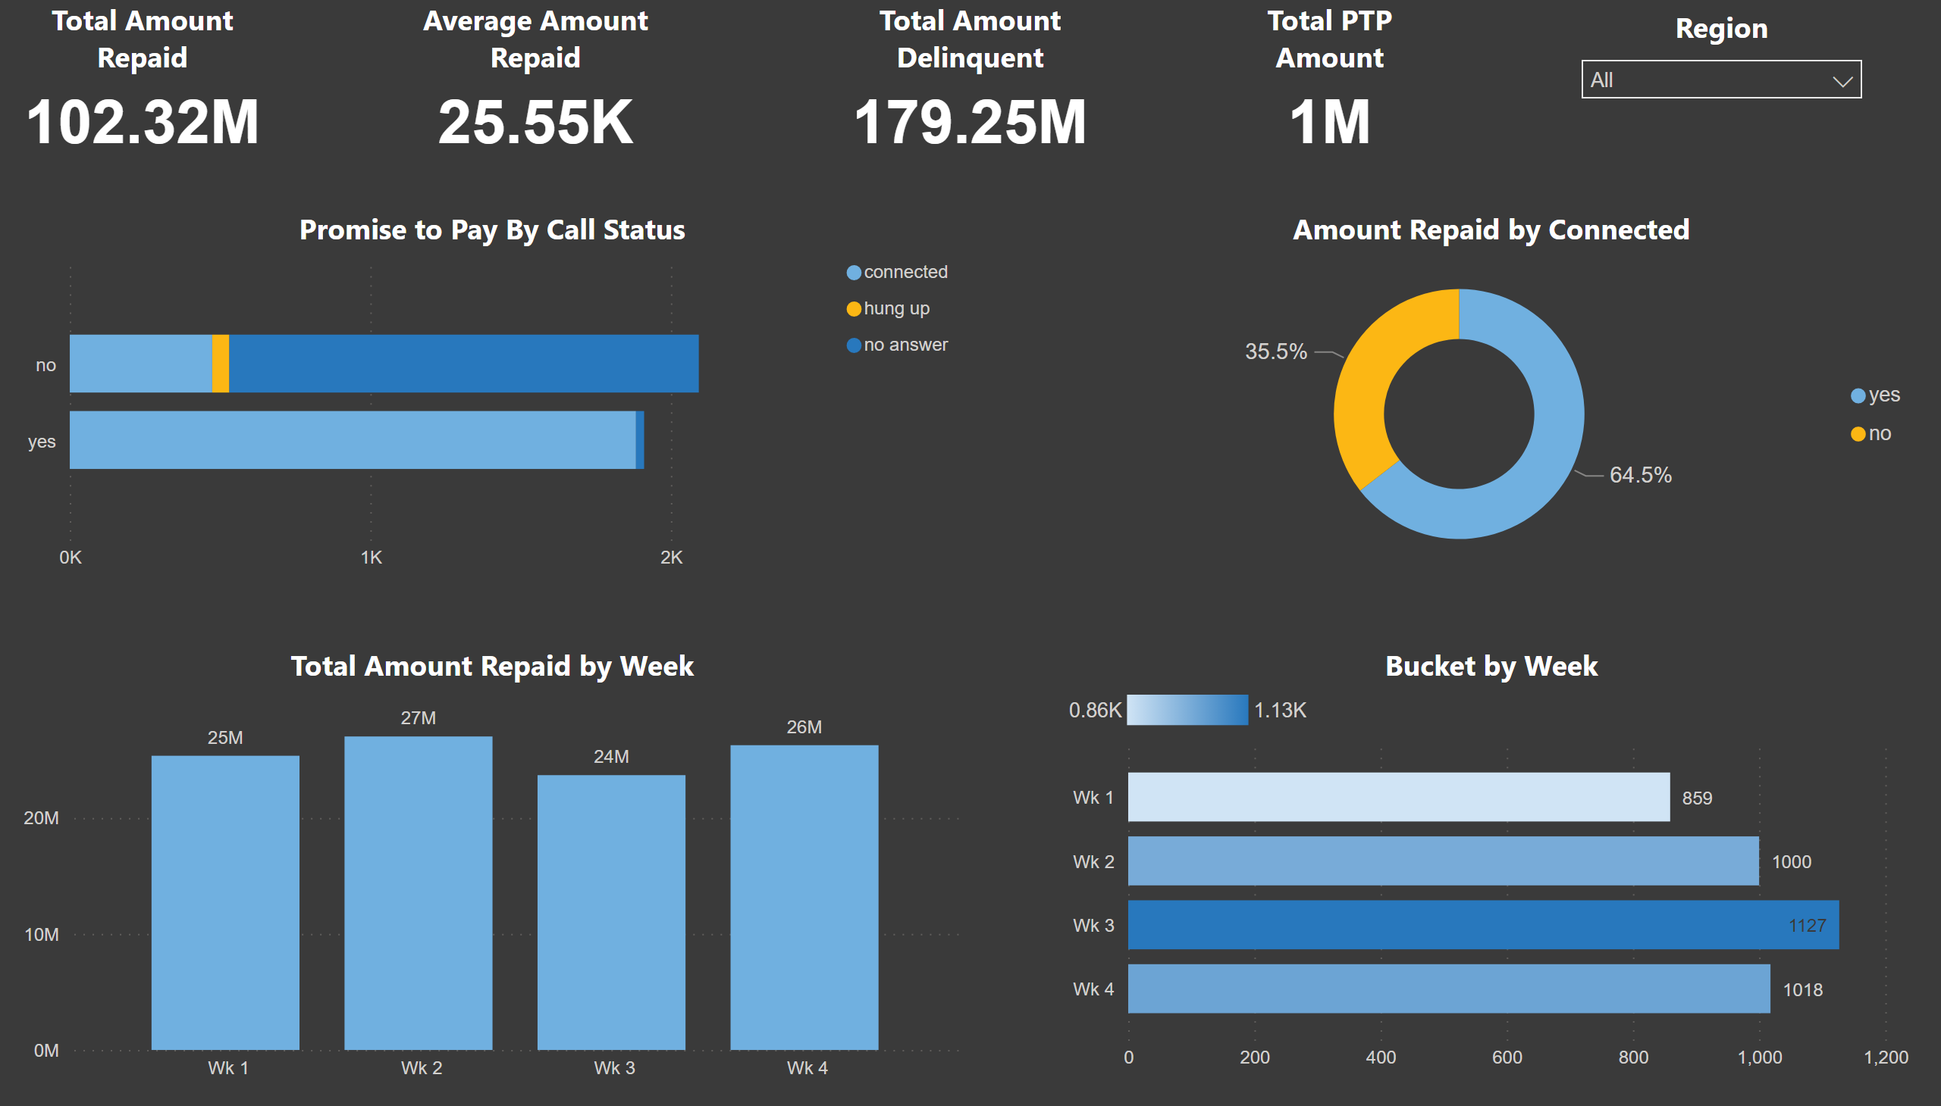
Loan Analysis1
Notes:
Promise to Pay By Call Status
No alt text provided
Total Amount Repaid by Week
No alt text provided
Bucket by Week
No alt text provided
Amount Repaid by Connected
No alt text provided
Total Amount Repaid
No alt text provided
Total Amount Delinquent
No alt text provided
Total PTP Amount
No alt text provided
Average Amount Repaid
No alt text provided
Region
No alt text provided

Slide 4
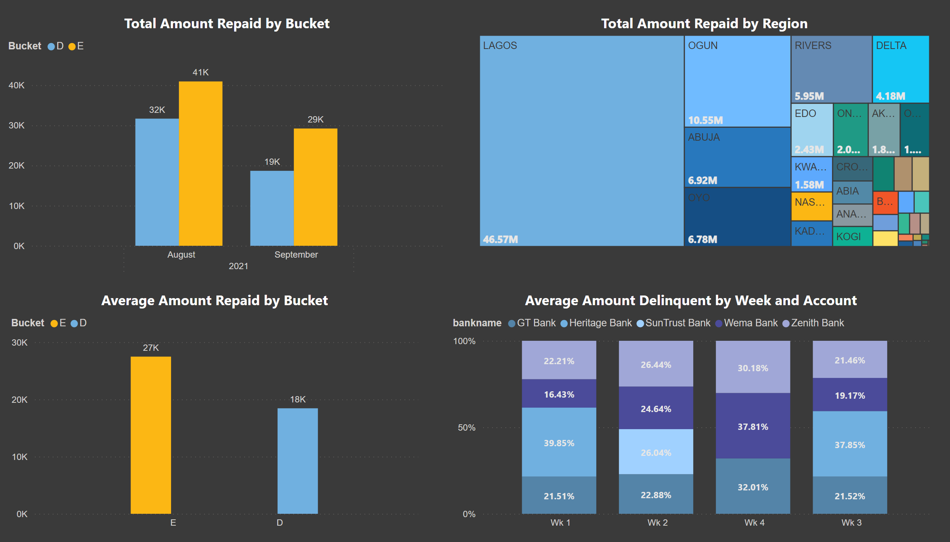
Loan Analysis2
Notes:
Total Amount Repaid by Bucket
No alt text provided
Average Amount Repaid by Bucket
No alt text provided
Total Amount Repaid by Region
No alt text provided
Average Amount Delinquent by Week and Account
No alt text provided

Slide 5
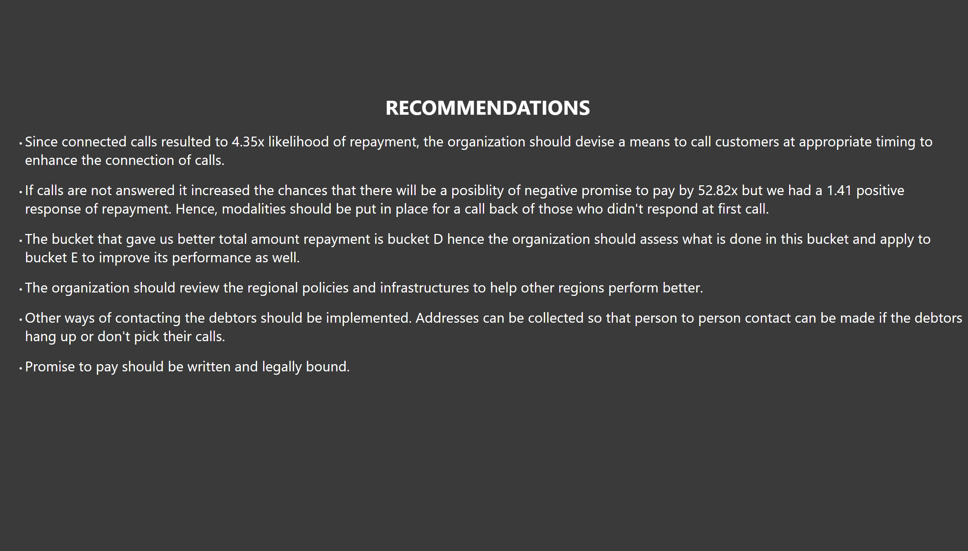
Recommendation
Notes:
textbox
No alt text provided
textbox
No alt text provided

