Slide 1

FIFA Player Performance Analysis
BeTechified September Cohort By Margaret Nosa Okungbowa
Tool Used: Tableau Desktop, Excel

Slide 2
Dataset Overview
Total Records: Approximately 18,200 Rows
Features (Columns): Over 25+ attributes, including
Passing skills (dribbling, passing, finishing, vision, etc.)
Physical stats (strength, stamina, agility, sprint speed)
Attacking skills (composure, positioning, reactions)
Financial data (value, wage)
Demographics (age, nationality, club, preferred foot)
Overall and potential performance ratings

Slide 3
Project Objectives
Identify top-performing players and clubs
Analyze performance by nationality and position
Understand factors influencing player market value
Evaluate player value for money
Discover trends by age, footedness, and position

Slide 4
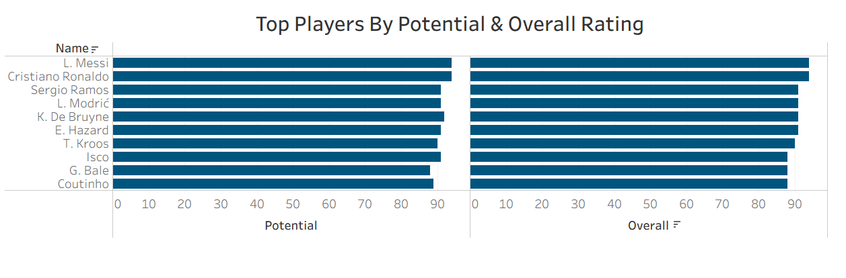
KBQ 1: players and clubs have the highest overall and potential ratings
Insight :
Messi , follow by Cristiano Ronaldo are the highest performing individual players across both metrics
Useful for scouting and Benchmarking

Slide 5
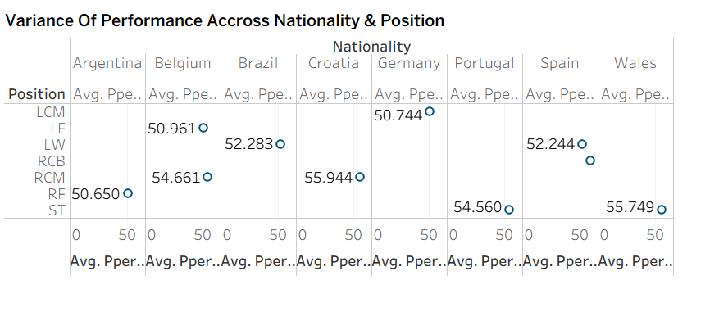
KBQ2:Performance metrics variance across positions and nationalities
Insight:
Performance varies widely by nationality across different positions. Clubs should scout based on the specific role they need to fill rather than relying only on overall player ratings.

Slide 6
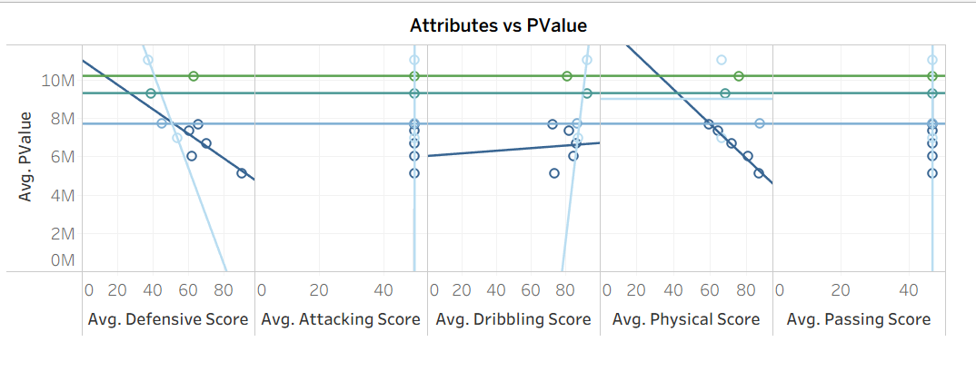
KBQ 3: Attribute Influence on Market Value
Insight:
Higher performance scores tend to attract higher wages and market valuations.
Clubs need to invest wisely, not emotionally.

Slide 7
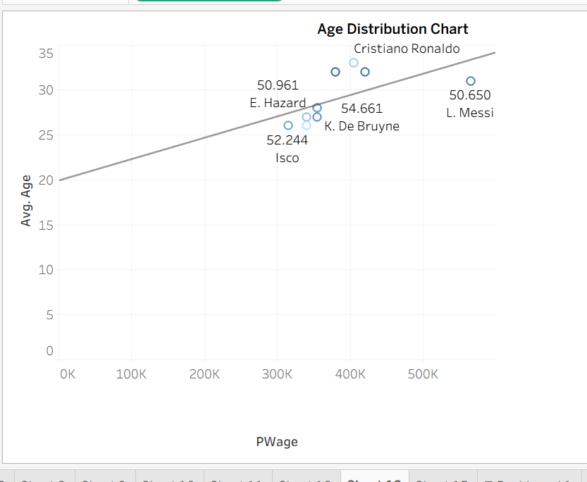
KBQ 4: Age vs Potential
Insight
Players between 20–35 earn more and have higher market value.
Younger teens (<18–19) are not paid much.
Players above ~35 begin to decline in pay/value.

Slide 8
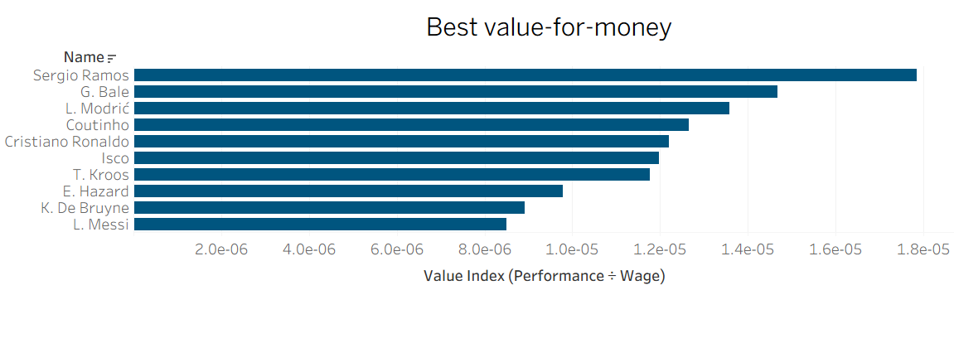
KBQ5 : Best Value-for-Money Players
Insights
High value does not always match high salary.
Clubs can optimize spending by scouting based on actual performance indicators rather than wage demands alone.
Data-driven recruitment can help teams identify overlooked but highly capable players, improving squad quality without overspending.

Slide 9
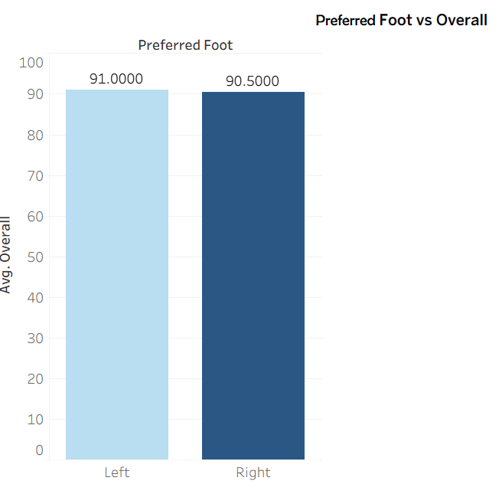
KBQ6: Players Foot Analysis
                Insight:
                Foot preference does not significantly influence player performance based on my analysis
                Teams should not prioritize scouting based on footedness alone, since both groups deliver nearly equal value. Other factors (such as position, technical attributes, and experience) are more important for evaluating performance.

Slide 10
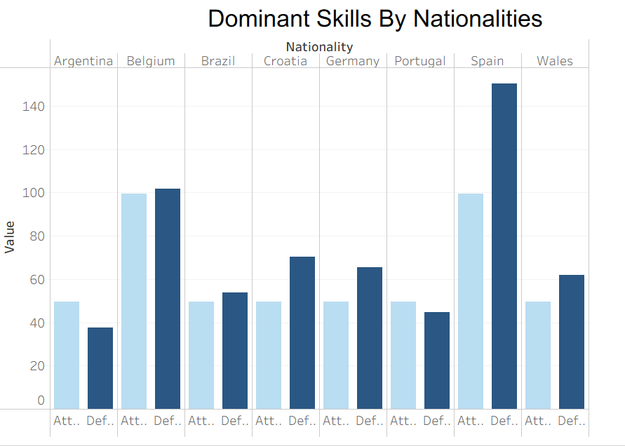
KBQ7: Nationalities Dominant skills
Insight:
Spain and Belgium show the strongest overall skill performance across both attack and defense, while most other nations perform average or strong in only one area.

Slide 11
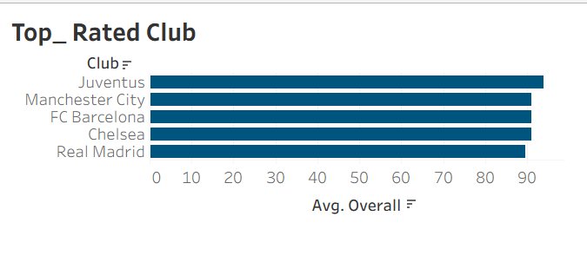
KBQ 8: Top Clubs by Squad Strength
Insight:
Juventus is the strongest squad teams.
Supports club-level benchmarking.

Slide 12
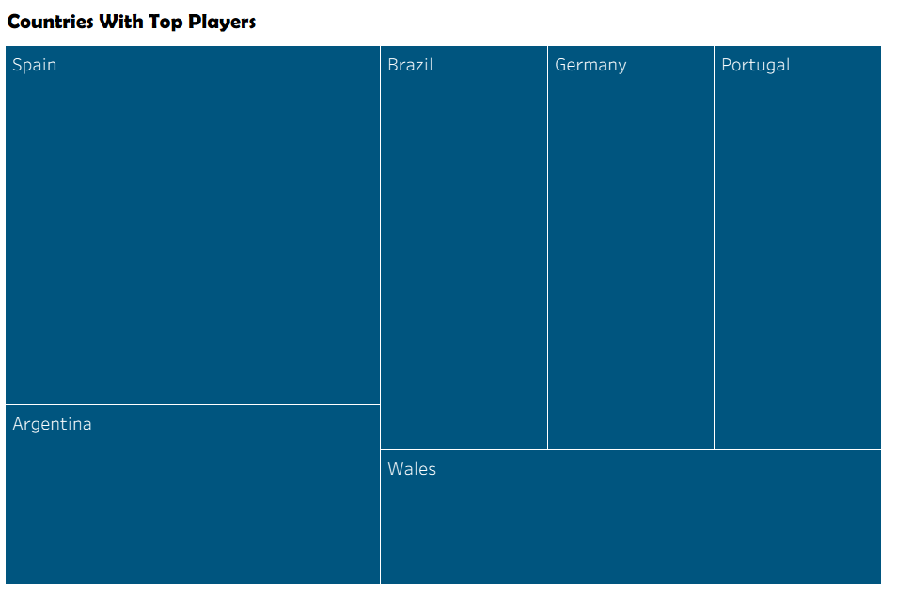

Slide 13
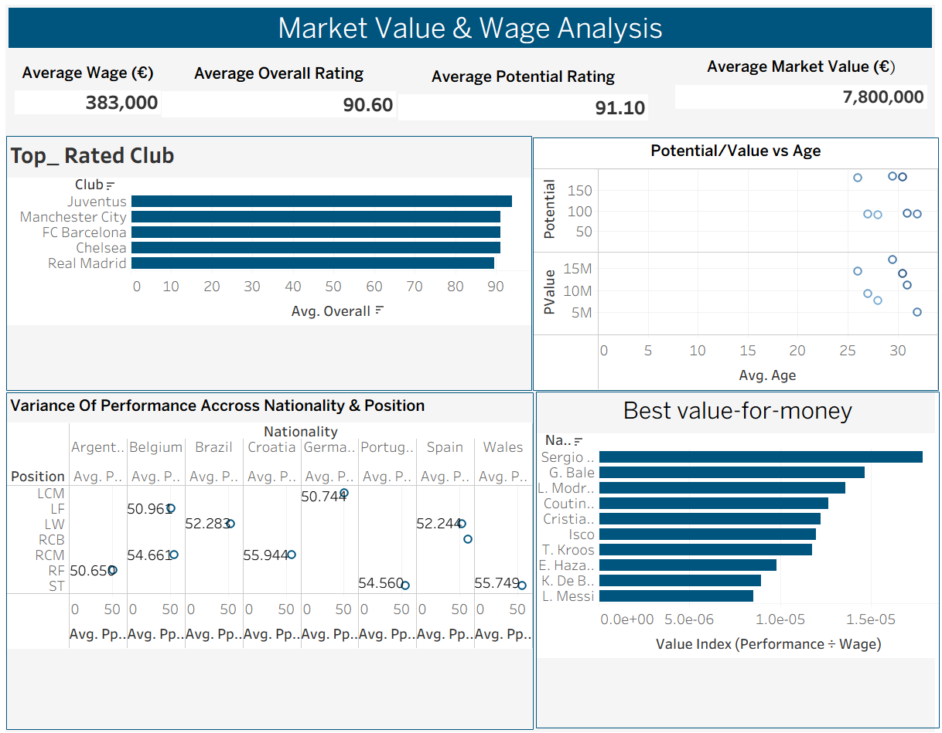

Slide 14
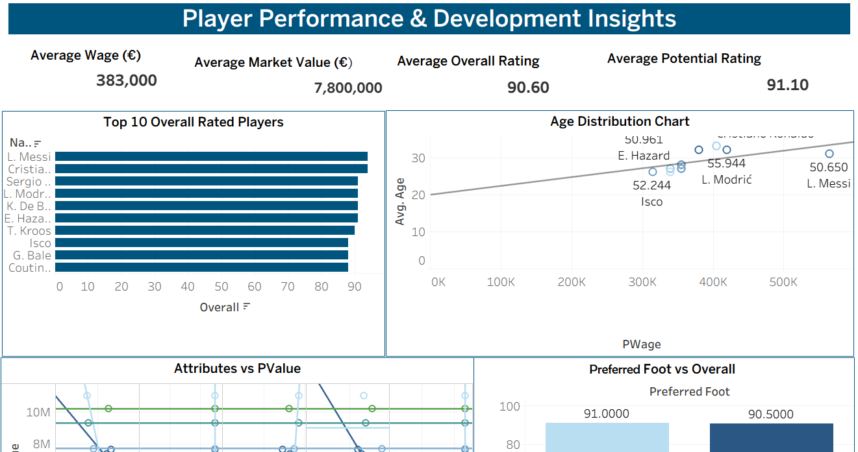

Slide 15

Findings
• Player performance and value are shaped by a combination of interconnected factors. including age. position. nationality. club strength. and key attributes.
• Younger players generally have higher potential. while some older players still deliver strong performance at lower wage cost.
• Strong clubs tend to field higher-rated squads. but high wages do not always equal high performance.
• Key attributes such as passing. dribbling. defending. and physical strength show strong links to player value.
• Different nationalities and positions excel in different skill areas. creating patterns that clubs can use to guide scouting.
.

Slide 16

Recommendations
• Prioritize players with high potential and identify older low-wage players who still perform strongly.
• Focus recruitment on players with the top attributes that drive performance for the position needed.
• Optimize wage spending by targeting undervalued players rather than relying on wage as a quality signal.
• Develop training plans that improve the attributes most linked to market value and on-pitch performance.
• Strengthen scouting by tracking nationalities and positions that consistently produce high performers.
• Use analytics to guide transfer decisions and build long-term player development strategy.

Slide 17
Any Questions ?

