Slide 1
Information Visualization Project Proposal and Dataset
G15-A
88647 – Yasser Zacarias
86473 – Margarida Morais
79457 – Maxwell Junior

Slide 2
INITIAL DATASET
01

Slide 3

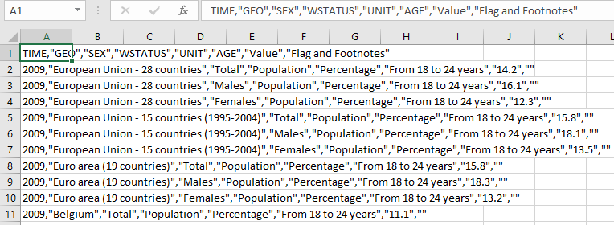
Initial Dataset
Eurostat
Early leavers from education

Slide 4
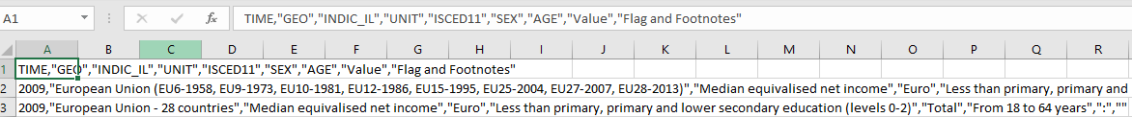
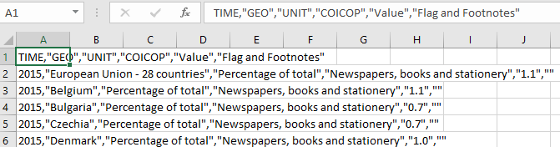
Average income by education level
Share of household expense in books/ reading material

Slide 5
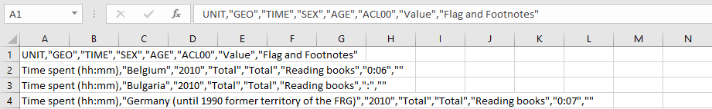

Average time spent Reading
Participation rate in education and training

Slide 6
Selected / derived data
02

Slide 7
Selected data
Data description
Reading Time
Average income
Academic success
Expenditure in books
Participation in education

Slide 8
Derived data
Derived data description
In the end, we want average values by country…
Users can explore the European Union countries and visualize the existing information for each country
Compare between countries
Understand the correlation between different kinds of information

Slide 9
Data abstraction
03

Slide 10
Data abstraction
Description:
Dataset type:

Slide 11
Data abstraction
Item1 description
Attribute1 description
Attribute2 description
Item2 description
Attribute1 description
Attribute2 description
…

Slide 12
Data abstraction
Semantics:

Slide 13
Dataset processing
04

Slide 14
Dataset processing
Dataset cleaning description
Entry1
Entry2
…

Slide 15
Dataset processing
Problems found:
Problem 1
Solution
Problem 2
Solution

Slide 16
Mapping
05

Slide 17
Mapping
Question 1
Data
Question 2
Data
…

