Slide 1
Information Visualization Project Proposal and Dataset
G15-A
88647 – Yasser Zacarias
86473 – Margarida Morais
79457 – Maxwell Junior

Slide 2
INITIAL DATASET
01

Slide 3

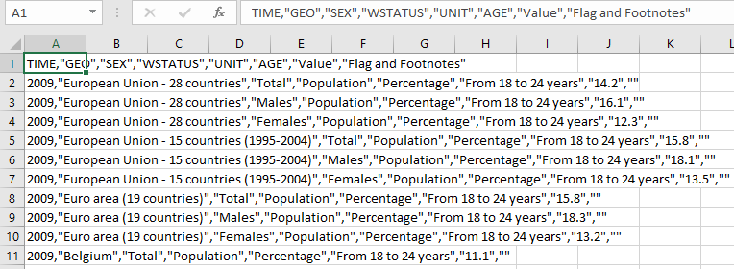
Initial Dataset
Eurostat
Early leavers from education

Slide 4
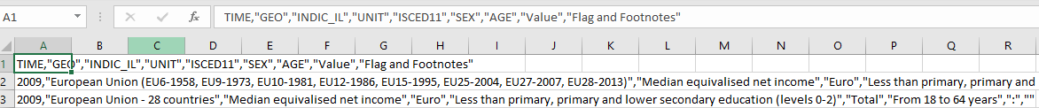
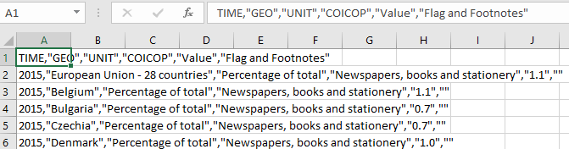
Average income by education level
Share of household expense in books/ reading material

Slide 5
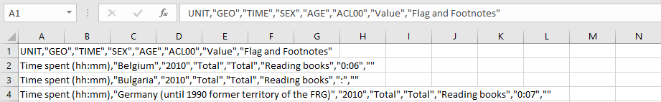

Average time spent Reading
Participation rate in education and training

Slide 6
Selected / derived data
02

Slide 7
Selected data
Data description
Reading Time
Average income
Academic success
Expenditure in books
Participation in education

Slide 8
Derived data
Derived data description
In the end, we want average values by country…
Users can explore the European Union countries and visualize the existing information for each country
Compare between countries
Understand the correlation between different kinds of information

Slide 9
Data abstraction
03

Slide 10
Data abstraction
Description:
Abstractly the data will consist in
(Country, Year, M₁*, M₂*,…)
*Metrics used
Dataset type:
Table (by country)
Multidimensional Table (by country, sex, time)

Slide 11
Data abstraction
1 - Participation rate in training and education
“Year” : Quantitative
“Sex” : Nominal
“Value” : Ratio/Continuous
“Country” : Nominal
2 - Early leavers from education
“Year” : Quantitative
“Sex” : Nominal
“Value” : Ratio
“Country” : Nominal

Slide 12
Data abstraction
3 – Average income by level of education
“Year” : Quantitative
“Value” : Ratio
“Country” : Nominal
4 – Share of household expenditure in books
“Year” : Quantitative
“Value” : Ratio
“Country” : Nominal

Slide 13
Data abstraction
5 – Time spent reading
“Value” : Ratio
“Country” : Nominal

Slide 14
Data abstraction
Semantics:
Year – year to which the item belongs
Sex – sex of the population to which the item belongs to
- Total , Males, Females
Value – it’s correspondent to the metrics used
- (Minutes, Percentages, Salaries)
Country – it describes a country

Slide 15
Dataset processing
04

Slide 16
Dataset processing
Dataset cleaning description
Clean
Standardize
Clean unwanted attributes
Standardize unknown cell values
Sort rows
Average by country

Slide 17
Dataset processing
Problems found:
Gaps in years
Solution: Only use data from corresponding years when merging data.
Lack of data and/or granularity (Confidentiality)
Solution:
- Remove from the instance of dataset for a given year where the 70-90% of data is missing
- Use a value of sentinel values
Data redundancies (irrelevant rows or/and columns)
Solution :
- Deletion

Slide 18
Mapping
05

Slide 19
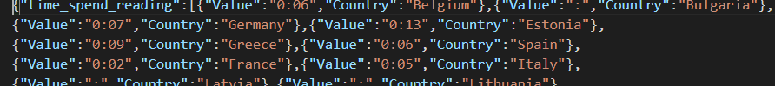
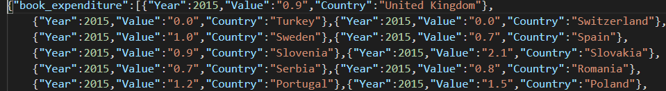
Mapping
How many hours, in average, do the countries in EU spend reading?
What is the average percentage of household expenditure in reading material by country?

Slide 20
Mapping
Given the reading habits of each country, what is the average income for education level comparing to other EU countries?
Given a country’s reading habits, what is the rate of dropout ?

Slide 21

What is the adult participation in learning after leaving the formal education?

Slide 22
The End
Questions?

