Slide 1
Information Visualization Visualization Sketch
G15-A
88647 – Yasser Zacarias
86473 – Margarida Morais
79457 – Maxwell Junior

Slide 2
Overview
01

Slide 3
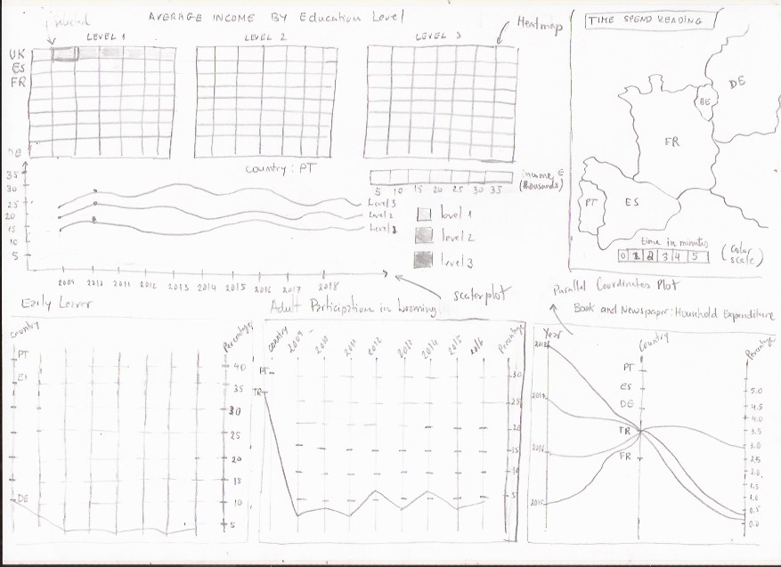
Overview

Slide 4
Visual encoding
02

Slide 5
Visual Encoding
Variable | Data Type | Visual Encoding
avg_year_income | Quantitative | Heatmap, scatter plot, colour scale
percentage_total_expend | Quantitative | Parallel Coordinates Plot, vertical
avg_reading_minutes | Quantitative | Map, colour scale
percentage_pop | Quantitative | Colour scale, line
Year | Quantitative | Shape, area, line
Country | Nominal | *

Slide 6
Answering the Questions
03

Slide 7
Questions
Questions | Encoding
How many hours in average do the countries in Eu spend in reading | Countries: Map with EU countries Average time: colour scale (for each country)
Average income for education for level | Education level: Heatmap + scatter plot Average Income: colour scale
Country reading habit and dropout rate | Parallel Coordinates plot
Education participation | Parallel Coordinates plot
Household expenditure in books | Parallel Coordinates plot

Slide 8
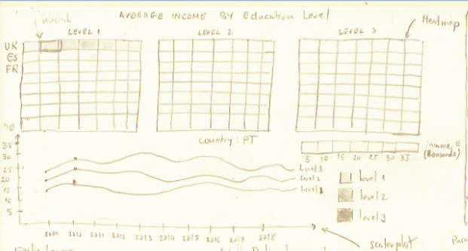
Question <2> Story Board
Story board: Average income for education level?
3 Heatmaps (for each education level)
Incoming Level (color scale)
Scatter plot (Evolution each level of education)

