Slide 1
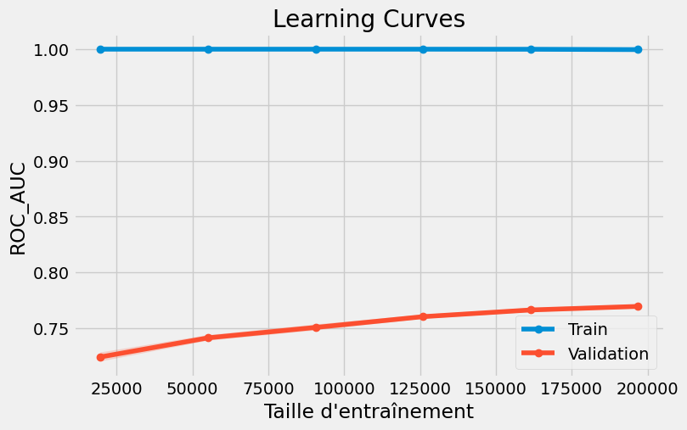
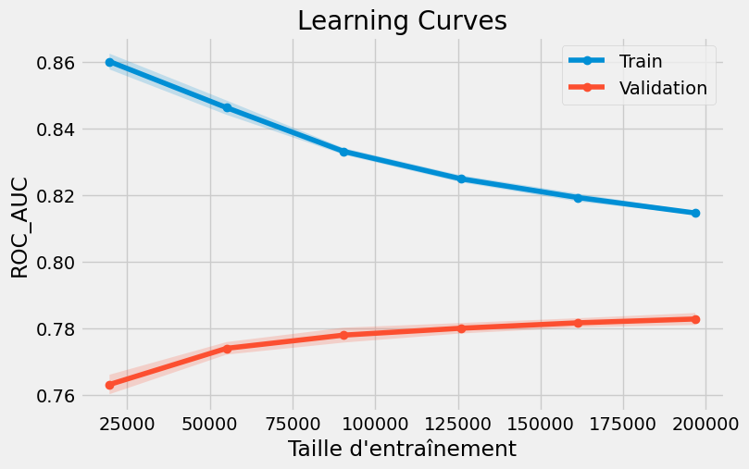

LGBMClassifier(
n_estimators=2500,
learning_rate=0.03,
num_leaves=16,
max_depth=6,
min_child_samples=300
min_split_gain=0.02
reg_alpha=1.0,
reg_lambda=15.0
subsample=0.7,
subsample_freq=1,
colsample_bytree=0.6
n_jobs=-1,
random_state=42,
force_col_wise=True)
LGBMClassifier(
n_estimators=5000,
learning_rate=0.03,
num_leaves=48,
subsample=0.8,
colsample_bytree=0.8,
max_depth=-1,
min_child_samples=50,
n_jobs=-1,
random_state=42,
force_col_wise=True)

Slide 2
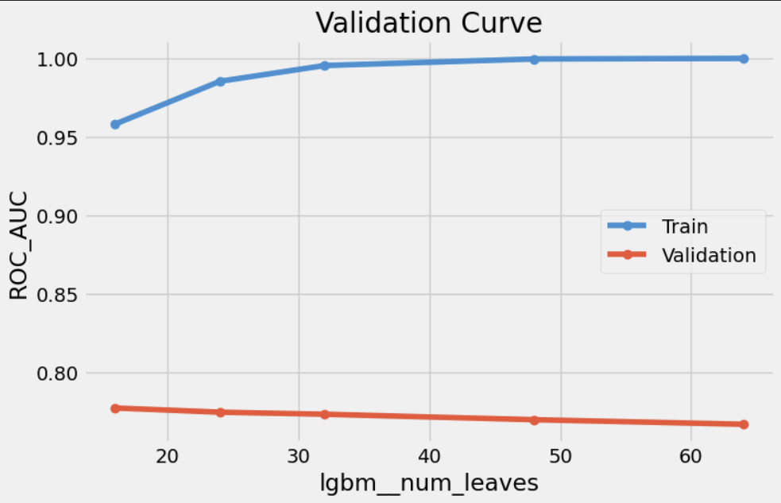
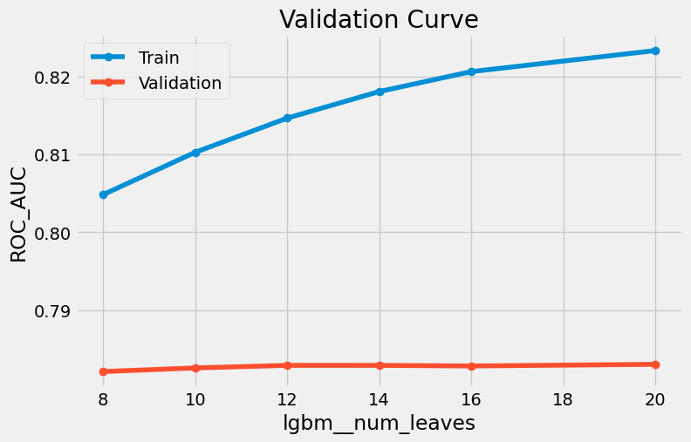
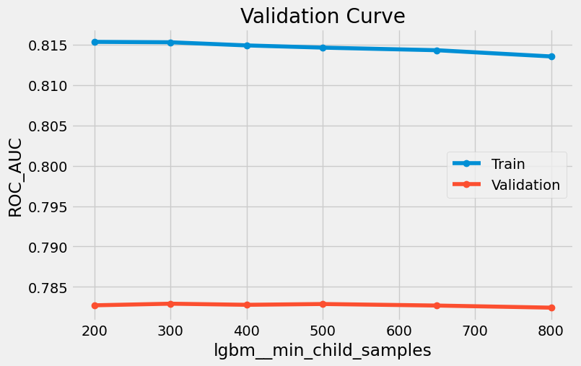
LGBMClassifier(
n_estimators=2500,
learning_rate=0.03,
num_leaves=16,
max_depth=6,
min_child_samples=300
min_split_gain=0.02
reg_alpha=1.0,
reg_lambda=15.0
subsample=0.7,
subsample_freq=1,
colsample_bytree=0.6
n_jobs=-1,
random_state=42,
force_col_wise=True)
LGBMClassifier(
n_estimators=5000,
learning_rate=0.03,
num_leaves=48,
subsample=0.8,
colsample_bytree=0.8,
max_depth=-1,
min_child_samples=50,
n_jobs=-1,
random_state=42,
force_col_wise=True)

